Slide 1
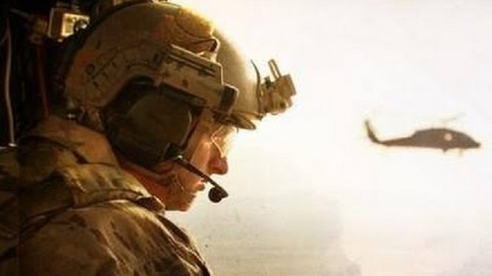
The rescue company 1

Slide 2
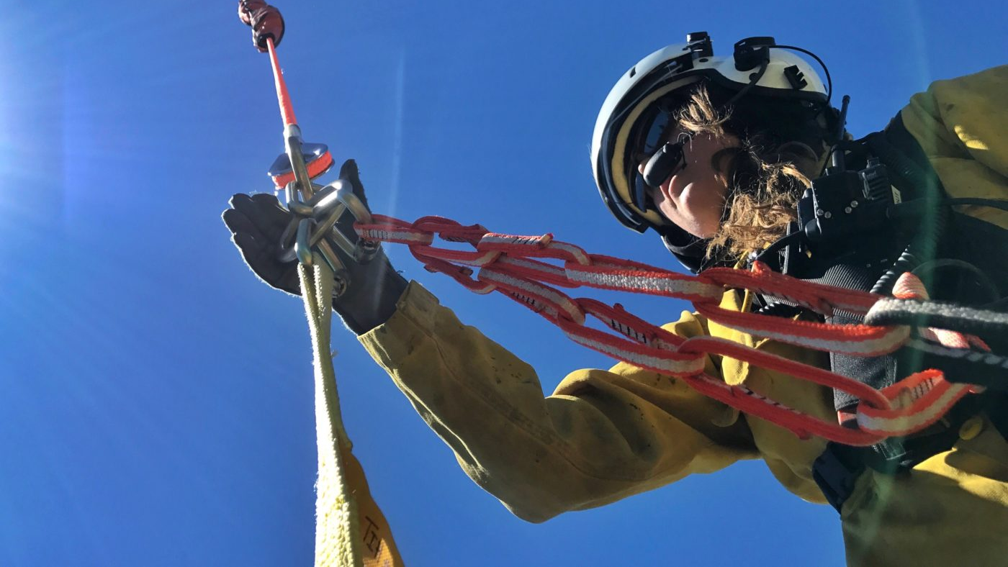
HELICOPTER SHORT-HAUL

Slide 3
Helicopter Short-haul
A helicopter short-haul rescue permits the insertion of personnel, suspended beneath a hovering helicopter on a fixed line, as well as the extraction of a subject or rescuers from a site where a helicopter cannot land.

Slide 4
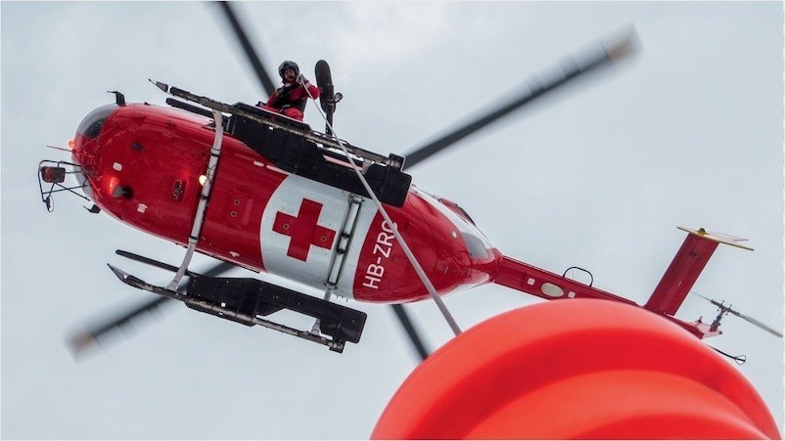
HISTORY
As early as November 1952, the so-called "helicopter lift" technique was utilized by Swiss Air Rescue, which later became known as REGA

Slide 5
OPERATIONAL CONSIDERATIONS
A helicopter short-haul is not a procedure that should ever be improvised on the spot.
Rescuer proficiency is easier to maintain with the short-haul technique than with helicopter rappelling, since short-haul technique requires fewer rescuer manipulations.

Slide 6
OPERATIONAL CONSIDERATIONS
The exposure time of the short-haul rescuer during forward flight is greater than during a helicopter rappel.
To minimize this exposure time, short-haul flights should be limited to the shortest possible flight distance practical.
The name "short-haul" is derived from this distance factor, rather than from the length of line used.

Slide 7
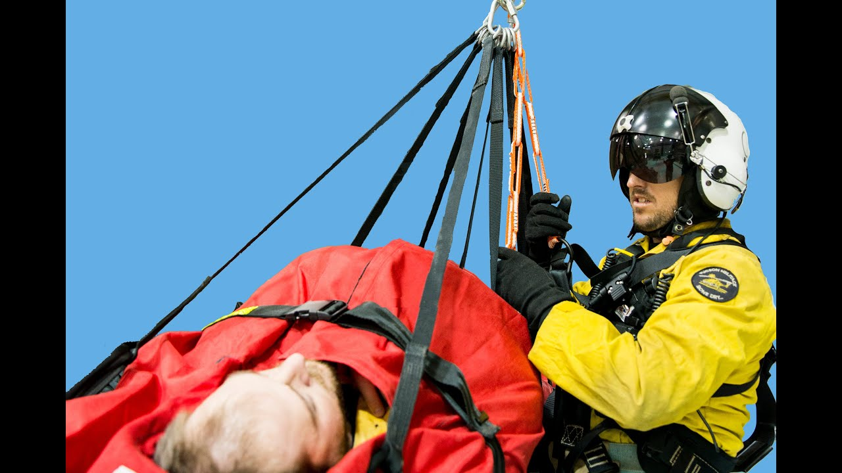
line configuration
Single line configuration common with most rescue organizations

Slide 8
line configuration
Multiple line configurations have been employed for redundancy but tend to be cumbersome, because of the risk associated with individual lines becoming entangled when they become slack.

Slide 9
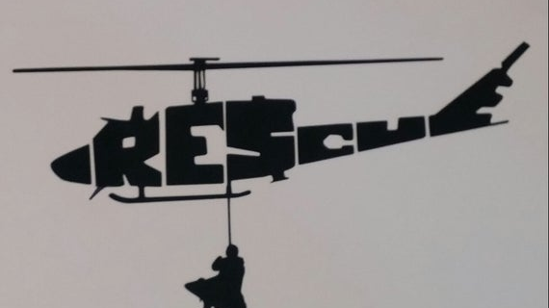
line configuration
A pre-rigged short-haul line with a solid metal ring or rope thimble at the terminus of the line provides rescue personnel with a point for easy attachment during a hook-up sequence.

Slide 10
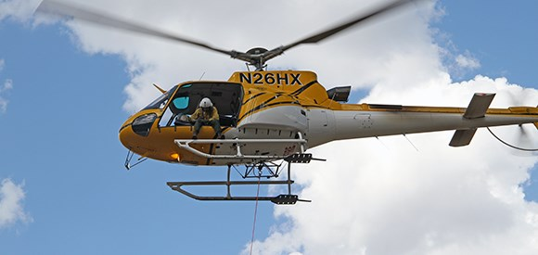
line configuration
The line length varies between agencies, however 100-200 foot (30-60m) lengths are most common.

Slide 11
line configuration
Longer lengths create a vertical reference challenge for the pilot to control the load.

Slide 12
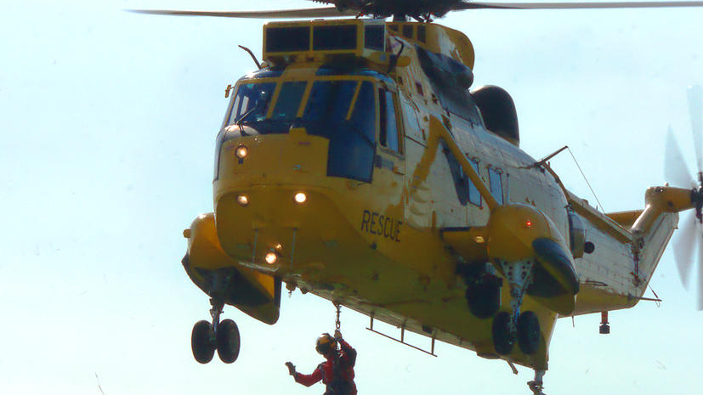
line configuration
The use of spring-loaded, auto­locking carabiners for all connection points, both at the aircraft and on the end of the line, provides a positive means to prevent in-flight vibration from accidentally unlocking a carabiner

Slide 13
anchor "system"
It is critical that the short-haul line be attached to an anchor "system" on the aircraft, which incorporates both a primary anchor point and secondary anchor point to prevent accidental release

Slide 14
anchor "system"
This redundancy in the short-haul anchor is designed to prevent a catastrophic loss of the short-haul load and HEC.
The primary and backup anchor must be designed for release in an emergency by the spotter or pilot, utilizing two separate and specific actions.

Slide 15
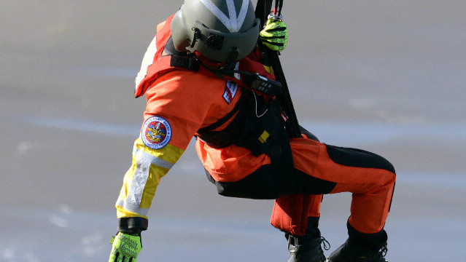
Rescue harness selection
Rescue harness selection for short-haul operations should evaluate how the rescuer will fly when encumbered with a loaded pack.
The best option is a configuration that does not require the rescuer to grasp the line to maintain an upright orientation.

Slide 16
Rescue harness selection
This can be accomplished by using a full-body harness with a sternal attachment point, which raises the CG of the wear.

Slide 17
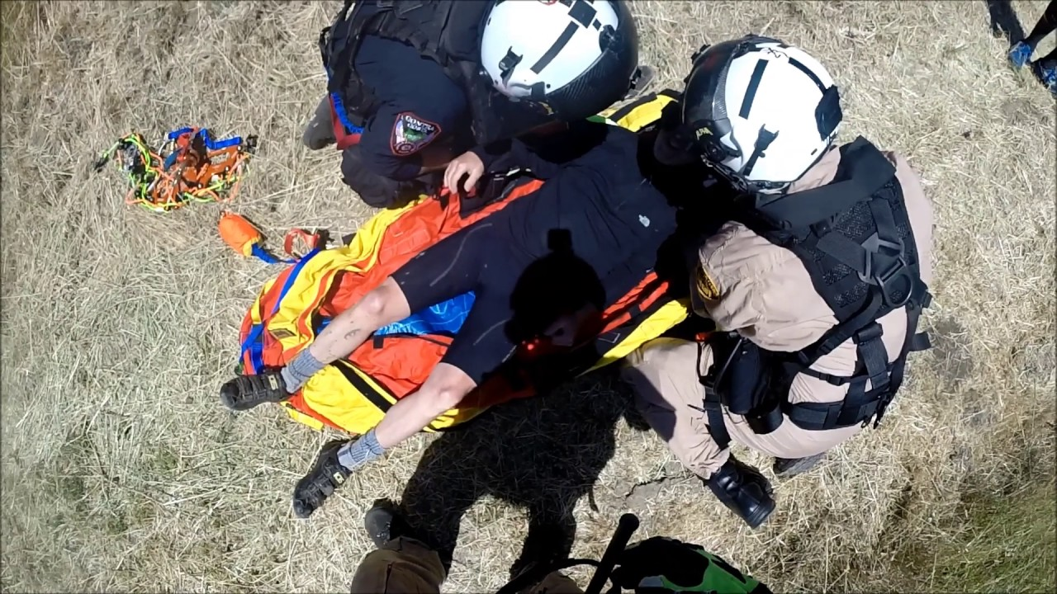
Rescue harness selection
Another option is to utilize a seat and chest harness combination in conjunction with preconfigured tether straps (e.g. daisy chains girth hitched to the seat harness and passed through the chest harness) that can quickly be attached to the short-haul line.

Slide 18
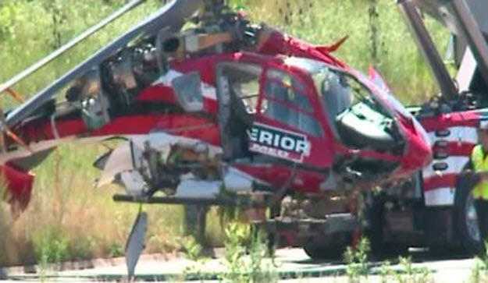
Short-haul Operational Hazards
The danger of line entanglement exists, because the short-haul line can quickly become snarled in vegetation or ground obstructions.

Slide 19
Short-haul Operational Hazards
The short-haul anchor point in the helicopter needs to be releasable in the event of line entanglement, which can't be cleared from the ground.
During extraction operations, all rescuers must be clear of potential entanglement hazards

Slide 20

Short-haul Operational Hazards
A very serious problem is the rotational spinning of a loaded litter during a short-haul evolution.

Slide 21
Short-haul Operational Hazards
Several factors can affect in-flight litter spinning, including the manner in which the litter is rigged (off center rigging aggravates a spin), an attendant off balance when lifted off the ground, rotor wash, and lack of forward airspeed.

Slide 22
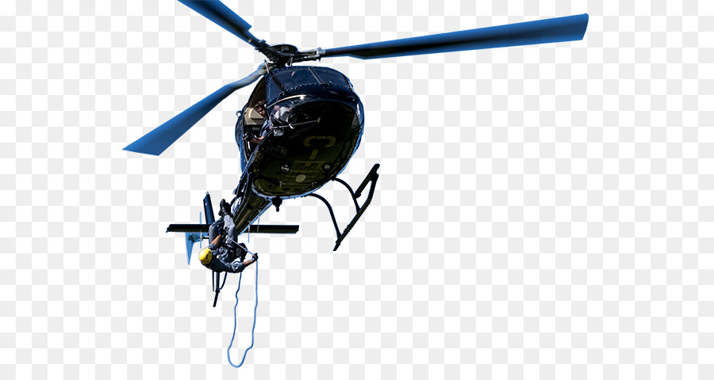
Short-haul Operational Hazards
Although some rescue organizations use a Stokes-style litter for short-haul rescue operations, a helicopter rescue bag (heli-rescue bag), such as a Bauman Bag provides a much more aerodynamic patient transport device.

Slide 23
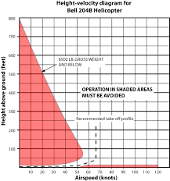

Slide 24
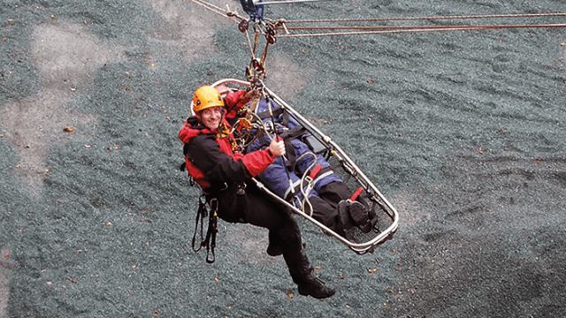
Litter Transfer in Exposed Terrain
Short-haul rescue operations in exposed technical terrain add a higher level of complexity

Slide 25
Litter Transfer in Exposed Terrain
When the stretcher is positioned in hazardously exposed terrain, it needs to be tethered with a dedicated cleanly rigged safety line to an anchor system, until the helicopter extraction is actually occurring.

Slide 26
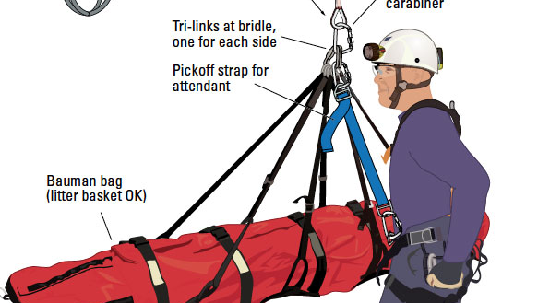
Litter Transfer in Exposed Terrain
The transfer to the short-haul line needs to occur in a well-coordinated and accurately briefed maneuver.

Slide 27
Litter Transfer in Exposed Terrain
When the terminus of the short-haul line is delivered to the ground rescuers, a designated team member should physically take control of it and position it within a few inches of the Bauman Bag connection point. When directed, a quick transfer of the Bauman Bag connection point is made from the safety line to the short-haul line.

Slide 28
Litter Transfer in Exposed Terrain
During this time the Bauman Bag will be momentarily disconnected from the safety line, however the aircraft will not become tethered directly to the ground.

Slide 29
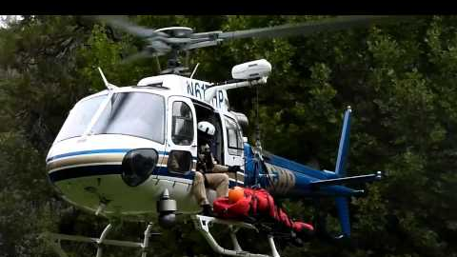
Bauman Bag

Slide 30
Litter Transfer in Exposed Terrain
There are more advanced belaying techniques for managing a completely suspended litter during the initial phase of a hoist extraction, which allow for a smooth transfer of weight to the short-haul line.

Slide 31
Litter Transfer in Exposed Terrain
The preferable scenario is to relocate the stretcher on to a shelf or outcropping, where the full weight is supported by the rock rather than a rope system.
during an extraction, the exposed downhill side of the stretcher should be kept free of personnel and rigging and considered off-limits.

Slide 32
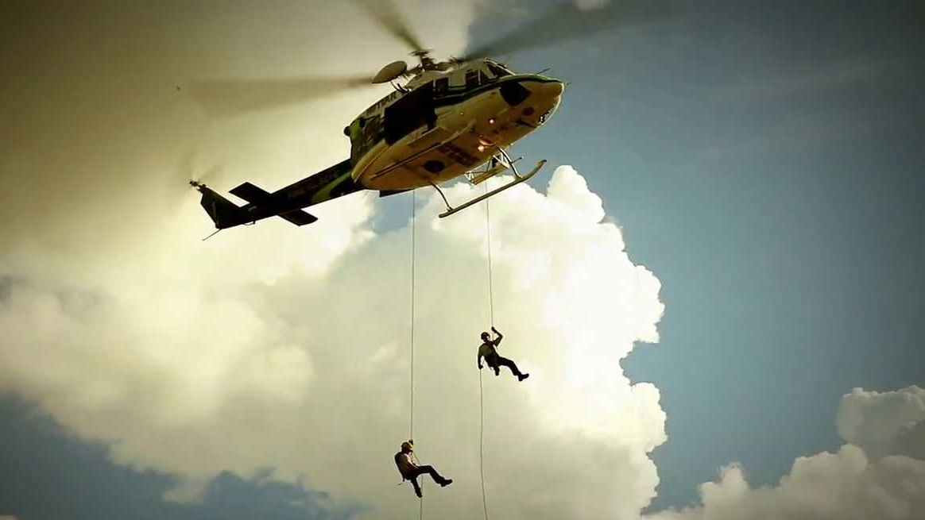
Litter Transfer in Exposed Terrain
Stepping to the downhill side of the litter during an extraction places a rescuer in jeopardy and creates the potential for entanglement to occur.

Slide 33
Short-haul Emergency Procedures
In the event of an in-flight emergency, jettisoning a human load from beneath a helicopter is not a realistic strategy.
A crash event occurs unbelievably quickly, and the reaction time of the spotter would likely be inadequate.

Slide 34
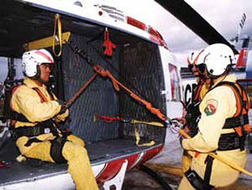
Short-haul Emergency Procedures
Survival of short-haul personnel during an in-flight emergency is best accomplished by having suspended personnel remain attached to the rope while the pilot attempts an emergency landing.

Slide 35
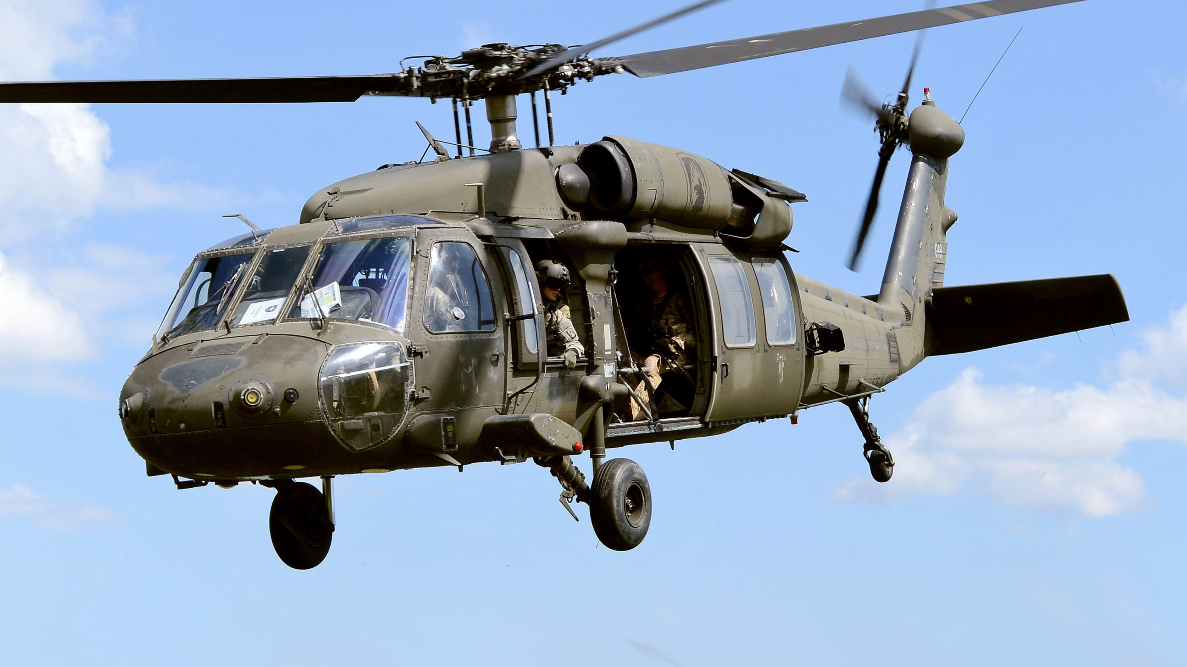
Short-haul Emergency Procedures
Rescuers should train in advance using the parachute landing fall (PLF) technique as a means of dissipating the energy of a hard impact.

Slide 36
Important considerations
An improvised helicopter short-haul during a rescue operation is dangerous.
Accidents and near-misses have occurred when agencies attempted to improvise a short-haul rescue without pre-planning or prior training.

Slide 37
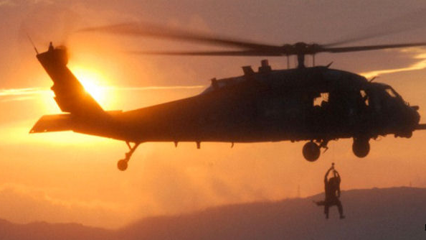
Important considerations
Helicopter short-haul requires pilot proficiency in vertical reference and precision placement flight operations.

Slide 38
Important considerations
The exposure time of the short-haul rescuer during forward flight is greater than during a helicopter rappel.
To minimize this exposure time, short-haul flights should be limited to the shortest possible flight distance practical.

Slide 39

Important considerations
A key advantage of helicopter short-haul is that hover time is typically shorter than with heli-rappelling or static hoist rescue operations.

Slide 40
Important considerations
Reliable clear radio communications are critical in addition to the use of standardized hand signals (Figure 42).

Slide 41
Important considerations
The shadow generated by the load provides a reference for the pilot and spotter in determining the height of the short-haul load above the ground.

Slide 42
Important considerations
Rescuer proficiency is easier to maintain with the short-haul technique than with helicopter rappelling, since short-haul requires fewer rescuer manipulations.
However, pilot proficiency with precision placement is significantly more critical.

Slide 43
Important considerations
A single line configuration for a short-haul line is most common with rescue organizations. Multiple line configurations create an added risk of entanglement when the lines become slack.

Slide 44
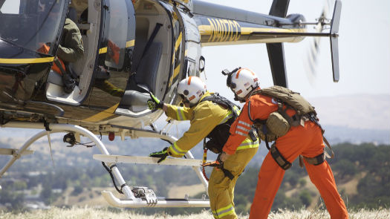
Important considerations
It is recommended that auto-locking carabiners be used for all connection points, both at the aircraft and on the end of the line, which provides a positive means to prevent in-flight vibration from accidentally unlocking a carabiner.

Slide 45
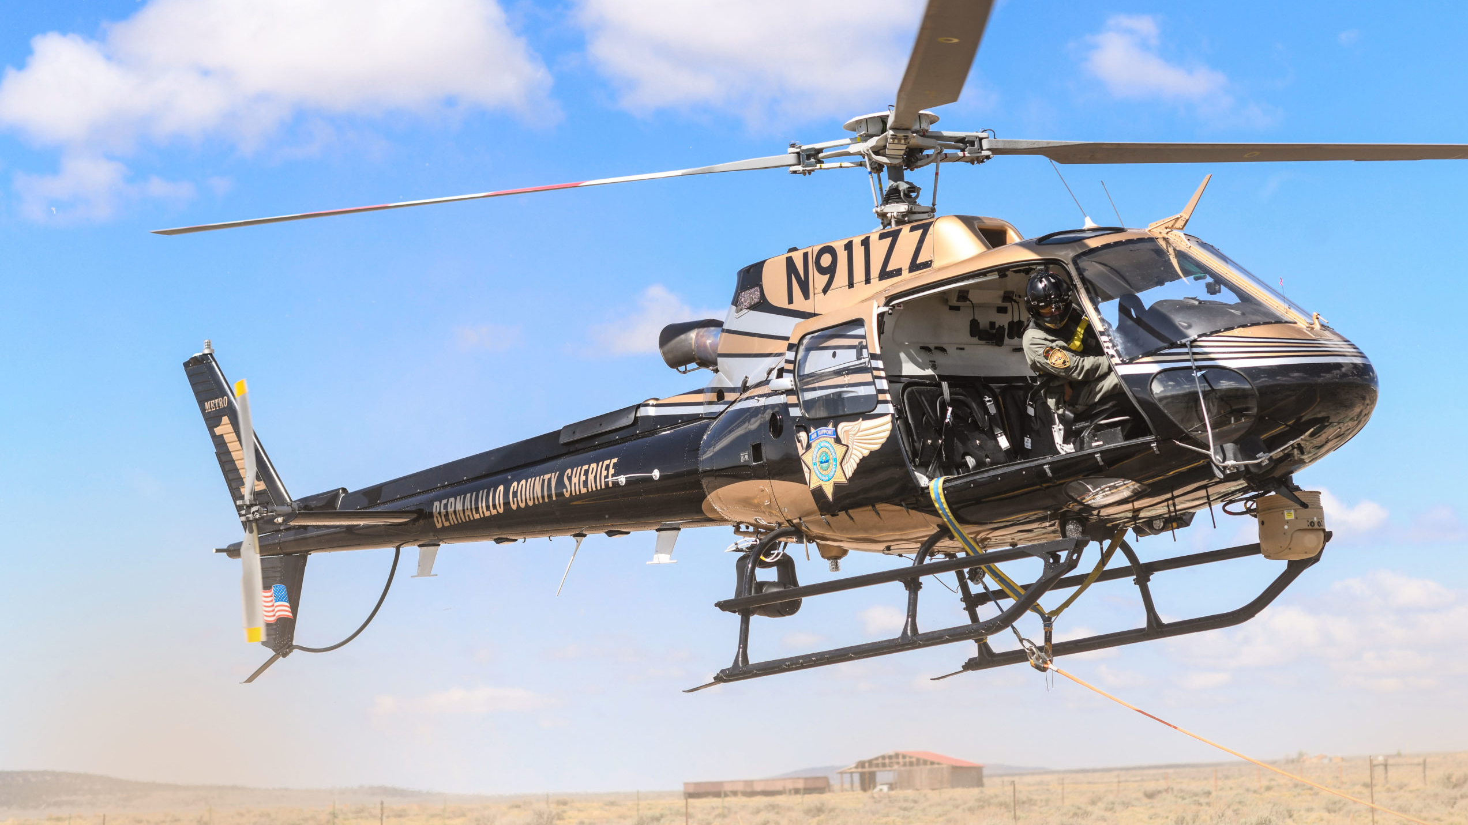
Important considerations
Rescue harness selection for short-haul operations should evaluate how the rescuer will fly when encumbered with a loaded pack.

Slide 46
Important considerations
The best option is a configuration that does not require the rescuer to grasp the line to remain upright.

Slide 47
Important considerations
This is accomplished by using a full-body harness with a sternal attachment point or a seat and chest harness with preconfigured straps (e.g. daisy chains) that can quickly be attached to the short-haul line.

Slide 48
Important considerations
When not in use, these attachment straps create a possible entanglement hazard, if left dangling from the harness. Secure the loose ends immediately when the attachment straps are not in use.

Slide 49
Important considerations
Knife or shears should be carried by all personnel and readily available in the event of line entanglement.
FM regulations, prohibit a person be carried as part of the external load under I FR conditions ( 14 CFR-Part 133.33[f]).

Slide 50
Helicopter Short-Haul Hand Signals
Move Upward
Move Downward
Hold Hover

Slide 51
Helicopter Short-Haul Hand Signals
Move Forward Wave-Off/Do Not Land Okay?/Okay

Slide 52
Helicopter Short-Haul Hand Signals
Connect
Disconnect

