Slide 1
Notes:
Chapter 9: Community Needs Assessment

Slide 2
Chapter 9 Community Needs Assessment
Notes:
Chapter 9: Community Needs Assessment

Slide 3
Introduction
Community health care needs
Identified by
Public health departments
Community paramedicine programs
Types of community health assessments
How the community paramedic uses them to address the needs of the whole patient
Notes:
Lecture Outline
I. Introduction
A. Community needs assessments
1. The community’s health care needs are identified by public health departments and community paramedicine programs.
2. This chapter discusses:
a. Two types of community health assessments
b. Role of the community paramedic in each type of community needs assessment
c. How community paramedics use community needs assessments
d. How the community paramedic assembles a list of community services that can address the needs of the patient

Slide 4
Community Health Needs Assessment (1 of 17)
Community health needs assessment (CHNA)
Formal assessment of the health demographics and health status of residents in a community
Performed by public health department, with a steering committee
Numerous health care, social service, and community-based stakeholders
Notes:
Lecture Outline
II. Community Health Needs Assessment
A. A community health needs assessment (CHNA) is a formal assessment of the health demographics and health status of the residents in a community.
1. Most often performed by a local public health department, with a steering committee comprised of numerous health care, social service, and community-based stakeholders

Slide 5
Community Health Needs Assessment (2 of 17)
Purpose of CHNA: Prioritize measures community will undertake to improve overall health of community
Common approach is:
Assemble the steering committee
Create a community map
Verify the collected data
Organize the collected data
Notes:
Lecture Outline
2. While each community decides how the CHNA will be developed, a common approach is outlined in this section.
3. The primary purpose of the CHNA is to prioritize measures that the community will undertake to improve the overall health of the community.

Slide 6
Community Health Needs Assessment (3 of 17)
Assemble the steering committee
Hospitals, physicians
Public health department
Elected officials, local universities
© Jones & Bartlett Learning.
Notes:
Lecture Outline
4. The first step in developing the CHNA is the assembly of the steering committee.
5. Typical stakeholders involved in the CHNA development process include:
a. Hospitals
b. Physicians
c. The local public health department
d. Medical and community clinics
e. School districts
f. Social assistance agencies (such as the United Way or the Area Agency on Aging)
g. Local universities
h. Elected and appointed officials
i. Emergency medical services (EMS) agencies
j. Home health and hospice agencies

Slide 7
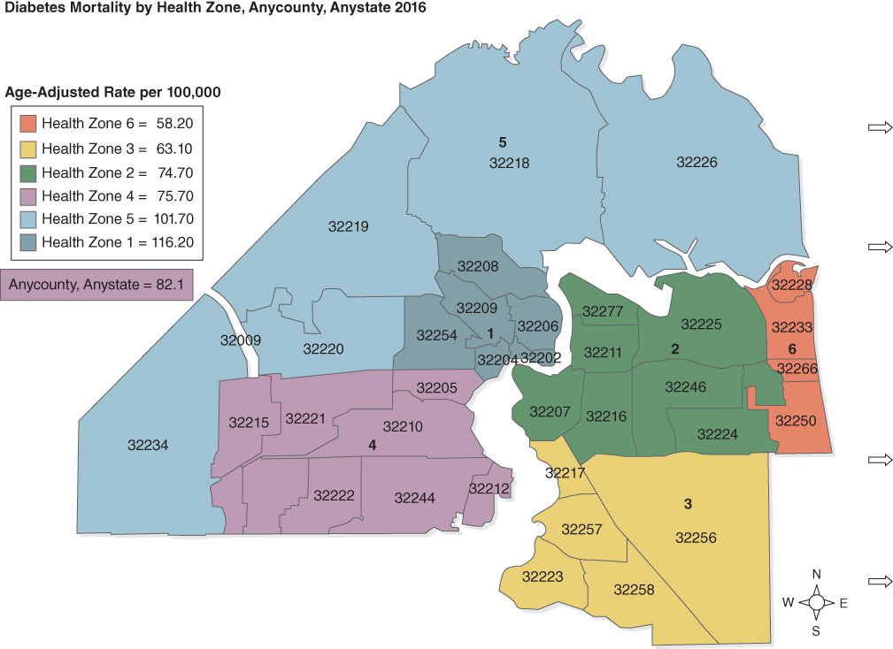
Community Health Needs Assessment (4 of 17)
Create a community map
Second step in developing a CHNA
Created by an assessor
An interactive tool that visually displays health care data in various overlays
© Jones & Bartlett Learning.
Notes:
Lecture Outline
B. Create a community map
1. The second step in developing a CHNA is the creation of a community map by an assessor.
a. An assessor is experienced at collecting and analyzing data.
2. A community map is an interactive tool that visually displays health care data in various overlays (layers of graphical data that highlight the locations of desired data).

Slide 8
Community Health Needs Assessment (5 of 17)
Create a community map (cont’d)
Overlays may include data such as:
Age, race, income of populations within a region
Prevalence of certain health conditions
Life expectancy
Health care utilization data
Notes:
Lecture Outline
3. Overlays of the community map may include data such as:
a. Age, race, and income of populations within a region
b. Prevalence of health conditions such as obesity, heart disease, diabetes, and asthma
c. Life expectancy
d. Health care utilization data such as frequency of 9-1-1 use, emergency department visits, and inpatient admissions

Slide 9
Community Health Needs Assessment (6 of 17)
Community maps are used as part of CHNA to provide health and health care insights to:
Policy makers
Journalists
Consumer groups
Academic researchers
Or as a stand-alone graphical depiction
Notes:
Lecture Outline
4. Community maps are used as part of the CHNA to provide health and health care insights to:
a. Policy makers
b. Journalists
c. Consumer groups
d. Academic researchers
5. It can also be used as a stand-alone graphical depiction of the community’s health.

Slide 10
Community Health Needs Assessment (7 of 17)
Community maps may help to identify geographical regions with:
High health risks
High health care utilization
Other factors that can be addressed by a community paramedicine program
Notes:
Lecture Outline
6. A community map may help to identify geographic regions with:
a. High health risks
b. High health care utilization
c. Other factors that can be addressed by a community paramedicine program

Slide 11
Community Health Needs Assessment (8 of 17)
Populating a community map
Data found in national, regional, and local resources
Most robust source: US Census Bureau
Also state and county public health departments
Notes:
Lecture Outline
7. Populating a community map
a. The data necessary to compile a community map can be found in many national, regional, and local resources.
b. The most robust source is the US Census Bureau, which collects:
i. Population, economic, and income statistics
ii. Data on several topics relating to health and health care, including:
a) Health insurance. The number and percentage of people in the community who have health insurance
b) Disability. The number and percentage of people in the community who have a disability
c) Health care industries. The number of health care–related businesses in the community
d) Social assistance industries. The number of agencies that provide community outreach services such as the United Way or Meals on Wheels
c. Many state public health departments publish health and related data that can be useful at the county or city level to populate a community map.
d. A county’s public health department is also an invaluable source of health and health care statistical information.
e. Most of these data resources can be accessed and downloaded into various statistical analytic tools that can be used by an assessor to populate a community map.

Slide 12
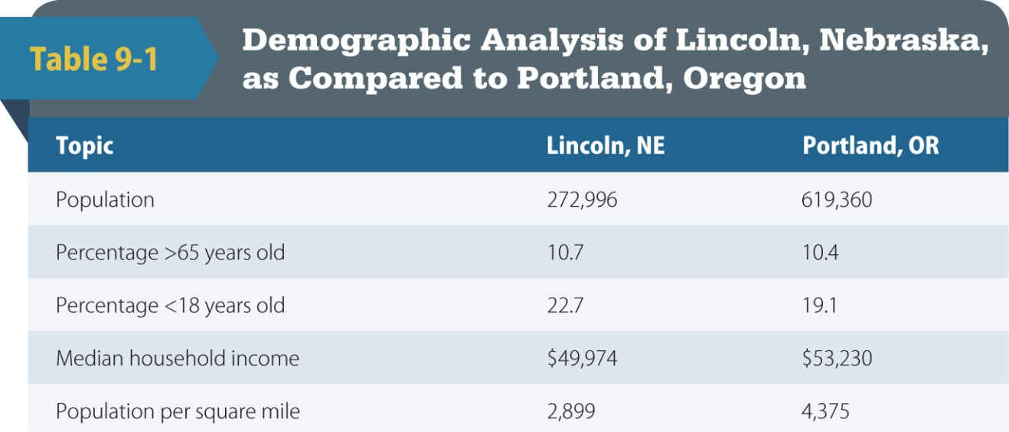
Community Health Needs Assessment (9 of 17)
Population
US Census Bureau
Department of Health and Human Services (DHHS)
Specific demographics
Source: US Census Bureau. QuickFacts: Portland City,Oregon.
http://www.census.gov/quickfacts/table/PST045215/4159000,00,3128000. Accessed July 7, 2016.
Notes:
Lecture Outline
8. Population
a. The US Census Bureau is an excellent resource to determine the population of a service area.
b. The assessor may also consult the state or local county’s Department of Health and Human Services (DHHS) offices.
c. The assessor will also acquire information on specific demographics of the community, including race, ethnicity, age, income, employment, and education.

Slide 13
Community Health Needs Assessment (10 of 17)
Health Statistics
Centers for Disease Control and Prevention (CDC) provides data on topics from:
Alcohol use to life expectancy
Data and statistics can be extracted at national, state, and county levels.
Comparison between all three levels can identify local needs.
Can be used as a data tool
Notes:
Lecture Outline
9. Health statistics
a. After collecting the population data for the community, the assessor digs deeper to help identify the specific health needs of the community.
b. The Centers for Disease Control and Prevention (CDC) provides close-to-current data and statistics on topics ranging from alcohol use to life expectancy.
c. Data and statistics on critical health topics can be extracted at the national, state, and local county levels.
d. A comparison between all three levels can help identify local needs that may not be recognized on a federal level.
e. The assessor will gather data and statistics on the following:
­Alcohol use
­Asthma
­Cancer
­Chronic disease
­Deaths and mortality
­Diabetes
­Cardiovascular disease
­Immunizations
Life expectancy
f. This information could be used as a data tool to secure funding to support existing or new public health efforts.
g. A data tool is the organization and presentation of compelling information on the need(s) in a community for local stakeholders.

Slide 14
Community Health Needs Assessment (11 of 17)
University resources
Example: University of Wisconsin’s Population Health Institute
Mental health data and statistics
DHHS: best source of information
Alcohol and drug dependency
Suicide
Notes:
Lecture Outline
10. University resources
a. Local and state universities are excellent resources for existing data bases in public health.
i. Example: University of Wisconsin’s Population Health Institute has a public access website (www.countyhealthrankings.org) that provides detailed overviews on the health and wellness of individual states and counties.
11. Mental health data and statistics
a. Government-based agencies, such as the DHHS, are the best source of information for mental health data and statistics.
b. Alcohol and drug dependence rates will be included in this set of data.
c. Example: A community’s incidence of suicide maybe higher than that of the state. Data revealing that the community also has a higher dependence on alcohol would serve as evidence to support a program channeling education/funding to combat substance abuse in an effort to prevent suicide.

Slide 15
Community Health Needs Assessment (12 of 17)
Verify the data
Compare the findings to existing community needs assessments in the area
Most counties and/or cities will compile an annual report; assessor compares these data against his or her data
Some data may be more current than others
Notes:
Lecture Outline
C. Verify the data
1. The next step in creating a CHNA is to verify the validity of the data by comparing the findings to existing community needs assessments in the area.
Most counties and/or cities will compile an annual report that includes the changes in their populations based on US Census reporting and local DHHS findings.
a. It is important for the assessor to compare these data to his or her findings because some data may be more current than others.
3. The reason current data are essential is illustrated in the following example:
a. The last CHNA in a county identified a significant incidence of emergency department visits for pediatric asthma cases, especially from three specific zip codes in the service area.
b. As a result, the local public health department created a storefront pediatric clinic to increase access to pediatric primary care, which resulted in a significant decrease in emergency department visits.
c. Relying on data from the previous CHNA and identifying a need that is already being addressed would have diverted scarce resources from new needs that may have developed in the community.

Slide 16
Community Health Needs Assessment (13 of 17)
Organize the data
Organized information will reflect strengths and weaknesses
Assessor may use a:
Spreadsheet
Chart
Bulleted list
Notes:
Lecture Outline
D. Organize the data
1. The next step is to organize the collected data.
2. This organized information will reflect the strengths and weaknesses in the local area.
3. The assessor may use a:
a. Spreadsheet
b. Chart
c. Bulleted list

Slide 17
Community Health Needs Assessment (14 of 17)
Organize the data (cont’d)
Data will be organized by category, including:
Gender
Race
Diseases
Mortality
National, state, local
Notes:
Lecture Outline
4. Data will be organized by category, including:
a. Gender
b. Race
c. Diseases
Mortality
National, state and local

Slide 18
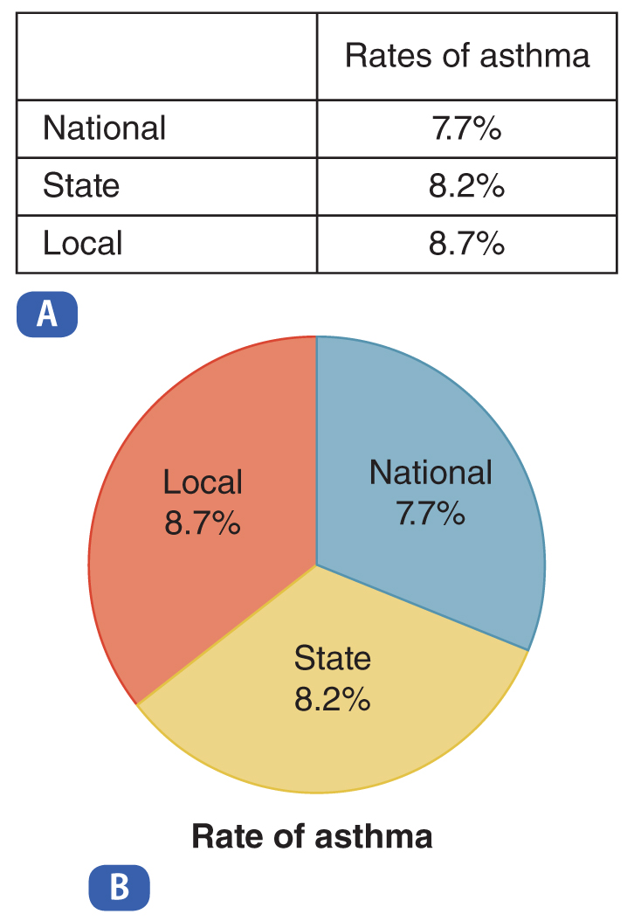
Community Health Needs Assessment (15 of 17)
Organize the data (cont’d)
Graphs and charts are visual tools to reinforce findings
Easier to comprehend than raw data
© Jones & Bartlett Learning.
Notes:
Lecture Outline
5. Once the data are organized, graphs and charts are generated as simple visual tools to reinforce the findings.
a. Graphs and charts are useful when submitting findings to influence community leaders because a visual representation of statistical information is often easier to comprehend than raw data.

Slide 19
Community Health Needs Assessment (16 of 17)
Statistical maps
Visual depiction of statistics
Often reveals correlations between factors that:
Lead to health disparities
Help identify community health needs
Notes:
Lecture Outline
6. Statistical maps
a. A statistical map is a visual depiction of statistics.
b. Often reveals correlations between factors that:
i. Lead to health disparities
ii. Help identify community health needs

Slide 20
Community Health Needs Assessment (17 of 17)
Statistical maps (cont’d)
Break down population demographics based on socioeconomic factors and health factors, such as:
Median income, gender, and employment by location, cardiovascular disease, stroke, diabetes, cancer, mortality rates
Statistical maps can identify geographic hot spots for public health issues.
Notes:
Lecture Outline
c. Statistical maps break down population demographics based on socioeconomic factors and health factors such as:
Median income by location
Gender and race by location
Employment by location
Cardiovascular disease
Stroke
Diabetes
Cancer
Mortality rates
d. When selecting the data to include in a statistical map, the assessor needs to determine the categories in which the local area is higher or lower as compared to the national average.
e. Mapping the area with statistics
i. Statistical maps of the community can strategically identify geographic hot spots for chronic disease and public health issues.
ii. A target area is the focused geographic and health-specific profile being addressed.
iii. To better prepare a strategy to combat a specific problem, public health officials would reference a demographic profile map (visual depiction of data such as age and gender) and socioeconomic profile map (visual depiction of data such as income, employment, and health status) created from the data.
iv. A statistical map will also help community paramedics understand the local issues that may influence an individual patient’s health.

Slide 21
Health Care Delivery System Gap Analysis
A health care delivery system gap analysis identifies gaps in local health care system.
Group format, as community paramedicine program is being developed
Participants may include hospital representatives, state and regional emergency medical services (EMS), public officials
Notes:
Lecture Outline
III. Health Care Delivery System Gap Analysis
A. A health care delivery system gap analysis identifies the potential gaps in the local health care system.
1. The health care delivery gap analysis is best achieved in a group format, with all stakeholders represented.
Participants in the health care delivery system gap analysis may include:
Hospital representatives
State and regional EMS officials
Public health departments
Home health agencies
Hospice agencies
Community-based organizations (eg, United Way, Meals on Wheels, area agency on aging, faith-based charities, Salvation Army)
Clinics
Educational institutions
Mental health agencies
Public officials
3. It may also include a brief overview of the community paramedicine concept to help guide the discussion to identify any gaps the participants believe to exist in the current local delivery system.
4. Typically, this meeting will occur as the community paramedicine program is being developed.
a. Thereafter, it may occur periodically to reassess the needs of the community and to assess how the community paramedicine program is impacting the community.

Slide 22
Community Resource Capacity Assessment (1 of 2)
Community resource capacity assessment
Assessment of all the resources available in the community that may assist community paramedic in management of patient
Community paramedicine program should:
Bring the people leading resources together
Have them update/communicate changes
Notes:
Lecture Outline
IV. Community Resource Capacity Assessment
A. Assessing all community resources
1. The community resource capacity assessment is an assessment of all the resources available in the community that may assist the community paramedic in the management of a patient.
a. Case managers and social workers develop their own list of resources, but rarely is there a complete compendium of these resources available to everyone involved in a patient’s care.
b. These resources are not always updated on a regular basis, leading to frustration or confusion.
2. The community paramedicine program should help facilitate an effort to bring the principal people leading the various community resources together on a regular basis so that these leaders may communicate any changes in their contact information or in the services they provide.
a. May be referred to as a Care Coordination Council or Community Resource Panel
b. As these meetings occur, participants should be encouraged to bring new resources or agencies to the meeting for introduction and to provide information on their services to the group.

Slide 23
Community Resource Capacity Assessment (2 of 2)
Outreach services
A program designed to deliver health care or social services as directly to the patient as possible
As a community paramedic, use the CHNA and the community resource capacity assessment to compile a list of available outreach services.
Notes:
Lecture Outline
B. Outreach services
1. An outreach service is a program designed to deliver health care or social services as directly to the patient as possible.
a. Many patients will not go to the community resource; therefore, the resource needs to come to them.
b. Some may argue that a community paramedicine program meets the definition of an outreach service.
c. Example of an outreach service: the Mobile Crisis Outreach Team (MCOT) in Texas
2. As a community paramedic, you will use the CHNA and the community resource capacity assessment to help compile a list of outreach services available in your community.

Slide 24
Web of Resources (1 of 8)
A collection of the outreach services available catalogued and referenced by:
Type
Geography
Eligibility
Hours of operation
Notes:
Lecture Outline
C. Web of resources
1. Typically a web of resources is a collection of the outreach services available, cataloged and referenced by:
a. Type
b. Geography
c. Eligibility
d. Hours of operation

Slide 25
Web of Resources (2 of 8)
Can be an online guide or map
Example: 504HealthNet project
Community paramedic can use it to send patients to the appropriate outreach services.
Notes:
Lecture Outline
2. This collection can be an online guide, or an online map, such as the one created by the 504HealthNet project in New Orleans.
3. The community paramedic can use a web of resources in navigating patients to the outreach services necessary to improve the patient’s health status.
a. Example: If the patient lacks health insurance and is ineligible for Medicaid, knowing that a Federally Qualified Health Center (FQHC) is available/accessible in the community allows the community paramedic to make the proper referral.

Slide 26
Web of Resources (3 of 8)
Outreach service mapping
Should be collaborative
List hospitals first
Have outreach services already in place (eg, CPR courses for new parents)
Notes:
Lecture Outline
4. Focus: outreach service mapping
a. The process of mapping outreach services in the community should be collaborative.
b. A logical process for building the resource inventory that can be put into a web of resources is to regularly host a collaborative meeting of all health care partners.
c. The first step in mapping outreach services is to list the hospital(s) in the area.
i. Hospitals may have outreach programs already in place (eg, CPR courses for new parents)

Slide 27
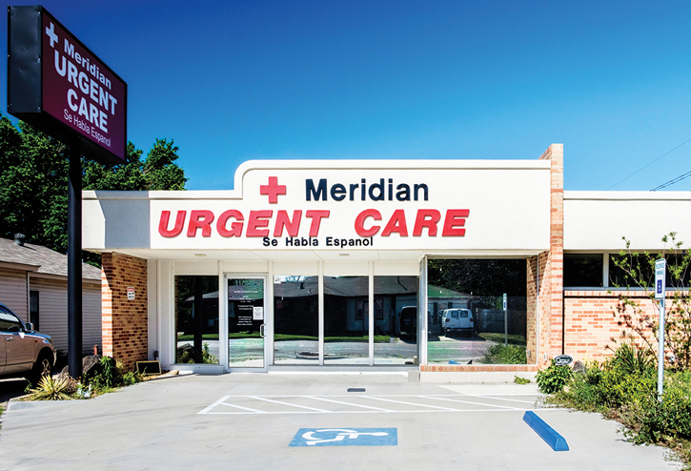
Web of Resources (4 of 8)
Hospitals (cont’d)
May be affiliated or support free or subsidized medical, dental, and eye clinics
Organize providers by specialty
© Betty LaRue/Alamy.
Notes:
Lecture Outline
Hospitals may be directly affiliated or support free or subsidized medical, dental, and eye clinics in the area.
iii. Urgent care center may also offer care on a sliding scale based on income and insurance plans.
d. Along with the clinics that help support patients based on income, a complete list of medical care providers in the community should be assembled.
e. Organize the medical care providers by specialty, including:
i. Primary care
ii. Obstetrics and gynecology (OB/GYN)
iii. Cardiology
iv. Pulmonology
v. Endocrinology
vi. Geriatric
f. Some medical care providers may offer subsidized care or provide community outreach education programs.
i. As a community paramedic, your role is to be a navigator to services, not the direct provider of services already available in the community.
ii. Before providing a patient with further information on a medical care provider, verify with the medical director or the patient’s primary care physician that you may proceed with the referral.

Slide 28
Web of Resources (5 of 8)
Employment services
Include requirements
Housing
Shelters and housing resources
Mental health and substance abuse services
Example: US Department of Veterans Affairs (VA)
Notes:
Lecture Outline
5. Employment services
a. Employment services should be included in the web of resources.
i. Private employment staffing agencies
ii. Public or nonprofit agencies
Along with contact information for each resource, the web of resources should list what types of requirements are needed.
i. A background check
ii. Completion of a physical
iii. An established place of residence
6. Housing
a. Available housing and shelter resources are rarely advertised in plain view of the general public, so it is realistic that someone who is homeless does not know how to access these resources.
b. There are many different levels of eligibility for these resources, and an extensive list with the entrance and occupancy requirements is key to proper use of what is available (eg, some shelters require employment).
c. Shelter and housing resources can be broken down by the situation that caused the need for housing or shelter.
i. Domestic violence shelters
ii. Long-term subsidized housing through government or foundation funding
iii. Short-term and long-term housing of veterans
iv. Mental crisis housing
v. Halfway housing where eligibility is based on the penal system
vi. Crisis housing supported by humanitarian organizations (eg, American Red Cross, United Way, and Salvation Army)
7. Mental health and substance abuse
a. Mental health and substance abuse services can include any combination of short-term, long-term, and crisis care.
b. There may be a variety of agencies available that could provide both outpatient and inpatient care.
Outreach services in this category should be organized according to the types of mental health services provided by each agency.
Some of these agencies are subsidized by government funding and may require focused eligibility requirements prior to patient enrollment.
i. Example: US Department of Veterans Affairs (VA)

Slide 29
Web of Resources (6 of 8)
Extended and transitional care facilities
Long-term placement of patients
Point of contact: social workers, case managers
© Photographee.eu/Shutterstock.
Notes:
Lecture Outline
8. Extended and transitional care facilities
a. Extended and transitional care facilities are a valuable resource.
b. Extended care facilities are facilities such as skilled nursing and assisted living facilities.
c. They are generally used for long-term placement of patients unable to care for themselves independently.
d. Points of contact: social workers and case managers

Slide 30
Web of Resources (7 of 8)
Religious organizations
Department of Health and Human Services
Special needs services
Easter Seals, The Red Cross, The National Autism Association
Notes:
Lecture Outline
9. Community outreach through religious organizations
a. Religious organizations often help to provide food and clothing to the community.
b. Note that eligibility for services through some religious organizations may vary based on their overall mission and the focus of the program enrollees.
c. The mental health needs of a patient may be complemented through the social support of a religious network.
i. In the case of mental health referrals, coordinate these referrals with the medical director or the patient’s primary care physician, depending on local protocols.
d. Volunteers may be able to perform tasks such as housing repairs, assisting with special housing needs such as building ramps, and home visits.
10. Department of Health and Human Services
a. The federal and state offices of the DHHS provide significant outreach services.
b. Local offices should be contacted to learn the services available in the community.
c. Examples of services offered by the Texas Health and Human Services Commission include education on:
i. Education on nutrition
ii. Administration of guardianship programs for patients who are unable to manage their daily needs due to disease or injury
iii. Support for people with special needs
iv. Information on the health and human services available in each community
d. Contacts within the DHHS may include, but are not limited to:
i. Senior population case workers help the patient navigate the various services available.
ii. Pediatric population case workers help the patient navigate the various services available.
iii. Grant officers help patients obtain funding for necessary health care or social needs.
iv. Public health officers may identify additional health care resources available for patients being cared for in the community paramedicine program.
v. Inventory officers may provide goods such as food, clothing, medical supplies, or even furniture.
vi. Case managers may help obtain insurance coverage for patients through Medicare and Medicaid.
vii. Indigent medical disability case workers may assist with navigation of patients to services available to indigent patients.
11. Special needs
a. Special needs services can encompass a variety of needs.
b. Determining the nonmedical needs of a patient enrolled in a community paramedicine program should be part of the overall patient intake process.
i. Checklists can be exceptionally valuable to help determine these needs.
c. A great way to begin this process is to first consult the local DHHS office for a list of organizations.
d. A few examples of outreach services for patients with special needs include the following:
i. Easter Seals provides teams of therapists, teachers, and other health professionals to help people overcome challenges.
ii. The American Red Cross provides disaster relief to people impacted by everything from a house fire to a natural disaster.
iii. The American Cancer Society provides support, education, and resources for patients and families of people with cancer.
iv. Early childhood intervention services are organizations that provide developmental therapies to children at risk of or displaying developmental or social delays.
v. The National Autism Association, the Autism Society of America, and Autism Speaks are organizations that provide support to parents and caregivers of children and adults on the autism spectrum disorder.
vi. Therapeutic animal services are organizations that provide therapy with horses, cats, and dogs for patients with vision, hearing, mobility, and behavioral challenges.

Slide 31
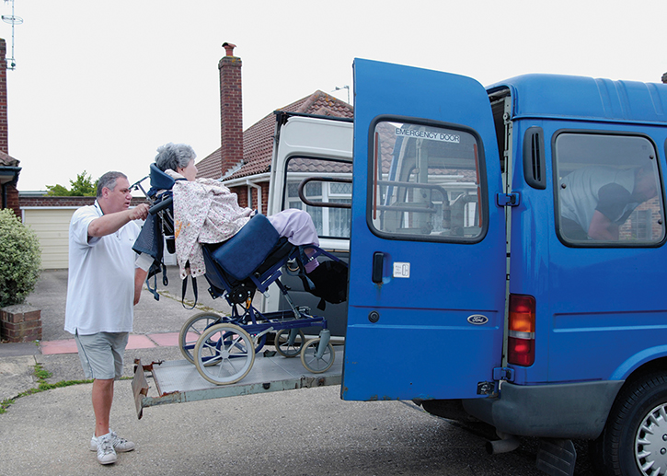
Web of Resources (8 of 8)
Transportation
Services should be organized by specific services provided
Safety net programs
Cash transfers, food-based programs, fee waivers
© Patricia Nelson/Getty.
Notes:
Lecture Outline
12. Transportation
a. Transportation services should be organized by the specific services provided, such as bus vouchers or handicapped-accessible services.
b. Access to services is key, because some patients will not have their own transportation or the funds to obtain it.
c. Some hospitals may offer limited transportation services to and from medical appointments.
13. Safety net programs
a. Safety net programs are programs that seek to prevent those in poverty or those vulnerable to poverty from falling below a certain poverty level.
b. Safety net programs may be provided by the public sector, such as:
i. Federal
ii. State
iii. Local government
Or by the private sector, such as:
i. Nongovernmental organizations
ii. Private firms
iii. Charities
iv. Informal household transfers
c. Safety net programs include the following:
i. Cash transfers. Local charitable organizations may be able to provide cash assistance for patients to help with utility bills, rent, or even prescription medications.
ii. Food-based programs. Communities often have supplementary feeding programs and programs to distribute food stamps, vouchers, and coupons.
iii. In-kind transfers. Local charitable organizations may provide school supplies and uniforms.
iv. Price subsidies. Some programs provide assistance for purchasing food, electricity, or public transport.
v. Public works departments. Utilities may have special programs to help make utility bills more affordable to those in need.
vi. Fee waivers and exemptions. Programs may be available to assist in health care, schooling, and utilities costs.

Slide 32
Applying Community Needs Assessments in Patient Care (1 of 2)
Application example
55-year-old man; frequent trips to the emergency department for depression; more than average alcohol consumption
Community paramedic should:
Educate man on his condition
Strengthen access to use of primary care
Use access points in web of resources
Notes:
Lecture Outline
V. Applying Community Needs Assessments in Patient Care
A. Application example
1. Let’s apply the information the community paramedic can gain from studying the CHNA, health care delivery system gap analysis, and community resource capacity assessment for an individual patient.
a. Example: Mr. Corbett is 55-year-old man who makes frequent trips to the emergency department for depression. He has been referred to your program to see if he can find better resources for his needs. He has congestive heart failure and you learn that he consumes more than the average daily intake of alcohol.
b. Typical referrals that may help Mr. Corbett include both medical and mental health components.
i. Educate him on his condition
ii. Ensure medication compliance
iii. Strengthen access to and use of primary care
c. Using the access points contained in your web of resources for agencies that help patients with depression and/or anxiety conditions could help prevent the need for actual substance abuse treatment in the future.

Slide 33
Applying Community Needs Assessments in Patient Care (2 of 2)
Patient referral process
Key to linking patients with proper outreach services to meet their needs
Community paramedic or social worker should make phone calls to refer patient directly
Community paramedic: navigator of services to treat patient as a whole person
Notes:
Lecture Outline
B. Patient referral process
1. The patient referral process is key to linking patients with the proper outreach services to meet their needs.
2. To truly serve the patient, it is important that phone calls be made to help actually refer the patient directly.
a. Depending on local protocols, these calls may be made by the community paramedic, a case manager, or a social worker on the patient’s health care team.
b. Since one of the goals of enrollment in a community paramedicine program is to empower patients to self-manage their needs, the community paramedic should teach the patient how to access these resources by having the patient participate in the phone call.
It is the duty of the community paramedic and the patient’s health care team to ensure that the patient is not simply told about a resource, but is truly referred to a resource.
Anytime a patient receives care from multiple providers, there is a risk that no one will see the patient as a whole.
a. As the community paramedic, you need to help fill this gap by being the navigator of services to the patient and the eyes and ears of the medical director.

