Slide 1
Advanced GEMS Course
Lesson 6
Foley and Colostomy Bag Care

Slide 2
Objectives
Identify the patient with a Foley catheter and/or colostomy bag.
Know what role the Foley catheter and colostomy bag play in an older patient.
Know the basic equipment and operation of the Foley catheter and colostomy bag.
Discuss and describe the special concerns of a Foley catheter and colostomy bag in an older patient.
Notes:
INSTRUCTOR NOTES AND TIPS By the end of Lesson 6, participants should be able to:
Identify the patient with a Foley catheter and/or colostomy bag.
Know the Foley catheter and colostomy bag basic operational function, settings, and equipment.
Discuss and describe the special concerns of a Foley catheter and/or colostomy bag in the older patient.
Describe the signs and symptoms of a patient with a malfunctioning Foley catheter and/or colostomy bag.
Discuss how patients with a Foley catheter and/or colostomy bag are managed.

Slide 3
Objectives
Describe the signs and symptoms of a patient with a malfunctioning Foley catheter and/or colostomy bag.
Discuss how patients with a Foley catheter and/or colostomy bag are managed.
Notes:
INSTRUCTOR NOTES AND TIPS By the end of Lesson 6, participants should be able to:
Identify the patient with a Foley catheter and/or colostomy bag.
Know the Foley catheter and colostomy bag basic operational function, settings, and equipment.
Discuss and describe the special concerns of a Foley catheter and/or colostomy bag in the older patient.
Describe the signs and symptoms of a patient with a malfunctioning Foley catheter and/or colostomy bag.
Discuss how patients with a Foley catheter and/or colostomy bag are managed.

Slide 4
Dispatch
The triage officer has assigned your transport unit to Mr. Robert “Bob” Sachamono. Mr. Sachamono is a patient with a Foley catheter bag and colostomy bag in place. He is to be evacuated to the Kenwood Manor Assisted Living and Rehab.
Notes:
INSTRUCTOR NOTES AND TIPS
Triage assignment: The triage officer has assigned your transport unit to Mr. Robert “Bob” Sachamono, a 79-year-old male patient in Room 17. Mr. Sachamono is a stable patient with a Foley catheter bag and colostomy bag in place. He is to be evacuated to the Kenwood Manor Assisted Living and Rehab.

Slide 5
Initial Observation
The patient is being evacuated due to the flood.
He is stable and has no complaints, but due to his Foley catheter and colostomy bag, he needs medical observation during transport.
He is English speaking, awake, alert, and fully oriented.
No one else is in the room with him.
Notes:
INSTRUCTOR NOTES AND TIPS
Scene safe: Secure
Situation: Evacuation relocation
Cultural: English speaking
Communication: Awake, alert, and oriented x4
Medical devices: Foley catheter and colostomy bag
Chief complaint: He has no complaints of physical discomfort.

Slide 6
Primary Survey
LOC: Awake and alert; A&O ×4
Airway: Intact and open
Breathing: Clear lungs, RR: 14
Circulation: Skin is pink and dry, pulse is normal rate rhythm and quality, HR: 82
Sick or not sick?
Notes:
INSTRUCTOR NOTES AND TIPS
Level of consciousness: Awake and alert
Airway: Open, intact
Breathing: Normal rise and fall, clear lung sounds, RR: 14
Circulation: HR: 82, pulse has good rate rhythm and quality
First impression: Stable patient with Foley catheter bag and colostomy bag
Differential diagnosis: None at this time

Slide 7
GEMS Assessment
G: 79-year-old male
E: Skilled nursing facility
M: Colon cancer, bladder cancer, and RA
S: Moderate family support; visitors monthly; limited physical activity due to age and RA
Notes:
INSTRUCTOR NOTES AND TIPS
Geriatric: 79-year-old residing in a skilled nursing facility
Environmental: Skilled nursing facility with no other patients in the room
Medical: Colon cancer (proctocolectomy to remove cancer), colostomy bag; bladder cancer, Foley catheter; and rheumatoid arthritis
Social: Moderate family support; visitors monthly; limited physical activity due to age and RA

Slide 8
Discussion
What is a urinary catheter?
What are the indications for a urinary catheter?
© Medicimage/Science Source.
Notes:
INSTRUCTOR NOTES AND TIPS
Urinary catheters are hollow, partially flexible tubes that collect urine from the bladder.
Urinary catheters come in many sizes and types.
Catheters can be made of:
Rubber
Plastic (PVC)
Silicone
Latex
The catheter tube leads to a drainage bag that holds collected urine.
What are the indications for catheter insertion?
Urinary catheters are used when a patient is unable to empty their bladder. The goal of the catheter is to ensure kidney damage does not occur by emptying the bladder and avoiding any backup of urine.
Older people may need to use urinary catheters for a long amount of time and sometimes on a permanent basis.

Slide 9
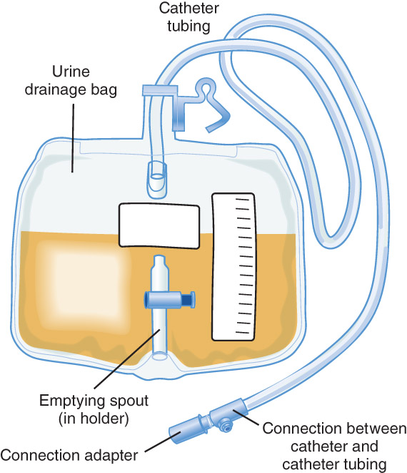
Discussion (cont’d)
What are the parts of an indwelling (Foley) urinary catheter?
© Jones & Bartlett Learning.
Notes:
INSTRUCTOR NOTES AND TIPS
What are the parts of an indwelling (Foley) urinary catheter?
Catheter tubing
Urine drainage bag
Emptying spout
Explain to the participants the process of placing a urinary catheter (sterile procedure).
Discuss why sterile application is so important (infection).
Foley catheters can dislodge either by balloon deflation or trauma if pulled out with an intact balloon.
In the case of a dislodged catheter, the EMS practitioner should NEVER attempt to put the same catheter back in the patient. Sterile technique is needed, which means a new catheter is the only option.
Complications of a urinary catheter include:
Healthcare-associated urinary tract infections (UTIs); symptoms include:
Fever
Chills
Headache
Cloudy urine (due to pus)
Burning of the urethra or genital area
Leaking of urine out of the catheter
Blood in the urine
Foul-smelling urine
Low back pain and achiness
Allergic reaction to the material used in the catheter, such as latex
Bladder stones
Blood in the urine
Injury to the urethra
Kidney damage (with long-term indwelling catheters)
Infection of the urinary tract, kidney, or blood (septicemia)
Urosepsis, trauma, and dehydration
Altered mental status is a significant sign with urosepsis.
Concentrated dark, minimal urine output is a significant sign of dehydration in the older patient.
Sediment in the bag can also be a sign of dehydration or other medical issues.
Bleeding or blood clots noted in the Foley catheter bag may be a sign of trauma.

Slide 10
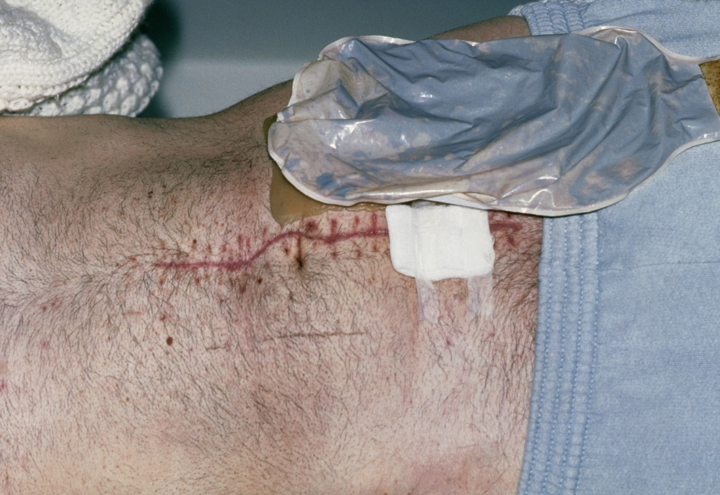
Discussion (cont’d)
What is a colostomy bag?
© Dr P. Marazzi/Science Source.
Notes:
INSTRUCTOR NOTES AND TIPS
What is a colostomy bag?
A small, surgically constructed opening is made in the patient’s stomach where the colon that is left in the body is attached. The colostomy bag is attached to this opening; it collects fecal matter that exits the body through this hole instead of through the anus.
The patient wears the bag, which attaches to their skin around the opening and collects fecal matter. The bag is changed regularly to prevent skin irritation, infection, and/or odor.
Discuss with participants that the contents of the bag have a lot to do with where the stoma is placed.
If the stoma is connected to the small intestines, a more liquid content is expected.
If the stoma is connected to the large intestines, a more solid content is expected.

Slide 11
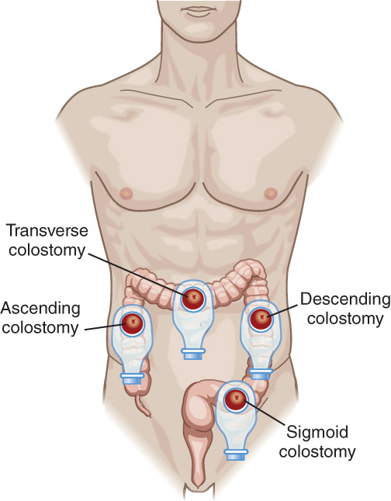
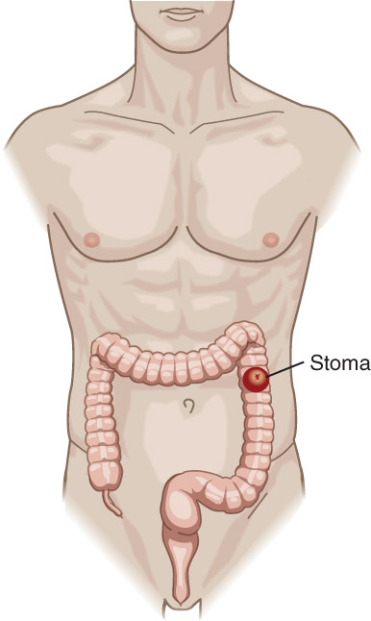
Discussion (cont’d)
What are the complications associated with a colostomy bag?
© Jones & Bartlett Learning.
© Jones & Bartlett Learning.
Notes:
INSTRUCTOR NOTES AND TIPS
Parastomal hernia
A hernia is when an internal part of the body pushes through a weak or compromised area in the muscle or tissue wall.
A parastomal hernia is when the intestines push through the muscles around the stoma. This results in a noticeable bulge under the skin.
Due to the weakening of the abdomen muscles during surgery, people with colostomies have an increased risk of developing parastomal hernias.
Patients may avoid parastomal hernias by:
Wearing a support belt or support underwear
Avoiding heavy lifting and straining
Maintaining a healthy weight
A parastomal hernia may make it more difficult to hold the colostomy appliance in place and change it.
Stoma blockage
Patients develop blockages in their stoma due to the buildup of food.
Signs of a blockage include:
Watery stools
Infrequent stools
Bloating and/or swelling of the abdomen
Cramps
Swollen stoma
Nausea and/or vomiting
Skin irritation and/or infection: The skin around the stoma becomes red, raised, irritated, and sore.
Stomal fistula: A small channel develops in the skin alongside the stoma.
Stoma retraction: The stoma migrates below the level of the skin after the initial swelling goes down. This can lead to leakages and the inability for the bag to properly seal.
Stoma prolapse: The stoma comes out too far above the level of the skin. This can be corrected with a different type of bag; if too severe, surgery will be required.
Stomal stricture (stenosis): The stoma becomes scarred and narrowed. Surgery may be required to fix.
Leakage: Digestive waste leaks from the colon onto the external skin or inside the abdomen. Different bags may help with this issue; however, surgery may also be needed to correct.
Stomal ischemia: The blood supply to the stoma is restricted and reduced after surgery. This too may require further surgery to correct.

Slide 12
Pre-transport Check
Records: No medical records can be located. The staff states that they will send/fax them to the receiving facility when they are found.
ECG: HR: 82, NSR, RR: 14, BP: 133/84
Personal items and medications are packed and ready for transport.
Urine output: 800 cc, yellow and clear
Colostomy bag: ¼ full
Notes:
INSTRUCTOR NOTES AND TIPS
The patient has missing medical records.
Prior to departure, obtain the patient report. The nurse gives a brief patient report stating he is stable and ready for immediate transfer. He has no allergies and takes Actemra (medication for his RA). He is AAO x4, with a GCS of 15.
Urine output is 800 cc in the bag, yellow and clear. (Document and then drain the bag prior to departing.)
Colostomy has no signs of leakage, infection, or irritation. Bag is ¼ full. Empty/change the bag prior to departing, especially if the bag is filled with air (gas). This will avoid the chance of the bag being compressed, which can lead to leakage or even total bag failure. Document the contents for consistency and amount.
Discuss with participants the need to document the urine output. (What is normal and what is not normal for this patient?)
The normal range for an adult urinary output is between 400 and 2,000 mL of urine daily; this decreases with age.
Normal fluid intake is about 2 liters per day for a healthy adult; this too decreases with age.
Additional factors that contribute to a decrease in daily urine output include:
Kidney disease
Perspiration
Caffeine
Alcohol
Medications
Age

Slide 13
En Route (cont’d)
Patient status: Patient is reassessed.
Airway: Patent
Breathing: 14 bpm
Circulation: HR: 80, BP: 126/81. Skin is pink and dry. NSR on monitor.
Foley and colostomy bag remain intact without leakage or issue.
Notes:
INSTRUCTOR NOTES AND TIPS
Manage ABCs (airway, access, monitoring).
Reassess the urine catheter and colostomy, especially after moving the patient, to ensure both are in place and without leakage or issue. Upon arrival to the transfer destination, document the amount in the bags and report to the receiving staff.

Slide 14
Detailed Assessment
S: N/A
A: NKDA
M: Actemra (RA), stool softener
P: Colon cancer with colectomy (colostomy bag); bladder cancer (long-term urine catheter in place); rheumatoid arthritis
E: Relocation due to evacuation
Notes:
INSTRUCTOR NOTES AND TIPS
Signs/Symptoms: N/A
Allergies: NKDA
Medications: Actemra taken for the rheumatoid arthritis; stool softener taken for recent issues with slowed stool passing.
Past medical history: Colon cancer with colectomy (colostomy bag); bladder cancer (long-term urine catheter in place); and rheumatoid arthritis
Events: Relocation due to evacuation

Slide 15
Detailed Assessment (cont’d)
Risk factors: ?
HEENT: PERRL
Chest: Unremarkable
Abdomen: Colostomy bag in place; stoma without redness, irritation, or infection
Pelvis: Stable; Foley catheter in place
Extremities: Unremarkable
Notes:
INSTRUCTOR NOTES AND TIPS
Risk factors: Leakage, infection, and dislodgement with movement
Assessment and reassessment before and after moving the patient needs to be done to ensure dislodgement did not occur of both the urine catheter and colostomy bag.

Slide 16
Case Summary
Short- and long-term urine catheters are common medical items seen in older patients.
Hospital-acquired infections from urine catheter placement is one of the leading causes of severe and even deadly infections (sepsis) in the elderly.
Notes:
INSTRUCTOR NOTES AND TIPS
Discuss with the class the importance of a good assessment and the appropriate documentation when working with urine catheters.
Discuss sepsis and the relationship it has with Foley catheters.

Slide 17
Case Summary (cont’d)
Proper familiarity and assessment of patients with urine catheters can help identify abnormalities and assist in the prevention of infection.
Proper documentation of output amounts, along with urine color and consistency, is also essential.
Notes:
INSTRUCTOR NOTES AND TIPS
Discuss with the class the importance of a good assessment and the appropriate documentation when working with urine catheters.
Discuss sepsis and the relationship it has with Foley catheters.

Slide 18
Case Summary (cont’d)
Colostomy bags are usually cared for by the patient, the patient’s family, or a direct caretaker. However, the EMS practitioner may encounter the colostomy bag when working with the geriatric population.
Proper assessment of the stoma (infection, blockage, unusual discharge) can help with overall care of the patient and the accuracy when delivering report.
Notes:
INSTRUCTOR NOTES AND TIPS
Discuss with the class the importance of a good assessment and the appropriate documentation when working with colostomy bags. Discuss appropriate transfer protocols to ensure the best outcomes for the patient.

Slide 19
Case Summary (cont’d)
Draining or replacing the bag prior to transport is recommended to avoid leakage or damage to the bag.
Notes:
INSTRUCTOR NOTES AND TIPS
Discuss with the class the importance of a good assessment and the appropriate documentation when working with colostomy bags. Discuss appropriate transfer protocols to ensure the best outcomes for the patient.

