Slide 1
Notes:
Chapter 17: Communication Strategies for Children With Special Needs

Slide 2
Chapter 17 Communication Strategies for Children with Special Needs
Notes:
Chapter 17: Communication Strategies for Children with Special Needs

Slide 3
Introduction
Children with special health care needs
Children with chronic physical, developmental, behavioral, or emotional conditions
Require special services
In-home follow-up
Preventive care services
Notes:
Lecture Outline
I. Introduction
A. Children with special health care needs
1. More than 11 million children younger than 18 years of age in the United States are classified as having special health care needs.
a. Such conditions affect 23% of US households with children.
b. The federal Maternal and Child Health Bureau defines children with special health care needs as children with chronic physical, developmental, behavioral, or emotional conditions who require special services (eg, health care, educational resources, and behavioral therapy).
2. Because a child with special health care needs may require unique and/or frequent health and related services, he or she may benefit from:
In-home follow-up
Preventive care services
i. Depending on the community paramedicine program, the community paramedic may be called to provide these services.
3. Central to every patient encounter are the principles of:
a. Patient- and family-centered care
b. Good communication skills
4. Significant challenges to communication include:
a. Physical, developmental, and behavioral conditions
b. Common health care provider misperceptions and misunderstandings

Slide 4
The Community Paramedic’s Role (1 of 3)
Pediatric care forms a distinct niche as community paramedicine evolves
Demonstration project at Indiana University
Milwaukee, WI: Community paramedics identify risks to infants in the home to reduce infant mortality
Notes:
Lecture Outline
II. The Community Paramedic’s Role in Caring for Children With Special Needs
A. The pediatric care niche
1. In the prehospital emergency setting, emergency medical services providers and community paramedics may have limited experience with children who have special health care needs.
2. As community paramedicine continues to evolve, pediatric care is beginning to form a distinct niche within this field.
a. Demonstration project at Indiana University (funded by an Emergency Medical Services for Children Targeted Issues grant)
b. Milwaukee, WI: Community paramedics trained to identify and address risks to infants in the home to reduce infant mortality

Slide 5
The Community Paramedic’s Role (2 of 3)
Pediatric care niche (cont’d)
Follow-up and preventive care for asthma
Specific community paramedicine intervention
© Hero Images Inc./Alamy.
Notes:
Lecture Outline
3. Follow-up and preventive care for asthma is emerging as an example of a specific, evidence-based community paramedicine intervention.

Slide 6
The Community Paramedic’s Role (3 of 3)
Specific role for community paramedicine in caring chronic conditions in pediatric population has yet to be defined
Primary care physician: develops the plan of care for patients with chronic conditions
Community paramedic’s role: monitor–manage–educate triad of responsibilities
Notes:
Lecture Outline
4. A specific role for community paramedicine in caring for issues directly related to chronic physical, developmental, behavioral, or emotional conditions in the pediatric population has yet to be defined.
a. In general, a primary care physician develops the plan of care for patients with such chronic conditions, and the community paramedic’s role is limited to the monitor-manage-educate triad of responsibilities.

Slide 7
Developmental Milestones (1 of 11)
Child development
Developmental milestones may be measured in terms of:
Gross motor skills
Fine motor skills
Communication and language development
Cognitive maturity
Notes:
Lecture Outline
III. Developmental Milestones
A. Child development
1. Childhood development varies according to a combination of factors, including:
a. Genetics
b. Environment
2. Developmental milestones may be measured in terms of:
a. Gross motor skills
b. Fine motor skills
c. Communication and language development
d. Cognitive maturity

Slide 8
Developmental Milestones (2 of 11)
Child development (cont’d)
Best way to understand the functional level of any child is to ask the parent/caretaker
Ask at which age or grade level the child functions or how the child expresses basic emotions
Ask the best way to approach the child, and which techniques to use to mitigate the child’s anxiety
Notes:
Lecture Outline
3. The best way to understand the functional level of any child is to ask the parent/caretaker.
a. Ask at which age or grade level the child functions or how the child expresses basic emotions such as pain or fear.
b. Ask the best way to approach the child and which techniques can be used to mitigate the child’s potential anxiety of working with an unfamiliar person.

Slide 9
Developmental Milestones (3 of 11)
Developmental delays
Four main areas are subject to developmental delays:
Speech or language development
Motor development
Social and emotional development
Cognitive development
Notes:
Lecture Outline
B. Developmental delays
1. Developmental delay refers to the situation in which a child does not reach specific developmental milestones by an expected age.
2. Four main areas are subject to developmental delays:
a. Speech or language development includes the ability to communicate effectively with others, including both receptive and expressive language.
b. Motor development includes the ability to balance, walk, use the hands or fingers, and demonstrate eye–hand coordination.
c. Social and emotional development includes the ability to have meaningful relationships with others, interact with others, and pick up on social cues.
d. Cognitive development includes thinking skills, learning, reasoning, and memory skills.

Slide 10
Developmental Milestones (4 of 11)
Communication disorders
Encompass a wide array of problems in:
Language
Speech
Hearing
Conditions due to factors such as disfluency, aphasia, and delays in speech and language development
Notes:
Lecture Outline
C. Communication disorders
1. Communication disorders encompass a wide array of problems in:
a. Language
b. Speech
c. Hearing
2. Conditions due to a wide variety of factors:
a. Disfluency (stuttering and other disruptions in speech flow)
b. Aphasia (difficulty using words)
c. Delays in speech and language development
3. Conditions associated with communication disorders:
a. Cerebral palsy
b. Deafness
c. Anatomic abnormalities such as cleft lip or cleft palate
4. The first 3 years of life are the most critical period acquiring speech and language skills.
a. By the first grade, approximately 5% of children have noticeable speech disorders, including:
i. Stuttering
ii. Speech sound disorders
iii. Dysarthria (difficult or unclear speech articulation)
b. Children with special health care needs who have communication deficits may develop their own type of sign language to communicate.

Slide 11
Developmental Milestones (5 of 11)
Motor and movement disorders
Often recognized at the infant and toddler stages of development
Child is unable to perform age-appropriate skills such as walking, catching a ball, playing sports
Most common cause is cerebral palsy
Notes:
Lecture Outline
D. Motor and movement disorders
1. Motor and movement disorders are often recognized at the infant and toddler stages of development, when a child is unable to perform age-appropriate skills such as:
a. Walking
b. Catching a ball
c. Playing sports
2. The most common cause of motor disorders in children is cerebral palsy.

Slide 12
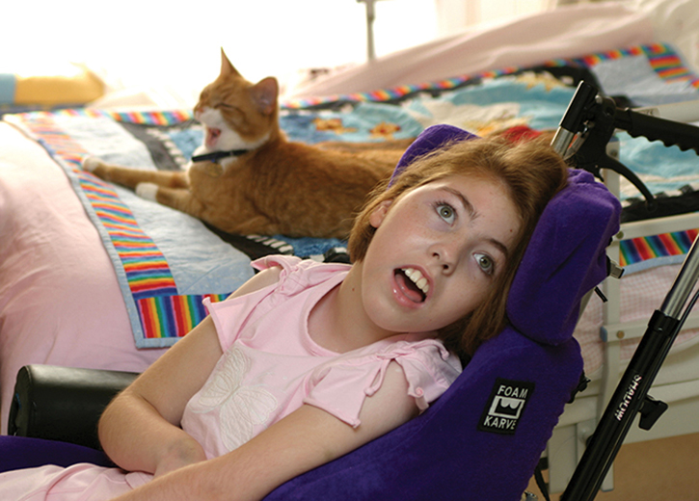
Developmental Milestones (6 of 11)
Cerebral palsy
Neurologic disorders that impact muscle coordination
May not be diagnosed until infant or toddler stages
© Ben Molyneux People/Alamy.
Notes:
Lecture Outline
a. Cerebral palsy: umbrella term for a group of neurologic disorders that impact muscle coordination due to dysfunction of the part of the brain that controls muscle movements
b. Most children with cerebral palsy are born with it, but it may not be diagnosed until they are at the infant or toddler stages of development.

Slide 13
Developmental Milestones (7 of 11)
Autism spectrum disorder (ASD)
Neurobiologic spectrum disorder that encompasses a range of complex neurodevelopment disorders
Unable to interpret all or some forms of sensory input
Reactions overresponsive or underresponsive
Notes:
Lecture Outline
E. Autism spectrum disorder
1. Autism spectrum disorder (ASD), more commonly called autism, is a neurobiologic spectrum disorder that encompasses a range of complex neurodevelopmental disorders.
a. Occurs in all ethnic and socioeconomic groups
Affects every age group
Boys are 4.5 times more likely than girls to be diagnosed with the disorder.
4. Many people with ASD demonstrate difficulty with:
a. Social interactions/relationships and social thinking (ie, viewing situations from another person’s perspective)
b. Children with ASD may have challenges in interacting with and playing with their peers.
5. Some people with ASD are unable to interpret all or some forms of sensory input and may exhibit reactions that are either overresponsive or underresponsive to sensory stimuli.

Slide 14
Developmental Milestones (8 of 11)
ASD (cont’d)
Difficulties may manifest in person’s behaviors:
Rocking
Hand-flapping
Twirling
Vocal sounds
Notes:
Lecture Outline
a. Difficulties with interpreting and responding to sensory input may manifest in a person’s behaviors. Such behaviors may include repetitive movements such as:
i. Rocking
ii. Hand-flapping
iii. Twirling
iv. Vocal sounds
b. Overstimulation manifests in some people with ASD as self-injurious behaviors such as:
i. Biting
ii. Head-banging

Slide 15
Developmental Milestones (9 of 11)
ASD (cont’d)
Hallmark signs and characteristics, but each person with ASD is unique
Own special behaviors
Specific interventions
Ask caregivers for guidance
Notes:
Lecture Outline
2. There are many hallmark signs and characteristics of ASD, yet each person with ASD is completely different.
Each person with ASD also has his or her own special behaviors and specific interventions that can assist the community paramedic with managing those behaviors and traits.
6. Every person with ASD is unique. It is important to ask caregivers for guidance on the best way to approach a patient with ASD.
a. Caregivers can be useful in:
i. Performing physical examinations
ii. Assisting with medication administration
b. Caregivers should always be engaged when working with patients if the community paramedic is unfamiliar with the patient or unsure of how to approach him or her.

Slide 16
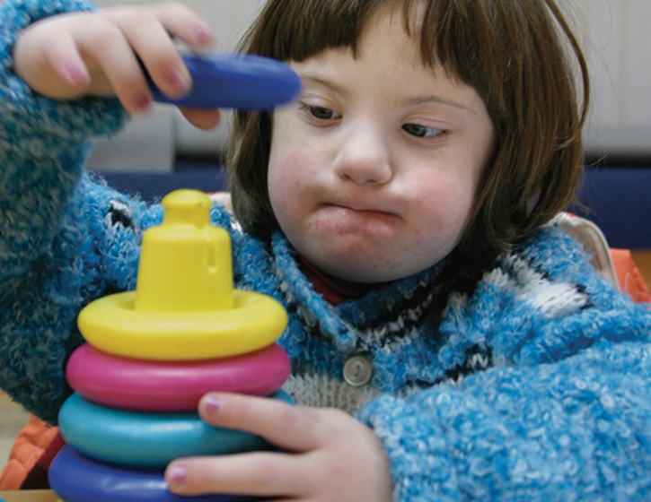
Developmental Milestones (10 of 11)
Down syndrome
Genetic disorder
Developmental delay
Cognitive impairment
Unusual physical features
© PhotoCreate/Shutterstock.
Notes:
Lecture Outline
F. Down syndrome
1. Down syndrome is an inherited genetic disorder that is responsible for:
a. Developmental delay
b. Cognitive impairment
c. A pattern of unusual physical features
2. Patients can be identified visually from certain telltale features of the person’s head, face, and neck.
3. Features include:
a. Flattened face and nose
b. Short neck
c. Upward-slanting eyes
d. Protruding tongue
e. Single crease noted on the palms of the patient’s hands
4. Down syndrome is also known as trisomy 21.
a. Normal human cells have 23 pairs of chromosomes that create the cell’s genetic identity.
b. In Down syndrome, an extra chromosome attaches to the 21st pair, becoming the third chromosome 21 or trisomy 21.

Slide 17
Developmental Milestones (11 of 11)
Down syndrome (cont’d)
Associated chromosomal changes may cause:
Structural heart defects
Seizures
Numerous gastrointestinal problems
Speech alterations
Hearing loss
Other abnormalities
Notes:
Lecture Outline
5. Chromosomal changes associated with Down syndrome may cause:
a. Structural heart defects
b. Seizures
c. Numerous gastrointestinal problems
d. Speech alterations
e. Hearing loss
f. Other abnormalities
6. Persons with Down syndrome also have a shorter life expectancy.
7. Depending on their level of mental disability, persons with Down syndrome may:
a. Function relatively independently OR
b. Require constant assistance with even basic tasks

Slide 18
Communicating With Children With Special Needs (1 of 18)
Providing effective care
Community paramedic does not need to know all characteristics of a child’s chronic condition
Every health care professional should:
Have an understanding of communication barriers associated with social, behavioral, physiologic conditions
Be prepared with effective strategies to overcome them
Notes:
Lecture Outline
IV. Communicating With Children With Special Health Care Needs
A. Providing effective care
1. A community paramedic may, at any time, be called upon to provide services for children with special health care needs.
2. You do not need to know all of the characteristics of a child’s chronic condition.
3. Every health care professional should:
a. Have an understanding of the communication barriers associated with common social, behavioral, and physiologic conditions
b. Be prepared with effective strategies to overcome them

Slide 19
Communicating With Children With Special Needs (2 of 18)
Providing effective care (cont’d)
Keys to providing most effective care:
Adapting to the child’s norms
Keeping him or her at the center of attention
Working with the family and caregivers as a team
Remember patients are children first; tailor communication strategies
Notes:
Lecture Outline
4. Keys to providing the most effective care:
a. Adapting to the child’s norms
b. Keeping him or her at the center of attention
c. Working with the family and caregivers as a team
5. It is important to embrace the idea that these patients are children first, and effective communication strategies must be tailored to meet these patients’ needs.

Slide 20
Communicating With Children With Special Needs (3 of 18)
Overcoming general barriers to communication
The child’s age and stage of development
Environmental and situational stress or anxiety
Developmental or behavioral disorders
Physical and physiologic barriers
Cultural considerations
Language barriers
Notes:
Lecture Outline
B. Overcoming general barriers to communication
1. For any pediatric patient encountered by the community paramedic, barriers to effective communication may include:
a. The child’s age and stage of development
b. Environmental and situational stress or anxiety
c. Developmental or behavioral disorders
d. Physical and physiologic barriers
e. Cultural considerations
f. Language barriers

Slide 21
Communicating With Children With Special Needs (4 of 18)
Effective communication
Built on trust
Founded on concepts of patient-/family-centered care
Identify each child’s unique communication needs
Notes:
Lecture Outline
2. The goal for the community paramedic is to understand:
a. The patient’s specific stage of development
b. The barriers to communication
3. Regardless of any special physical, emotional, developmental, or behavioral needs a child may have, effective communication is:
a. Built upon trust
b. Founded on the basic concepts of patient and family-centered care
4. The community paramedic can use the following tips to avoid communication breakdowns:
a. Use one main provider for direct care of the child. Only one person should be asking questions at a time. Avoid performing hands-on care while another person is talking to the child.
b. Get down to child’s eye level.
c. When possible, talk before touching. Calm and reassure the child before invading his or her space.
d. Begin a physical examination using only your hands; use tools only after a trusting relationship is built.
e. Show equipment before using it on the child. Let the child see and touch the device. Elicit the child’s “help” in using tools; for example, let the child listen first with the stethoscope or hold the bell over his or her heart while you listen.
f. Speak in a calm, quiet voice.
g. Never become impatient. Take a break from the situation if necessary because of frustration.
h. Offer choices, but only where they exist. Never ask the child’s permission to do something that will be done anyway. If the child says no and you do it anyway, all trust is gone. For example, when taking a blood pressure, explain what will happen and offer a choice of which arm to use.
i. Minimize time between talking about a procedure and doing it. Do not leave supplies in view until it is time to use them.
j. Involve caregivers. Inform them and integrate them into all decisions and care.
k. Be honest, using nonthreatening language.
l. Be gentle and reduce pain when possible.
m. Encourage, praise, and console the child whenever possible.
5. Identifying each child’s unique communication needs can be thought of as a variation on a theme—namely, figuring out what works best and varying communication approaches accordingly.

Slide 22
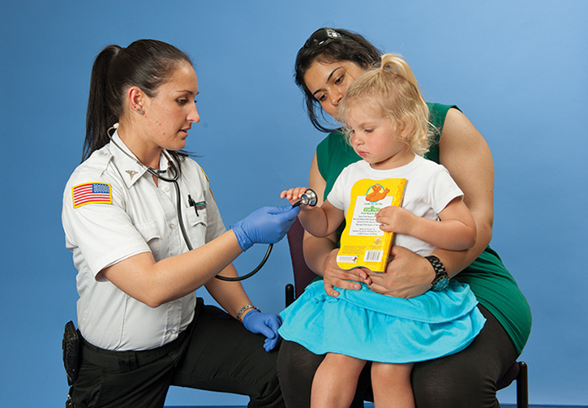
Communicating With Children With Special Needs (5 of 18)
During physical examination
Explain what you are doing and why
Demonstrate procedures
Use a calm tone
© Jones & Bartlett Learning. Photographed by Glen E. Ellman.
Notes:
Lecture Outline
6. During a physical examination:
a. Always warn the child before touching him or her, and explain what you are going to do and why.
b. It may be helpful with some children to demonstrate procedures such as taking a blood pressure reading or listening to lung sounds on a stuffed toy or family member.
c. Keep needles and other frightening equipment out of sight until just before their use to avoid anticipation anxiety.
d. Use a calm, even tone of voice, and speak to the child in short, to-the-point language (“Please stand up”). Avoid requests that could result in the child saying no, a response that, if not honored, will quickly erode trust.

Slide 23
Communicating With Children With Special Needs (6 of 18)
People-first language
Encourages providers to think of people with disabilities as people first
How provider talks to or about a child impacts:
Provider’s ability to communicate with the child
How provider thinks about the child
How provider treats the child
Notes:
Lecture Outline
7. The community paramedic must always be sensitive to language that can inadvertently diminish trust and derail the communication train.
a. Never overtly draw a distinction between the child with special health care needs and a “normal” child.
i. The challenge is to identify each child’s norms and adapt communication styles and techniques as needed.
b. Avoid attempts to fit patients and families into narrow, preconceived ideas of normal.
i. Never compare a child to other children that are “normal.”
c. Although the meaning is basically the same, “typical” and “neurotypical” are commonly used terms for people who are not on the autism spectrum.
i. “Typical” may have less of a negative connotation.
8. People-first language is communication approach that encourages providers to think of people with disabilities as people first, rather than by their disability or condition.
a. It is based on the idea that how the provider talks to or about a child impacts:
i. The provider’s ability to communicate effectively with the child
ii. How the provider thinks about the child as an individual
iii. How the provider treats the child as a patient

Slide 24
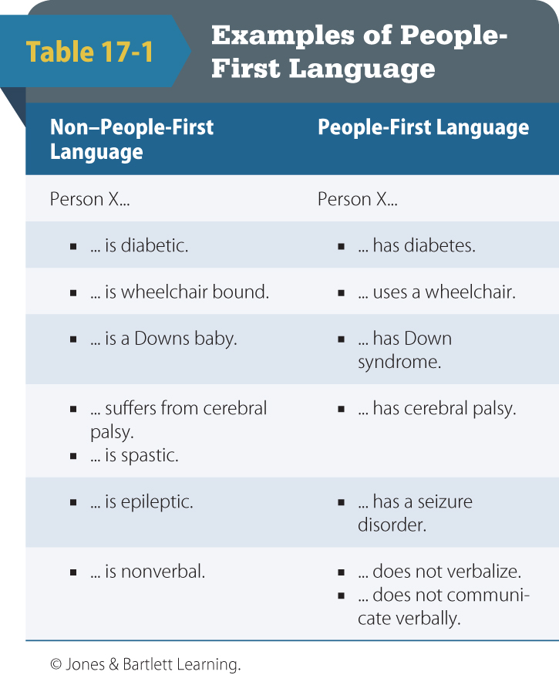
Communicating With Children With Special Needs (7 of 18)
People-first language (cont’d)
The condition is something the patient has, not what the patient is
© Jones & Bartlett Learning.
Notes:
Lecture Outline
b. Example: “Billy is autistic” would be better phrased as “Billy has autism.” Autism is something Billy has, not something he is.

Slide 25
Communicating With Children With Special Needs (8 of 18)
People-first language (cont’d)
Another common communication pitfall:
Talking about the patient and not to the patient
Keep the child at the center of attention, even when you have to get answers from the parent or caregiver.
Notes:
Lecture Outline
9. Another common communication pitfall when caring for children with special health care needs is talking about the patient but not to the patient.
a. The provider speaks directly to the parents or caregivers either because the child is unable to communicate or because there is a misperception about the child’s cognitive or communicative abilities.
b. Failure to directly acknowledge the child can be demeaning to both the child and the parent and will diminish trust.
10. To avoid this communication barrier, the community paramedic should keep the child at the center of attention, even when it is necessary to get answers from the parent or caregiver.
a. Always direct questions and instructions to the child first.
b. Many children with special health care needs are very knowledgeable about their condition, including their:
i. Health history
ii. Medications
iii. Special equipment
c. Involving them directly in their care will help achieve cooperation and compliance.
11. As part of family-centered care, the community paramedic should also encourage the child’s caregivers to participate in all aspects of planning and care.
a. Remember that they are “experts” when it comes to their child.
i. They know how the child communicates
ii. They can advise the community paramedic how best to approach the child, how to ask questions, and how to avoid stress triggers.

Slide 26
Communicating With Children With Special Needs (9 of 18)
Overcoming communication barriers related to communication disorders
Disfluency, aphasia, dysarthria
Minimize background noise.
Slow your rate of speech.
Allow the child sufficient time to speak.
Use simple sentences and questions.
Notes:
Lecture Outline
C. Overcoming barriers related to communication disorders
1. Many children with chronic physical, developmental, behavioral, or emotional conditions exhibit one or more speech disorders such as:
a. Disfluency
b. Aphasia
c. Dysarthria
2. These conditions are often exacerbated when the child is stressed or anxious, such as during the patient assessment.
3. Following the basic principles of effective, patient and family-centered communication techniques will help reduce the patient’s anxieties and minimize speech-related complications.
4. Communication tips to help care for children with speech disorders
a. Minimize background noise.
b. Get the child’s attention before speaking, and speak in a normal voice.
c. Pay attention and watch as the child speaks; do not try to listen while doing something else.
d. Slow your rate of speech. It may help to pause before responding or asking the next question to slow down the pace of the conversation.
e. Allow the child sufficient time to speak; avoid finishing sentences or offering words.
f. Avoid suggestions like “slow down” or “relax.”
g. Use simple sentences and questions that can be answered with a simple “yes” or “no” when possible.
h. Let the child know what you understood and what you did not so the entire message does not have to be repeated.
i. If you still have difficulty understanding, try communicating with drawings or writing or with an augmentative and alternative communication device or computer-aided communication tools such as a computer or tablet device with special apps or a speech-generating device.
j. Encourage, do not discourage, questions and participation in decision making.

Slide 27
Communicating With Children With Special Needs (10 of 18)
Overcoming communication barriers related to ASD
Children with ASD may be anywhere along continuum from entirely nonverbal to fluent.
Allow child with ASD extra processing time after:
Asking questions
Giving commands
Notes:
Lecture Outline
D. Overcoming communication barriers related to ASD
1. ASD is among the most prevalent of the developmental and behavioral disorders, with as many as 1 in 45 children affected in the United States.
a. Key characteristics of ASD include:
i. Social impairment
ii. Communication difficulties
b. In terms of their communication abilities, children with ASD may fall anywhere along the continuum from entirely nonverbal to fluent.
c. Children with ASD process information one step at a time and may be unable to process communication-related stimuli quickly, especially when stressed.
d. The community paramedic should allow the child with ASD extra processing time after asking a question or giving a command.
i. Acknowledge responses with a “Thank you” or “Great job!”, thereby signaling the end of each segment in the communication, and then move on to the next question or instruction.
2. Children with ASD are frequently uncomfortable with eye contact and may avoid it altogether. They may not understand:
a. Nonverbal cues such as facial expressions or other forms of body language
b. Social cues
c. The feelings of others (or to be able express their feelings in a typical way)
3. Sensitivity or reaction to any kind of sensory stimulation (sound, tactile cues, smell, or temperature changes) may be heightened or diminished.
4. It may be helpful to demonstrate the planned intervention on a stuffed animal or a family member to decrease the child’s fear and anxiety.
5. Some children may not tolerate oral medications. The community paramedic should work with the family or primary caregiver to help the child with medications; they usually know what works for their child and may be the only ones to whom the child will respond.
6. Sudden, unexpected changes in routine can cause confusion and fear in children with ASD, leading to sensory overload and meltdown, or tantrum.
a. Withdrawal
b. Freezing up
c. Elopement (wandering)
d. Increased self-stimulation, such as fist-pounding, flapping of the hands, or shouting repetitive phrases in a loud voice
7. If the child becomes aggressive or has a meltdown, the community paramedic should:
a. Remain calm
b. Stop talking
c. Back up and give the child more space
d. Open your palms and place your arms by your sides
e. Allow the situation to play out
f. Speak in a low voice, and be reassuring and nonthreatening
8. Communication tips to help care for children with ASD
a. Speak to the child in a strong, calm voice. Don’t assume that a child with autism is not listening or does not understand if he or she does not answer. Give these children extra time to process each question or instruction before moving to the next. Do not continually repeat questions, as this may cause the processing to start all over again each time and may aggravate the child.
b. Provide careful, sequential, descriptive explanations for your actions, and be literal. Give instructions and tasks one at a time.
c. If the child becomes agitated or experiences a meltdown, ask for help from the parents or caregivers and remove any upsetting stimuli.
d. Unless immediate life threats (eg, uncontrolled bleeding) must be addressed, allow a little extra time to establish rapport and to provide the child with enough time to engage his or her self-stimulating coping behaviors to restore the child’s sense of control.
e. Encourage nonharmful routines such as pacing, hand-flapping, or excessive rocking. Self-stimulation is an important coping mechanism for many children with ASD, and attempts to stop it will simply make the situation worse. Ask the family what usually calms the child, such as a particular toy or music.
f. Ask about augmentative and alternative communication devices or computer-aided communication tools such as a computer or tablet device with special apps or a speech-generating device. Children with ASD may use these devices to help them communicate.
g. Many children with ASD respond negatively to light touch, so it is often better to apply gentle but firm pressure when necessary to touch the child. Keep in mind that touch from another person in general—even from parents and caregivers—may be a major source of discomfort for children with ASD. Consequently, such tactile stimulation should be minimized as much as possible, and should always be preceded by careful, descriptive explanation of what you need to touch and why. Explain one procedure, do it, and then explain the next procedure.
h. Do not restrain the child unless absolutely necessary to protect the patient from harm. Work closely with the family to identify dangerous behaviors and to devise a plan to calm the patient or to restrain him or her if it does become necessary.

Slide 28
Communicating With Children With Special Needs (11 of 18)
Overcoming communication barriers related to Down syndrome
Difficulties in understanding speech of a child with Down syndrome are prevalent.
Be patient and ask for clarification when necessary.
Notes:
Lecture Outline
E. Overcoming communication barriers related to Down syndrome
1. Another condition seen in children that is associated with developmental delays is Down syndrome, also known as trisomy 21.
a. Down syndrome affects approximately 1 in every 700 babies born in the United States.
b. Life expectancy for children with Down syndrome has increased dramatically over the years; they live more than four times longer today than did their counterparts in 1960.
c. They remain at a higher risk for a number of serious medical conditions and disabilities.
2. Difficulties understanding the speech of a child with Down syndrome are quite prevalent.
3. When communicating with a child with Down syndrome, be patient and ask for clarification when necessary.

Slide 29
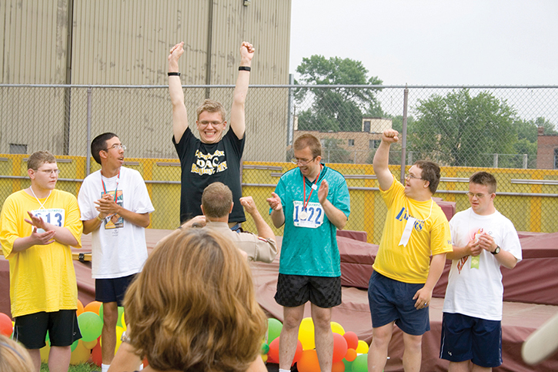
Communicating With Children With Special Needs (12 of 18)
Down syndrome (cont’d)
Every child is unique
Cognition and communication vary widely
© Steve Skjold/Alamy
Notes:
Lecture Outline
d. Every child with Down syndrome is unique, and cognition and communication abilities among these children vary widely.
4. Communications tips to help care for children with Down syndrome
a. Ask the parent or caregiver about the child’s level of communication and understanding. Do not assume that the child is unable to understand what you are saying or doing.
b. Involve the child in all aspects of care. Encourage questions or conversation. Do not discourage chatter; it serves a similar calming purpose as self-stimulating behavior in children with autism.
c. Be concrete and literal when giving explanations and instructions, and ask only one question or give one instruction or explanation at a time.
d. Ask direct questions about pain or discomfort with each segment of the physical examination. Do not misinterpret lack of outward expression of distress as lack of pain or other discomfort.
e. Provide a comfort item or distraction.

Slide 30
Communicating With Children With Special Needs (13 of 18)
Overcoming barriers related to hearing impairments
Communication skills and preferences are unique to patient
Should be determined at initial meeting
Notes:
Lecture Outline
F. Overcoming barriers related to hearing impairments
1. There are many types and causes of hearing loss, and the degree ranges from mild hearing impairments to profound deafness.
2. For the community paramedic, communication with children who have significant hearing loss can be challenging, especially when associated with other physical, developmental, or behavioral conditions.
3. When independent of other factors, deafness and the use of sign language have been associated with:
a. Lower health knowledge
b. Decreased use of preventive services
c. Increased health disparities
4. Note that many people in the deaf community do not view deafness as a disability, but as a culture with its own language and shared values.
5. Communication skills and preferences are unique to the individual and should be determined in the initial meeting with the patient and caregivers.
a. Important resources in developing an effective communication strategy:
i. Physician’s plan of care
ii. School’s individualized education plan

Slide 31
Communicating With Children With Special Needs (14 of 18)
Overcoming barriers related to hearing impairments (cont’d)
Communication methods may include:
Oral communication
Lipreading
Sign language
Gesturing
Notes:
Lecture Outline
6. Methods of communication vary widely and differ significantly between communicating with others in the deaf community.
a. Communication methods may include some combination of:
i. Oral communication
ii. Lipreading
iii. Sign language
iv. Gesturing

Slide 32
Communicating With Children With Special Needs (15 of 18)
Overcoming barriers related to hearing impairments (cont’d)
Communication methods (cont’d):
Drawing
Writing
Use of text or computer word processors
Graphic imaging
Notes:
Lecture Outline
v. Drawing
vi. Writing
vii. Use of text or computer word processors
viii. Graphic imaging

Slide 33
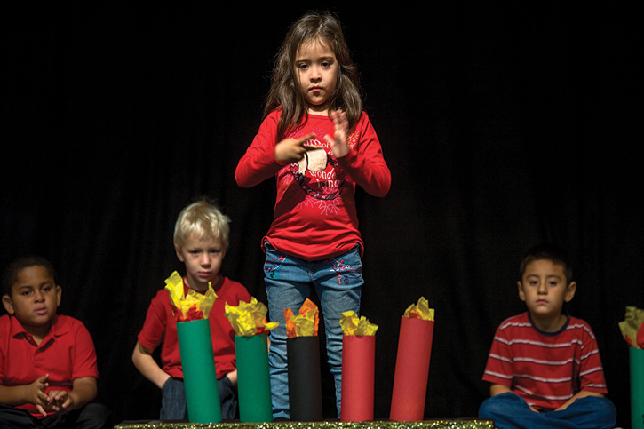
Communicating With Children With Special Needs (16 of 18)
Hearing impairments (cont’d)
American Sign Language (ASL)
Defined set of hand gestures, facial expressions
© Marmaduke St. John/Alamy.
Notes:
Lecture Outline
7. American Sign Language (ASL) is considered the primary language of Americans who are deaf or hard of hearing, although there are other communication options used.
a. ASL comprises a strictly defined set of hand gestures and facial expressions, whose meaning can be changed by an inflection in facial expression or body movement/gesture.
b. ASL is not a word-for-word translation of spoken language, but a way to convey meaning through visual symbols.
c. People who are fluent in ASL may not speak, write, or read English.
d. Americans With Disabilities Act
i. Professional ASL interpreters or a reasonable alternative may be required by law for most nonemergent patient encounters
ii. This act also requires the use of an interpreter when the pediatric patient’s parent or caregiver is deaf or hard of hearing.
iii. A family member who is fluent in sign language may not be considered a reasonable alternative to professional interpreters.
8. Communication tips to help care for children who are deaf or hard of hearing
a. Go to a quiet, well-lit space and sit or stand so that the light is not behind you.
b. Get the patient’s attention before speaking, and make eye contact.
c. Ask the patient about communication preferences, such as lipreading, writing on paper, using a computer or tablet, or sign language. Keep in mind that even the best lip-readers only understand about 25% of what is said.
d. Speak clearly at normal pace and volume.
e. Use open-ended questions to verify understanding.
f. Rephrase questions that are not understood rather than repeating the questions continuously.
g. Use gestures, facial expressions, and body language to help convey meaning.
h. Be patient and avoid statements such as “Never mind” or “It’s not important anyway.”
i. When writing back and forth to communicate, use shorter, simpler sentences at first and build upon them based on the patient’s understanding and responses.
j. When using an interpreter, have the interpreter stand beside and slightly behind you so that you can speak directly to the patient. Keep your focus on the patient even when the interpreter is translating the patient’s answers to you.

Slide 34
Communicating With Children With Special Needs (17 of 18)
Overcoming physical and physiologic barriers to communication
Disabilities that interfere with communication:
Muscular dystrophy
Cerebral palsy
Paralysis
Structural deformity secondary to illness or injury
Notes:
Lecture Outline
G. Overcoming physical and physiologic barriers to communication
1. Many physical disabilities can interfere with the ability to communicate including:
a. Muscular dystrophy
b. Cerebral palsy
c. Paralysis
d. Structural deformity secondary to illness or injury
2. Communication difficulties may stem from physiologic or structural problems or from the use of special equipment such as tracheal tubes and ventilators.

Slide 35
Communicating With Children With Special Needs (18 of 18)
Overcoming physical and physiologic barriers to communication (cont’d)
Not all physical disabilities are associated with cognitive or developmental disorders.
Common, avoidable barrier:
Misconception of child’s cognitive abilities based on physical appearance
Notes:
Lecture Outline
3. While some physical disabilities are associated with cognitive or developmental disorders, many are not.
4. Misperception of children’s cognitive abilities based on physical appearance poses an all too common, yet completely avoidable, communication barrier.
a. Example: Many people with cerebral palsy do not have cognitive deficits.
5. Communication tips to help care for children with physical or physiologic barriers
a. Do not make assumptions about cognition or the ability to communicate. Ask the child and family about abilities and communication preferences.
b. Avoid talking over the patient, and always include the patient in the conversation and care regardless of physical or cognitive abilities or limitations.
c. Be patient with communication, and allow time for the child to answer fully. Although family members and caregivers will sometimes do so, avoid the temptation to finish sentences when the child’s speech is slow.
d. When urgency is necessary, let the child know that you are still listening in case he or she needs something.
e. Be honest about your difficulty understanding speech or what the patient is trying to tell you. Do not try to fake it; this approach is seldom successful and can lead to significant miscommunication and loss of trust.
f. Offer alternatives. Many children are quite adept at communicating with a computer or other technology, and some do well with pen and paper.
g. As always, work closely with the family and caregiver.

Slide 36
Children Using Technology-Assistive Equipment (1 of 2)
Community paramedics should:
Become familiar with various types of medical technologies
Most common types of technology
Some form of respiratory support (eg, supplemental oxygen or mechanical ventilation)
Technology to support nutrition, such as gastronomy tubes
Notes:
Lecture Outline
V. Children Using Technology-Assistive Equipment
1. Children who use technology-assistive equipment constitute a subset of children with special health care needs that may require health care providers’ assistance.
2. It is important for community paramedics to become familiar with the various types of medical technologies that they may encounter and have to troubleshoot.
3. The most common types of technology used by children with special health care needs include:
a. Some form of respiratory support, such as supplemental oxygen or mechanical ventilation
b. Technologies to support nutrition, such as gastrostomy tubes
4. While community paramedics are not expected to provide daily, ongoing monitoring of such devices, the community paramedics should be familiar with:
a. The operation of the device
b. The conditions for which they are indicated
5. Patients who use home respiratory support either in the form of supplemental oxygen or mechanical ventilation may have tracheostomy tubes.
a. Some complications noted among tracheostomy-dependent children include:
i. Dislodgement of the tube
ii. Obstruction
iii. Infection
iv. Hemorrhage
b. These patients often have a higher level of home skilled nursing and caregivers who are trained in tracheostomy suctioning or replacement.
c. Patients with devices for nutritional support usually have equipment that allows for feeding directly into the gastrointestinal tract.
d. Similar to patients with tracheostomy tubes, these patients may be at risk for gastrostomy tube dislodgement, obstruction, infection, or hemorrhage.

Slide 37
Children Using Technology-Assistive Equipment (2 of 2)
An increasing number of children dependent on technology are being cared for in the home.
An approach that requires coordination among the family, primary care providers, case managers, and specialists—a health care team
Notes:
Lecture Outline
6. There are numerous reasons for dependence on technologies for children with special health care needs. Some of the reasons are:
a. Present from birth (eg, heart defects)
b. Due to conditions acquired during childhood
7. An increasing number of these children who are dependent on technology are being cared for in the home—an approach to care that requires coordination among the family, primary care providers, case managers, and specialists: a health care team.

