Slide 1
FIRST ON THE SCENE
WHAT TO DO UNTIL EMS ARRIVES
Notes:
Instructor Notes:
Lesson 1: Activate the 911 System
Materials:
Local 911 public education materials.
Local emergency and disaster preparation public education materials.
Resources and schedules for other local training (CPR, first aid, etc.).
Reference copy of the Good Samaritan law for your state/locality.
Instructor Notes:
Welcome to the First On The Scene course presented by NAEMT.
This course provides an introduction to emergencies and what to do until help arrives.
Introductions:
Share your experience, qualifications, and role with your agency
Ask the participants to introduce themselves and their interest in taking the course
Discuss housekeeping items:
Take a moment to give the locations of bathrooms, break areas, and emergency exits
Describe the policy on phones/pagers and to answer/place calls outside of the classroom
Describe the policy on snacks and drinks in the classroom and where they may be purchased and consumed
Let participants know that they will have an opportunity to evaluate the course and provide feedback at the end of the course

Slide 2
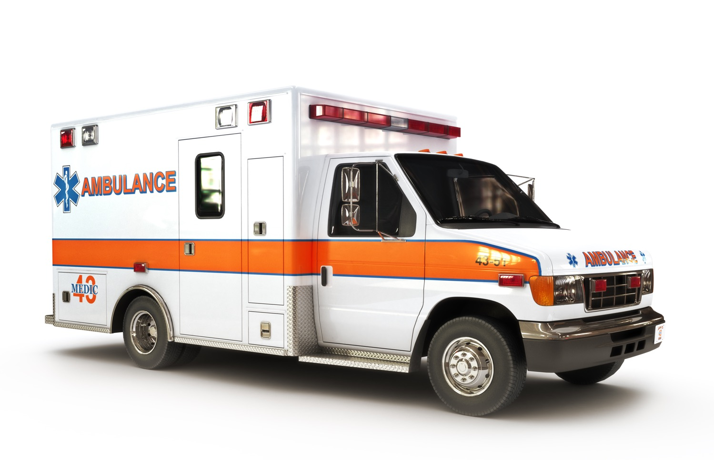
Lesson 1: Activate the
911 System
Notes:
Lesson 1: Activate the 911 System
Instructor Notes:
In this lesson we will discuss:
The 911 system and how to call 911 for help
The local non-emergency dispatch center phone number and when to use it
Participant Engagement:
Advise participants to refer to the following resources for this lesson:
Handouts provided by the sponsoring organization
Online Resources:
Website: 911.gov – National Highway Traffic Safety Administration (NHTSA) National 911 Program
Website: know911.org – The National Association of State 911 Administrators
Website: nena.org – National Emergency Number Association (NENA)
Website: ready.gov – US Department of Homeland Security

Slide 3
Lesson 1: Objectives
At the completion of this lesson, participants will:
Recognize the importance of calling 911 and requesting help
Recall the importance of providing an accurate location of an incident
Prepare answers to the 911 operator’s questions
Employ the pre-arrival instructions provided by the dispatcher
Notes:
Instructor Notes:
Lesson 1 Objectives:
At the completion of this lesson, participants should be able to:
Recognize the importance of calling 911 and requesting help
Recall the importance of providing an accurate location of an incident
Prepare answers to the 911 operator’s questions
Employ the pre-arrival instructions provided by the dispatcher

Slide 4
What is an Emergency?
Any situation posing an immediate threat to a person, property or environment:
  A medical emergency
  An unconscious or semiconscious person
  Explosion
  Fire
  Fuel leak
  Motor vehicle collision
  Person choking or not breathing
  Violence or terrorist situation
Notes:
Instructor Notes:
What is an emergency?
Any situation posing an immediate threat to a person, property or environment:
A medical emergency (examples: severe bleeding, heart attack, stroke, etc.)
An unconscious or semiconscious person who is difficult to arouse
There are many reasons why a person would present as semiconscious or unconscious. These will be discussed in future lessons.
Explosion
Fire (examples: building on fire, vehicle on fire)
Fuel leak (example: gasoline spill on a public roadway)
Motor vehicle collision
Person choking or not breathing
Violence or terrorist situation
Teaching Points:
Define types of situations that constitute an emergency.
Define types of situations that are not emergencies.
Participant Engagement:
Ask participants to think of additional situations and discuss how those are considered emergencies.
Discuss what situations are not an emergency.
Ask participants if any of them have called 911 in the past and to briefly describe the situation.

Slide 5
What to Do in an Emergency
Ensure your own safety
Take a deep breath
Know your location
Call 911 and request assistance
Follow any instructions provided by the 911 operator
Do not hang up until told to do so
Render assistance until help arrives
Notes:
Instructor Notes:
What to Do in an Emergency
Ensure your own safety
Take a deep breath
Know your location
Call 911 and request assistance
Follow any instructions provided by the 911 operator
Do not hang up until told to do so
Render assistance until help arrives
Assess for massive hemorrhage, breathing, and pulse.
Teaching Points:
Stress the importance of ensuring personal safety first.
Taking a deep breath provides a moment to gather your thoughts and to remember your training.
Know your location so it can be provided to the 911 operator.
Call 911 and request assistance (this can be delegated to another person or other people present).
Following the 911 operator instructions allows you to perform any necessary first-aid care.
Render assistance until help arrives by continuing any first-aid care needed.
All 50 states in the United States have enacted Good Samaritan laws to protect persons who render basic first aid from liability.
Participant Engagement:
Ask participants if any of them have rendered aid in an emergency situation.

Slide 6

Know Your Location
Home
Work
Roads and highways
Interstate
Notes:
Instructor Notes:
Know Your Location
Home
Work
Roads and Highways
Interstate
Teaching Points:
When an emergency occurs, stress can affect memory; thus, preparing before an emergency occurs can be helpful.
Home: Place a note with the home address near home phones (especially if you have recently moved or have children or older adults in the residence).
Work: Know the process for placing outside calls and place a note with the work address and location of your office or work area.
Roads and Highways: Look for street signs and landmarks to provide to the 911 operator when calling for assistance.
Interstate: Look for the closest mile marker and entrance/exit ramp numbers and names.
Participant Engagement:
Discuss the highway emergency assistance cell phone numbers and their use (highway/vehicle problems, accidents, etc.) – typically this number goes to the state police or transportation dispatch center.
Discuss how to safely pull off onto the shoulder of the highway or Interstate and to use caution when exiting the vehicle.
Discuss when at a business or work knowing the location of emergency equipment (AED, bleeding control station, fire extinguisher, first-aid equipment).

Slide 7
Rendering Assistance
Lessons in the course:
  Hands-only CPR
  Nasal naloxone
  Epinephrine auto-injector
  Bleeding control
  Occlusive dressings
  Moving patients to safety
  Positioning injured/sick patients
Notes:
Instructor Notes:
Rendering Assistance
Lessons in the course:
Hands-only CPR
Nasal naloxone
Epinephrine auto-injector
Bleeding control
Occlusive dressings
Moving patients to safety
Positioning injured/sick patients
Teaching Points:
This course provides instruction on selected topics of rendering aid.
Opportunities for additional instruction are available in other courses in CPR and First Aid.
Be prepared by placing emergency equipment (bleeding control kit, fire extinguisher, first aid kit, etc.) in your home and vehicles.
Participant Engagement:
Discuss any concerns or reservations with the participants and address them

Slide 8
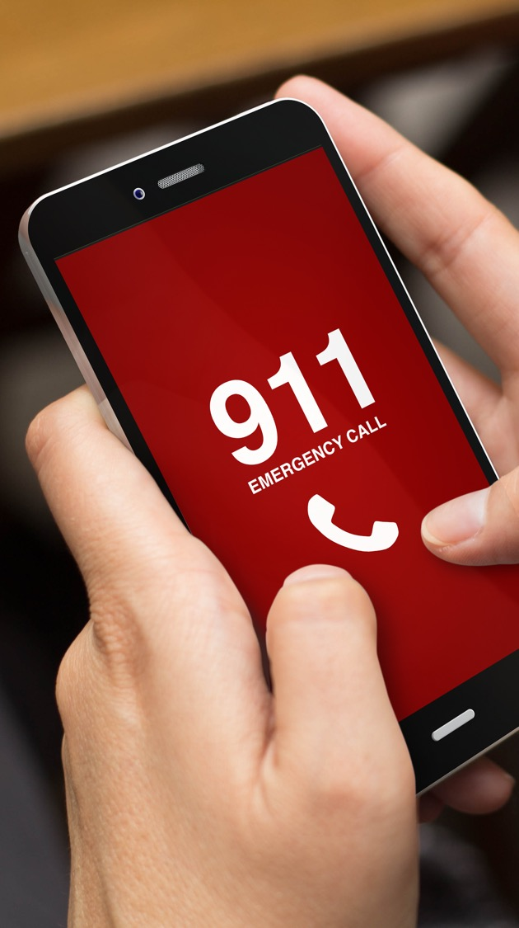
Calling for Assistance
Dial 911 for emergency assistance
Dispatch center non-emergency number
Emergency versus non-emergency
  When in doubt call 911
Notes:
Instructor Notes:
Calling for Assistance
Dial 911 for Emergency Assistance
Dispatch Center Non-Emergency Number
Emergency versus Non-Emergency
When in doubt call 911
Teaching Points:
Calling for assistance may be delegated to another person if other people are with you (and rendering aid may be delegated as well).
Place the local dispatch center non-emergency number near your phones.
Teaching others at your home or work about calling 911 is a proactive step in preparing for an emergency.
Participant Engagement:
Discuss how Internet-connected phone systems (voice-over-IP or VoIP) differ from legacy phone systems (the location of the phone line should be configured in the system).
Discuss when calling 911 on a cell phone that the call may be routed to another dispatch center than the location (the call may be transferred to the appropriate dispatch center).
Discuss the local dispatch center non-emergency number and its use for non-emergency calls (when in doubt, call 911).

Slide 9
Lesson 1: Summary
Calling for assistance is a critical step in an emergency
Rendering aid can save a life!
Lessons in this course:
  Bleeding control
  Hands-only CPR
  Nasal naloxone
  Epinephrine auto-injector
  Occlusive dressings
  Moving patients to safety
  Positioning injured/sick patients
Notes:
Instructor Notes:
Lesson 1: Summary
Calling for assistance is a critical step in an emergency
Rendering aid can save a life!
Lessons in this course:
Bleeding control
Hands-only CPR
Nasal Naloxone
Epinephrine auto-injector
Occlusive dressings
Moving patients to safety
Positioning injured/sick patients

Slide 10

Lesson 1: Wrap-Up
Notes:
Instructor Notes:
Lesson 1: Wrap-Up
Ask participants if they have any questions about this lesson.

