Slide 1
Fourth Edition
Lesson 1: Pediatric Development and Assessment
Notes:
Instructor Notes
Lesson 1: Pediatric Development and Assessment. This first lesson focuses on pediatric development and assessment.
Assessing and treating pediatric patients can be challenging due to the low frequency of pediatric calls the average EMS provider encounters in their career.
Education programs such as Emergency Pediatric Care will aid in providing you with the confidence to care for your pediatric patients.
National trends indicate that roughly 10% of the nation’s EMS calls (in the U.S.) involve pediatric patient ages 0 to 9 years. Of those patients, 11% will have a respiratory complaint.
Studies have shown that about 6–10% of all EMS calls in the U.S. are for children. Of those calls, roughly 10% are for children requiring ALS care in the field. That means that approximately 1% of all EMS calls are for children with potentially critical illnesses or injuries. Given these statistics, it’s not surprising that EMS providers don’t feel comfortable addressing the needs of many of their pediatric patients; after all, if practice makes perfect, what’s the result of a lack of practice? (Source: NAEMT EPC Transition Course)

Slide 2
Lesson Objectives
Explain the developmental and physiological differences in pediatric patients based on their age.
Understand the Pediatric Assessment Triangle.
Explain the interplay of appearance, breathing, and circulation in the child.
Demonstrate the pediatric assessment.
Understand the use of family-centered care.
Notes:
Instructor Notes
Discuss the learning objectives and the importance of thoroughly understanding each one.
Explain the developmental and physiological differences in pediatric patients based on their age.
Understand the Pediatric Assessment Triangle.
Explain the interplay of appearance, breathing, and circulation in the child.
Demonstrate the pediatric assessment.
Understand the use of family-centered care.

Slide 3





Developmental Stages
Optional Activity 1: Split up into groups of three to five students. Each group will receive an envelope with notecards. One set has milestones, and the other set has age groups. Take 8 minutes to match the age groups with the milestones in your group.
© Cyndi Monaghan/Stone/Getty Images
© Rawpixel.com/Shutterstock
© Sarah Casillas/DigitalVision/Getty Images
© yuliaisupova/Shutterstock
© Sharomka/Shutterstock
Notes:
Instructor Notes
Ask the students to form groups of three to five, based on class size. Give them 8 to 10 minutes to match the developmental milestones to the age. Then go around the classroom and have each group state which milestone coordinates to the age, in the order of birth to adolescent. As the students report on each age group, discuss the assessment style (head to toe versus toe to head) recommended with that age group. (Toe to head is recommended until toddler age to develop trust between the provider and patient.)
Also ask the students to discuss red flags they may find during their assessment based on the age group. Some examples are below:
Birth–1 month has not hit the milestone of rolling over. A red flag should be recognized if the parent states the child rolled off the bed and is not responding.
2–3 months should be able to focus on objects and begin to smile. Lacking the ability to focus should be a red flag.
6–8 months with multiple bruises in various parts of the body should be a red flag. Children of this age are not walking/running and should not have any bruising. In children 12–18 months, multiple bruises on the shins would be considered more common.
Adolescents should be assessed without a caregiver present to provide the patient with the opportunity to report harassment, abuse, or neglect regarding the caregiver, if applicable. Same-sex provider is preferred (if possible) during transport to decrease the opportunity for allegations regarding the patient and EMS provider.
Ensure that the classroom is engaged and tells you the above versus you telling them. You may be surprised at the knowledge within the classroom, and facilitated learning will assist with participation, learning, and holding the students’ attention.

Slide 4
Developmental Milestones
Birth–1 month
2–3 months
4–6 months
6–8 months
8–12 months
12–18 months
18–24 months
2–3 years
4–5 years
6–12 years
13–17 years
Notes:
Instructor Notes
An optional activity can be found on Slide 3 to better understand developmental milestones. If you are using the activity, ensure that you have printed and cut out the notecards in your instructor toolkit and are prepared to expand on the content below after the activity. If not using the activity, just review the developmental stages and milestones with the class.
Expand on the following points. Facilitate a discussion on the expectations of the emotional, physical, and cognitive development of the following age groups:
Birth–1 month
Newborns do not focus on faces or objects.
Infants typically will control their gaze on the faces of parents and siblings by 1 month of age.
Sleeps often, looks around, does not follow movement.
Crying is a means of communication.
Recognition of parents and trust begins to develop.
Nose breathers.
2–3 months
Will focus on objects and faces, following them with their eyes and then their heads.
Inability to follow movement of objects should be a red flag.
They may be developmentally delayed or have experienced abuse.
Critical thinking and further assessment are required.
Begins to smile.
Increased awareness with their body.
Nasal breathers, so may have nasal congestion.
4–6 months
Socially smiles and laughs.
Seeks attention.
Can roll over, attains control of head and neck.
Begins eating soft foods.
Teething may begin.
Most will sleep through the night.
6–8 months
Development between 6 and 12 months is variable, but it is usually during this period that children sit up unassisted, and then to a crawl.
Separation anxiety; keeping the infant close to their caregiver will usually improve your assessment ability.
This is also the age when children go from cooing (vowel sounds only) and laughing to babbling (consonant sounds) and saying single or double nonsense syllables.
8–12 months
This is one of the most dangerous periods of early childhood because the child becomes mobile and puts thing in their mouth.
Watch for foreign body ingestions and aspirations and injuries due to falls from furniture or down the stairs.
Tantrums begin.
Remembers things and is curious about them.
12–18 months
Begins to stand, creep, and learns to walk.
Front teeth appear.
Understands four to six words.
Recognizes body parts.
Imitates others.
This age group will likely stay close to their guardian for security.
18–24 months
Walking improves, along with balance.
Begins running and climbing.
Begins labeling items.
Speech increases dramatically.
Speaks about 100 words.
2–3 years
Toilet training may begin.
Follows commands.
Knows colors.
Speaks about 500 words.
Separation from caregiver becomes easier.
4–5 years
Rapidly acquires new motor, cognitive, and communication skills.
Older preschoolers start to understand why they are told not to do things, such as touching a hot stove.
Able to communicate thoughts and feelings.
Older preschoolers can carry on conversations and answer questions about what happened and how they feel.
Younger children in this age group have little concept of the future and do not understand about danger.
Use simple sentences.
Age of the ego; center of their own world.
They start to feel comfortable away from their caregivers for longer periods of time and explore new environments with all their senses.
Can name a friend.
Show modesty.
Exhibit “magical thinking,” sometimes believing that everything happens because of something they did or did not do or say.
Take time to reassure these children that they are not in trouble and that their caregivers are not angry with them for getting hurt or sick.
6–12 years
School-aged children are used to being in different environments, enjoy being independent from their parents, and can communicate well.
When stressed, they may regress, clinging to their caregivers and behaving irrationally, especially if they have had scary or painful past experiences with healthcare providers.
Never belittle or embarrass school-aged children as “acting like a baby;” acknowledge and validate their fears and fully explain what’s going to happen and why.
Allow them to help manage their own pain or discomfort by breathing deeply, holding still, or squeezing someone’s hand.
Advise about painful procedures right before you must do them.
The anticipation is often worse than the actual procedure.
Puberty may begin as early as 10 years of age.
13–17 years
Vital signs will level off to adult ranges.
Allow them to take part in the decision-making process.
Reproductive changes.
Examination of patients at this age may need to be private, and a single practitioner should not be alone with them.
Growth spurts.

Slide 5
Vitals Signs for the Pediatric Patient
Age | Pulse | Respiratory | Systolic BP
0–6 months | 100–190 | 30–60 | >60
6–12 months | 100–160 | 30–60 | >60
1–3 years | 90–150 | 20–30 | 80–100
3–5 years | 80–140 | 20–25 | 80–100
6–12 years | 70–120 | 15–20 | 80–110
13–17 years | 60–100 | 12–20 | 90–110
Notes:
Instructor Notes
Briefly review the table and discuss the average pulse, respiratory rate, and blood pressure for each age group. It is important to understand the normal range of vital signs for your pediatric patient. In the event the patient falls outside this range for any of these vitals, the provider should start utilizing their diagnostic tools to better understand potential complications, signs/symptoms, and potential illnesses to develop a differential diagnosis and treatment plan. Occasionally, vital signs outside of these ranges may be normal for the patient. For instance, a child with a congenital heart defect may have a heart rate or blood pressure that appears abnormal but is perfectly normal for them. Likewise, an active teenager who is athletic may have a lower heart rate in the 50s, which could be perfectly normal for them. Involving the family and caregivers in your family-centered care is imperative to ensure that you have a full understanding of the patient.

Slide 6

Case Presentation
You are assessing a preschool-aged patient (3 years old) who complains of left arm pain after falling on the playground. Discuss the differences in the scene size-up, general impression, primary and secondary surveys, and treatment for adult versus pediatric patients.
© Ruslan Merzliakov/Shutterstock
Notes:
Instructor Notes
Discuss the following points of scene management:
What are differences between adult and pediatric assessment with regard to:
Scene size-up.
Scene awareness.
Assess for scene safety.
Specific safety considerations as they apply to pediatrics.
Mechanism of injury.
Nature of illness.
General patient impression.
Assessment must be adapted to your patient as age appropriate.
PAT and Quick vs. Not Quick will be further examined in this lesson.
Primary survey and treatment.
Primary survey.
X (eXsanguinating hemorrhage): Identify severe external bleeding.
A (Airway management and cervical spine stabilization): Identify airway compromise or potential for this to develop.
B (Breathing): Identify breathing inadequacy or potential for this to develop.
C (Circulation): Identify hypoperfusion; control mild to moderate bleeding.
D (Disability): Identify neurologic dysfunction.
E (Expose/environment): Identify significant injuries.
Discuss various pediatric age-appropriate equipment and tools used in your region.
Discuss the toe-to-head assessment approach for ages 3 and younger.
Secondary survey and treatment.
Difference in vital signs by age.
Focused history and physical.
Serial reassessments.
Determine need for nonemergent treatment.

Slide 7
Pediatric Assessment Triangle (1 of 4)
Used with permission of the American Academy of Pediatrics, Pediatric Education for Prehospital Professionals, © American Academy of Pediatrics, 2000
Notes:
7
7
Instructor Notes
The Pediatric Assessment Triangle, or PAT, is a tool you will use to get your first impression of a pediatric patient. This begins as soon as you first see the child and leads into your primary survey (XABCDE).
The PAT focuses on the ABCs of a pediatric patient
Instead of Airway, “A” stands for general Appearance.
“B” is still Breathing, but focuses on work of breathing, which includes an assessment of airway status.
“C” is still Circulation, but the PAT focuses on signs of poor circulation to the skin, because these are among the earliest signs of hypoperfusion.
A toe-to-head assessment should be used with patients age 3 and younger.
Aids in building trust with your patient by starting at the toes, because it is furthest away from the child and least likely to scare them.
Healthcare providers should assess the injured area last (if possible) to further develop trust with the patient.
A pediatric patient can compensate for long periods of time prior to deteriorating.
Recognizing life threats early is key for positive outcomes and avoiding decompensation.
It is important to note that if all sides of your triangle are considered within normal limits, your child is likely compensating and you have time to perform your primary assessment, take vitals, obtain a history, and ensure that you begin your family-centered care.
If one side of the triangle is compromised but the child’s appearance is normal, then the child is likely compensating.
If the child’s appearance is abnormal, then use the other two sides of the triangle to identify whether the respiratory system or circulatory system (or both) is compromised and the child should be “quick.”
If all three sides of the triangle are compromised, this child is sick, and you need to move quickly. In the event circulation is compromised, the child is likely “quick.“

Slide 8
Pediatric Assessment Triangle (2 of 4)
Case study: The child appears to have good tone and interacts with you by establishing eye contact as you walk up to the scene. They look scared and are not crying while holding their left arm. Do you believe the appearance to be compromised?
Used with permission of the American Academy of Pediatrics, Pediatric Education for Prehospital Professionals, © American Academy of Pediatrics, 2000
Notes:
Instructor Notes
General appearance on the Pediatric Assessment Triangle refers to how the child looks overall. What does this mean for compensated or not compensated?
Abnormalities in the appearance are concerning for a child who is NOT compensating. Further assessment is quickly needed.
Normal appearance means they are compensating.
APPEARANCE
General appearance is the part of the PAT that will give you an impression of how the child is doing.
The general appearance will tell you whether the child’s physiology is compensated or not compensated.
Another evaluation tool prehospital providers can utilize in patient assessment prior to being “hands on” with the patient is a mnemonic called TICLS, which is strongly endorsed by the AAP (American Academy of Pediatrics).
Tone: Is the child active or listless? Will the child engage with you?
Interactiveness: Does the child want to interact with you or the environment? Do they respond to sounds or movements? Will they reach for a favorite toy?
Consolability: Does the child act normally for the situation? A child who has stranger anxiety should exhibit signs of agitation when confronted by EMS. Can the child be comforted or calmed by the parent or caregiver?
Look (or gaze): Does the child look off into space or do they focus on objects and movement?
Speech (or cry): Is the child able to speak? Make sounds?
If the child has abnormalities in tone, interactiveness, consolability, look/gaze, or speech/cry, then the child is not compensating. Quickly check the other sides of the triangle—do they have increased work of breathing or compromise to their circulation?

Slide 9
Pediatric Assessment Triangle (3 of 4)
Case study: The child is sitting in a normal position without signs of respiratory distress. Is this area of the triangle compromised?
Used with permission of the American Academy of Pediatrics, Pediatric Education for Prehospital Professionals, © American Academy of Pediatrics, 2000
Notes:
Instructor Notes
BREATHING
The “B” side of the triangle looks at work of breathing and helps the PAT tell you if respiratory function is a problem.
Breathing is evaluated on this side of the PAT and helps develop an understanding of respiratory function. This side of the triangle helps to identify respiratory difficulty with the child.
If the patient is positioning, they are doing so to increase oxygenation and ventilation into their system. This means they are compensating for their respiratory distress.
Nasal flaring is a sign of distress, as are any audible sounds from the airway.
Retractions can be seen in many areas. Look for intercostal retractions as a sign that the child has increased work of breathing. Providers should always expose the pediatric patient’s chest if they feel there could be respiratory compromise.
If the patient doesn’t have increased work of breathing, then they are breathing adequately.
Discuss the FRAP mnemonic and what is considered normal versus abnormal for each area:
F is for Flaring. We are looking for nasal flaring, which may be very subtle in infants.
R is for Retractions in the intercostal, supraclavicular, and, most important, the subcostal areas.
A is for Audible sounds such as stridor, wheezing, coughing, grunting, and gurgling.
P is for Positioning and can be combined with the audible sounds to help determine where the obstruction is. Children with upper airway obstructions may tripod to maximize air movement.
Case study: This child’s respiratory appearance is normal. There is no nasal flaring, no retractions or audible sounds, and normal positioning. Respiratory function does not appear to be a problem for this patient.

Slide 10
Pediatric Assessment Triangle (4 of 4)
Case study: The skin color is normal. Is this area of the triangle compromised?
Used with permission of the American Academy of Pediatrics, Pediatric Education for Prehospital Professionals, © American Academy of Pediatrics, 2000
Notes:
Instructor Notes
CIRCULATION
The “C” of the PAT tells us if one of the main physiologic malfunctions, the circulatory system, is functioning properly.
How can you predict circulatory compromise in a child (the third side of the triangle)?
You can assess skin color and appearance or take a “quick look” at the child. This tells you a lot about their status and whether they should be considered quick or not quick.
“Quick” versus “not quick.”
Quick is used for patients who are sick and for decompensated patients.
Not quick is used for patients who are not sick and who do not have immediate life threats.
Quick assessment, treatment, and transport will ensure positive pediatric patient outcomes.
Many prehospital providers have difficulty assessing younger pediatric patients because they often cannot talk to you.
The PAT will help you recognize that children can tell you a story without saying a word.
Listen with your eyes to what their bodies are saying.
Discuss with participants how they can often predict “compensated” or “not compensated” simply by looking at a still photo.
Case study: This patient’s skin is normal, which tells you they are compensating for their arm injury. Now that you know the appearance, work of breathing, and skin are all normal, is this child quick or not quick?

Slide 11
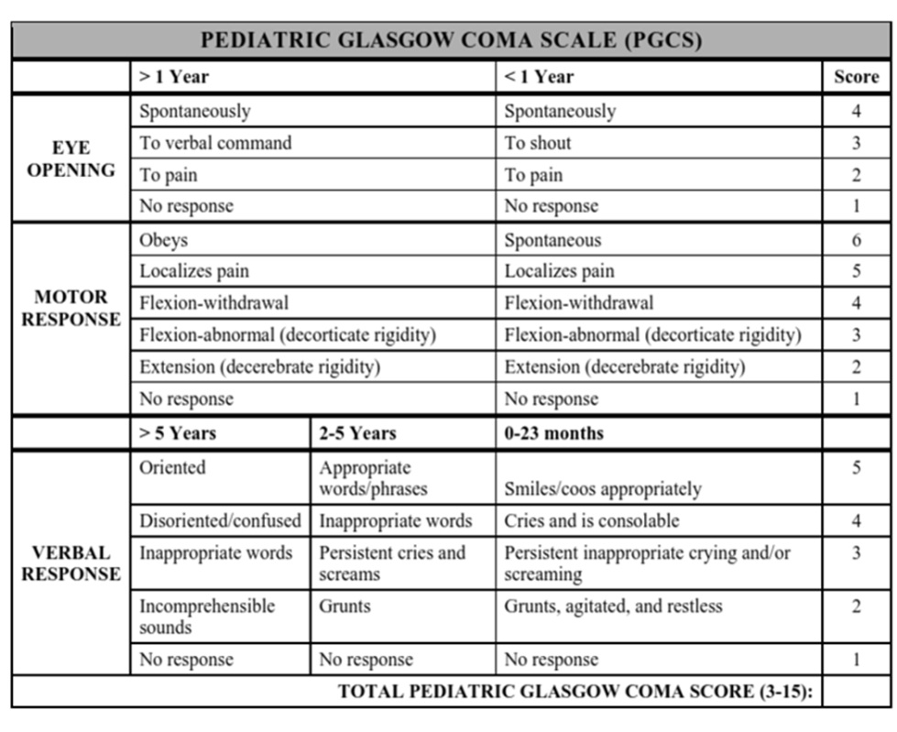
Case Study
Your patient has open eyes, obeys commands, is oriented, and uses appropriate words. What would their Pediatric Glasgow Coma Scale (PGCS) score be?
Notes:
Instructor Notes
Discuss the Pediatric Glasgow Coma Scale (PGCS) and how it applies to pediatric patients.
If the child is responding normally in all areas of the PGCS, they would be assigned a 15.
If the child had normal responses to everything except no motor response, they would be assigned a 10.
If the patient had no motor response, how would this change their PGCS score?
If everything was normal but their verbal response was disoriented, how would this affect the PGCS score?
What is the lowest PGCS score a patient can be assigned (3)? Highest (15)?

Slide 12
Pediatric Management Diagram
Notes:
Instructor Notes
The Pediatric Management Diagram (PMD)
The PMD is designed to give a generalized overview of the care and management of the pediatric patient and begins with the information obtained from the PAT.
If the general impression that the provider develops using the PAT points to a child who appears unstable or decompensated, such as a child with an altered appearance in the presence of an increased work of breathing, then the provider should progress down the “Quick” side of the diagram.
“Quick”
Generalized term used for providers to determine the need to take immediate action, whether it involves goal-oriented care or calling for immediate transport, to manage the critically ill or injured child.
Begins with the primary survey, with the assessment of the level of consciousness (AVPU), and the XABCs.
If, at any time, any life threats are uncovered during the primary survey, providers must attempt to take immediate corrective actions based upon their level of care.
These “critical interventions” are those interventions that are life-saving, determined by inadequacies found under the primary survey and include, but are not limited to, airway and ventilatory management as well as controlling external hemorrhage.
Transport should begin as soon as feasibly possible with the rapid head-to-toe assessment accomplished en route.
“Not Quick”
Refers to patients who may or may not show abnormalities in the PAT but who are stable and compensating.
With these patients, the provider should build a rapport with the child as they begin their primary survey.
Once this is done, the provider should consider if the child is suffering an injury from a significant mechanism of injury (MOI) or if the nature of illness has the potential for rapid deterioration, such that the provider should move over to the “Quick” side despite the child’s presentation.
If the patient has neither of these, then the focus of the assessment and management is aimed at gathering a comprehensive history.
Essential interventions are based on any conditions or injuries found during the rapid head-to-toe assessment.
Providers need to look at the overall condition of the patient.
They should perform a risk–benefit analysis as to how the proposed treatment would make a difference in the patient’s outcome versus how long it would take to accomplish that treatment when compared to the other injuries or illnesses the patient is suffering from.
Throughout the interaction, no matter how critical the child, the providers must continue to engage the caregivers in ongoing communication.

Slide 13
Quick vs. Not Quick
Notes:
13
Instructor Notes
“Quick” means that the patient must be quickly managed and transported due to initial findings.
“Not Quick” means that you can take additional time to find out specific history and additional information.
Proceed to the following slides, allowing participants to determine Quick or Not Quick.
13

Slide 14

You Make the Call
© Kmatta/Moment/Getty Images
Notes:
Instructor Notes
Use the Pediatric Assessment Triangle (PAT) to assess the pediatric patient in the image as Quick or Not Quick.
Would you quickly manage this little girl and rapidly transport?
She is not decompensated! She is calm, playing with the EMS provider’s tools, engaged, and appears to be in no distress.
Not quick. Take your time to better understand the symptoms, vitals, history, surveys, and treatment.

Slide 15
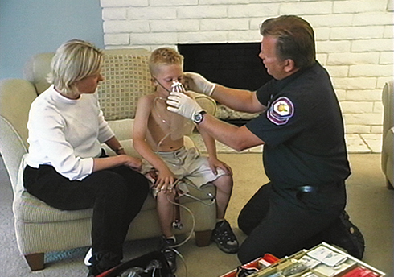
You Make the Call
Notes:
Instructor Notes
Use the Pediatric Assessment Triangle (PAT) to assess the pediatric patient in the image as Quick or Not Quick.
Increased work of breathing + a borderline poor general appearance = Quick!
Even though the child is awake, the fact that she seems lethargic indicates that she may be starting to decompensate and likely tiring from the increased work of breathing. Quick, efficient assessment to identify and treat life threats is essential.
On the slide, the image shows a child in tripod position in respiratory distress.
This child is in the tripod position, and you hear audible wheezes as you approach.
Using the PAT, would this patient be considered as Quick or Not Quick?
Answer: Quick.
What findings did you base your decision on? The child is in the tripod position and with audible wheezes demonstrates an increase with their work of breathing and attempting to maximize their air movement. The child may decompensate quickly.

Slide 16

You Make the Call
© fotorawin/Shutterstock
Notes:
16
Instructor Notes
Use the Pediatric Assessment Triangle (PAT) to assess the pediatric patient in the image as Quick or Not Quick.
Answer: Not Quick.
Is this little one compensating?
Despite the dramatic rash, this child’s general appearance tells us she does not need immediate intervention.
She is looking directly at the provider, is awake and alert, and shows not difficulty with breathing or circulation.
This child has a rash called erythema multiforme, which has several causes and is rarely anything more than uncomfortable.
16

Slide 17

You Make the Call
© Loisjoy Thurstun/Alamy Stock Photo
Notes:
17
Instructor Notes
Use the Pediatric Assessment Triangle (PAT) to assess the pediatric patient in the image as Quick or Not Quick.
Answer: Not Quick.
Is this child dehydrated?
Absolutely! She has dry mucus membranes and sunken eyes.
Information you would not obtain in the PAT:
A heart rate in the 160s
This child has had vomiting and diarrhea for 3 days.
Although this child clearly needs urgent medical attention and hydration, she is physiologically compensated.
She is sitting up, holding her own glass, and drinking water.
This child is compensating.
You have time to follow your protocols for vascular access and possibly intravenous (IV) hydration.
You also have time to build that trusting relationship with the child and her parents.
This should not be a “scoop and run” call, even if you are a basic life support (BLS) provider and cannot initiate an IV line.
17

Slide 18

You Make the Call
© kdshutterman/Getty Images
Notes:
18
Instructor Notes
Use the Pediatric Assessment Triangle (PAT) to assess the pediatric patient in the image as Quick or Not Quick.
Answer: Quick.
This is another child with 3 days of vomiting and diarrhea.
Compare this patient to the previous girl with dehydration.
Is there a difference in their general appearance?
She is not sitting up or holding her own glass of water.
She has dry mucus membranes, and sunken eyes.
Would you expect a well child of this age—about 6 years—to lie still on a stretcher?
No, you should expect her to be acting developmentally appropriate for her age.
This patient is not interacting normally with her environment, which means she looks worse than our previous patient.
Her decreased interaction could be due to dehydration and poor perfusion, hypoglycemia, sepsis, or any combination of the three.
18

Slide 19


Not Quick vs. Quick
© kdshutterman/Getty Images
© Loisjoy Thurstun/Alamy Stock Photo
Notes:
19
Instructor Notes
Discuss the PAT findings in the comparison of the two dehydrated patients.
If you were faced with these two patients simultaneously, would you need more information to decide who to treat first?
The patient on the right shows the same sunken eyes as the patient on the left and is clinically dehydrated but is beginning to decompensate.
Your eyes can quickly provide what you need to make that decision before you can even touch your patient.
19

Slide 20

Primary Survey From Case Study
    Primary survey
      X – No bleeding found.
      A – Open.
      B – Respirations are normal. Lung sounds clear bilaterally.
      C – Brachial pulses are strong, capillary refill normal. Skin is warm.
      D – GCS = 15.
      E – Sitting on the ground and holding left arm.
© Ruslan Merzliakov/Shutterstock
Notes:
Instructor Notes
Discuss the primary survey
Note that the PAT is completed prior to the primary survey (XABCDE approach).
Ask participants to explain any abnormal findings of their patient(s), physically and/or developmentally.
Discuss any life threats identified in this case.
There are no life threats at this time.
Primary survey
X – No bleeding found.
A – Open.
B – Respirations are normal. Lung sounds clear bilaterally.
C – Brachial pulses are strong. Capillary refill is normal. Skin is warm.
D – GCS 15.
E –Sitting on the ground and holding left arm.
What would your initial treatment be?
Discuss treatment options per local guidelines and policy.
Treatment should be focused on evaluation of arm injury: splinting if needed, pain control (ice pack, distraction from injury, medications if needed).

Slide 21
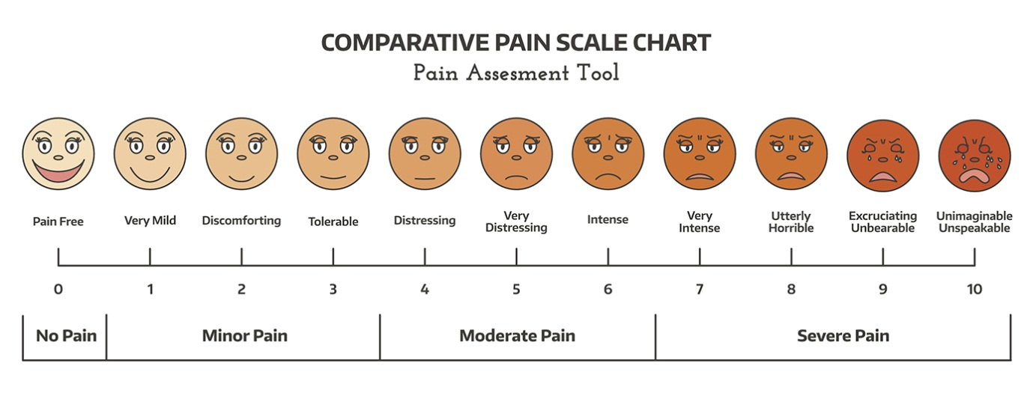
Detailed Assessment
History taking
  O – Sudden after falling while playing on the playground
  P – Movement of arm
  Q – Throbbing
  R – None
  S – 7, sad face with tears
  T – 15 minutes
Notes:
Instructor Notes
Review history taking using the OPQRST mnemonic.
O – Sudden
P – Movement of arm
Q – Throbbing
R – None
S – 7, sad face with tears
T – 15 minutes
Participant engagement
Discuss the importance of continuous reevaluation.
Discuss questions that should be asked given the physiological presentation of the patient.
Visual pain scales
Used to overcome communication/developmental barriers when patients self-report pain.
Quantifies pain based on a visual representation selected by the patient.
Allows assessment of the effectiveness of interventions.
Examples: FACCES, OUCHER, Visual Analogue Scale.

Slide 22
Detailed Assessment
History taking:
    S – Left arm pain with deformity
    A – No known allergies
    M – None
    P – None
    L – Breakfast
    E – Playing and fell from the slide approximately 4 feet
    R – None
Notes:
Instructor Notes
Review history taking using SAMPLER.
What additional questions would you want to ask the child?
Does she remember the entire event?
Is she having any other pain?
Be sure to assess the neck and spine for pain, because this injury could be distracting for the patient.
At what point should you include the family or school in the assessment questions?
It’s always good to see if there were any witnesses who can corroborate the story, especially considering the child's age.
Were there any teachers who witnessed the fall? Did she have any loss of consciousness?
Has the parent/guardian been contacted?
Do you need parental/guardian consent prior to treatment/transport?
Answer: You can use implied consent if the parent or guardian cannot be contacted. Oftentimes, schools receive consent forms from parents and may be able to make medical decisions on behalf of the patient or guardian in the event they cannot be reached.

Slide 23
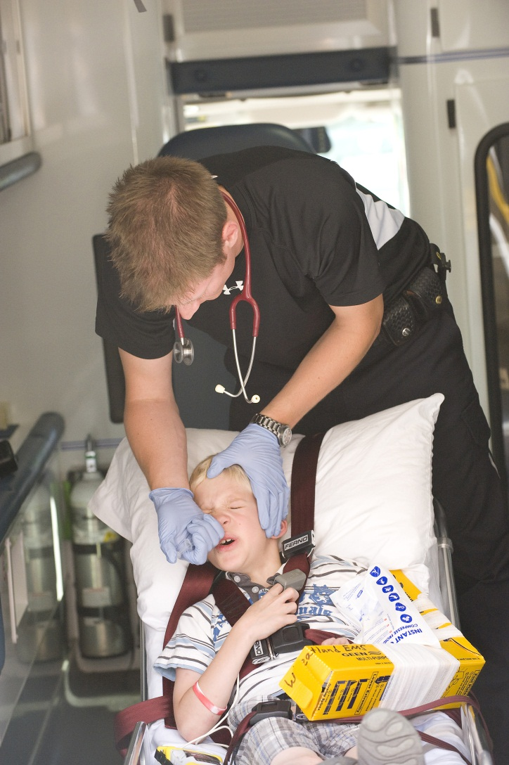

Treatment Plan
Treatment
  Physical comfort measures
  Distraction
  Coaching
  Analgesia
© Ralph R. Echtinaw/Shutterstock
© Kevin Link/Science Source
Notes:
Instructor Notes
Treatment plan
Physical comfort measures
Splints and slings: You would splint this child’s arm, making sure the splint immobilizes the joints above and below the area that may be broken.
Cold and heat: Make sure you get an ice pack for the child.
Rubbing or patting (younger patents may benefit from touch): In this child, touch away from injury site.
Infants and neonates benefit from skin-to-skin contact, swaddling, and kangaroo care.
Distraction
Distracting activities benefit the patient because of the role that anxiety and distress play in the pain experience.
Infants or preschoolers can be distracted by bubbles, light, sounds, music, and books.
Older children can be distracted by art, drawing, modeling clay, and interactive activities such as video games and movies.
Coaching
Analgesia (discuss your protocol and if/when this patient should be given analgesia for pain): Ideally the pain can be decreased with the above techniques, but you should treat your patient in pain if physical comfort measures, distraction, and coaching do not help with the pain.
Acetaminophen
NSAIDs
Inhaled anesthetics
Opioids
Ketamine

Slide 24

Pediatric Transportation
What are some considerations for pediatric transport?
When should you consider a helicopter versus ground transport?
When should transport to a community hospital be considered?
What is a pediatric readiness score, and how is it associated with outcomes of a pediatric patient?
© Jaromir Chalabala/Shutterstock
Notes:
Instructor Notes
Pediatric transportation
What are some considerations for pediatric transport?
Pediatric transport should always consider the most appropriate facility for the patient.
Ideally, pediatric patients should be transported to pediatric capable facilities that can initiate specialty care immediately upon their arrival. Do not delay treatment/transport to a closer facility, if needed. A child who does not have an airway is in a life-or-death situation and minutes count. Getting the patient to the closest facility is imperative. Pediatric readiness scores can assist in understanding the capabilities of your local hospitals.
Unless the child is in critical condition and requires immediate intervention, allow them to stay in the arms or lap of a trusted caregiver during your assessment.
However, during transport, DO NOT transport in the arms or lap of a trusted caregiver.
The pediatric patient and all vehicle occupants should be safely and appropriately restrained. Use of the child’s car seat or an approved device is important.
Specialty patients such as pediatric trauma victims benefit from initial transport to a pediatric trauma center. Special-needs patients also benefit from initial transport to the specialty center where they routinely receive their care, if this is possible without jeopardizing care. Any concern for airway should be transported immediately to the closest facility.
When should you consider helicopter versus ground transport?
The location of your patient and the transport time to a facility should help you understand whether a helicopter or ground transport is needed. If a child is sick/quick, they need to get to a facility quickly. If the closest facility is 45 minutes away, and you have a flight resource available, consider utilizing them. Follow local protocol.
When should transport to a community hospital be considered?
Pediatric readiness scores are beneficial in determining the readiness of a hospital for the pediatric patient. The following link provides details of the pediatric readiness scores and initiative:
https://emscimprovement.center/domains/hospital-based-care/pediatric-readiness-project/

Slide 25
Notes:
25
Instructor Notes
Family-centered care
The principle of family-centered care is reinforced throughout this course.
Communication is critical to the success of family-centered care.
Family-centered care is grounded in collaboration among patients, families, physicians, nurses, and other professionals for the planning, delivery, and evaluation of health care, as well as in the education of healthcare professionals. These collaborative relationships are guided by the following principles:
Respecting each child and his or her family.
Honoring racial, ethnic, cultural, and socioeconomic diversity and its effect on the family’s experience and perception of care.
Recognizing and building on the strengths of each child and family, even in difficult and challenging situations.
Supporting and facilitating choice for the child and family about approaches to care and support.
Ensuring flexibility in organizational policies, procedures, and provider practices so services can be tailored to the needs, beliefs, and cultural values of each child and family.
Sharing honest and unbiased information with families on an ongoing basis and in ways they find useful and affirming.
Providing and/or ensuring formal and informal support (e.g., family-to-family support) for the child and parent(s) and/or guardian(s) during pregnancy, childbirth, infancy, childhood, adolescence, and young adulthood.
Collaborating with families at all levels of health care, in the care of the individual child, and in professional education, policy making, and program development.
Empowering each child and family to discover their own strengths, build confidence, and make choices and decisions about their health.
It is critical to consider your pediatric patients within the context of their families, whether family members are blood relatives or other accustomed caregivers.
Family members must be considered as part of your healthcare team.
Allow them to assist you and your patient in providing care.
Family member participation in the care of their loved ones is becoming an established principle in pediatric and adult health care.
Respect their opinions and conclusions and enlist their cooperation.
In many cases, caregivers are knowledgeable of the patient's condition.
When the medical personnel are gone, it is the family that must take over care of the child; therefore, it is desirable to have family members involved as much as possible in all phases of care.
If the child’s family members are not working with you, but rather are working against you, you may not be able to establish a trusting relationship through which you may temporarily take control over what’s happening with their child.
25

Slide 26
Wrap-Up
Adult vs. pediatric
Pediatric Assessment Triangle
Quick vs. Not Quick
Be honest
Notes:
Instructor Notes
Expand on the following points.
Adult vs pediatric
Be confident with your assessment of pediatrics.
Know the difference between adult and pediatric anatomy and vital signs.
Pediatric Assessment Triangle
Use the PAT, it works!
Quick vs. Not Quick
Knowing when to be Quick vs. Not Quick with the treatment and transport of a pediatric patient could mean life or death.
Be honest with your patient.
Credibility and rapport are essential for communication with children of all ages.
When appropriate, do whatever you can to get the child to smile.
When a child smiles, it relaxes everyone, including the caregivers, you, and your teammates.

Slide 27

Questions?
© Nujumuddin Mohamad Yaman/EyeEm/Getty Images
Notes:
Instructor Notes
Allow time for a question-and-answer session about the topics presented in the lesson.

