Slide 2
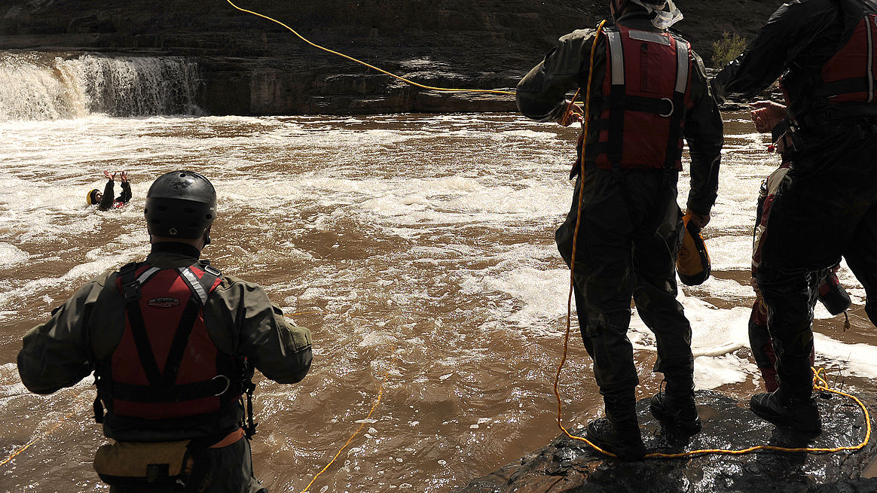
River Dynamics

Slide 3
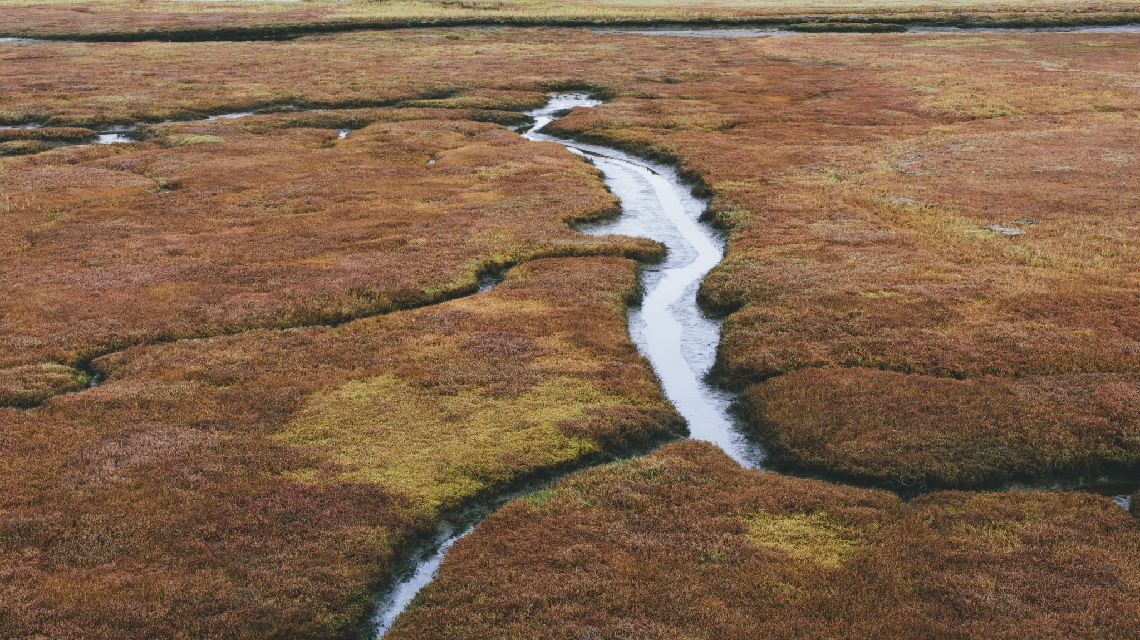
River Dynamics
Moving water has power.
A Swiftwater rescuer needs to understand moving water.

Slide 4
River Dynamics
River currents
River obstacles
River hazards.

Slide 5
River Currents
River Right and River Left
Primary Current

Slide 6
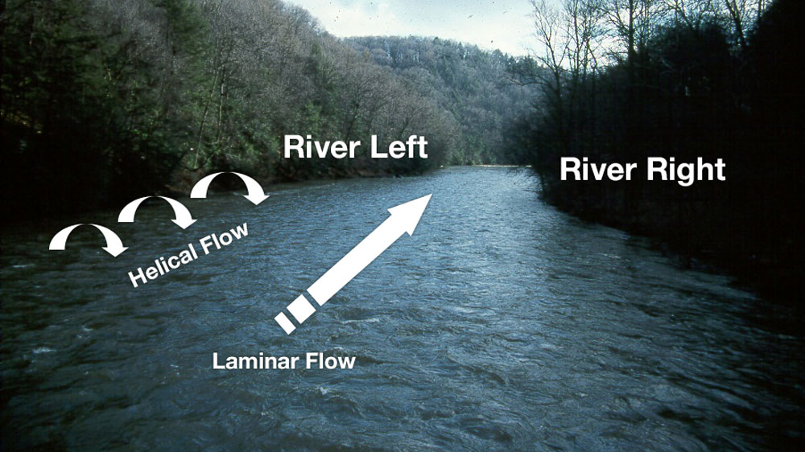

Slide 7
River Right and River Left
River right and river left are an orientation used by river users.
Looking downstream
Looking upstream

Slide 8
River Right and River Left Looking downstream
Looking downstream, river right is the right shore
River left is the left shore.

Slide 9
River Right and River Left Looking upstream
Looking upstream, river right is the left shore (if looking downstream)
River left is the right shore (if looking downstream).
Looking upstream, what is on the right is really on the left, and what is on the left is really on the right.

Slide 10
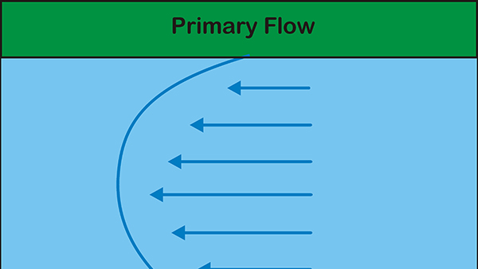

Slide 11
Primary Current
The primary current refers to the general direction in which the river is flowing.
It is the current found in an unobstructed main channel.
The primary flow is represented by the laminar flow.

Slide 12
Primary Current
The slowest moving water is next to the bottom and each successive layer of water toward the surface flows faster than the layer below it.
The fastest moving water is found just below the surface.
This is because the air next to the surface creates friction which slows the surface water slightly.

Slide 13
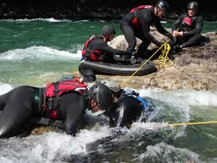
Laminar Flow
Laminar flow is like a series of sheets of plywood where each layer travels at the speed of the sheet below it plus its own speed

Slide 14
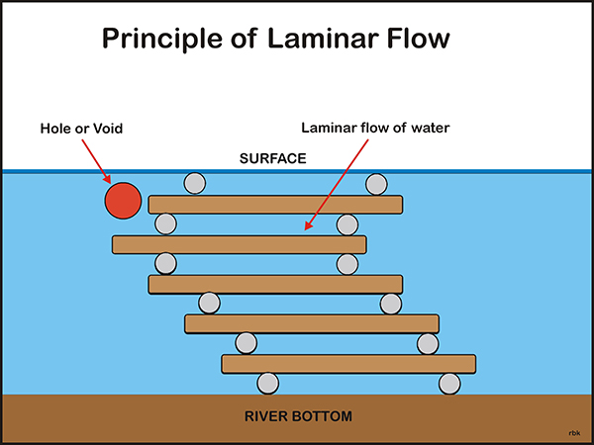

Slide 15
Downstream and Upstream "Vs"
Two rocks or other objects can create a restriction in the water where the water flows between the rocks to form a small chute.
The rocks form an upstream V and the chute between the rocks forms a downstream V.

Slide 16
Downstream and Upstream "Vs"
There is a difference in vertical height between the upstream and downstream Vs.
The water piles up against the rock creating an increase in the vertical height of the water

Slide 17
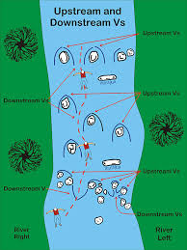

Slide 18
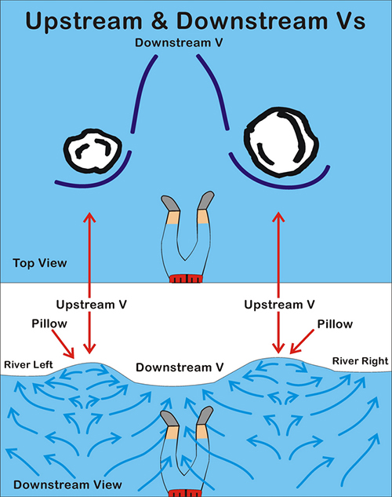

Slide 19
Bends
When the river bends, inertia forces the main current toward the outside of the bend.
As the deeper, faster and the more powerful current reaches the outside of the bend
It turns downward and creates a spiraling effect off the bottom of the river that leaves more room for surface water on the outside of the bend.

Slide 20
Bends
The force of the water tends to erode the outside of the bend where trees and other debris fall into the river where they can form strainers.
In contrast, the slower, shallower and less powerful current is usually found on the inside of the bend.

Slide 21
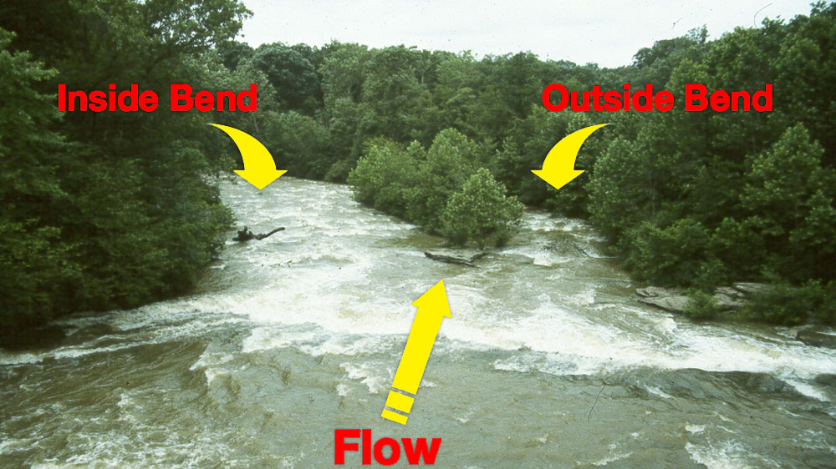

Slide 22
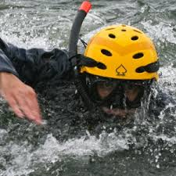
Bends
When swimming around a bend, the swimmer normally hugs the inside of the bend where the current is slower.

Slide 23
Bends
Moving to the outside of the bend
The swimmer encounters the faster water which tends to push the swimmer into the outside bank where the swimmer is likely to encounter a strainer or other obstruction.

Slide 24
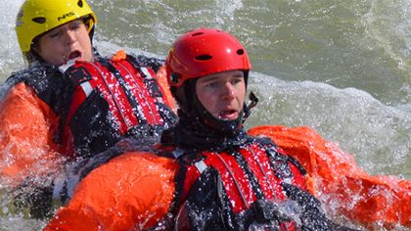
Bends
When swimming a bend, the swimmer sets a slight ferry angle with the head pointing toward the inside of the bend.

Slide 25
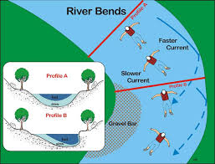

Slide 26
Chutes and Waves
A narrow constriction in the water forces the water to increase its speed through the constriction.
This water usually forms a smooth tongue of water.

Slide 27
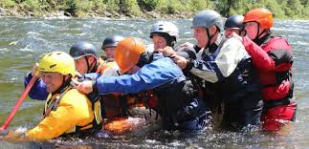
Chutes and Waves
After the water passes through the constriction
Deceleration into a deeper and slower water results in a series of uniformly spaced scalloped shaped standing waves.

Slide 28
Chutes and Waves
The constriction can vary several feet in width to a river wide constriction.
The former creates a simple drop with small waves.
The latter river wide constriction can create large standing waves several feet in height from the trough to top of the wave.

Slide 29
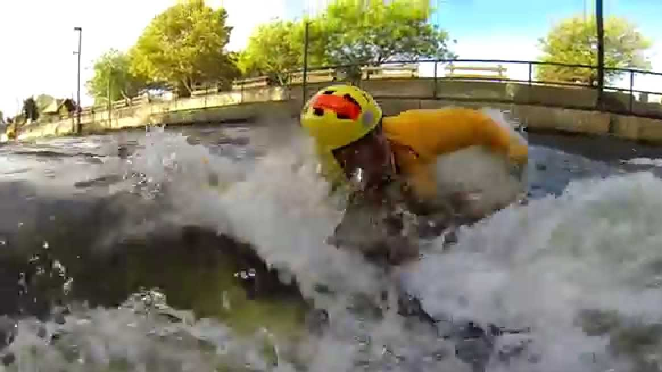
Chutes and Waves An important consideration for the swimmer
Coordinate breathing so that breaths in between the waves and not as she goes through the wave.

Slide 30
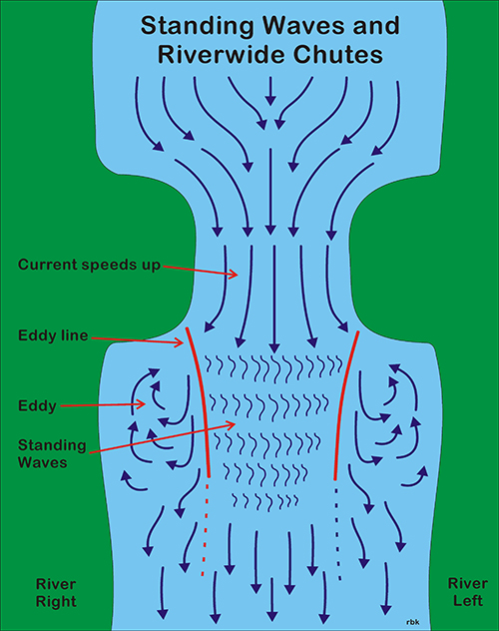

Slide 31
River Features
Rocks
Pillows
Holes
Eddies

Slide 32
River Features Rocks
Rocks are the main obstacles found in a river.
The depth of the rock in the water and its size are key factors in determining the effect of the rock on river dynamics.

Slide 33
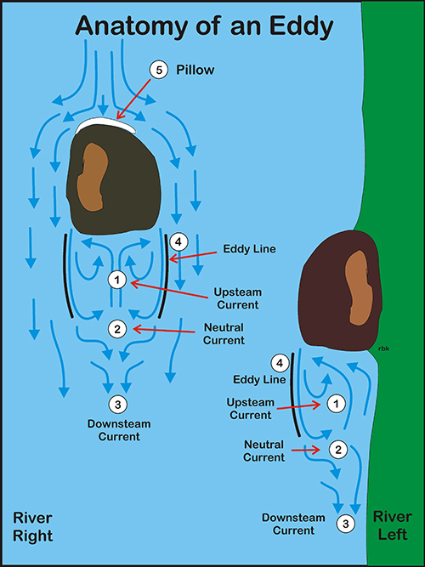

Slide 34
Eddies
Eddies are formed behind rocks or other obstructions in the river.
Water flows past the obstruction creating a void behind the object which the water attempts to fill.
There are three distinct parts of an eddy which are created by the water attempting to fill the void.

Slide 35
The first part of the eddy
The first part of the eddy is where the water in the main current rushes by the rock so fast that in order to fill the void the water must flow back upstream
This creates a very strong current differential between the main current and the current in the eddy.

Slide 36
The first part of the eddy
The interface between the downstream current and the upstream current creates an eddy line or even an eddy wall.
As the current increases dramatically, the eddy line becomes an eddy wall.

Slide 37
The first part of the eddy
An eddy wall is the vertical height difference between the downstream current and the current in the eddy attempting to fill the void behind the rock.

Slide 38
The first part of the eddy
If there is an eddy wall, there is a noticeable downhill current inside the eddy also.
For a rescue swimmer, this powerful of an eddy can be problematic and the rescue swimmer can find the eddy unfriendly.

Slide 39
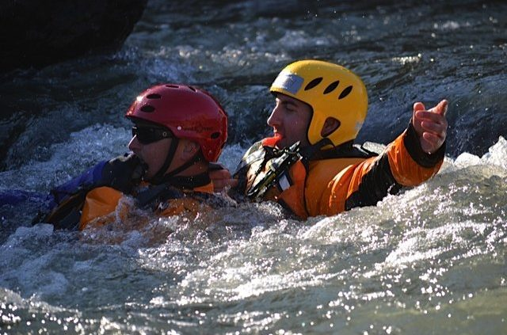
The first part of the eddy
However, most eddies will have an eddy line where there is little or no vertical difference between the main current and the upstream current in the eddy.

Slide 40
The second part of the eddy
The second part of the eddy is the interface between the current moving upstream and downstream in the eddy. c

Slide 41
The third part of an eddy
The third part of an eddy is where the water in the main current enters the void behind the rock so far downstream
It continues downstream but at a slower rate then the main.

Slide 42
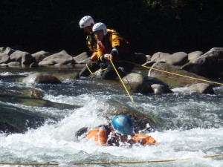
The third part of an eddy
This area of an eddy can be problematic for rescue swimmers because rescue swimmers may think that they are in the upstream current in the eddy when they are really moving downstream

Slide 43
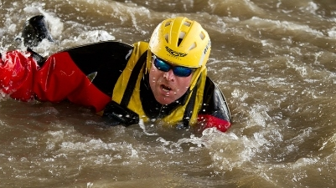
The third part of an eddy
In addition, since the current is moving downstream in the eddy, there is no real eddy line present in this portion of the eddy.

Slide 44
The third part of an eddy
Many beginning rescue swimmers will prefer entering an eddy in this area because there is no current differential and there is less risk of having to cross the eddy line.
This is okay but remember to swim upstream into the eddy.

Slide 45
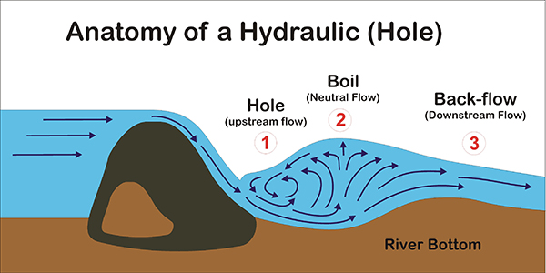

Slide 46
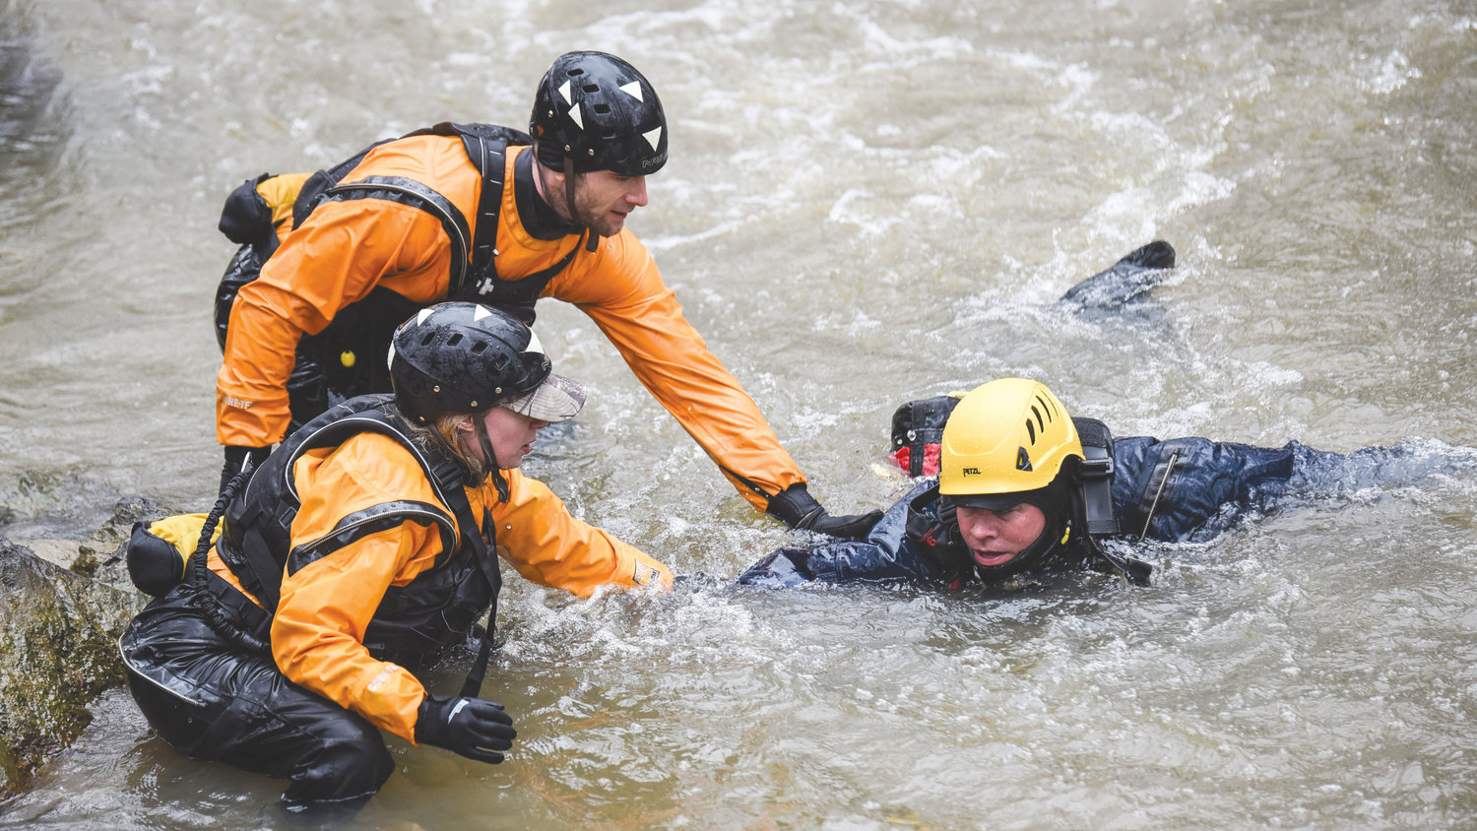
Hydraulics and Holes
A hole occurs in the river when a rock or other obstruction of sufficient width to prevent the water from filling in the obstruction from the side forces the water flowing over the rock to fill the void or depression behind the rock.

Slide 47
Hydraulics and Holes
As the water flows over the rock, it plunges down to the bottom of the river and races downstream.
As it races downstream, the water shoots back up to the surface where it moves in one of three directions.
A portion of the water re-circulates back upstream to fill the void behind the rock (1). "

Slide 48
Hydraulics and Holes
Further downstream, some of the water comes up to the surface and continues on downstream (3).
This water travels at a slower rate than the general flow of the river and quickly picks up speed as it moves downriver.

Slide 49
Hydraulics and Holes
In between or at the interface of the upstream and downstream flow
The flow is neutral in that it is not really flowing downstream or upstream (2).
This neutral area is called the "boil."

Slide 50
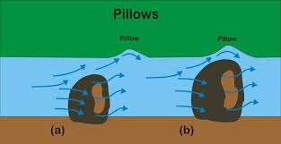

Slide 51
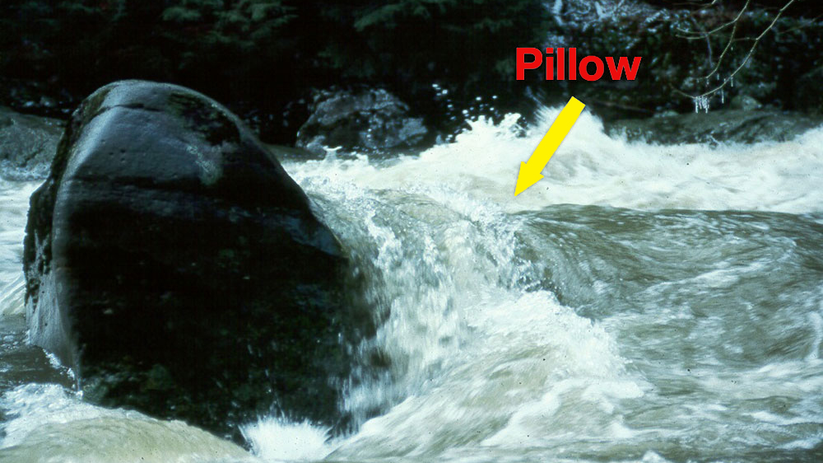
Pillows
As the rock approaches the surface, it will force the water passing over it upward to the surface creating a small rounded wave or pillow downstream of the rock.

Slide 52
Pillows
The further underneath the water that the rock is in the water, the further downstream the pillow.
And, as the rock moves closer to the surface, the pillow moves closer to the rock until it is directly over it.

Slide 53
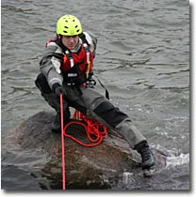
Pillows
It takes experience for a Swiftwater rescuer to recognize which pillows are close to the surface and need to be avoided and which ones are deep enough not to pose a problem.

Slide 54
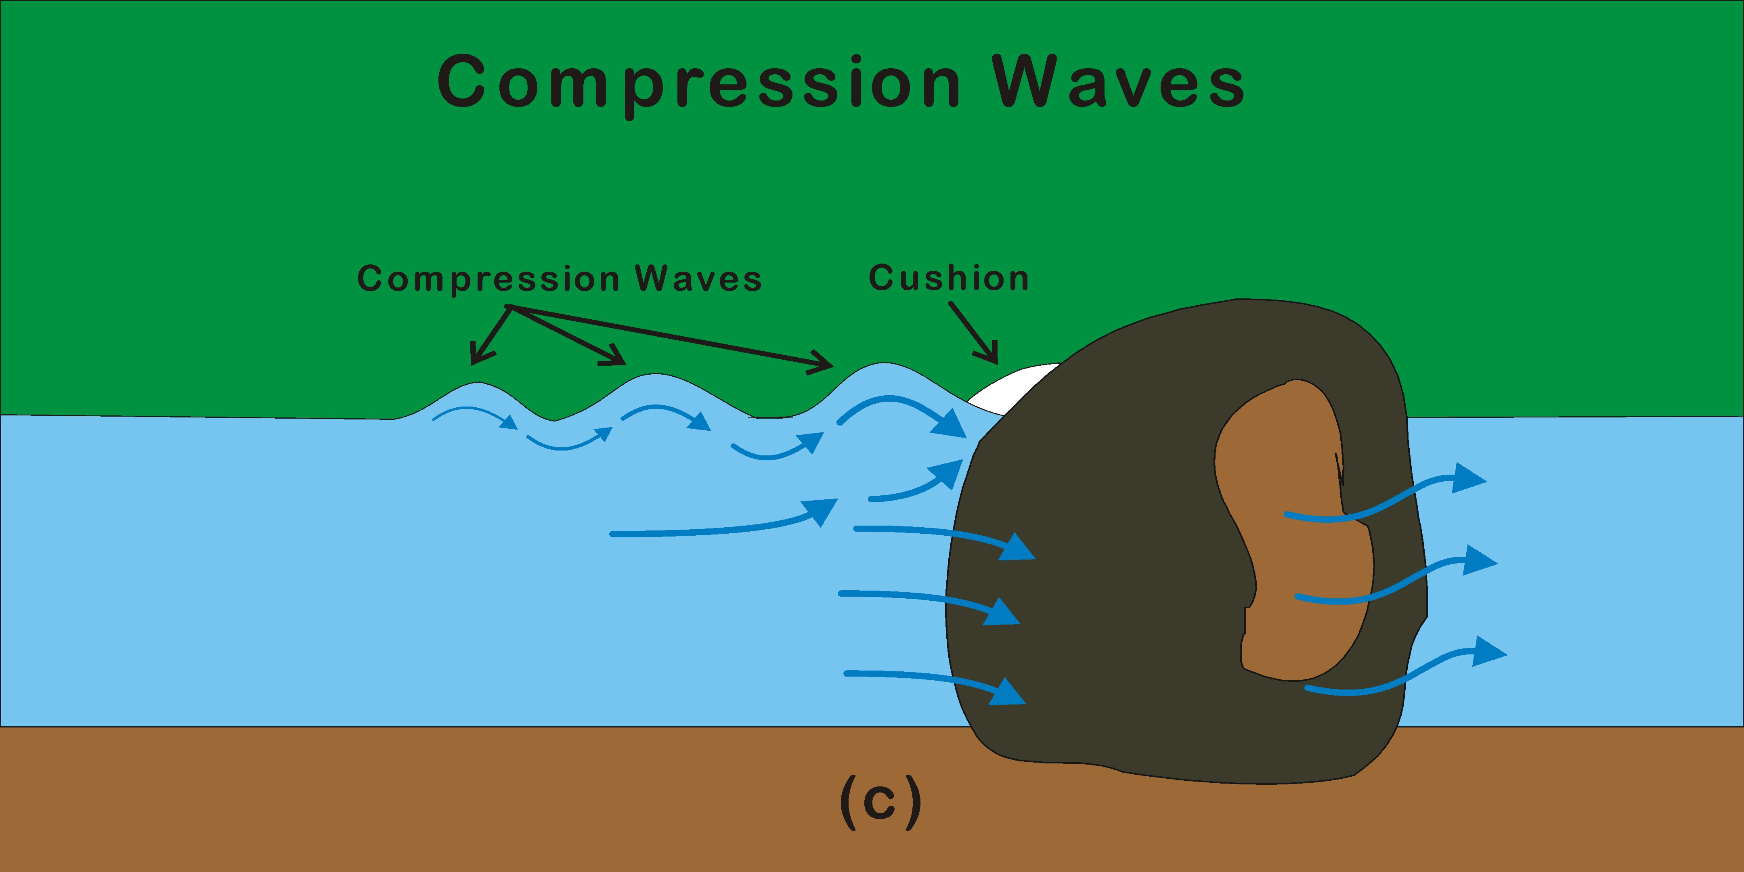

Slide 55
River Hazards
Strainers
Undercut rocks
Low-head Dams
Old Man-made Structures
Drowning Trap Flows

Slide 56
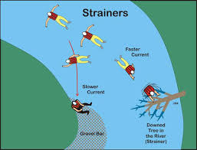

Slide 57
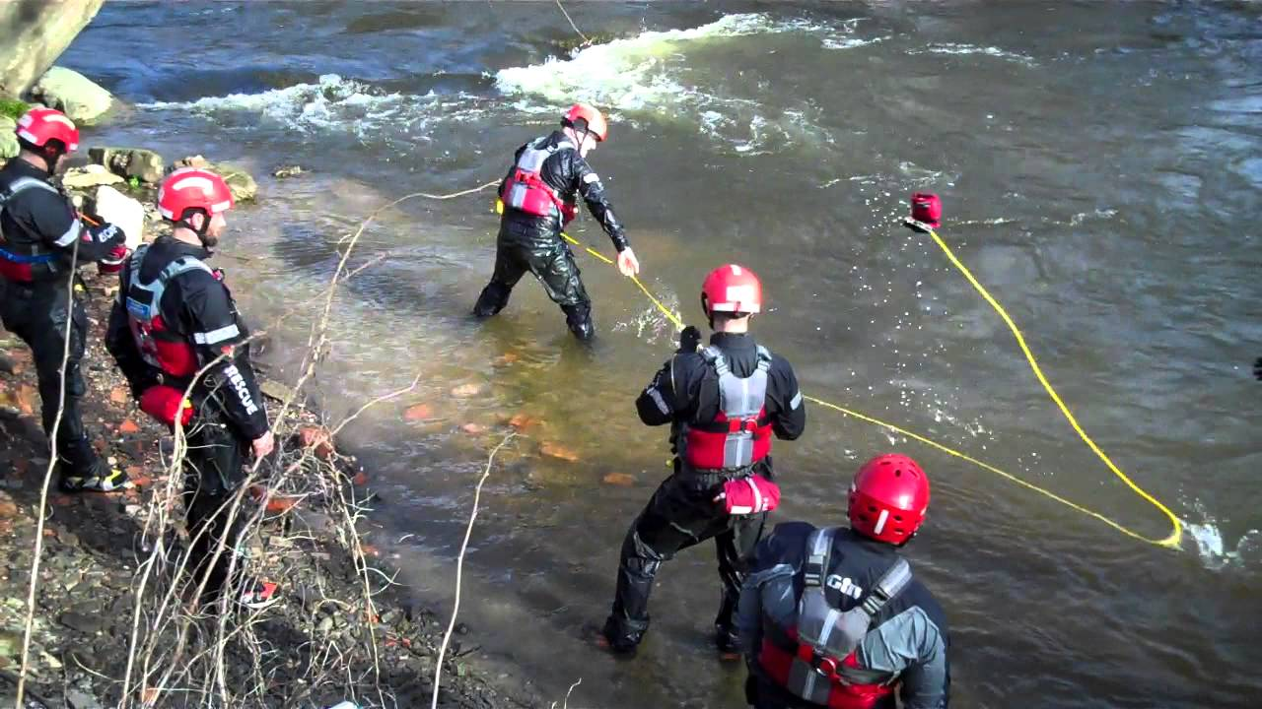
Strainers
Strainers are formed when water flows through an obstacle.
Much like spaghetti in a colander, water flows through the strainer leaving the victim trapped helplessly.
Stainer's are most formed by trees and rocks.
STRAINERS ARE KILLERS.

Slide 58
Strainers
They are extremely dangerous and river users should always avoid them.
Trees are the most encountered form of strainers found on a river.

Slide 59
Strainers
As a river continues to carve out a bend in the river
Trees along the bend will fall into the river channel as the river current undermines the foundation underneath the tree.

Slide 60
Strainers
Strainer on the bend of a river is particularly dangerous
The current is faster there
The rescue swimmer who is flowing with the current is more likely to be swept into the strainer.

Slide 62
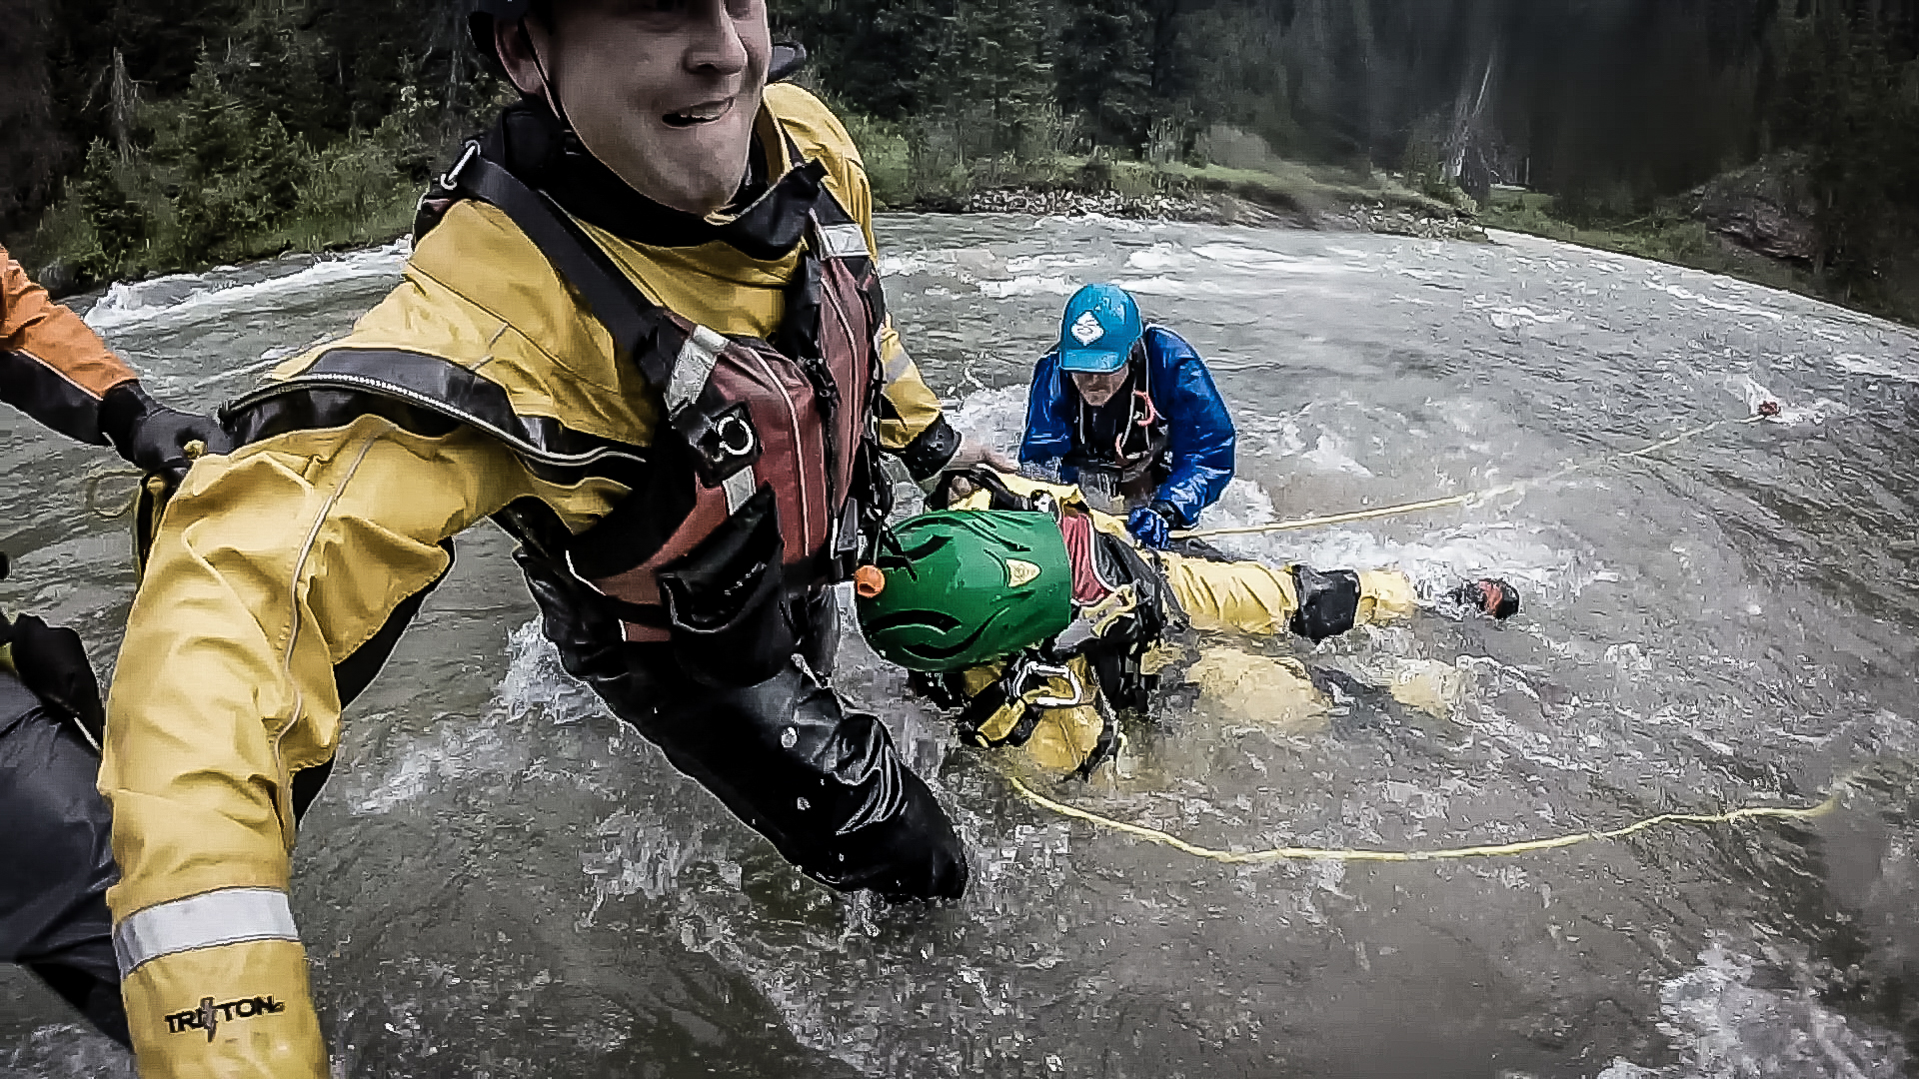
Undercut rocks
Undercut rock is that the water flows underneath rather than around the rock.
Depending on its size, the current can sweep a victim underneath the rock and impale the victim in the orifice of the undercut rock (strainer).

Slide 63
Undercut rocks
For most boaters, a good indication of an undercut rock is that normal river features like an eddy don't behave as they normally do.
They seem weird or different and they act weird because the currents are different.

Slide 64
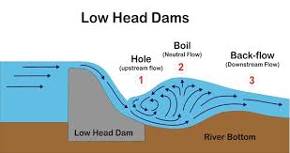

Slide 65
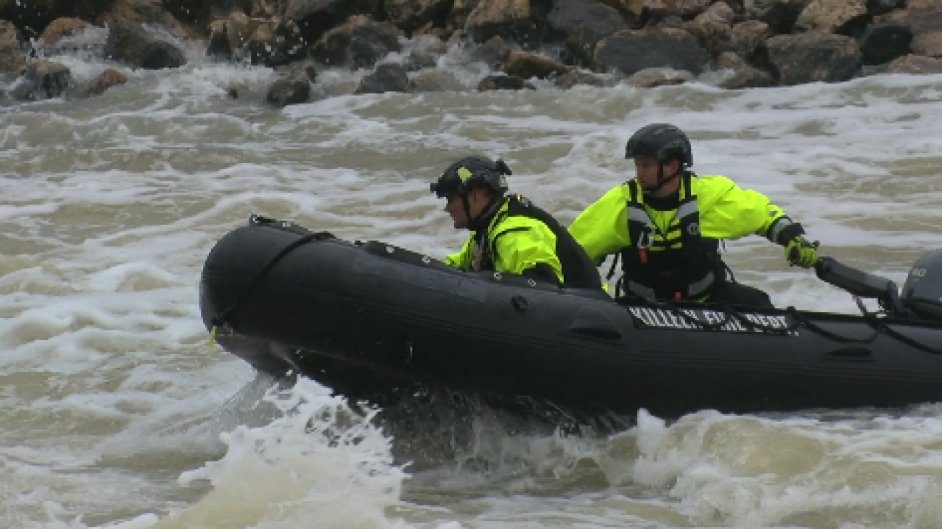
Low-head Dams
A low-head dam and a hydraulic are essentially the same with some important differences.

Slide 66
Low-head Dams
The hydraulic behind a low-head dam is a "perfect" hydraulic.
It goes from one river abutment to the other.
The only exit may be to dive down and catch the water moving downstream.

Slide 67
Low-head Dams
In contrast, naturally formed hydraulics are imperfectly formed and can usually be escaped.
A low-head dam is designed to disperse the kinetic energy of the falling water upward rendering it harmless.

Slide 68
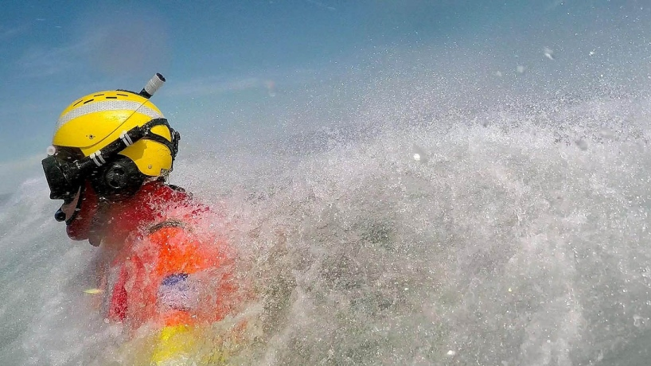
Low-head Dams
Unfortunately, hydraulic is perfectly formed and extends from one abutment to the other abutment.
Therefore they are called the drowning machine.

Slide 69
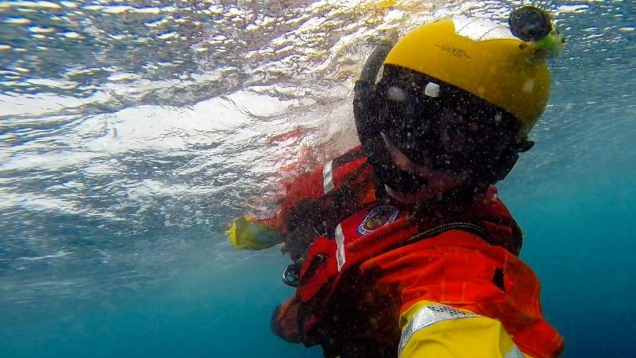
Old Man-made Structures
Most rivers contain man-made structures such as old dams or bridge abutments that have fallen in disuse.
Sometimes these structures are potentially a fun place to play with a canoe or kayak.

Slide 70
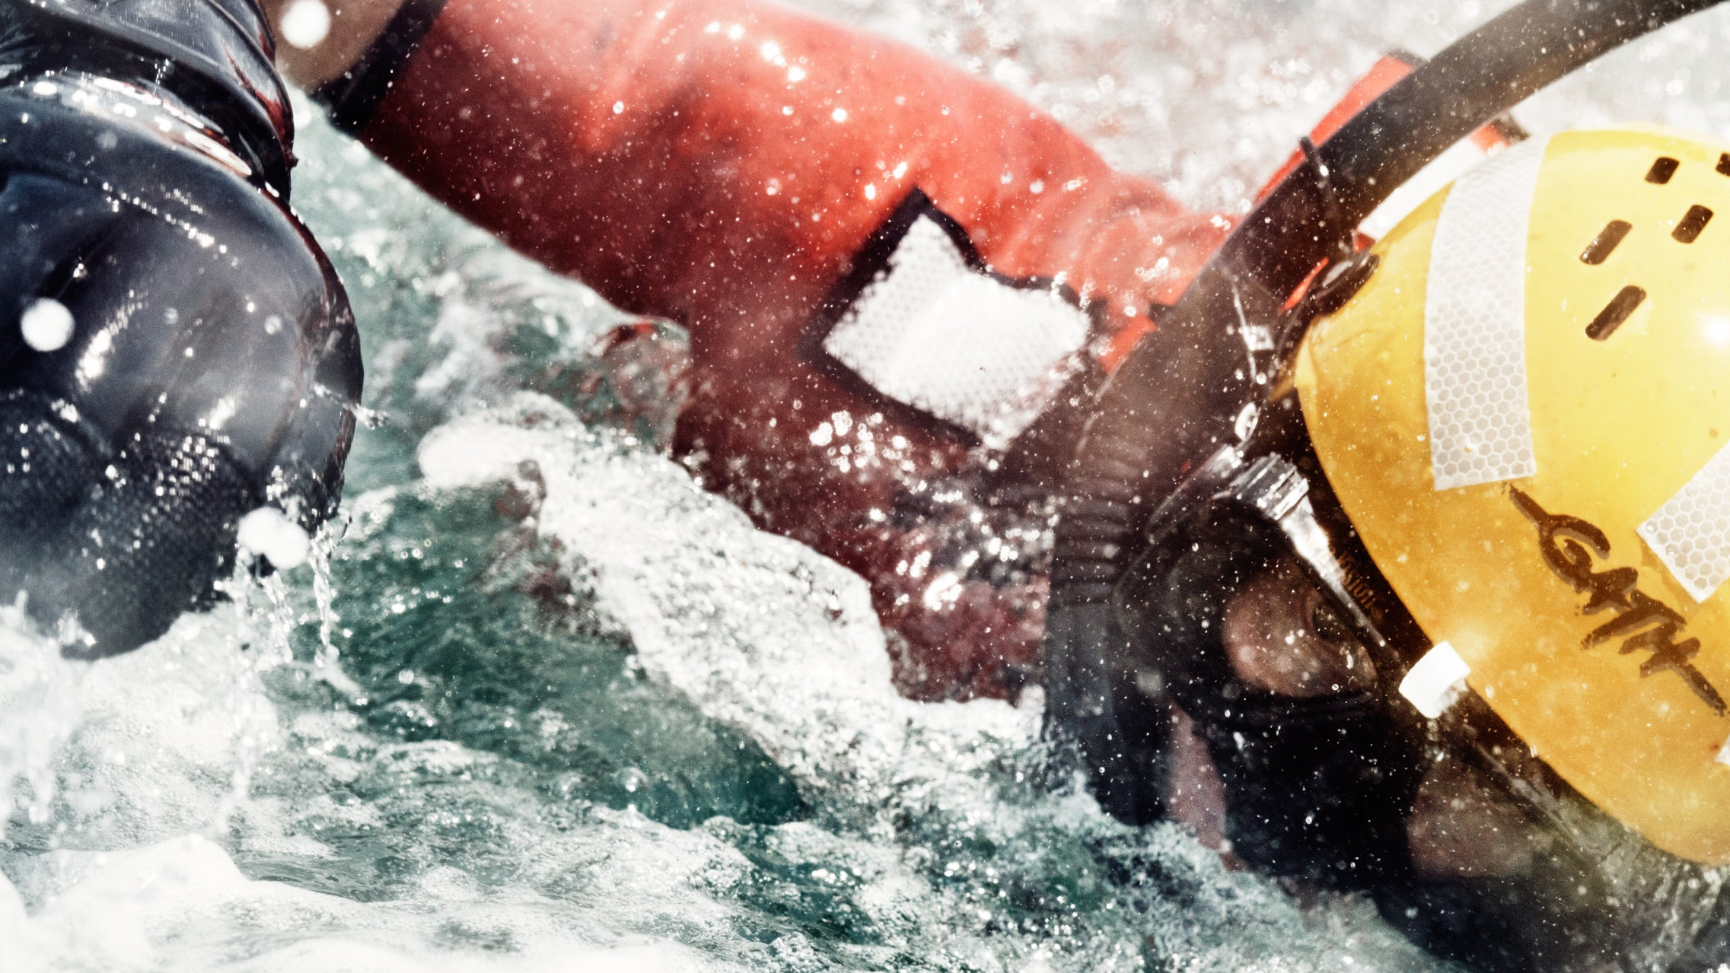
Old Man-made Structures
Always use caution around these structures.
Rip-rap may contain large spikes.

Slide 71
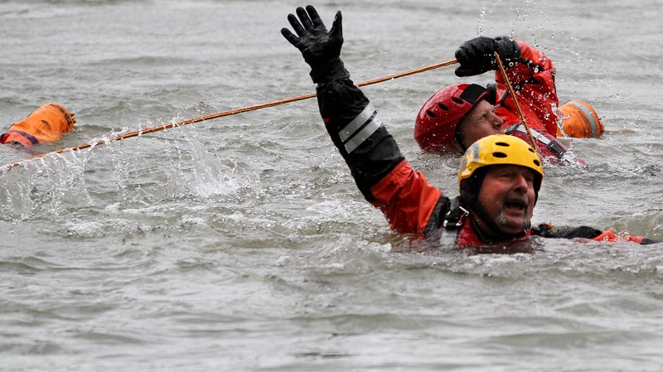
Old Man-made Structures
Old dams and bridge abutments may contain reinforcing rods or sharp rocks that can create nasty injuries.
Check the site at low water for hazards and if there is any doubt, find another place to play.

Slide 72
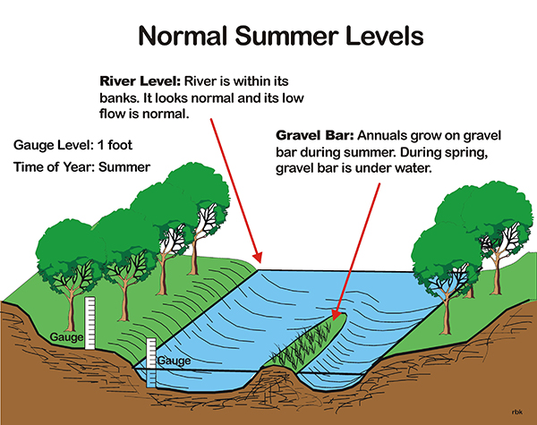
Drowning Trap Flows
Any water level on the river can be hazardous.

Slide 73
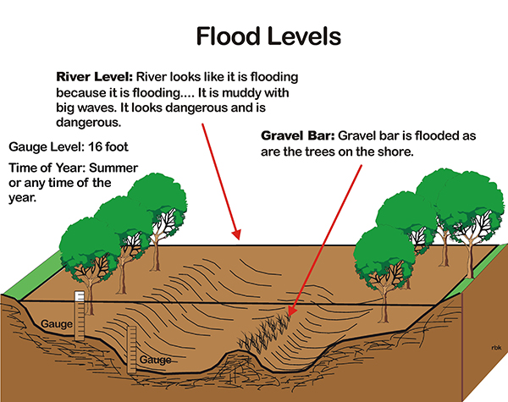
Drowning Trap Flows
Most people associate flood-like conditions with danger like muddy water, water flowing over the banks, water in the trees, floating debris and big waves.

Slide 74
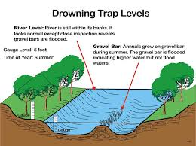
Drowning Trap Flows
Floods and high water are dangerous, and most people recognize the danger and stay off the river.

