Slide 1
THE RESCUE COMPANY 1

Slide 2
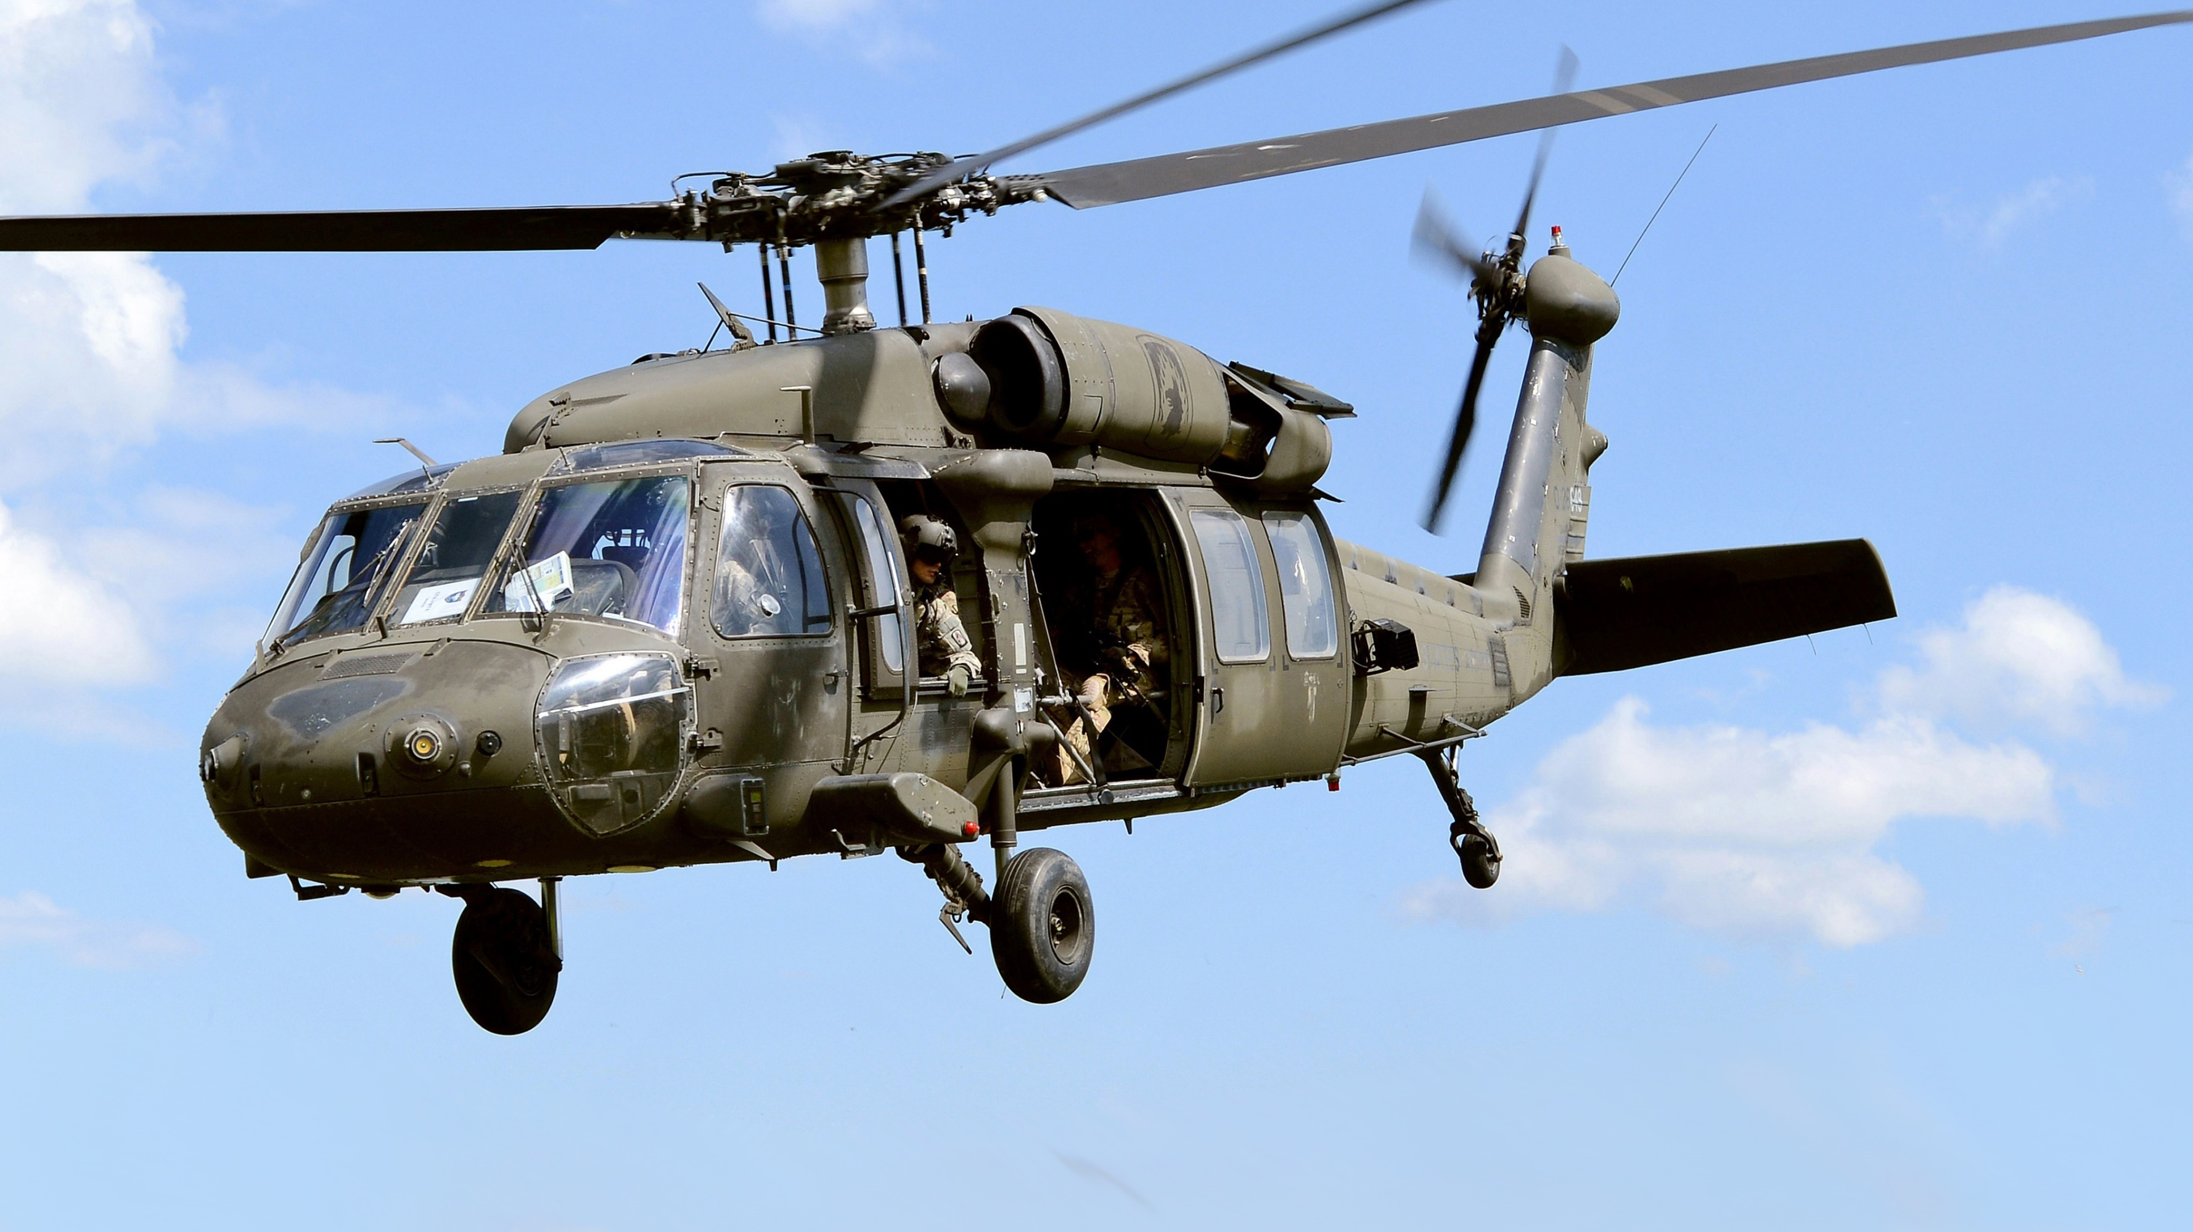
Principles of Flight

Slide 3
Ground Effect
Ground effect is a condition of improved performance that a helicopter experiences when operating near the ground.
This is interaction between the helicopter's rotor wash and the ground

Slide 4
in Ground Effect (IGE)
This compressed air provides additional lift to the helicopter.
In Ground Effect (IGE) occurs to its greatest extent at approximately one-half of the rotor diameter above the ground.

Slide 5
Out of Ground Effect (OGE)
Conversely, a helicopter experiences "Out of Ground Effect" (OGE) performance when the rotor wash is not affected by proximity to the ground.
OGE usually occurs when the helicopter is more than one-half of the rotor diameter above the ground.

Slide 6
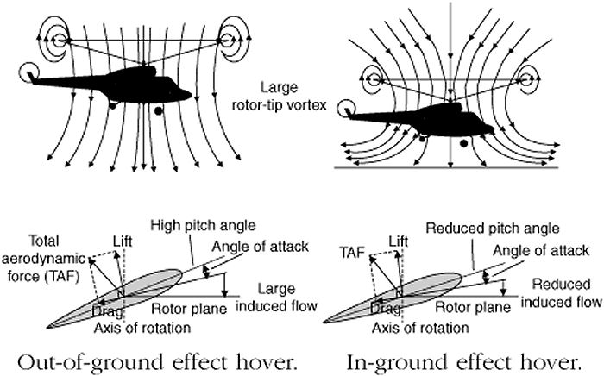

Slide 7
Translational Lift
Horizontal movement of the surface wind increases the efficiency of the hovering rotor.
As increasing velocities of airflow enter the rotor system, turbulence and vortices are left behind and airflow becomes horizontal.
This improved rotor efficiency resulting from directional flight is called "translational lift."

Slide 8
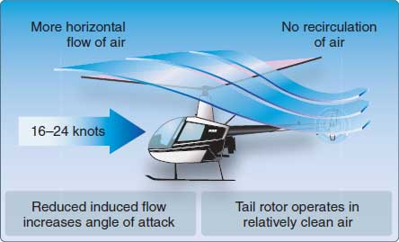

Slide 9
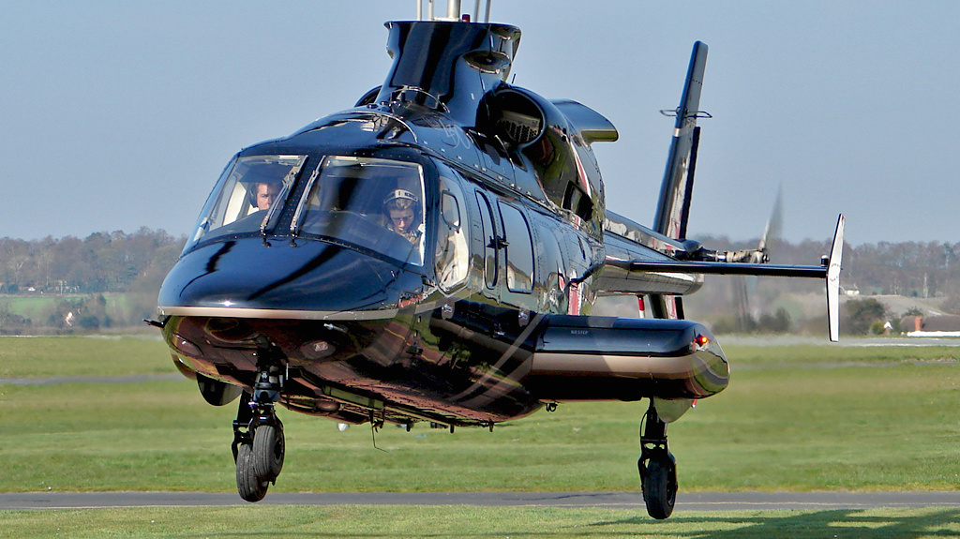
Normal Takeoff
Normal takeoff is the procedure used where flight of the helicopter is not limited by the presence of obstructions---natural or man­made.

Slide 10
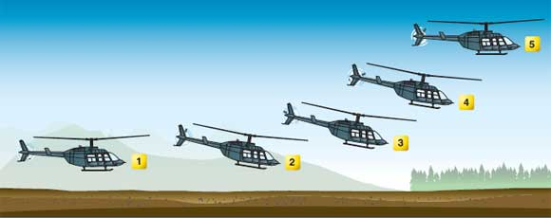

Slide 11
Maximum Performance Takeoff
"Maximum performance takeoff' is the takeoff procedure used when departing a confined area, that is, where flight of the helicopter is limited by terrain or other obstructions.
rotor system is less efficient and the takeoff requires a greater demand on the helicopter's power plant, with less engine power in reserve as a safety margin.

Slide 12
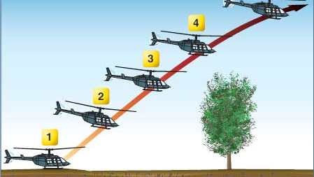

Slide 13
Auto rotation
"Autorotation" is the flight condition during which no engine power is supplied to the rotor system and the movement of air up through the rotor blades enables sustained flight.
Autorotation allows the pilot to use the inertia generated by this airflow to slow the rate of descent and effect a safe landing

Slide 14
