Slide 1
THE RESCUE COMPANY 1

Slide 2
Knots, Hitches, & Bends

Slide 3
Knots
The critical element in determining a knot is that when it is tied, it is self-contained and self ­supporting.
It does not need another object or rope to maintain the integrity of the knot (e.g. a hitch does). And, it does not tie two ropes together

Slide 4
Hitch
A hitch needs an object or another rope to tie it.
Without the object or other rope, it will fall apart.
The other object or rope assists in maintaining its structure.

Slide 5
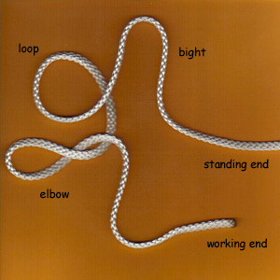
Bends
Bends are used to tie two ropes together.
The water knot is used to tie the two ends of webbing together to create a sling.
Also, the water knot and double fisherman's knot are really bends.

Slide 6
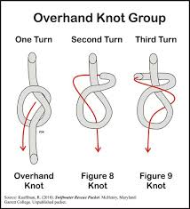

Slide 7
Families
Examination of knots reveals that their internal structure tends to repeat itself in other knots.
This suggests that knots can be grouped into families.
Also, this helps when visually examining knots because the configurations are the same.

Slide 8
Parts of a Rope
Bight
Loop
Working End
Standing End
Running End

Slide 9
Bight
A bight is a bend in the rope where the line comes back on itself but doesn't cross over itself.
It is a loop where the rope doesn't cross over itself.
It is usually taken out of the center of the rope.

Slide 10
Loop
In contrast with a bight, a loop is a turn in the rope where the lines cross over each other.
When tying a bowline, the first step is to make a loop.

Slide 11
Working End
The working end is attached to the item being rigged or hauled.
Think of it as the end of the rope working or currently occupied.

Slide 12
Standing End
The standing part of a rope includes all the rope excluding the working end.

Slide 13
Running End
The running end is the free end of the rope.
Sometimes it is called the free end.
It is part of the standing end of the rope and it is the section of the rope used to tie a knot, hitch or something else.

Slide 14
Tying Considerations
Some knots are selected because of their strength.
Some are chosen because a life might depend on the knot being "bombproof'.

Slide 15
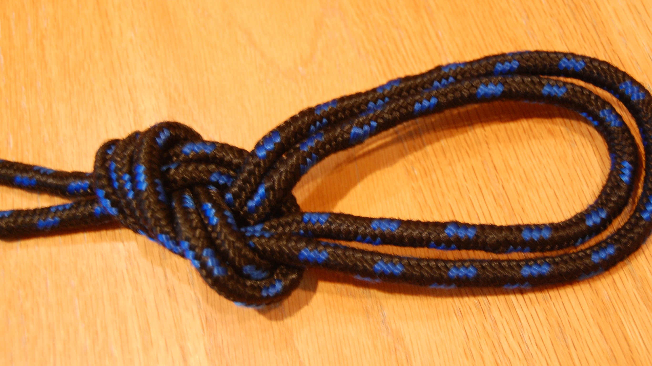
Tying Considerations
Some knots are selected because they can be tied quickly and untied easily ( e.g. bowline).
Others have a specific purpose or functions (e.g. double fisherman, Prusik, water knot).

Slide 16
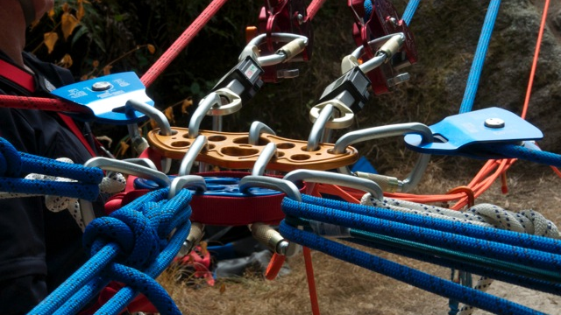
Function
Many knots are designed for specific uses and functions.
A sheet bend and double fisherman are designed to tie two ropes together.
A water knot is designed to tie two pieces of webbing together but not two ropes.

Slide 17
Function
A bowline is designed to tie a loop in the rope.
A clove hitch is designed to tie a rope to a branch or peg.

Slide 18
Strength
Tie a knot in a rope and it will immediately lose 1/4 to ½ of its strength.
A figure eight retains roughly 75%-80% of its original strength.
In contrast, a square knot retains only 43%-47% of the rope's original strength

Slide 19
Strength
The knot creates a stress point where the fibers on the outside of the bend are stretched more and those on the inside of the bend are stretched less.
On the inside of the bend, the strands may even become compressed.
The differential in stresses can lead to rope failure at this point.

Slide 20
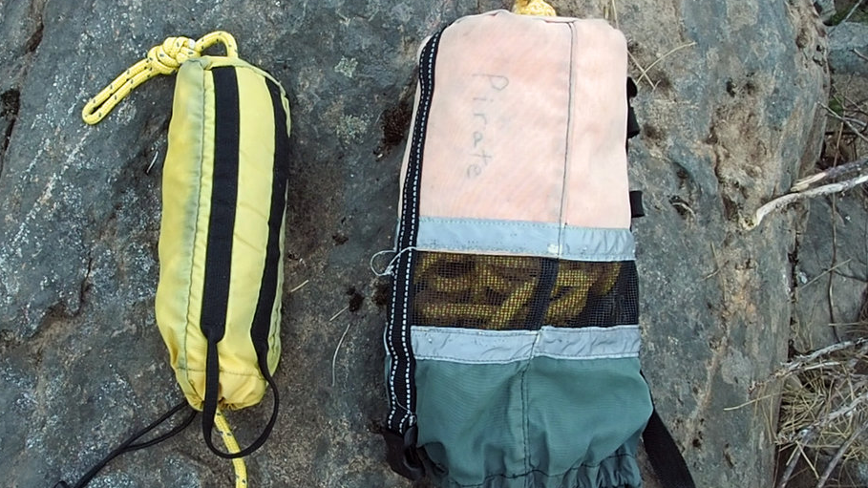
Strength
A good rule to remember is that when the object around which a rope is bent is at least four times the diameter of the rope (e.g. pulley, branch, a knot, etc)

Slide 21
Ease to Tie/Untie
A knot should be relatively easy to tie.
When tying a line around a post or object, the bowline is easier and quicker to tie than a figure-8 follow-through.
In contrast, once under load, a double fisherman can be virtually impossible to untie.

Slide 22
Setting and Dressed
In tying a knot, the knot is tied loosely.
Setting is the process of tightening the knot so that it becomes dressed.
A knot is dressed when it is configured properly.

Slide 23
Setting and Dressed
This is important because, a properly dressed knot makes for easier inspection
An improperly dressed knot can lose up to 50% of its strength.

Slide 24
Inspection
It is important to determine that a knot is tied properly and is safe.
A figure-8 knot has a unique and distinct configuration. It looks like the figure eight.

Slide 25
Amount of Rope Used
Some knots consume more rope than others.
A figure eight on a bight consumes 36% more rope than a bowline.
Yet both knots create loops in the end of a rope.

Slide 26
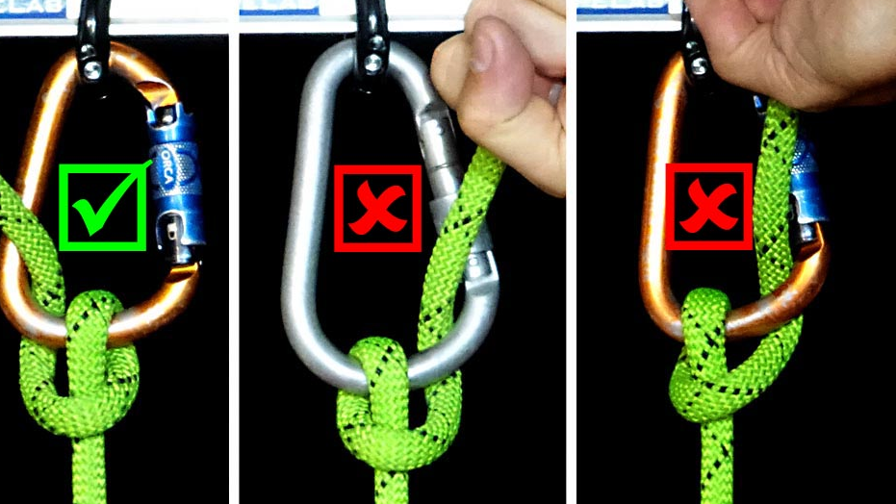
Amount of Rope Used
A simple experiment was conducted with 8mm cord.
With a 2.5" loop, a bowline consumed 11.5 inches of cord.
Figure eight on a bight consumed 18 inches of cord or 36% more cord than a bowline.
The amount of rope consumed in tying the knot can affect its use.

Slide 27
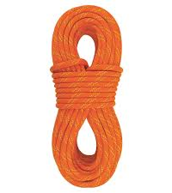
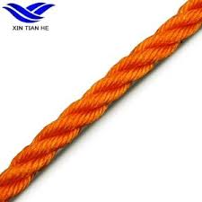
Types of a Rope
Laid
Braided
Kernmantle

Slide 28
laid rope
In a laid rope, the strands are usually twisted to be in opposition to each other
This encourages the rope from becoming unraveled.

Slide 29
laid rope
A major disadvantage of the laid rope is that abrasion cuts the outside strands which weaken the rope when that strand move inward and becomes a supporting strand.

Slide 30
Kernmantle
Kernmantle is comprised of the kern and the mantle.
The mantle is a woven outer sheathing that protects the kern.
Kernmantle ropes are either dynamic or static.
The kern in a dynamic rope consists of twisted strands of fibers.

Slide 31
Dynamic ropes
Are used in climbing and are designed to stretch.
Specifically, they are designed to absorb the fall of a climber.

Slide 32
static rope
The kern in a static rope consists of parallel unidirectional strands of fibers.
The design minimizes stretch.
They are used in rescue situations and not in lead climbing or in situations designed to absorb falls.

Slide 33
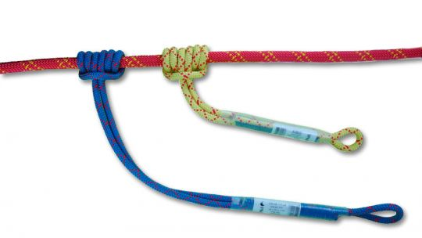
Rope construction
Ropes are constructed out of nylon, spectra, and polypropylene as well as natural and other materials.

Slide 34
Nylon
Nylon is one of the more common materials.
It is strong, flexible, and doesn't float in water.

Slide 35
Spectra
Spectra is much stronger than nylon which is reflected in its cost.
Also, it floats.
In whitewater situations, spectra is often the rope of choice because it is strong and floats.

Slide 36
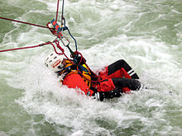
Polypropylene
Polypropylene has less strength than nylon.
It is inexpensive and it floats in water.

