Slide 1
Chapter 5: The Flat Water Beach
Notes:
Describe the unique features of flat water beaches and misconceptions of the users of that environment.
Identify the effects of water buoyancy and resistance on the body.
Describe the hazards associated with the use of flotation devices.
Describe the hazards associated with offshore attractions.
Identify the challenges associated with crowd density.
Describe the types of currents found at flat water beaches.
Describe conditions and engineering structures that affect beach topography.
Describe the problems associated with weeds and plant life in the beach area.
Describe the effects of turbidity to the flat water beach.
Describe the condition of a seiche.

Slide 2
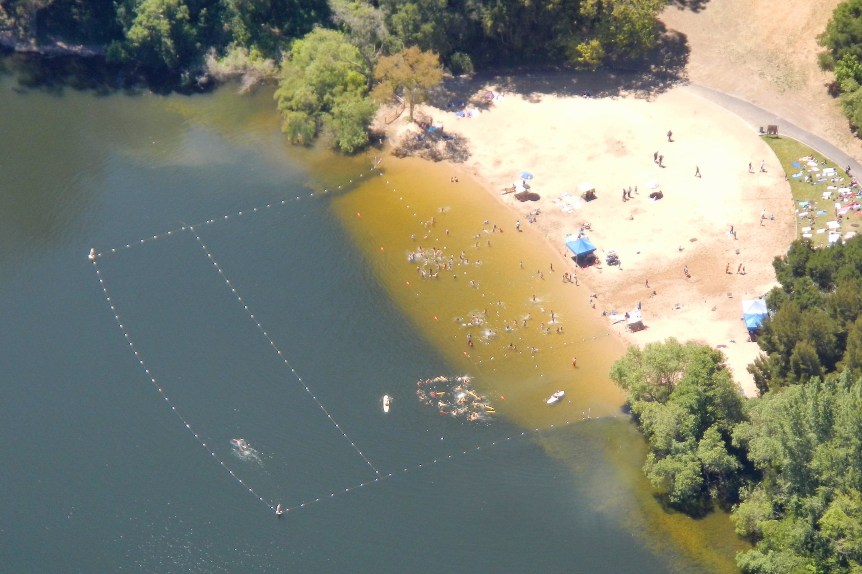
Lack of Surf
“Flat” water can be deceiving
Notes:
The term “flat water beach” refers to any body of water lacking surf
conditions. Examples include: small lakes, rivers, bays, reservoirs and ponds.
Flat water beaches usually seem tranquil. However, distress situations often develop immediately and unpredictably, requiring instant action by the lifeguard.
Poor swimmers seem to be more confident in a flat water environment versus the surf beach

Slide 3
Buoyancy
Most flatwater areas are freshwater
People are more buoyant in salt water
There’s less time to rescue in freshwater
Notes:
Many flat water environments are freshwater, rather than saltwater.
Because freshwater is less dense than saltwater, swimmers are less buoyant in freshwater.
In freshwater people cannot stay afloat as long as they might in salt water and will sink faster once the sinking process starts.

Slide 4
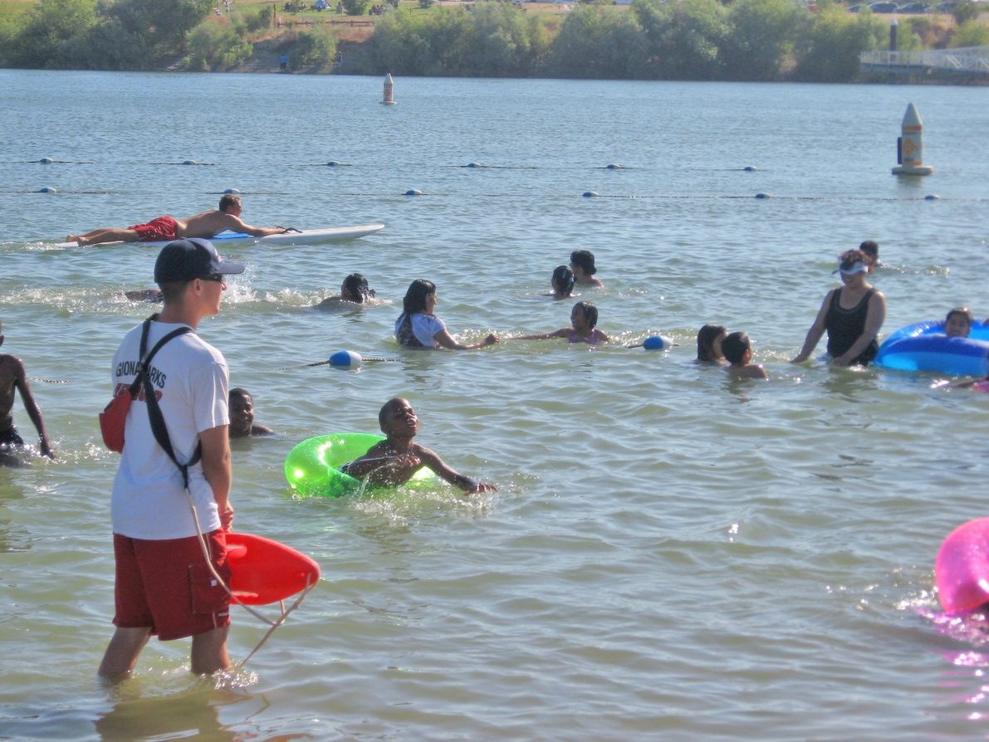
Flotation Devices
More people use or misuse floatation devices in flatwater areas
Notes:
Surf generally prevents poor swimmers with floatation devices from venturing out, but no such impediment is present at flat water beaches.
It is difficult to assess swimming ability when people use flotation devices.
Many poor swimmers rely on flotation devices.

Slide 5
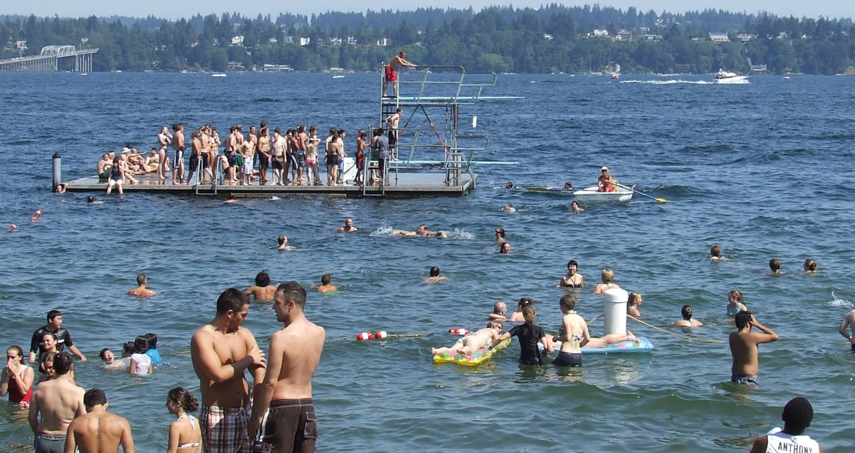
Offshore Attractions
Notes:
Attractions can create a visual block to lifeguard observation
Attractions may entice people to exceed their abilities
Buoy lines may cause people to venture into deep water

Slide 6
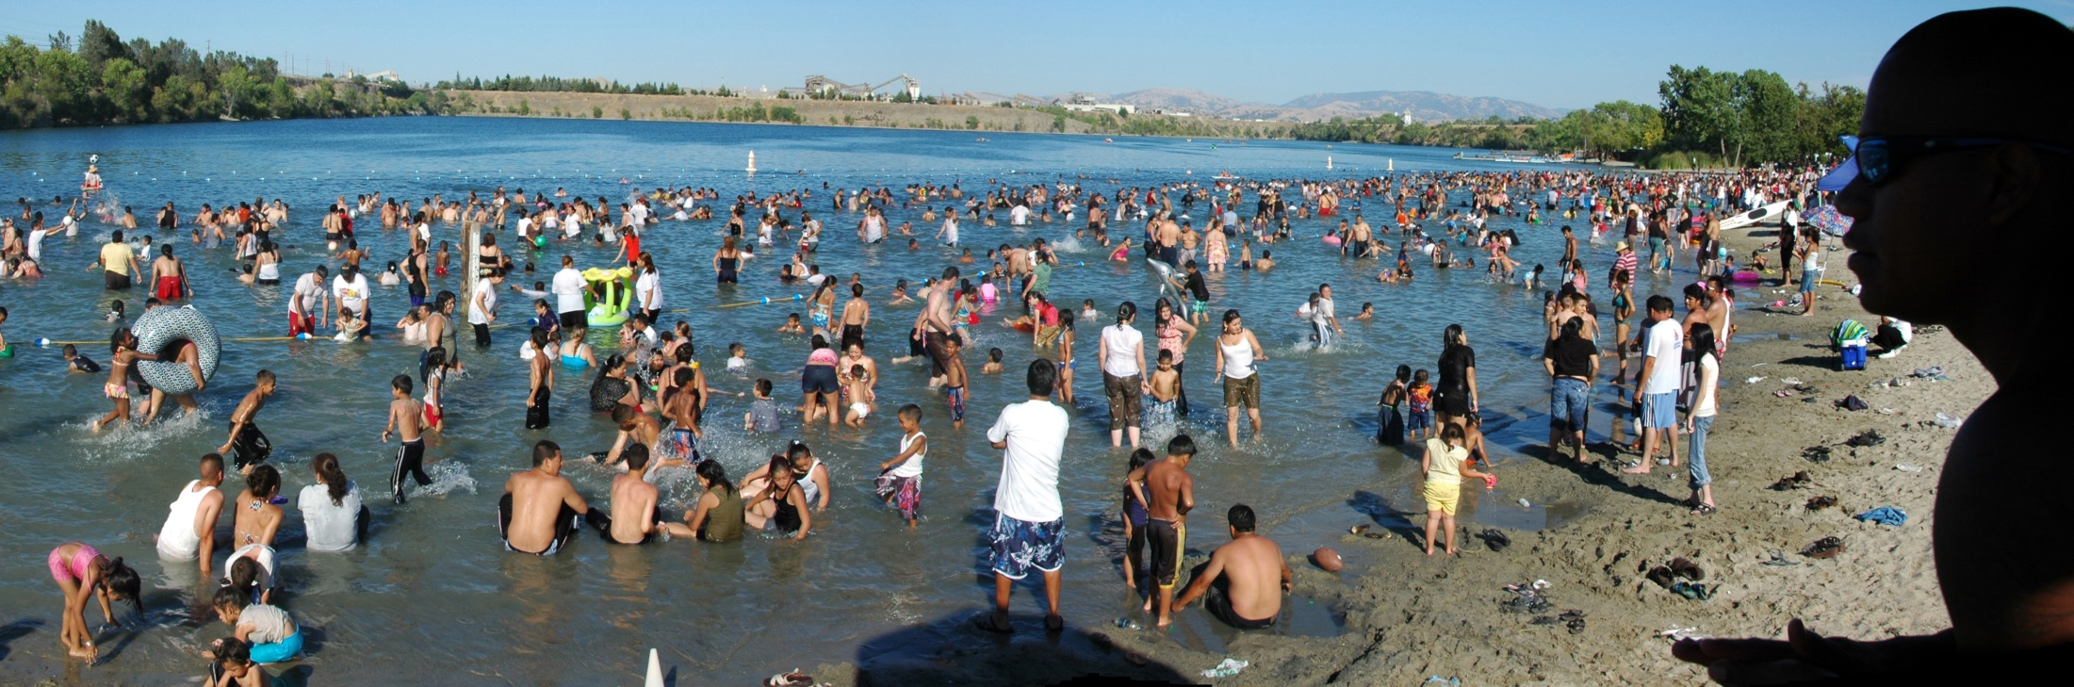
Crowd Density
Notes:
Crowd density is a challenge for lifeguards.
During heat waves, crowd density can skyrocket.
This makes it more difficult for lifeguards to spot trouble.
It is difficult to monitor ever swimmer.

Slide 7
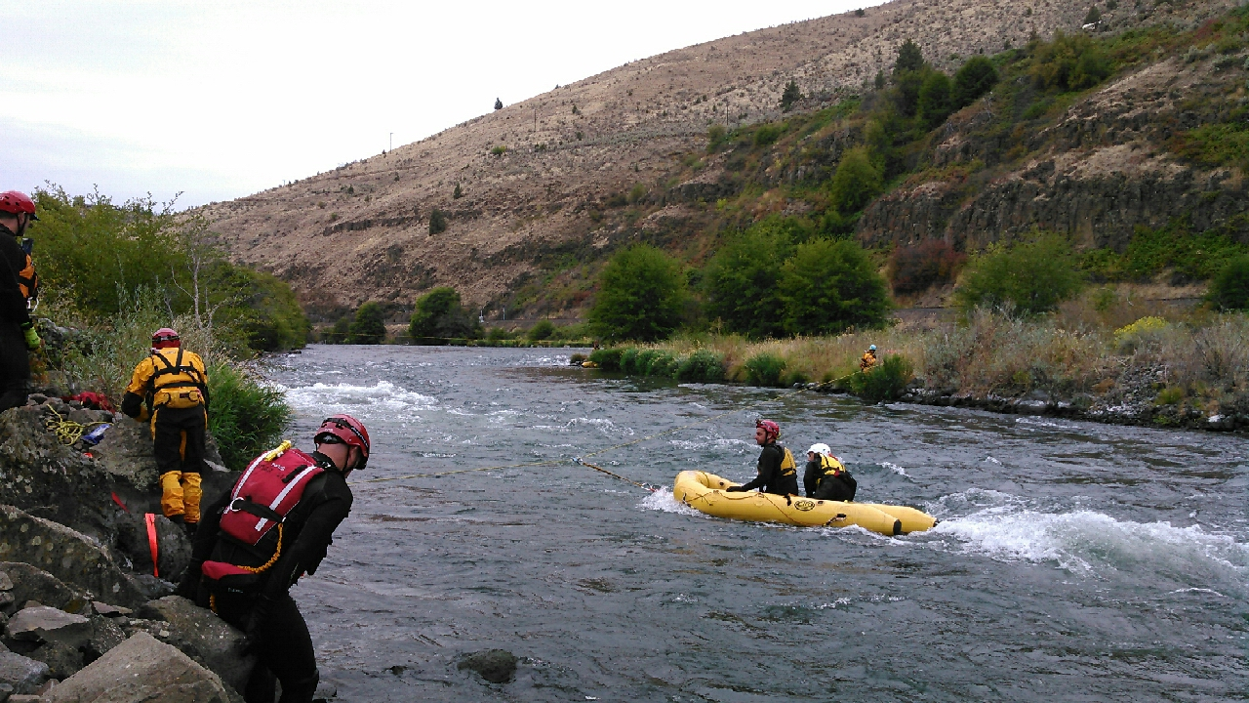
Currents

Slide 8
Tides
Rivers
Lakes
Notes:
Significant currents can exist.
Tides in bays and estuaries - in and out going.
Rivers - consistent current.(no lull and the current can move over obstacles)
Lakes - outflows and inflows.
Lifeguards must be familiar with the dynamics of the environment.

Slide 9
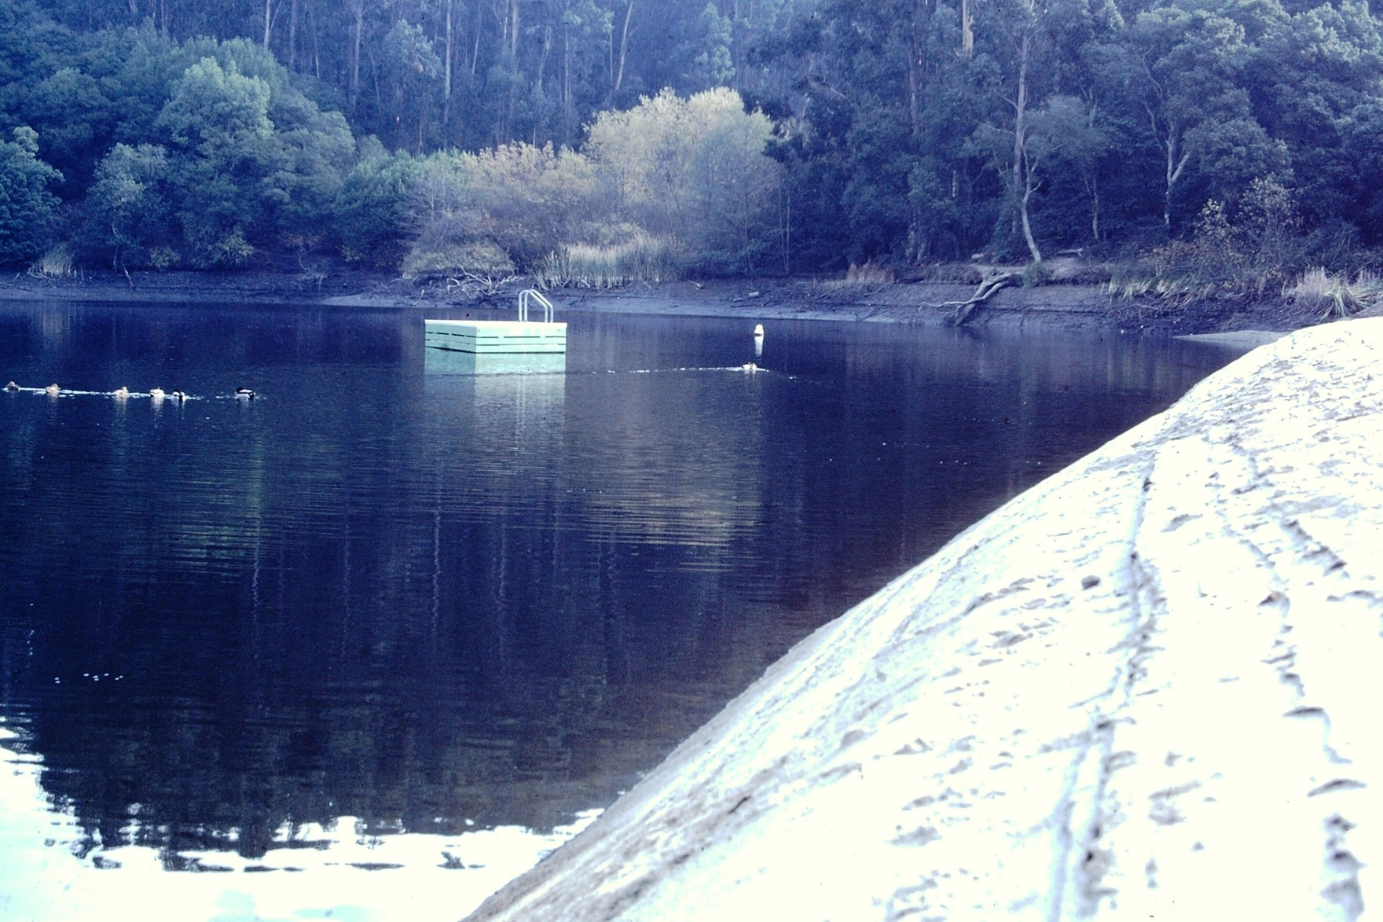
Beach Topography

Slide 10
The natural and man-made environment affect swim areas and water conditions
Weeds and plant life
Notes:
Shoreline and water bottom are affected by:
Currents
Tides
Natural configurations
Human engineering
Ice
Flooding
Rocky shorelines.
Outflow pipes.
Docks.
Submerged Objects.
Drop-offs.
Weeds and Plant Life
Flourish in the absence of strong currents.
Can cause swimmer panic for fear of entanglement.

Slide 11

Turbidity

Slide 12
Increased turbidity makes it more difficult to see below the surface of the water
Notes:
Sediment builds up on the bottom.
When activity, water becomes cloudy.
Heavy rain can cause an increase of turbidity.
Debris can be churned up by existing currents

Slide 13
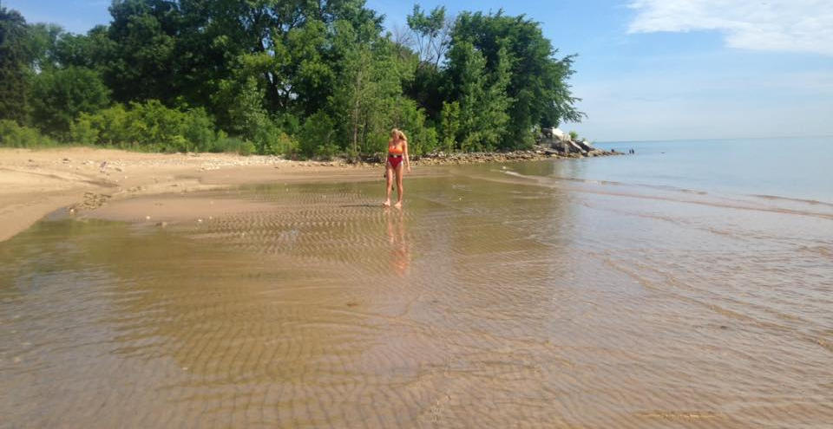
Seiche

Slide 14
Landlocked bodies of water
Caused by pressure systems
The wave sways from side to side
Seismic events can also cause seiche like events
Notes:
A seiche is a rare condition that typically occurs in a large, landlocked body of water.
It involves oscillation of the water surface.
A seiche can be created by the same events as tsunami.

Slide 15
Notes:
Divide “Discussion Points” among pairs of students. Ask students to review each point and share with the class.

