Slide 1
Fourth Edition
Lesson 3: Trauma
Notes:
Welcome to Lesson 3: Trauma.

Slide 2
Lesson Objectives
  Discuss the kinematics of pediatric trauma.
  Review the trauma triad of death.
  Identify the common types of injuries and their treatments.
  Discuss the management of pediatric trauma patients using the Pediatric Assessment Triangle and XABCDE approach.
Notes:
Instructor Notes
Discuss the learning objectives and the importance of thoroughly understanding each one.
Discuss the kinematics of pediatric trauma.
Review the trauma triad of death.
Identify the common types of injuries and their treatments.
Discuss the management of pediatric trauma patients using the Pediatric Assessment Triangle and XABCDE approach.

Slide 3

Introduction
Trauma is the leading cause of death and disability in the pediatric population.
Trauma caused by transportation incidents are the leading cause of death/disability.
  Automotive passengers
  Pedestrians
  Bicycle accidents
Injury prevention must be a priority.
© shisu_ka/Shutterstock
Notes:
Instructor Notes
Discuss the prevalence of traumatic deaths and injuries, including the responsibility for healthcare workers to educate about and advocate for patient safety.
Deaths
In a report published in 2008, on average 12,175 children (ages 0 to 19) died from an unintentional injury that year.
Males had higher injury death rates than females (almost two times more).
Injuries due to transportation were highest as occupants of motor vehicles but also includes pedestrians and bicycle accidents.
Two-thirds of unintentional injury deaths in children younger than 1 year of age were due to suffocation.
Injuries
Estimated 9.2 million children annually had an emergency department visit for an unintentional injury.
Injuries due to falls were the leading cause of nonfatal injury.
Fire/burn-related injuries and drowning were highest for children 4 years and younger.
Injuries can be prevented.
Prevention is the best treatment for injuries.
EMS, fire, and first responder organizations should take an active role in providing community education on injury prevention.
Discuss the importance of family education on the following:
The importance of restraints, proper installation of car seats, and proper rider location in vehicles (age-appropriate front vs. rear seating).
The dangers of co-sleeping, proper positioning of the infant during sleep, and the removal of hazards from the sleeping area.
The importance of fire safety and pool/swimming safety.
Look at CDC breakdown by age: https://www.cdc.gov/injury/wisqars/pdf/leading_causes_of_death_by_age_group_2018-508.pdf

Slide 4
Kinematics of Pediatric Trauma
Smaller frame/smaller mass results in limited ability to dissipate forces.
Improper seat belt usage leads to more significant injuries.
Falls from varying heights create different patterns of injury.
Bicycle collision injuries are dependent on the use of protective equipment.
Notes:
Instructor Notes
Discuss the kinematics of trauma in different mechanisms of injury so that the student will better understand the different patterns of injury to suspect.
Absorption and dissipation of forces
Smaller frame results in more concentrated forces when struck by an object.
Physical characteristics limit child’s ability to dissipate forces.
Forces are transferred to internal organs without obvious evidence of external injuries.
Seatbelt usage
Improper seatbelt usage leads to the potential for significant multisystem trauma, including head, neck, face, chest, abdominal, and lower spine injuries.
Children also have more malleable bones, and are therefore more prone to internal injuries in the absence of bony fractures.
Falls
Low height: Upper extremity trauma/fractures.
Medium height: Head and neck injuries, upper and lower extremity fractures.
High height: Multisystem trauma more likely, including head, neck, upper and lower extremity, and pelvic injuries.
Young children are more prone to falls secondary to having a large head relative to the rest of their body, and thus a higher center of gravity.
Bicycle collision injuries
Without protective equipment (helmet): Head, neck, face, and upper extremity injuries.
With protective equipment (helmet): Upper extremity fractures.
Frontal impact damage (e.g., striking the handlebar): Results primarily in intraabdominal injuries.

Slide 5
Trauma Triad of Death
Notes:
Instructor Notes
Discuss the three components of the trauma triad of death.
The three components are acidosis, coagulopathy, and hypothermia.
Discuss how the components of the triad worsen the other components, ultimately leading to death.
When there is an airway, breathing, or circulation problem, oxygen does not reach the cells, resulting in anaerobic metabolism, which results in acidosis.
The lack of energy production from anaerobic metabolism produces less body heat, which causes the patient to become hypothermic.
When the patient becomes hypothermic, coagulopathy worsens.
As the patient shivers to generate heat, more energy is consumed, and acidosis worsens.
If bleeding is the cause and it is not addressed, coagulopathy, acidosis, and hypothermia will worsen.
Children are especially prone to heat loss compared to adults secondary to a high metabolism and low fat stores.
Once XABCs are addressed and perfusion is restored, acidosis will improve.
Improved perfusion will result in the return to aerobic metabolism, which will allow the patient to start to generate heat better; this can be supplemented with hypothermia management.
Once acidosis and hypothermia are addressed, the body has a better chance at returning to homeostasis involving the coagulopathy.
Another treatment to manage coagulopathy can be to include TXA to manage potential hyperfibrinolysis.

Slide 6
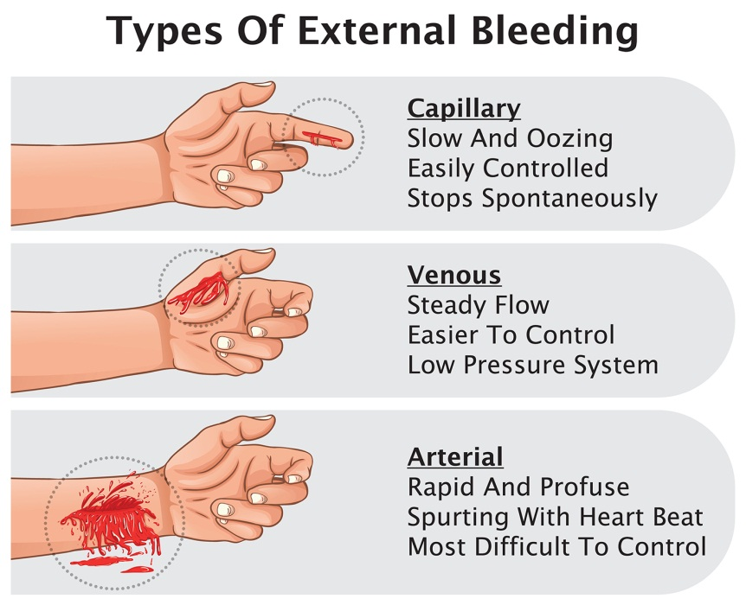
Types of Injuries (1 of 5)
External hemorrhage
  Extremity
  Junctional
Internal hemorrhage
  Non-compressible
© N.Vinoth Narasingam/Shutterstock
Notes:
Instructor Notes
Briefly discuss the types of injuries that may be encountered in a pediatric trauma patient and their treatments.
There are two types of bleeding: external and internal.
External bleeding may be:
Capillary (slow and oozing, easily controlled)
Venous (steady flow, easier to control than arterial)
Arterial (rapid and profuse, most difficult to control)
Internal bleeding collects in the body’s cavities and is not visible.
It is critical to assess and manage life-threatening bleeding in patients.
Damage control resuscitation (DCR)
An overall approach rather than a specific intervention aimed at keeping a patient alive by focusing on avoiding the triad of death.
External hemorrhage
Controlled by direct-pressure dressing, hemostatic dressing, and/or tourniquets.
Hemorrhage at the junction of an extremity with the torso (axillary, inguinal) without the control of direct pressure and hemostatic dressings needs a junctional tourniquet.
Internal hemorrhage
Cannot be controlled in the prehospital environment.
Requires DCR.

Slide 7

Types of Injuries (2 of 5)
Airway injuries
  Airway compromise from injuries
Chest injuries
  Open pneumothorax
  Closed pneumothorax
  Hemopneumothorax
© Anatta_Tan/Shutterstock
Notes:
Instructor Notes
Continue to discuss the types of injuries that may be encountered in a pediatric trauma patient and their treatments.
It is critical to assess and properly manage a pediatric airway to ensure that the patient is able to oxygenate and ventilate.
Airway
Airway maneuvers/adjuncts
Simple maneuvers, positioning/suctioning, OPA/NPA, supraglottic devices, endotracheal intubation, surgical cricothyroidotomy
Discuss the limitations of SGA to include the presence of FBAO, swelling, bleeding, anatomic disruptions.
Chest
Open pneumothorax
Occlusive dressing, ventilatory support (if needed), needle decompression (for suspected tension pneumothorax)
Closed pneumothorax
Ventilatory support (if needed), needle decompression (for suspected tension pneumothorax)
Simple vs. tension
The only difference is that a tension pneumothorax is a pneumothorax with signs of obstructive shock.
Hemopneumothorax
A combination of blood and air in the chest cavity.
Discuss the option of finger thoracostomy in certain circumstances like traumatic arrest with penetrating chest trauma.

Slide 8
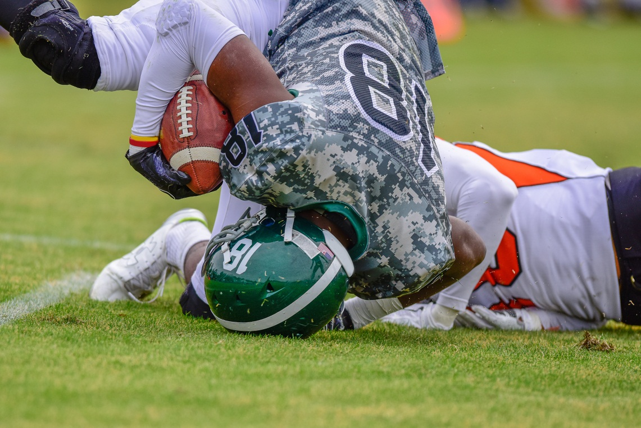
Types of Injuries (3 of 5)
Head injuries
  TBI
  Concussion
© Margaret Kite/Shutterstock
Notes:
Instructor Notes
Briefly discuss head injuries.
Traumatic brain injuries (TBIs) are the leading cause of mortality and morbidity in pediatric trauma.
A child’s head is disproportionally large until 5 to 6 years of age.
Therefore, the brain and head are likely to be injured by blunt trauma.
Falls are the most common cause of head injury in pediatrics.
Motor vehicle crashes are second.
Child abuse is a major cause of head injury in pediatric patients younger than 2 years.
Concussions (mild TBI)
Common among children and adolescents playing contact sports.
Falls and accidents are other causes of concussion.
Estimated 1.6 to 3.8 million annually in the U.S.
Concerning signs include impact seizure, loss of consciousness, amnesia/repetitive questioning, vomiting (if younger than 2 years), signs of skull fracture, altered mental status, and significant mechanism of injury.
Pediatric patients may have sustained an intracranial injury with little to no external evidence.
Mental status using the GCS and AVPU should be assessed frequently during transport.
GCS score of 8 or less: Focus on adequate oxygenation and ventilation should be the all-time goal, and not the placement of an ET tube.
Treatment
Resuscitation measures should focus on ventilation, oxygenation, and perfusion to minimize secondary brain injury and the severity of the patient’s injury.
Ensure adequate oxygenation, ventilation, and perfusion support.
A single episode of hypotension (< 90 mm Hg) or hypoxia (SpO₂ < 90%) will typically result in worse outcomes.
Controlled hyperventilation may be needed only in the management of impending cerebral herniation.
Mild hyperventilation = ETCO₂ 30 to 35 mm Hg.
Hyperventilation is indicated in patients with:
Asymmetric pupils
Dilated and nonreactive pupils
Extensor posturing or no response on motor examination
Neurologic deterioration
A decrease in GCS of 2 or more points in a patient with initial GCS < 8

Slide 9

Types of Injuries
Fractures
  Distal radius
  Hand
  Clavicle
  Tibia
© Mimma Key/Shutterstock
Notes:
Instructor Notes
Briefly discuss fractures.
Fractures
Make up approximately 20% of injuries in pediatrics.
Children have more strength in their tendons than in their bones and the cartilaginous (open) growth plates near the ends of bones, making them more vulnerable to fracture rather than sprain or strain.
Fractures should be suspected whenever a patient won’t use an extremity or has a limited range of motion and point tenderness.
Absence of bruising, swelling, or deformities should not rule out a fracture.
Treatment: Splinting and pain management.

Slide 10
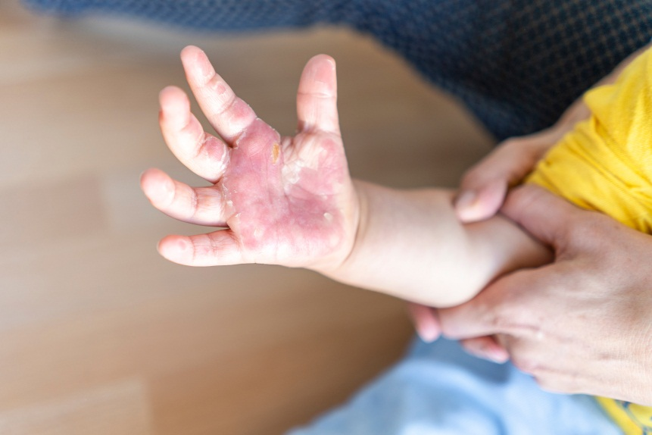
Types of Injuries (5 of 5)
Burns
  Superficial burns
  Partial-thickness burns
  Full-thickness burns
  Subdermal burns
© Sopotnicki/Shutterstock
Notes:
Instructor Notes
Briefly discuss burns.
Burns
Approximately 25% of all burn injuries around the globe occur in children younger than 16 years of age.
Majority of the children are younger than 5 years.
Typical causes of burns include child abuse, fire, and scald injuries.
Scald injuries are the most common type of injury in children younger than 5 years.
Types of burns
Superficial burns
Involve only the epidermis.
Categorized as red and painful.
Partial-thickness burns
Involve the epidermis and varying portions of the underlying dermis.
Appear as blisters or as burned areas with a wet-appearing base.
Full-thickness burns
May have several appearances.
Result in complete destruction of the epidermis and dermis.
Most often will appear as thick, dry, white, leathery burns.
Subdermal burns
Burn all layers of the skin and underlying fat, muscles, bone, or internal organs.
The total body surface area (TBSA) in burns may be assessed using the rule of nines or the rule of palms.
Treatment
Stop the burning process.
Remove clothing and any jewelry.
Apply dry, sterile, nonadherent dressings to the wound.
Cover with a dry and clean sheet.
Hypothermia management: A blanket may be placed over the dry sheet to maintain body heat.
Fluid resuscitation
Parkland formula is the most notable guide to fluid resuscitation.
Amount of fluid given in the first 24 hours should equal 4 mL × the patient’s body weight in kg × percentage of body surface area burned.
Half of this fluid needs to be administered within the first 8 hours of injury, and the remaining half of the volume from hours 8 to 24.
Children tend to lose more fluids than adults in burn injuries due to their small body weight-to-body surface ratio.
Also, they have less metabolic glycogen reserves in their liver to sustain adequate blood glucose during burn resuscitation.
Pediatric patients (weighing less than 44 lb [20 kg]) should receive 5% dextrose in lactated Ringer’s.
Pain management: Fentanyl and ketamine are options for pain management.

Slide 11
Case 1
Dispatch
  You and your partner respond to a reported pedestrian versus a motor vehicle. A 10-year-old male was struck by a vehicle while riding his scooter in his neighborhood. The outside temperature is 84°F (28.9°C).
Notes:
Instructor Notes
For students other than prehospital practitioners, dispatch information can be modified.
What are your initial concerns from the dispatch information?
Initial impression begins when the dispatch information is received.
Scene safety considerations: Traffic?
Potential for significant multisystem trauma.
Air medical vs. ground transport times.
Closest pediatric-capable trauma center.
Discuss the importance of scene assessment and awareness.
Determine the significance of the MOI.
Ensure that the public and responders are safe during the response.
Discuss additional precautions or concerns that may be warranted based on the scene.
PPE to include gloves and eye protection, at minimum, due to the potential presence of blood.
What equipment should you bring to the patient’s side?
Basic trauma equipment (bleeding control devices, splinting, airway adjuncts, ventilation equipment, spinal stabilization equipment, etc.).
Note to instructor: Case 1 involves a 10-year-old male with an open fracture of the femur and minor liver laceration.

Slide 12
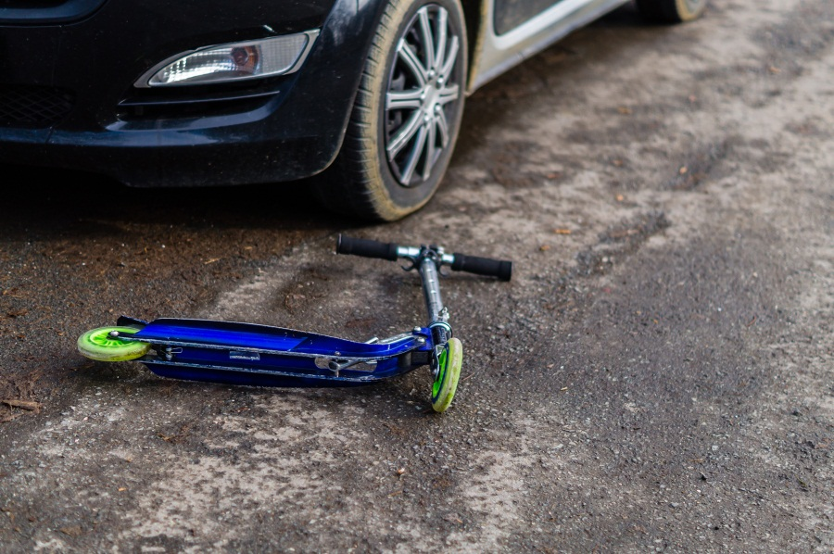
Initial Observations
© Animaflora PicsStock/Shutterstock
Used with permission of the American Academy of Pediatrics, Pediatric Education for Prehospital Professionals, © American Academy of Pediatrics, 2000
Notes:
Instructor Notes
Discuss the following initial observations of the scene and PAT findings:
As you arrive on scene, you determine that traffic is minimal through the quiet neighborhood.
Should you still consider the potential for an accident? How can this be managed?
Yes, park the ambulance or other responding vehicles in a way that protects the scene.
If law enforcement is on scene, have them direct any vehicles.
The driver of the vehicle and the identified father of the patient look panicked.
They tell you the child is losing a lot of blood.
You see the child lying on the ground in a pool of blood and screaming.
PAT
Appearance: Alert and restless.
Work of breathing: Rapid, shallow, and equal.
Circulation: Skin is pale and diaphoretic.

Slide 13
Discussion
Is this patient “Quick” or “Not Quick”?
Have you identified possible red flags?
Notes:
Instructor Notes
Is this patient “Quick” or “Not Quick”?
The patient is “Quick.”
Expand on how this determination was made.
This patient needs immediate treatment of life threats.
Have you identified any possible red flags?
Restless, rapid breathing.
Skin is pale and diaphoretic.

Slide 14
Primary Survey
    Primary survey
      X – Pulsatile bleeding from an open femur fracture to the right thigh.
      A – Open, screaming in pain.
      B – Respirations rapid, shallow, and equal.
      C – Radial pulses are weak and rapid. Capillary refill time delayed. Skin is pale, diaphoretic, and clammy.
      D – Alert and restless; GCS = 15 (E4, V5, M6).
      E – Lying on ground in middle of roadway. Bruising to abdomen, multiple abrasions/lacerations.
Notes:
Instructor Notes
Discuss the primary survey and PAT findings.
Note that the PAT is completed prior to the primary survey.
Ask participants to explain any abnormal findings of their patient, whether physical and/or developmental, and why.
Discuss any life threats identified in this case.
Pulsatile bleeding, rapid respirations if tidal volume is inadequate, potential for internal bleeding.
Primary survey
X ‒ Pulsatile bleeding from an open femur fracture to the right thigh.
A ‒ Open, screaming in pain.
B ‒ Respirations rapid, shallow, and equal.
C ‒ Radial pulses are weak and rapid. Capillary refill time is delayed. Skin is pale, diaphoretic, and clammy.
D ‒ Alert and restless; GCS = 15 (E4, V5, M6).
E ‒ Lying on ground in middle of roadway. Bruising to abdomen, multiple abrasions/lacerations.
What would your initial treatment be?
Discuss treatment options per local guidelines and policy.
C-spine stabilization (based on MOI and distracting injuries).
Control bleeding (a tourniquet may be a better option, applying a pressure dressing to an open fracture may be extremely painful and ineffective).
Treat for shock (high-flow oxygen, ventilatory support if needed, hypothermia prevention, supine positioning).
Rapid load to ambulance and transport.
Participant engagement:
Remind participants that stabilizing life threats during the primary assessment is the most important intervention. IVs, fluids, pain management, splinting, and other treatments for non-life-threatening injuries should be done during the secondary assessment or during transport for patients who are critical once life threats are stabilized.

Slide 15
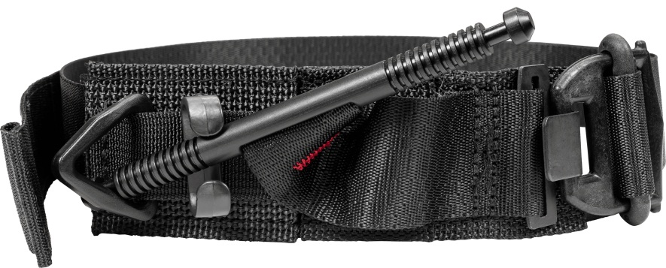
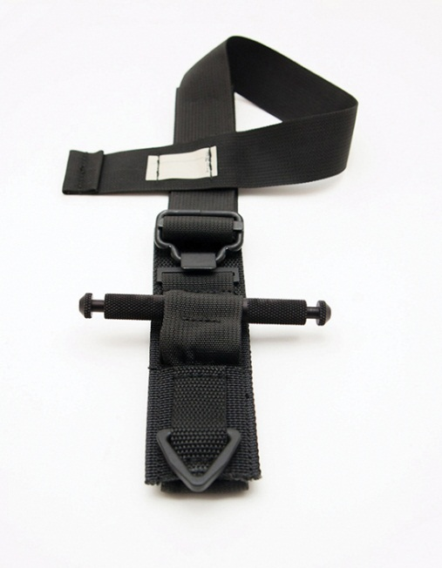
Tourniquets (1 of 2)
When should a tourniquet be used?
When should a tourniquet not be used?
What are some important points to remember with tourniquet use?
Reproduced with permission from Tactical Medical Solutions https://www.tacmedsolutions.com/SOF-Tactical-Tourniquet-Wide
Reproduced with permission from North American Rescue https://www.narescue.com/combat-application-tourniquet-c-a-t
Notes:
Instructor Notes
When should a tourniquet be used?
For any pulsatile, extremity arterial bleeding (or heavy venous bleeding) not controlled with a pressure bandage
For any extremity amputations
For any bleeding that is not rapidly controlled by other means when there are signs of shock or other life threats and a limited number of providers
Example: A patient has multiple life threats and only one provider is available. You may not have time to wait for bleeding to be controlled with a pressure dressing to address other life threats.
Apply a tourniquet and move on to the other life threats.
When should a tourniquet not be used?
For minor bleeding that can be controlled with a pressure dressing or other means
Do not use for junctional wounds (neck, groin, axillae) (unless junctional tourniquet is available).
What are some other points to remember with tourniquet use?
Tourniquets must be pulled tight before windlass is turned (for windlass style tourniquets).
Tourniquets must not only stop the bleeding, but the distal pulse should be eliminated.
If the first tourniquet does not stop the bleeding, apply a second tourniquet.
Tourniquets should not be used over joints or over clothing made of bulky material.
It is preferred not to put tourniquets over fractures, if possible.
Do not release the tourniquet.
Can cause ongoing bleeding and the potential release of micro emboli and acidosis into circulation.
Pain management may be needed; if applied correctly, the tourniquet should hurt!

Slide 16
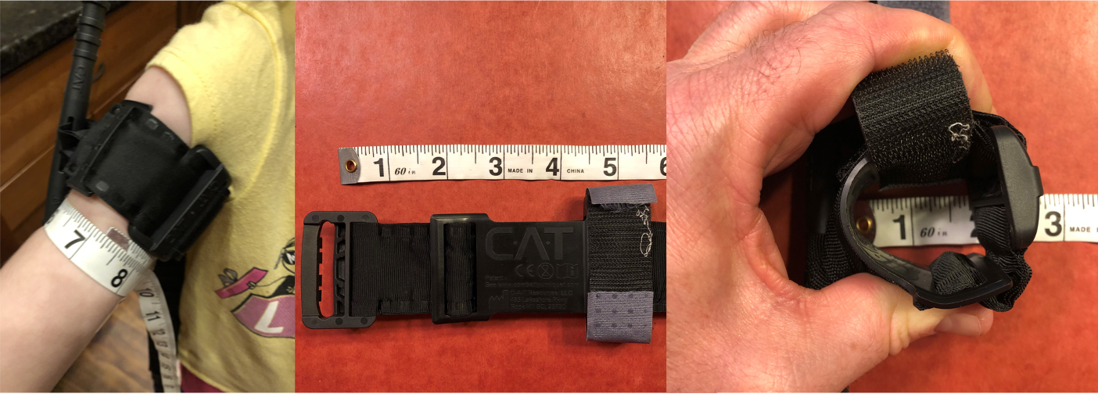
Tourniquets (2 of 2)
Potential complications due to smaller extremity sizes in younger pediatrics.
Courtesy of Jonathan Willoughby
Notes:
Instructor Notes
Some tourniquets may be too large and not effective on smaller children or infants.
If a windlass or ratchet style tourniquet is too large, then an elastic style tourniquet, such as the SWAT-T, may be needed.
Tourniquets have been used on pediatric patients in war zones, which has been shown to reduce the requirement of IV fluids and blood products for treatment.
One case in the U.S. showed a successful outcome with application of a CAT to the thigh of a 7-year-old pediatric patient.
Commercial tourniquets can apply the appropriate pressure to the small circumference of even an infant-sized extremity.
The mean circumference of a 6-month-old infant middle upper arm is 5.8 in. (14.9 cm) (WHO, 1997).
The pressure applied with a tourniquet need only exceed the patient’s systolic blood pressure.
The picture shows a 6-year-old female with tourniquet, tourniquet length in inches, and a visual of the smallest a tourniquet can go.

Slide 17
Detailed Assessment
History taking
  O – Rapid
  P – Movement
  Q – Sharp
  R – No
  S – 10/10
  T – 5 minutes
Notes:
Instructor Notes
Review history taking using the OPQRST mnemonic.
O – Rapid
P – Movement
Q – Sharp
R – No
S – 10/10
T – 5 minutes
Participant engagement:
Discuss the importance of continuously reevaluating mental status in pediatric patients.
Expand on additional measures that may be used to calm the patient.

Slide 18
Detailed Assessment
History taking
    S ‒ Obvious open fracture to right femur, bleeding controlled by tourniquet; bruising to abdomen, multiple abrasions/lacerations.
    A ‒ No known allergies.
    M ‒ None.
    P ‒ None.
    L ‒ Pizza around 1 hour ago with a juice box.
    E ‒ Was riding his scooter when he crossed the street and was struck by a car travelling approximately 25 mph.
    R ‒ None.
Notes:
Instructor Notes
Review history taking using SAMPLER.
S – Controlled lower extremity hemorrhage, obvious open fracture to right femur, bruising to abdomen, multiple abrasions/lacerations.
A – No known allergies.
M – None.
P – None.
L – Pizza around 1 hour ago with a juice box.
E – Was riding his scooter when he crossed the street and was struck by a car travelling approximately 25 mph.
R – None.

Slide 19
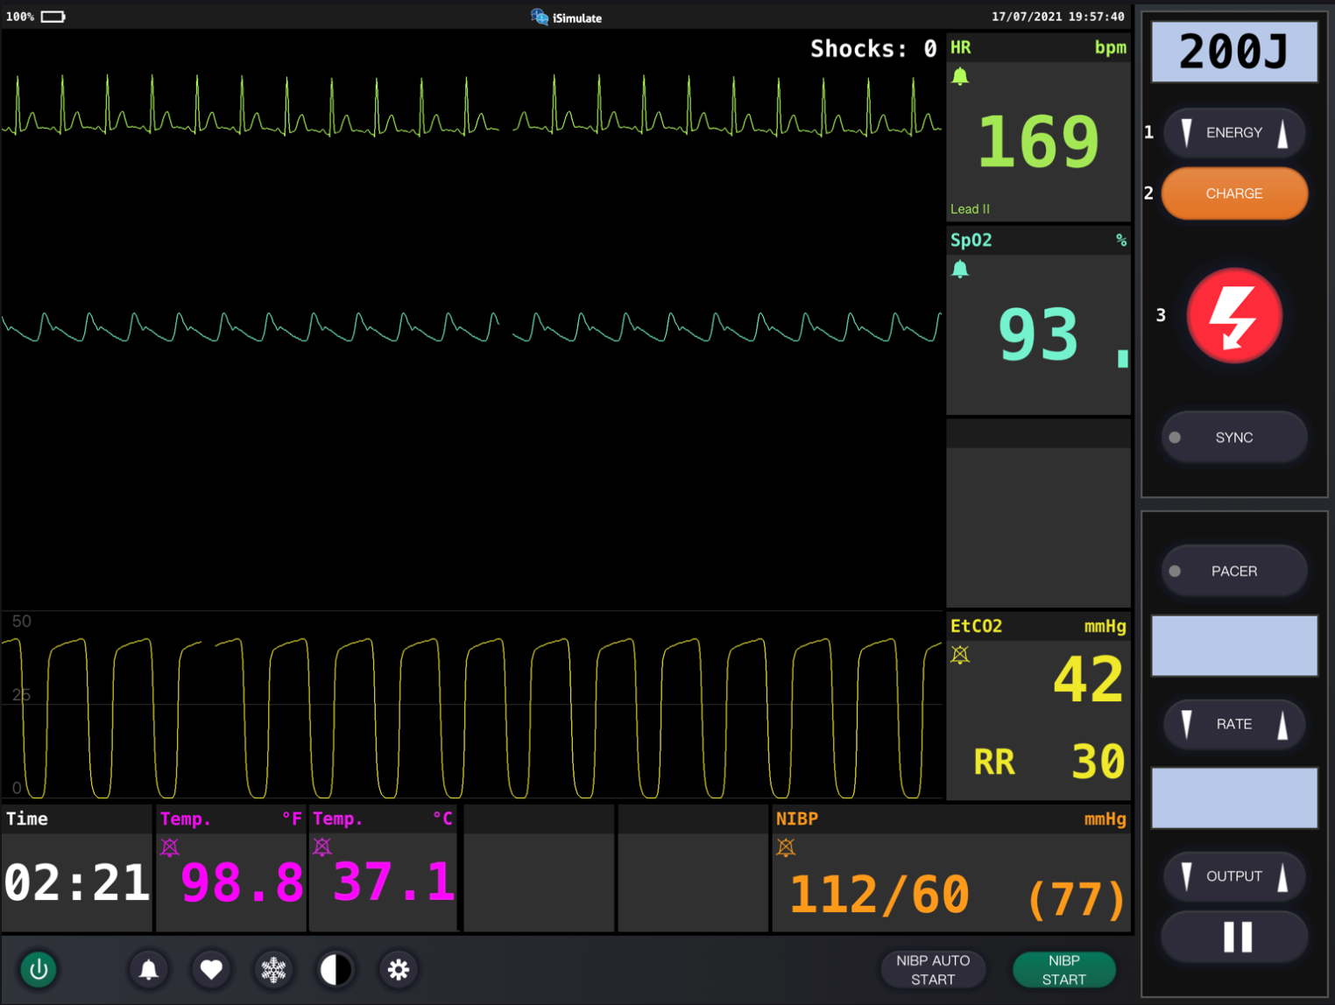
Vital Signs
Notes:
Instructor Notes
Discuss what the vital signs tell us about the patient.
SpO₂: 93% on room air and improves with high-flow blow-by oxygen.
Was oxygen needed?
Discuss treatment options in your region. Remember that hyperoxia can be as dangerous as hypoxia. The best approach to oxygenating the patient (nasal cannula or NRB) depends on the patient’s response to supplemental oxygen and whether the SpO₂ saturation increases significantly.
HR is 169 weak and rapid.
ETCO₂ is 42.
Respiratory rate is 30.
Discuss reason(s) for increased ventilatory rate.
Blood pressure is 112/60 mm Hg.
Do you need a BP to determine your patient is in shock?
No, low blood pressure in shock is an ominous sign.
Compensatory mechanisms can maintain a normal systolic blood pressure.
Permissive hypotension is not used in children because once hypotensive they decompensate quickly.
Early recognition and treatment of shock during this time is critical for optimal patient outcomes.
Once compensatory mechanisms fail and patient becomes hypotensive, odds of survival decrease significantly.
Blood glucose is 104 mg/dL (5.8 mmol/L).
Weight is 35 kg.
Diagnostics indicate sinus tach.
Participant engagement
Discuss expected typical vital signs for age.
Expand on initial measures that may be used to warm the patient, such as warm blankets or fluids to prevent hypothermia.

Slide 20
Detailed Assessment
Notes:
Instructor Notes
*Ask participants: Given the age of this child, would you perform a head-to-toe or toe-to-head assessment?
HEENT
Head: Minor abrasions
Eyes: PERRL
Ears: Unremarkable
Nose: Unremarkable
Throat: Unremarkable
Heart and lungs
Lung sounds, clear and equal. Heart sounds are normal, no murmur. Respirations rapid.
Neuro
Circulation, motor, and sensory (CMS) intact, restless and anxious. No pulse in right leg secondary to tourniquet application
Abdomen and pelvis
Bruising and rigidity noted to the abdomen
Upper extremities
Minor abrasions and lacerations
Rapid/weak radial pulses
Lower extremities
Open comminuted femur fracture to right leg

Slide 21
Treatment
BLS
  Hemorrhage control
  Shock management (O₂, hypothermia prevention, pelvic binder)
  Splinting
  Rapid transport
  Keep warm
ALS
  BLS care
  IV/IO access during transport, warmed fluids if indicated
  TXA
  Pain management
Critical care
  BLS/ALS care
  Administer blood
Notes:
Instructor Notes
Ask students how they would treat this patient according to their local protocols and scope of practice.
The patient should be treated with supportive care.
Be prepared for rapid deterioration.
Patient Management:
What are your goals for this patient?
Maintain ABCs
Rapid transport to trauma center.
Air medical transport if needed.
What are the indications for a pelvic binder?
Pelvic instability or injury
Signs of internal hemorrhage and shock associated with significant blunt/blast mechanism of injury
What are the indications for IV fluids? How much fluid do we administer?
Indications
Tachycardia and poor perfusion
How much
Start with 20 ml/kg. Administer enough fluid to maintain perfusion
Improved mental status
Goal of adequate distal pulses or capillary refill
Which fluids are recommended?
Lactated Ringer or normal saline can be used in moderation.
Fluids should be warmed, if able, so as to not worsen hypothermia.
Whole blood or blood products are recommended if patient does not respond to crystalloids.
Should begin with crystalloid solutions and then go to whole blood or blood products.
Majority of pediatrics will not require a transfusion.
What pain management strategy may be best?
Due to the potential for shock, a non-narcotic analgesic may be best as to not aggravate shock.
Ketamine may be a good option.
TXA will be discussed on the next slide.

Slide 22
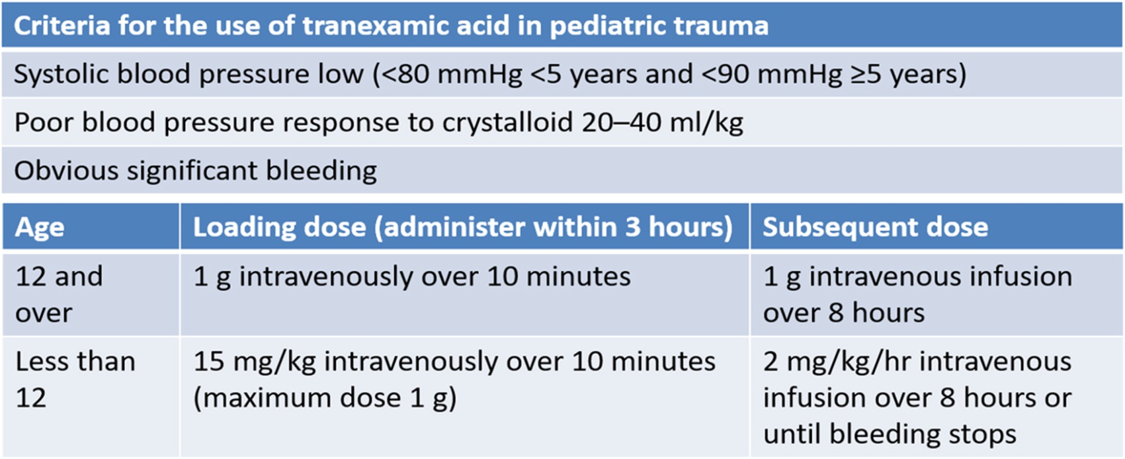
TXA in Pediatrics
Adapted with permission from Beno, S., Ackery, A.D., Callum, J. et al. Tranexamic acid in pediatric trauma: why not?. Crit Care 18, 313 (2014). https://doi.org/10.1186/cc13965
Notes:
Instructor Notes
What are the indications for TXA?
Low systolic blood pressure (< 80 mm Hg if 4 years or younger or < 90 mm Hg if 5 years and older).
Poor blood pressure response to crystalloids (20 to 40 mL/kg).
Significant blood loss.
What are the dosage and administration techniques for TXA?
See table on slide.
How does TXA work?
TXA works by slowing the mechanism in the body that is used to break down clots. Clots are therefore maintained, helping to maintain perfusion.
According to best available evidence as of 2014, TXA significantly decreased mortality in bleeding trauma patients 16 years of age and older without significantly increasing prothrombotic complications if administered within 3 hours of injury.
While the evidence specifically for TXA in pediatric trauma is not yet available, TXA should be considered for use in adolescent trauma patients in the same dosing regimen and indications as used in adults.
Most children can be managed without blood administration (TXA, hemorrhage control) and risk of infectious exposure/blood reaction.
Permissive hypotension has not been proven to be safe in children.

Slide 23
Ongoing Management
Reassess the patient.
Manage secondary injuries.
What is the most appropriate treatment destination and why?
Will you allow dad to ride in the ambulance?
Mitigate psychological trauma.
Can you safely transport this child in your ambulance?
Notes:
Instructor Notes
Discuss ongoing management options based on scope of practice and local protocols.
Reassess the patient for the potential to deteriorate.
Manage secondary injuries
Bandaging, splinting, etc.
Where is the most appropriate treatment destination and why?
Pediatric trauma facility if reasonably located.
Studies show decreased morbidity and mortality at pediatric trauma centers vs. adult or mixed trauma centers.
EMS agencies need to know the pediatric capabilities at destinations.
Not all trauma centers are pediatric ready.
Consider air medical transport if extended ground transport is probable.
Will you allow dad to ride in the ambulance?
Family-centered care is a priority, so we recommend allowing one parent to ride in the ambulance with the EMS crew if safety allows.
We encourage EMS to include a family member in the care of their child as a member of their care team.
The father rode with EMS crew and was restrained to the bench seat.
Be sure to provide supportive emotional care for the child. A situation like this is traumatizing, and any effort to reduce psychological trauma should be attempted.
You can safely transport this child on the stretcher due to size.

Slide 24
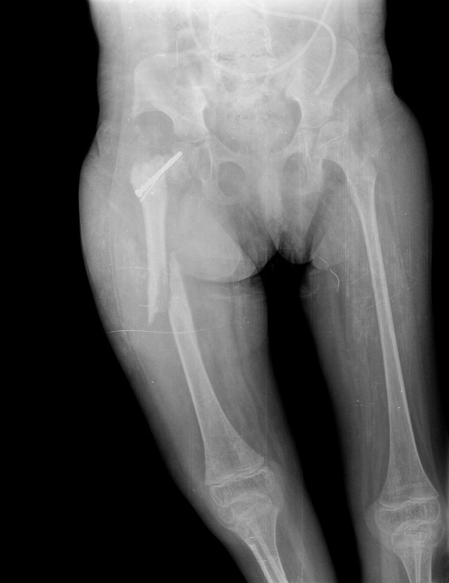
Case Wrap-Up
Diagnosis
  Significant blood loss secondary to damaged femoral artery and a minor liver laceration.
© martin81/Shutterstock
Notes:
Instructor Notes
Traumatic deaths in children are usually the result of an airway or breathing problem.
If a patient appears hypoperfused after management of airway and breathing has occurred, you should consider hemorrhagic shock to be the cause even without obvious bleeding.
Unrecognized internal bleeding is present in approximately 10% of major pediatric trauma patients.
Case Wrap-Up:
At the hospital, patient underwent successful surgery to repair his femur and femoral artery.
Patient is expected to make a full recovery.

Slide 25
Case 2
Dispatch
  You and your partner respond to a local farm for a 4-year-old female who was thrown from a horse. Outside temperature is 77°F (25°C).
Notes:
Instructor Notes
For students other than prehospital practitioners, dispatch information can be modified.
What are your initial concerns from the dispatch information?
Initial impression begins when the dispatch information is received.
Initial concerns
4-year-old with potential multisystem trauma depending on the height of the fall.
Scene safety concerns: access to riding grounds, other animals on site.
Discuss additional precautions or concerns that may be warranted based on initial observations.
Basic PPE is needed.
Note for instructor: Case 2 involves a 4-year-old female who has a closed pneumothorax.

Slide 26

Initial Observations
© ideabug/iStock/Getty Images Plus/Getty Image
Used with permission of the American Academy of Pediatrics, Pediatric Education for Prehospital Professionals, © American Academy of Pediatrics, 2000
Notes:
Instructor Notes
Discuss the following initial observations of the scene and PAT findings.
As you arrive at the front entrance, you are directed to the horse-riding grounds.
You see a 4-year-old female awake and sitting in the lap of a woman who identifies herself as the child's equestrian coach.
This lets you know the child’s mental status is currently adequate.
She states the child is complaining of chest pain and difficulty breathing.
Additional evaluation is needed to determine the level of difficulty breathing.
PAT
Appearance: Alert and anxious.
Work of Breathing: Rapid respirations with equal rise and fall of the chest.
Circulation: Skin is warm and dry.

Slide 27
Discussion
Is this patient “Quick” or “Not Quick”?
Have you identified possible red flags?
Notes:
Instructor Notes
Is this patient “Quick” or “Not Quick”?
The patient is “Not Quick.”
Discuss how you made this determination.
No apparent life threats. Secondary assessment needed to determine cause of fast respirations. Upset and anxious? Or is something else going on?
Have you identified possible red flags?
Anxious and rapid respirations.

Slide 28
Primary Survey
    Primary survey
      X ‒ No bleeding found.
      A ‒ Patent.
      B ‒ Respirations are rapid with equal rise and fall of the chest.
      C ‒ Radial pulses are rapid, strong, and regular. Capillary refill time is brisk. Skin is warm and dry.
      D ‒ Alert and anxious; GCS = 15 (E4, V5, M6).
      E ‒ Sitting on coach’s lap.
Notes:
Instructor Notes
Discuss the primary survey.
Note that the PAT is completed prior to the primary survey.
Ask participants to explain any abnormal findings of the patient, whether physically and/or developmentally, and why.
Discuss any life threats identified in this case.
Currently there are no life threats.
The patient is having fast respirations.
Is the patient just anxious or in pain and cannot take a full breath?
Secondary assessment needed.
Primary survey
X ‒ No bleeding found.
A ‒ Patent.
B ‒ Respirations are rapid with equal rise and fall of the chest.
C ‒ Radial pulses are rapid, strong, and regular. Capillary refill time is brisk. Skin is warm and dry.
D ‒ Alert and anxious; GCS = 15 (E4, V5, M6).
E ‒ Sitting on coach’s lap.
What would your initial treatment be?
Discuss treatment options per local guidelines and policy.
Initial treatment involves calming the child, if able, to allow for secondary exam.
Consider oxygen administration.

Slide 29
Detailed Assessment
History taking
  O – Difficulty breathing and chest pain after a 10-ft fall from being thrown from a horse.
  P – Nothing makes it better or worse.
  Q – Patient states, “It hurts to breathe.”
  R – No.
  S – Patient states, “it hurts bad,” and is crying.
  T – 10 minutes.
Notes:
Instructor Notes
Review history taking using the OPQRST mnemonic.
O – Difficulty breathing and chest pain after being thrown from a horse. (Fall was from approximately 10 feet.)
P – Nothing makes it better or worse.
Q – Patient states, “It hurts to breathe.”
R – No.
S – Patient states, it “hurts bad,” and is crying
T – 10 minutes.

Slide 30
Detailed Assessment
History taking
    S ‒ Increasing difficulty with breathing, developing accessory muscle use, now unable to speak in full sentences, auscultation reveals decreasing lung sounds on left side, uneven chest wall movement.
    A ‒ No known allergies.
    M ‒ None.
    P ‒ None.
    L ‒ Breakfast 2 hours ago.
    E ‒ Thrown from horse.
    R – None.
Notes:
Instructor Notes
Review history taking using SAMPLER.
S ‒ Increasing difficulty with breathing, developing accessory muscle use, unable to speak in full sentences, auscultation reveals decreasing lung sounds on left side, and uneven chest wall movement.
A ‒ No known allergies.
M ‒ None.
P ‒ None.
L ‒ Breakfast 2 hours ago.
E ‒ Thrown from horse.
R – None.
Participant engagement:
Discuss the importance of continuously reevaluating patients.
Ask the participants what they think is going on. Do not provide them with the answer yet.

Slide 31
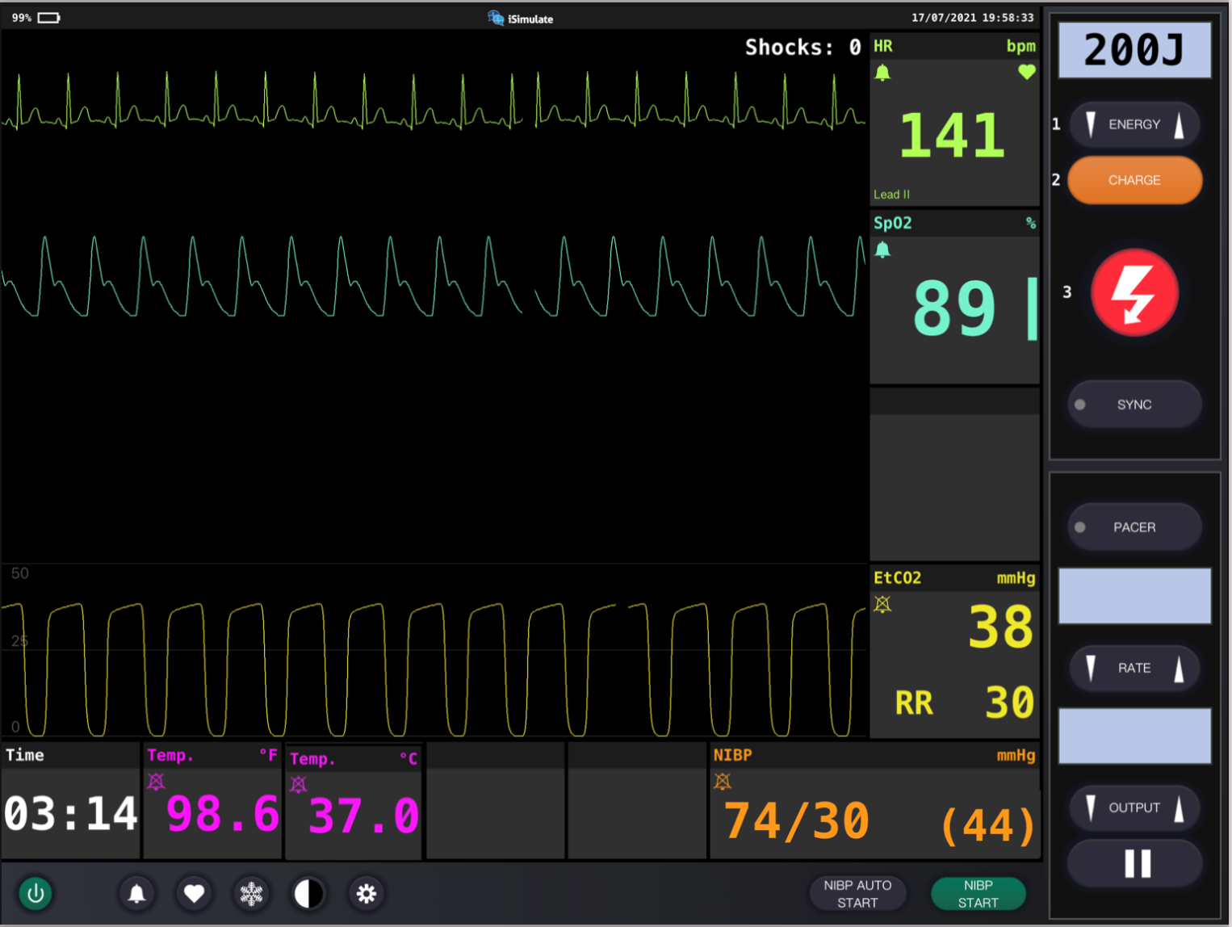
Vital Signs
Notes:
Instructor Notes
Discuss what the vital signs tell us about the patient.
Patient is exhibiting signs of shock.
SpO₂: 89% on room air.
Is oxygen needed?
Discuss treatment options in your region.
ETCO₂ is 38 mm Hg.
Respiratory rate is 48/min.
Blood pressure is 74/30 mm Hg.
Reiterate that you do not need a BP to determine your patient is in shock.
Hypotension in shock is an ominous sign.
Blood glucose is not taken.
Weight is 15 kg per length-based tape.
Diagnostics indicate sinus tachycardia.
Participant engagement
Discuss expected typical vital signs for age.
Discuss the signs and symptoms that show the patient’s condition is deteriorating.

Slide 32
Detailed Assessment
Notes:
Instructor Notes
*Ask participants: Given the age of this child, would you perform a head-to-toe or toe-to-head assessment? Does it matter in this scenario?
HEENT
Head: Unremarkable
Eyes: PERRL
Ears: Unremarkable
Nose: Unremarkable
Throat: JVD present along with mild right tracheal deviation. Both resolved after needle decompression.
Heart and lungs
Lung sounds, clear, diminished on left side, unequal rise and fall of the chest.
Heart sounds are normal, no murmur, not muffled.
Neuro
Motor and sensory intact, anxious.
Abdomen and pelvis
Soft, nontender. Bowel sounds are normal.
Upper extremities
Skin is now slightly pale and diaphoretic. Weak but present distal pulses.
Lower extremities
Skin is now slightly pale and diaphoretic. Weak but present distal pulses.

Slide 33
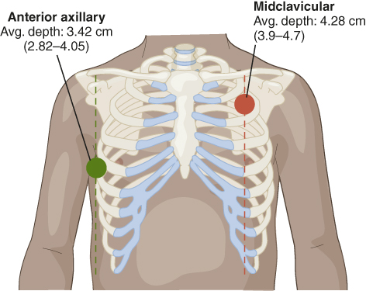
Chest Decompression
Needle thoracostomy
  4th or 5th intercostal midaxillary line
    2nd intercostal space, midclavicular remains an optional site for pediatric patients.
Notes:
Instructor Notes
The recommended site for needle thoracostomy in pediatric patients is the 4th or 5th intercostal midaxillary line.
2nd intercostal space, midclavicular remains an optional site for pediatric patients.
The 4th or 5th intercostal midaxillary line is easier to locate and, due to pediatric patients being smaller, there is less concern about reaching the pleural space. However, providers should use the approach with which they have the greatest experience/comfort.
Most importantly, these are rare events/procedures and providers should be comfortable with landmarks.
Recommend size: 14 to 16 gauge
1.5” to 2” needle < 13 years of age
3.25” to 3.5” needle > 13 years of age
Provider should insert the needle until a pop is felt or a hiss of air is heard.
Once this occurs, no further advancement of the needle should occur, and the needle should be removed.
The catheter should be taped in place and monitored.
If a subsequent tension pneumothorax occurs, an additional needle thoracostomy can be performed lateral to the previous insertion.

Slide 34
Treatment
BLS
  Monitor breathing
  Administer oxygen
  Position of comfort
ALS
  BLS care
  Chest decompression
Critical care
  BLS/ALS care
  Simple thoracostomy/chest tube
Notes:
Instructor Notes
Ask students how they would treat this patient according to their local protocol and scope of practice.
Patient management:
What are your goals for this patient?
The patient should be treated to optimize oxygenation and ventilation.
Discuss treatment options for this patient.
Be prepared for rapid deterioration.
Promptly identify a worsening pneumothorax.
Chest decompression to avoid cardiovascular collapse.
Transport rapidly to hospital.

Slide 35
Ongoing Management
Reassess the patient and interventions performed.
Can you safely transport this child in your ambulance?
Notes:
Instructor Notes
Discuss ongoing management options based on scope of practice and local protocols.
Reassess the patient’s oxygenation and ventilatory status throughout transport.
Reassess for the return of a tension pneumothorax and provide subsequent decompression, as needed.
Patient status improves and becomes less anxious with decreased respiratory difficulty during transport.
How would you safely transport this child in your ambulance?
Discuss policies and procedures for transporting pediatrics in your region.
This patient should be restrained in a pediatric-specific restraint system or a car seat.

Slide 36

Trauma Destinations
Where is the most appropriate treatment destination and why?
© VDB Photos/Shutterstock
Notes:
Instructor Notes
Where is the most appropriate treatment destination and why?
Discuss transportation destination options for pediatrics in your region for this patient.
This patient should be transported to the closest appropriate facility with pediatric trauma capabilities.
Current research shows that morbidity and mortality are lower at pediatric trauma centers vs. adult or mixed trauma centers. Therefore, EMS agencies need to know the pediatric capabilities of their destinations. Not all trauma centers are pediatric ready.
See: Webman RB, Carter EA, Mittal S, et al. Association Between Trauma Center Type and Mortality Among Injured Adolescent Patients. JAMA Pediatr. 2016;170(8):780–786. doi:10.1001/jamapediatrics.2016.0805
https://doi.org/10.1016/j.jpedsurg.2016.02.035
https://doi.org/10.1016/j.jpedsurg.2016.03.016
https://doi.org/10.1016/j.jpedsurg.2016.02.081

Slide 37
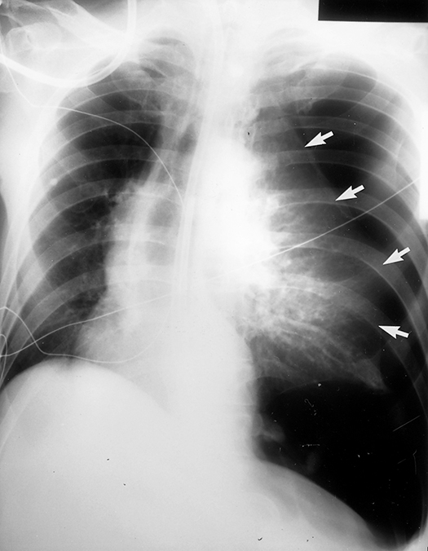
Case Wrap-Up
Diagnosis: Closed pneumothorax that progressed to a tension pneumothorax.
Courtesy of Leonard V. Crowley
Notes:
Instructor Notes
A pneumothorax takes time to develop into a tension pneumothorax. Reassessment is critical to identify deterioration.
A pneumothorax will progress into a tension pneumothorax more quickly if positive pressure ventilation is applied.
An open pneumothorax (sucking chest wound) is best managed with an occlusive (nonporous) dressing that is taped on three sides.
Due to chest wall pliability, pediatric patients may not show external signs of trauma but may have significant internal injuries.
Case Wrap-Up
At the hospital, the patient received a chest tube.
Child was admitted into the hospital and was discharged several days later with no surgery required.

Slide 38
Lesson Wrap-Up
Trauma is the leading cause of death and disability in pediatrics around the world.
Prevention is the best treatment!
Treatments for critically injured trauma patients should focus on identification and treatment of life-threatening conditions and rapid transport to a pediatric trauma center.
Coming Up, Lesson 4: Pediatric Shock.
Notes:
Instructor Notes
Trauma is the leading cause of death and disability in pediatrics around the world.
Prevention is the best treatment for traumatically injured patients.
Treatments for critically injured trauma patients should focus on identification and treatment of life-threatening conditions and rapid transport to a pediatric trauma center.
Coming Up, Lesson 4: Pediatric Shock.

Slide 39

Questions?
© Nujumuddin Mohamad Yaman/EyeEm/Getty Images
Notes:
Instructor Notes
Allow time for a question-and-answer session about the topics presented in the lesson.

