Slide 1
Chapter 4: Open Water Lifeguard Qualifications and Training
Notes:
Identify the USLA lifeguard training system.
Describe the USLA lifeguard training modes.
Recognize the USLA minimum recommended standards

Slide 2
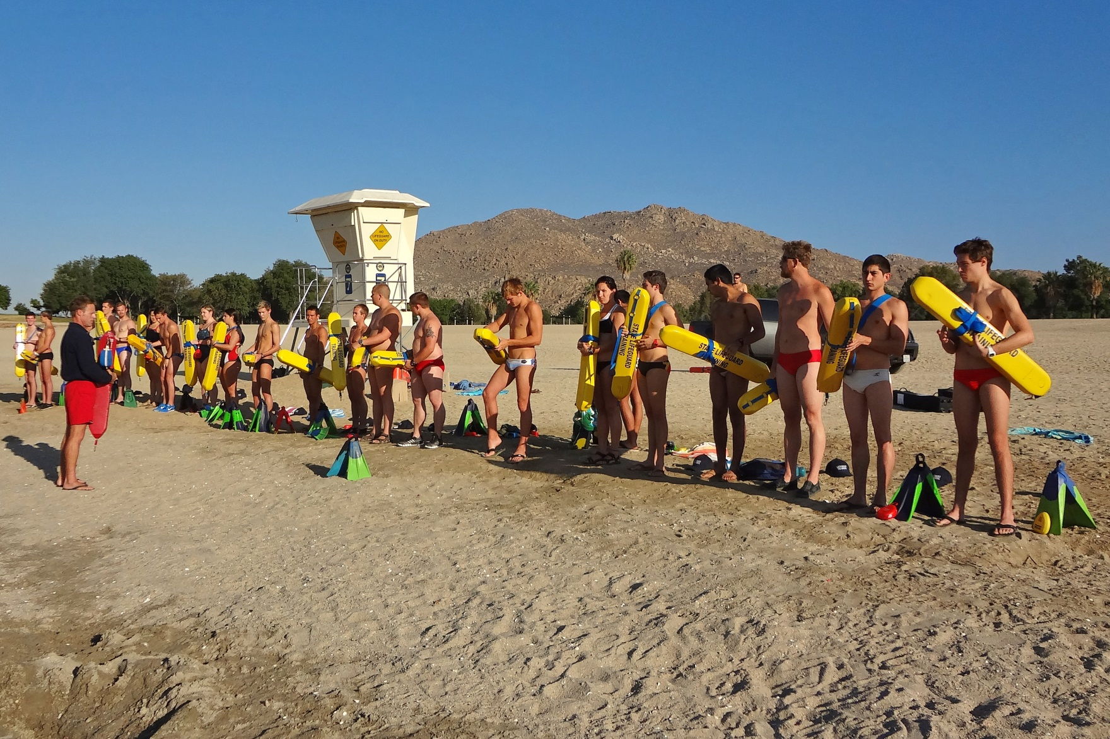
USLA Lifeguard Training System

Slide 3
Pools
Waterparks
Controlled Environments
Notes:
There are many different aquatic environments requiring lifeguard protection.
The USLA believes they fall into two general categories.
Controlled environment (pools and waterparks)

Slide 4
Oceans
Lakes and Reservoirs
Rivers
Natural Environments
Notes:
Natural environments (ocean, lakes, rivers, reservoirs, etc.).

Slide 5
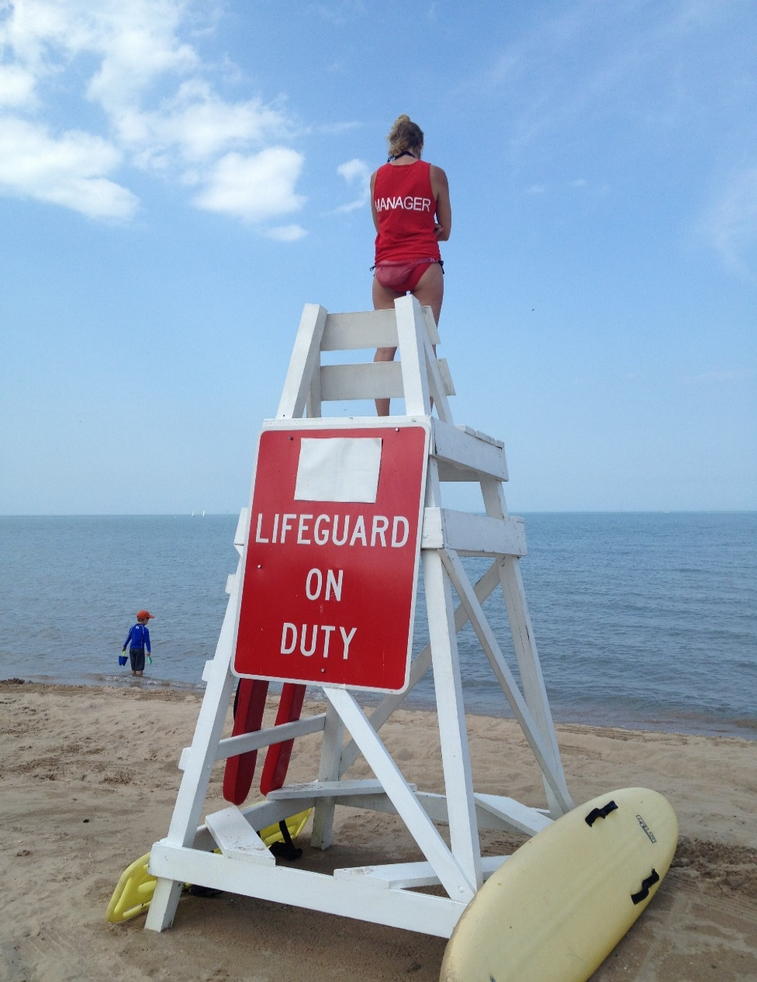
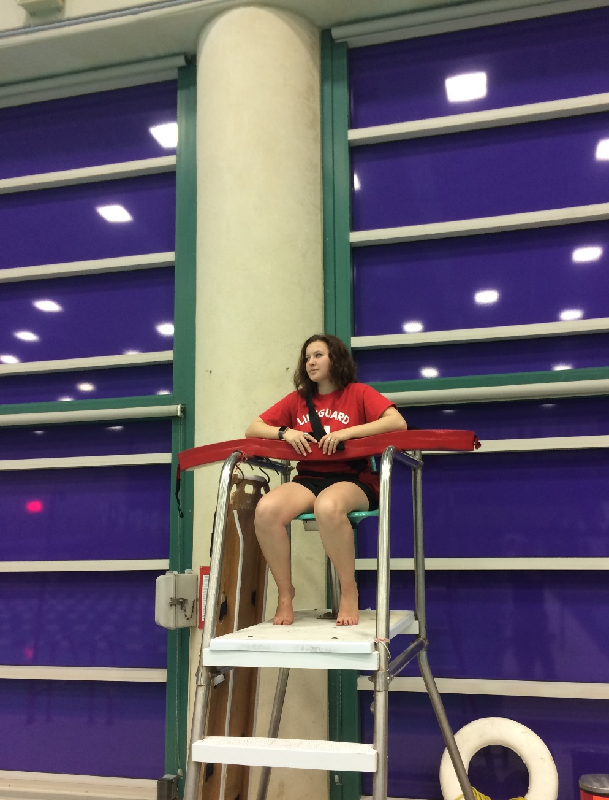
Open Water Guards vs. Pool Guards
Open Water
Lifeguards
Varying environments
Responsibilities differ greatly
Highly specialized training
Job is more physical
Staff qualifications are greater
Pool/Waterpark
Lifeguards
Similar environments
Responsibilities are consistent
One size fits all training
Job is less physical
Notes:
Two Categories of Lifeguards
Pool and waterpark lifeguards
Open water lifeguards
Comparison of Controlled Environment and Open Water Lifeguards
Pool and waterpark lifeguards
Training is highly standardized
Training accepted from one facility to the next due to similar environments.
Open water lifeguards
Environments vary greatly from one place to another.
Wide range of responsibilities.
Training and responsibilities based on local conditions.
Open Water Training is more intensive than in a controlled environment

Slide 6
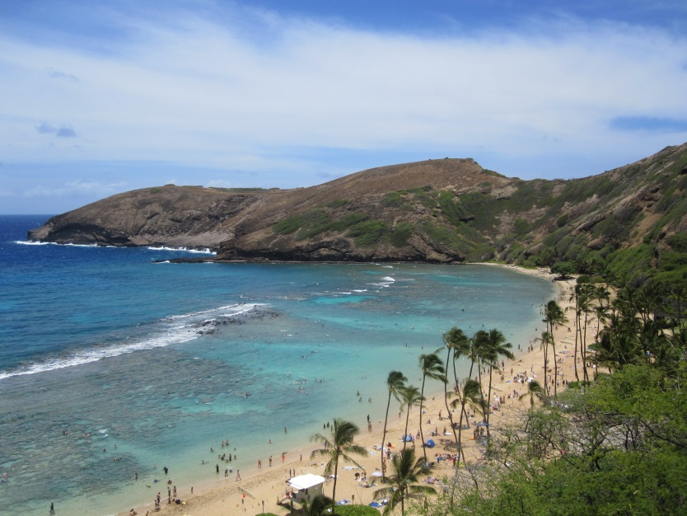
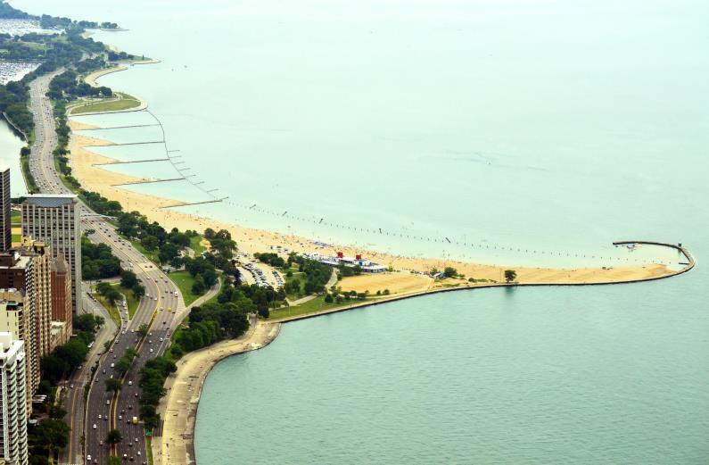
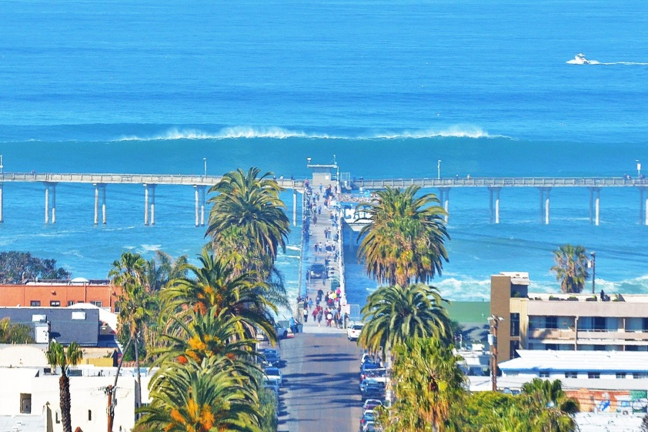
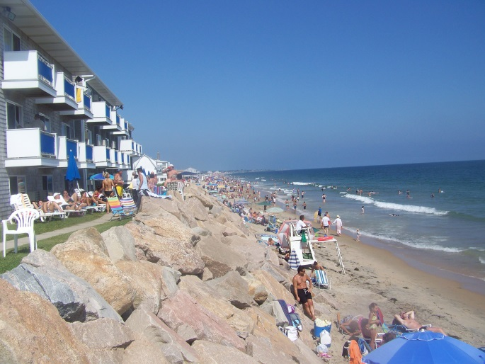
Open Water Variables
Water temperature
Water clarity
Natural hazards
Wave action and currents
Attendance levels and hours
Weather conditions
Rescue procedures
Equipment
Organizational structure

Slide 7
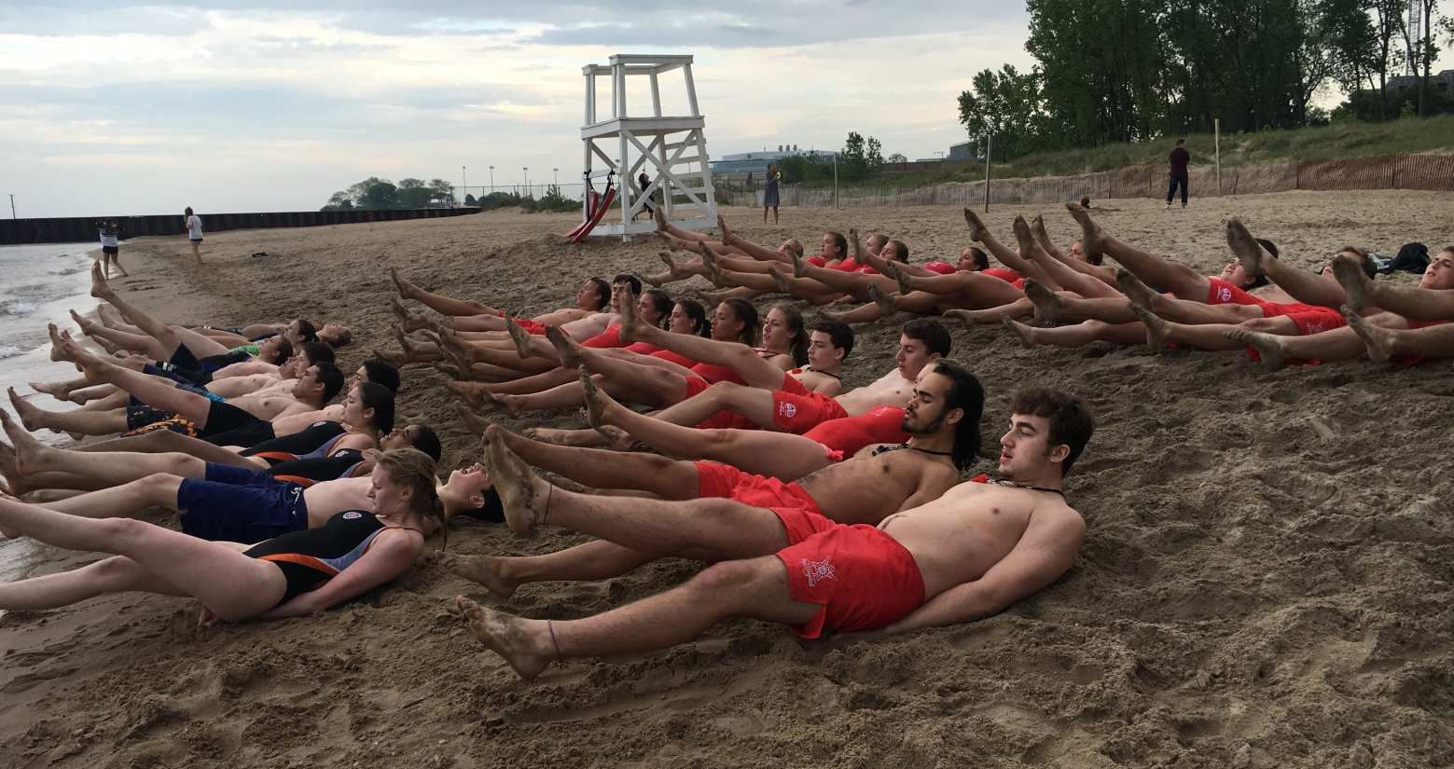
Training Modes

Slide 8
Prerequisite Training
Minimum requirements to apply (e.g. age, CPR certification, medical training etc.)
Notes:
Prospective employee may be required to have a minimum level of training before applying for a job.
Example: Employers may require CPR and medical training.

Slide 9
Pre-Service Training
Prior to being allowed to work
Lifeguard Academy or Rookie School
Shadowing
Notes:
Training provided before assignment to lifeguard duties.
Usually provided in a rookie school (lifeguard academy).
In some cases lifeguard candidates may receive pre-service training over a 30-day period (after initial CPR and medical training) under the guidance of an experienced lifeguard. This approach requires very tight supervision when lifeguards (trainees) who are not fully trained are assigned to work the beach.

Slide 10
In-Service Training
To develop and maintain skills
Minimum of 16 hours per year
Daily conditioning
Review of procedures and skills
Specialized training when required
Notes:
Subsequent to initial training
Used to develop and maintain skills and knowledge of lifeguarding
Minimum of 16 hours per year in formal training
Daily conditioning is required
Review of rescue procedures
Specialized training is necessary for specialized assignments

Slide 11
Minimum Standards
16 y/o – seasonal
18 y/o – year round
Advanced CPR training
40 hours of initial training
500m swim <10 min
Health and fitness
Scuba
Notes:
Minimum age – 16 for hourly and 18 for full time
Emergency medical care – 21 hours of training (not including CPR) for hourly lifeguards, Emergency Medical Responder for full time.
Advanced training in CPR – Adult, Child, Infant, Two Person and obstructed airway.
Lifeguard training – 40 hours
500 Meter swim – Swim 500 meters or 550 yards over a measured course in ten minutes or less (must be met and maintained throughout employment).
Health and fitness – must possess adequate vision, hearing acuity, physical ability, and stamina.
Scuba Training – Basic level certifications – is required for any lifeguard if scuba is utilized in the course of employment.

Slide 12
Notes:
List the differences between open water lifeguards and pool lifeguards.
Compare and contrast the various beaches you have visited citing the uniqueness of each.
List five types of in service trainings the lifeguards might participate in.
List three reasons open water lifeguards need to be mature.
Identify why lifeguards must be strong swimmers.
Explain why lifeguards need to be trained to high levels of emergency care.
Explain the need for lifeguards to have advanced CPR training.

