Slide 1
Chapter 18: Medical Care in the Aquatic Environment
Notes:
Explain lifeguard medical training.
List lifeguard medical equipment.
Describe how to provide medical care.
Explain resuscitation of drowning victims.
Describe the types of injuries from aquatic life.
Explain the impact of spinal injuries and how to provide medical care.
Describe the effects of cold water injuries.

Slide 2
Lifeguard Medical Training
Notes:
Most medical cases handled by lifeguards involve minor injuries which can be resolved at the beach.
More serious injuries, such as difficulty breathing or serious trauma, require both lifeguard care and that of additional EMS responders.
Lifeguards must be capable of supporting life, sometimes for an extended period of time, until a higher medical authority can take over.
The USLA has set minimum recommended standards for emergency training for all open water lifeguards.
The information offered here is intended to supplement this training with medical care information that is specific to the role of a professional open water lifeguard.

Slide 3
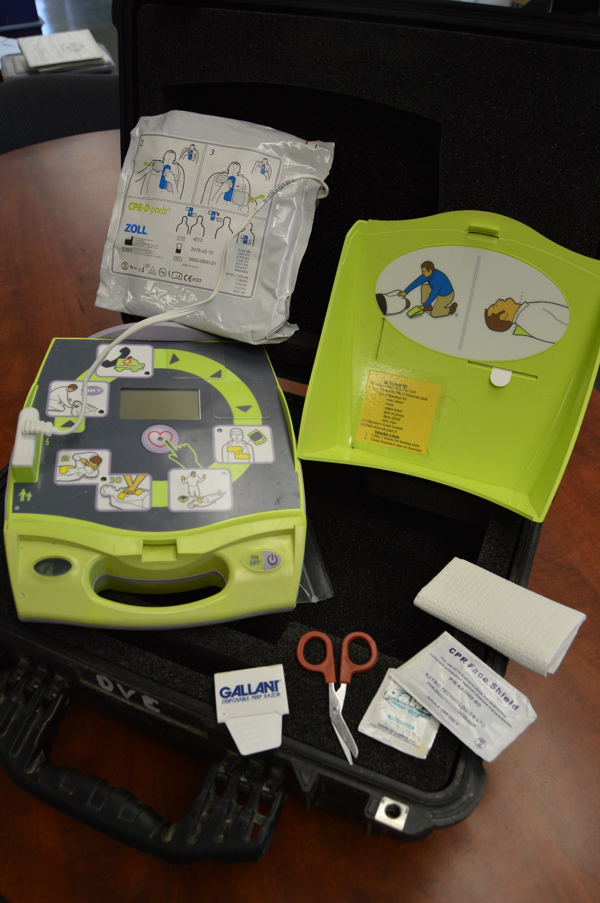
Lifeguard Medical Equipment
USLA standards
Medical aid upplies
Equipment should be inspected and maintained
Notes:
USLA sets recommended standards for medical equipment, which should be made available to lifeguards. They are detailed in the chapter on Lifeguard Facilities and Equipment.
First aid supplies and each first aid kit should be clean and properly stocked at all times.
Oxygen and other medical equipment should also be inspected daily, and maintained in a ready condition.

Slide 4
Providing Medical Care
Notes:
Lifeguards should provide care in accordance with their training, agency policies, agency protocols, and any applicable regulations.

Slide 5
Levels of Injury
Minor injuries
Moderate injuries
Acute injuries and illness
Notes:
Injuries that lifeguard commonly encounter can be divided into three levels.
Minor injuries – are conditions unlikely to require medical treatment beyond primary care. These injuries include minor abrasion, cuts, and scrapes.
Moderate injuries – are those, which are not immediately life, threatening, but which require further care at a medical facility. These injuries are minor lacerations that require sutures, minor puncture wounds to the extremities, and other similar injuries. Moderate injuries require that decisions be made by lifeguards as to whether an ambulance should be summoned or the person released with advice to seek further care. Agency policies are key to this decision.
Acute injuries and Illness – is defined as any injury or illness requiring urgent care at a medical facility. This includes immediately life-threatening injuries, such as uncontrolled bleeding, as well as those which are not immediately life-threatening, such as a simple, closed fracture.

Slide 6
Treatment Guidelines
Determine that the area is safe
Summon necessary backup
Use universal precautions for infection control
Treat immediate problems according to level of medical training including:
Airway
Breathing
Circulation
Bleeding
Determine mechanism of injury
Conduct a full assessment for any and all injuries
Stabilize injuries according to medical protocol and level of training
Avoid moving the victim until the full extent of injury is determined
Monitor and record vital signs
Protect body temperature
Make the victim as comfortable as possible
Recommend further treatment in cases that victim is not transported to the hospital
Document your actions
Notes:
The following are some general guidelines for treating injuries and ailments which may be modified in accordance with the severity of injury and general circumstances:

Slide 7
Treatment Principles
Prioritize responsibilities
Inspect and treat the injury
Assess carefully
Treat carefully and thoroughly
Keep bystanders back
Maintain control
Use discretion
Avoid inappropriate release from care
Encourage follow up treatment
Document and advice
Notes:
In addition to general guidelines for treating injuries, the following tips should help lifeguards address issues they will commonly encounter:
Prioritize Responsibilities – treating a minor injury that does not require immediate care may not take precedence over water surveillance.
Inspect and treat the injury – beach goers occasionally request medical supplies for self-treatment of minor injuries, without revealing the injury. This should be discouraged. Lifeguards should offer to assist in treatment.
Assess Carefully – assessment of injuries requires a good judgement and skills on the part of the lifeguard.
Treat carefully and thoroughly – whenever a lifeguard initiates medical treatment for an injury, the lifeguard undertakes a responsibility to treat properly.
Treat minors with care – if there is a parent or an adult supervisor of the minor readily available, the lifeguard should make sure that the adult knows of the injury, preferably before treatment.
Keep bystanders back – a pushing crowd can aggravate the fear and anxiety of an injured person. Keep onlookers away.
Maintain control – it is important for lifeguards to maintain control of the situation and keep treatment within the lines of established protocols. Be cautious of bystanders who say, “I’m a doctor,” or “I’m a paramedic.”
Use discretion – the beach is a public place. If treatment of a wound will require removal of clothing, it may be best to bring the victim inside, if possible. Privacy is a secondary issue in the case of a life-threatening injury, but it should be taken into account.
Avoid inappropriate release from care – lifeguards must be careful not to release a person whose status may quickly deteriorate.
Encourage follow up treatment – it is wise to recommend the victims follow up with their physicians.
Document treatment and advice – the treatment provided, advice rendered, and all recommendations for further treatment of injuries should be carefully documented of medical reports.

Slide 8
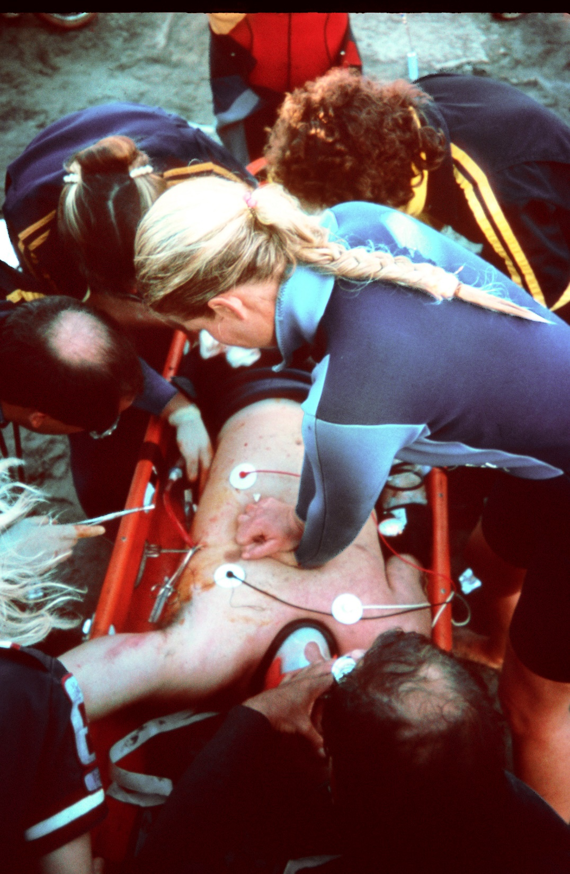
Resuscitation of a Drowning Victim

Slide 9
Conscious or unconscious
Hypoxia
CPR protocols differ in drownings
Immediate ventilation
Barrier devices
Abdominal thrusts not advised
Expect vomit
Notes:
Drowning victims may be conscious and alert or they may be unconscious. They may have a pulse with no respiration or may have neither.
Hypoxia caused by immersion or submersion, if not corrected, results first in respiratory arrest. If respiratory arrest is not corrected, it is followed by cardiac arrest.
American Heart Association (AHA) guidelines for treating drowning have consistently made clear that drowning resuscitation priorities differ in key ways from standard CPR for sudden cardiac arrest.
The first and most important treatment of the drowning victim is the immediate provision of ventilation.
Victims with only respiratory arrest usually respond after a few artificial breaths are given.
CPR for drowning victims should follow A-B-C vs C-A-B because drowning is a hypoxic event.
If available, a barrier device should be used for rescue breathing. Barrier devices have not been shown to reduce the low risk of transmission of infection.
Per the International Life Saving Federation: “Studies suggest that the chance of contracting a communicable disease via mouth-to-mouth resuscitation attempts is extremely small. On the other hand, the chance of saving a life in these cases is high.” Drowning victims commonly aspirate water, but there is no need to clear the airway of this water because only a modest amount is aspirated by the majority of drowning victims, and aspirated water is rapidly absorbed by the body. Attempts to remove water from the breathing passages by any means other than suction (e.g., abdominal thrusts or the Heimlich maneuver) are unnecessary and potentially dangerous
Drowning victims do commonly vomit.

Slide 10
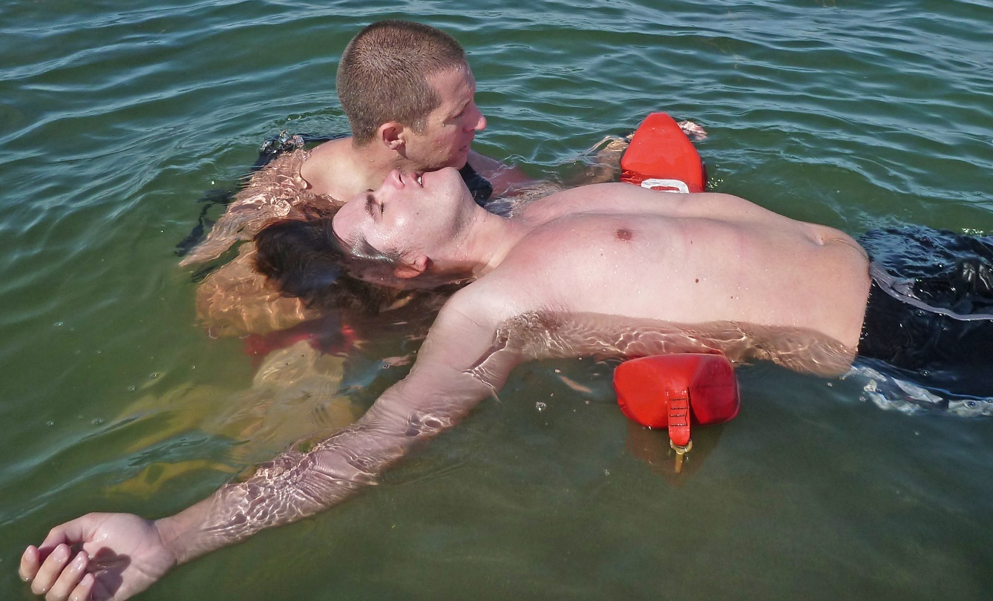
Non-Breathing Victim Recovered in Deep Water
Position victim face up
Extend neck to open position
Attempt to ventilate for one minute
Continue ventilation while moving victim to shore
Notes:
For a nonbreathing victim recovered in deep water, research has shown that immediate ventilation is the priority and can be crucial to resuscitation, Position the victim face up, extending the neck to open the airway. Use an RFD or rescue board. [Demonstrate.]
Attempt to ventilate for approximately one minute (12 to 16 ventilations). If ventilation is restored, proceed toward shore, intermittently stopping to check for spontaneous breathing.
If not and if nearshore, rescue the victim while ventilations are continued or stop every one or two minutes to ventilate again.
If a long swim, continue ventilation one additional minute in place and check for movement or reaction to ventilation. If present, use the same procedures as with the short swim. If movement or reaction to ventilation is absent, the bring the victim to shore without further ventilations.

Slide 11
Positioning a Drowning Victim
On a slope victim should be parallel to waterline
Never head-down the slope
Keep victim out of the water (consider incoming tide and wave sets)
Notes:
On a sloping beach, the victim should be placed in a position parallel to the waterline, lying supine, so that the body is level.
Do not position the victim head-down on the slope of the beach, as this will increase the likelihood of vomiting.
Ensure that you bring the victim far enough up the beach to avoid uprush and an incoming tide

Slide 12
Oxygen
Oxygen can be given by:
Oronasal mask
Non-rebreather
Demand valve
Bag valve mask
Notes:
When a drowning victim is recovered from the water, the person is typically experiencing hypoxia. It is ideal to provide the victim with 100 % pure oxygen to reverse hypoxia.
Oxygen regulators should receive annual service check.

Slide 13
Defibrillators
AED’s are standard equipment
Intended for sudden cardiac events
AED’s can sometimes stop V-fib or VF (not typically associated with drownings)
Notes:
AED’s are a common tool of lifeguards.
Primarily intended to correct problems associated with sudden cardiac arrest (versus drowning).
AED’s can sometime stop ventricular fibrillation (VF), an uncontrolled beating of the heart. VF is rare in submersion victims.

Slide 14
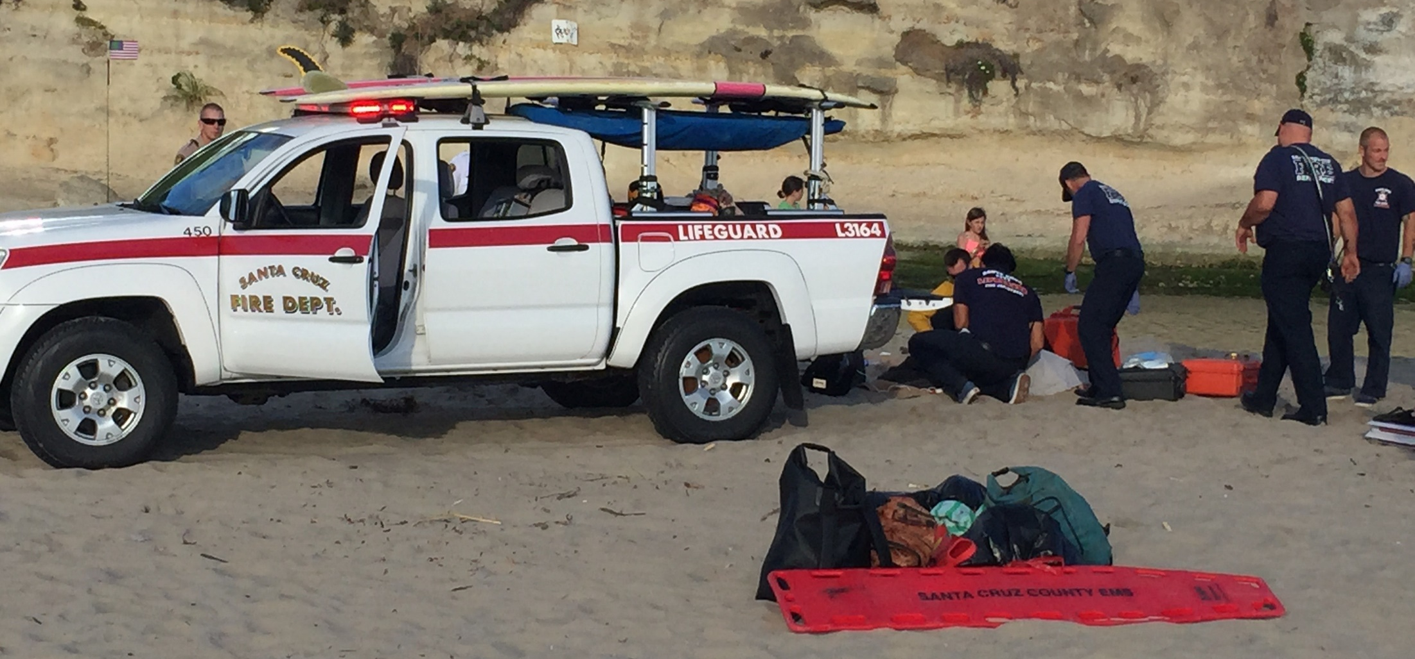
Release of Drowning Victims from Care

Slide 15
Further Treatment is Needed
The following people should be sent to the hospital in most cases:
Any victim who lost consciousness even for a brief period
Any victim who required rescue breathing
Any victim who required cardiopulmonary resuscitation
Any victim in whom a serious condition is suspected such as heart attack, spinal injury, other injury, asthma, epilepsy, stinger, intoxication, delirium, etc.
Notes:
Whenever a victim has aspired water in a drowning incident, but is conscious, the lifeguard must make a determination whether further treatment is needed or the victim can be released from care.
The following are recommended guidelines from the International Life Saving Federation:

Slide 16
Further Treatment May Not Be Needed
The following people may be considered for release from care at the scene if, after 10-15 minutes of careful observation, while being warmed with blankets or coverings as required and the victim meets all of the requirements listed below
Fully conscious, awake and alert
An oxyhemoglobin saturation level over 95%
No cough
Normal rate of breathing
Normal circulation as measured by pulse in strength and rate, and blood pressure
Normal color and skin perfusion
No shivering
Notes:
There is always a risk of delayed lung complications. All immersion victims should be warned that if they develop cough, breathlessness, fever, or any other worrying symptom, they should seek medical advice immediately. Special care and observation should be given to child victims.

Slide 17
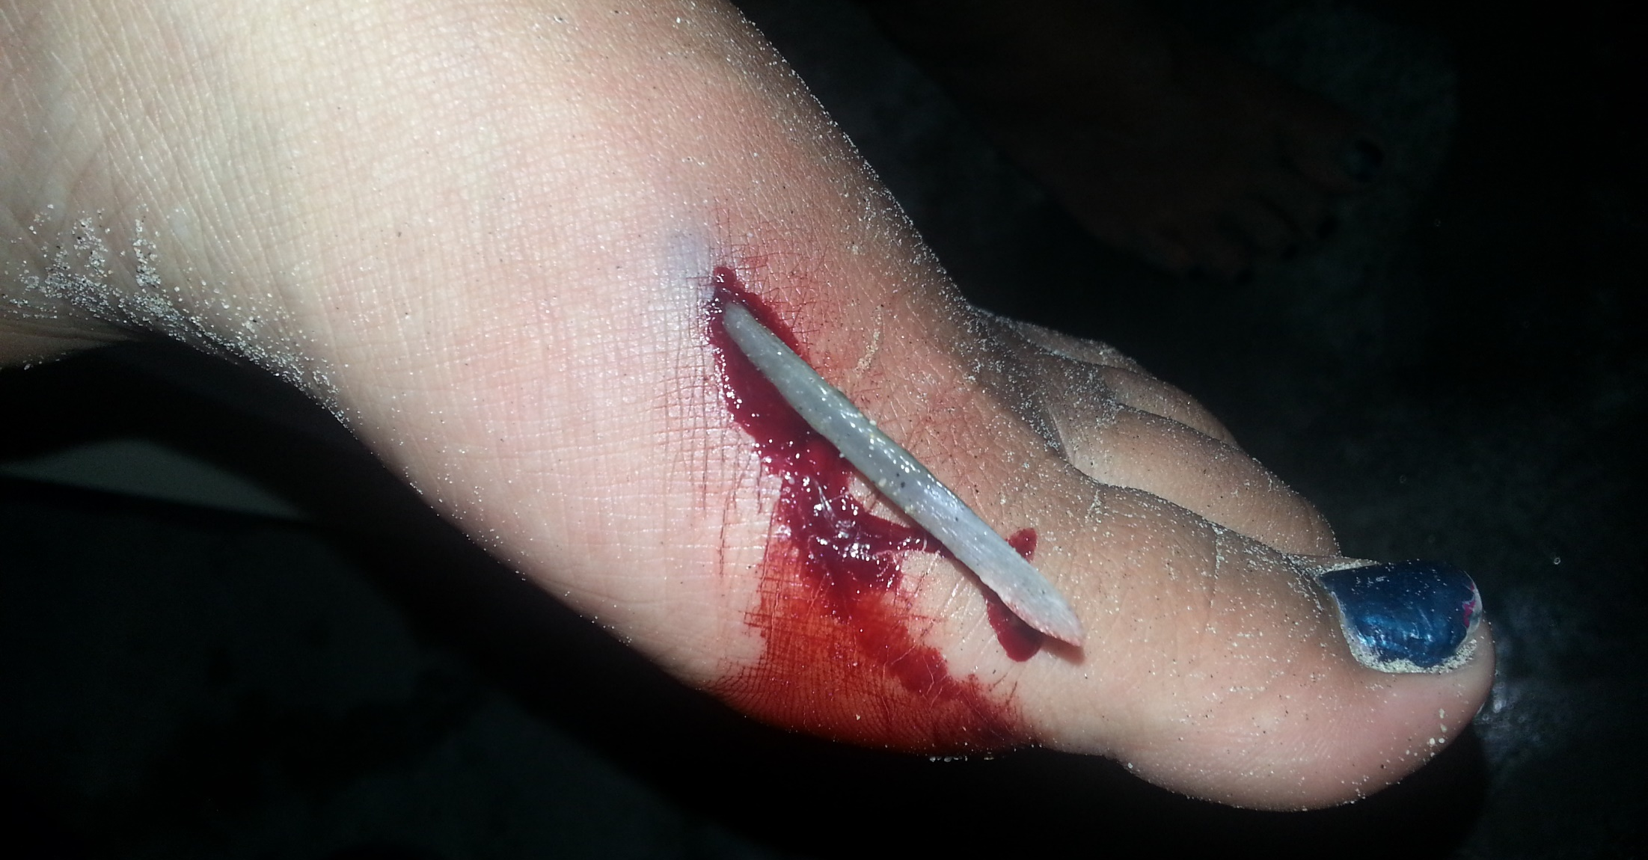
Injuries from Aquatic Life

Slide 18
Bites
If bitten by a predatory fish, crucial to get the victim out of the water
Minor wounds should be cleaned and disinfected
Major wounds require immediate transport to a medical facility
A tetanus shot should be recommended

Slide 19
Stings
Treatment may vary based on level of training and local protocols
Victim should be evaluated for any reaction that extends beyond bleeding and pain

Slide 20
Jellyfish and Portuguese Man-of-War
Absent medical complications, calm the victim and provide pain relief
Remove any remaining tentacles using medical gloves or your fingers
Immerse affected area in hot water
No commercial products or noncommercial solutions have been scientifically proven to work
Monitor until resolve or send for treatment
Notes:
A hot shower, or application of a heat pack provide the best pain relief.
If heat treatment unavailable, cold packs have been shown to be effective, but less so than heat.
Vinegar has been shown, in some cases, to worsen the discharges and the sting with some species

Slide 21
Stingrays
Check wound to make sure the sheath and barb are completely removed
Immerse the injury site in very warm (not scalding) water
In most cases very warm water will reduce the pain
Continue treatment until extremity can be removed without pain
A tetanus shot is recommended

Slide 22
Scorpion Fish
Treat the same as a stingray
Complications more likely than for stingray
Monitor victims for reactions

Slide 23
Sea Urchins
Penetration wounds from spines
Often break off below surface
Can cause weakness, loss of body sensation, facial swelling and irregular pulse (paralysis, respiratory distress have occurred)
Apply hot compresses or soak affected area in hot water
Recommend follow-up with doctor, especially if broken off spines remain
Tetanus shot may be appropriate

Slide 24
Mollusks
The shells can cause abrasions and lacerations
Clean wounds and apply sterile dressings
Tetanus shot may be appropriate

Slide 25
Coral
Coral cuts should be rinsed with seawater
May require antibiotics and tetanus shot

Slide 26
Snakes
Toxic signs (appearing within twenty minutes) can cause malaise, anxiety, euphoria, muscle spasm, respiratory problems, convulsions, unconsciousness, and all signs of shock
Transport to a medical facility normally appropriate

Slide 27
Leeches
A common practice is to simply place salt directly on the leech, which typically causes it to release

Slide 28
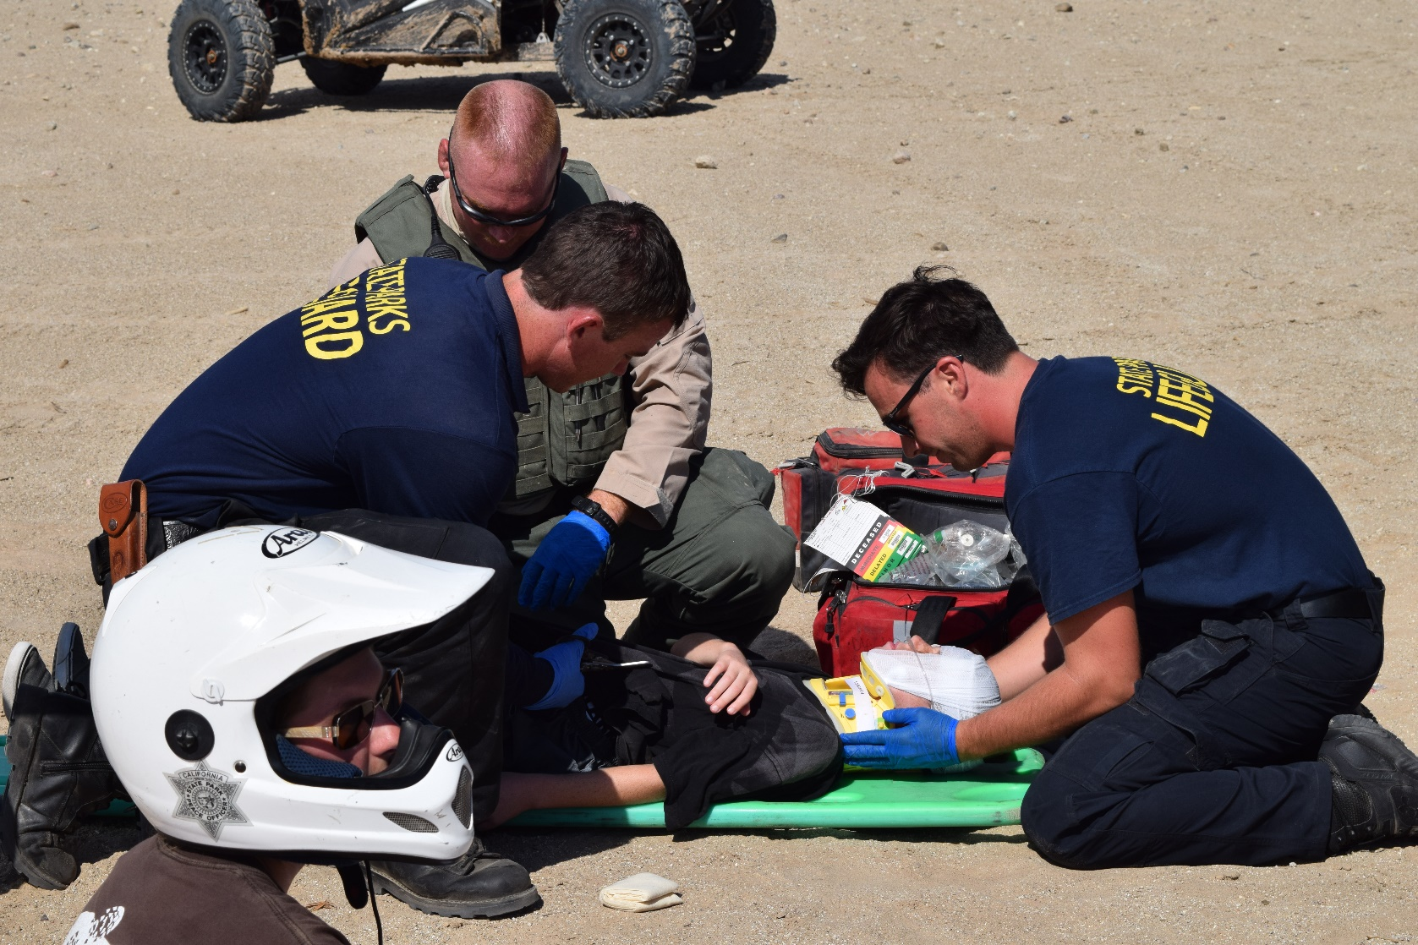
Spinal Injuries

Slide 29
Recognition
Any sign of neck or back pain needs to be treated as a potential spinal
Move slowly and in unison
The best method of treatment depends on available resources
Notes:
In cases of nonbreathing victims or those with compromised breathing, resuscitation is the priority. The reported incidence of cervical spine injury in drowning victims is low.
The first step in treatment of spinal injury victims is recognition.
Any neck or back pain after injury (even trivial injury) or head trauma needs to be treated appropriately.
Unless victim is endangered, move slowly and in unison. Unless the victim is in imminent mortal danger and must be moved quickly, all actions should be taken slowly, carefully, and in unison.
Act in accordance with your level of medical training and train regularly.
Best methods will depend upon:
Location – onshore or offshore, deep or shallow water, surf or flatwater distance from shore.
Available lifeguards – strength, training, and numbers.
Victim – sizes and condition.
Available equipment and transportation

Slide 30
Beach Presentation
Often reported by a victim who complains about neck or back pain
Recognition
Immobilization
Just because someone can walk doesn’t mean it’s not a spinal
Use standing backboard technique
Notes:
Many of the spinal injuries a lifeguard will see involve people who walk up to the lifeguard complaining of neck and back injury sustained during water reaction, such as bodysurfing, or a shallow water dive in which the bottom was struck.
Recognition and immobilization are of tremendous importance to minimize further injury.
Don’t assume because the victim is able to walk, there is not a serious injury to the spine.
The victim should not be allowed to lie down.
Use the standing backboard technique.

Slide 31
Standing Backboard Technique
The lifeguard moves to the rear of the victim and stabilizes the head and neck with one hand on each side
A second lifeguard applies a cervical collar
First lifeguard maintains stabilization
At least two other lifeguards then stand facing the victim and grasp opposite sides of the backboard through the victim’s armpits and gently lower the board to the sand
Follow standard procedures for securing the victim to the backboard

Slide 32
Water Presentation
Avoid creating added turbulence
If rescue breathing is needed use modified jaw thrust
Use a buoyant backboard if available
Use of one of the following techniques to stabilize
Notes:
Victims found in the surf or floating in shallow water, or those seen diving, need appropriate precautionary care for possible spinal injury.
When approaching avoid unnecessary turbulence.
If victim is not breathing begins rescue breathing. Use modified jaw thrust
There are three in-water spinal immobilization techniques.
Use a backboard that floats, if available.

Slide 33
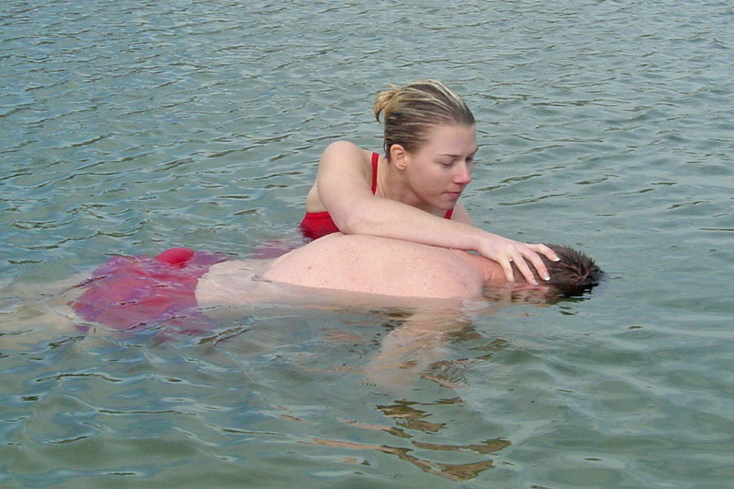
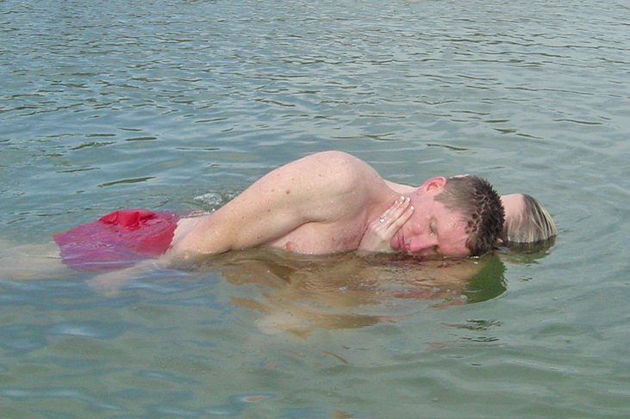
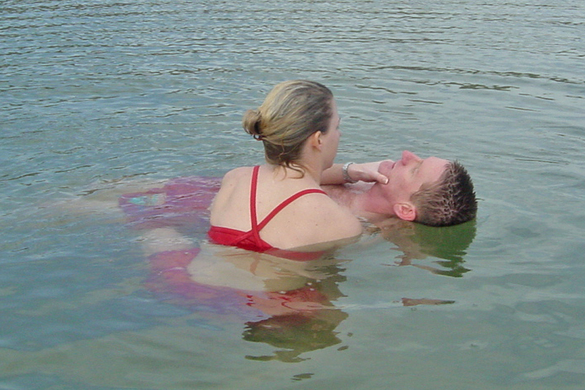
Vice Grip
Notes:
Approach from the victim’s side, place the lifeguard’s dominant arm along the victim’s sternum, and stabilizes the chin with the hand.
The lifeguard’s other arm is then placed along the spine with this hand cupping the back of the victim’s head.
The arms squeezed together forming a vice, which provides stabilization.
Avoid excessive pressure on the airway.
If face down, slow rotate the victim toward the lifeguard.
Works in deep and shallow water.

Slide 34
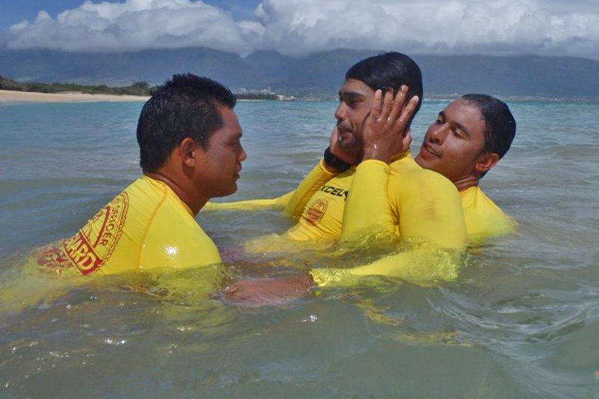
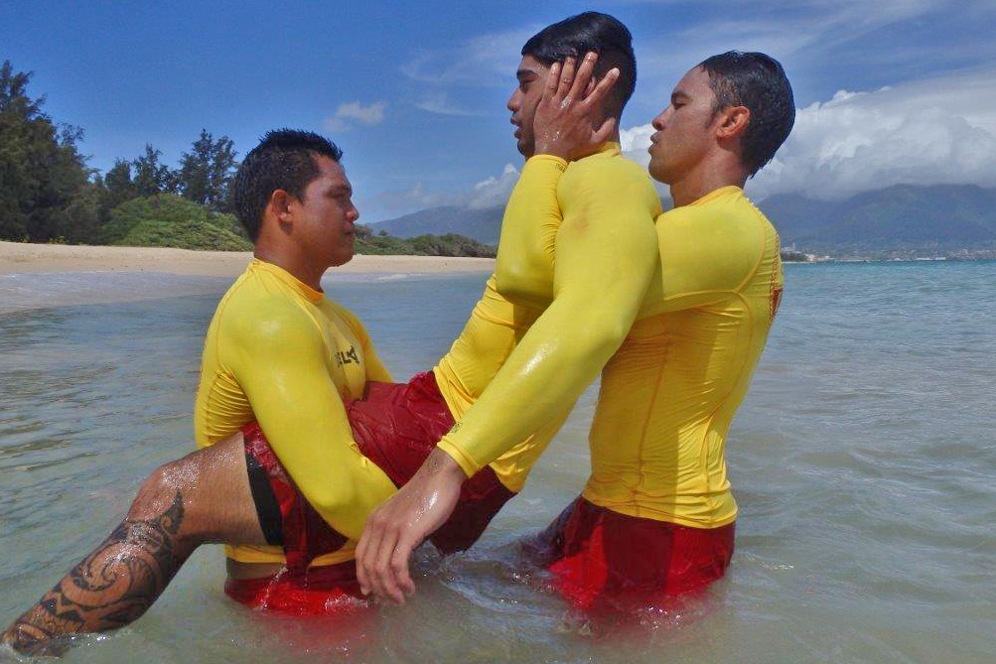
Body Hug
Notes:
Lifeguard approaches the face up victim from behind and partially submerges.
The lifeguard then places their arms through the victim’s armpit from back and places their hands over the victim’s ears, thus stabilizing the head.
The lifeguard’s face is place next to the victim’ head.
For face down the lifeguard uses the same arm and hand placement and then rolls the victim toward the lifeguard.
Provides great immobilization.
Impractical in shallow water.
A change in immobilization technique is required before placing on a spineboard.

Slide 35
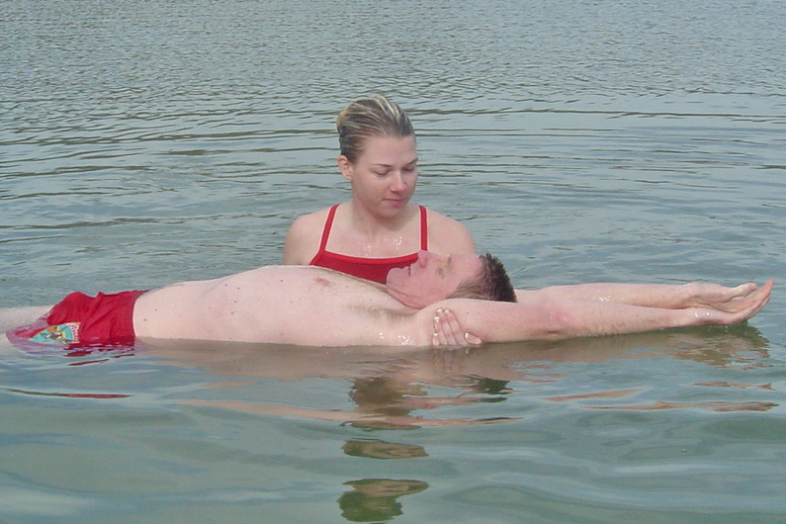
Extended Arm Grip
Notes:
Lifeguard takes a position at the victim’s side and grabs the victim’s arm just above the elbow right-to-right and left-to-left.
Carefully raise the arms above the victim’s head pressing them together against the ears. This immobilizes the head.
If face down applies as mentioned and then rolls towards the lifeguard, placing the victim in the crook of their arm.
Works in shallow water.
Some concerns about the degree of immobilization with this method, especially toward flexion forces.

Slide 36
Rescue to Shore (deep water)
Use a floating backboard and carefully submerge it under the victim and secure the victim to it with the least amount of movement
A last resort would be to use a rescue tube to help support the lifeguard and victim until additional lifeguards arrive

Slide 37
Cold Water Emergencies
Keep victims as horizontal as possible
Remove wet clothing
Wrap in warm blankets
Maintain open airway
Nobody is dead until they are warm and dead
Notes:
All cold water immersion victims should be quickly rescued.
Victims how have been in cold water for a considerable amount of time should be rescued in a near horizontal attitude to prevent a potentially adverse fall in blood pressure.
Remove wet clothing and replace with dry clothing.
Wrap in warm blankets.
Maintain open airway.
In cardiac arrest, follow CPR protocols.
Avoid hasty diagnosis. No one is dead until they are warm and dead.
Individuals have survived cold water submersion up to one hour in ice cold water

Slide 38
Notes:
Divide class into small groups. Assign a “Discussion Point” to each group. Ask each group to share the most important parts of their lesson point with the rest of the class. Expand on each group’s comments so that all lesson material is covered.

