Slide 1
THE RESCUE COMPANY 1

Slide 2
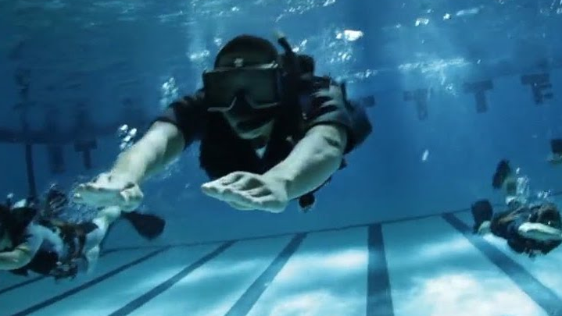
RESCUE swimming

Slide 3
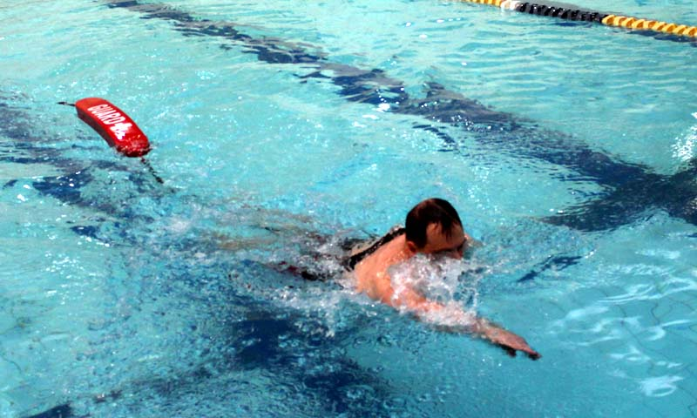
front crawl
Front crawl is the fastest, most efficient stroke of them all.
This is largely down to the streamlined body position and continuous propulsion from the arms and legs.

Slide 4
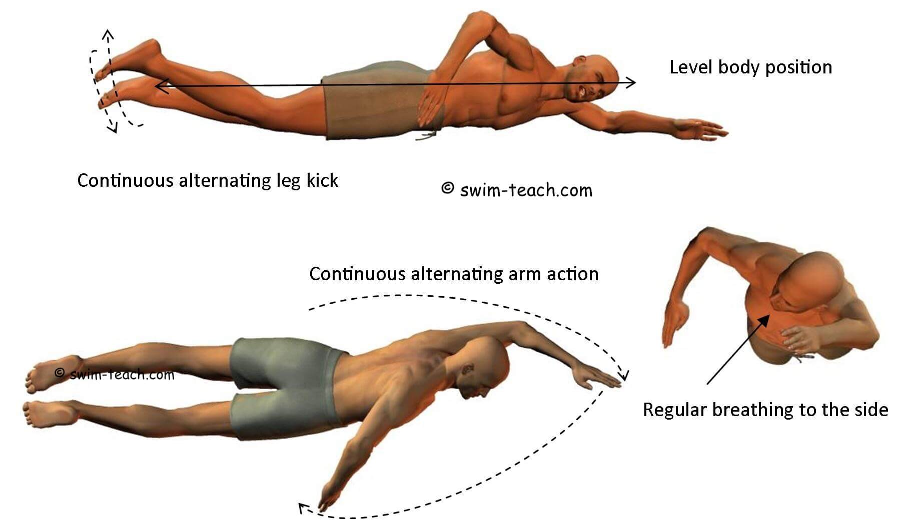

Slide 5
front crawl
body position
The front crawl stroke, or freestyle stroke, is a face-down stroke, and it is the fastest stroke.

Slide 6
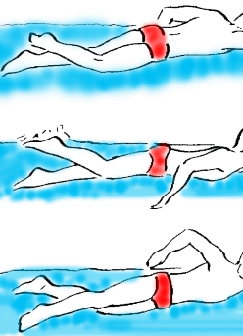
front crawl
Your body should be horizontal (flat) in the water, face down, and streamlined.

Slide 7
front crawl
legs
The legs will perform a flutter kick, which is a powerful kickwhere the feet are pointed, and ankles are relaxed.

Slide 8
front crawl
legs
The motion should come from the hip, so the legs stay virtually straight -but not stiff.
During the downward kick the knee is slightly bent and finishes when the leg straightens and the foot snaps like kicking a ball.

Slide 9
front crawl
legs
Then the upward kick begins and the leg is straight throughout until the heel breaks the surface of the water.
The kick is a very important part of the front crawl, especially swimming in the ocean.

Slide 10
front crawl
legs
The kick not only propels the swimmer through the water, it also keeps the body hydrodynamic and horizontal in the water.

Slide 11
front crawl
Arms
Your arms will make an alternating stroke, with palms facing downwards, and fingers cupped.

Slide 12
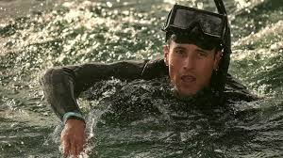
front crawl
Arms
As you alternate strokes the body should roll slightly around the midline (imaginary line from head to feet that divides the body in equal halves).
The first part of the stroke is called the Power Phase with the Catch, Mid-Pull, and Finish. before reentering the water.

Slide 13
front crawl
Arms
In the Catch the hand will enter the water with the arm fully extended.
Now is when you begin to roll the body.

Slide 14
front crawl
Arms
Next during the Mid-Pull, the hand will pull down with a slight outward curve as if you were hugging a barrel
Finish the hand pushes the water down towards your feet and out as the hand exits the water by your hip.

Slide 15
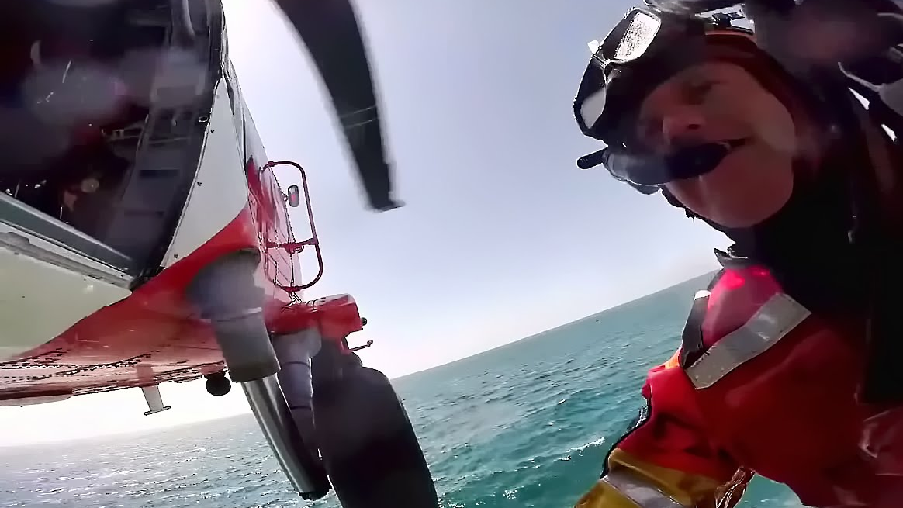
front crawl
The Power Phase is what propels the body forward.
The second part of the stroke is the Recovery.

Slide 16
front crawl
Arms
During the Recovery, the arm should be relaxed and bend at the elbow so the hand "zips up" the side and then extend the arm fully before reentering the water.

Slide 17
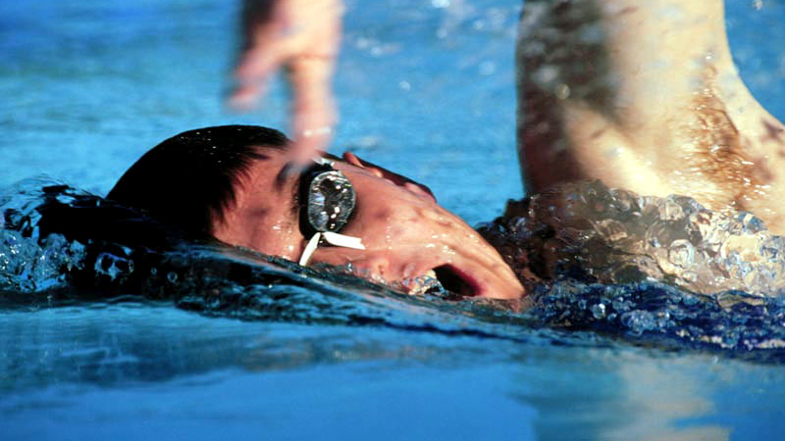
front crawl
breathing
The face should remain in the water at all times, except to breathe.
Breathing may take place to one side every stroke or by alternating sides every other stroke.

Slide 18
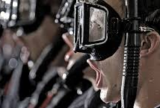
front crawl
breathing
Breathing is done simply by turning the head to one side without rolling the body and taking a deep breath back close to your shoulder

Slide 19
front crawl
breathing
then quickly returning your face to the water and exhaling slowly.
Remember where the head goes the body goes so keeping the head down and relaxed between breaths will save energy.

Slide 20
RESCUE swimming
Rescue Swimmers are athletes who save lives.
They keep a sharp eye for all who enter the water before them.
When the time comes to save a life they rush into the water with confidence because they know they have trained hours for this moment, which has now become just an instinct.

Slide 21
RESCUE swimming
In order to perform lifesaving skills in an ever changing, chaotic environment such as the ocean, lifeguards must keep their bodies in superb physical condition.
This includes living a healthy lifestyle, stretching and warming up before physical training, and preventing injury by training with proper swimming and running techniques.

Slide 22
RESCUE swimming
What follows is a guideline to becoming a stronger, more proficient lifeguard.
These are just tips and workouts that can help improve swimming and running ability.
It is up to each individual to seek the advice of an experienced coach so their swimming and running technique can be critiqued by a trained eye.

Slide 23
RESCUE swimming
If swimming in the ocean isn't challenging enough, lifeguards have to modify their swimming technique when swimming to a victim and making a rescue.

Slide 24
RESCUE swimming
As a rescue swimmer you first must know which way the currents are moving so when you enter the water to rescue a swimmer in distress, you will be able to swim the fastest route to the victim.

Slide 25
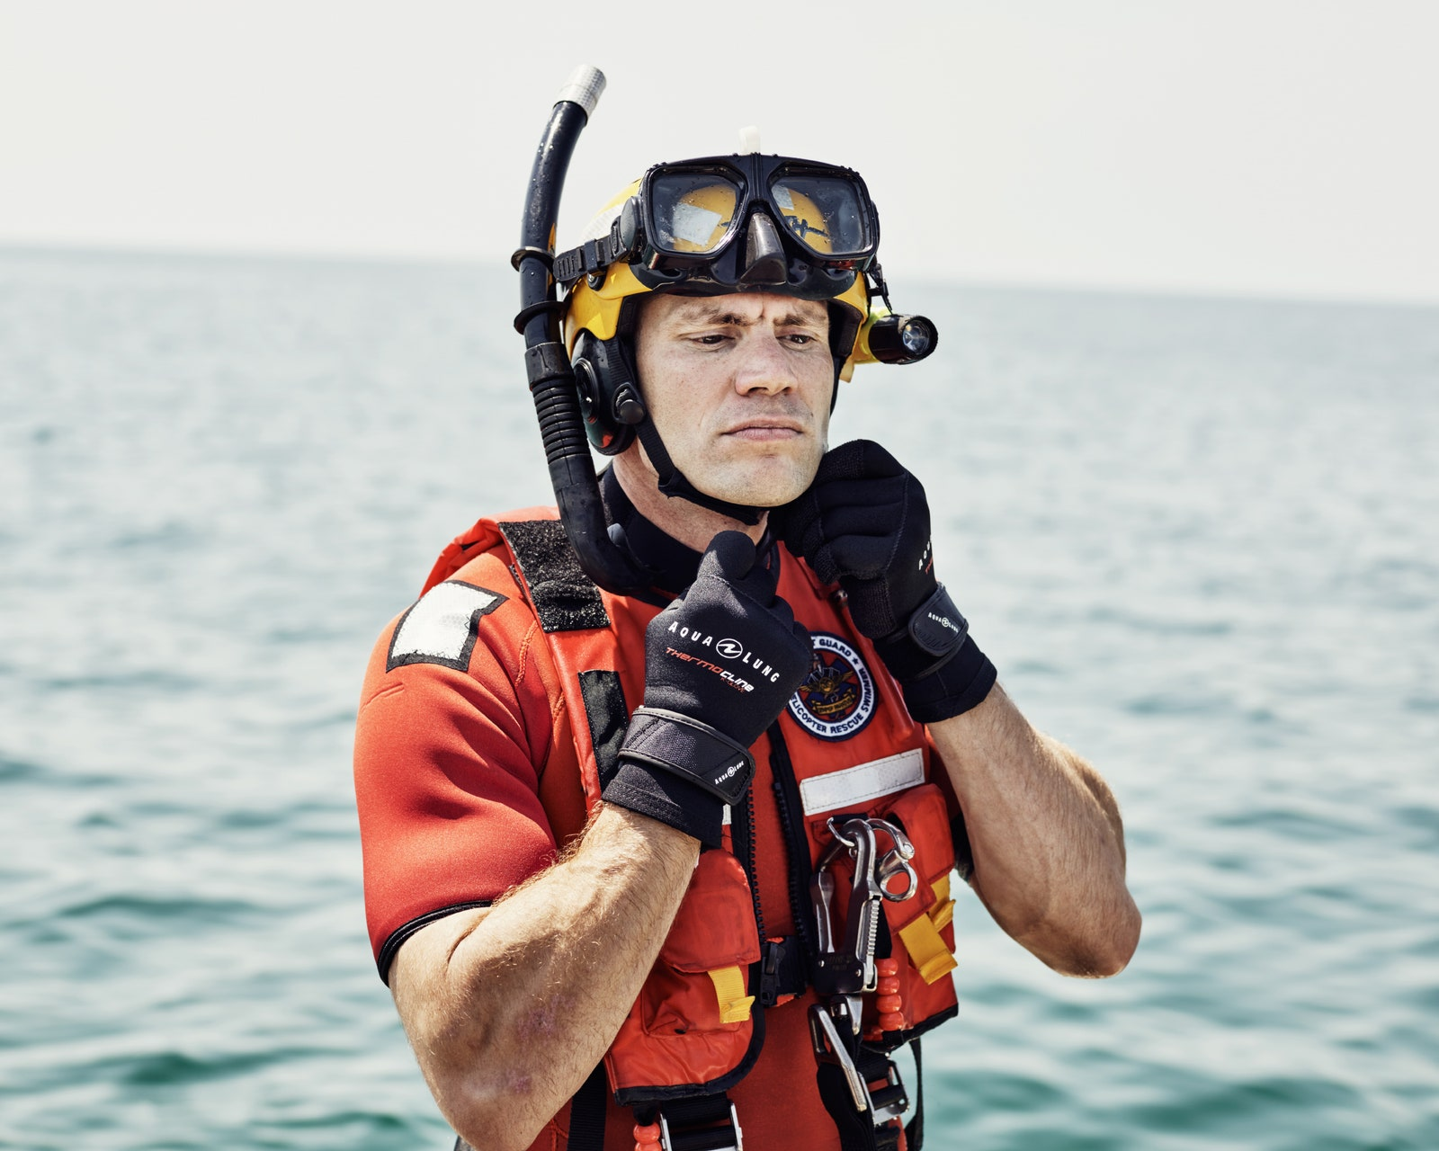
RESCUE swimming
This may require running some distance down the beach before entering the water and using the current to help carry you right to the victim.

Slide 26
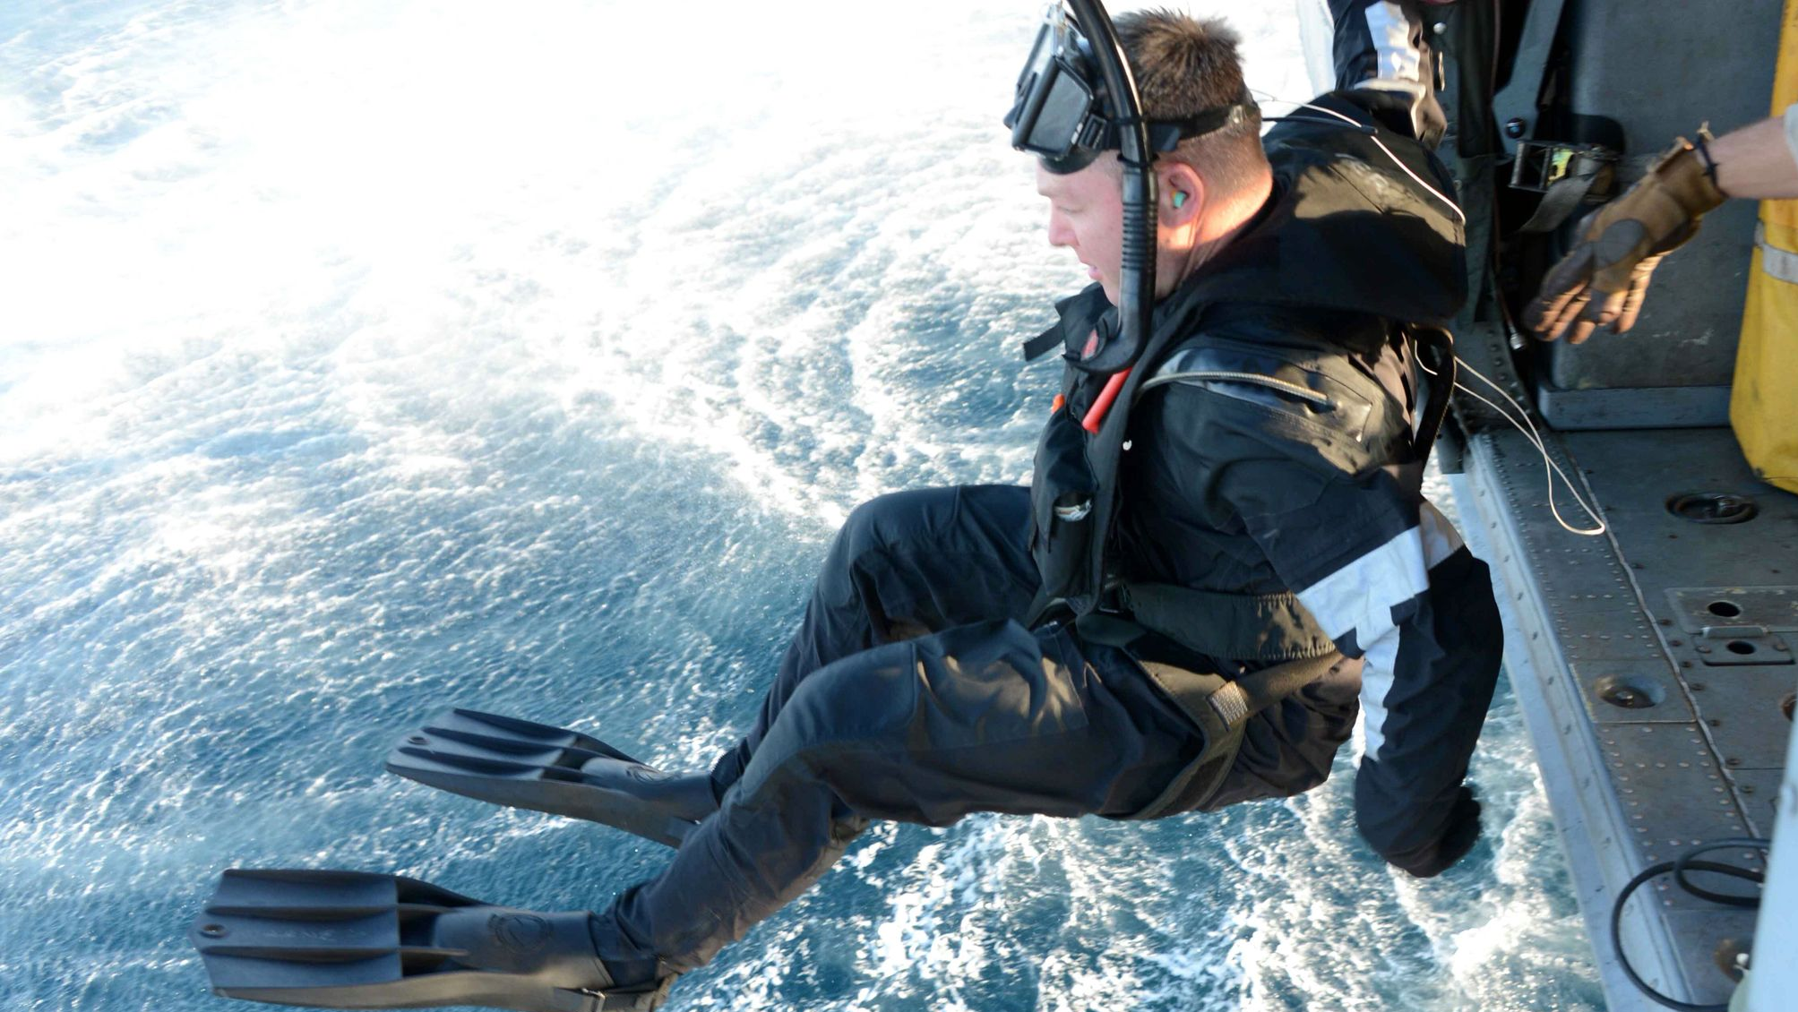
RESCUE swimming
Once in the water it is important to not lose sight of your victim.
You must keep your eyes on the victim while high-stepping, dolphin diving, and even swimming to them.

Slide 27
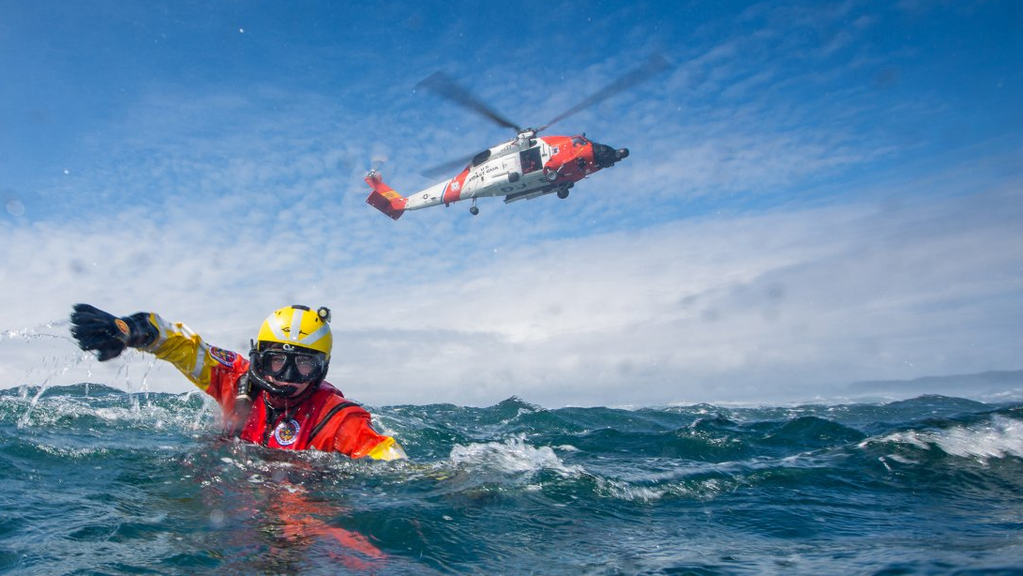
RESCUE swimming
In order to swim and keep their eyes on the victim the rescue swimmer has to modify their swimming technique.

Slide 28
RESCUE swimming
This requires you to lift your head straight up and out of the water every few strokes while swimming freestyle and searching for the victim.
Sometimes you might see them right away and sometimes it may take a few tries because waves get in the way.

Slide 29
RESCUE swimming
It is important to be fast and efficient but just as important to keep sight of the victim.
During this "Tarzan" stroke it is also important to kick hard as not to lose too much momentum while lifting your head up out of the water.

Slide 30
RESCUE swimming
This is why swimmer train and train to increase their endurance and strengthen their swimming skills.

Slide 31
SPEED TRAINING FOR RESCUE swimming
Monday: Run 1-2 miles
Tuesday: Cross Training
Wednesday: 10x200 meters
Thursday: Cross Training
Friday: 10 minutes hard run
Saturday: Run 1-2 miles
Sunday: Rest

Slide 32
SPEED TRAINING FOR RESCUE swimming
Cross-Train -This could include swimming, biking, weightlifting or yoga.
10 X 200 Meters or 1-2 Minutes - Run hard for 200 meters or up to 2 minutes, then walk or jog for the same distance/time. Repeat 10 times.
10 Minute Hard Run - Run near maximum effort for 10 minutes.

Slide 33
SPEED TRAINING FOR RESCUE swimming
training days can be moved around to fit your schedule as long as there are rest days or cross train days in between run days.
Jog easy before and after these workouts for proper warm-up and cool-down.

Slide 34
SWIM TRAINING
Swimming is one of the key component in a rescue swimmer arsenal for saving someone's life.
Swimming in the ocean to a distressed swimmer takes speed, strength, and endurance.

Slide 35
SWIM TRAINING
It takes many hours of practice for a rescue swimmer to get to a level of swimming that is required to pass a 500-meter swim in under 10 minutes, let alone fight waves and currents to get to a distressed swimmer and pull them to the safety of the shore.

Slide 36
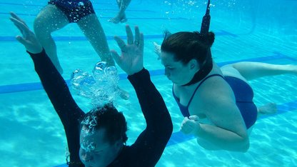
SWIM TRAINING
The key to swimming, especially in a rescue, is efficiency.
A rescuer who can save energy with proper swimming technique is going to be able to swim farther and faster and have the energy to bring a victim safely back to shore.

Slide 37
Swim Practice
If you find the main set challenging, then swim one 500 free instead of two, or you can even break it up into 5 x 100s with no more than 20s rest between.

Slide 38
Swim Practice
If it is easy, then challenge yourself to add a third and fourth 500 free to the main set and see if you can get faster each one.
Repeat this workout 3 times a week minimum and set a goal to finish all 500s under the 9:00 minute mark!

Slide 39
Swimming Workout
Dry land Stretch for 10 minutes
Warm up 200 Swim, 200 Kick, 200 Drill, 200
Swim Catch-Up Drill - swim freestyle and let one hand "catch-up" and slap the other hand before each pull.

Slide 40
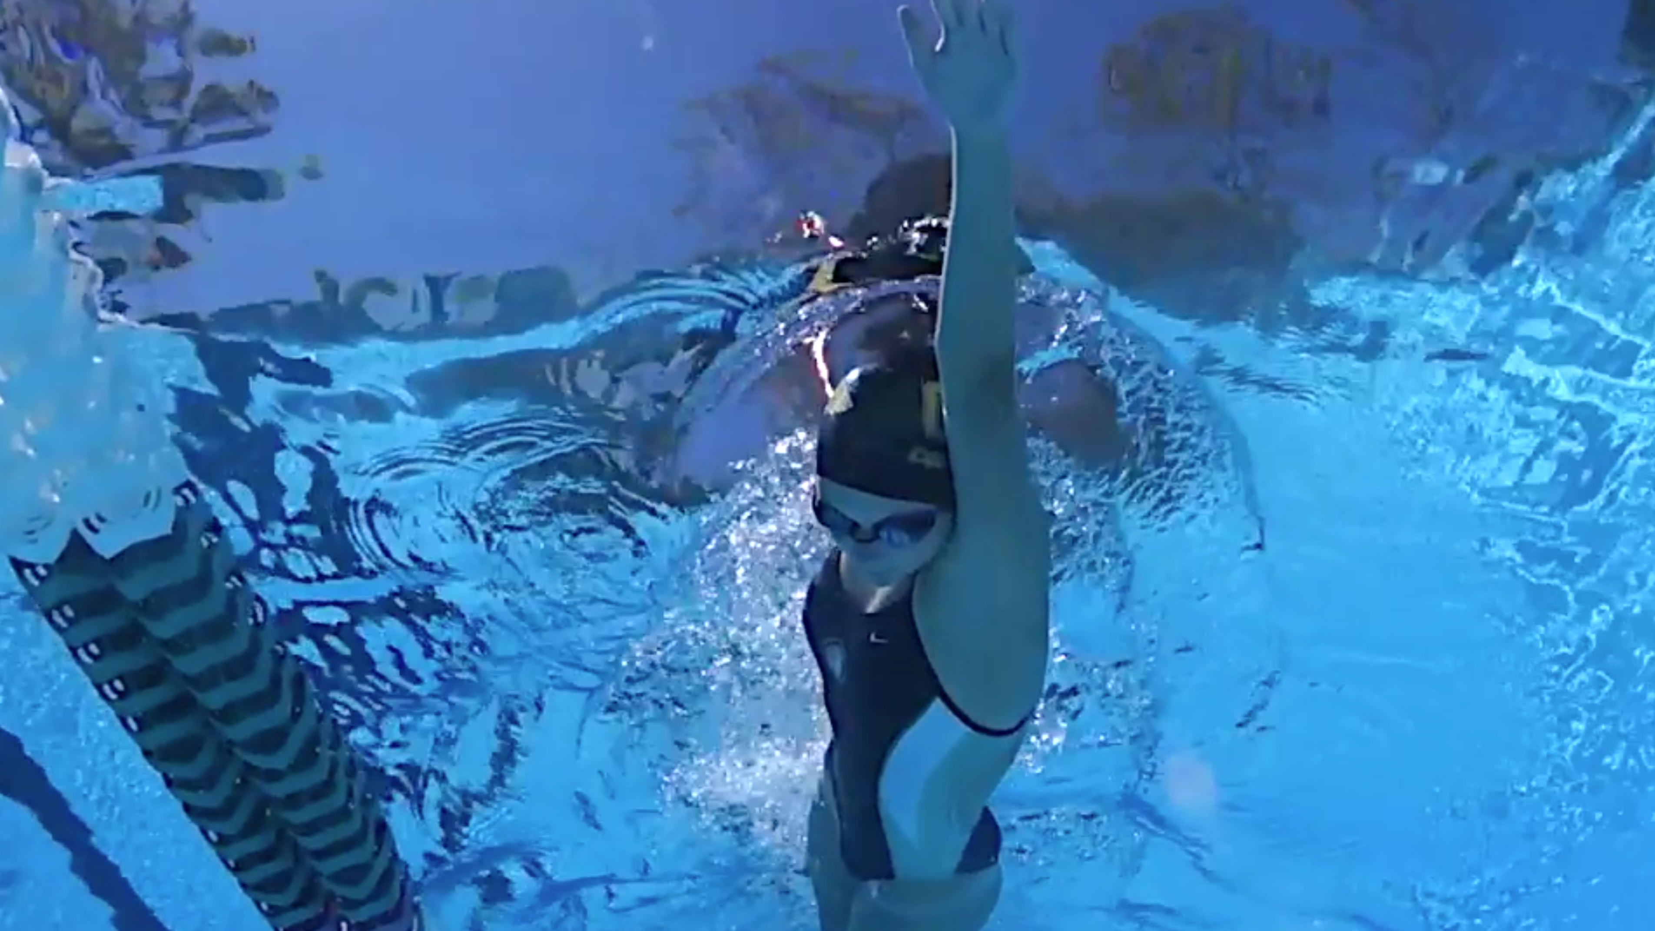
Swimming Workout
Fingertip Drag Drill - During the recovery phase of freestyle, drag your fingertips across the top of the water all the way until you start the Catch phase.

Slide 41
Swimming Workout
Pre-Set
6 x 50 Freestyle, Build 1-3 and 4-6 on 1:00minYou should get no more than 10s rest between so adjust the interval accordingly, and keep that interval for all 6.

Slide 42
Swim Practice
70% effort
80% effort
90% effort
75% effort
85% effort
95% effort

Slide 43
Swimming Workout
Main Set
2 x 500 Freestyle for time with 1:00min rest between 500s.
Build each 100 within the 500.

Slide 44
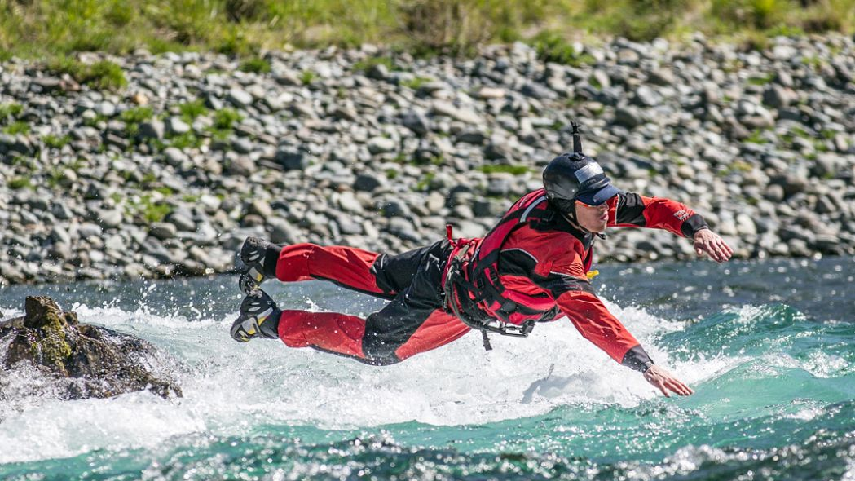
Swimming Workout
Main Set
Keep strokes long and strong and maintain a good kick throughout each 500.
On #2 try to beat your time from #1!

Slide 45
Swim Practice
Warm Down
200 Freestyle slow and easyIf your heart rate is still elevated, then swim a 2nd 200 Easy Free.
Total= 2300

