Slide 1
Lost in the Wilderness

Slide 2
Setting the Stage
You are on a trip to Alaska to visit an old friend. From Chicago to Anchorage you are the only passenger in a small, three man plane. Midway through the flight something goes wrong--your plane crashes! The pilot dies and you are left all alone in the mountains of Canada.

Slide 3
Questions : You only brought 3 items with you on your trip. After the crash you can only find one of them. Of the three, which would you most like to have, and why?
Matches
A knife
Your sleeping bag

Slide 4
Questions : Just before the plane crashed the pilot swerved left, then right, then left again. You have no idea where you’ve landed, or which way you need to go. Would you guess a direction and try to walk your way out? Or would you sit still and wait for help to come?

Slide 5
Questions : Being alone in the wilderness raises lots of concerns. You’ll need food, water, and shelter until the rescuers arrive. Of these three, which need is the most urgent? In what order would you look to satisfy them?

Slide 6
Questions : What people/things from home would you miss the most while you were lost?

Slide 7
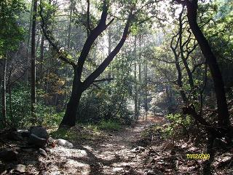
Survival

Slide 8
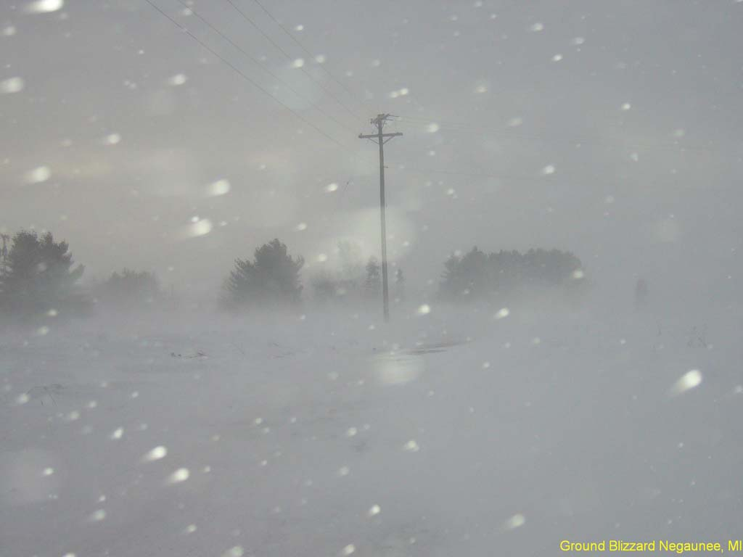
–1983 Thanksgiving storm.
88 people died. (2/hour)
How did they die??

Slide 9
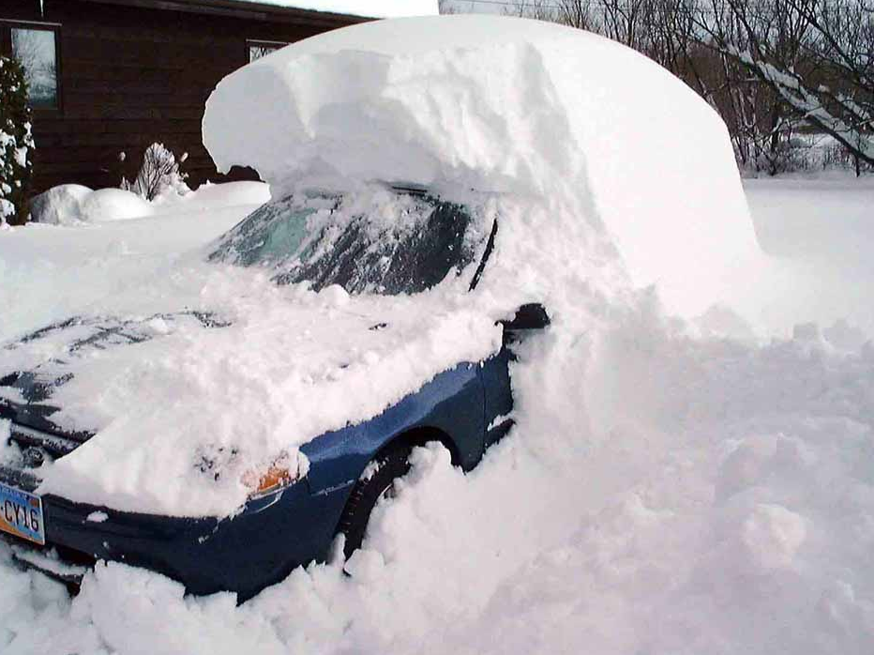
–85 % from Carbon Monoxide
–Allow vehicle to become covered with snow. Snow doesn’t get below 26-28
Degrees F.

Slide 10
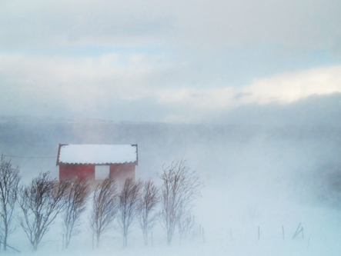
–95 % of Wilderness Deaths in Northern Climates are caused by Hypothermia!
–In the past 10 years the outdoor death rate has more than doubled.

Slide 11
Survival Is:
10 % Skill
10 % Equipment
80 % Positive Mental Attitude

Slide 12
Survival Is:
Personal
Seasonal
Geographical

Slide 13
Getting Lost:
–87 % of All people who become lost or stranded will panic to some degree!

Slide 14
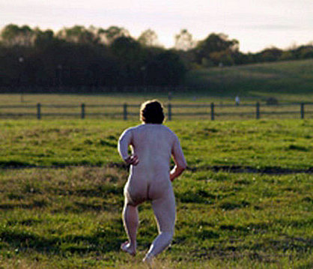
– 50 % of these people will run until they
drop from exhaustation

Slide 15
–Every time you pass a fork in the trail go past, stop and look back

Slide 16
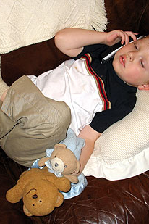
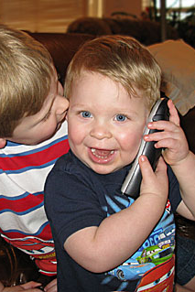
–Let someone know where you are going and when you’ll be back.

Slide 17
–If you become Lost:

Slide 18
S.T.O.P.
Stop
Think
Observe
Plan

Slide 19
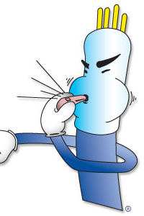
Stop, sit down Look around 2) Blow whistle

Slide 20
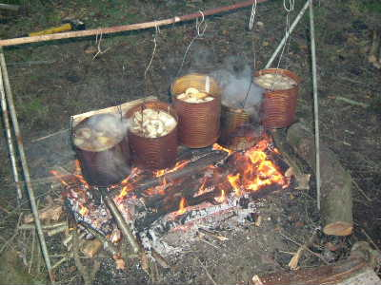
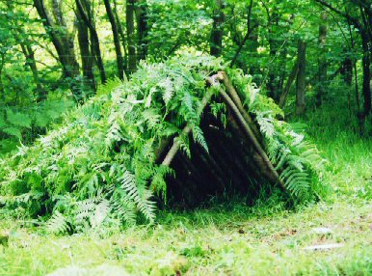
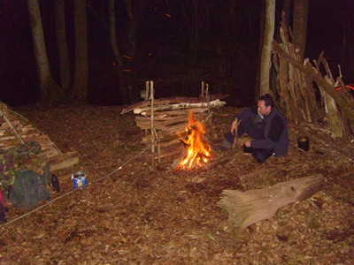
Priorities
Medical Care
Shelter & fire
Signal
Water and sustenance

Slide 21
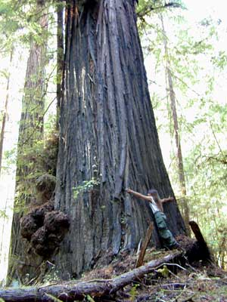
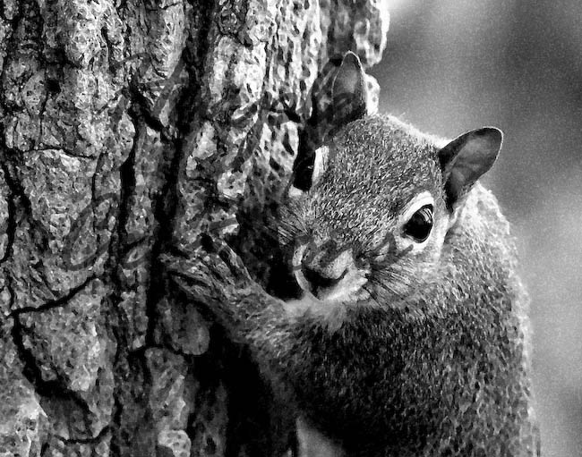
Before Dark:
1) Find a big tree with low branches
2) Hug the down wind side
3) Stay Put!

Slide 22
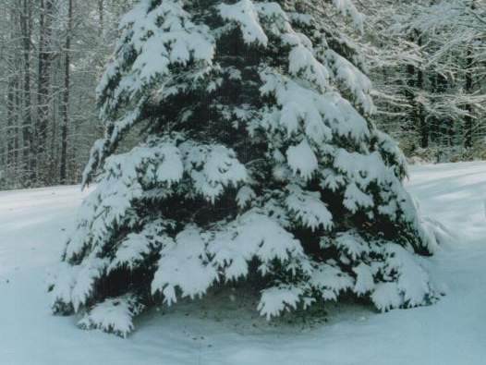

Slide 23
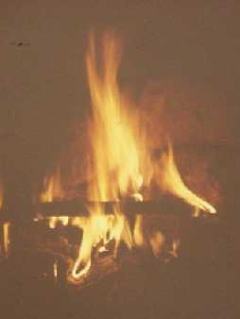
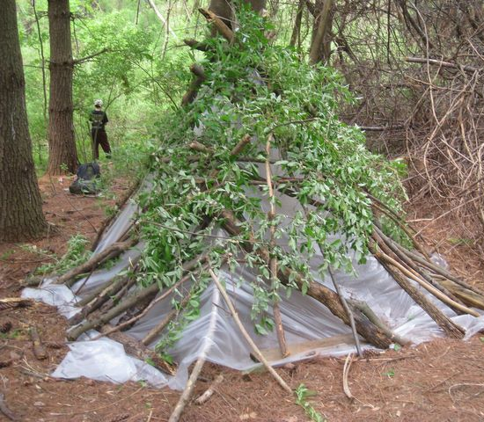
–3 requirements for surviving the night :
1) shelter
2) Fire
3) Signal

Slide 24
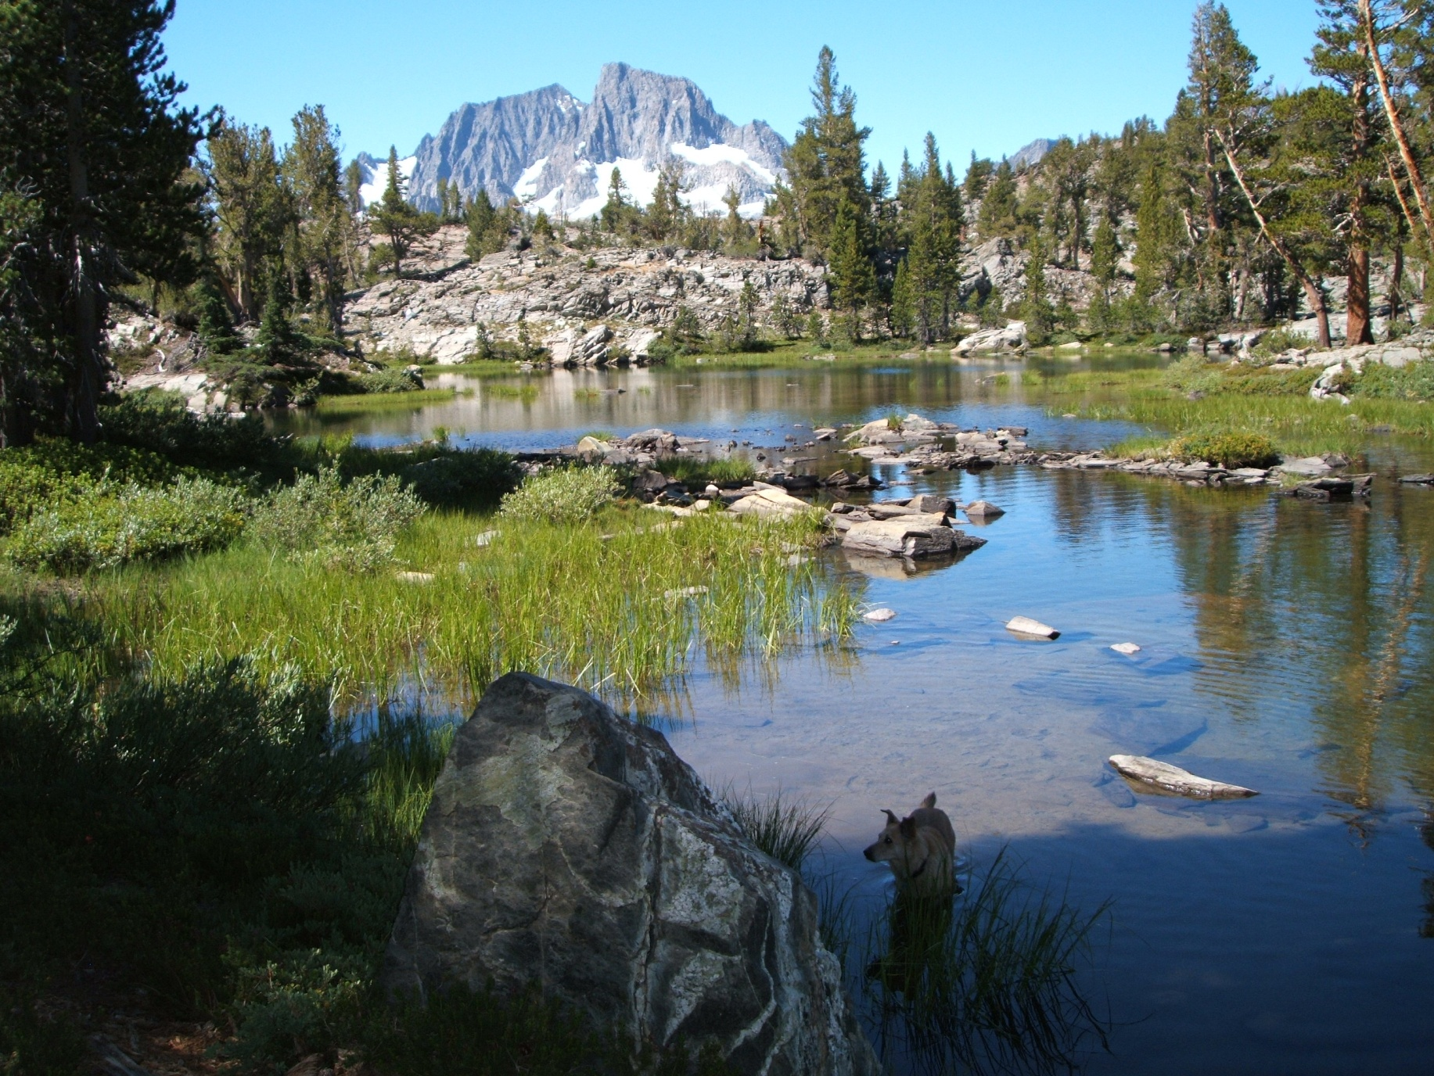
6 Priorities of Life:

Slide 25
1) Shelter:

Slide 26
2) Fire:

Slide 27
3) Be Where You Are: S.T.O.P.

Slide 28
4) Water:

Slide 29
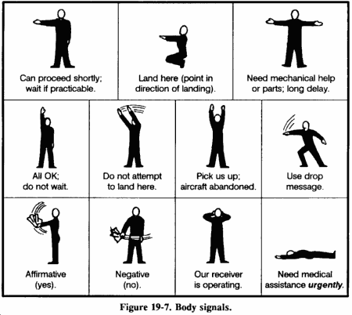
5) Signal:

Slide 30
6) Food:

