Slide 1

The rescue company 1
Helicopter Swiftwater Rescue

Slide 2
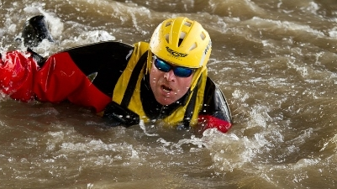
Wading, Swimming, and Crossings

Slide 3

Crossing Techniques
Line Crossing
Diagonal Traverse

Slide 4
Line Crossing
A static line is stretched across the moving water.
It is tied off to a tree or rock on either or both sides.
If belayers are used, a sitting belay should be used.

Slide 5
Line Crossing
Normally, the belayer is backed up.
The backup emphasizes pushing down on the belayer to prevent them from sliding into the water.

Slide 6
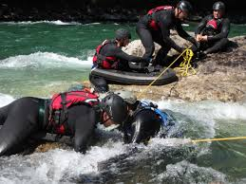
Line Crossing
It is not uncommon to tie or carabiner two throw bags together to reach across the moving water.

Slide 7
Line Crossing
The purpose of the rope is to provide stability. In a sense, it provides triangulation between the rope and the wader's two feet.
The trick for the wader is to provide moderate tension on the line.
No tension results in instability.

Slide 8
Line Crossing
As with the other wading techniques avoid crossing the legs when moving.
Move the right foot close to the left foot.
Move the left foot and then move the right foot close to the left foot again.

Slide 9
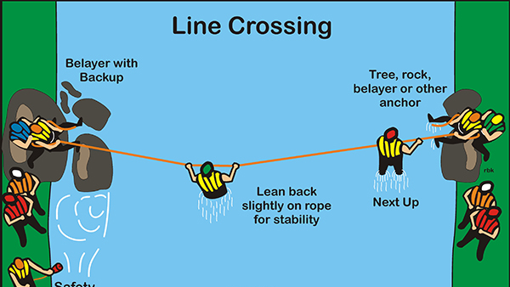

Slide 10
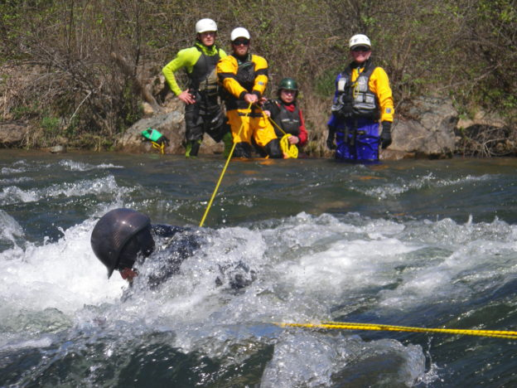
Diagonal Traverse
In contrast to the line crossing, the diagonal traverse is designed to place the line across a stretch of river at a sufficient angle to the current

Slide 11
Diagonal Traverse
to allow the current to vector or move the swimmer across the moving water.
It utilizes the same principle as ferrying.

Slide 12
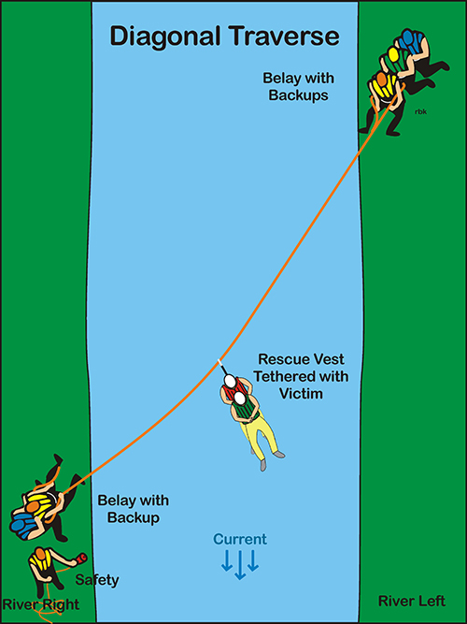

Slide 13
Setting Up of Line
It is necessary to get the line across the river.
It can be thrown.
A swimmer can swim it across.
Boater can tow it across.

Slide 14
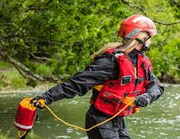
Throw
The first approach to setting up a line across moving water is to throw the rope to someone on the other side.
As a general rule, the higher the thrower's elevation, the further the throw bag can be thrown.

Slide 15
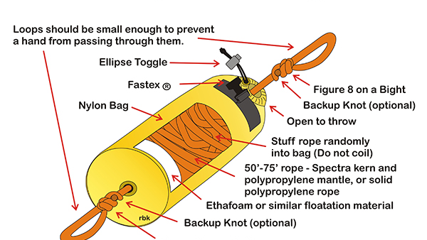

Slide 16
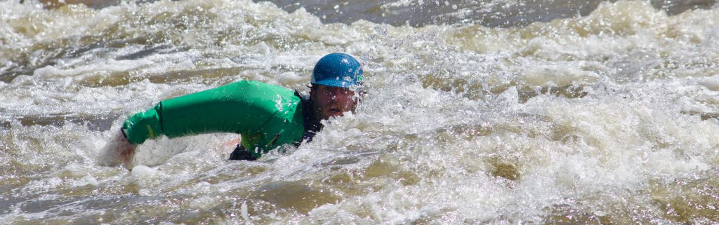
swimming the line
The line is clipped into the rescue vest's quick release tether with a carabiner.
Do not tie the line directly to the swimmer.

Slide 17
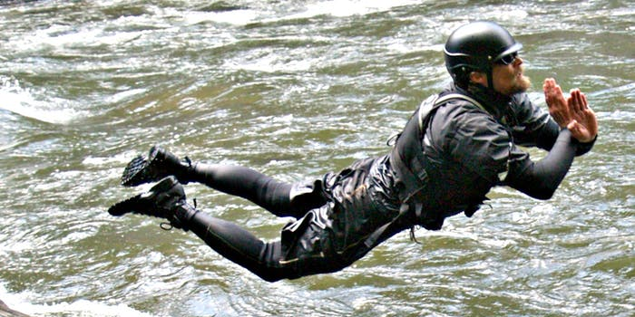
swimming the line
The swimmer enters the water with a rescue dive (i.e. a belly flop with hands guarding the face).

Slide 18
swimming the line
Using aggressive swimming, the swimmer aggressively swims to the other shore.
An important tip for the person feeding out the line is to let the line drift in the current.

Slide 19
swimming the line
This reduces drag on the swimmer.
Slack can be removed from the line once the swimmer is on the other side.
Clipping another throw bag into the line extends the line.

Slide 20
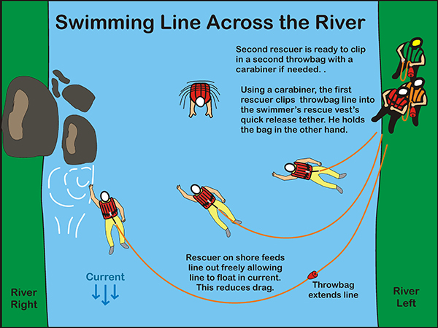

Slide 21
Using Boat to deploy line
A boater can ferry the line across the moving water.
The same principles used for the swimmer apply to the boater.

Slide 22
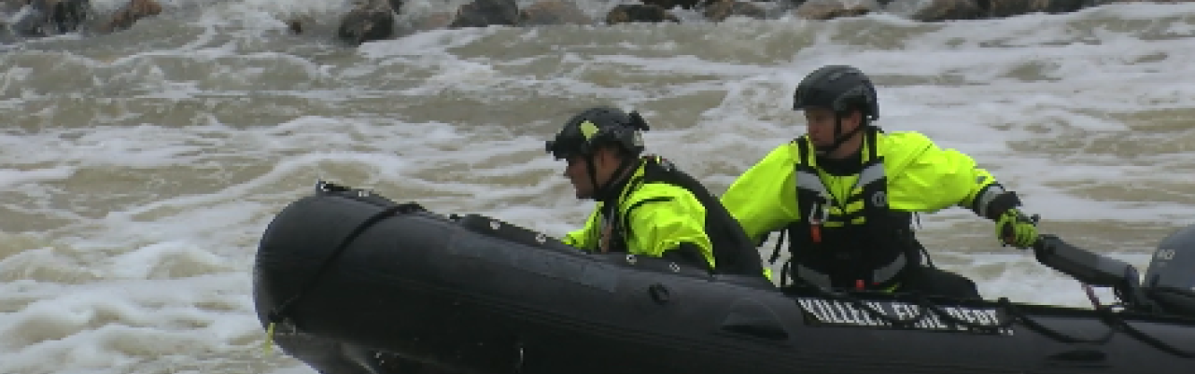
Using Boat to deploy line
Do not tie the line to either paddler or boat. Use the detachable tether on the rescue vest.

Slide 23
