Slide 1
The rescue company 1

Slide 2
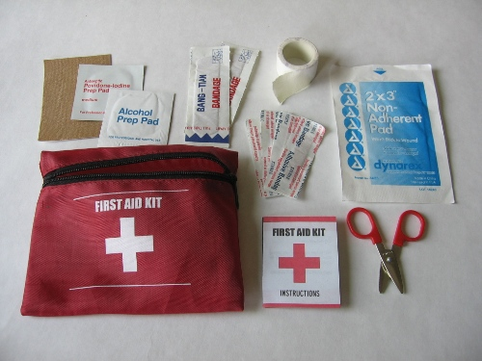
First Aid SURVIVAL MEDICINE

Slide 3
Immediate First Aid Actions Note
Immediate First Aid Actions Note: Following assessment and control of patient's airway
The next important step is to look for and control severe bleeding injuries.

Slide 4
Immediate First Aid Actions Note
Determine responsiveness.
If unconscious, arouse by shaking gently and shouting.
If no response:
Keep head and neck aligned with body.
Roll victim onto back.
Airway: Open airway.

Slide 5
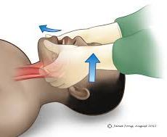
Note
If spinal injuries are suspected use the jaw thrust method

Slide 6
Breathing
Look, listen, and feel for air exchange for 3 to 5 seconds.
If victim is not breathing:
Check for a clear airway; remove any blockage.
Cover victim's mouth with your own.
Pinch victim's nostrils closed.
Fill victim's lungs with two slow breaths that last for 1
If no air goes in reposition and try again
If no change patient condition is out of scope

Slide 7
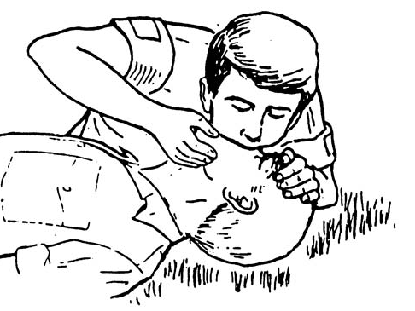
Breathing
If victim is unconscious but breathing:
Keep head and neck aligned with body.

Slide 8
Breathing other
Roll victim on side (drains the mouth and prevents the tongue from blocking airway).

Slide 9
bleeding
Stop bleeding using conventional methods
Direct pressure
Elevation
Pressure points

Slide 10
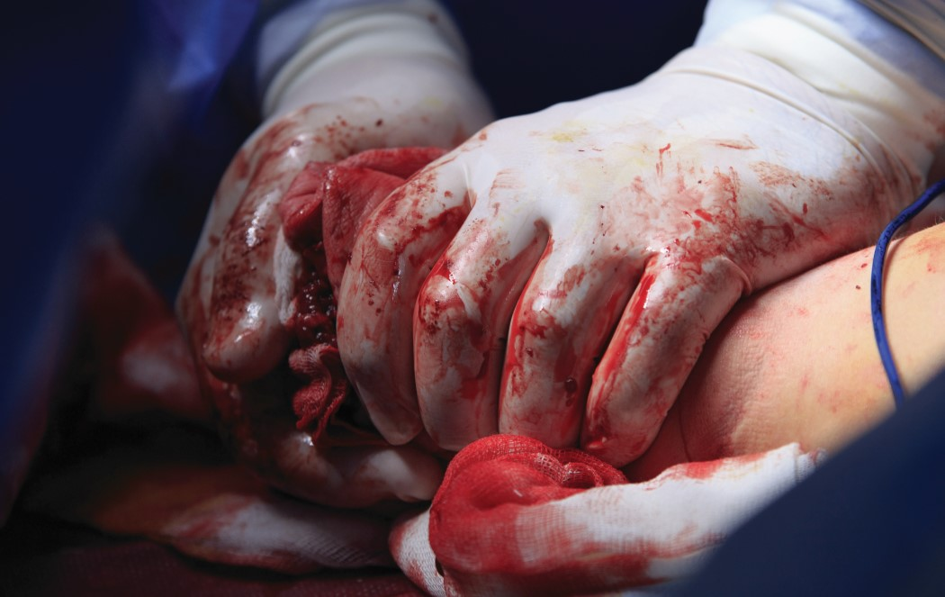
CAUTION
Use a tourniquet when severe, uncontrolled bleeding will cause loss of life

Slide 11
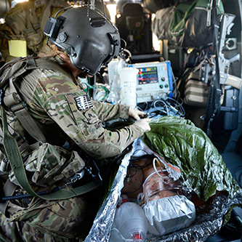
bleeding
Wrap wound with compression bandage. If no compression bandage is available, hold pressure with gauze or available bandage.

Slide 12
bleeding
If bleeding is still uncontrolled with conventional methods, apply a
Combat-Application-Tourniquet or
Improvised tourniquet (a band at least 3 inches or wider is best) just above bleeding site on limb.

Slide 13
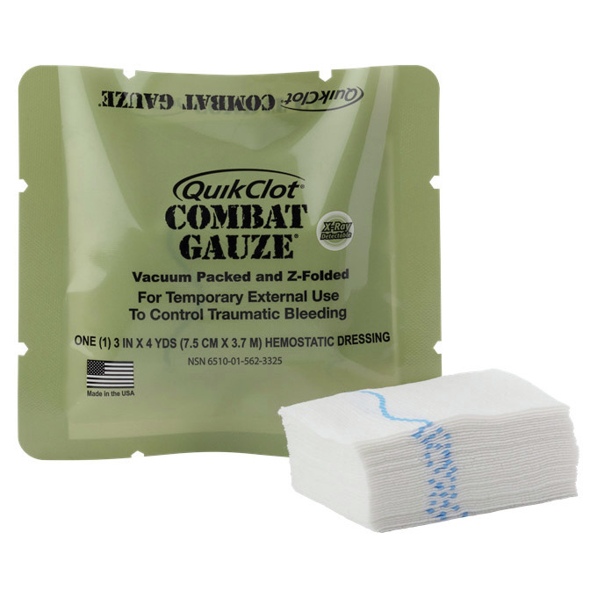
bleeding
If bleeding continues after applying a tourniquet, apply QuikClot.

Slide 14
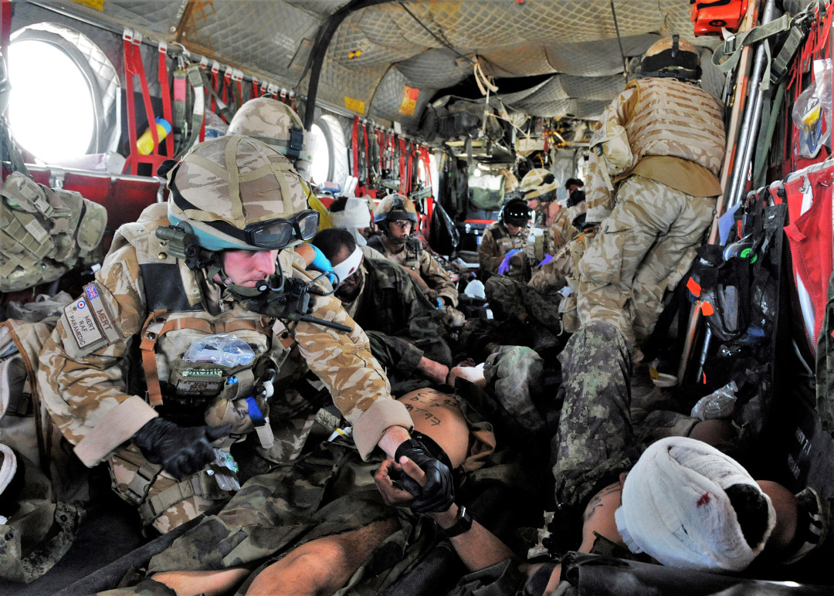
QuikClot
Hold pack of QuikClot away from your face and tear open.
Remove pressure dressing and gauze from wound and wipe any excess pooled blood
Preserving any clots in the wound if possible.

Slide 15
QuikClot
Apply
Apply QuikClot.
Pour
Slowly pour QuikClot directly into the wound until layer of tan granules is observed.
Wipe
Immediately wipe excess that falls onto surrounding tissue
Apply
Apply firm pressure to the wound with gauze roll.
Use
Only use enough QuikClot to stop the bleeding.

Slide 16
CAUTION
When tactical situation allows
Reassess tourniquet to determine if it should be replaced with direct pressure/dressing.

Slide 17
Apply more QuikClot if bleeding does not stop
Reapply pressure.
pressure for 3 minutes, and then apply a pressure dressing.

Slide 18
Apply more QuikClot if bleeding does not stop
Apply
If situation does not allow for manual pressure, apply pressure dressing directly over the roll of gauze.
Pack
Pack wound with the gauze roll.
Apply
Apply manual Treat shock.

Slide 19
Identify by one or more of the following
Pale, cool, and sweaty skin.
Fast breathing and weak, fast pulse.
Anxiety or mental confusion.
Blood loss.

Slide 20
Identify by one or more of the following
Treat
Treat underlying injury.
Maintain
Maintain normal body temperature.
Remove
Remove wet clothing.
Give
Give fluids.

Slide 21
Identify by one or more of the following
DO NOT give fluids to an unconscious victim.
DO NOT give fluids if they cause victim to gag.

Slide 22
Identify by one or more of the following
Insulate
Insulate from ground.
Shelter
Shelter from elements.
Place
Place conscious victim on side.
Allow
Allow mouth to drain.
Prevent
Prevent tongue from blocking airway.

Slide 23
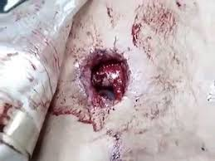
Treat chest injuries
Sucking Chest Wound.
This occurs when chest wall is penetrated; may cause victim to gasp for breath; may cause sucking sound; may create bloody froth as air escapes chest.

Slide 24
Treat chest injuries
Expose wound and immediately seal wound with airtight material (e.g., candy wrapper, plastic bag, bandage wrapper, etc.).

Slide 25
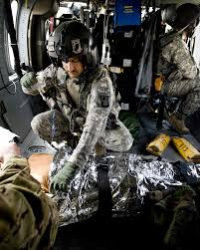
chest injuries Monitor breathing and check dressing
If victim develops trouble breathing
Lift side of dressing to allow trapped air to escape and immediately reseal.
Position casualty on injured side or in a sitting position, whichever makes breathing easier.

Slide 26
chest injuries Fractured Ribs
Stabilize
Stabilize as follows:
Place
Place rolled-up clothing or bulky pad over site.
Tape
Tape pad to site.
DO NOT constrict
DO NOT constrict breathing by taping ribs.

Slide 27
Treat fractures, sprains, and dislocations.
Control bleeding.
Remove watches, jewelry, and constrictive clothing.
If fracture penetrates skin-apply dressing over wound.
If no pulse below the break, attempt to straighten limb to restore circulation.

Slide 28
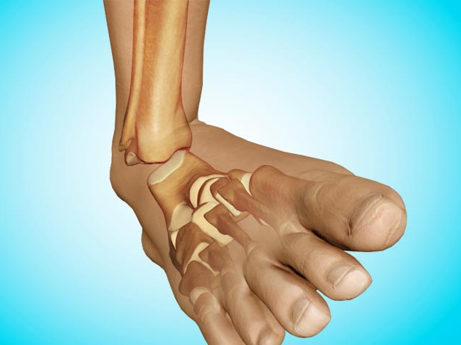
Treat fractures, sprains, and dislocations.
Position limb as normally as possible.
Splint in position in which found (if unable to straighten

Slide 29
Improvise a splint with available materials
Sticks or straight, stiff materials from equipment.
Body parts (for example, opposite leg, arm to chest).
Attach with strips of cloth at least 2-inches wide.

Slide 30
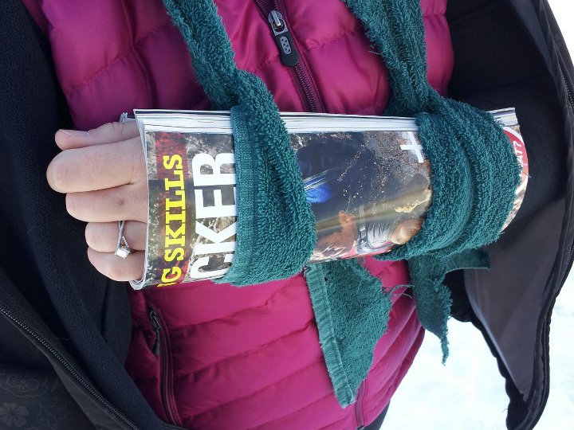
Improvise a splint with available materials
Keep fractured bones from moving by immobilizing joints on both sides of the fracture.
If fracture is in a joint, immobilize bones on both sides of joint.

Slide 31
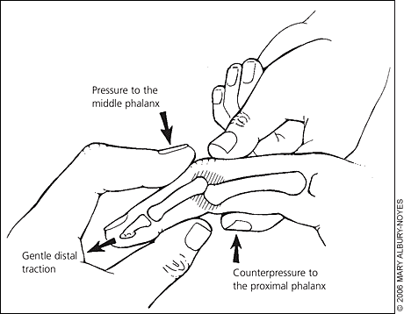
Note
Splint fingers in a slightly flexed position, NOT in straight position.

Slide 32
pms
Elevate
When resting, elevate injured area above heart level to reduce swelling.
Check
Check periodically for pulse/signs of circulation beyond the injury site.
Loosen
Loosen bandage or reapply splint if no pulse is felt or if swelling occurs because bandage is too tight.

Slide 33
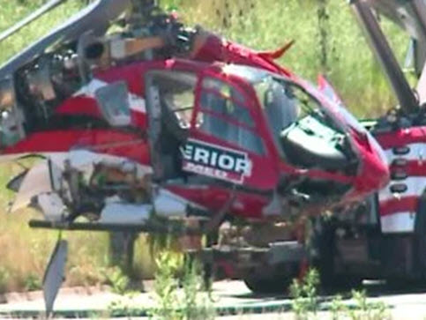
Common Injuries and Illnesses Burns
Flush burned skin for chemicals and irritants.
Cool burned area with water.
Use immersion or cool compresses.
Avoid aggressive cooling with ice or frigid water.

Slide 34
Common Injuries and Illnesses Burns
Remove
Remove watches, jewelry, constrictive clothing.
Cover
Cover with dry sterile dressings.
DO NOT use
DO NOT use lotion or grease.

Slide 35
Common Injuries and Illnesses Burns
Drink
Drink extra water to compensate for increased fluid loss from burns.
Add
(Add 1/4 teaspoon of salt and 1/4 teaspoon of sugar [if available] to each quart of water.)
Change
Change dressings when soaked or dirty

Slide 36
Eye injuries
Sun/snow
Sun/snow blindness (gritty, burning sensation, and possible reduction in vision caused by sun exposure):
Prevent
Prevent with improvised goggles
Treat
Treat affected area with cool compress.

Slide 37
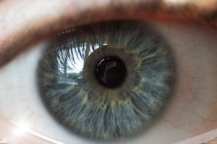
Eye injuries Foreign body in eye
Irrigate with clean water from inside to outside corner of eye.

Slide 38
Eye injuries Foreign body in eye If foreign body is not removed by irrigation
Improvise a small swab.
Moisten and wipe gently over affected area.
If there is a foreign object in the eye - both eyes should be bandaged.

Slide 39
Heat injury Heat cramps
Cramps in legs or abdomen
Rest in cool or shady area.
Slowly sip one quart of water.
Add 1 /4 teaspoon of salt per quart.

Slide 40
Heat injury Heat exhaustion
Heat
Heat exhaustion (pale, sweating, moist, cool skin):
Rest in
Rest in shade.
Sip
Slowly sip one quart of water.
Protect
Protect from further heat exposure.

Slide 41
Heat injury Heat stroke
Victim disoriented or unconscious, skin is hot and flushed (sweating may or may not occur), fast pulse

Slide 42
Heat injury Heat stroke
Cool
Cool as rapidly as possible (saturate clothing with water and fan victim).
Remember
Remember to cool the groin and armpit areas. Cooling may be facilitated by pouring water on the head and back of neck (avoid overcooling).
Maintain
Maintain airway, breathing, and circulation.

Slide 43
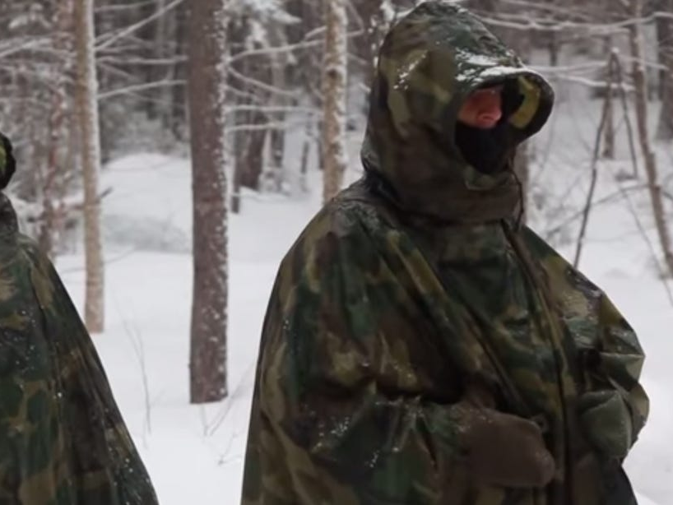
Cold injuries Frostbite
Signs and symptoms.
Ears, nose, fingers, and toes are affected first.
Areas will feel cold and may tingle leading to numbness
That progresses to a waxy appearance with stiff skin that cannot glide freely over a joint.

Slide 44
Cold injuries Hypothermia
Hypothermia [fumble, mumble, stumble].
It is a progressive injury.
Intense shivering.
Altered mental state, difficulty speaking.

Slide 46
Cold injuries Hypothermia
Impaired ability to perform complex tasks.
Muscular rigidity with blue, puffy skin; jerky
Coma, respiratory and cardiac failure.

Slide 47
Cold injuries Hypothermia Protect victim as follows
Remove
Remove wet clothing and put on dry clothing.
Prevent
Prevent further heat loss.
Cover
Cover top of head and back of neck.
Insulate
Insulate from above and below.
Warm
Warm with blankets, sleeping bags, warm fluids, or shelter.

Slide 48
Cold injuries Hypothermia Protect victim as follows
Warm body core before extremities.
Skin-to-skin contact.
Place heat packs at groin, armpits, and around avoid causing burns to skin.

Slide 49
Cold injuries Hypothermia Protect victim as follows
Dry
Dry socks and shoes.
Keep
Keep feet protected.
Loosen
Loosen clothing and boots to improve circulation.
Keep
Keep area dry, warm, and open to air.

Slide 50
CAUTION
Handle hypothermia victim gently.
Avoid overly rapid re-warming, which may cause cardiac arrest.

Slide 51
Re­warm victim
Skin-to-skin contact by volunteer(s) inside a sleeping bag/shelter.
Pat dry; DO NOT rub.
Skin tissue will be sensitive.

Slide 52
Skin tissue damage
Immersion injuries (skin becomes wrinkled):
Avoid walking on affected feet.

Slide 53
Saltwater sores
Change
Change body positions frequently.
Keep
Keep sores dry.
Use
Use antiseptic (if available).
DO NOT open or squeeze
DO NOT open or squeeze sores.

Slide 54
Snakebite
Treat
Treat all snakebites as poisonous.
Remove
Remove watches, rings, boots, and other constricting items on the affected limb.
Minimize
Minimize activity and limit movement to prevent spread of venom.

Slide 55
Snakebite DO NOT
Cut bite site
Use mouth to create suction.

Slide 56
Snakebite
Bite
Clean bite with soap and water; cover with a dressing.
Splint
Splint bitten extremity to prevent motion (constantly check
Treat
Treat for shock.
Force
For conscious victims, force fluids.

Slide 57
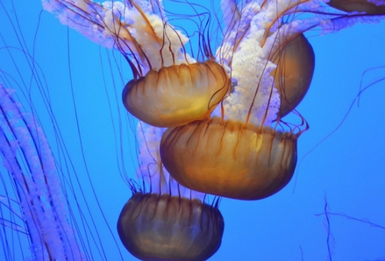
Marine life Stings
Flush wound with salt water (fresh water stimulates toxin release).
Urine may be used to flush area in a survival situation.

Slide 59
Marine life Stings
Remove
Remove jewelry and watches.
Remove
Remove tentacles and gently scrape or shave skin.
DO NOT rub
DO NOT rub area with sand.
Treat
Treat for shock.

Slide 60
Skin irritants (includes poison oak and poison ivy)
Wash with large amounts of water. Use soap, if available.
Keep covered to prevent scratching.

Slide 61
Infection
Keep wound clean.
Change bandages, as needed.

Slide 62
Dysentery and diarrhea
Drink
Drink extra water.
Eat
Eat charcoal.
Make
Make a paste by mixing fine charcoal particles with water. (It may relieve symptoms by absorbing toxins.)

Slide 63
Dysentery and diarrhea
Constipation (can be expected in survival situations).
Drink extra water.

Slide 64
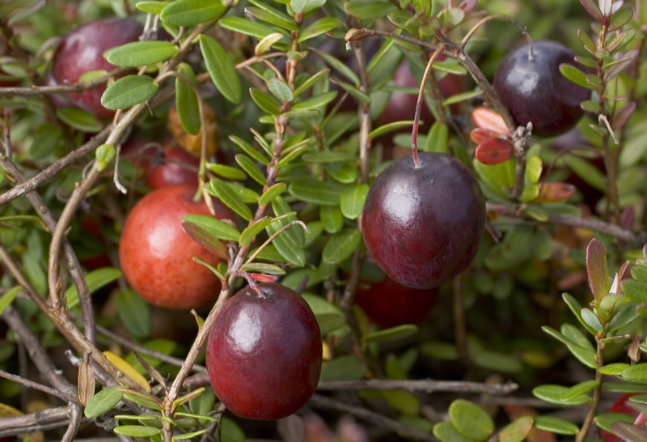
Plant Medicine Tannin
Prevents infection and aids healing.
Use to treat burns and skin problems and for parasites, diarrhea, and dysentery.

Slide 65
Plant Medicine Tannin Sources
Found in outer bark of all trees
Acorns
Banana plants
Common plantain
Strawberry leaves
Blackberry stems.

Slide 66
Plant Medicine Tannin Preparation
Brew
Brew tannin tea
Place
Place crushed source
Leach out
Leach out tannin by soaking or boiling.
Increase
Increase tannin content by longer soaking time.
Replace
Replace depleted material with fresh bark/plants.

Slide 67
Plant Medicine Tannin Treatments Burns
Moisten bandage with cooled tannin tea.
Apply compress to burned area.
Pour cooled tea on burned areas to ease pain.

Slide 68
Plant Medicine Tannin Treatments Diarrhea, dysentery, and worms
Drink strong tea

Slide 69
Plant Medicine Tannin Treatments Skin problems
Skin problems (dry rashes and fungal infections).
Apply cool compresses or soak affected part to relieve itching and promote healing.
Lice and insect bites.
Wash affected areas with tea to ease itching

Slide 70
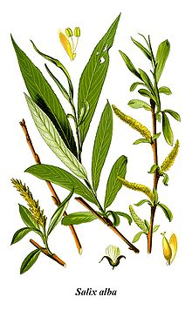
Plant Medicine Salicin/salicylic acid
Medical uses. Salicin/salicylic acid has aspirin-like qualities.
Use to treat colds, sore throat, fever, inflammation, aches, pain, and sprains.

Slide 71
Plant Medicine Salicin/salicylic acid Sources
Willow (Salix alba)
Aspen (Populus tremula) trees

Slide 72
Plant Medicine Salicin/salicylic acid Preparation
Gather twigs, buds, or cambium layer (soft, moist layer between the outer bark and the wood) of willow or aspen.

Slide 73
Plant Medicine Salicin/salicylic acid Preparation
Brew
Brew tea following method as described in Talon
Make
Make poultice.
Crush
Crush plant or stems.
Make
Make pulpy mass.

Slide 74
Plant Medicine Salicin/salicylic acid Treatments
Chew on
Chew on twigs, buds, or cambium for symptom
Drink
Drink tea for colds and sore throat.
Use
Use warm, moist poultice for aches and sprains.
Apply
Apply pulpy mass over injury.
Hold in
Hold in place with dressing.

Slide 75
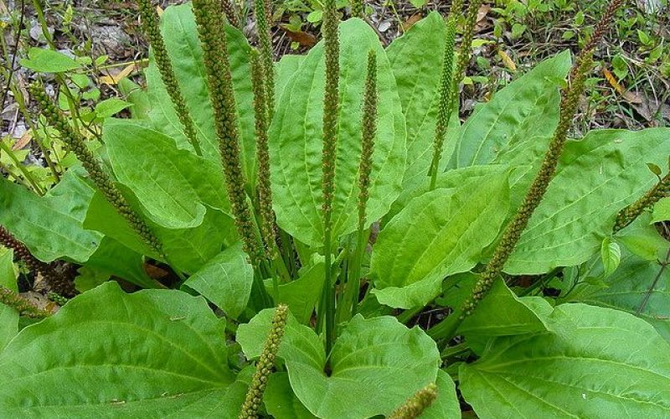
Plant Medicine Common plantain (Plantago major)
Medical uses. Use to treat itching, wounds, abrasions, stings, diarrhea, and dysentery.

Slide 76
Plant Medicine Common plantain (Plantago major)
Source. There are over 200 species in the plantain family (Plantaginaceae) with similar medicinal properties.

Slide 77
Plant Medicine Common plantain (Plantago major)
Plantago major and is common in North America.
Do not confuse this plantain with the starchy, banana-like fruit, Musa paradisiaca.

Slide 78
Plant Medicine Common plantain (Plantago major)
Preparation:
Brew tea from seeds.
Brew tea from leaves.
Make poultice of leaves.

Slide 79
Plant Medicine Common plantain (Plantago major)
Treatments:
Drink tea made from seeds for diarrhea or
Drink tea made from leaves for vitamin and minerals.
Use poultice to treat cuts, sores, burns, and stings.

Slide 80
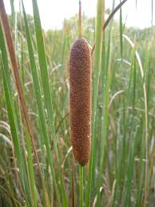
Common cattail (Typha latifolia)
Medical uses.:
Wounds, sores, boils, inflammations, burns, as well as an excellent food source. \
Source:
Cattail plants are found in marshes

Slide 81
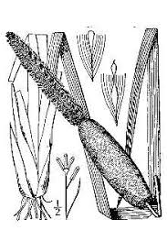
Common cattail (Typha latifolia)
Preparation:
Pound roots into pulpy mass for poultice.
Cook and eat green bloom spikes.
Collect yellow pollen for flour substitute.
Peel and eat tender shoots (raw or cooked).

Slide 82
Common cattail (Typha latifolia)
Treatments:
Apply poultice to affected area.
Use plant for food, vitamins, and minerals.

Slide 83
CAUTION
Do not confuse with the poisonous daffodil (Amaryllidaceae) and poisonous iris (Iris species) shoots, which have similar leaves.
If a stand is still topped by last year's cottony seed heads, you know you have the right plant

Slide 84
Health and Hygiene
Stay clean (daily regimen).
Prevent and control parasites:
Check body for lice, fleas, ticks, leeches, or other parasites.
.

Slide 85
Health and Hygiene
Check
Check body regularly.
Pick off
Pick off insects and eggs; DO NOT crush.
Wash
Wash clothing and use repellents.
Use
Use smoke to fumigate clothing and equipment.

Slide 86
Rules for Avoiding Illness
Purify all water obtained from natural sources by using iodine tablets or bleach
Bringing to a rolling boil for at least 10 minutes and then strain.
Avoid contaminating water source with human waste.

Slide 87
Rules for Avoiding Illness
Wash
Wash hands before preparing food or water.
Clean
Clean all eating utensils after each meal.
Prevent
Prevent insect bites by using repellent, netting, and clothing.

Slide 88
Rules for Avoiding Illness
Dry
Dry wet clothing as soon as possible.
Eat
Eat what you can.
Try
Try to rest.

Slide 89
Hypothermia
Lowering of the bodies core temperature
Hypothermia occurs when body core temperature lowers below 35°C/95°F.

Slide 90
Hypothermia
Hypothermia does NOT require temperatures below freezing to occur!
In fact more people die of hypothermia in the summer than in the winter!

Slide 91
Symptoms of Hypothermia
Stage One
Shivering, blue extremities, numbness, tingling, and blotchy skin.
Stage Two
Decreased coordination, muscle rigidity, slow breathing, and slow or irregular pulse
Stage Three
dilated and fixed pupils, absent reflexes, coma, cardiac arrest and death

Slide 92
Symptoms you may recognize as trouble:
Shivering.
Fatigue.
Stumbling.
Poor speech.
Poor orientation.
Careless attitude

Slide 93
Signs of Hypothermia trouble in your friends:
Poor coordination.
Slowing of pace.
Stumbling.
Forgetfulness.

Slide 94
Signs of Hypothermia trouble in your friends:
Thickness of Speech.
Dilation of pupils
Decreased attention.
Careless attitude.

Slide 95
Treatment
Dry
Dry the victim and cover with blankets.
Shelter
Shelter the victim from wind and water.
Provide
Provide heat to the neck, underarms, and groin

Slide 96
Treatment
Administer warm fluids only after the victim stops shivering
Avoid moving/jarring the victim suddenly because this may trigger an abnormal heart rhythm.

