Slide 1
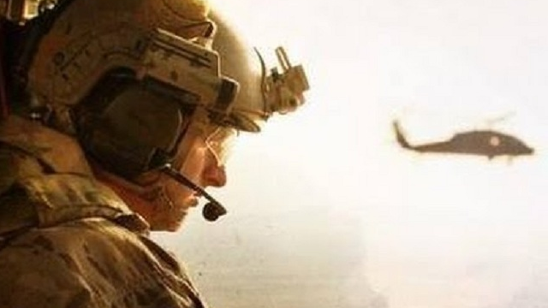
THE RESCUE COMPANY 1

Slide 2
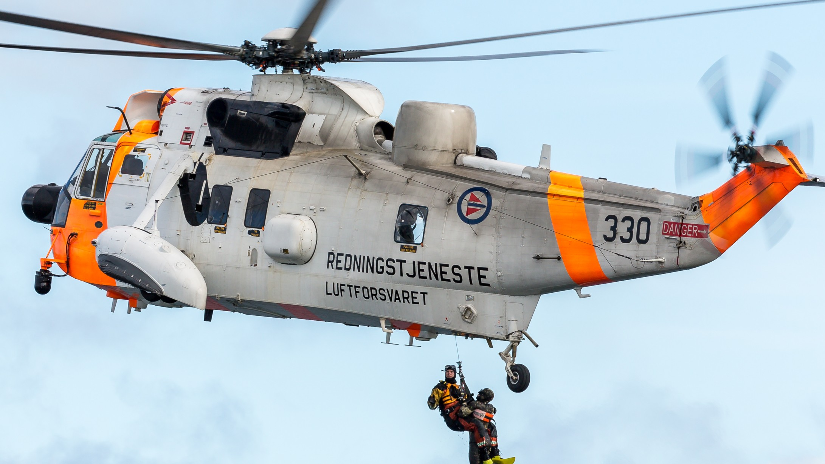
Helicopter Management and Safety Precautions

Slide 3
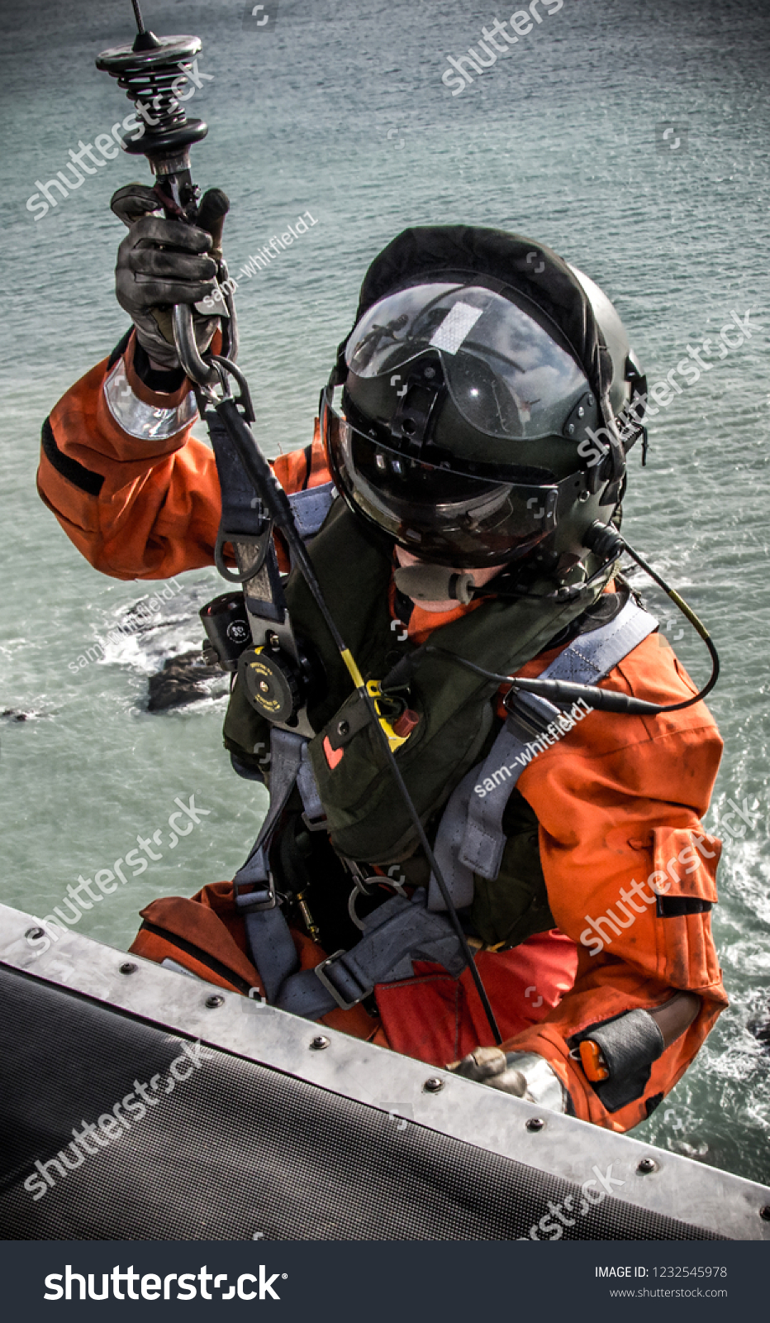
(AFRCC)
The Air Force Rescue Coordination Center (AFRCC), located at Tyndall Air Force Base, FL, serves as the single agency responsible for coordinating on-land federal SAR activities in the 48 contiguous United States while also providing SAR assistance to Mexico and Canada.
Additionally, the AFRCC will not launch a rescue helicopter for a known civilian fatality recovery. unless the ground recovery effort would place a rescue team in potential jeopardy.

Slide 4
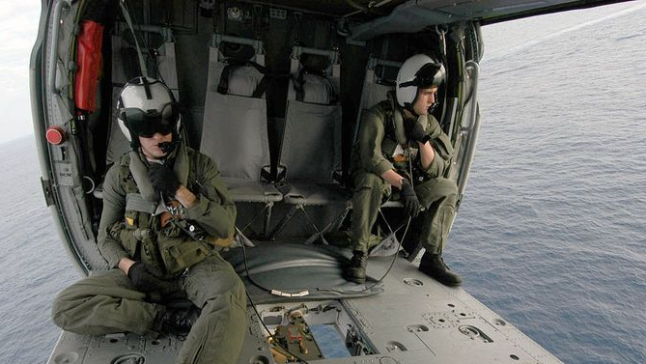
AFRCC MISSION GO/NO GO CRITERIA.
The mission coordinator determines that a valid distress or perceived distress situation exists and no legal restrictions apply (Posse Comitatus, Stafford Act, etc.) Distress is the reasonable certainty that an aircraft (or other craft) or persons is threatened by grave and imminent danger and requires immediate assistance. The mission go/no-go criteria are a threat to life, limb, eyesight, or undue suffering

Slide 5
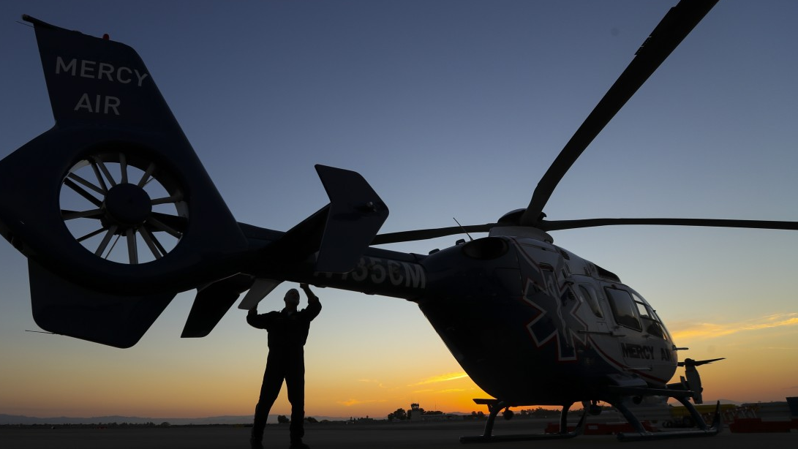
Safety training
Those overseeing helicopter operations should conduct a briefing prior to each day's operation.
The SAR team should limit helicopter flights to daylight hours whenever possible ( defined as ½ hour before sunrise to ½ hour after sunset).
personnel should remain 100 feet away from helicopters, except when loading.

Slide 6
Safety training
Helicopter hand signals should be used as needed, but only by personnel trained in the used.
No unauthorized personnel should be allowed to fly on any mission.

Slide 7
briefing
This briefing should set forth the plan of action for the pilots and the ground personnel
Review of on-the ­ground and in-the-air safety precautions.
Pertinent safety plans and flight hazard maps should be reviewed before a flight is scheduled.

Slide 8
briefing prior to the flight
Location of emergency exits.
Fire extinguishers
The emergency electrical and fuel shut-off
The emergency locator transmitter (ELT) manual switch
First aid kits and survival gear.

Slide 9
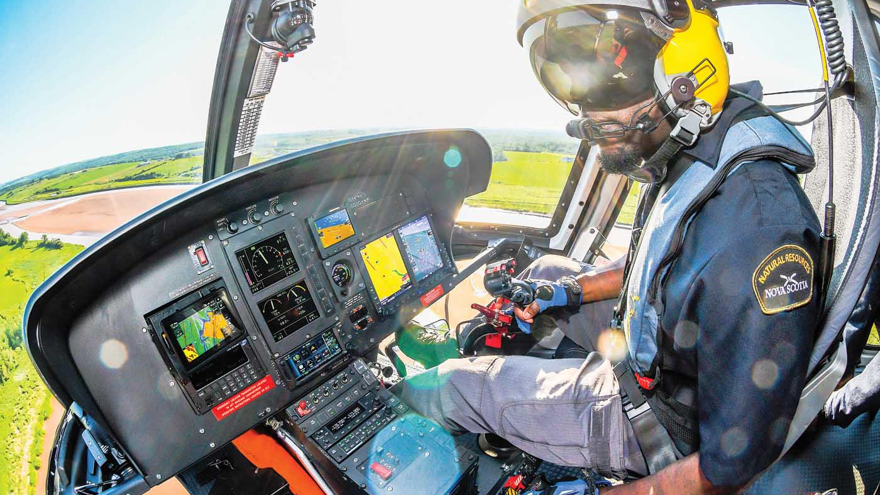
The pilot in command (PIC)
Is responsible for the safety of the helicopter at all times,
Should participate in operational planning to improve his ability to keep the machine and its occupants safe from harm.

Slide 10
The mission's leadership
must track wind velocity and visibility in any anticipated flight path and halt any mountain flight when the average wind velocity exceeds a helicopters' limitations.
Coordinate with PIC

Slide 11
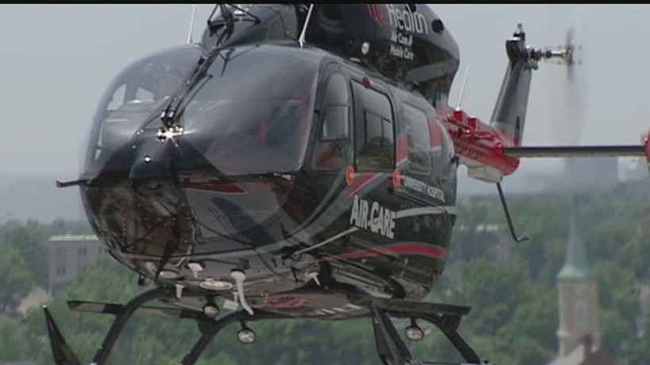
Landing Zones (lz)
Heliolaters generally will not take off or land vertically. Rather they need a landing zone.
The ideal helispot is a flat strip 100 feet wide and 300 feet long (roughly the size of a football field).
Flat ridges and saddles often provide the best helispots in the field.

Slide 12
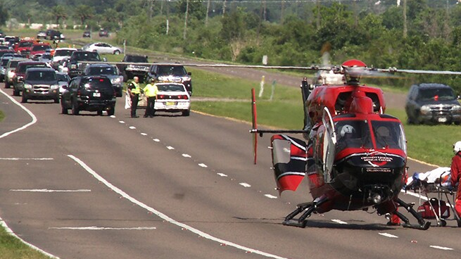
Landing Zones (lz)
Highways, streets or roads unobstructed by outlying trees can make for excellent landing zones, but their use requires that law enforcement be available to control traffic and crowds.

Slide 13
Landing Zones (lz)
A primary reason helicopters need large landing zones is to improve safety.
helicopter is more likely to experience engine failure during takeoff due to the high engine stress takeoff entails, and if it does, it will need extra room to land safely.
Helispots should be designed in such a way that the helicopter can land and take off into the wind to increase lift.

Slide 14
"Out of Ground Effect"
Helicopter performance when the ground is not close enough to allow interaction with rotor wash.
In OGE, a helicopter's hover depends entirely upon engine power, receiving no assistance from the ground.
OGE conditions can occur near the ground when the helicopter hovers over tall grass, water, and certain types of rough terrain.

Slide 15
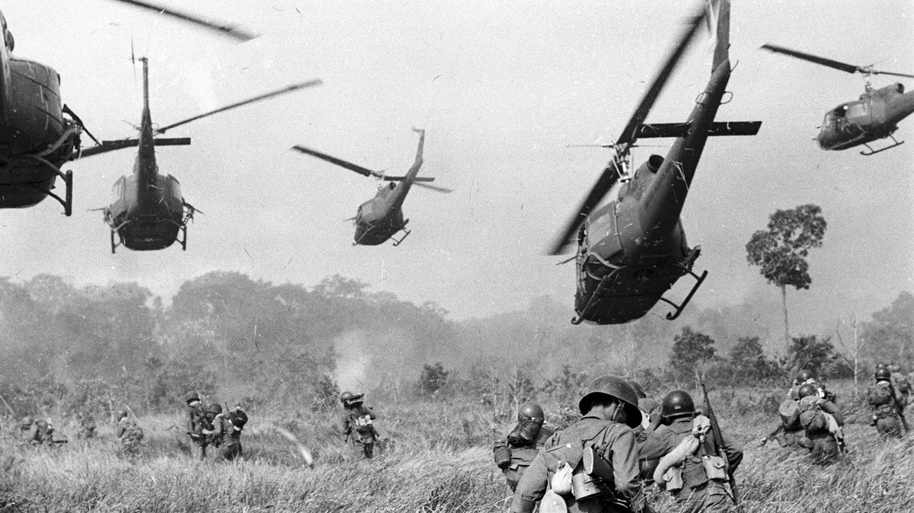
"hover hole"
landing zone where, due to its size restrictions or the presence of obstacles, the pilot must slow to a hover above the landing area and then descend to the ground
the pilot must use all available engine power, leaving little or no room for error.
SAR teams should create "hover hole" helispots only as a measure of last resort.

Slide 16
Night “lz”
consider whether the benefits of night operations outweigh their risks.
Every effort should be made to inform the pilot of the optimal flight paths to avoid hazards such as trees, peaks, ridges and especially power lines.
At night, rescuers can use headlamps to mark a helispot, provided the lamps are able to provide steady and consistent light

Slide 17
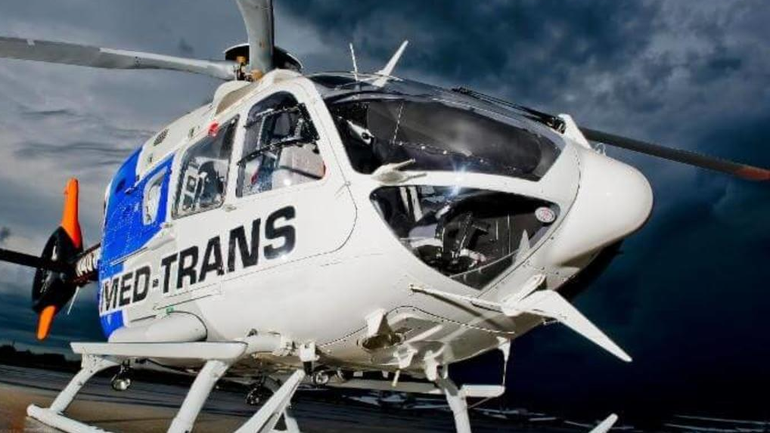
Night “lz”
Two vehicles can illuminate a helispot with headlights.
Vehicles should be positioned 40 yards downwind from and at opposing 45-degree angles to the landing site.
The helicopter will then approach between the intersection of the lights
Roughly 40 yards upwind from the vehicles.
Low beams must be used to prevent blinding the pilot or flood the instrument panel with light.

Slide 18
Weather and Nighttime Limitations
Daytime flight operations for aircraft are limited by visual flight rules (VFR) basic weather minimums.
An exception applies to helicopters in uncontrolled air space below 1200 feet.

Slide 19
Weather and Nighttime Limitations
U.S. federal land management agencies adhere to the following visibility and wind restrictions for special use missions involving light helicopters:
Maximum sustained winds of 35 mph
Or a wind gust spread of 17 mph and at least one-half mile forward visibility

Slide 20
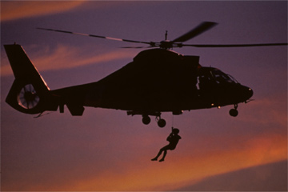
Night Rescue Operations by Helicopter
Conducting a night rescue by helicopter in a remote setting dramatically increases operational risk.
A study of helicopter emergency medical service (HEMS) accidents found that those air crashes occurring in darkness or bad weather increased the likelihood of a fatal outcome by 95 percent.
It is important to review carefully the option of stabilizing the subject at the scene and initiating the rescue at daybreak.

Slide 21
Night Rescue Operations by Helicopter
HEMS operators are equipping helicopter fleets with enhanced ground proximity warning systems (EGPWS), which is a type of terrain awareness warning system (TAWS), to prevent controlled flight into terrain (CFIT) accidents.

Slide 22
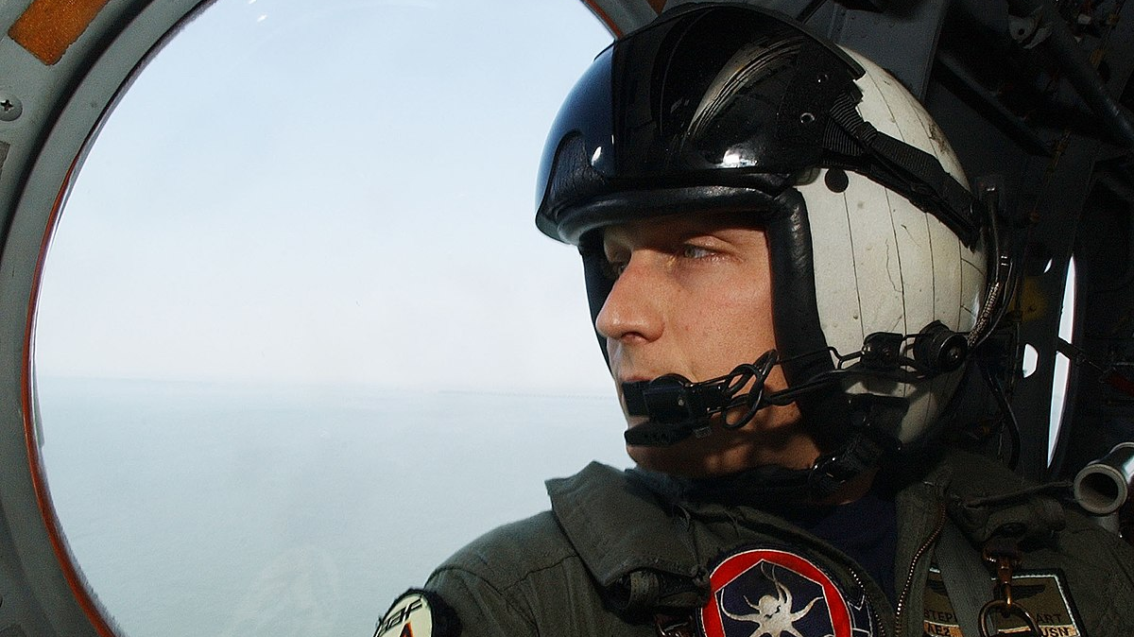
Night Rescue Operations by Helicopter
Additionally, traffic collision avoidance systems (TCAS) are being employed to alert flight crews to the presence of other transponder-equipped aircraft, which may present the threat of a midair collision.

Slide 23
Night Rescue Operations by Helicopter
Night vision goggles (NVGs) increase the aircrew’s situational awareness and ability to navigate safely, and dramatically decrease.
© Swiss Air-Rescue Rega, reprinted with permission.

Slide 24
Night Rescue Operations by Helicopter
They do have operational limitations, including difficulty identifying suspended wires, which are difficult to see day or night.

Slide 25
Night Rescue Operations by Helicopter
NVGs use a green-colored screen because the human eye is most sensitive to the wavelength spectrum associated with green light.
Courtesy of Aviation Specialties Unlimited (ASU).

Slide 26
Night Rescue Operations by Helicopter
A lighted cell phone can easily be seen by NVG from 1.2 m (2 km) on a dark night.

Slide 27
Landings and Takeoffs
Landings and takeoffs are generally made easier in the presence of a light, steady breeze (such as 10 knots or 12 mph) than in still air.
In addition, the pilot may choose not to take off or land in a wind greater than 45 knots (approximately 50 mph) or with a gust spread of over 20 knots (23 mph).

Slide 28
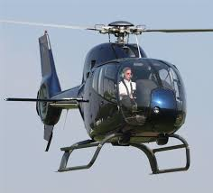
Landings and Takeoffs
When landing, a pilot will often make a high level pass over the helispot to note obstacles and wind indicators

Slide 29
Landings and Takeoffs
During final approach, only one ground crew - the person working as 'parking tender' - should be in the helispot.
The parking tender will indicate the touchdown point by standing upwind of the landing site with his or her back to the wind while pointing with his or her arms toward the desired landing spot.

Slide 30
Ground-to-Air communication during landings and take-offs
The location should be clearly specified
obstructions to include their distances and bearings
Aerial wires must be mentioned
longitudinal/latitudinal coordinates
weather conditions

Slide 31
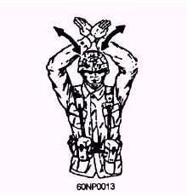
Hand Signals
"Wave-off‘’: waving arms' is the "Wave-off'' signal that tells the pilot not to land!
spontaneous signaling conveyed the wrong message to pilot.

Slide 32
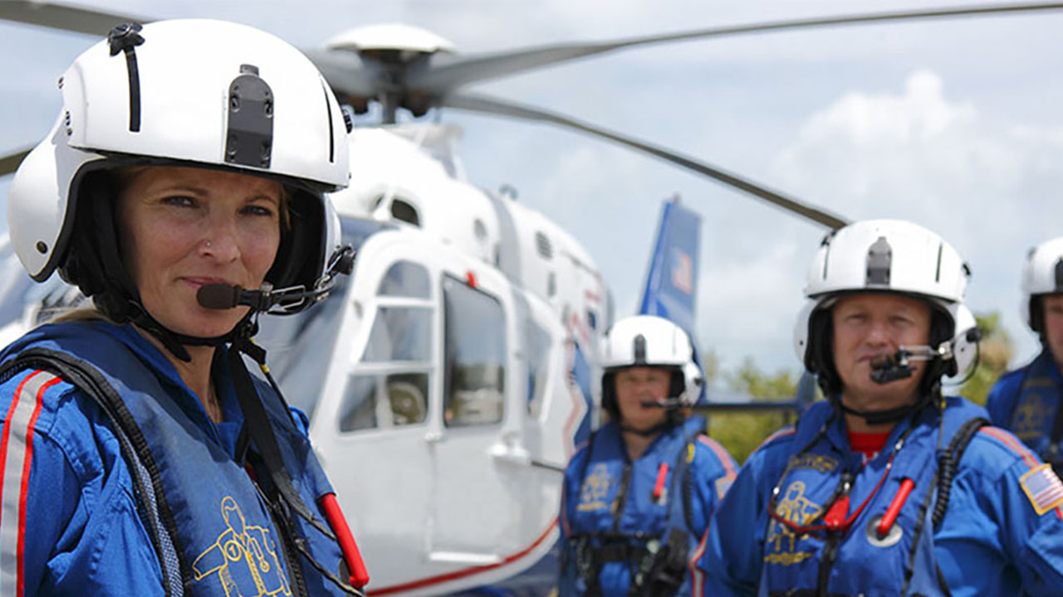
Safety Precautions on the Ground
Ground personnel should never run when approaching or leaving a helicopter.
Approach and leave the helicopter with head and equipment low but maintain eye contact with the pilot
Approaches should be made in a crouched position from the front or side in full view of the pilot (except with Chinooks)

Slide 33
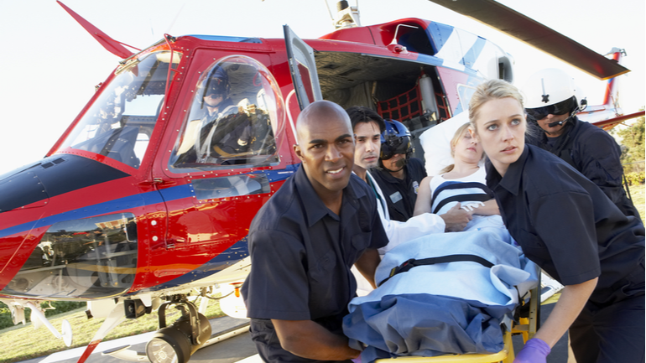
Safety Precautions on the Ground
Never be approached from the side where the ground is higher than where the helicopter is standing or hovering.

Slide 34
Rescuers onboard a helicopter
Should wear a helmet at all times when near or onboard the helicopter. Fire-resistant clothing and leather boots should be worn if at all possible.
Rescue members should carry a portable two-way radio capable at a minimum of transmission on air-to-ground and ground­to-ground frequencies.

Slide 35
Rescuers onboard a helicopter
If at all possible, rescuers should wear the radio in a chest harness
Turn the radio off while onboard to avoid feedback with the on-board radio headsets.

Slide 36
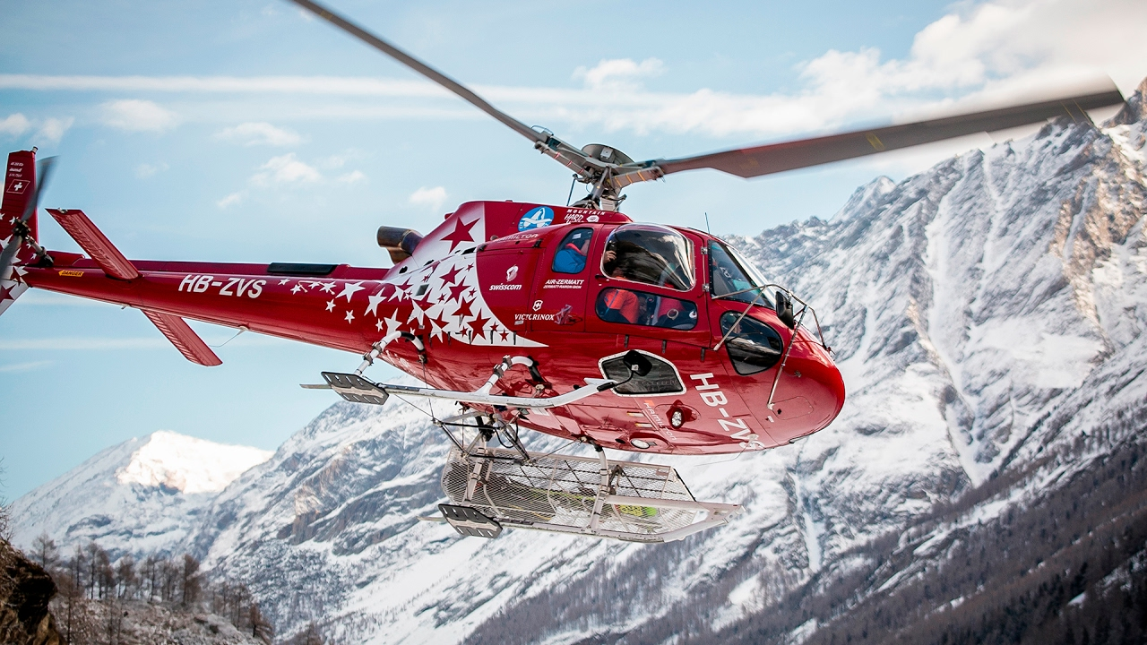
one-skid or hover jump exit
the rescuer should store his or her backpack securely between the legs with all loose items secured.

Slide 37
In-flight Precautions
First, the pilot's word is final as to whether or not a flight can be made.
Before takeoff, all passengers must fasten and adjust the safety belt and shoulder harness
After landing, they should keep this equipment fastened until instructed to leave the helicopter.
The passenger should refasten this equipment on the seat and assure that no belts are outside the helicopter as the door is closed

Slide 38
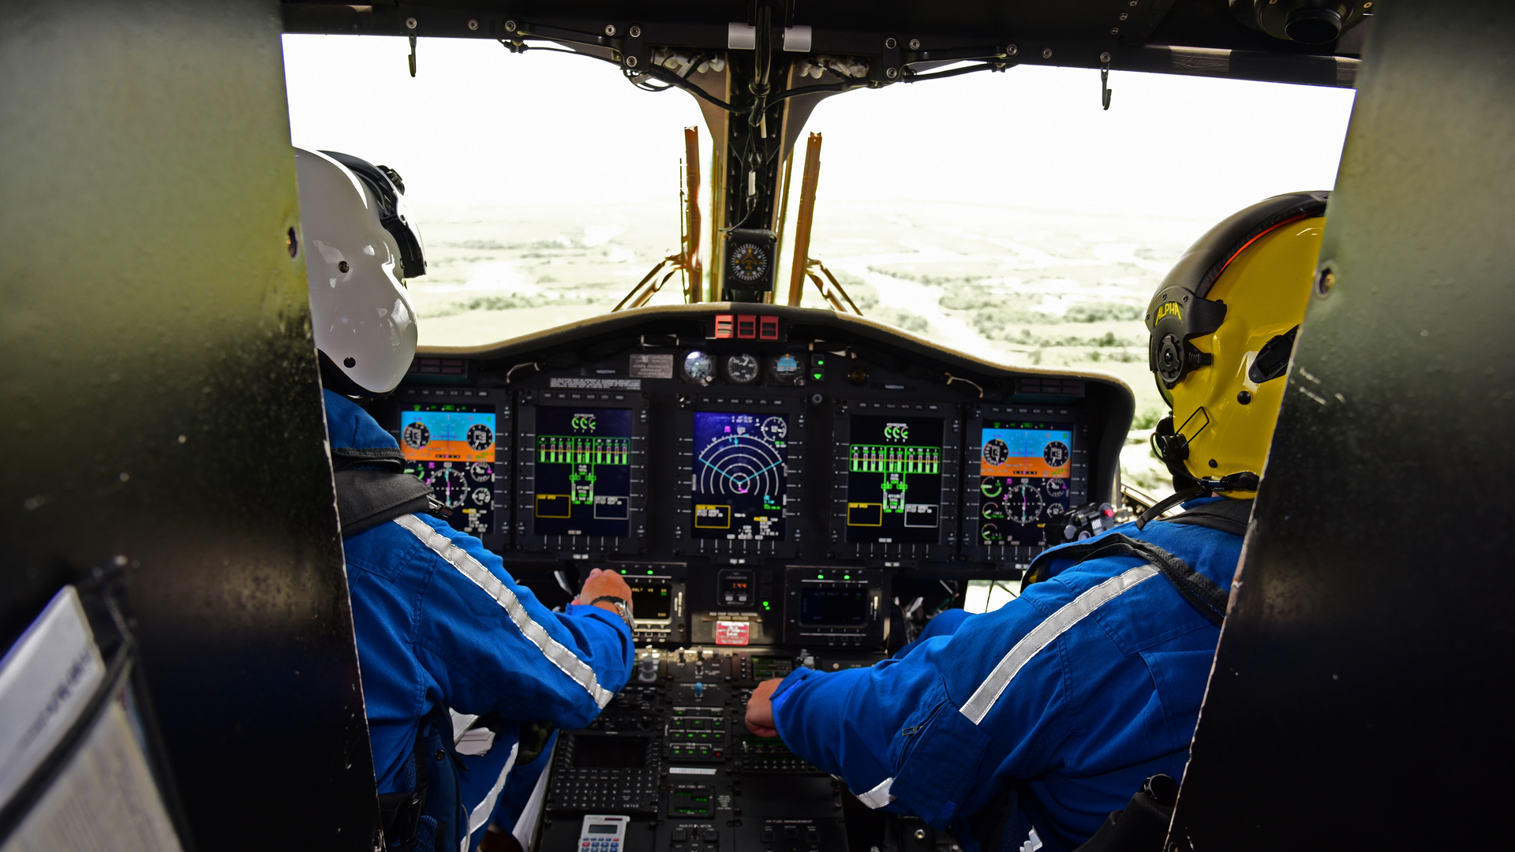
NO SMOKING during takeoffs or landings. Even at the pilot's discretion, rescue personnel will NOT smoke during the flight.

Slide 39
Air-to-Air Communications
When multiple helicopters are operational, it is important for SAR command to alert each airborne aircraft when others take flight.
These aircraft can often communicate with each other air-to-air (often on a VHF frequency such as 123.025) to prevent interference between aircraft.

Slide 40
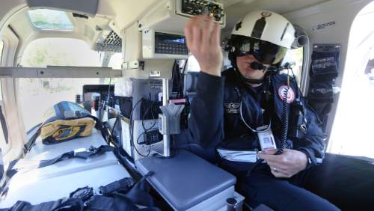
Sterile Cockpit
All crew cease unnecessary and casual communication.
It mandates no conversation on the aircraft intercom radio during departures and arrivals until a safe altitude is reached.
Allows the crew to focus solely on clearing the airspace and communicating with air traffic control.

Slide 41
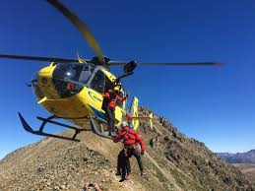
Weather and Nighttime Limitations
One mile (1.6 km) of forward visibility
500 ft. (152 m) of clearance below a cloud ceiling
1000 ft. (300 m) above clouds
2000 ft. (610 m) horizontal clearance from clouds

Slide 42
Weather and Nighttime Limitations
Maximum sustained winds of 35 mph (30 knots)
Wind gust spread (range from minimum to maximum) of 17 mph (15 knots)
One-half mile (0.8 km) forward visibility.

Slide 43
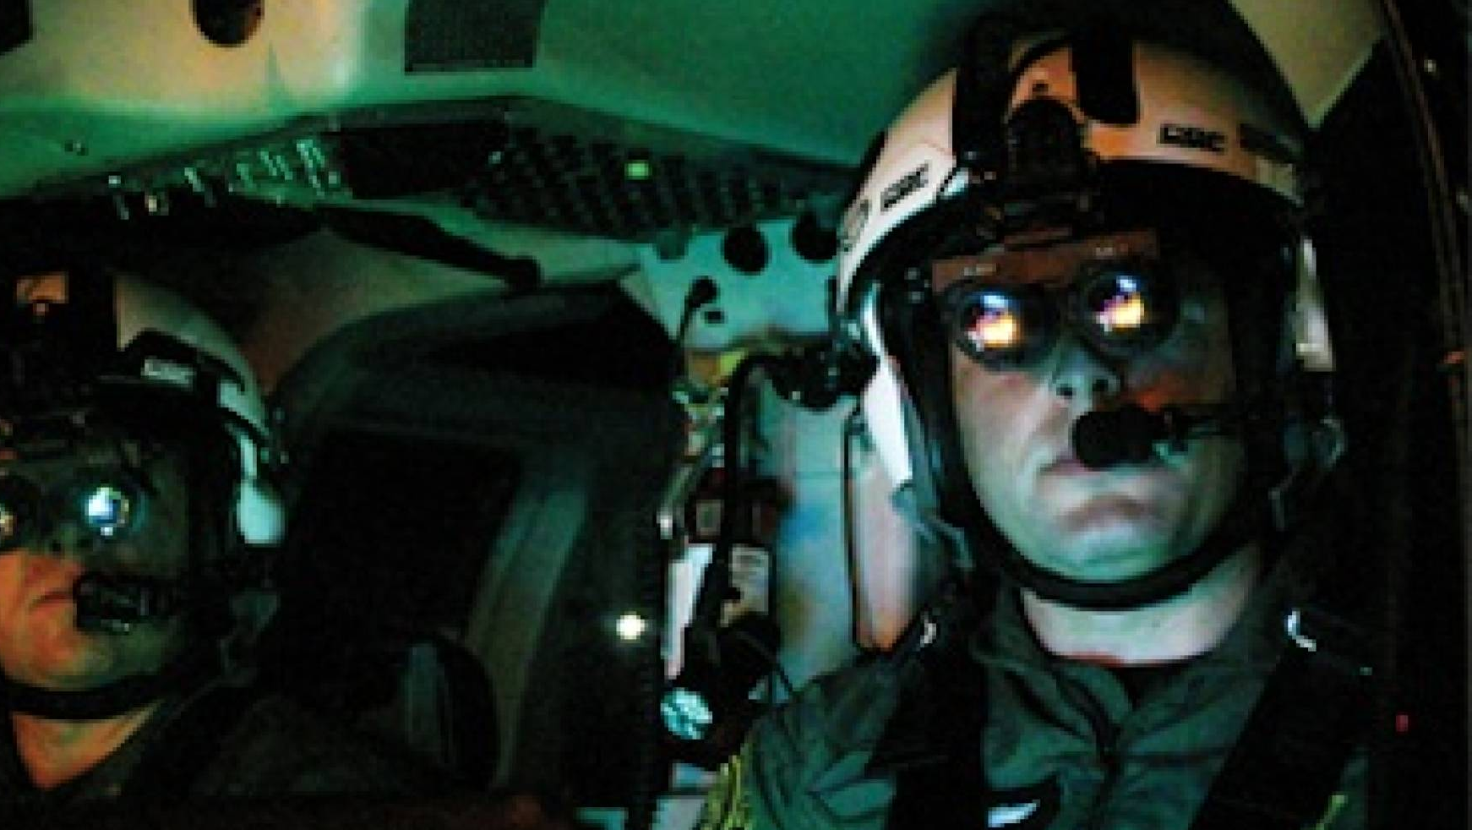
Helicopter Night Rescue Operations
A study of HEMS accidents found that those air crashes occurring in darkness or bad weather increased the likelihood of a fatal outcome by 95%
VFR night flight minimum clearances (the visual distance minimums required for night-time flights) are three statute miles (4.8km) forward visibility and a minimum of 500 ft.

Slide 44
Night vision goggles (NVG)
increase the aircrew's situational awareness, ability to safely navigate, and dramatically decrease the associated risk
In comparison to daylight operations, they do have operational limitations, including reducing a user's depth perception, which is an important factor during external work such as hoist operations.

