Slide 1
FIRST ON THE SCENE
WHAT TO DO UNTIL EMS ARRIVES

Slide 2
Lesson 6: Chest Wound Trauma
Notes:
Welcome to Lesson 6: Chest Wound Trauma.

Slide 3
Lesson 6: Objectives
Identify the signs of a “sucking” chest wound
Understand the importance of checking the front, back, and axillary areas of the torso for penetrations
Properly seal sucking chest wounds with both commercial and improvised occlusive dressings
Notes:
Instructor Notes:
In this lesson, you will learn to:
Identify the signs of a “sucking” chest wound.
Understand the importance of checking the front, back, and axillary areas of the torso for penetrations.
Properly seal sucking chest wounds with both commercial and improvised occlusive dressings.
Explain to participants what “occlusive” means and why it is important for these dressings.

Slide 4
What is Happening to the Patient?
The patient is experiencing difficulty breathing, with noticeable penetration to the chest.
What should you do?
When is it appropriate to perform an intervention?
What is the desired outcome of the patient?
Seal the chest to improve breathing after a penetrating wound to the chest
Penetrating injury changes negative pressure in the chest, decreasing oxygenation and ventilation of the patient
Notes:
Instructor Notes:
A brief description of the respiratory cycle:
Our respiratory cycle is dependent on the tendency of air to flow from an area of higher pressure to an area of lower pressure. As we inhale, our diaphragm lowers, flattening from its normally domed position. At the same time, the scalene and intercostal muscles flex, lifting the ribs upward and outward.
Have everyone practice breathing to notice these movements.
Explain to participants what happens when that cycle is disrupted, especially by a penetrating object to the chest.
Remind participants to always call 911 first!!

Slide 5
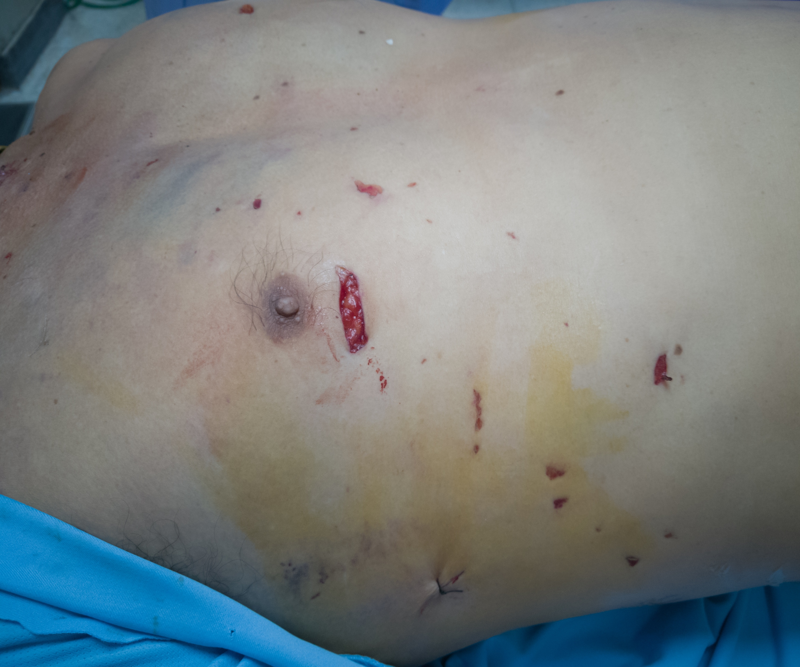
Step 1: Locate the Wound
Call 911
Locate the injury
Look for:
An opening in the chest, back, or flanks of the patient
Hissing or sucking sounds when the person inhales or exhales
Coughing up blood
Notes:
Instructor Notes:
Review steps on the slide with the class.

Slide 6
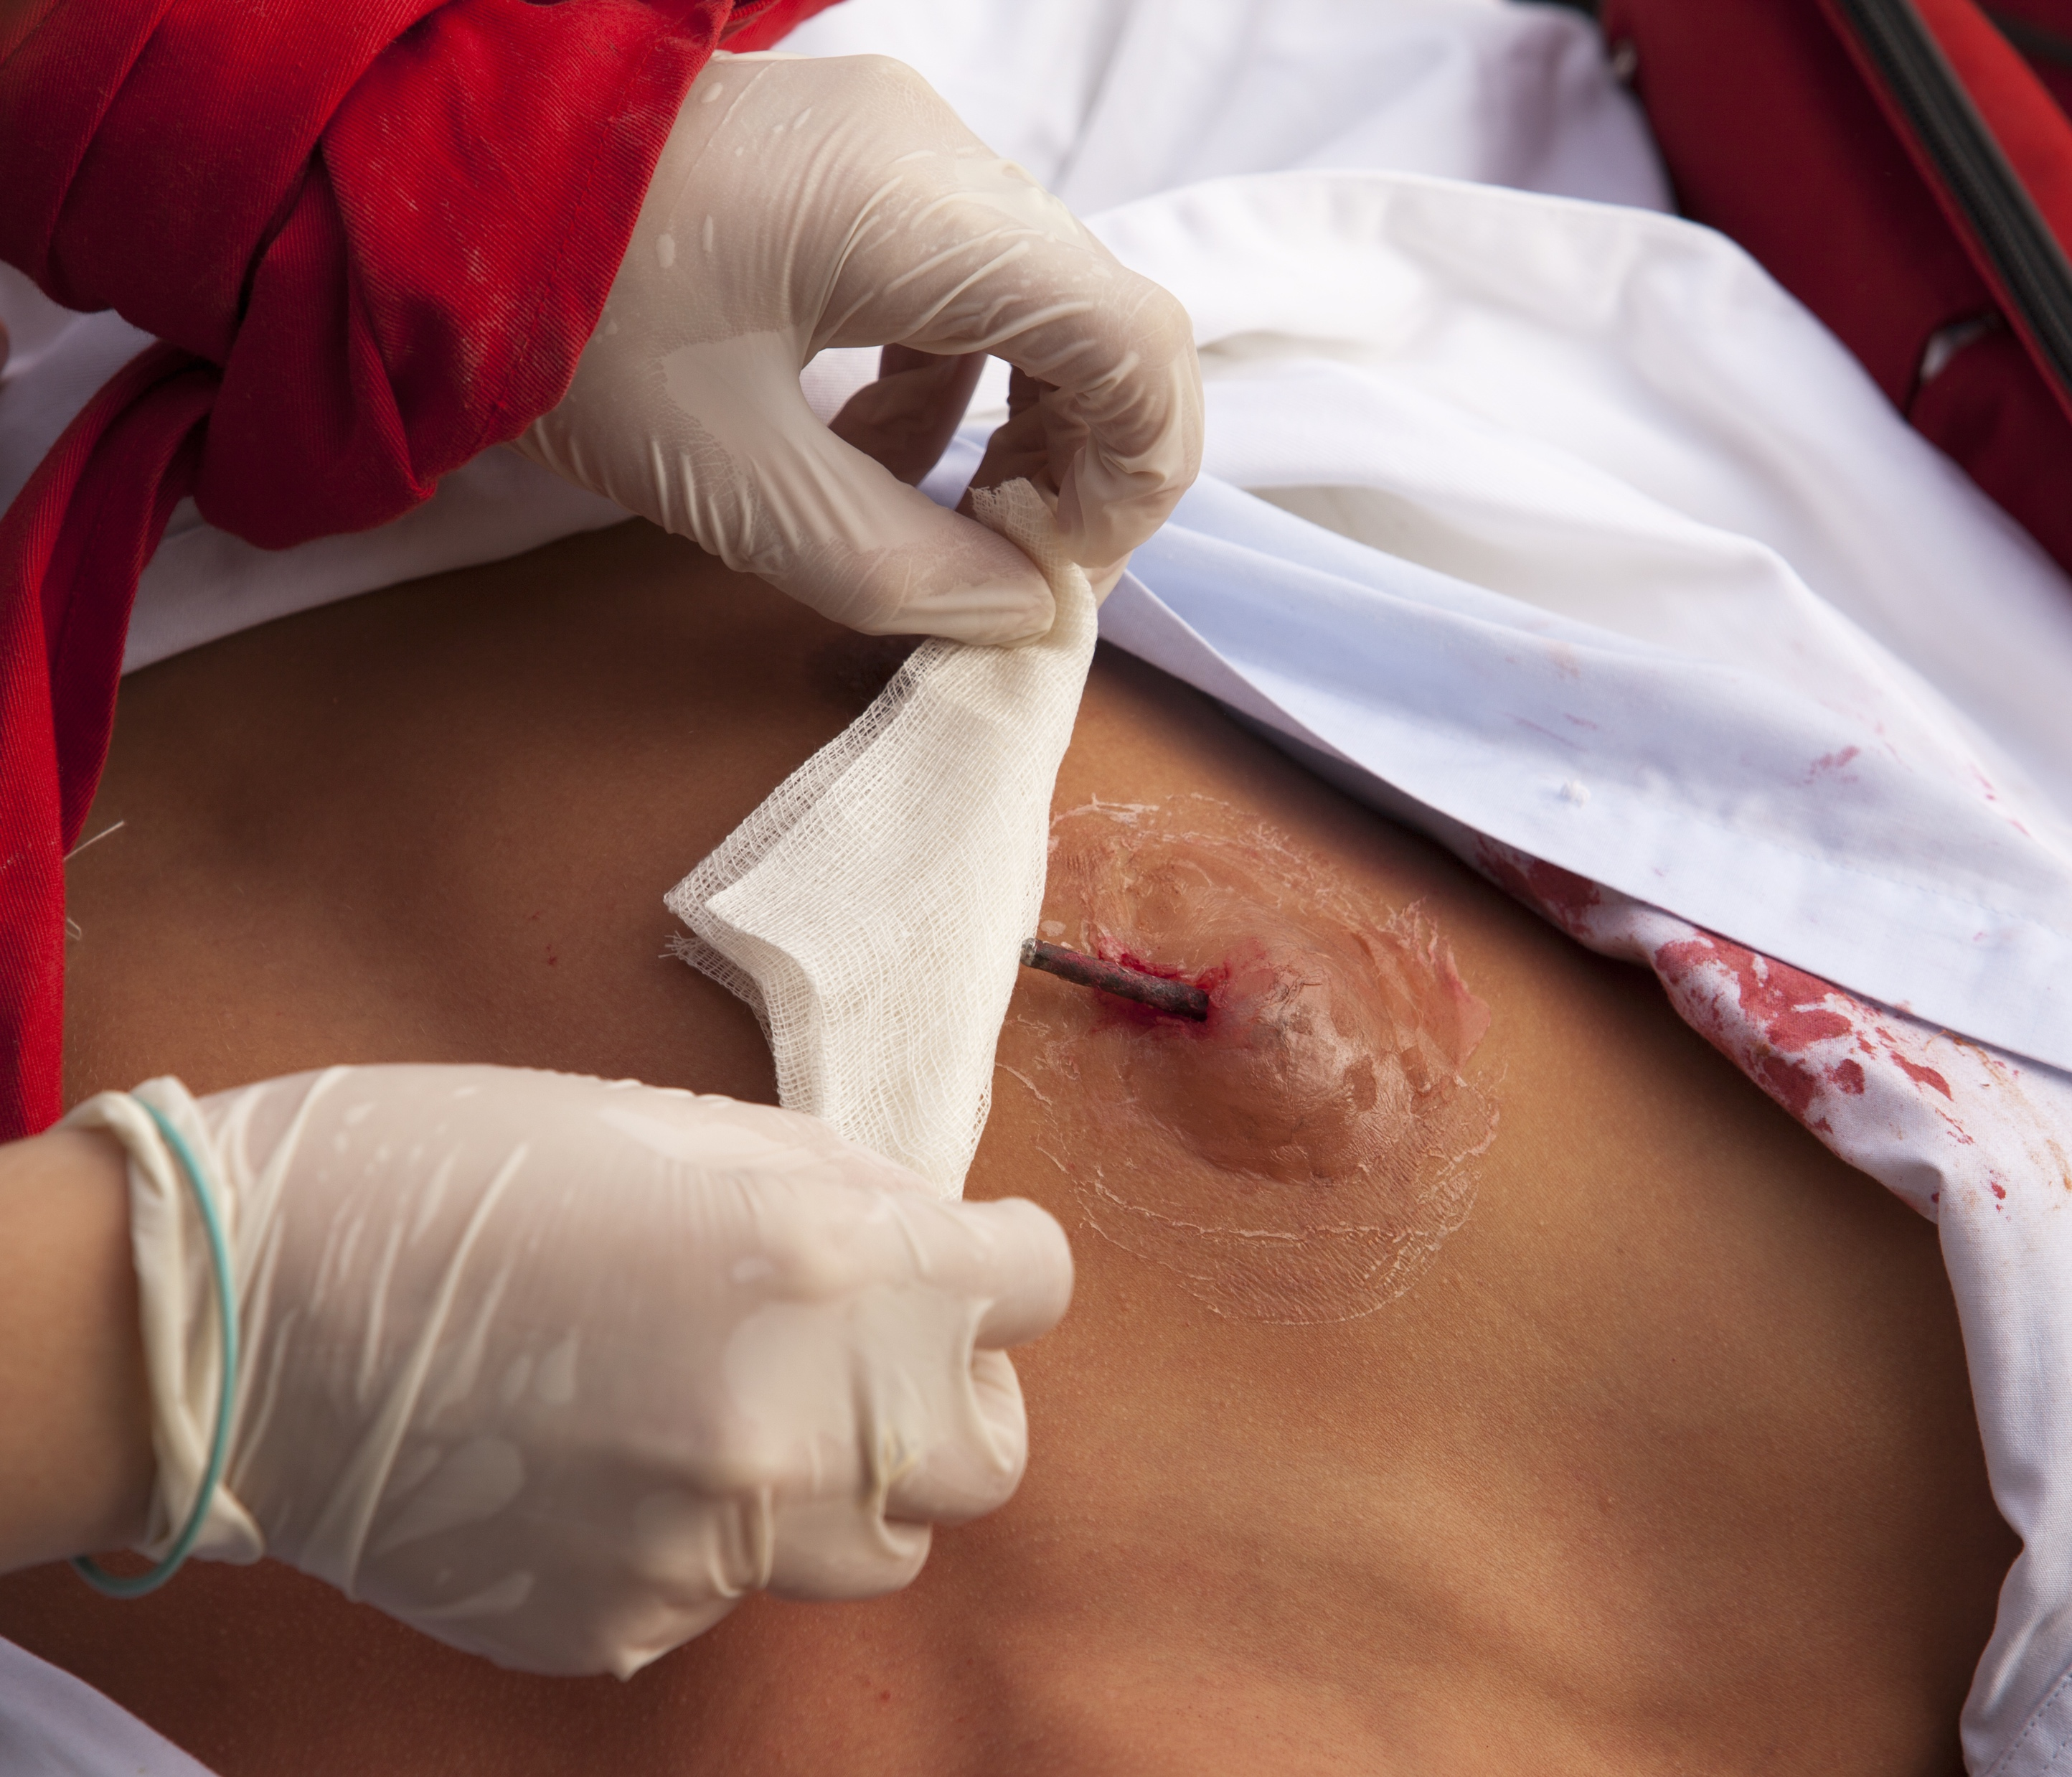
Sealing the Wound: Improvised Seal
Attempt to get emergency help as soon as possible
Seal the wound
Find something plastic (preferably clean or sterile)
Tape
Place the plastic over the wound and tape all four sides of the cover.
If an exit wound is found on the back, you need to seal the hole with plastic and tape all four sides
Notes:
Instructor Notes:
Review the steps of sealing a wound with the class. Give examples of plastic(s) they might find and use to create a seal.
If no seal is available, use a gloved hand to “seal” the wound until help arrives. Emphasize use of a gloved hand to stop bleeding whenever possible.

Slide 7
Applying a Chest Seal
Watch the following video: https://www.youtube.com/watch?v=b9LkKZRP53A
After watching the video, you will have the opportunity to practice looking for a chest would and applying an improvised chest seal.
Notes:
Instructor Notes:
Play video for students. Have students practice chest wound skills.

Slide 8
Lesson 6: Summary
Call for emergency help immediately
Identify wound
Chest wall penetration; looking for a hole the size of a coin
Check the front, back, and sides of the patient
Listen for a hissing or sucking sound
Seal the wound
First with your hand
Find a clean piece of clean plastic if a commercial dressing is unavailable
Place piece of plastic over the wound, taping it down on 4 sides

Slide 9
Lesson 6: Wrap-Up
Notes:
Instructor Notes:
Ask participants if they have any questions about this lesson.

