Slide 1
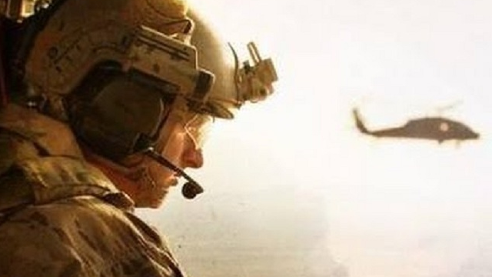
THE RESCUE COMPANY 1

Slide 2
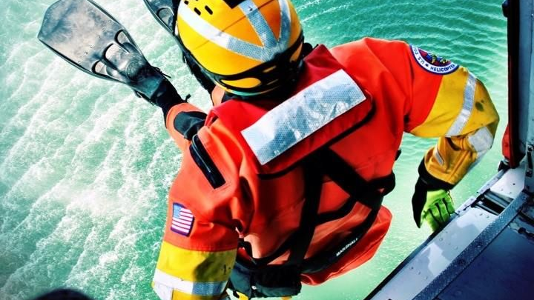
Helicopter rescue swimmer ROPE RESCUE

Slide 3
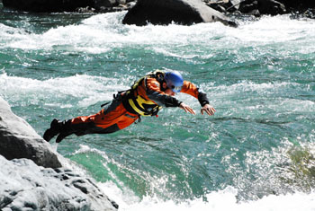
Surface Water Rescue

Slide 4
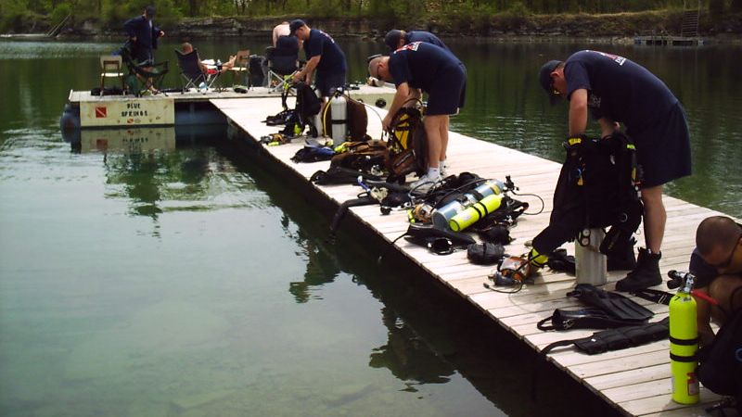
Scene Considerations
Request divers early in an incident
Victims at the surface may submerge
Keep incident operating in rescue mode

Slide 5
Available Recourses
Dive Team
Police
Back up Team
PIO
Support Unit
Air Rescue Support

Slide 6
How often would I use these skills?
According to 2005 data from the Centers for Disease Control and Prevention, drowning is the second leading cause of accidental death in the United States.
In 2005, there were 3,582 fatal unintentional drownings nationwide, totaling 10 deaths per day.

Slide 7
How often would I use these skills?
Florida leads drowning statistics in the U.S
Broward County leads statistics in Florida

Slide 8
Water Rescue Skills & Techniques
TALK – Awareness Level
REACH – Operations Level
THROW – Operations Level
ROW – Operations Level
TOW – Technician Level
GO – Technician Level
HELO – Technician Level
ALWAYS WEAR YOUR PFD!

Slide 9
TALK
Communicate with victim and direct them to safety
Victim may be able to walk, float or swim to shore

Slide 10
TALK
Use tools like PA (B-57)
Be creative use traffic cone as a megaphone.

Slide 11
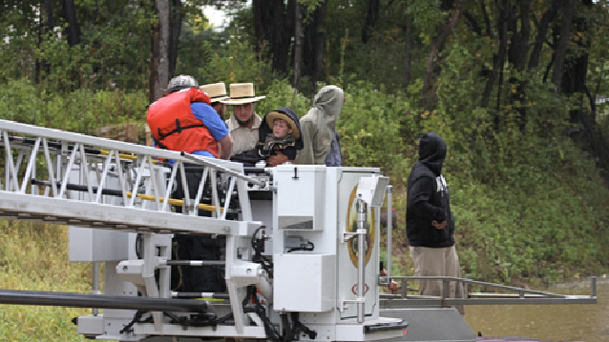
REACH
Use anything available to reach victim
Commonly available items include pike poles, brooms, branches, etc…
Aerial ladders ??? Depends on manufacture and vehicle limitations.

Slide 12
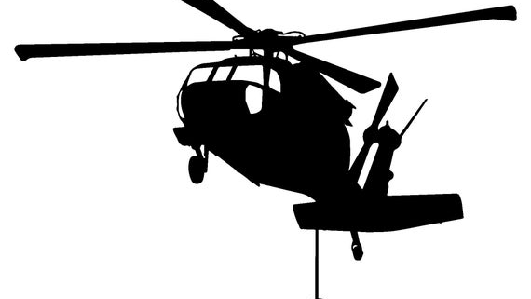
THROW
When victim is out of reach
Water rescue throw bag is your tool of choice

Slide 13
THROW
You have between 50-75 ft of floating rope
Practice your throwing techniques

Slide 14
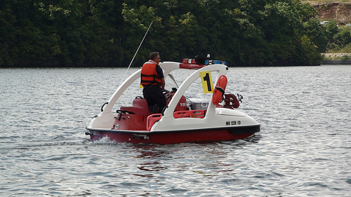
ROW
When victim is beyond reach and cannot be retrieved using a throwing device
If utilizing a Watercraft (PWC) or boats you must wear PPE
Emergency boat training is required

Slide 15
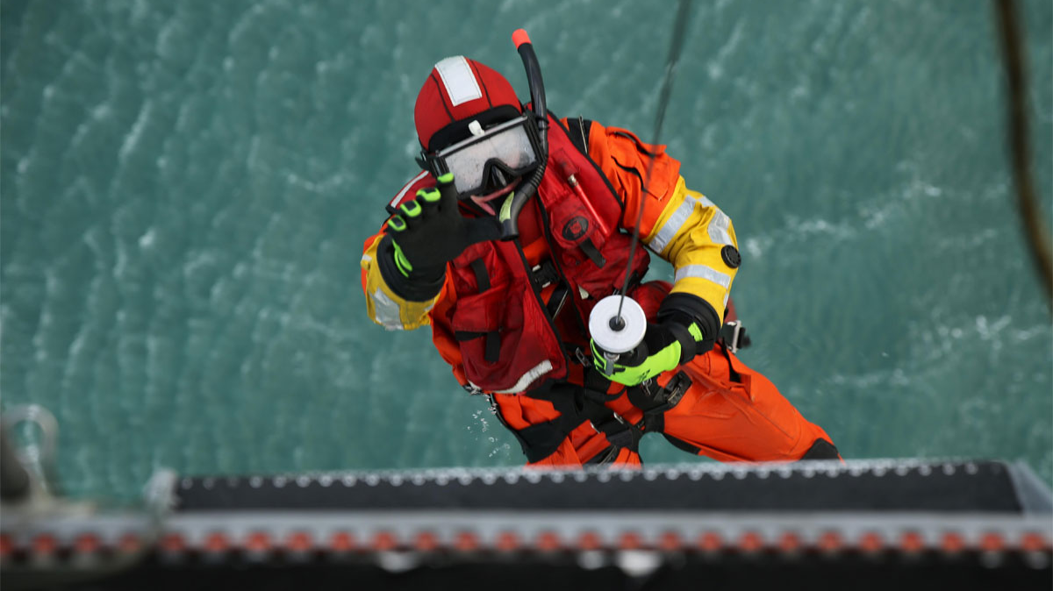
TOW
Rescuers passes an object to victim and then tows them to safety
It may require for the rescuer to be in the water with victim

Slide 16
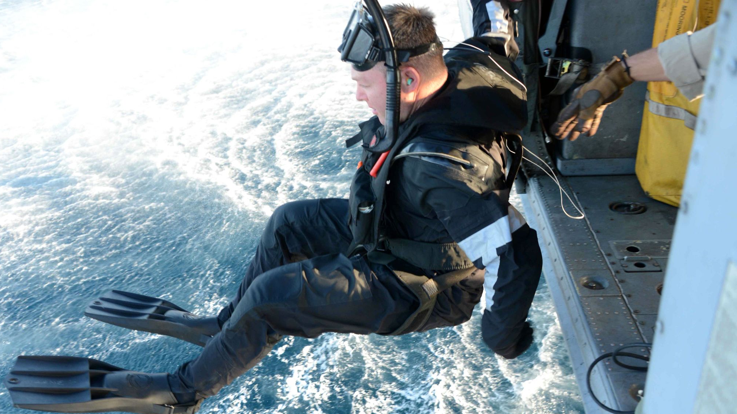
GO
A contact rescue mode
The rescuer physically grabs the victim and swims or drags them to safety

Slide 17
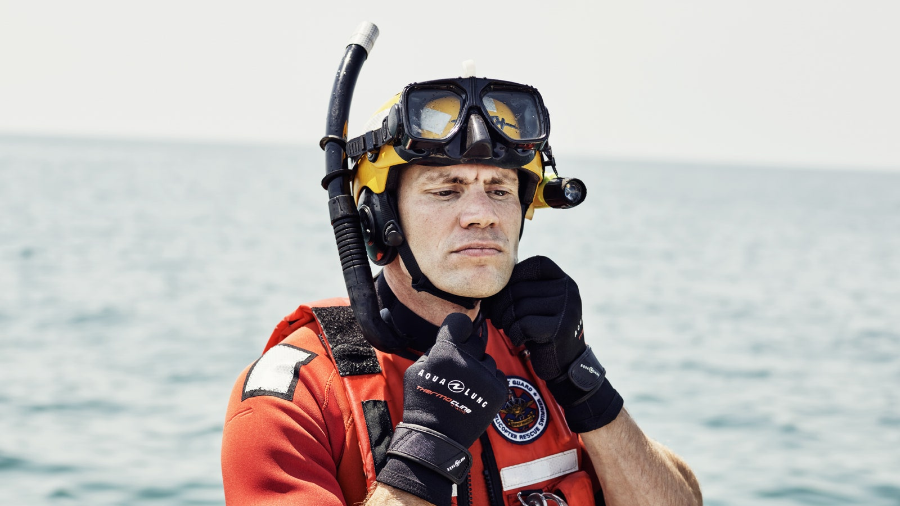
GO
The odds are not always in our favor
We face the same challenges the victim is facing

Slide 18
HELO
Helicopters are very useful in water rescue
There must be good visibility and fair weather for them to operate
Consider using them for illumination purposes

Slide 19
Dive Team Support

Slide 20
Line Tendering
As a line tender you are the only life line that a diver has to the outside world
As visibility is usually limited to none for the diver, the tender is responsible for being the eyes and ears of the diver
Tenders send and receive signals through the use of tugs/pulls on the line
Line tenders are responsible for keeping the diver on their search pattern. You control where the diver goes and does not go.

Slide 21
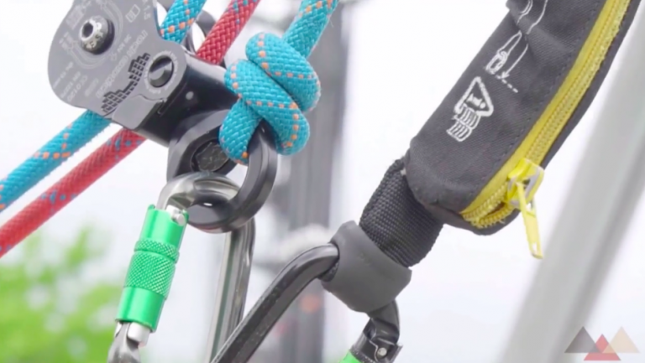
Role of the Line Tender
Tender must remain focused only on tendering and their diver in the water.
MUST WEAR PFD – if the tender is in the water they cannot help the diver.

Slide 22
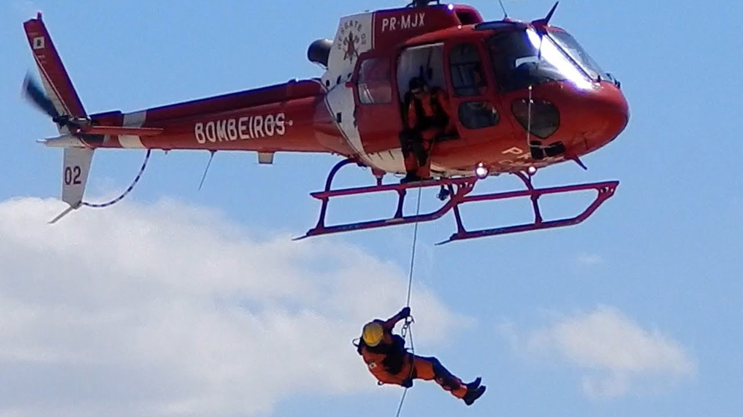
Role of the Line Tender
Tender must control pattern and keep diver in area around last seen reference points.
Tender must mark line at turns with simple knot in line and keep sweep pattern at regular intervals.

Slide 23
Line Tendering
Tender positioned on bank of water wearing PFD.
Tender main priority is line control.
Tender controls diver communications and search pattern.

Slide 24
Search Patterns
Search patterns allow diver to cover all areas with minimal effort and time.
Tender is in control of maintaining diver position within search pattern.
Tender controls diver pattern with line length and pulls/tugs.

Slide 25
Line Communications
TENDER TO DIVER
DIVER TO TENDER
1 – Are you OK?
2 – Stop, change direction (180 degree turn)
3 – Surface
4 – Danger, stay on bottom
1 – I’m OK, I understand
2 – Need more line
3 – Object found
4 – Emergency, I need help, Send in secondary (safety) diver

Slide 26
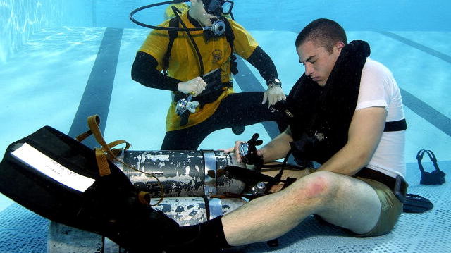
Water Survival for rescuer

Slide 27
Background
Fear + Ignorance = Panic

Slide 28
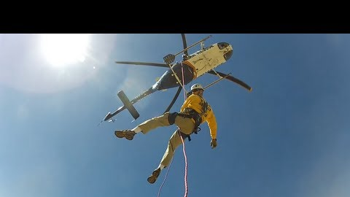
Keys To Survival
The first critical seconds of immersion
The swimmer will float to the surface of the water
Assume horizontal position on your back (supine)
Natural instincts would cause you to attempt to go vertical

Slide 29
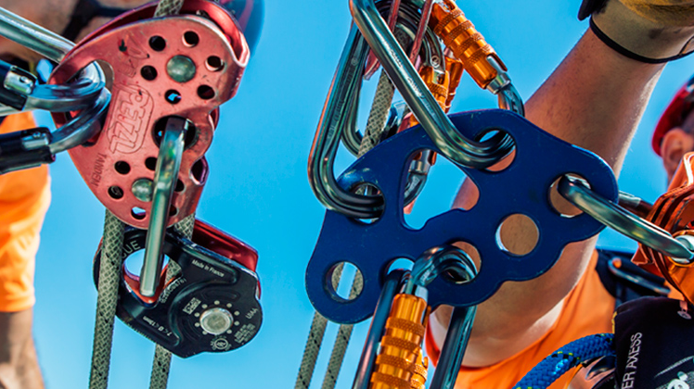
Keys to Survival
You should only use underwater arm movement to get to safety
Your helmet can be used to trap air and when placed over hips, will help you afloat

