Slide 1
FIRST ON THE SCENE
WHAT TO DO UNTIL EMS ARRIVES

Slide 2
Lesson 4: Anaphylaxis and the Use of an Auto-Injector
Notes:
This lesson reviews anaphylaxis and how to use an autoinjector.

Slide 3
Lesson 4: Objectives
Learning Objectives
Identify signs of an anaphylactic reaction
Discuss what epinephrine is, its role in an anaphylactic reaction, and how to administer it
Identify the proper location of injection site
Demonstrate the proper use of an epinephrine auto-injector
Notes:
Instructor notes:
Review learning objectives with the class.
Ask participants if anyone has witnessed an anaphylactic reaction.

Slide 4
What is happening to the patient? Signs and symptoms to recognize
Patient symptoms
Warm flushed skin
Itching
Swollen red eyes
Swelling of the face and tongue
Shortness of breath
Nausea, vomiting, and/or stomach pain
Loss of consciousness (or fainting)
Notes:
Instructor Notes:
In addition to the symptoms on the slide, the patient may be sweating, coughing, wheezing, or state they have a lump in their throat.
A common, significant and often misunderstood sign of anaphylaxis is gastrointestinal symptoms such as nausea, vomiting and/or stomach pain. See reference: https://www.ncbi.nlm.nih.gov/pmc/articles/PMC3666145/pdf/1939-4551-1-S2-S18.pdf.
Anaphylaxis is a multi-system reaction. There is a persistent myth that anaphylaxis is “when your throat swells.” Swelling of the mucosal membranes can be one sign. The cause of death from anaphylaxis isn’t suffocation cause of a swollen throat. It’s a steep drop in blood pressure, which leads to cardiac arrest. The immune system cells that are released during an anaphylactic reaction cause this.

Slide 5
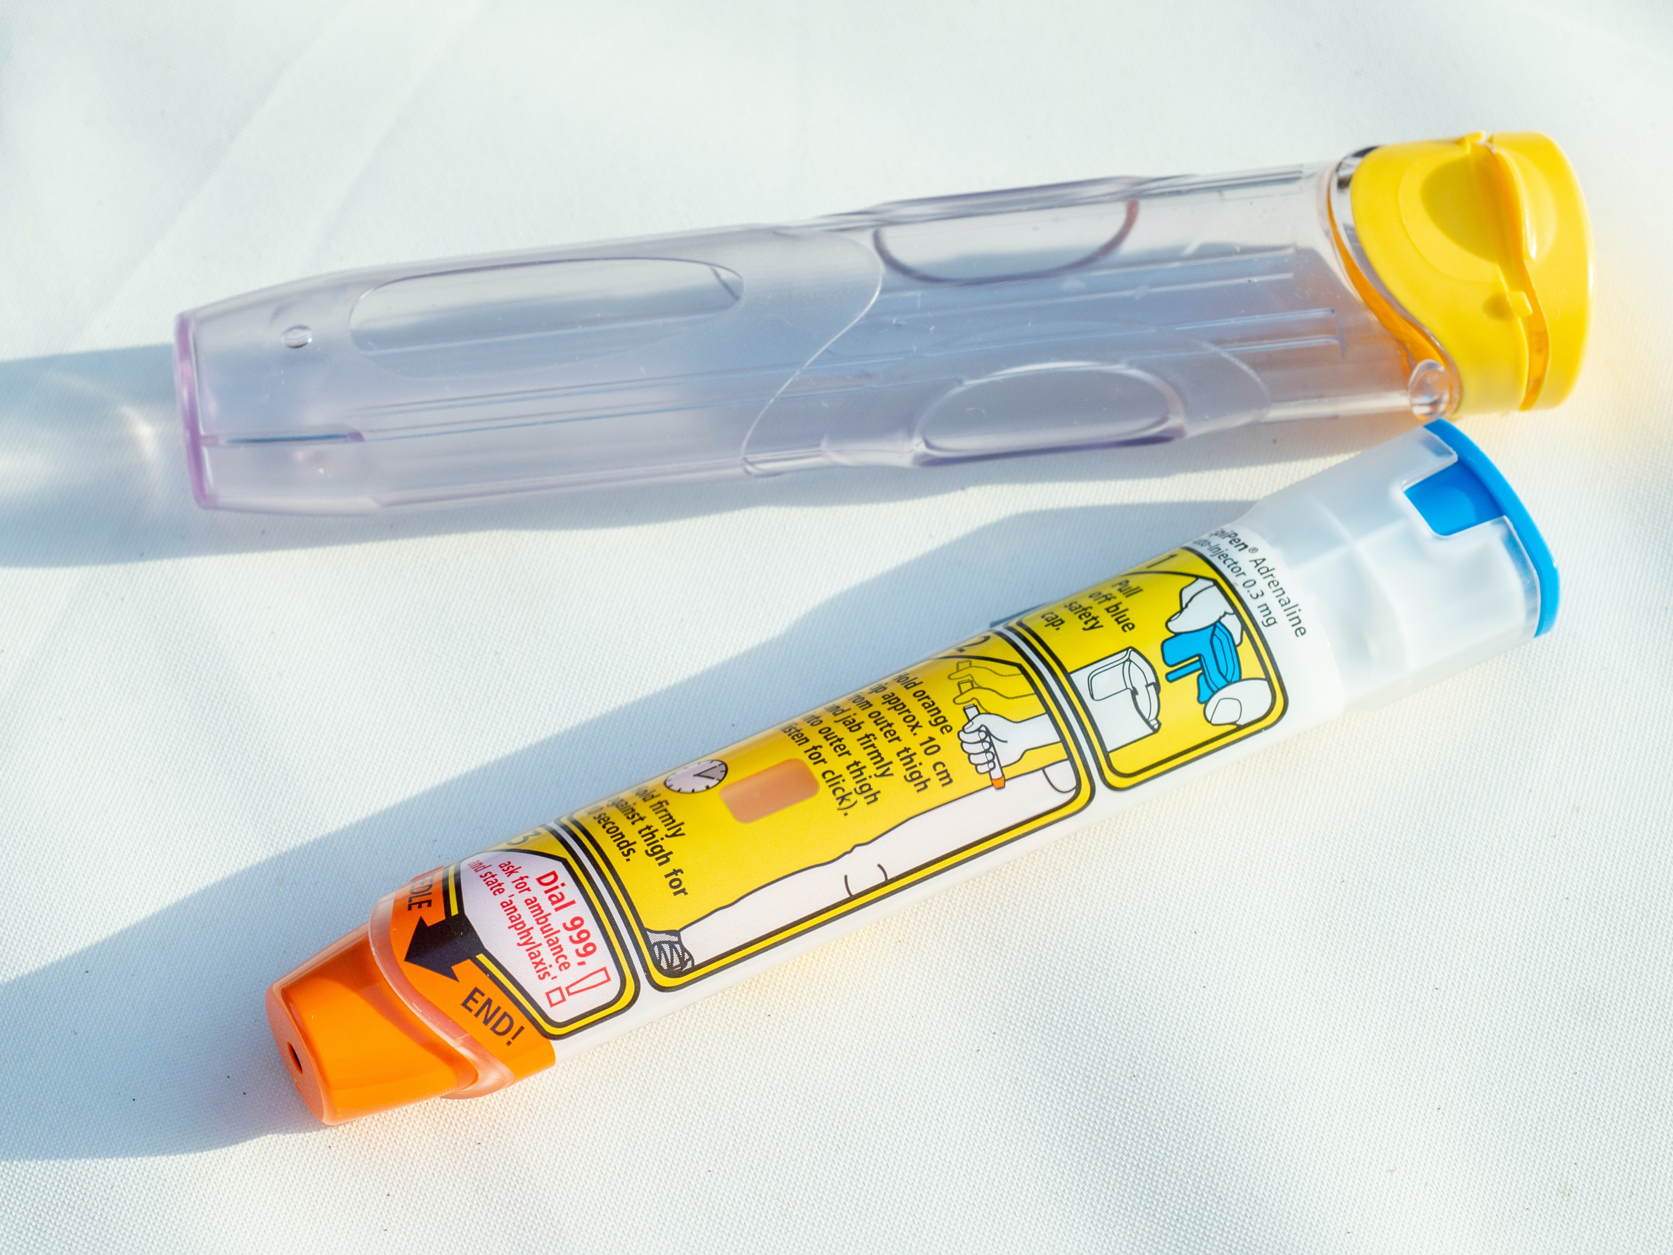
What Should I Do?
As with all situations, determine if it’s safe to approach the patient
Ask the patient if they have an “EpiPen” or auto-injector
The EpiPen or auto-injector should be used if the patient presents with signs and symptoms of an anaphylactic reaction
Notes:
Instructor Notes:
The instructor should provide simple examples of scene safety.
Call for EMS.
Assist the patient in the administration of the EpiPen or generic autoinjector.

Slide 6
Intervention: Use of the EpiPen
Steps for administration of the EpiPen
Locate the patient’s EpiPen Remove cap and follow the instructions depicted on the pen
You can assist the patient, allowing them to inject the pen with assistance
Or, pull off the cap, inject into the patient’s leg, holding the pen firmly for 10 seconds against the leg
Notes:
Instructor Notes:
Walk participants through the steps of EpiPen/auto-injector administration.
Explain to participants: EpiPen is the brand name. There are several other brands in use, including generic epi and Auvi-Q, which offers audio instructions on how to inject it. The most common is the EpiPen, but there are others, including generic and Auvi-Q which looks a LOT different from an EpiPen.

Slide 7
What Should I Do?
The desired effect of the epinephrine is to reverse the allergic reaction
The goal is to improve the patient’s breathing, heart rate, and most importantly – their blood pressure.
Notes:
Instructor Notes:
Explain to participants the desired effect of epinephrine (to reverse the allergic reaction). How will they know for certain the medication is working?
Participants may ask how long they should expect before they see a change in the person’s breathing.
Important note: Note that is OK to administer the epinephrine through clothing (pants). The needle will go right through them. There is no need to remove clothing. This is very important because you may be somewhere (like a restaurant) where pulling down your pants isn’t an option, and the last thing you want is for people to run to the bathroom. People have done that, collapsed and died inside the stall. Teenagers (girls especially) sometimes don’t use their autoinjector because they don’t want to pull their pants down in front of people. So if you need to, just epi through clothes.
Emphasize that it is important to give epinephrine SOONER rather than later. Death from anaphylaxis usually occurs because epinephrine has been administered too late. The longer an anaphylactic reaction is allowed to progress, the less likely the epinephrine will work. So don’t delay. Delaying epinephrine is a major issue. Reference: See section: “Underutilization of epinephrine by patients, parents and caregivers.” https://www.ncbi.nlm.nih.gov/pmc/articles/PMC3666145/pdf/1939-4551-1-S2-S18.pdf)
In the body, epinephrine causes the blood vessels to constrict, which raises blood pressure, increases heart rate to prevent cardiovascular collapse, and can send the system into shock.
In many (or even most) people there is no throat closing. Instead they are itching, wheezing, breaking out in hives, and vomiting or doubled over in stomach pain. If it progresses, blood pressure drops. Your heart stops. Game over.
One of the goals of this course is to correct some of the misunderstanding of what anaphylaxis is and what it looks like.
See reference: https://www.allergicliving.com/experts/how-does-epinephrine-turn-off-an-allergic-reaction/

Slide 8
Auto-injector Functions and Intervention
Watch the video: https://www.youtube.com/watch?v=WzEWl2hflF0&feature=emb_logo and practice auto-injector epinephrine administration.
Notes:
Instructor Notes:
Play video for participants to show how to use an auto-injector. https://www.youtube.com/watch?v=WzEWl2hflF0&feature=emb_logo

Slide 9
Lesson 4: Summary
Call 911
Identify if it’s safe to approach the patient
Identify if the patient is showing signs and symptoms of an allergic reaction
Ask the patient if they have an EpiPen auto-injector or equivalent
Assist or use the auto injector following confirmation the medication is prescribed to the patient
Notes:
Instructor Notes:
Review the summary points with students.

Slide 10
Lesson 4: Wrap-Up
Notes:
Instructor Notes:
Ask students if they have any questions about this lesson.

