Slide 1


THE RESCUE COMPANY 1

Slide 2
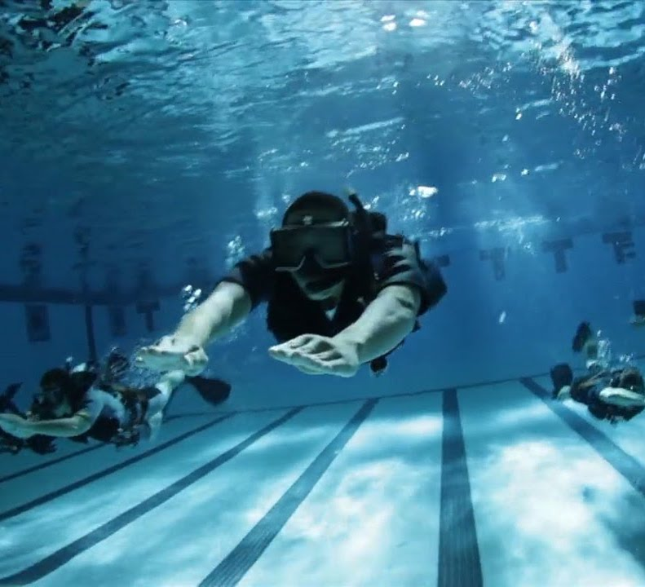
SWIMMING BASICS

Slide 3
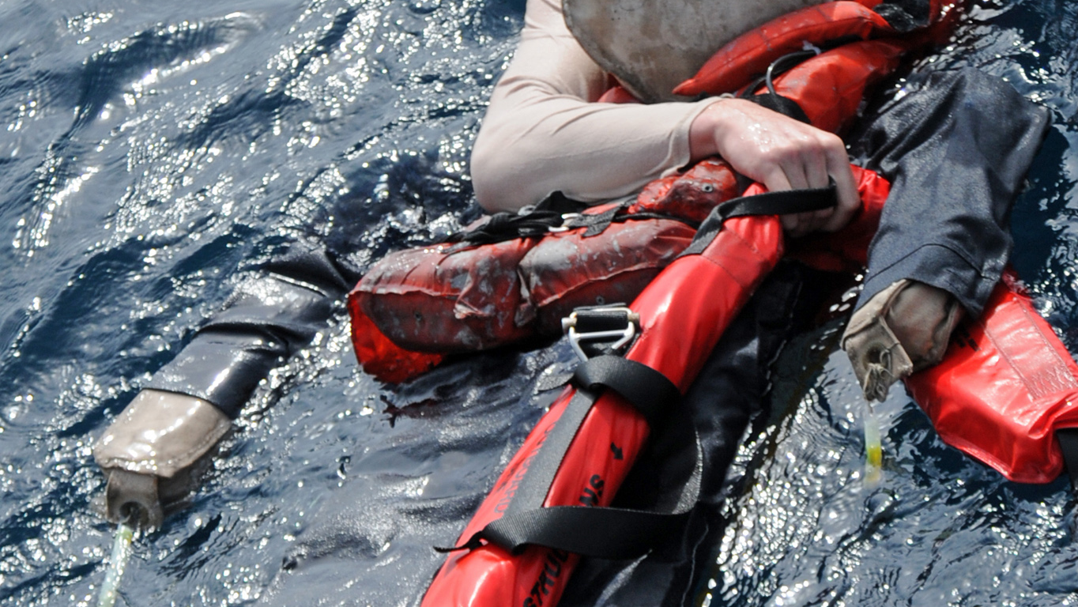
swimming science
Buoyancy
Propulsion
Resistance

Slide 4
buoyancy
A basic understanding of this is a crucial element of overcoming a fear of water.

Slide 5
buoyancy
Floating is a characteristic of the human body.
It's all down to our relative density.

Slide 6
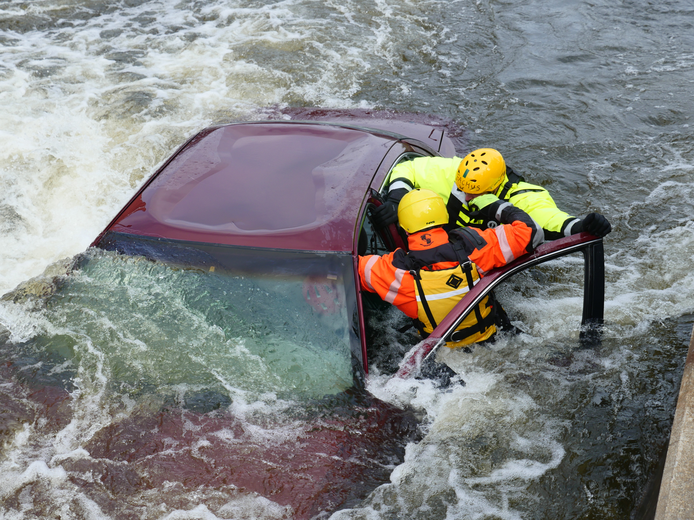
relative density
In other words, how dense our body structure is, compared to the density of the water we are attempting to float in.

Slide 7
relative density
Freshwater has a density of 1g/cm3
Saltwater has a density of 1.024g/cm3
Male density of 0.98g/cm3
Female 0.97g/cm

Slide 8
Propulsion
Paddling
Sculling
Kicking

Slide 9
Paddling
Paddling is likened to oars on a boat.
A large flat surface area pulled in one direction causes another object to move in the opposite direction.

Slide 10
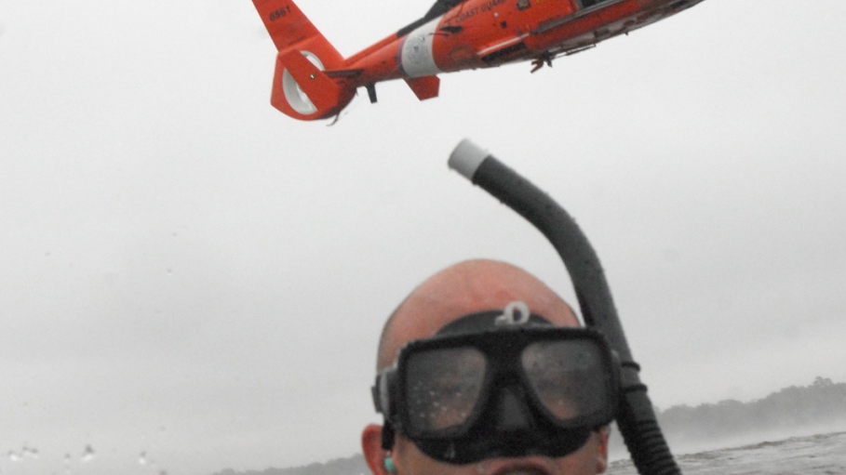
Paddling
In the case of the human body, we pull or push with our hands and arms, causing us to move backwards or forwards in the water accordingly.

Slide 11
Sculling
Sculling takes the form of a curved shape in the water made by the hands as they move to find still, undisturbed water.
Water that is not moving provides more propulsion than water that has already been moved.

Slide 12
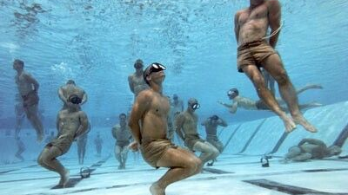
Sculling
All of the swimming strokes require some kind of sculling action.
Sculling is the most efficient way of moving our hands and arms through the water.

Slide 13
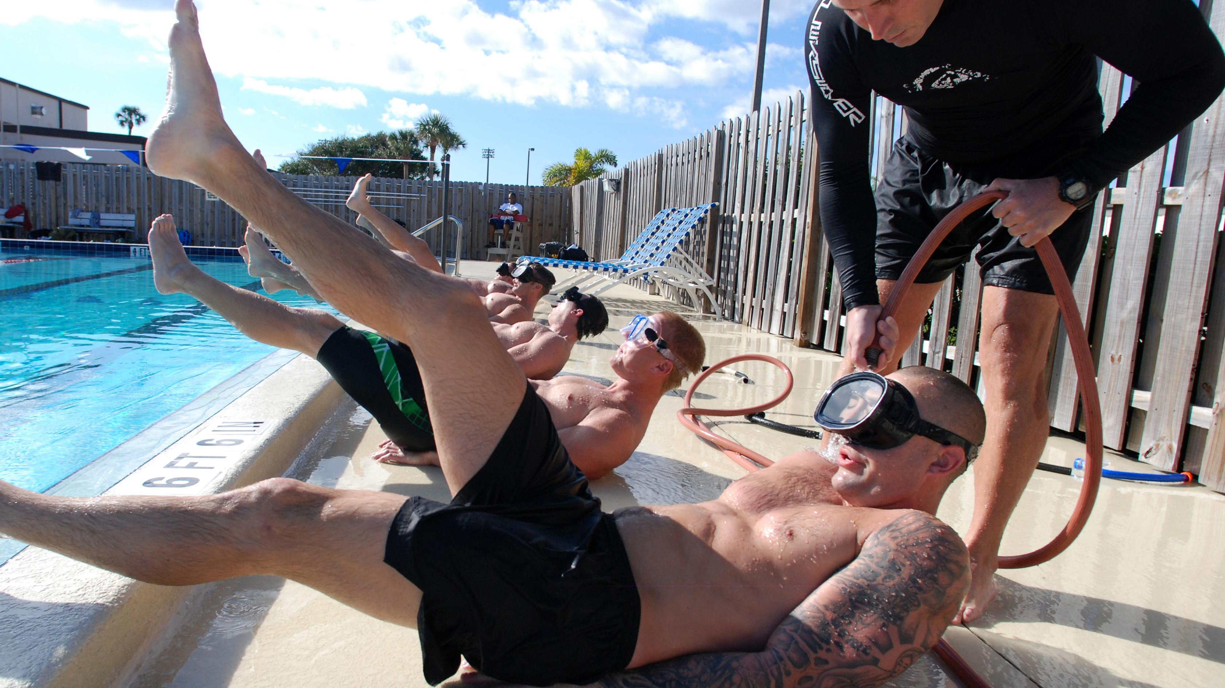
Kicking
Kicking the water with the legs is the least efficient way of moving through the water as it can require a rapid movement that can very quickly become tiring.

Slide 14
Resistance
As the body moves through the water, it is met by resistance
Resistance is to be easily overcome by being streamlined as possible.

Slide 15
Resistance
Profile resistance
Viscous drag
Eddy currents

Slide 16
Profile resistance
As the swimmer moves forward through the water
The profile resistance is pushing him/her back.
If profile resistance is to be minimized, the body must be made as narrow and thin as possible.

Slide 17
Viscous drag
As a swimmer moves through the water, friction slows him/her down by creating a drag force.
As water meets the skin, forward motion is compromised by the dragging force backwards.
Excess body hair and baggy swimming shorts cause large increases in viscous drag.

Slide 18
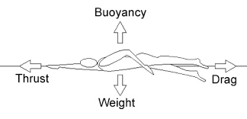
Eddy currents
these are caused by an object moving through the water, causing the surrounding water to move and create turbulences.

Slide 19
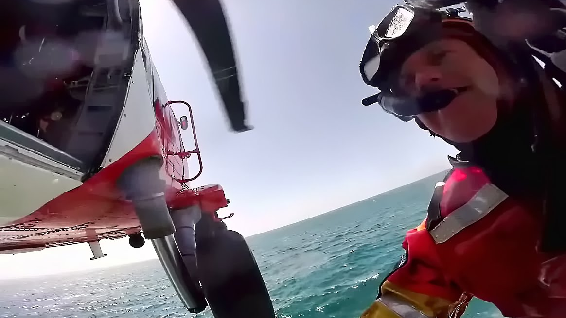
non-swimmer-essential basics
Entry
Submersion
Regaining standing

Slide 20
Entry
Slide-In Entry
Stride Jump
Compact Jump
Run-and-Swim Entry

Slide 21
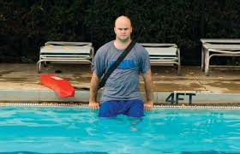
Slide-In Entry
The slide-in entry is slower than other entries,
Safest entry to use in most conditions.

Slide 22
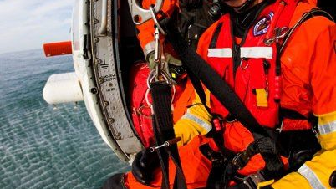
Slide-In Entry
Useful in:
shallow water, crowded water
When a victim with a head, neck or back injury is close to the side of the pool or pier.

Slide 23
Slide-In Entry
Sit down on the edge of the pool deck or pier, facing the water. 2. Gently slide into the water.
Retrieve the rescue tube.
Place the rescue tube across the chest with the tube under the armpits and begin the approach.

Slide 24
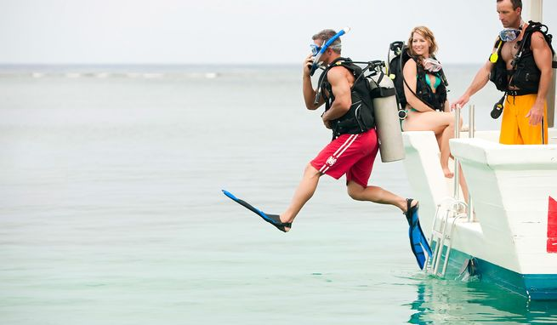
Stride Jump
A lifeguard should use the stride jump with a rescue tube only if the water is at least 5 feet deep and he or she is no more than 3 feet above the water.

Slide 25
Stride Jump
Squeeze the rescue tube high against the chest with the tube under the armpits
Hold the excess line to keep it from getting caught in the lifeguard chair or other equipment when jumping into the water.
Leap into the water with one leg forward and the other leg back

Slide 26
Stride Jump
Lean
Lean slightly forward, with the chest ahead of the hips, and focus on the victim when entering the water.
Squeeze or scissor
Squeeze or scissor the legs together for upward thrust
Focus on
Focus on the victim and begin the approach

Slide 27
Compact Jump
When more than 3 feet above the water, such as on a lifeguard stand, helicopter or pier,
Only if the water is at least 5 feet deep.
The com­pact jump can also be done from a pool deck into the wa­ter.

Slide 28
Compact Jump
Squeeze the rescue tube high against the chest with the tube under the armpits.
Hold the excess line to keep it from getting caught in the lifeguard chair or other equipment when jumping into the water
Jump out and away from the lifeguard chair, pool deck or pier
In waves pool, time the jump to land on the crest (top) of a wave

Slide 29
Compact Jump
Bend
Bend the knees and keep the feet together and flat to absorb the shock if hitting the bottom. Do not point the toes or keep the legs straight or stiff.
Let
Let the buoyancy of the rescue tube bring the life­guard back to the surface.
Focus on
Focus on the victim when surfacing and begin the approach.

Slide 30
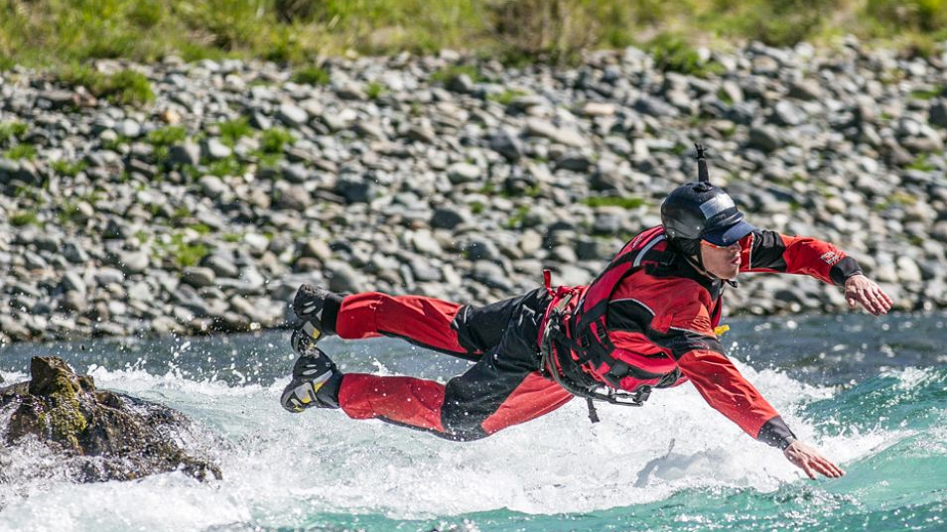
Run-and-Swim Entry
To enter the water from a gradual slope, such as a shore­line or wave pool, the lifeguard should use the run-and­ swim entry.

Slide 31
Run-and-Swim Entry
Hold the rescue tube and the excess line and run into the water, lifting the knees high to avoid falling.

Slide 32
Run-and-Swim Entry
When the lifeguard can no longer run, he or she should either put the rescue tube across the chest and lean forward or drop the tube to the side and start swimming, letting the rescue tube trail behind.
Do not dive or plunge head-first into the water; this could result in a serious head, neck or back injury.

Slide 33
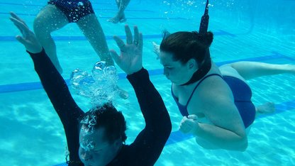
Submersion
Relax
Make sure your facial muscles are not tensed up as it gives rise to inefficient air exchange.

Slide 34
Submersion
Breathe Out
Most novice swimmers tend to hold their breath underwater instead of breathing out when swimming.
When your face is submerged in water, you should be breathing out gently and bubbles should come out of your mouth or nose.

Slide 35
Submersion
Breathe In - Most swimmers breath in through their mouth.
This action should be quick and last only a second.
Timing - Breathing out in the water should be about twice as long as breathing in above the water
helps build a comfortable rhythm to your breathing.

Slide 36
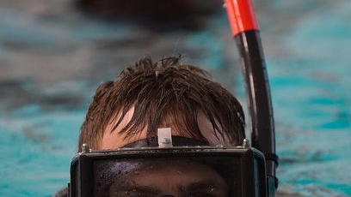
Regaining standing
Regaining a standing position from a face down (prone) position in the water is an essential movement to learn and is often overlooked when learning how to swim and overcoming the fear of water.

Slide 37
Regaining standing
Once you are able to execute this movement confidently, then your confidence will be enhanced. Knowing you can stand up from a floating or moving position will spur you on to greater things.

Slide 38
Regaining standing
Movement should be relaxed and smooth, knees are drawn forward as the arms simultaneously pull downward and backwards as the head lifts and faces forward.

Slide 39
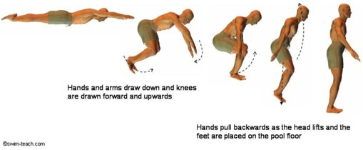
Regaining standing

