Slide 1
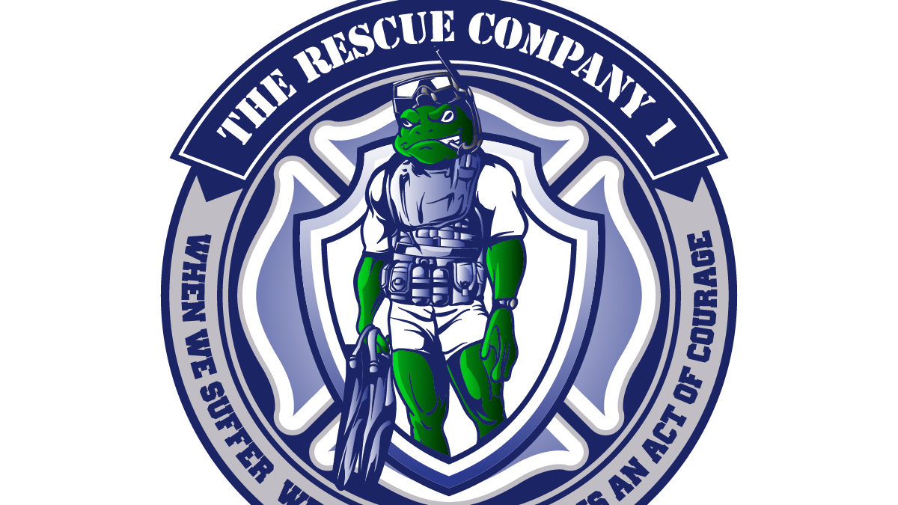
THE RESCUE COMPANY 1

Slide 2
Rescue Helicopter Personnel Protective Equipment

Slide 3
Fire-resistant clothing
A loose-fitting flight suit or clothing made of fire­resisitant material, such as Nomex® or Polybenzimidazole (PBI), helps protect against injuries from fire. The loose-fitting style provides an airspace between the fabric and the skin that acts as insulation against heat sources. Although the fabric reduces the risk or severity of tissue damage, it does not prevent thermal injury to the skin.

Slide 4
Fire-resistant clothing
Nomex® is a fire-resistant aramid fiber manufactured by the DuPont Corp, which does not melt or flow at high temperatures. Above 700°F(370° C), Nomex® will degrade rapidly to a friable char. At the point at which woven nylon fabrics melt (489°F, 254° C), fabrics woven of Nomex® fiber retain about 60% of their original strength. 2

Slide 5
Fire-resistant clothing
PBI is a synthetic fiber produced by PBI Performance Products, Inc. PBI will not ignite, and retains fiber integrity in addition to suppleness when exposed to flames. It does not have a melting point but has a decomposition temperature 1300° F (700° C).

Slide 6
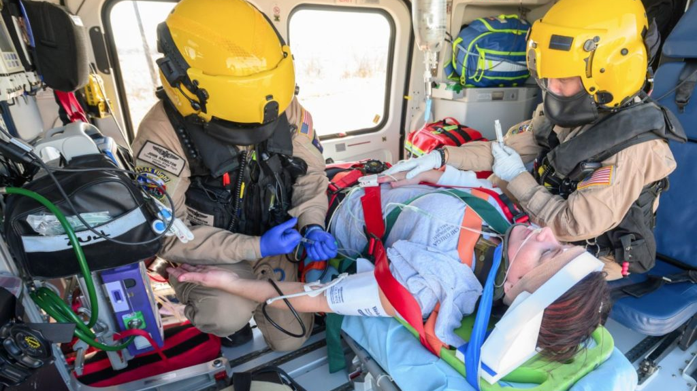
Flight helmet
It provides a maximum peak force deceleration up to 300 g's (0.4milliseconds duration) inside the helmet during a sustained impact(using ANSI Z-90.1 test design),which enables the helmet to distribute the impact to a survivable level for the wearer.

Slide 7
Flight helmet
The flight helmet's design allows communication through a noise-canceling microphone and earphones in the ear cups.

Slide 8
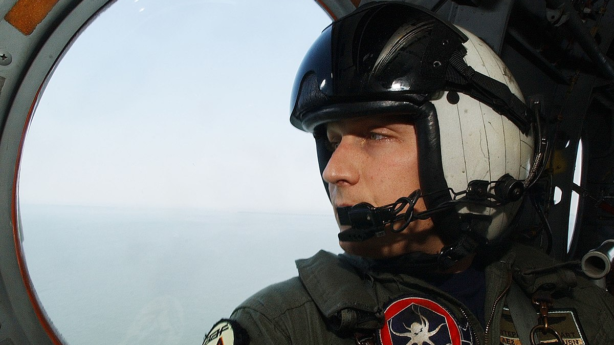
Flight helmet
Other features of a flight helmet include noise suppression, a protective visor, and an energy-absorbing liner. A maxillofacial shield (M FS), which can be attached with latches to an HGU-56/P helmet, protects the lower facial area from flying debris.

Slide 9
Rescue helmet
rescuers aboard helicopters on rescue missions frequently wear climbing helmets and firefighter hard hats, a flight helmet is a superior protective device, since it is specifically designed for this application.

Slide 10
Footwear
leather boots that are at least ankle height, provide added protection against fire injuries. Nylon components on lightweight hiking boots can melt in a post-crash fire, resulting in burn injuries.

Slide 11
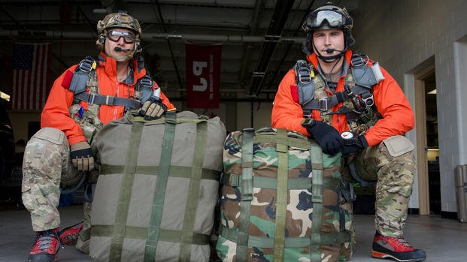
Footwear
The environment of the rescue, such as winter alpine conditions or over-water operations, may dictate footwear (e.g., plastic mountaineering boots) that is more reasonable for outside conditions.

Slide 12
hand, eye, and ear protection
Fire resistant or leather gloves
Sunglasses or clear safety goggles provide excellent eye protection for the blowing prop wash generated by helicopters. Disposable earplugs provide added hearing protection against the high decibel levels of helicopters.

Slide 13
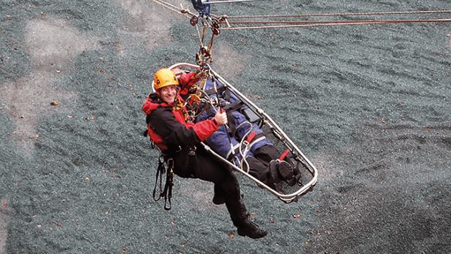
Harnesses
During hoisting, short-haul, and rappelling operations, mission­ specific rescue harnesses are worn by crew chiefs/spotters as a tether to the aircraft.

Slide 14
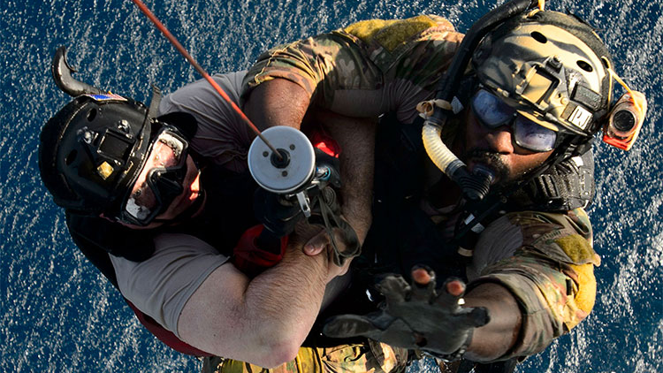
Harnesses
Rescuer/ paramedics/HEMS crewmembers wear harnesses approved by their flight program. The features of these harnesses can include dorsal attachment points, full-body harness design, and suspension comfort

Slide 15
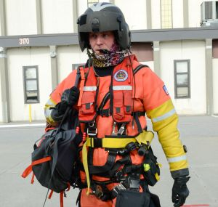
TRI-SAR Helicopter Rescue Harness
Integrated flotation vest (inflated manually with CO2 or orally with air) features a low profile, easy to swim in design, with user variable buoyancy up to 35 lbs.

Slide 16
TRI-SAR Helicopter Rescue Harness
professional grade helicopter hoistable rescue harness with integrated flotation and dual recovery capability. It is standard equipment and approved for US Navy Aviation & US Navy Surface Swimmers.

Slide 17
TRI-SAR Helicopter Rescue Harness
This full body harness is constructed primarily of MIL-SPEC Types 10 and 13 nylon webbing and features quick adjusting stainless steel hardware.

Slide 18
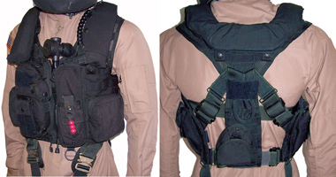
Life vest
When over-water flights lack sufficient glide distance to shore, the aircrew should don an aviation life vest for personal safety.

Slide 19
Life vest
A manually inflatable (not auto inflate), FAA-approved aviation life vest is required as opposed to a bulky, U.S. Coast Guard-approved, foam-filled personal flotation device (PFD), which would restrict a user's ability to safely exit an aircraft submerged in water.

Slide 20
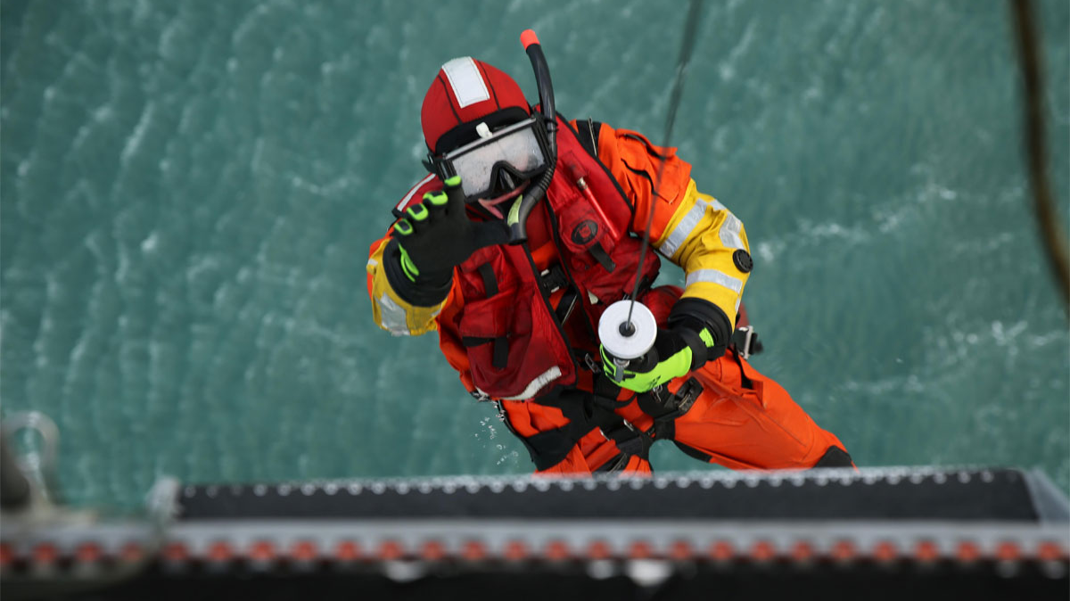
The complete PFD includes the following standard issue equipment
Emergency strobe
Water rescue knife
Whistle
2 Locking Aluminum Carabineers

Slide 21
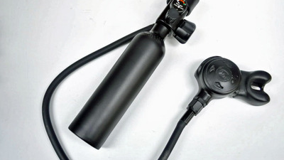
Helicopter Emergency Egress Device (HEED)
The Helicopter Emergency Egress Device (HEED) is designed to enhance the survivability of crewmembers in the event of a water landing.

Slide 22
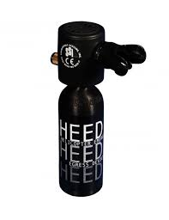
Helicopter Emergency Egress Device (HEED)
The bottle provides approximately 30 breaths to give the user the needed time to exit a submerged aircraft. It may be refilled from a scuba tank and has and external PSI gauge

Slide 23
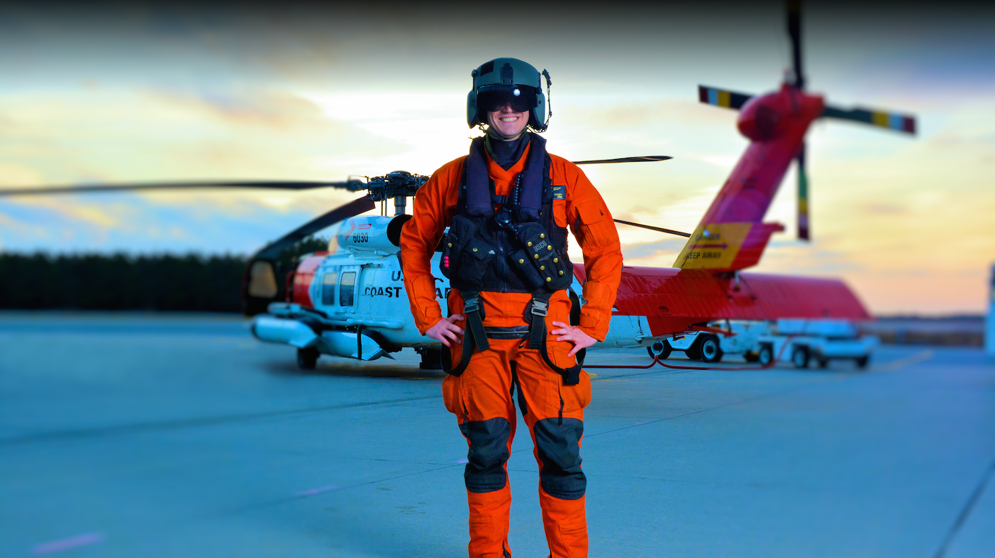
Mustang Dry Suit
Mustang Survival's constant wear dry suit.It is based on the functionality of our legendary Swift Water Rescue Dry Suit

Slide 24
Mustang Dry Suit
GORE-TEX® waterproof & breathable dry suit fabric
Integrated GORE-TEX dry socks
Pull adjust waist band
SOLAS retro-reflective tape on the arms for increased visibility
Neoprene knee pads and elbow pads help prevent injury
Nylon reinforced seat

Slide 25
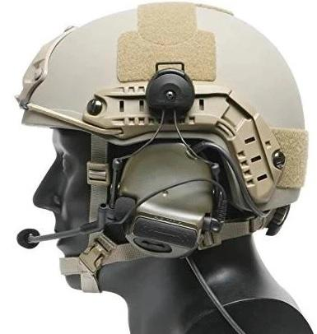
OTTO Tactical 3 Comm/Peltor/TEA
Tactical/Military Grade Push To Talk(PTT) Adapter For 2 Pin Kenwood, Relm/BK, Baofeng, AnyTone & More. Helicopter Helmet Comms Compatible!

Slide 26
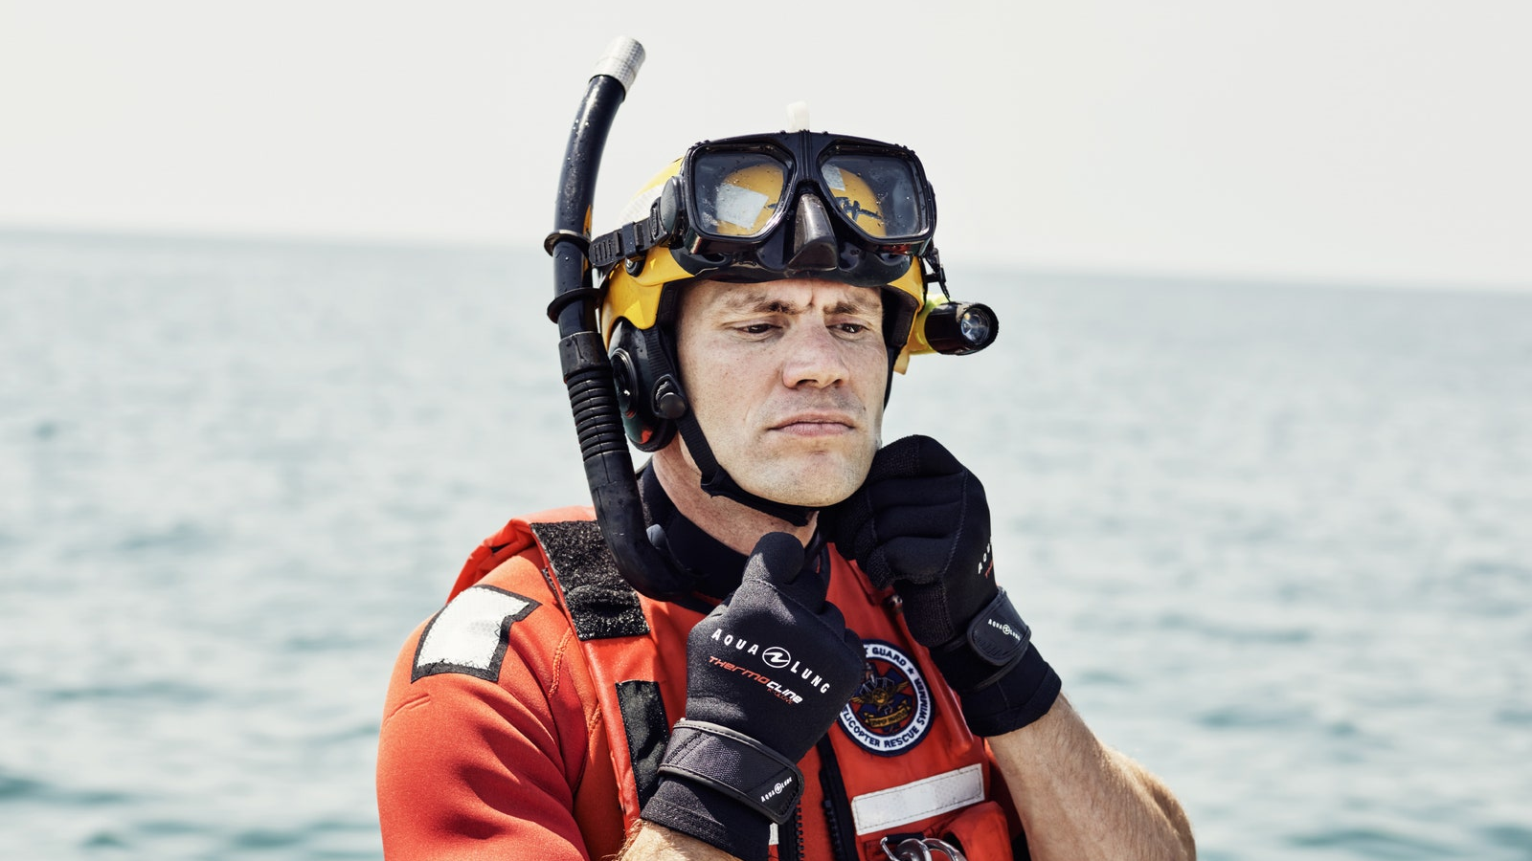
Mask
Heavy-duty, design with impact resistant lens exceeds ANSI 286.11-1985. Black frame and components.

Slide 27
Snorkel
Black neoprene snorkel made by Aqua Lung/ US Divers. Currently approved for use by US Navy and US Coast Guard rescue swimmers. Large bore with flex tube design. Features a flexible mouthpiece.

Slide 28
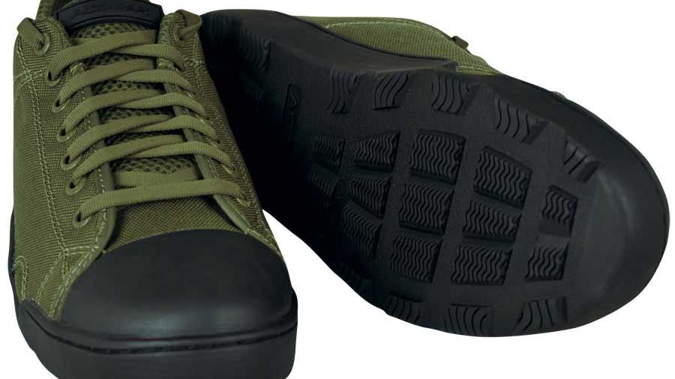
Water Rescue Boots
water-based boot designed for underwater and above water operations. Fits most XL fin pockets making this boot ideal for rescue swimmers, providing improved support, stability, & drainage compared to wetsuit type booties.

Slide 29
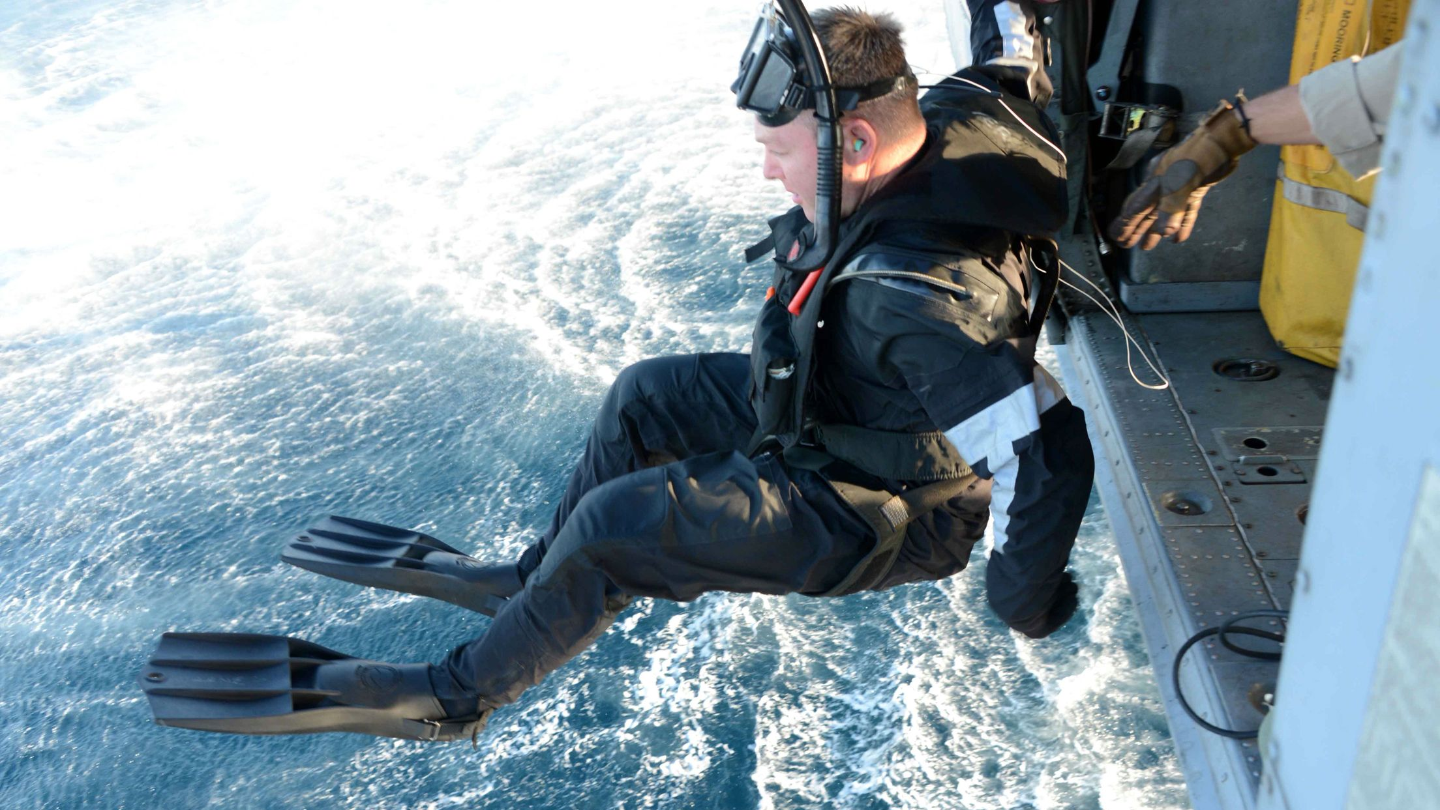
Fins
Rocket Fins
Shredder SAR Rescue Fins

Slide 30
Rocket Fins
Unique rubber compound allows you to achieve greater efficiency by reducing the overall weight. One size fits most.

Slide 31
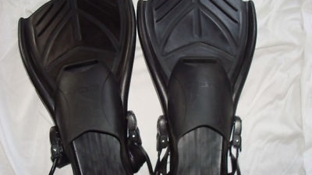
Shredder SAR Rescue Fins
Features a hydrodynamic blade design for improved thrust with less fatigue. Ultra light polymer blade with large foot pocket (fits boots of ice rescue suits). Fin strap with adjustable buckles and quick-release leash.

Slide 32
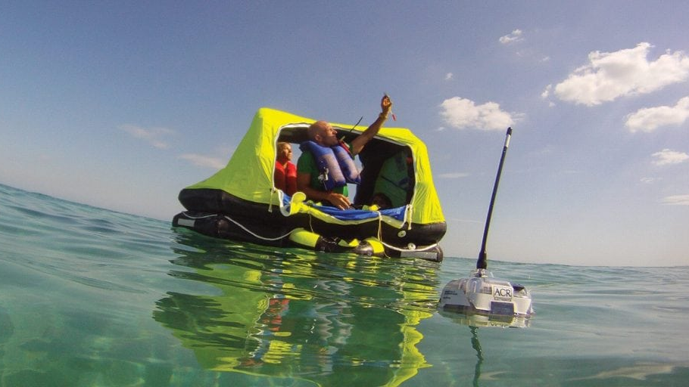
EPIRBs
Category I (automatic hydrostatic deployment) or Category II (manual deployment) mounting options. Each beacon transmits your digital identifier to the COSPAS/SARSAT monitoring system via 406 MHz signal. A separate 121.5 MHz homing signal then guides local search and rescue efforts.

Slide 33
Rescue Wetsuit
Rescue Wetsuit provides our highest level of insulation, while retaining the mobility you need to do your work.

