Slide 1
Lesson 3: Emergency Vehicle Safety
Notes:
Instructor Notes
Lesson 3 provides an overview on emergency vehicle safety.

Slide 2
Objectives (1 of 2)
Understand the risks associated with emergency vehicle operations
Discuss risk-reducing driver behaviors
Discuss the risks of excessive speed and the impact on the total stopping distance
Describe the risks of operating in emergency mode
Explore the impact of distracted driving
Notes:
Instructor Notes
Review the objectives for this lesson.
Expand on the following points:
Understand the risks associated with emergency vehicle operations
Discuss risk-reducing driver behaviors
Discuss the risks of excessive speed and the impact on the total stopping distance
Describe the risks of operating in emergency mode
Explore the impact of distracted driving

Slide 3
Objectives (2 of 2)
Describe the concept of codriving
Explain the importance of inspecting the ambulance and having preventive maintenance performed regularly
Understand importance of securing emergency medical services (EMS) practitioners, patients, and equipment
Describe the measures that can prevent injury in EMS practitioners who perform patient care while the ambulance is in motion
Notes:
Instructor Notes
Review the objectives for this lesson.
Expand on the following points:
Describe the concept of codriving
Explain the importance of inspecting the ambulance and having preventive maintenance performed regularly
Understand importance of securing EMS practitioners, patients, and equipment
Describe the measures that can prevent injury in EMS practitioners who perform patient care while the ambulance is in motion

Slide 4
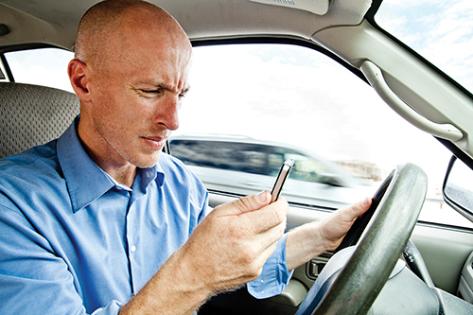
Defensive Driving
Aggressive drivers make operating the emergency vehicle defensively more important than ever.
© becon/iStockphoto.
Notes:
Instructor Notes
Expand on the following points:
We live in a society that engages in many distractions while behind the wheel.
Too many drivers practice aggressive driving.
As emergency vehicle operators, we must be on the defensive at all times when we are on the road.
That can be exhausting.
Often there is a partner in the cab who can help navigate around the hazards of the road.
Remember, two set of eyes are better than one.

Slide 5
Scenario
What went wrong?
Distraction
Speed
Assumption
Notes:
Instructor Notes
Present the fictional scenario and then lead a discussion on the events that preceded the motor vehicle crash.
Case study:
Rescue 35 was dispatched to respond to a motor vehicle crash (MVC). It was their fifth call in 5 hours.
When they received the call, they were in front of the ambulance eating lunch. The crew stopped eating and started enroute emergently to the location of the call.
As they approached an eight-lane highway, they had the red light.
Per company policy, the emergency vehicle operator came to a complete stop, carefully clearing lanes as they proceeded across the first six lanes.
His partner was looking down at the map while eating.
The incident they were responding to came into view approximately 500 ft. past the light.
It was an obviously serious crash.
The emergency vehicle operator started to think about where he would park, what equipment they would use, and what additional resources they would need.
There were two more lanes to cross, but it appeared that all the traffic on his right was stopped.
He accelerated without clearing the final two lanes.
Suddenly he heard his partner yell, “Car!” and heard the screeching of tires.
Then he felt the impact.
They slide down the road, vehicle on its side.
He felt searing pain in his left arm and leg.
When the unit came to a stop, he couldn’t move.
He was pinned under the rescue box and knew he was probably going to die.
He thought about his wife and baby girl before becoming unconscious.
He woke up in the ICU at the same local trauma center where he had transported hundreds of patients.
Eighteen days later he would be going in for his sixth surgery, to remove his arm that was so badly damaged that it could not be saved.
The emergency vehicle operator was told the driver of the other car had an excellent driving record.
He had the green light and did not see the ambulance until it was too late.
He was restrained and the air bag deployed, likely preventing serious injury.
Press the forward button and each of the key points will appear on screen:
Distraction
The emergency vehicle operator started clearing lanes carefully, but failed to continue to clear with caution after seeing the crash scene.
The partner was distracted with eating and a map instead of participating as a codriver.
Speed
The emergency vehicle operator accelerated while still crossing lanes against the light.
Assumption
The emergency vehicle operator assumed that all other drivers could see the ambulance, although he could not clearly see all of the lanes.

Slide 6
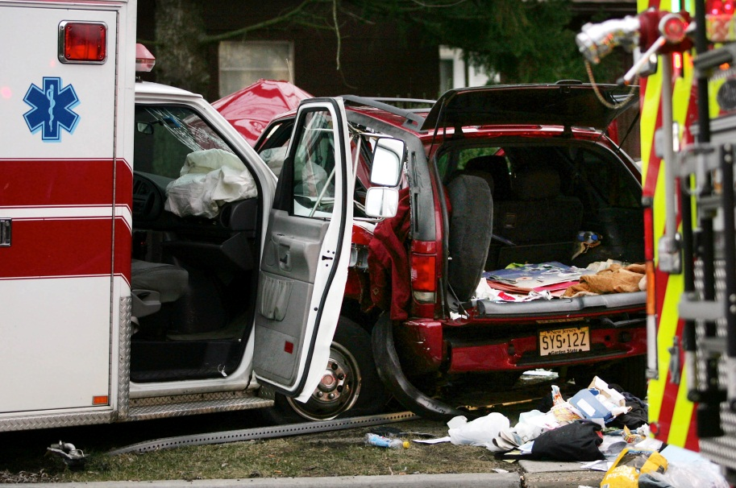
Avoiding Collisions (1 of 2)
MVCs occur on clear, dry days.
Most occur in intersections.
Intersection MVCs are the most severe.
Head-on collisions are the most deadly.
© Dale Gerhard/The Press of Atlantic City/AP Photo
Notes:
Instructor Notes
Expand on the following points:
The majority of MVCs involving ambulances occur on clear days with good visibility and dry roads.
Most occur in intersections during daylight hours.
MVCs in intersections have the highest rate of severity.
Head-on MVCs are the most deadly.

Slide 7
Avoiding Collisions (2 of 2)
Locations with traffic signals pose the greatest risk
Most fatal MVCs involve excessive speed
Seat belt use improves survivability
Near-misses are a warning!
Identify the risk factors to prevent them from repeating
Report near-misses to EMS Voluntary Event Notification Tool (EVENT)
Notes:
Instructor Notes
Continue with the discussion on avoiding collisions.
Refer back to the previous case study and video, as both clearly illustrate that human errors lead to MVCs.
Expand on the following points:
Locations where traffic signal devices exist present the greatest risk for an MVC involving an ambulance to occur.
Excessive speed is a factor in most fatal MVCs involving ambulances.
Wearing your seat belt improves your survivability.
Count your near-misses, they are a warning!
By identifying the risk factors, you can try to prevent them from happening again.
Report near-misses to the EVENT.
EMS practitioners can voluntarily and anonymously report near-misses.
The information is collected in a database and analyzed.
The analytics are used to help prevent similar events from repeating through the development of preventive measures such as training programs.
No individual responses are shared or transmitted to outside parties.

Slide 8
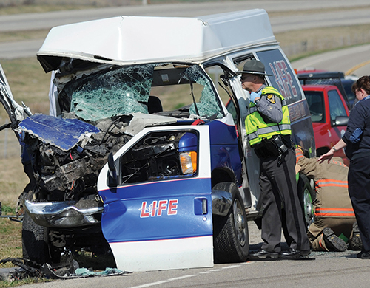
Collision Risk Factors (1 of 3)
Intersections
Following distance
Vehicle speed
Distractions
© Frank Robertson/Chillicothe Gazette/AP Photo.
Notes:
Instructor Notes
The four situations listed onscreen present the highest risk for an MVC.
Ask participants, “What are the driving practices we should be learning to mitigate the risk of collision from intersections, decreased following distance, excessive vehicle speed, and driver distraction?”
Lead a discussion about the risk factors and steps we can take to reduce the risks.
Ask participants about their agency’s policies and their state’s statutes for operating an emergency vehicle.
At the end of the discussion, continue to the next slide, which discusses how to mitigate the four common risk factors.

Slide 9
Collision Risk Factors (2 of 3)
Intersections
Change the siren cadence
Stop completely
Repeat the lane clearance process
Avoid excessive speed
Do not push drivers into an intersection
Notes:
Instructor Notes
Discuss the strategies to mitigate the intersection risk factors.
Expand on the following points:
Upon approaching an intersection, change the siren cadence
Come to a complete stop at red lights and stop signs
Then move cautiously through the intersection
When moving through multilane intersections, repeat the lane clearance process
Failure to clear all lanes is a common cause of MVCs
Partners in the front passenger seat should function as codrivers
Stay alert and participatory, especially in intersections
Uncontrolled intersections are a high risk, even when you have the right-of-way
Excessive speed through intersections is a causal factor in many serious ambulance crashes
If traveling through a green light:
Change the siren cadence
Reduce your speed
Cover the brake pedal with your foot to help you quickly react
Never “push” other drivers into an intersection against a red light
Remember that:
Yellow lights typically stay yellow for 1 second for every 10 miles per hour (mph) of the posted speed limit
For example, a 30-mph speed limit equals a 3-second yellow light
Crosswalks are a good way to judge traffic lights
Beware of “stale” green lights
Opticom can be a hazard when running with other agencies or units using the same technology

Slide 10
Collision Risk Factors (3 of 3)
Following distance
Decrease your speed and increase the following distance for poor visibility or road conditions.
Vehicle speed
Speed reduces reaction times and increases traumatic forces.
Distractions
Driving is one of the most important and dangerous elements of the job.
Notes:
Instructor Notes
Discuss the strategies to mitigate the risk factors of reduced following distances, excessive vehicle speed, and distracted driving.
Expand on the following points:
Reduced following distances:
Tailgating is a common cause of collisions, even in nonemergency driving.
Ambulances have a greater stopping distance than most cars.
Decrease your speed and increase the following distance in areas of poor visibility.
Decrease your speed and increase the following distance in adverse weather, road, or traffic conditions.
Excessive vehicle speed:
Excessive speed is a common factor in most serious ambulance crashes.
Speed reduces our ability to react.
Velocity significantly increases the forces in a collision.
Distractions:
We have many “opportunities” to be distracted while operating an emergency vehicle.
Driving is one of the most important and dangerous elements of the job.
Our patients, partners, families, and the general public deserve alert and professional emergency vehicle operators behind the wheel of all emergency vehicles.

Slide 11
Preventing Collisions
Leave yourself an escape route
Always maintain a safe following distance
Look ahead
Give other drivers time to react
Increase your following distance when needed
Use extreme caution if driving in tandem
Notes:
Instructor Notes
Some important pearls of wisdom to share with participants on preventing collisions.
Expand on the following points:
Leave yourself an escape route
Use a minimum 4-second following distance for speeds of 40 mph or less
Add 1 second for every 10 mph over 40 mph
At red lights, leave room in front of you when you are stopped
You should be able to see the rear tires on the car in front of you
Be aware of your surroundings
Look out for hazards and road work
Look ahead
Watch traffic patterns and traffic signals in the distance
Preplan and prepare
Ask yourself, “What if?”
Give other drivers time to react
Use your turn signals
Make 12-second lane changes
4 seconds—Blinker on
4 seconds—Check mirrors
4 seconds—Lane change, one wheel at a time
Allow others to pass you rather than tailgate you
Avoid being closely followed to the hospital by anxious family or friends
Increase your distance from drivers that you feel are unsafe
Increase your distance in situations where there is poor visibility
Use extreme caution with multiple unit responses
If driving in tandem with another emergency vehicle, allow enough distance so drivers will be aware of both emergency vehicles

Slide 12
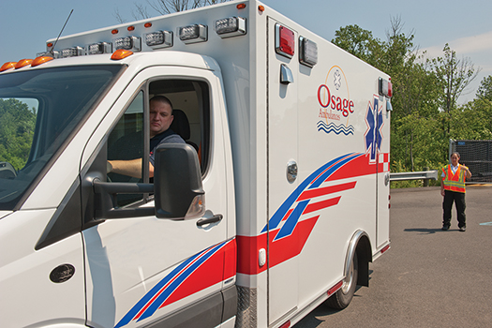
Backing
25% of commercial vehicle collisions
18,000 injuries annually
292 deaths annually
Avoid backing
Use a spotter when it is necessary
© Jones & Bartlett Learning. Photographed by Glen E. Ellman.
Notes:
Instructor Notes
Note to participants that according to Kidsandcars.org, fifty children are backed over by vehicles every week and that two children die from their injuries every week.
Ask participants about their agency’s policy on using spotters during backing.
Expand on the following points:
Backing is an important space management issue.
Do not back the ambulance unless absolutely necessary.
According to the Department of Transportation:
Backing collisions account for 25% of all commercial vehicle collisions.
Approximately 18,000 injuries from backing vehicles occur annually.
Approximately 292 deaths from backing vehicles occur annually.
Considering the average driver operates in reverse less than one mile a year, these are alarming statistics.
Disarmed backup alarms are surprisingly common in ambulances.
Regular use of a spotter significantly decreases the risks of backing.

Slide 13
Case Study
Lack of lighting
Headphones
Not following protocols
Disabled alarm
Notes:
Instructor Notes
Present the case study and then lead a discussion on the events that led to fatality of the EMS practitioner. The case is an example of how multiple factors are often involved in tragic events, and how quickly a simple backing maneuver can go very wrong.
Case study:
In Florida, a Vehicle Supply Technician (VST) was walking through the ambulance parking area at dusk.
The parking lot lights were delayed because of a recent time change.
She put her headphones on and walked toward the wash bay to clean some equipment.
Another technician had just finished restocking an ambulance and was preparing to move it to the parking lot.
The ambulance in front of him was in the middle of being restocked.
He decided to back his ambulance out of the bay into an open spot directly behind him.
The distance was approximately 100 ft.
The backup alarm was disabled.
The crash report states that he was traveling at approximately 10 to 15 mph in reverse.
When nearing the middle of the parking lot, the technician felt a bump.
He immediately stopped the ambulance and got out to investigate.
He found the first VST laying on the ground behind the ambulance.
She was unresponsive and bleeding from her head.
He ran for help. She was treated by paramedic staff and flown to the local trauma center.
She never regained consciousness and died 4 days later from a massive intracranial bleed.
Press the forward button and each of the key points will appear on screen:
What led to this tragedy?
The parking lot lights would normally be on.
The VST was wearing headphones and could not hear the ambulance.
There was a deviance in the normal routine of driving the ambulance forward through parking lot.
The clothing she was wearing was dark in color.
The backup alarm was disabled prior to backing.

Slide 14
Rate of Closure
The time to close the distance between you and another vehicle
Allow other drivers the time and distance to react safely
Do not tailgate
Notes:
Instructor Notes
Expand on the following points:
The rate of closure is the time to close the distance between you and another vehicle, relative to both speeds.
Allow other drivers to have sufficient time to react and to safely move out of your way.
Lights and sirens often startle people, and they may need time to overcome their momentary panic.
Assume nothing! Decrease your speed early enough to be able to safely stop if necessary.
Do not tailgate.
Remember the minimum following distances.
Several states have now changed the law from pull over to the right to pull over to the closest curb.
Others have not.
What does your state require?
Remember: people from other states often drive according to the laws in their own state, so always expect the unexpected!

Slide 15
Excessive Speed
Reduces the driver’s ability to react quickly.
Increases the consequences of a MVC.
Speeding is a deliberate and calculated behavior.
A speeding driver knows the risks and ignores the dangers.
Speeding in oncoming traffic is hazardous and reckless.
Notes:
Instructor Notes
Discuss the importance of speed related to defensive driving.
Expand on the following points:
Speeding is a contributing factor in 30% of all fatal crashes.
Speeding reduces the driver’s ability to react quickly.
It increases the consequences of an MVC.
Speeding is a deliberate and calculated behavior.
A speeding driver knows the risks and ignores the dangers.
Speeding in oncoming traffic is hazardous and reckless.

Slide 16
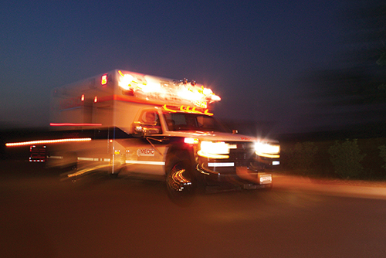
Operating in Emergency Mode (1 of 2)
What percentage of collisions happened while “running hot”?
70%
© Stockbyte/Thinkstock.
Notes:
Instructor Notes
Ask participants what percentage of ambulance collisions occur while the ambulance is operating in emergency mode.
Also called running hot, code 3 driving, or using lights and sirens.
After the participants have given their answers, click on the forward button and reveal the answer:
70%
Expand on the following points:
According to NHTSA, 70% of ambulance collisions happened while operating with lights and sirens.

Slide 17
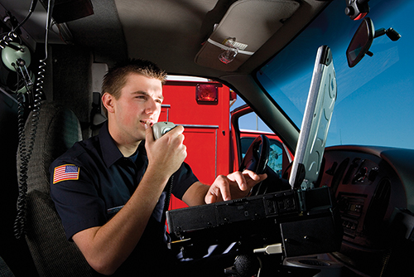
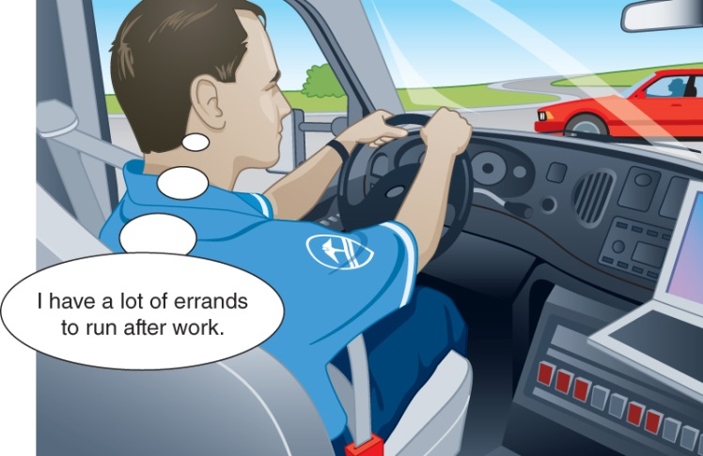
Distractions
Visual and manual distractions
Cognitive distractions
© Bounce/Cultura/Getty.
Notes:
Instructor Notes
Expand on the following points:
Distractions increase the risk of collisions.
Visual distractions are anything that lures you to take your eyes off the road.
Ask participants to list some examples of visual distractions.
Manual distractions are things that take your hands off the wheel.
Ask participants to list some examples of manual distractions.
Cognitive distractions are things that take your mind off the road.
Ask participants to list some examples of cognitive distractions.

Slide 18
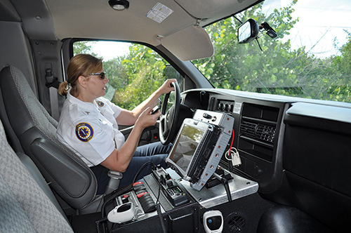
Text Messaging (1 of 2)
The perfect storm of distractions.
A combination of visual, manual, and cognitive distractions.
Courtesy Sunstar Paramedic.
Notes:
Instructor Notes
Expand on the following points:
Texting is a “perfect storm” of distraction.
It requires you to look at the device (visual distraction), manipulate the keys (manual distraction), think about what you are writing (cognitive distraction).
This means texting is a visual, manual, and cognitive distraction all in one.
Texting while driving is also an example of a self-reinforcing behavior.
Drivers get away with it repeatedly, which reinforces the behavior.
The reality is that drivers are unable to adhere to the responsibility of driving with utmost caution while engaged in this highly distracting action.

Slide 19
Test Your Focus (1 of 2)
Take out your cell phone
Text the message on the next slide to a friend or family member
Do not use any shortcuts or use the voice to text feature
Notes:
Instructor Notes
Before class, secure a tennis ball and bring it with you on the day of the class.
At this point in the lecture, begin the interactive exercise that proves that a driver cannot focus on safely operating a vehicle and text at the same time.
Hand the tennis ball to one participant.
Assign two participants to assist you by watching the ball and keeping track of how many times it passes back and forth.
Ask the rest of the participants to stand and take out their cell phones.
Next, ask the participants to put one hand out as if holding onto a steering wheel.
Ask the participants to text the message on the next slide to a friend or family member.
Participants should not use any shortcuts or use the voice to text feature.

Slide 20
Test Your Focus (2 of 2)
Start texting:
# This is only a test message☺
Notes:
Instructor Notes
Ask the participants to begin texting and keep track of how many times the ball is passed back and forth.
When the participants have finished texting, say “Stop.”
Now ask the participants how many times the ball was passed by a show of hands: 9, 10, 11, 12, 13 times?
Have your assistants give the actual results.

Slide 21
Codriving
The codriver is responsible for all nondriving tasks
Siren changes
Navigating
Responding to the radio
A protective distraction
© Tyler Olson/Shutterstock.
Notes:
Instructor Notes
Refer participants back to the principles of situational awareness from Lesson 2 and Chapter 2: Crew Resource Management.
Ask participants whether codriving is part of their routine.
Expand on the following points:
The person in the driver’s seat needs to focus on operating the vehicle.
The codriver in the passenger seat should be responsible for all nondriving tasks, including:
Siren changes
Navigating
Responding to the radio
Codrivers can be considered to be a protective distraction.
A cooperative partner can reduce the risks of driving emergently by staying engaged as a codriver.

Slide 22
Distracted Driving
What can we do to combat distracted driving?
Courtesy of Sunstar Paramedics.
Notes:
Instructor Notes
Ask participants, “What can we do to combat distracting driving?”
After participants have given their answers, discuss the strategies listed as follows.
Expand on the following points:
Leave your phone on silent and out of reach.
Only check for messages when your vehicle is in park.
Have your partner answer your phone or reply for you.
If you need to have a phone conversation or text, then have your partner drive.
Secure all objects in the ambulance.
Have your partner navigate or plan your route before driving.
Have your partner handle the radios whenever possible.
Talk on the radio only when it is safe to do so.
For example, prior to placing the vehicle in drive or at red lights
Place any object that you feel may distract you out of sight and out of reach.
Pull over to the side of the road if you feel the need to deviate from a safe practice.
Get a good night’s sleep and do not drive drowsy.
Remember:
Other drivers may be distracted while behind the wheel.
Stay alert and stay away from those who are blinded by distraction!

Slide 23
Advice to Live By
Emergency vehicle operators are professional drivers.
Always practice safe driving.
Skills should be refreshed yearly.
Learn from near-misses.
An ambulance should be a safe environment for the patient and crew.
Notes:
Instructor Notes
Expand on the following points:
Emergency vehicle operators are professional drivers.
Anything that takes your attention away from the road is dangerous.
Safe driving is not something to be practiced just some of the time.
Make a commitment to safe vehicle operation at all times.
Skills should be refreshed yearly.
Learn from near-misses.
An EMS vehicle should be a safe environment for the transport of the crew and the transport and treatment of the patient.
The best way we can stay safe is to stay committed to driving safely.

Slide 24
An Important Note
Unlike other professional drivers, emergency vehicle operators do not have hours of service rules.
Tired, drowsy, and fatigued driving is extremely dangerous.
Dangerous practices need to stop before exhaustion leads to death.
Notes:
Instructor Notes
Discuss why the hours of service are not regulated in emergency vehicle operators and the risks of fatigued driving.
Expand on the following points:
Unlike other professional drivers, there are no hours of service rules for emergency vehicle operators in EMS.
These are rules and regulations that govern how much rest between work shifts a driver must have.
It also limits the length of a shift.
Although federally mandated hours of service do not apply to EMS personnel, some states have enacted laws which impose criminal liabilities on those who are involved in a crash in which lack of sleep was a factor.
These laws have been used to prosecute ambulance drivers.
Tired, drowsy, and fatigued driving is extremely dangerous.
Sleep debt and microsleeping are covered in Lesson 7 and in Chapter 7: Personal Health.
Studies, including a 2003 study that appeared in the Journal of Sleep Research, have shown that being awake for 16 to 24 hours results in the same driving behaviors as someone who is legally intoxicated.
As EMS practitioners, we need to examine our regulations and work rules.
Emergency vehicle operators are professional drivers and need to be recognized as such.
Dangerous practices need to stop before exhaustion leads to death.

Slide 25
Vehicle Inspections
© LeventKonuk/iStockphoto.
Notes:
Instructor Notes
Ask participants, “What do you do to take responsibility for your vehicle?”
Expand on the following points:
Ambulances are poorly designed for maneuverability, quick stops, and handling under excessive forces.
Because of this, a well-maintained and routinely inspected vehicle is a crucial component of ambulance safety.
Vehicle inspections should be taught, monitored, documented, and retained.

Slide 26
Vehicle Maintenance
Show respect to all of the people and equipment that help you to do your job
Get to know your fleet mechanics
Know your vehicles!
Notes:
Instructor Notes
Expand on the following points:
Show respect to all of the people and equipment that help you to do your job safely
Particularly ambulances
Get to know your fleet mechanics
Taking this step will help you understand the mechanics’ challenges and help the mechanics understand yours.
Remember, these are the people who “pack your parachute.”
Know your vehicles
Pay attention to what they are telling you

Slide 27
Respect Your Vehicles
Respect it when you check it.
Respect it when you drive it.
Respond aggressively to any safety concerns.
Notes:
Instructor Notes
Explain the importance of vehicle respect.
Expand on the following points:
Your vehicle helps you to make a living and helps you treat and transport your patients.
It can also kill.
Respect it when you check it and respect it when you drive it.
Always respond aggressively to any safety concerns, like grinding brakes.

Slide 28
Occupants and Equipment
Everyone and everything must be restrained.
This reduces the inherent risks of being an occupant in an ambulance.
Notes:
Instructor Notes
Expand on the following points:
The risk of occupational injury and death is disproportionately high for EMS practitioners.
The majority of those casualties are associated with transportation incidents.
Ambulances are not built or used the same manner as standard passenger vehicles.
This results in safety concerns for both the caregivers and patient.
While there are inherent risks to occupants in an ambulance, some of the risks can be reduced by properly restraining occupants and equipment.

Slide 29
Seatbelt Use (1 of 2)
Seat belt use is for everyone.
Not just the patient and emergency vehicle operator.
Some EMS personnel still do not routinely use seat belts.
Notes:
Instructor Notes
Take a poll of the participants via a show of hands.
Ask the participants to raise their hands if they:
Always wear a seat belt while driving.
Always wear a seat belt while a passenger in the front seat.
Always wear a seat belt in the patient compartment.
Sometimes wear a seat belt in the patient compartment.
Never wear a seat belt in the patient compartment.
Expand on the following points:
Seat belt use is for everyone, not just the patient and the emergency vehicle operator.
Everyone.
Surveys continue to show a small percentage of EMS personnel still do not routinely use seat belts in the cab!

Slide 30
Seatbelt Use (2 of 2)
When the ambulance is in motion, seat belts should be on.
Failure to use provided restraint systems creates risks for ALL occupants.
© Stockbyte/Thinkstock.
Notes:
Instructor Notes
Continue with the discussion on seat belt use.
Expand on the following points:
Emergency or not, every occupant in the ambulance should always use seat belts while in motion.
Most organizational policies require restraint use.
Emergency vehicle operators should take responsibility for ensuring occupant restraint use.
Most states mandate driver responsibility.
Failure to use the provided restraint systems creates risks for all occupants, whether restrained or not.
Caregivers and other occupants become projectiles, endangering themselves and others.

Slide 31
Ambulance Crash Test (1 of 4)
Notes:
Instructor Notes
Click on the arrow to play the video.
Expand on the following points:
This video shows the results of a 30-mph laboratory controlled test crash.
Note that there is minimal damage to the exterior of the patient compartment.

Slide 32
Ambulance Crash Test (2 of 4)
Notes:
Instructor Notes
Click on the arrow to play the video.
Expand on the following points:
The second video is a view of an ambulance crash test from the patient compartment.

Slide 33
Ambulance Crash Test (3 of 4)
Notes:
Instructor Notes
Click on the arrow to play the video.
Expand on the following points:
The third scene is a view of an ambulance crash test from the patient compartment.
Note the patient crashing into the seated EMS practitioner.

Slide 34
Ambulance Crash Test (4 of 4)
Notes:
Instructor Notes
Click on the arrow to play the video.
Expand on the following points:
The fourth video is a view of an ambulance crash test from the CPR seat.
Traditional cardiopulmonary resuscitation CPR seat configurations have been shown in numerous tests to have a high likelihood of severe injury in a frontal impact/frontal deceleration event.
At the conclusion of the video, ask participants what other options we should be considering to decrease this risk.

Slide 35
Patient Compartment (1 of 2)
Risks include:
Unsafe structural designs
Hostile interior surfaces
Side-facing seats
The need to be unrestrained to provide patient care
Human and other projectiles
Notes:
Instructor Notes
Ask the participants, “What it is about this structure that makes occupants so vulnerable to injury when the ambulance is in motion?”
After the participants give their answers, click on the forward button and discuss the risks listed below in further detail.
Expand on the following points:
The risks of the patient compartment include:
Unsafe structural designs
Hostile interior surfaces
Side-facing seats
The need to be unrestrained to provide patient care
Human and other projectiles

Slide 36
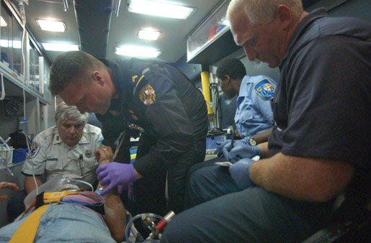
Patient Compartment (2 of 2)
Injuries can occur from:
Sudden evasive maneuvers
Curb strikes
Aggressive braking
Unanticipated cornering
Slips and falls
© Mark C. Ide.
Notes:
Instructor Notes
Ask participants how many of them have NOT been thrown around while providing care in a moving ambulance.
Expand on the following points:
Injuries can occur in a patient-care compartment without an actual collision.
Injuries can occur due to:
Sudden evasive maneuvers
Curb strikes
Aggressive braking
Unanticipated cornering
Slips and falls

Slide 37
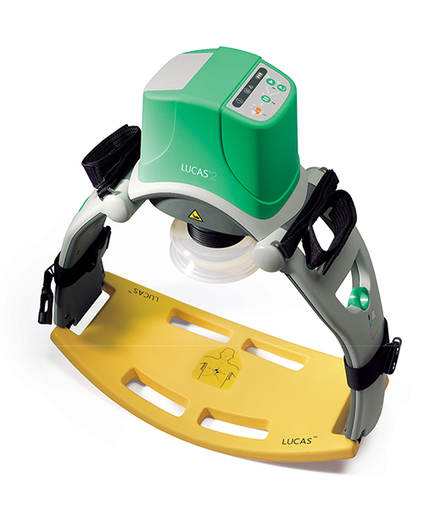
Risk Mitigation
Use restraints
Use a rear-facing seat
Avoid standing
Allow only necessary occupants
Use hands-off care and communications technology
Courtesy of Physio-Control, Inc.
Notes:
Instructor Notes
Expand on the following points:
Some important strategies for minimizing the risks related to collisions and noncollisions include:
Use restraints whenever possible
Use a rear-facing jump seat when possible
Avoid standing
Allow only necessary occupants in the patient compartment
Consider “hands-off” patient care and communications technology

Slide 38
Working in Motion
Consider the preparation and ergonomics actions you can take to preserve your safety.
Avoid running code with unrestrained personnel!
Notes:
Instructor Notes
Ask participants:
“What can be done to minimize the risks while the ambulance is in motion?”
“What patient care procedures can be done prior to setting the ambulance in motion?”
“What equipment and supplies can be placed in reach to limit the need to move from your seat?”
“What unnecessary actions can you eliminate while in motion in order to stay seated?”
After the participants have shared their answers, present the key point below.
Expand on the following points:
Avoid running code with unrestrained personnel.
Are the minutes saved worth the increased risk?

Slide 39
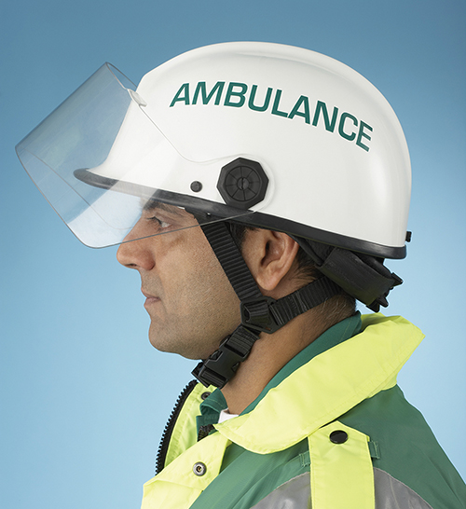
Helmet Use
Pros
Cons
© Volt Collection/Shutterstock.
Notes:
Instructor Notes
Lead a discussion on the pros and cons of wearing a helmet while in the patient-care compartment.
Some pros may include:
“It’s just like a flight medic.”
Flight medics have “cool looking” helmets.
The cons may include:
The helmet for “ground medics” is not “cool looking.”
Remind participants that many of the arguments for not wearing helmets now are the same arguments that used to be made about wearing gloves and using pocket masks.

Slide 40
Adult Patient Restraint
Straps must be:
Used correctly
Secure and snug
For patients—not equipment
Shoulder restraints must be used!
Complacency is dangerous and unacceptable.
Notes:
Instructor Notes
Ask the participants, “Why is it difficult to restrain adult patients?”
Answers may include:
No one position works for all patients
Patient comfort issues
The presence of medical equipment
Equipment limitations
After the participants have shared their answers, review the importance of using straps to secure adult patients.
Expand on the following points:
All restraints must be used per manufacturer guidelines.
Straps should be secure and snug.
Use the patient restraints only for the patient—not equipment—during transport.
Shoulder restraints are a must!
Complacency is dangerous and unacceptable.

Slide 41
Patient Safety
Stretcher is completely secure in mounts.
Patient faces rearward.
Patient’s head elevated if appropriate.
Stretcher is the preferred patient location.
Notes:
Instructor Notes
Expand on the following points:
For the safety of the patient, the patient stretcher must be completely secure in its mounts.
Ideally, the patient faces rearward.
The patient’s head should be elevated, when medically appropriate.
The stretcher is the preferred patient location because the patient can be sitting up.
Versus on the side-facing bench seat.

Slide 42
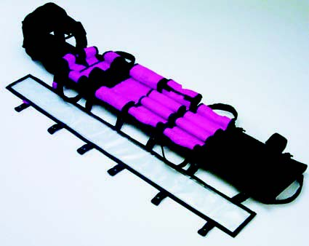
Pediatric Patient Transport (1 of 3)
Need child-specific transport equipment.
Stretcher is designed for adults.
Children come in all sizes.
Child safety equipment must be carried and used.
Courtesy of Allied Healthcare Products, Inc.
Notes:
Instructor Notes
Expand on the following points:
Children present a unique set of challenges to transport safely in an ambulance.
EMS practitioners cannot be complacent in using properly placed restraint devices designed for children.
Discuss the challenges to restraining pediatric patients:
The stretcher is made for adults.
Children come in all heights and weights.
Additional child safety equipment must be carried and used.
The tendency to be closer to and comfort children leads to unrestrained occupants.

Slide 43
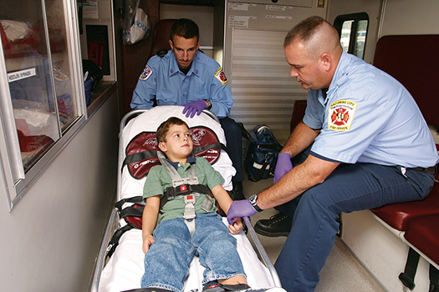
Pediatric Patient Transport (2 of 3)
Do:
Use properly sized child restraint devices
Fully secure child restraint systems per guidelines
Ensure ALL occupants are restrained
Notes:
Instructor Notes
Expand on the following points:
According to EMS for Children (EMSC) experts we should:
Use properly sized child restraint devices.
Fully secure child restraint systems per the manufacturer’s guidelines.
Ensure ALL occupants are restrained when in motion.

Slide 44
Pediatric Patient Transport (3 of 3)
Don’t:
Transport kids who are not patients
Allow occupants to be unrestrained
Hold the patient during transport
Notes:
Instructor Notes
Expand on the following points:
According to EMSC experts we should NOT:
Transport children who are not patients.
Use alternate transportation in passenger vehicle when available.
Allow parents, caregivers, EMS practitioners, or other passengers to be unrestrained during transport.
Allow the pediatric patient to be held during transport.

Slide 45
Securing Equipment
Unsecured equipment is a projectile hazard.
Secure equipment with straps and brackets.
Notes:
Instructor Notes
Expand on the following points:
In EMS, we like our stuff.
We continually add new equipment to better care for our patients, but could do better when securing those items.
Unsecured equipment is a projectile hazard, increasing risk of injury to all ambulance occupants.
Additionally, unsecured equipment is frequently damaged, even with normal vehicle operations.
Secure equipment with brackets and straps to prevent injuries.

Slide 46
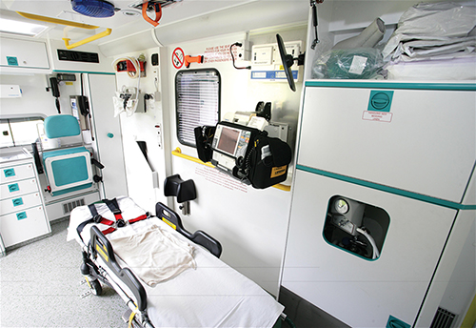
Potential Projectiles
Personal protective equipment (PPE) gear
Patient belongings
Medical equipment
Personal gear
Firefighting gear
Wheelchairs
Flight team equipment
© Jones & Bartlett Learning.
Notes:
Instructor Notes
Expand on the following points:
Any unsecured item could become a projectile during a collision and/or sudden deceleration or rollover.
To the extent possible, store these items in exterior compartments.

Slide 47
Securing Equipment Do’s
Ensure all normal daily equipment has its place and is secured
Use cabinets and brackets
Secure needed equipment in reach
Select soft over hard kits
Store unnecessary items in exterior compartments
Use seat belts to secure “surprise” items
Plan ahead
Notes:
Instructor Notes
Ask participants: “What items or supplies do you keep unsecured on the bench seats?”
After the participants share their answers, review the “Do’s” list of securing equipment.
Expand on the following points:
Ensure that all normal daily equipment has its place and is routinely secured
Use cabinets, straps, and brackets to secure items
Secure needed equipment in reach, when possible
Select soft over hard kits for use in the patient compartment
Stow unnecessary items in exterior compartments
Use seat belts or straps to secure “surprise” items
Plan ahead to avoid last minute complacency

Slide 48
Securing Equipment Don’ts
Leave hard or heavy items unsecured
Transport unnecessary items
Secure equipment with restraints intended to secure the patient
Get complacent
Notes:
Instructor Notes
Expand on the following points:
Review the “Don’ts” list of securing equipment:
Leave hard or heavy items unsecured while in motion
Have unnecessary items in the patient compartment
Attempt to secure monitors and oxygen bottles with restraints intended to secure your patient
Get complacent
Laptops, portable radios, and other small, hard items can be deadly projectiles

Slide 49
Summary (1 of 2)
Due to aggressive drivers, it is vital to practice defensive driving.
Near-misses are a warning!
If you must back the ambulance, use a spotter.
Texting is the perfect storm of distractions.
Emergency vehicle operators are professional drivers.
Notes:
Instructor Notes
Expand on the following points:
Due to aggressive drivers, it is vital to practice defensive driving.
Near-misses are a warning!
Analyze what led to the near-miss and how you can ensure it does not happen again.
If you must back the ambulance, use a spotter.
Texting is the perfect storm of distractions.
When operating the ambulance, the sole focus should be on driving.
Emergency vehicle operators are professional drivers.

Slide 50
Summary (2 of 2)
Respect your vehicles.
Always wear a seat belt.
Use straps for adult patients and pediatric restraint systems.
Secure the patient compartment.
Notes:
Instructor Notes
Expand on the following points:
Respect your vehicles.
Always wear a seat belt.
Use straps for adult patients and pediatric restraint systems.
EMS does a poor job securing ourselves and patients yet we judge others who don’t use seat belts or child seats
Secure the patient compartment.

Slide 51
Wrap-Up
Questions?
Notes:
Instructor Notes
Ask the participants if they have any questions.

