Slide 1
FIRST ON THE SCENE
WHAT TO DO UNTIL EMS ARRIVES

Slide 2
Lesson 7: Properly Moving Patients to Safety
Notes:
Welcome to Lesson 7: Properly Moving Patients to Safety

Slide 3
Lesson 7: Objectives
Demonstrate how to perform a one-person drag and carry
Demonstrate how to perform a two-person carry, and how to use rescue drag tarps
Notes:
Instructor Notes:
In this lesson, you will learn how to perform a one-person drag and carry.
You will also learn how to perform a two-person carry and how to use rescue drag tarps.

Slide 4
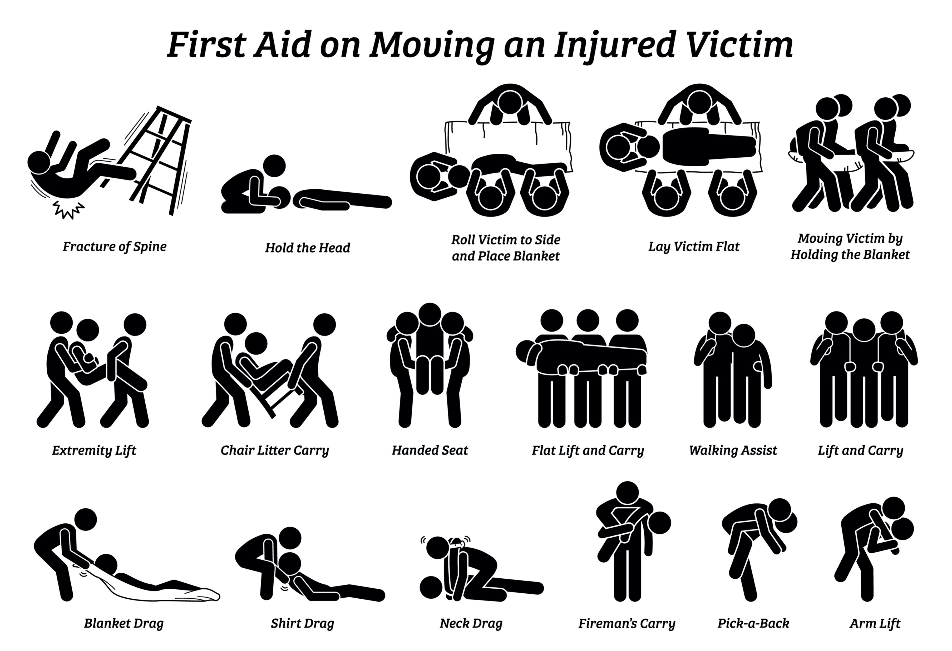
Drag and Carry Options
Multiple options exist based on the situation and resources
When?
Person has multiple injuries, cannot walk or is unconscious
Why?
When a person needs to be moved to safety and away from danger
Notes:
Instructor Notes:
Review with the participants the various injuries that a person may sustain that may render them unresponsive or critically injured.
Many lay people have never had to access emergency services before so discuss the reasons why a person may need to be moved before EMS arrives. In addition, make them aware that depending on geography and location, it may be some time before other help arrives; especially in the case of a mass casualty incident.
Stress the importance of lifting with their legs and not their back. If the rescuer becomes injured, he/she will not be able to help and will now be an additional victim needing to be carried.
Stress that scene safety is most important – not to put yourself in harm’s way.

Slide 5
Moving Techniques Overview
In this section, we will review the following techniques for moving victims to safety.
One-person drag
One-person walking assist
One-person arm carry
One-person pack strap carry
Two-person drag
Two-person side-by-side carry
Rescue blanket drag
Notes:
Instructor Notes:
In this section, we will review the following techniques for moving victims to safety.
One-person drag
One-person walking assist
One-person arm carry
One-person pack strap carry
Two-person drag
Two-person side-by-side carry
Rescue blanket drag

Slide 6
One-Person Drag
Drag the person by pulling on the clothing in the neck and shoulder area
Steps to perform
Grab clothing just behind the collar
Use your arms to support the head
Drag the person out of danger to safety
https://www.youtube.com/watch?v=h2nvbDc6a2s
Notes:
Instructor Notes:
Explain the steps of a one-person drag.
Notes:
Play video to demonstrate for students.

Slide 7
One Person Walking Assist
Steps to Perform
Help the person to stand
Have the person place one arm around your neck and hold the patient’s wrist
Put your free arm around the patient’s waist and help the patient to walk
Notes:
Instructor Notes:
This carry is to be used when a patient is conscious and able to bear some weight.
Each person, based on their injuries, may need more or less assistance.
If the injured person progresses to be unable to bear any weight, the type of carry/assistance may need to be adjusted to a two-person assist or a full carry.

Slide 8
One-Person Arm Carry
Steps to Perform
Arm around person’s back and under the knees, lift.
Recommended for children or lighter adults
Notes:
Instructor Notes:
This carry may be difficult for a smaller adult to perform.
If the injured person is a larger adult, it may not be possible to perform for longer distances.

Slide 9
One-Person Pack Strap Carry
Have the patient stand
If person is unconscious, a second rescuer is needed to help position person on your back
Position yourself with your back to the person, back straight, knees bent, so that your shoulders fit into the person’s armpits
Hold both person’s wrists with one hand to maintain balance and open doors
Notes:
Instructor Notes:
Will need a second person to help position an unconscious person on your back.
If the patient is in the proper position, a longer carry is possible.
May be difficult to maintain balance while opening doors, etc. So it is important to be a bit slower and deliberate in these actions.

Slide 10
Two-Person Drag
Similar to the one-person drag
Steps to perform
Two rescuers each grasp clothing in the neck and shoulder area using one hand to pull person to safety
Notes:
Instructor Notes:
This is a drag performed by two people. Explain the process to the class. Note to students that this is a common military drag.

Slide 11
Two-Person Side-by-Side Carry
Cradle the person between the two carriers
Steps to Perform
Start by kneeling beside the patient near the patient’s hips
Raise the patient to a sitting position; the rescuers link arms behind the patient’s back
Rescuers place their free arms under the person’s knees and link arms
If possible, the patient places his or her arms around the necks of the rescuers
Notes:
Instructor Notes:
Go over the steps of this carry with the class.

Slide 12
Rescue Blanket Drag
Steps to Follow
Fold up a blanket and place it between you and the victim
Roll the patient away from you and unfold the blanket to place it up against the victim
Roll the victim back towards you on their side and onto fully extended blanket
Gather blanket at the head with both hands and drag victim to safety
Notes:
Instructor Notes:
Explain the steps of this rescue drag to the students.

Slide 13
Patient Skill Station
Practice skills
Review each of the drags and carries
Work in pairs and in teams on these rescue skills
Notes:
Instructor Notes:
All carry skills will be demonstrated to the participants for proper body mechanics and techniques by the instructors.
The WHOLE-PART-WHOLE teaching method is to be used. The instructors should demonstrate the entire carry skill without interruption first, then show it step by step and finally as an interrupted demonstration.
The participants will then be grouped or teamed up to perform each carry skill with the instructors to mentor, guide and instruct them on each step.
Skill sheets are to be distributed to the participants for review and then to be used as a reference during the performance of the carry skill.

Slide 14
Lesson 7: Summary
Lift with your legs and not your back
Always ask for help to lift if available
Choose the best carry technique for the situation
Utilize the patient’s clothing, a blanket or tarp if available to drag the person
One- and two-person carries can be challenging
Notes:
Instructor Notes:
Summarize the following points with students:
Lift with legs and not back.
Always seek help carrying if available.
Be sure to relate to the participants that one size does not fit all. Choose the best carry technique for the situation. Those considerations may include size of each person, severity of the injury, environment the person is in, and speed with which the person may need to be moved.
Reinforce that proper technique is just as important as strength when carrying or dragging a person.

Slide 15
Lesson 7: Wrap-Up
Notes:
Instructor Notes:
Ask the participants if they have any questions about this lesson.

