Slide 1
THE RESCUE COMPANY 1

Slide 2
Mechanical Advantage

Slide 3
Mechanical Advantage
The primary purpose of a hauling system is to gain mechanical advantage.
There are several ways to calculate mechanical advantage.

Slide 4
ways to calculate mechanical advantage
A scale can be attached to the effort and the load.
Dividing the weight of the load by the weight on the effort line provides the mechanical advantage.

Slide 5
ways to calculate mechanical advantage
Second, measure how far the effort line moves in terms of how far the load moves.
If the effort lines moves nine feet for a corresponding movement of one foot on the load, there is a nine to one mechanical advantage.

Slide 6
ways to calculate mechanical advantage
Some people will count the number of lines supporting the load.
This method may work on some systems, but with many of the complex systems it is inaccurate.
For example, the double Z-rig has five supporting lines and a mechanical advantage of 9: 1

Slide 7
Compound Pulley Systems
These are pulley systems where one pulley system is pulling on the effort of another system.

Slide 8
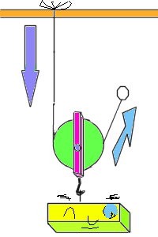

Slide 9
Compound Pulley Systems
4:1 piggy-back is a 2:1 pulling on a 2:1 system
The 5:1 is a 3:1 Z-drag and 2:1 system hooked together in parallel
The double Z-rig is a 3:1 Z-rig pulling on another 3: 1 Z­-rig.
Are examples of compound systems.

Slide 10
Self adjusting Brake
Self-adjusting brake is a prusik knot fastened to the haul line that maintains tension on the haul line as the hauling system is readjusted for a new pull.
In addition, the brake provides a safety on the haul line in case for some unknown reason someone let's go of the rope.

Slide 12
Self adjusting Brake
In general, the use of a prusik is preferred over mechanical devices ( e.g. ascenders).
In contrast to mechanical devices which tend to dig into the rope
The use of a prusik will begin to slip at around 900 lbs of pressure releasing tension on the haul line well before the braking point of the haul line.

Slide 13
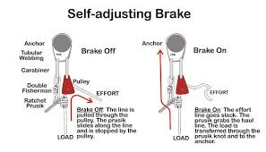

Slide 14
Self adjusting Brake
In tests where the system was pulled until it fatigued
The pressure of nylon on nylon burnt through the mantle (i.e. the braided protective sheath) and the prusik slid down the kern (i.e. center core of kernmantle rope).

Slide 15
Range of System
The range of the system is defined as the length of the hauling system.
It can be as long as desired.
However, there are practical limitations.

Slide 16
Range of System
As a rule, the longer the hauling system becomes
The more cumbersome the hauling system becomes to manage.
Often the range is limited by obstacles or features in the landscape.

Slide 17
Range of System
Also, the longer the hauling system becomes
It multiplies the amount of rope needed to configure the system.
Increase the range of a 5:1 system by one foot, and an additional five feet of rope is needed within the hauling system to gain that one-foot increase in range.

Slide 18
Throw
Throw is defined as the distance the hauling system moves before it needs readjustment.
Throw and range of the system are interrelated.

Slide 19
Throw
The piggy-back is a 2:1 system pulling on another 2:1 system.
When the system is exhausted or pulled to its limit at the anchor
The second or top pulley moves half the distance of the "range of the system.
" This distance is "throw."

Slide 20
Throw
Lack of throw makes the piggy-back a more cumbersome system to use since it needs constant readjustment.
An advantage of the 5: 1 system is that it has both good mechanical advantage ( 5: 1) and the same throw as a 2:1 system or a 3:1 Z-rig.

Slide 21
Throw
This means that the 5:1 system moves the same distance as the 2:1 or 3:1 systems before it needs to be readjusted.
In contrast, a 4:1 piggy-back system has half the throw as the 5: 1 system.

Slide 22
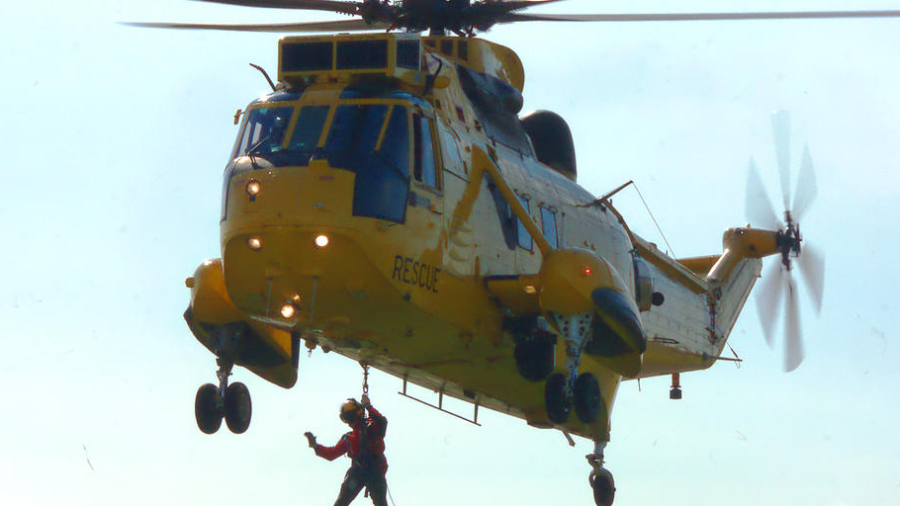
Throw
The throw for the different pulley systems discussed in this section are summarized in Figure 6.4.

Slide 23
Internal Versus External Hauling Systems
Internal system, the hauling system and hauling line are one and the same.
The Z­-rig is a classic example of the internal hauling system.
In the external system, the hauling system acts independently of the haul line.
The Piggy-back is a classic example of an external system.

Slide 24
Internal Versus External Hauling Systems
The piggy-back system is designed to be rigged as an external system and not as an internal system.
However, the Z-rig can be rigged as either an internal or external system.

Slide 25
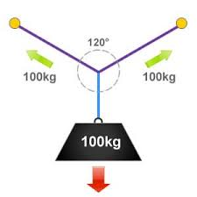

Slide 26
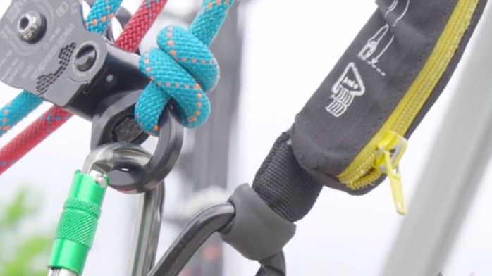
120° Rule and Directional Pulley
Derived from the climbing literature, when the angle between two anchors is roughly 120 degrees
The force on each anchor equals the weight of the load.

Slide 27
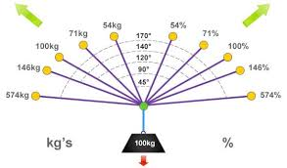

Slide 28
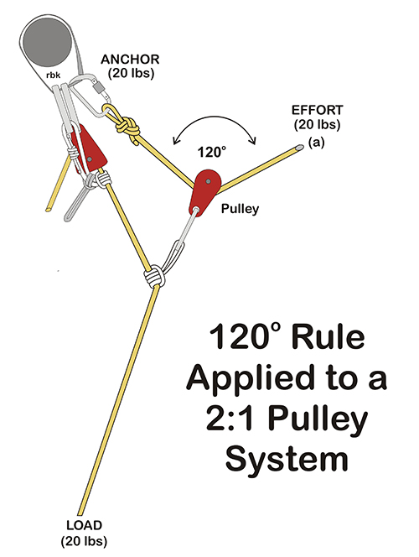
120° Rule and Directional Pulley
It is a 1: 1: 1 ratio between the two anchors and load.
In pulley systems, when the angle between the anchor and the effort is 120 degrees
The force on the anchor, effort and load are all the same
The result is that there is no mechanical advantage.

Slide 29
Types of Systems
There are three basic pulley configurations:
2:1 Pulley System
3:1 Z-rig
The block and tackle.

Slide 30
Types of Systems The block and tackle
Although the block and tackle receives a minor role, it should be given more consideration as an external hauling system
Particularly in search and rescue situations.

Slide 31
Types of Systems
For the purposes of this discussion, all of the pulley systems are a combination of the 2:1 and Z-rig systems.
The block and tackle system is treated separately.

Slide 32
2: 1 Pulley System
Normally, it is configured as an external hauling system.
It doesn't lend itself as an internal hauling system because it can't be readjusted.
Not including a directional pulley, the system can be constructed with one pulley and a prusik.

Slide 33
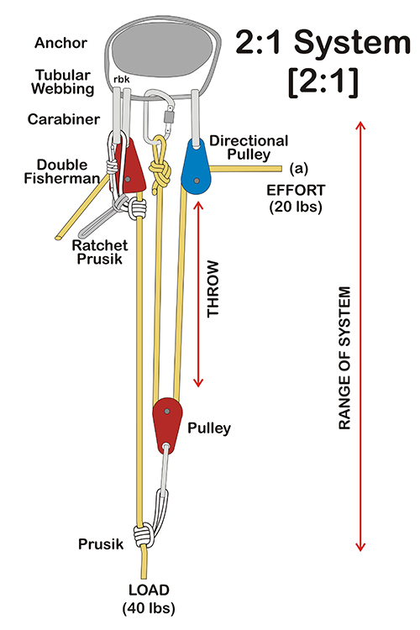

Slide 34
2: 1 Pulley System
The self-adjusting brake adds another prusik and pulley to the system.
Throw is the same as the range of the system.
As a practical matter and because of its low mechanical advantage

Slide 35
2: 1 Pulley System
There is little benefit of using a 2: 1 pulley system by itself.
It is usually used in combination with itself in the piggy-back ( 4: 1)
Or in concert with other systems such as in the 5: 1 system.

Slide 36
Z-rig
Normally, the Z-rig is used as an internal system where the haul line is used as part of the hauling system.
The Z-rig has a throw equal to the range of the system.
The Z-rig can also be configured as an external hauling system.

Slide 37
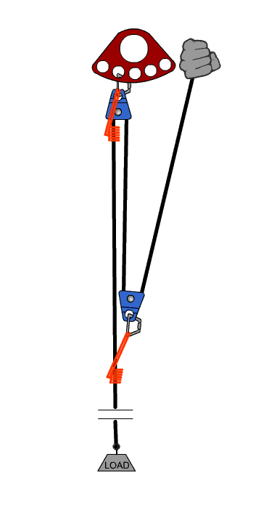

Slide 38
Z-rig
It can be used in more complex systems like the 5:1 pulley system or the double Z-rig.
In some circles, the Z-rig has fallen into disfavor because with the inherent inefficiencies and friction found in any of these system.

Slide 39
Z-rig
In practice, the system is closer to a 2: 1 mechanical advantage.
For this reason, if mechanical advantage is needed, consider the 5: 1 system.

Slide 40
Piggy-back 4:1
The 4:1 piggy-back system is literally a 2: 1 pulley system pulling on another 2: 1 pulley system.
It is normally rigged as an external system.
Not including the directional pulley, it requires two pulleys and a separate haul line.

Slide 41
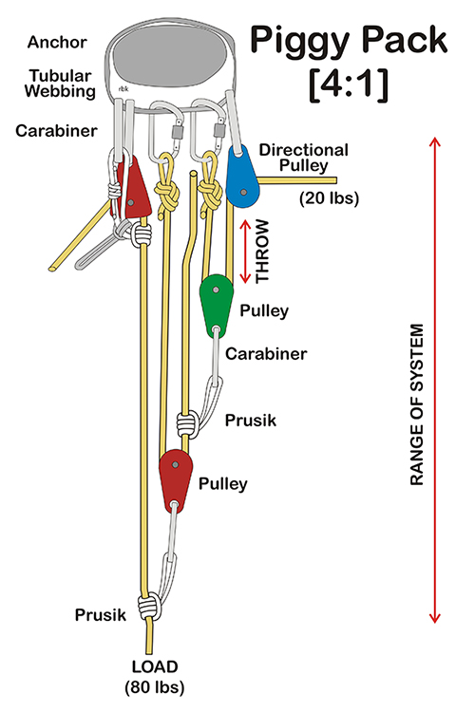

Slide 42
Piggy-back 4:1
Obtaining a 4: 1 mechanical advantage with only two pulleys can be considered an advantage of the system.
The self-adjusting brake adds another prusik and pulley to the system

Slide 43
Piggy-back 4:1
As a practical matter, most 4: 1 systems utilize three pulleys.
Often users tend to compensate for the lack of throw by increasing the range of the system.
However, that can be problematic also.

Slide 44
5:1 System
The 5: 1 system is a 2: 1 pulley system pulling on 3: 1 Z-rig.
It requires four pulleys and if used, a directional pulley is the fifth pulley.
The self-adjusting brake adds another Prusik to the system, but not another pulley.
Since the base system is a 3: 1 Z-rig, the 5: 1 system is usually configured as an internal system.

Slide 45
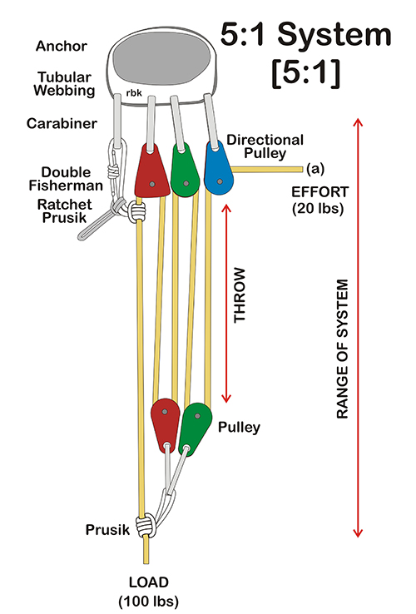

Slide 46
5:1 System
However, it can be configured as an external system if desired.
A significant advantage of the 5: 1 system is that it has a throw equal to the range of the system.

Slide 47
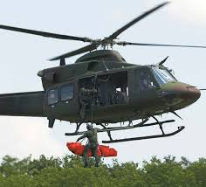
5:1 System
It has the same throw as a 2: 1 system or Z-rig, yet it has a mechanical advantage of 5: 1.

Slide 48
5:1 System
The 5: 1 system has sufficient mechanical advantage to more than compensate for the practical losses of mechanical advantage resulting from the inefficiencies and friction associated with a simple 2: 1 or Z-rig.
This makes it an excellent alternative to these and the piggy-back systems.

Slide 49
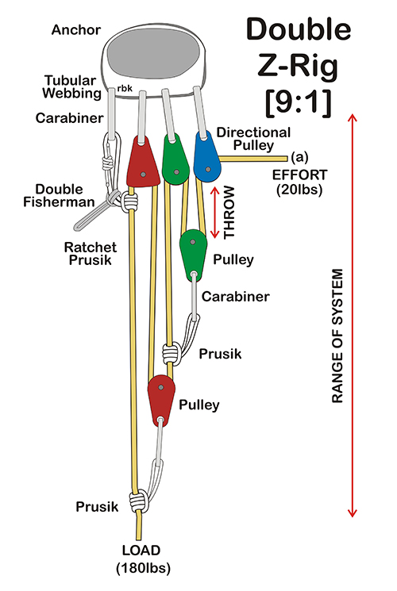

Slide 50
The 9:1 double Z-rig system
The 9:1 double Z-rig system is a 3:1 Z-rig pulling on another 3:1 Z-rig.
It requires four pulleys or the same number of pulleys as in the 5: 1 system.

Slide 51
The 9:1 double Z-rig system
A directional pulley is the fifth pulley.
The self­ adjusting brake adds another prusik to the system.

Slide 52
The 9:1 double Z-rig system
Although it is usually used as an internal system, it can be configured as an external system if needed.
In contrast to the 5:1 system, the double Z-rig maximizes mechanical advantage at the expense of throw.
Normally, the double Z-rig system is rigged as internal system.

Slide 53
The 9:1 double Z-rig system
The main haul line is used to configure the pulley system and no additional lines are necessary to configure the hauling system.
If desired, the double Z-rig can be rigged as an external system.

Slide 54
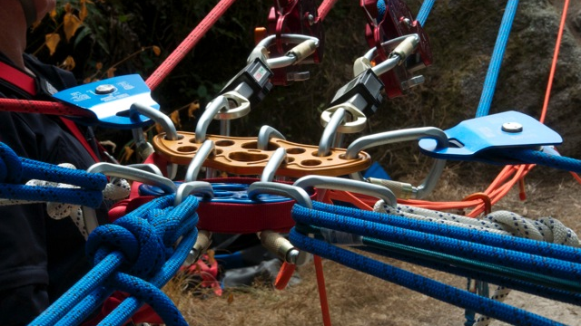
Block and Tackle
A block and tackle system consists of two or more pulleys pulling in opposition to each other.
Usually, there are two or more pulleys housed within each of the two blocks or housings.

Slide 55
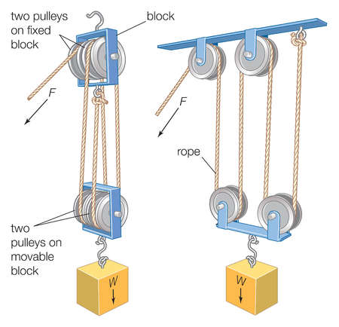

Slide 56
Block and Tackle
When configured as an internal system, lifting is finished when the two pulleys are drawn together
The system cannot be readjusted.
As an internal system, the block and tackle system is relatively impractical except for lifting heavy loads short distances.

