Slide 1
Chapter 17: Aquatic Life and Related Hazards
Notes:
Describe components of marine life ecosystems.
Identify the risks inherent in freshwater animal species

Slide 2
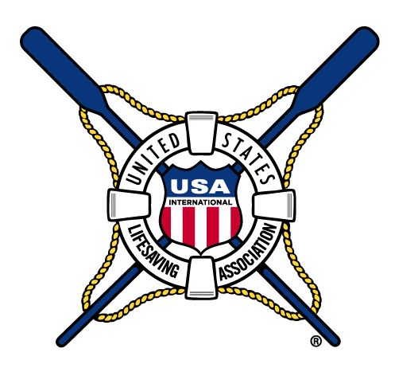
Marine Life
Notes:
A host of highly adapted organisms, some of which can injure or be injured by humans resides in aquatic ecosystems.
The initial consideration when dealing with any form of potentially dangerous marine life is early, accurate identification.

Slide 3
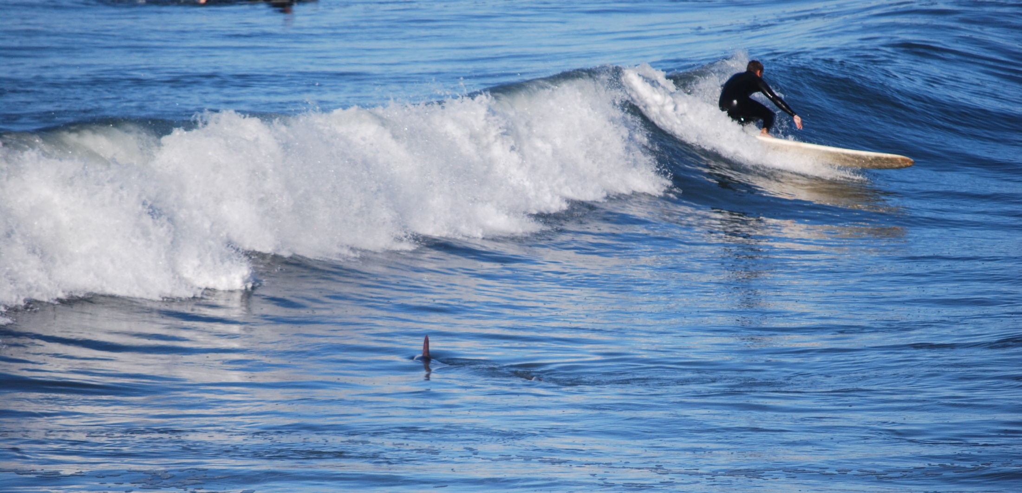
Sharks

Slide 4
Shark attacks are very rare
Most likely to attack surfers or other boarders
Higher risk states include: FL, HI, SC, CA, NC, and TX
Different species cause different severity of wounds
Greatest culprits: Great White, Tiger, Bull
Most likely areas near shore and near drop-offs
More likely in murky water
Mistaken identity for prey animals
Dolphins and porpoises are often mistaken for Sharks
Different environmental factors make shark attacks more likely
Notes:
In fact, the danger of shark attacks is statistically miniscule — there are 75 times as many deaths from lightning strikes.
People recreating on a surfboard or other floatation device are the most common victims of shark attacks, followed by swimmers, divers, and waders, in that order.
States with highest incidence of shark attacks include Florida, Hawaii, South Carolina, California, North Carolina, and Texas, in that order. But outcomes vary. About 1% of Florida attacks are fatal, while about 12% of California attacks are fatal.
Different species in different areas of U.S. waters result in differing attacks and wounds.
Over 200 species of sharks; but only a few are considered a serious threat to people. Most frequent attackers of humans: great white shark, tiger shark, and bull shark, in that order
Most shark attacks occur near shore, including sandbar areas and areas with steep drop offs.
Attacks occur more commonly in murky water.
It is believed that most shark attacks occur as a result of a prey identification mistake, mistaking a human for natural prey (like a seal).
Dolphin and porpoises are often mistaken for sharks but normally are harmless to swimmers.
West Coast attacks more frequent during heavy seal and sea lion activity. East Coast and Gulf Coast often occur near schooling fish. Onshore winds along the east coast of Florida can result in concentrations of fish and sharks in poor visibility water. In Hawaii, surfers and swimmers should avoid dawn and dusk periods and the areas around the mouths of rivers, especially after heavy rains, where tiger sharks may scavenge.

Slide 5
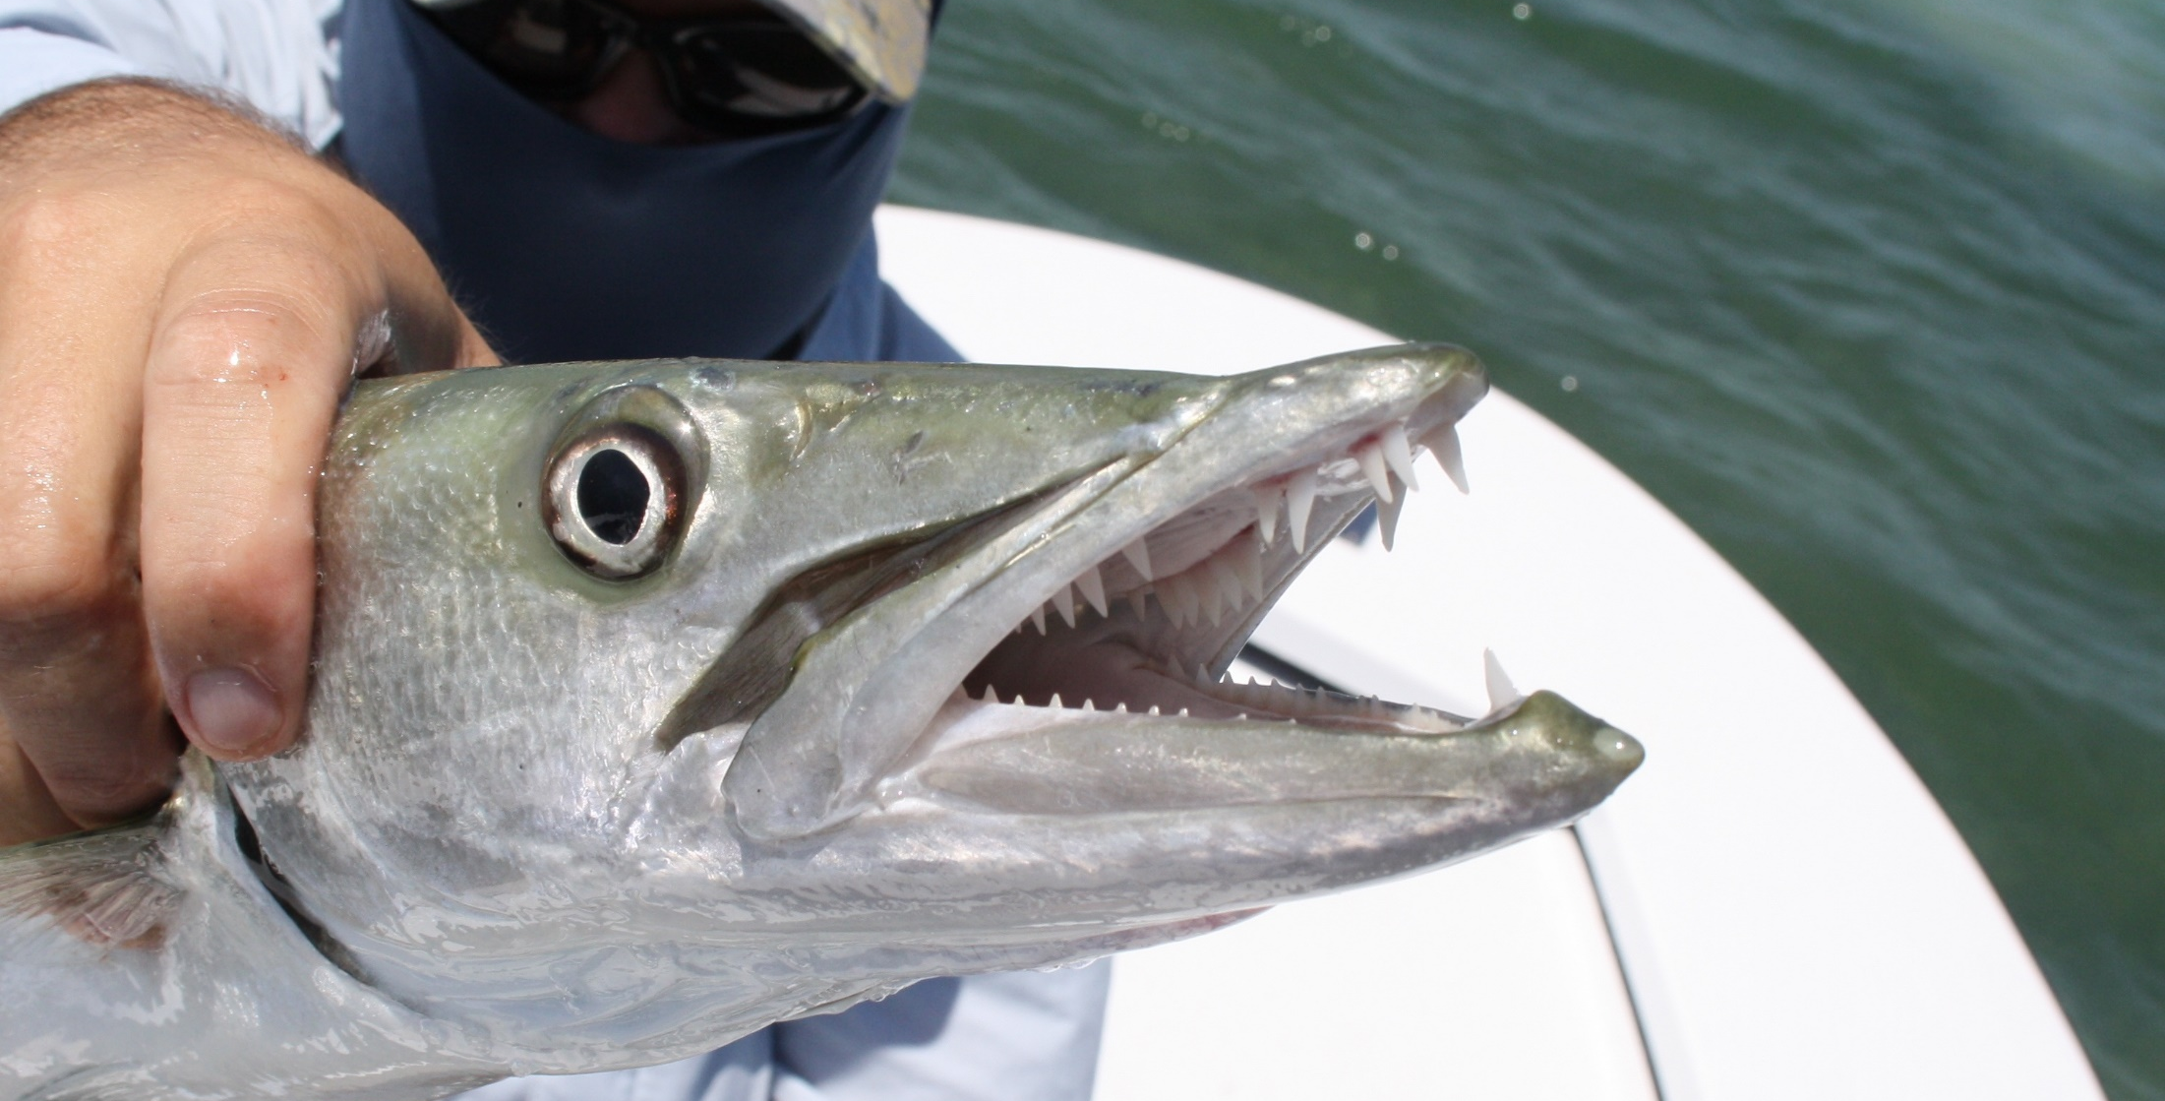
Barracuda

Slide 6
Large, streamlined predator fish
Twenty or more species of barracuda, the Great Barracuda is the only one considered dangerous
Attacks rare and usually associated with blood in the water

Slide 7
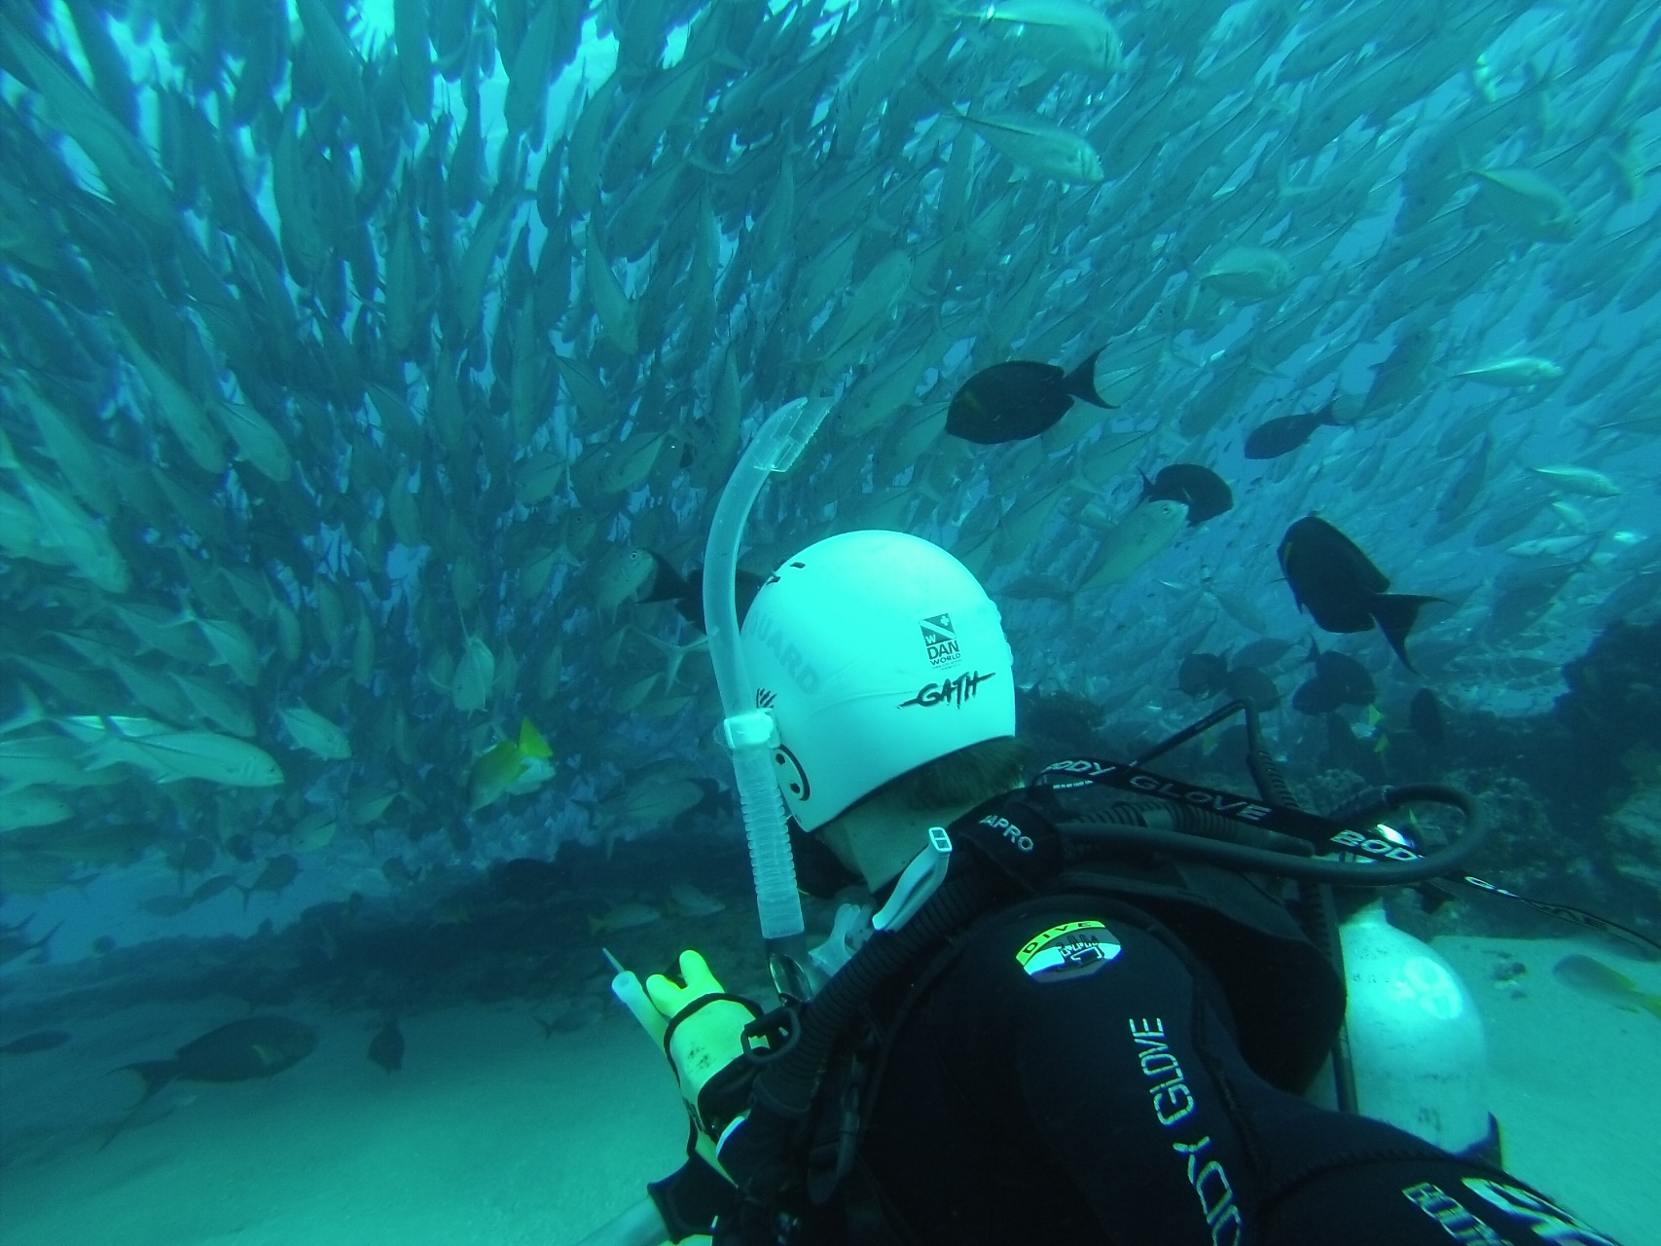
Schooling Fish

Slide 8
Usually harmless
Schooling Jacks, Tarpon, Mackerel and Bluefish can be dangerous
“Feeding Frenzies”
Attracting predators
Monitor large schools
Notes:
Most schooling fish do not represent danger or harm.
Selected species represent harm, including jacks, tarpon, mackerel and bluefish.
Migration and feeding frenzies may result in some species brushing against swimmers and causing lacerations and abrasions.
Schooling fish also may attract large, predator fish.
Schools of large fish should be carefully monitored.

Slide 9
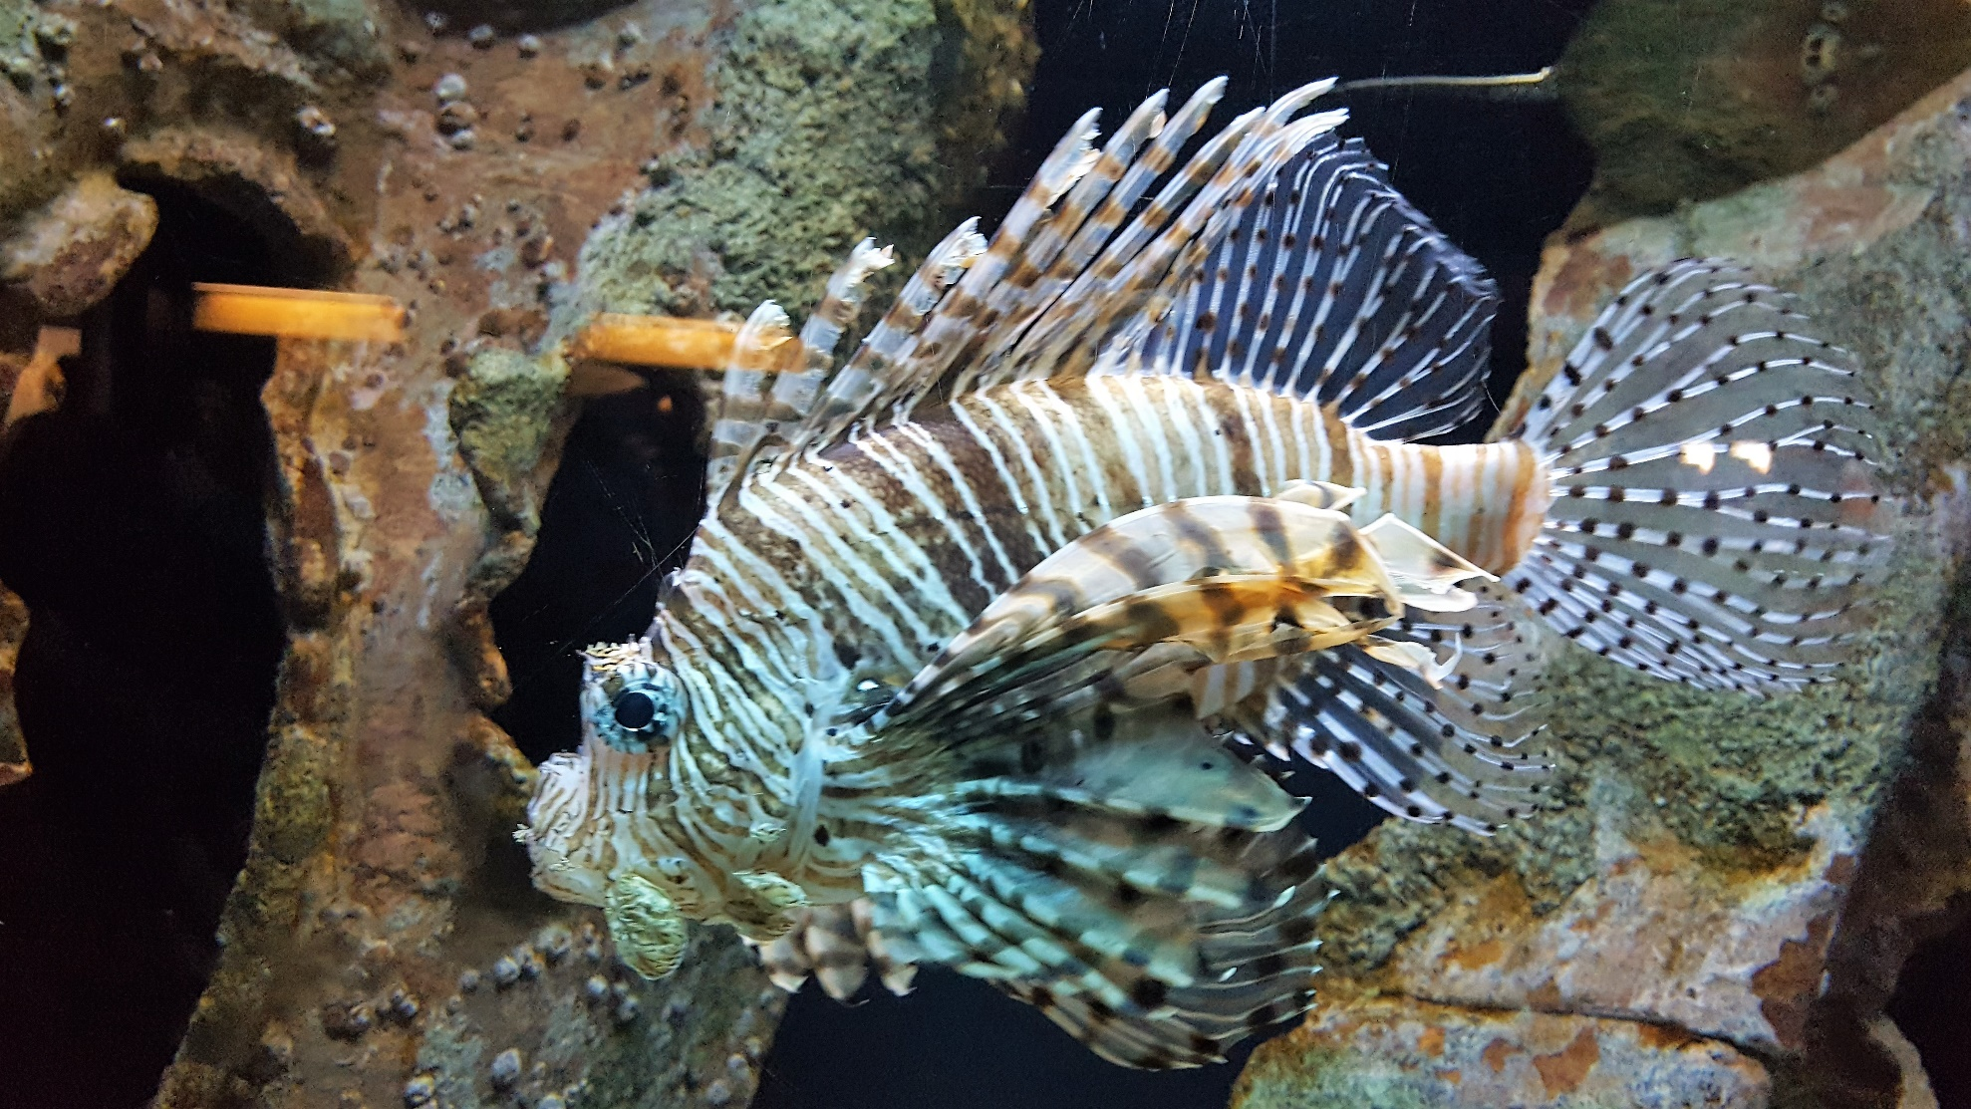
Venomous Fish

Slide 10
Hundreds of species
Divided into two groups lion fish and stone fish
Injection of venom
Victims may suffers convulsions and nervous disturbances
Notes:
Hundreds of species.
Divided into two groups: scorpionfish and stonefish.
Stonefish are found in tropical waters, including those adjacent to the continental U.S Common names are: lionfish, rockfish, turkeyfish and sculpin.
Usually bottom feeders and many are found in coral reefs or kelp beds.
No confirmed deaths for scorpionfish but there are a few confirmed deaths from stonefish.
Inject venom into victims resulting in a sharp, shooting pain.
Victims may suffer convulsions and nervous disturbances.

Slide 11
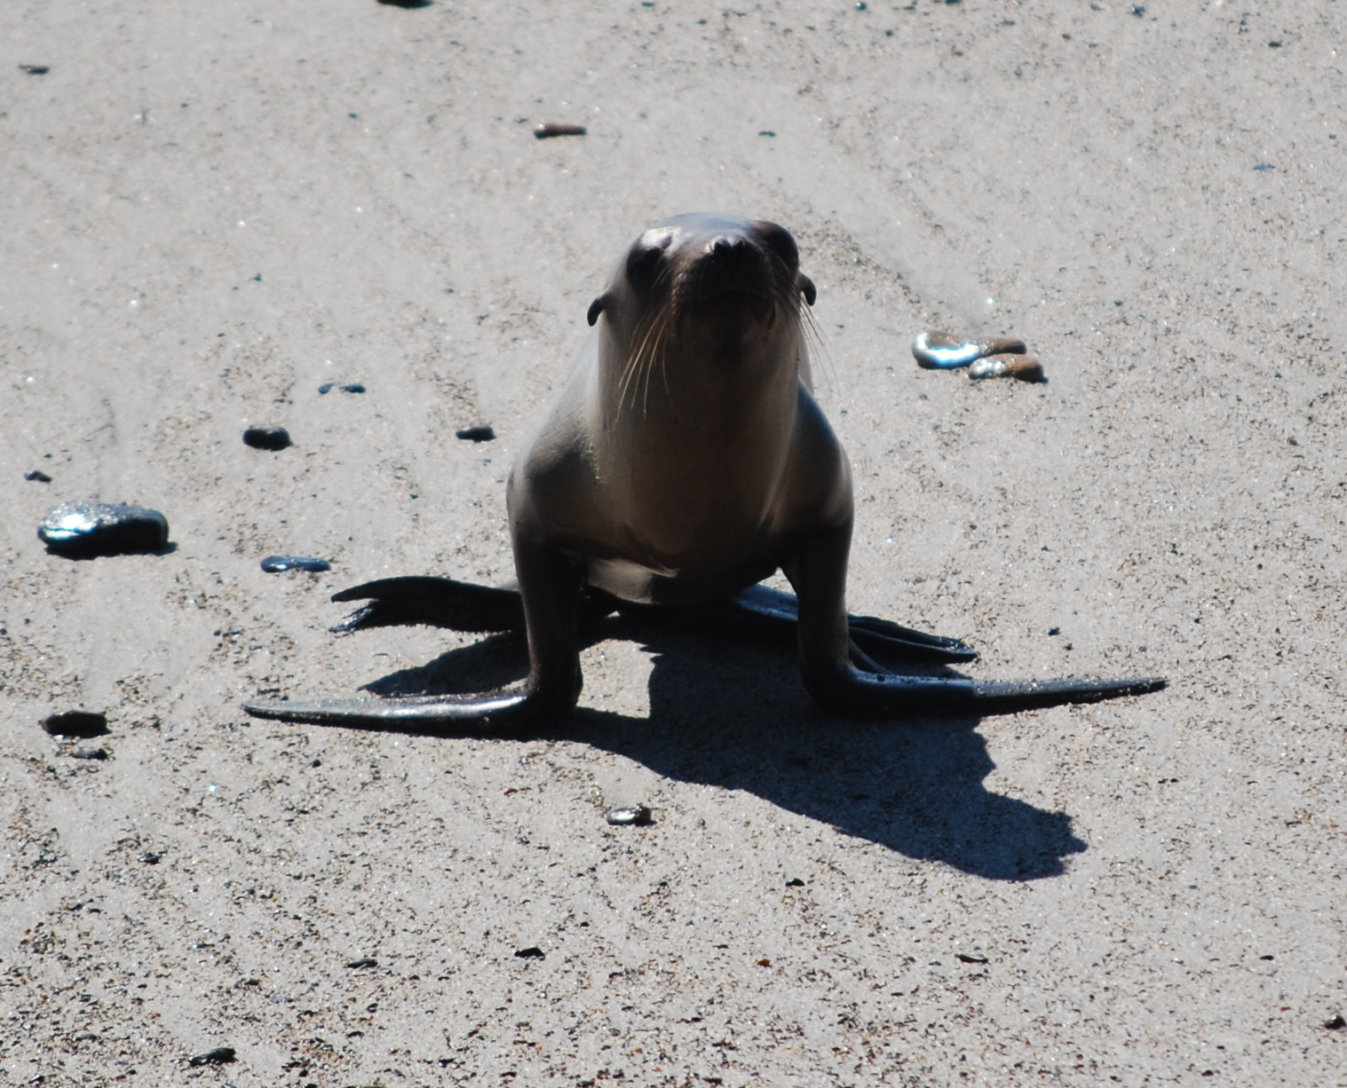
Marine Mammals

Slide 12
Whales, manatees, dolphins, porpoises, seals, sea lions and sea otters
Typically not dangerous unless stressed or injured
Keep distance
Protected animals
Notes:
Common visitors to nearshore waters.
Include whales, manatees, dolphins, porpoises, seals, sea lions and sea otters.
Not dangerous under normal conditions.
If stressed or injured, can pose a considerable danger.
People should be kept at a distance if a sick or injured mammal is beached.
Various state and federal laws protect marine mammals from harm or harassment.
Marine Mammal Protection Act of 1972 protects marine mammals in the wild.
Lifeguards may be asked to protect them.

Slide 13
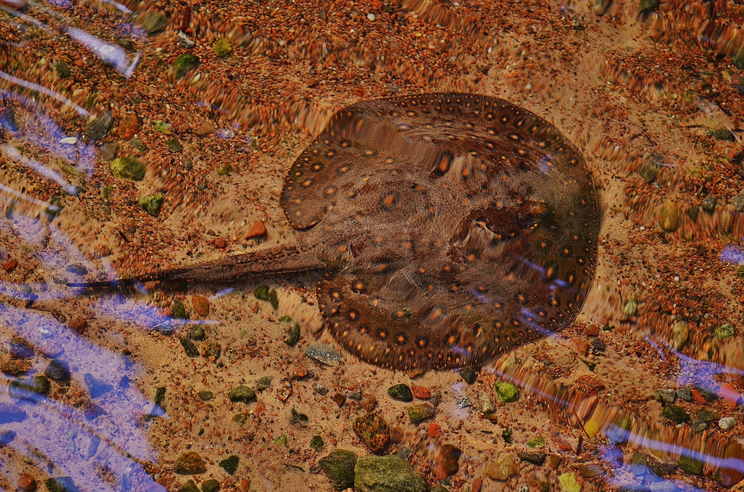
Stingray

Slide 14
Most rays aren’t dangerous
Stingray
Non-aggressive
They hide in sand and attack defensively when stepped on
Do the stingray shuffle
Serious bleeding or even arrhythmia can occur
Notes:
Only a few members of the ray family are considered dangerous.
Most common dangerous ray is the stingray, whose tails have venomous barbs.
Not naturally aggressive.
Often bury in shallow water and may be stepped on accidentally, causing a reflex in the barbed tail.
To avoid stepping on a stingray, walk with a “shuffle” step.
Most common stingray injury is an intense, sharp, shooting pain in the affected area.
Serious bleeding can result in selected cases and death can result from massive blood loss.
Some stings may result in heart arrhythmia, rapidly declining blood pressure and muscular paralysis leading to death.
Most common site for the bite is the foot or ankle.

Slide 15
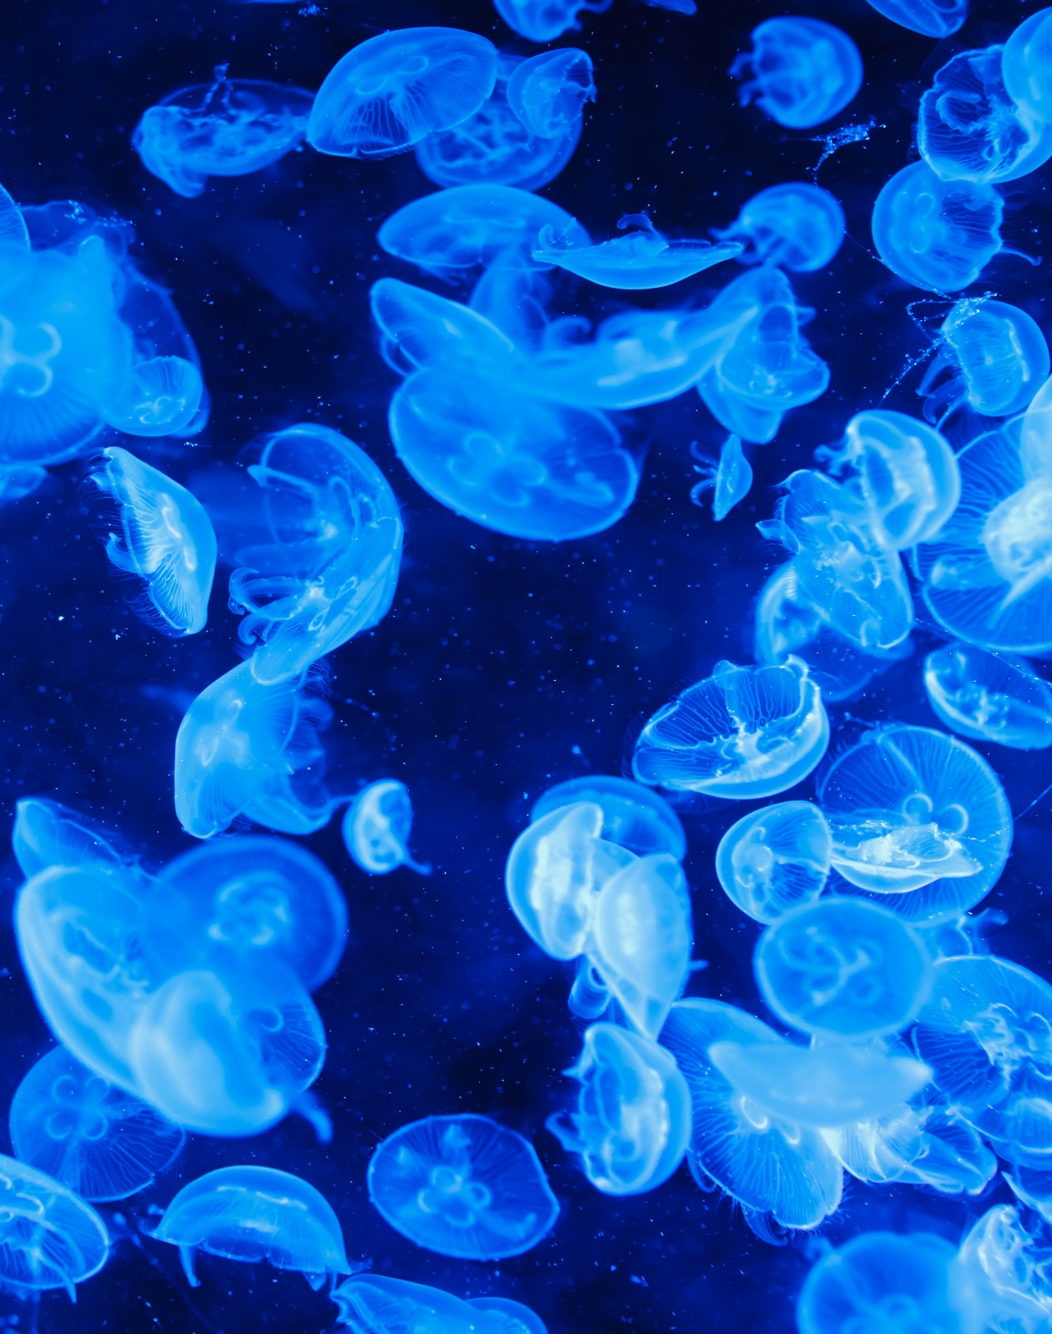
Jellyfish
Free swimming
Colorless
Nematocysts
Few are dangerous
Notes:
Free swimming and colorless.
Appearances tend to be seasonal.
Sting by the use of nematocysts in tentacles.
Only a few jellyfish are considered dangerous.

Slide 16
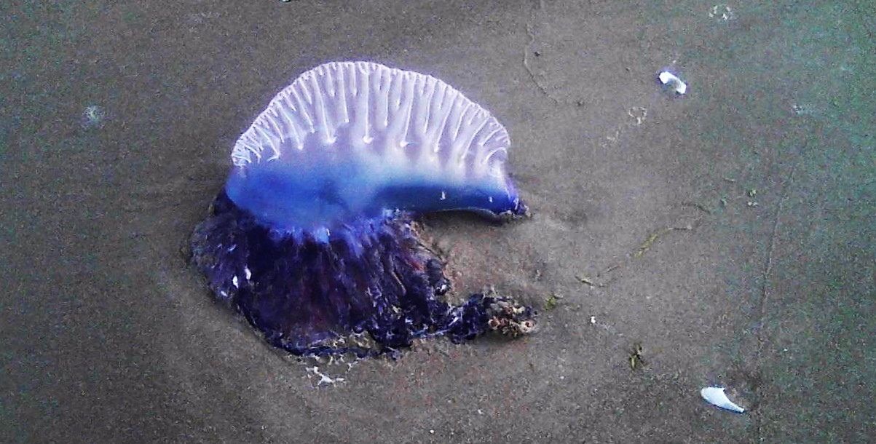
Portuguese Man-of-War

Slide 17
Not a jellyfish but a colony of animals (hydroids)
Usually found in warm waters
Identified by their float (sail)
Tentacles hang below or sway with current and sting
Notes:
Sometimes confused with the jellyfish.
Is a colony of animals called hydroids.
Found in warm water areas but drift on warm currents to cooler areas.
Most often found near the U.S. in the Gulf Stream of the northern Atlantic Ocean.
Most readily identified in the water by a brilliant blue, pink or violet float which is gas filled and bladder-like.
Tentacles hang below and sting as with the stingray

Slide 18
Other Marine Life and Hazards

Slide 19
Coral
Can cause severe cuts and abrasions
Severe reactions are unusual

Slide 20
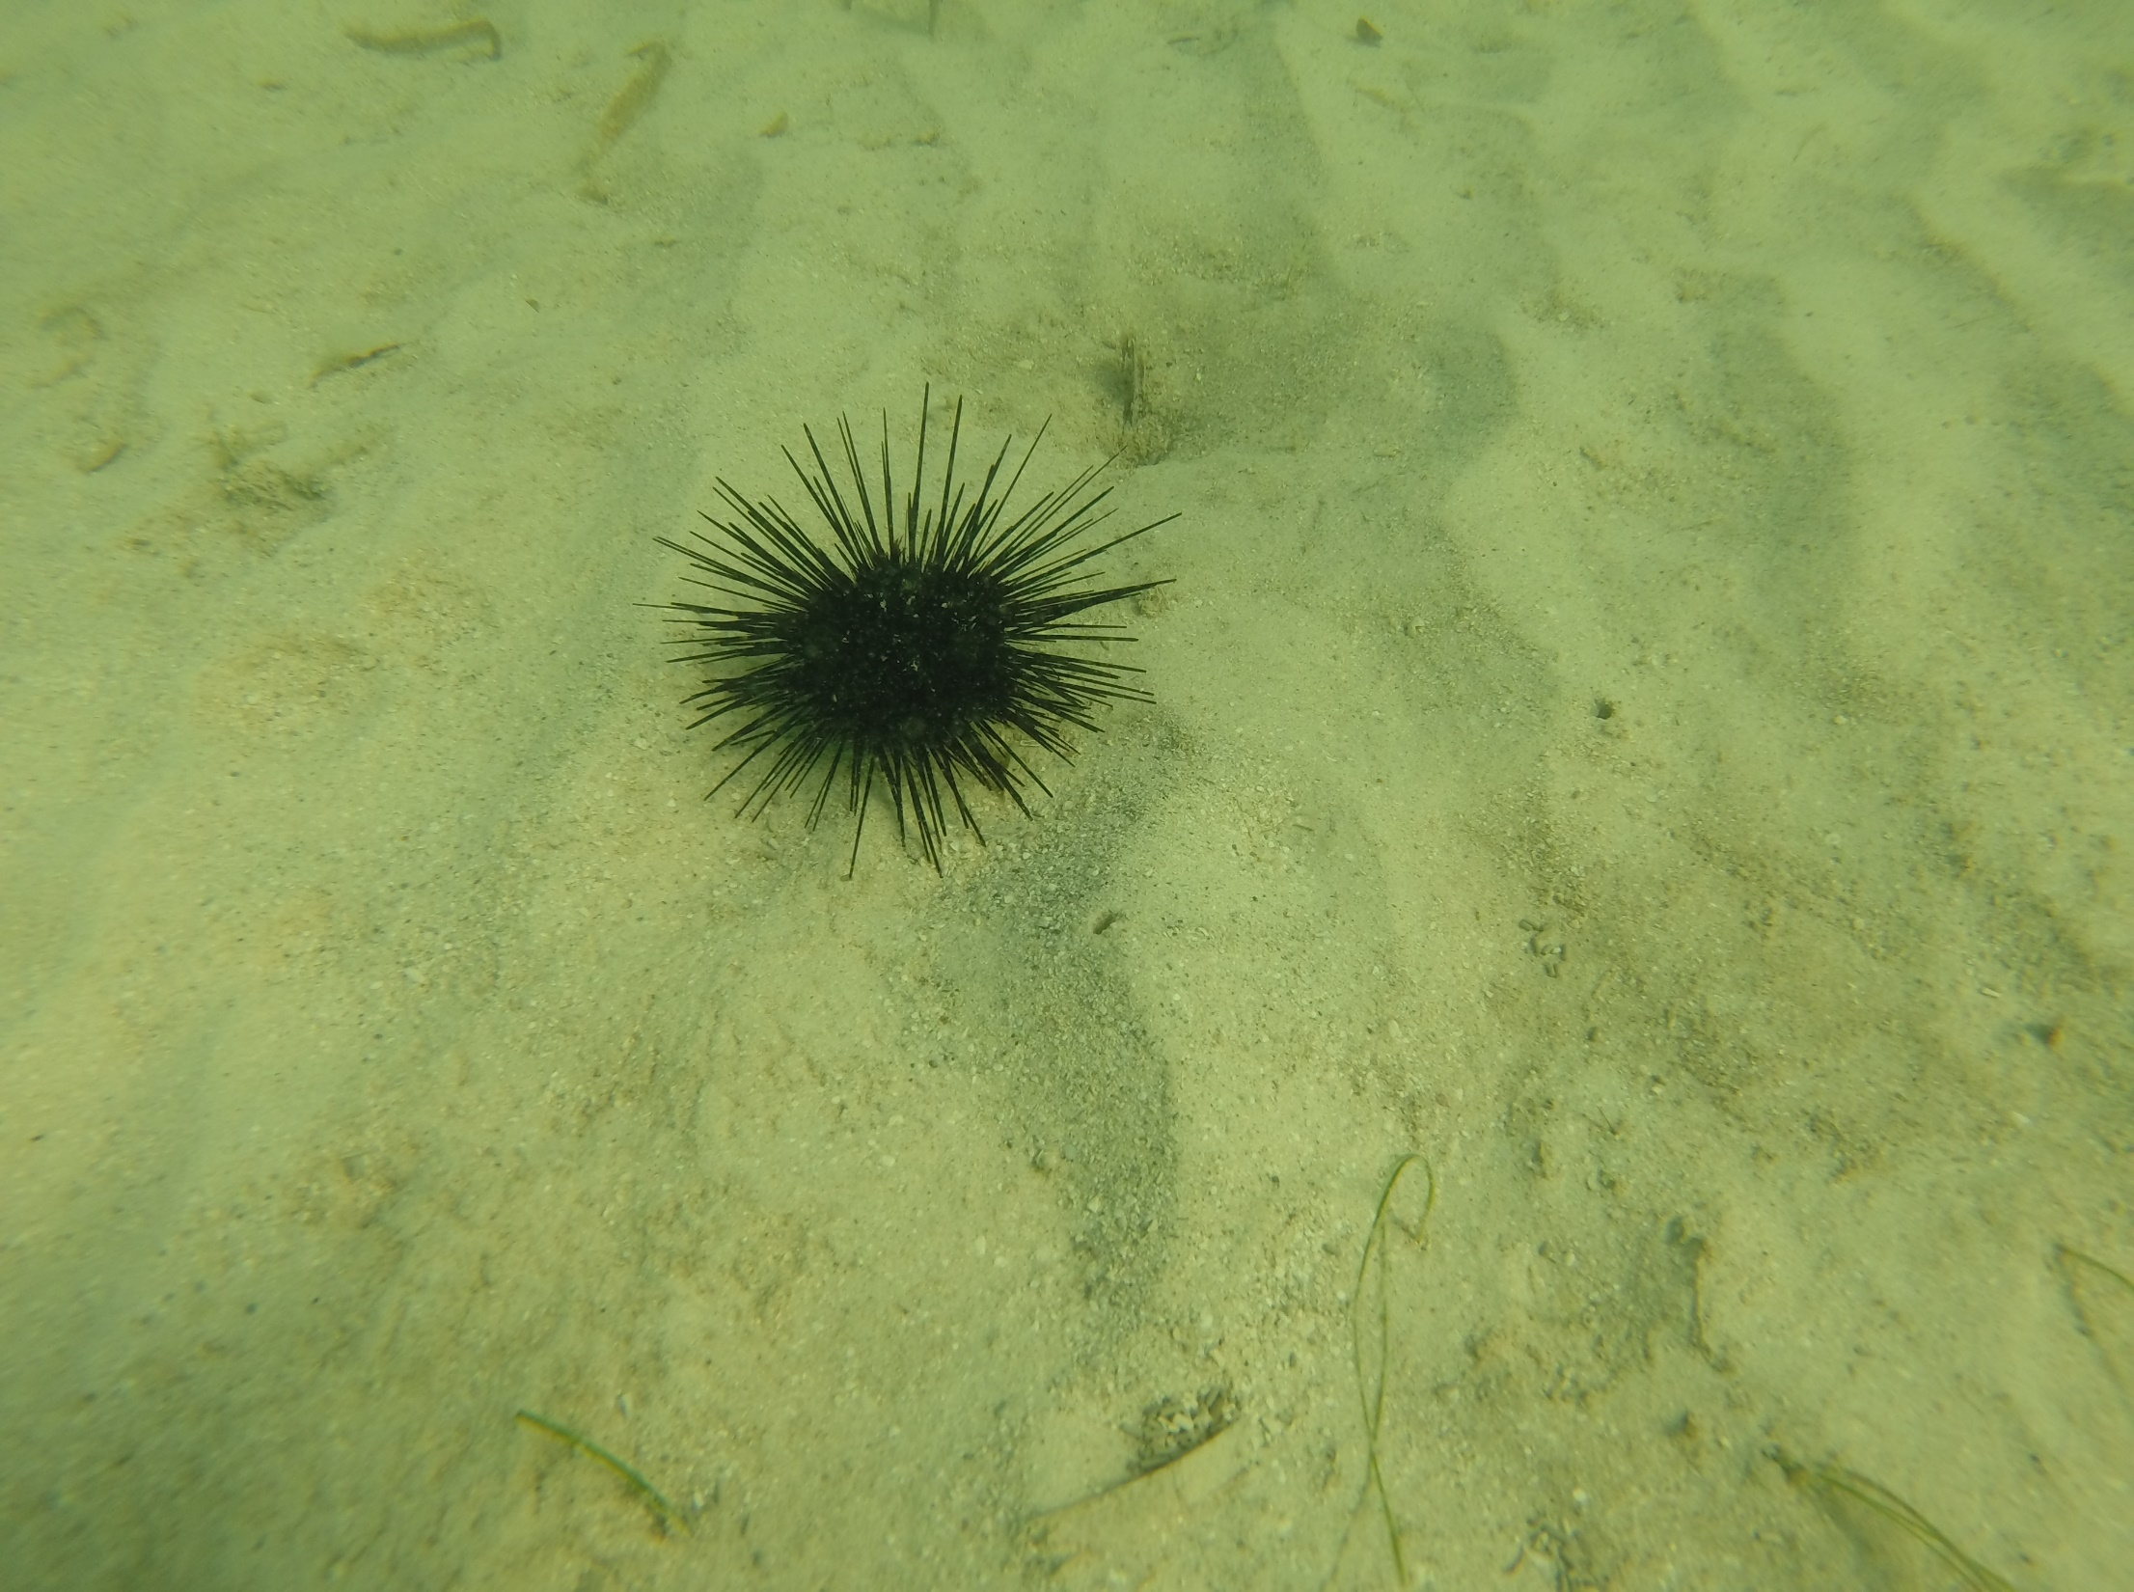
Sea Urchins
Spiny marine invertebrates
Spines penetrate skin causes burning sensation

Slide 21
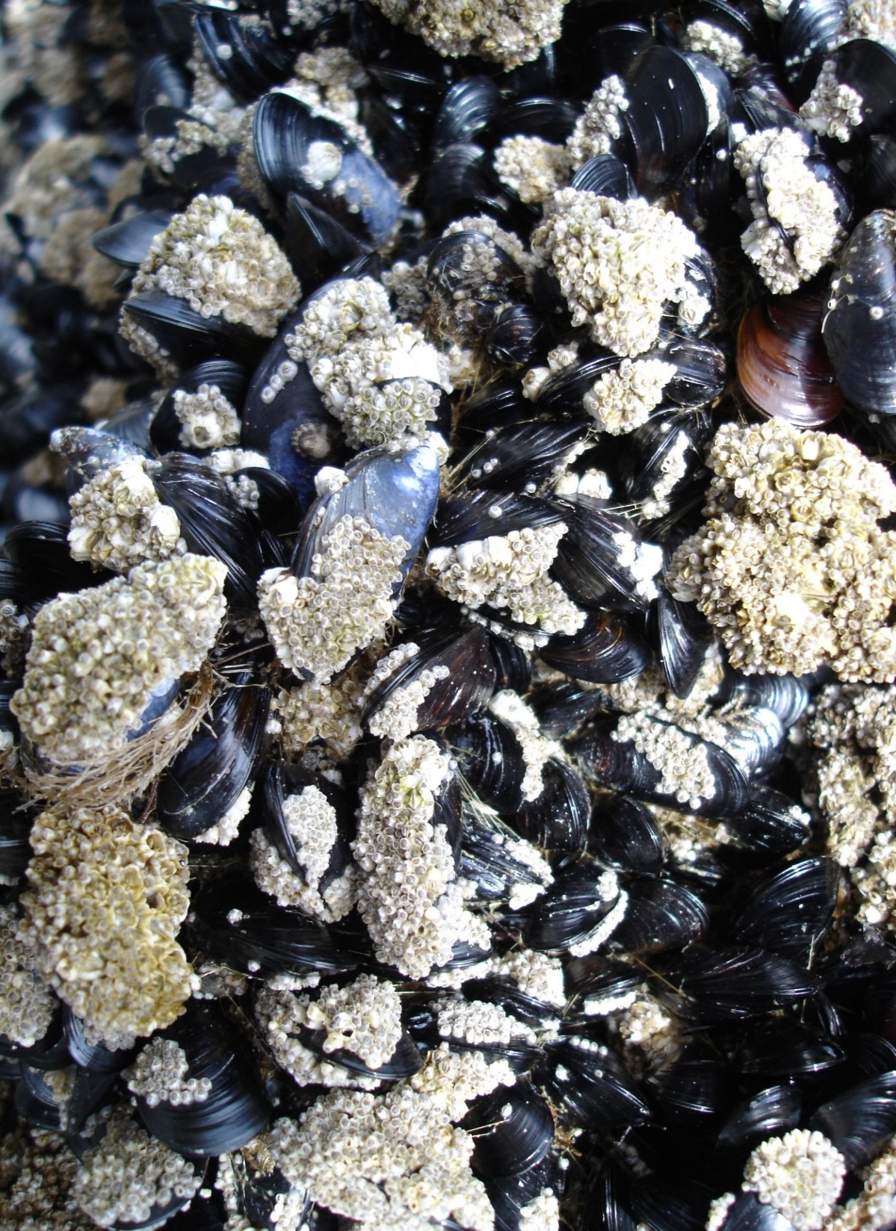
Mollusks and Crustacean's
Barnacles, mussels, oysters, etc.
Can cause lacerations that are easily infected

Slide 22
Microscopic Stingers
Various marine organisms, commonly referred to as sea lice
Notes:
During summer months high concentrations of these stinging larvae may float in "clouds" or "blooms" that affect large areas of the ocean.
Common symptoms: intensely itchy red rash with small blisters and elevated areas of skin.
Severe reactions to exposure may include fever, chills, headaches, nausea and vomiting, especially in children.
Extreme allergic reactions may include anaphylactic shock and require hospitalization in rare cases.

Slide 23
Sea Snakes
Can bite with toxic signs appearing within twenty minutes. Can include malaise, anxiety, euphoria, muscle spasm, respiratory problems, convulsions, unconsciousness and all signs of shock

Slide 24
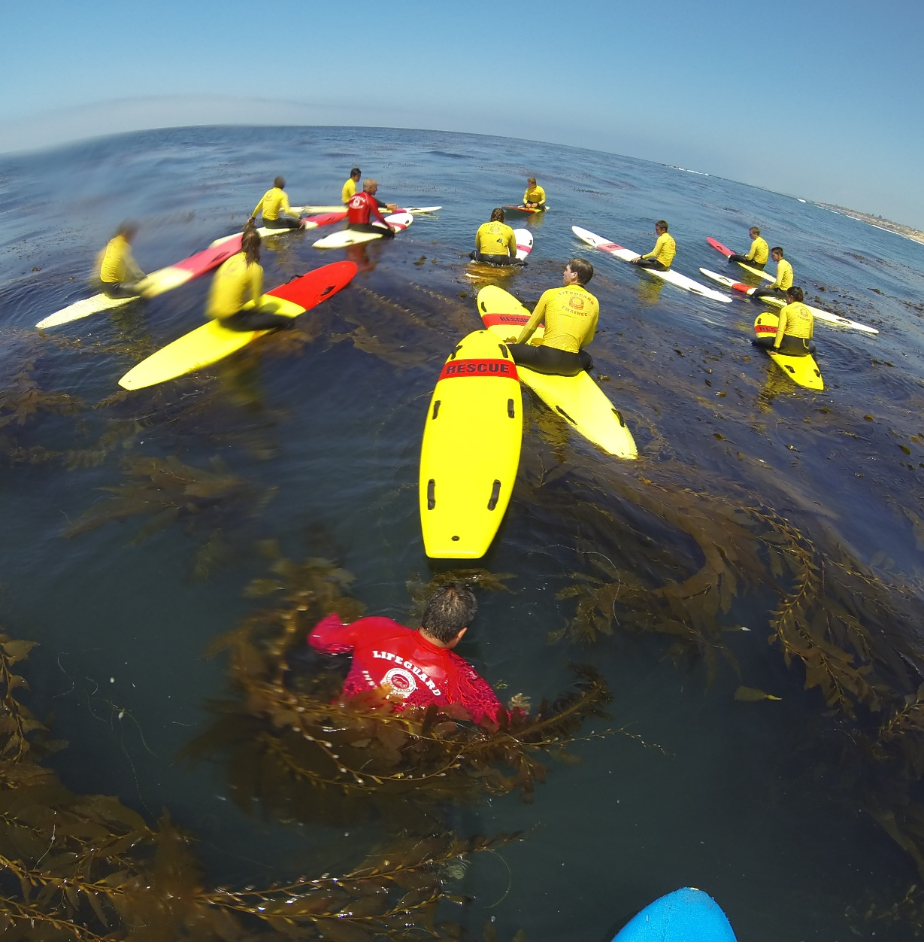
Kelp
A leafy seaweed
Home to many species of marine life
Hazard is entanglement
Avoid the situation with good dive training and carrying a dive knife for extrication

Slide 25
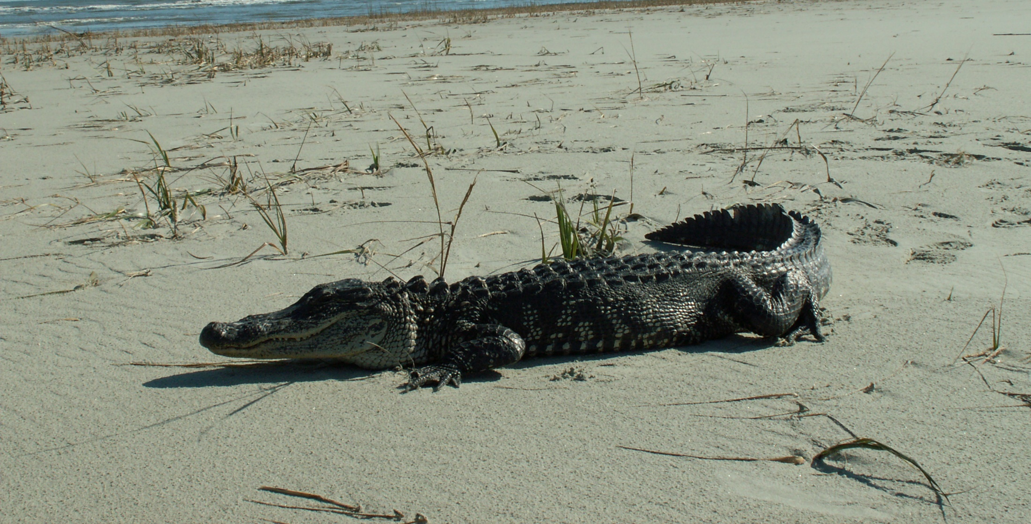
Freshwater Life

Slide 26
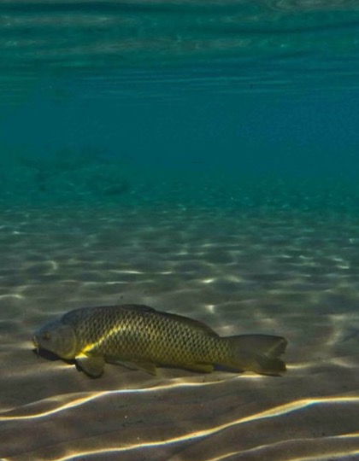
Leeches
Snapping turtles
Mussels
Fish
Snakes
Other reptiles
Semi-aquatic animals
Non-native plants
Notes:
Leeches – bloodsucking worms. Not life threatening.
Snapping Turtles – Have powerful jaws and can inflict painful bites if trapped or threatened.
Mussels – edges of shells can be very sharp and result in lacerations.
Fish – few pose threat to swimmers. Most injuries occur when removing hooks during fishing.
Snakes – problems are regional in nature and selected types can be dangerous or poisonous.
Other Reptiles – problems are regional. Alligators in the southern U.S. can be extremely dangerous.
Semi-Aquatic Animals – spend a great deal of time in the water environment. Beavers, otters, muskrats and waterfowl are in this category. Most pose no threat to humans but allergic reactions to the animals and parasites carried by the animals pose the greatest threat.
Non-native Freshwater Plants – weeds that result from the dumping of aquariums. Pose threat due to choking out natural plants and causing an unbalanced ecosystem

Slide 27
Notes:
Divide “Discussion Points” among pairs of students. Ask students to review each point and share with the class.

