Slide 1
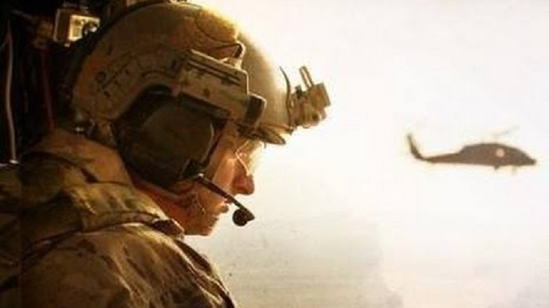
THE RESCUE COMPANY 1

Slide 2
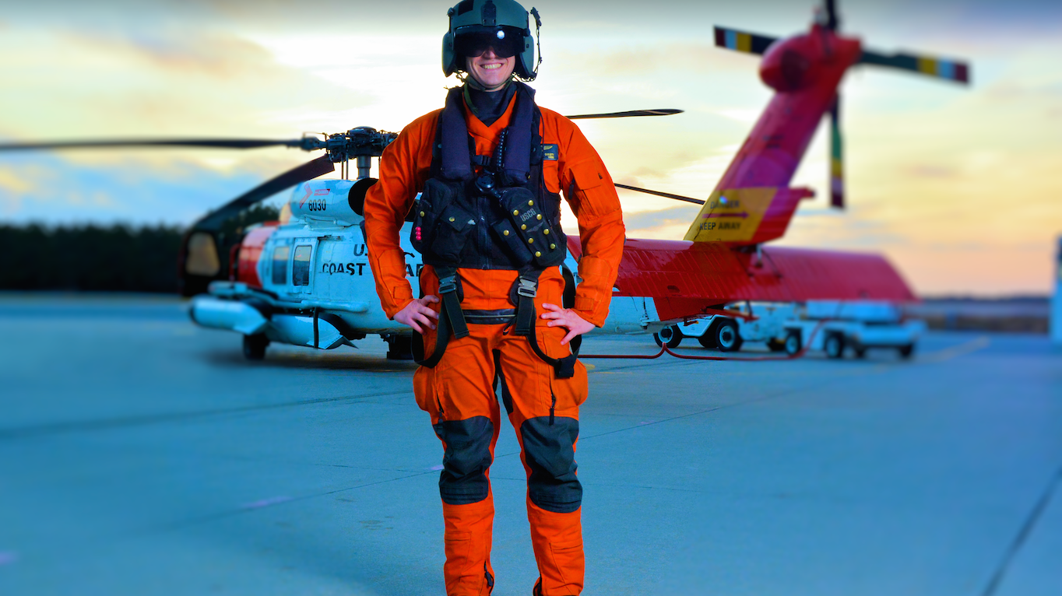
Introduction to Helicopter SEARCH & Rescue

Slide 3
Objectives
Understand
Understand the basic functions and operation of helicopters,
Identify
Identify key elements of aerodynamics, helicopter design and controls,
Implement
Implement helicopter management and safety precautions, and
Recognize
Recognize key issues that contribute to effective use of helicopters in search and rescu

Slide 4
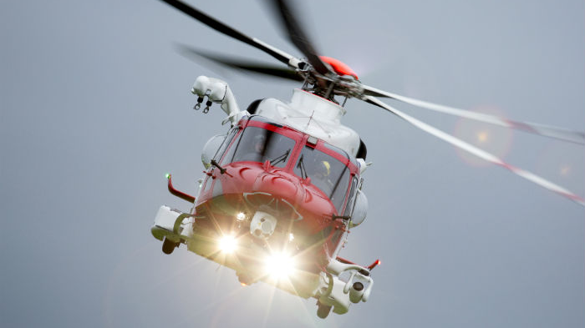
HELICOPTER USES
The search for a lost or injured person or persons
Their subsequent evacuation
The insertion or extrication of rescuers
An aerial survey of topography by search and rescue leadership

Slide 5
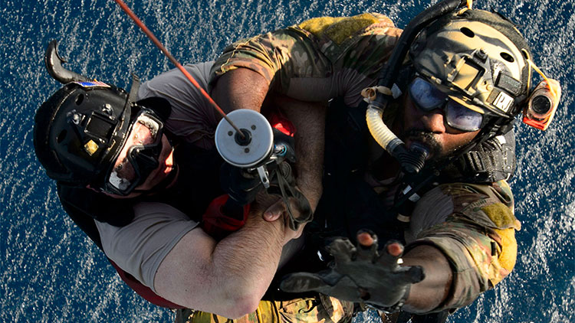
Introduction
helicopter aviation dramatically changed the reach and power of search and rescue work.
The past several decades have seen helicopters play an increasing role in search and rescue.

Slide 6
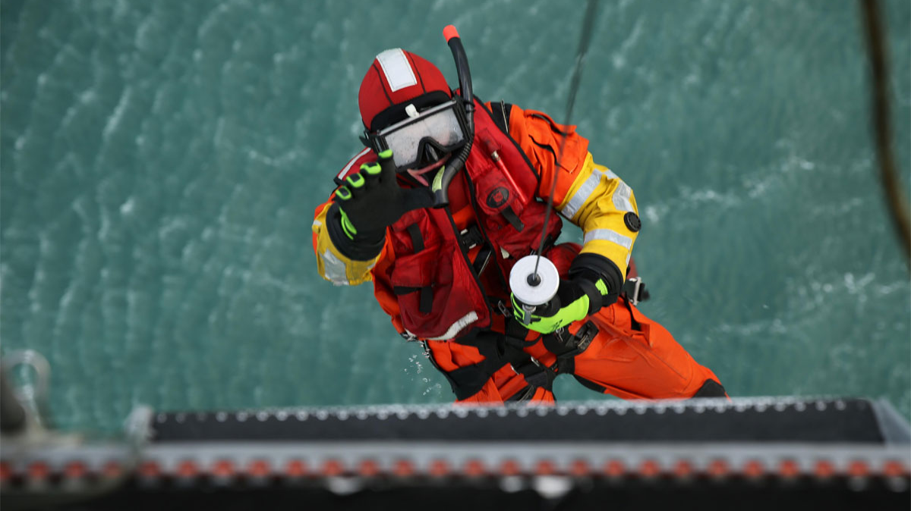
Use of Helicopters
The search for a lost or injured person or persons
Their subsequent evacuation
The insertion or extrication of rescuers
An aerial survey of topography by search and rescue leadership

Slide 7
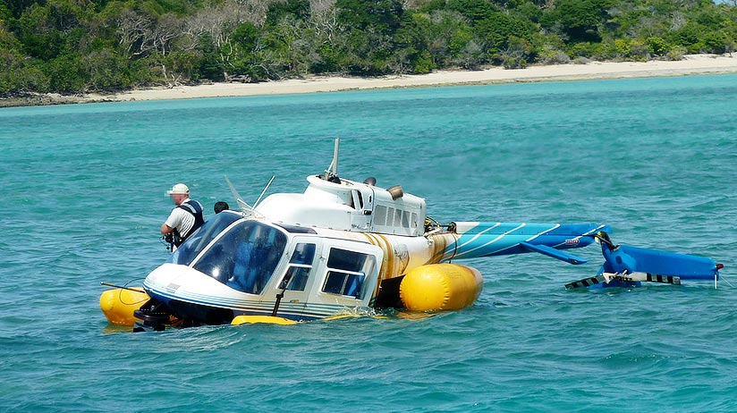
Helicopter
Limitations
Visibility Minimums
Weather Conditions
Fuel
Mechanical

Slide 8
Visibility Minimums
Visual Flight Rules (VFR): VFR requires that a pilot maintain visual contact with the environment and must avoid clouds.
Instrument Flight Rules (IFR): IFR allows flight using instruments.

Slide 9
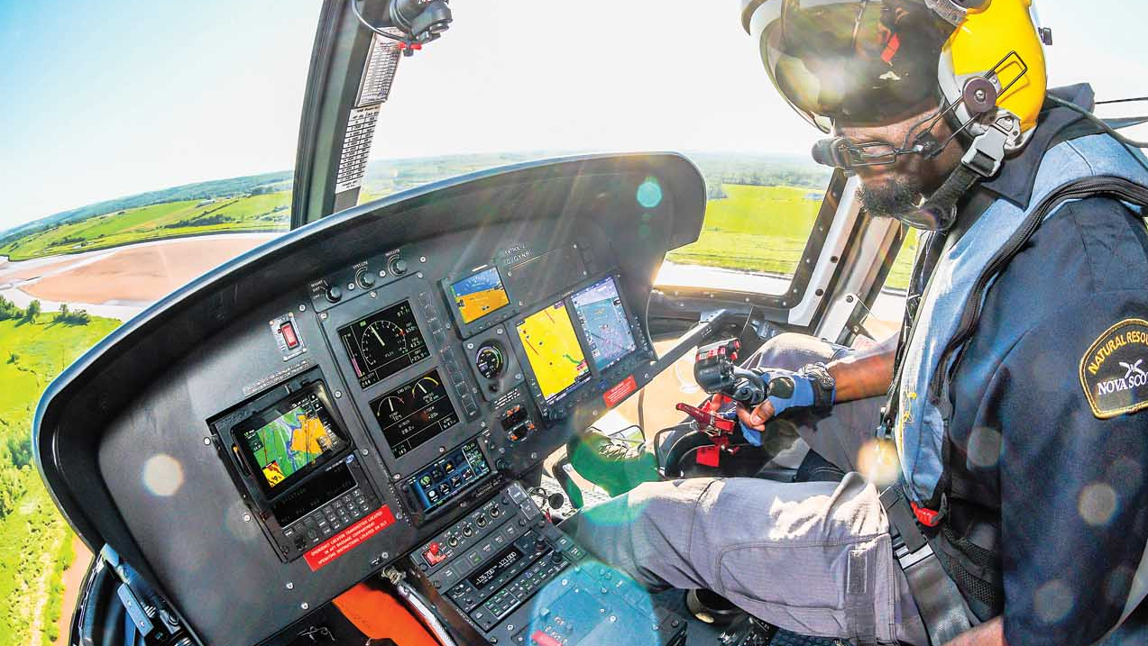
Visibility Minimums
Instrument Meteorological Conditions (IMC) : IMC is an aviation flight category that describes weather conditions that require pilots to fly primarily by reference to instruments, and therefore under instrument flight rules (IFR).
Visual Meteorological Conditions (VMC): VMC is an aviation flight category in which visual flight rules (VFR) flight is permitted—that is, conditions in which pilots have sufficient visibility to fly the aircraft maintaining visual separation from terrain and other aircraft.

Slide 10
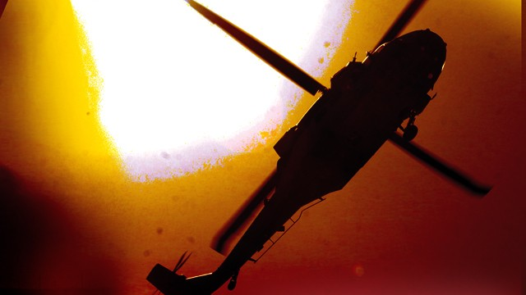
Inadvertent IMC
Inadvertent entry into IMC is a situation where pilots lose visual contact with the ground due to deteriorating meteorological conditions. ... Inadvertent IMC encounters are some of the most demanding, disorienting, and dangerous conditions a pilot can experience.

Slide 11

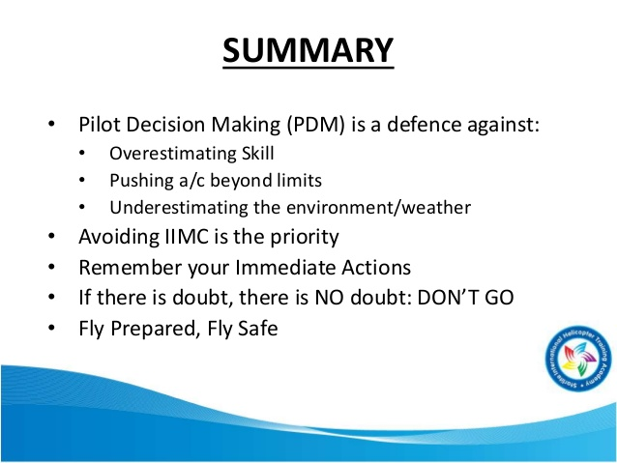
SURVING IMC

Slide 12
Weather Conditions
Turbulence is the rough air that causes sudden and undesired movement in flight.
Heavy turbulence can make helicopter flight difficult or even unsafe and can render the careful control required for many rescue operations challenging or impossible.
There are several causes of turbulence: storm wind, rising air and the air currents around mountains are common examples.

Slide 13
Weather Conditions
Cumulus clouds indicate turbulence with strong updrafts and downdrafts.
Downdrafts often flow in the middle of a valley and can challenge a helicopter's lift, especially at high altitudes with their consequent reduction in engine power.
Updrafts often exist over ridges or on the sunny side of a rising hill or mountain.
The leeward side of a ridge (that side sheltered from the predominant wind) may have severe downdrafts.

Slide 14
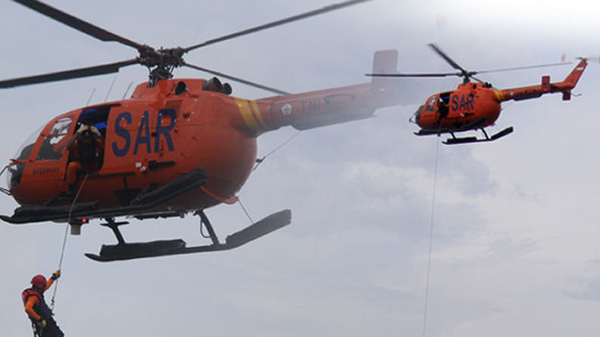
Fuel
Helicopters are often based some distance from the search and rescue mission, and the journey from this base to the point of action costs time and fuel.
SAR leadership might engage a mobile fuel tanker at the operation's heliport to refuel helicopters during an extended search mission, but more often than not helicopters will have to leave the scene to refuel.

Slide 15
Mechanical
Helicopter are machines
Failure can be unpredictable and catastrophic.
SAR teams must conduct a thorough risk-benefit analysis prior to each and every helicopter operation.

Slide 16
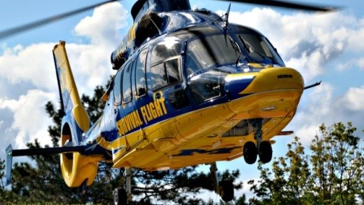
Classifications of
Helicopters
Helicopter Emergency Medical Services (HEMS)
Law Enforcement Helicopters
Civilian Helicopters
Media Helicopters
Military Helicopters

Slide 17
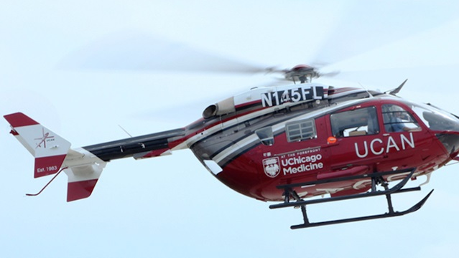
Helicopter Emergency Medical Services (HEMS)
These air ambulances enable an emergency medicine and critical care team to provide immediate intensive care to a patient at the site of injury and to transport that patient as rapidly as possible to the hospital for definitive care.

Slide 18
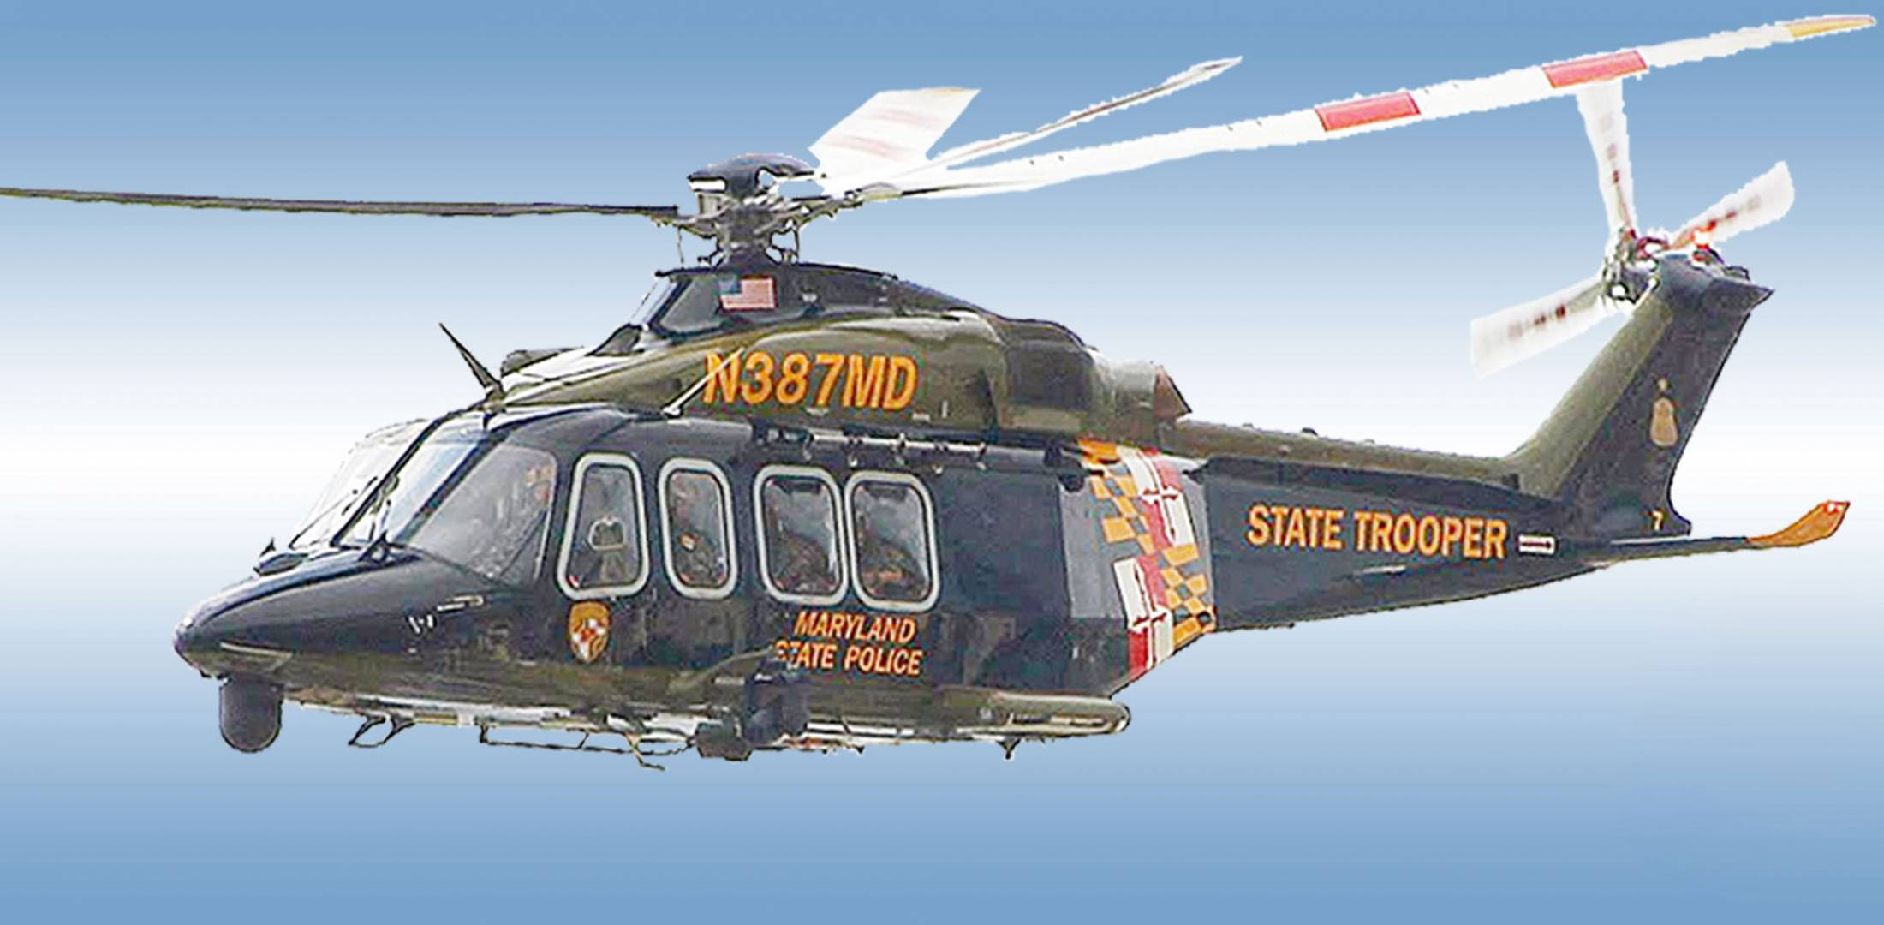
Law Enforcement Helicopters
The altitude limits of these helicopters often preclude their use in the mountains but may allow for search and rescue flights in the foothills.

Slide 19
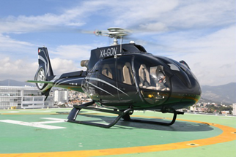
Civilian Helicopters
Although charter helicopters can be a valuable resource for SAR teams, the possible benefit they bring requires forethought and anticipatory planning if the benefit is to be fully realized.
Often these helicopters and their pilots lack extensive experience in search and rescue flights and sometimes in flying at altitude.

Slide 20
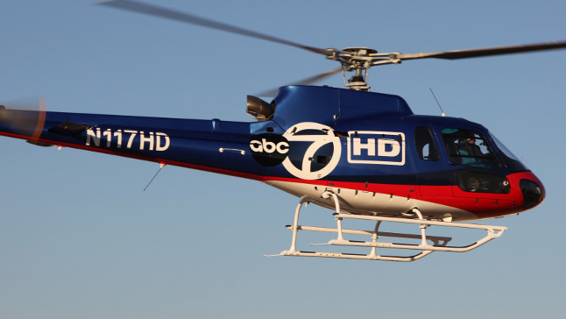
Media Helicopters
Search and Rescue overhead teams should keep in mind that the media helicopter pilot and crew have two important objectives.
The first objective is to "bring home the news story."
The second objective is to assist in the SAR mission.
The overhead team must respect the media's needs while focusing on its own objectives.

Slide 21
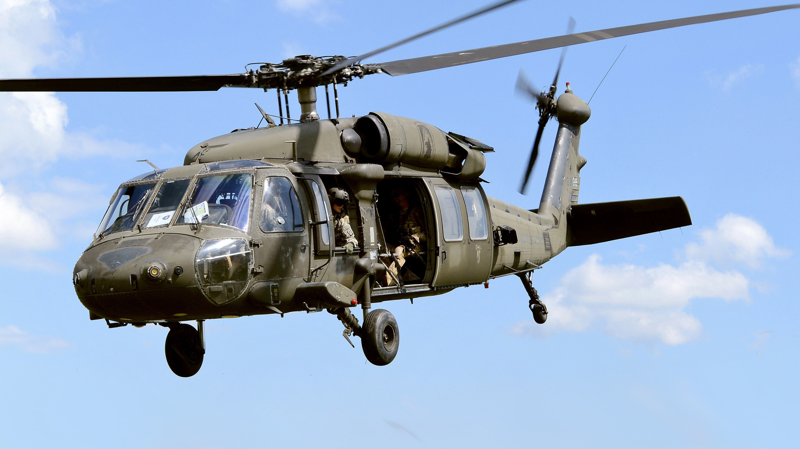
Military Helicopters
The US military generally employs three types of helicopters to assist in SAR work
The double rotor Chinook and the single rotor UH-70 Lakota and Blackhawk.

Slide 22
Aerodynamics
Most helicopters operate with a single main rotor coupled with a single tail rotor.
If a helicopter with a single main rotor lacked a tail rotor, the torque of the main rotor would cause the fuselage of the ship to spin in the direction opposite to that of the rotor blades.
The tail rotor acts to counteract the effect of this torque, allowing the helicopter to fly without spinning.

Slide 23
Aerodynamics
Twin rotor helicopters correct the spinning effect of this torque by having the two main rotors turn in opposite directions.
The actual "lift" in a helicopter is accomplished by the main rotor blade, which has a cross-section similar to the wing of an airplane.
As this "wing" moves through the air, spinning on an engine­driven shaft, lift is generated.

Slide 24
Helicopter Design
The main rotor turns at speeds of approximately 300 RPM.
In helicopters with a single main rotor, the tail rotor is the smaller rotor in the rear or the aircraft, rotating in the vertical plane.
The tail rotor generally turns between 1,500 1,800 RPM, making it impossible to see while in motion, especially at night.

Slide 25
HELICOPTER TYPES
TYPE
TYPE I (HEAVY)
TYPE
TYPE II (MEDIUM)
TYPE
TYPE III (LIGHT)

Slide 26
TYPE I (HEAVY)
15 PLUS SEATS
5000 pounds (2268 kg) PAYLOAD
Bell 214, Sikorsky S-70 (UH-60/HH-60) Black Hawk, Augusta-Westland AW 139, Sikorsky S-64 Skycrane, Boeing-Vertol BE-234, Boeing CH-47

Slide 27
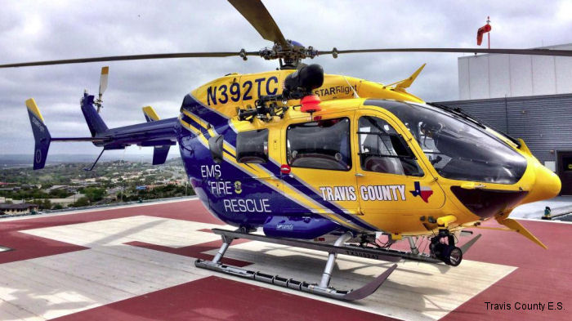
TYPE II (MEDIUM)
9-14 SEATS
2500 pounds (1134 kg) PAYLOAD
Bell 212, Bell 412, Eurocopter EC-145, Eurocopter UH-72 Lakota

Slide 28
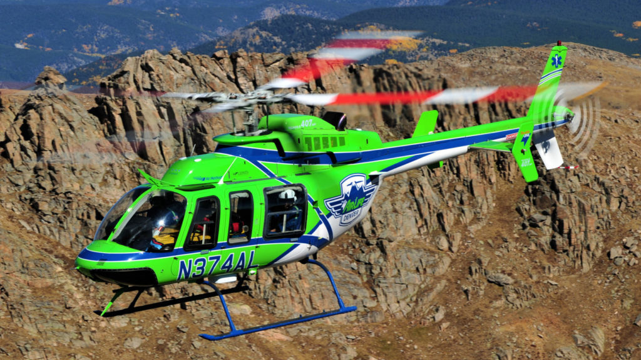
TYPE III (LIGHT)
4 TO 8 SEATS
1200 pounds (544 kg) PAYLOAD
Bell Long Ranger L-3, Bell 407 Eurocopter AS350 B3, Eurocopter EC-135, MD500, MD900 Explorer

Slide 30
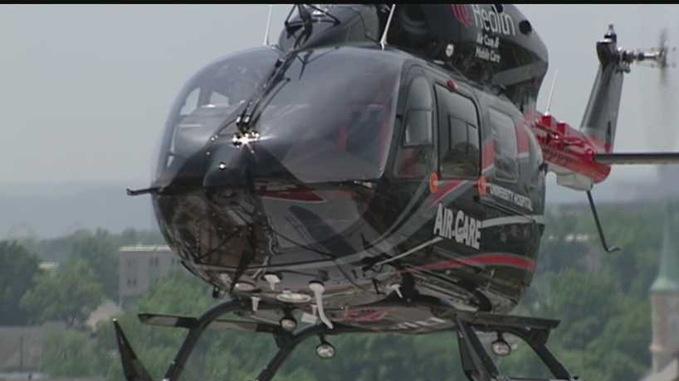
Rotor Systems
There are two basic helicopter designs, the single main rotor helicopter or the dual (a.k.a. tandem or twin) main rotor helicopter.
The most common design uses a single main rotor, which imparts lift and thrust, and a smaller tail rotor, which compensates for torque induced by the powered turning of the main rotor.

Slide 31
Helicopter Controls
Collective Pitch Control
The "collective pitch control" lever is located to the left of the pilot and moves in a simple up and down motion.
The collective pitch control is positioned relative to the pilot's seat (to its left) and not simply on the left (port) side of the aircraft.
The collective allows the pilot to vary the angle of attack, or "pitch," of the main rotor blades, increasing the corresponding lift.

Slide 32
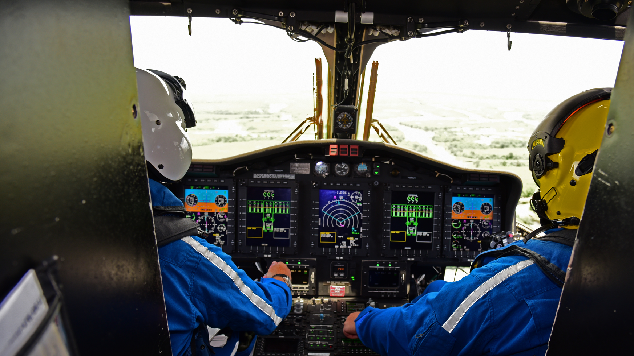
Helicopter Controls
Collective Pitch Control
The throttle increases or decreases the rate of revolution of the main rotor blade.
On piston powerd Increasing the pitch of the main rotor blades requires more engine power to maintain rotor RPM when the helicopter lifts off or climbs.
On turbine-powered helicopters, this power coordination is accomplished automatically through the fuel control and governor systems of the turbine engine.

Slide 33
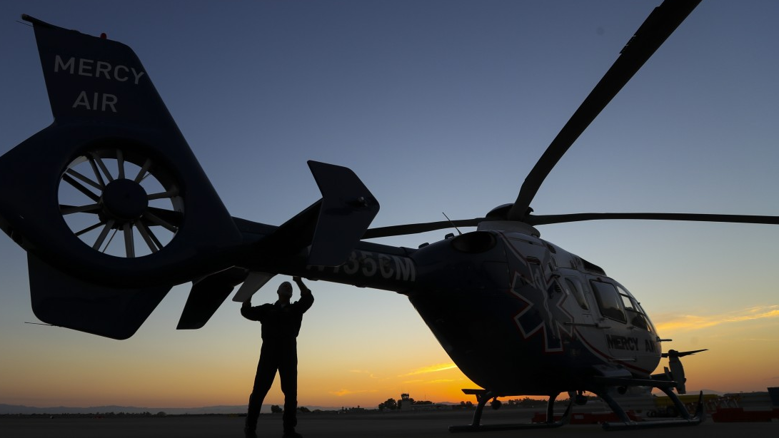
Helicopter Controls
Anti-torque Control
The two floor pedals provide "anti-torque" control by varying the amount of thrust generated by the helicopter's tail rotor by adjusting the pitch (angle of attack) of the tail rotor blade(s).
Anti-torque control is essential: it prevents the helicopter from spinning out of control.

Slide 34
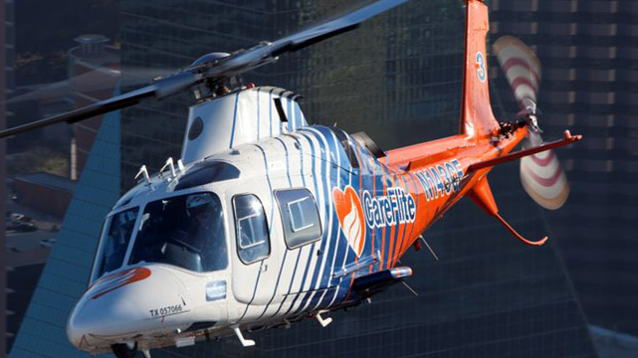
Helicopter Controls
Cyclic Control
primary flight control is the "cyclic" control stick, which is controlled by the pilot's right hand via a lever that projects between the legs.
The cyclic pitch control produces changes in pitch to each rotor blade individually.

Slide 35
Cyclic Control
If the pilot pushes the cyclic stick forward, the pitch of each blade is increased as it sweeps toward the tail of the helicopter.
As each blade swings forward, toward the nose of the helicopter, pitch is flattened.
The result is that each blade produces more lift as it swings to the rear than when it swings ahead.

Slide 36
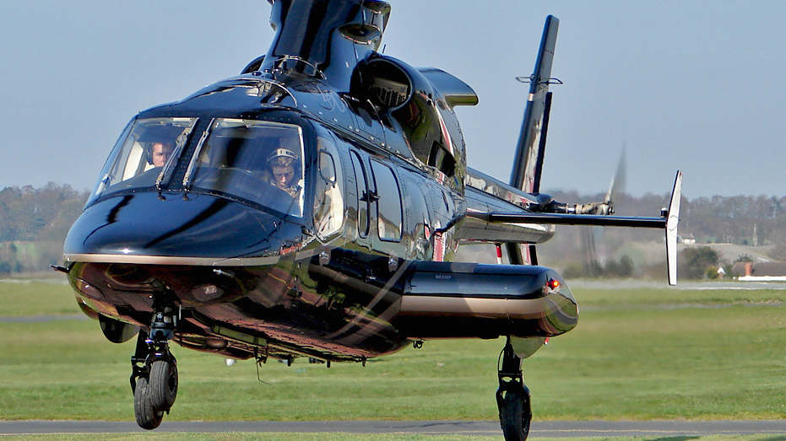
Types of Landing
Gear
Wheels
Wheels are primarily used on medium- and heavy-class helicopters. Helicopters with wheels are often capable of movement on the ground, an important ability when necessity requires repositioning at a heliport.

Slide 37
Types of Landing
Gear
Skids
Skids are the most common type of landing gear used in light- and medium-class helicopters. Skids are permanent, non­retractable horizontal "feet" which provide a long, flat touchdown surface for the helicopter.

Slide 38
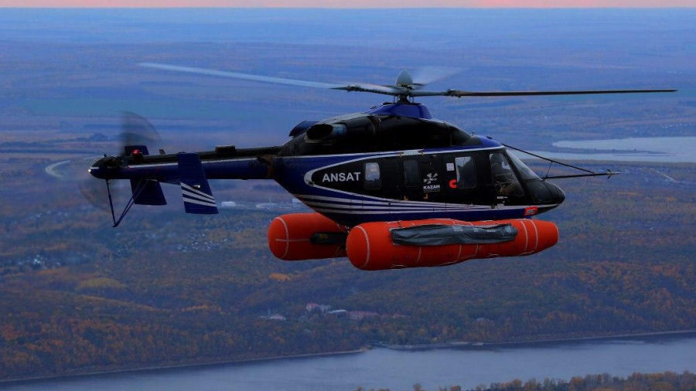
Types of Landing
Gear
Floats
Floats can be used on land as well as water. There are two types of floats, "fixed" and "inflated."

Slide 39
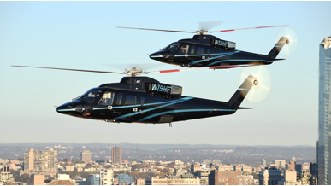
Types of Landing
Gear
Retractable Landing Gear
Some of the more refined helicopters are equipped with landing gear that may be retracted during flight. The retraction of landing gear makes the helicopter more aerodynamic.

