Slide 1
Chapter 16: Lifeguard Health and Safety
Notes:
Explain the link between lifeguard responsibilities and those of an athlete.
Identify methods of protecting skin from the sun.
Identify methods of protecting eyes from sun damage.
Identify methods of protecting ears from chronic irritation.
Identify methods of universal protection from infection.
Identify recommendations on handling exposure to bloodborne pathogens.
Explain the function of the Occupational Health and Safety Administration regarding occupational exposure to health infection.
List ways that lifeguards can take steps to stay healthy.
Recognize the standard ways post-traumatic stress syndrome is associated with the profession of lifeguarding.

Slide 2
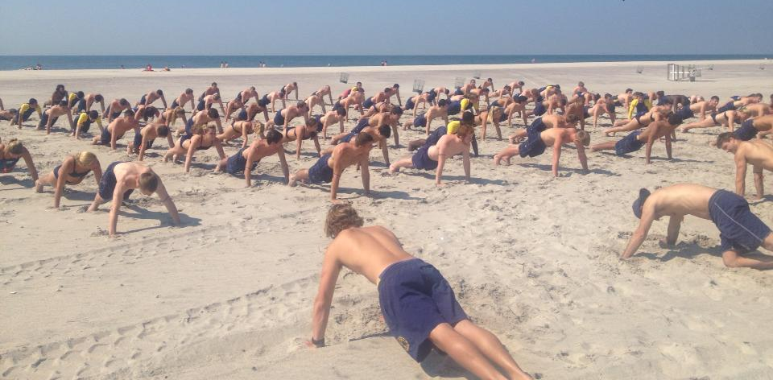
The Lifeguard Athlete

Slide 3
More physical than most jobs
It’s always a sprint
Injuries are to be expected and varied
Seasonal guards may be more vulnerable
Notes:
Open water lifeguarding is an athletic profession that exceeds the athletic requirements of most others.
The critical tasks required by the lifeguard are highly dependent on athletic skills.
Unlike an athletic competition, when proceeding on a rescue lifeguards usually need to go all out and can’t pace themselves.
Lifeguards can’t avoid their athletic activity. They can’t skip an event or a heat because they don’t feel up to it .
There are a wide variety of injuries that can be sustained in the course of lifeguard activity.
The seasonal basis of some lifeguards adds increased potential for injury risk due to the lack of lifeguard related activity in the off-season.

Slide 4
Injury Causes
Overuse Injuries
Back Injuries
Swimmer’s shoulder
Paddling
Running
Running on sand
Barefoot punctures
Jumping from heights
Rescue boats
The public
Notes:
Overuse injuries occur when the lifeguard has been trying to do something too often, too hard, for too long, or incorrectly, thus over-stressing or straining involved muscles and tendons, leading to inflammation, pain, and decreased function.
Back injuries, for example, may occur because lifeguards must lift, push, or carry things, like removing a victim from the water or pushing a rescue boat off the beach.
A common overuse injury is swimmer’s shoulder, which represents a tendonitis of the inner shoulder muscles of the rotator cuff.
The use of swim fins is recommended to lessen shoulder stress during the rescue.
Paddling long rescue boards over great distances also causes shoulder, neck, back and elbow problems.
Because lifeguards depend on running during training and rescues, they are susceptible to numerous overuse injuries including kneecap discomfort, shin splints, tendonitis, and heel spurs.
Running on the sand can cause various injuries, including Achilles tendonitis, foot problems, sprains, and strains.
Lacerations and punctures to bare feet are also common injuries.
Dismounting from an elevated beach post can strain their calf, sprain ligaments, or injure joints.
Rescue boats and emergency vehicles of all types can be an injury source.
Even the public can also be a source of injury.

Slide 5
Preventing Injury
Some injury is to be expected
Many are preventable
Physical exams
Workouts should include rescue equipment
Cardiovascular - daily
Strength - 3X per week
Cross-train
Proper body mechanics
Keep beach clean
Uneven surfaces
Equipment should be maintained, repaired or replaced
Helmets
Notes:
Some degree of injury in lifeguarding is inevitable due to the nature of the job.
Many lifeguard injuries can be prevented.
The USLA recommends that all lifeguards receive a pre-employment physical, and then annually, whether on their own or through their agencies, lifeguards should obtain a preseason physical exam.
Workouts should include drills using all items of rescue equipment that will be used in rescue, including RFDs, swim fins, and rescue boards.
On a daily basis, lifeguards should engage in physical exercise, including cardiovascular workouts which stress the respiratory and circulatory systems.
Strength workouts should be carried out several times a week.
Lifeguard athletes are advised to cross-train, not just pursue a single type of exercise.
Use proper body mechanics when lifting and enlist several lifeguards to share the load and reduce injury.
Keep the beach area free of unnecessary debris and consider use of footwear.
Be vigilant when running on uneven surfaces.
Equipment should be properly maintained to prevent damage, breakdown, or failure, any of which may result in injury. Proper training should be provided (e.g. use of helmets).

Slide 6
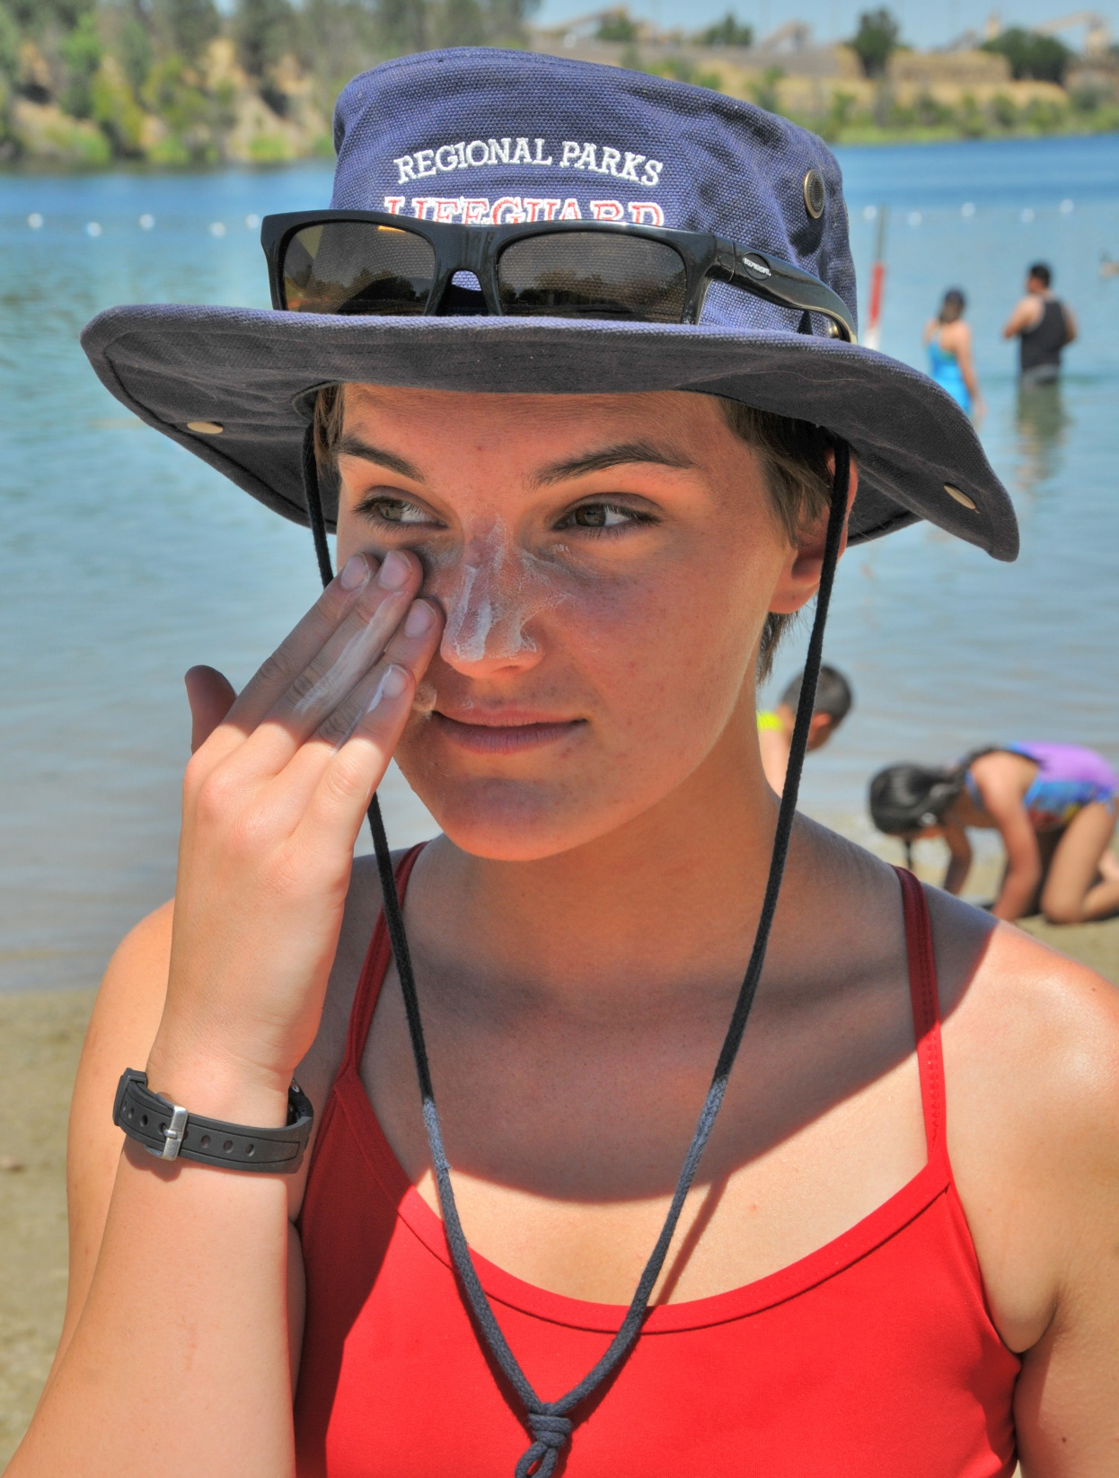
Skin Protection

Slide 7
Skin Protection
Skin cancer is the most common type of cancer
17,000 die yearly
Skin cancer has killed lifeguards
UV light
No “safe” tan
Damage on the cellular level
UV-A & UV-B
Melanin
Skin ages in the sun
Types of skin cancer
Early detection is vital
Awareness training
SPF 30
Apply 20-30 early
Notes:
The skin is the largest organ of the body and is susceptible to many injuries.
Skin cancer is the most common type of cancer, and lifeguards are very vulnerable because of the high levels of sun exposure they sustain and because of the strength of the sun’s rays at the beach where the damaging effect of sun rays can be tripled.
While skin cancer is highly curable if found early and treated, over 17,000 people die of skin cancer in the United States each year.
Skin cancer can and has killed lifeguards, even at a young age.
The most serious threat comes from a spectrum of sunlight called ultraviolet (UV) light..
There is no such thing as a “safe” tan! Even gradual tanning damages the skin.
Because sun damage to the skin occurs at the cellular level, DNA is directly harmed.
There are two types of UV light – UV-A and UV-B.
The body produces melanin to protect the skin from damage. Melanin is the pigment that darkens (tans) the skin.
Skin exposed to sun ages at an accelerated rate.
Skin cancers include melanoma (the deadliest form), squamous-cell carcinoma, and basal cell carcinoma.
If caught early, the deadly forms of skin cancer can usually be removed and their spread often stopped.
The USLA recommends awareness training for lifeguards, to help them better understand the problem and to check themselves for skin cancer, as well as annual evaluations by qualified medical experts.
A higher SPF number indicates greater protection, but increases above SPF 30 are marginal. An SPF 15 sunscreen blocks 93% of UVB radiation, while SPF 30 blocks about 97%.It is important for lifeguards to know that damage occurs to the skin, even when sunscreen is properly applied.
Sunscreen should be applied to dry skin, 20 to 30 minutes before sun exposure.
It should be used even on cloudy days because up to 80% of UV rays penetrate clouds. Sunscreen must be applied to all exposed parts of the body (including lips, ears, nose, shoulders and head).
Tightly knit, opaque clothing and the use of a wide brimmed hat can also protect the skin from sun damage.
It has been demonstrated that mandating use of sunscreen and protective clothing by lifeguards reduces the incidence of skin cancer and related workers compensation claims.

Slide 8
Skin Protection (cont.)
Use sunblock even on cloudy days
Tightly knit opaque clothing
Brimmed hat
Mandatory
Notes:
It should be used even on cloudy days because up to 80% of UV rays penetrate clouds. Sunscreen must be applied to all exposed parts of the body (including lips, ears, nose, shoulders and head).
Tightly knit, opaque clothing and the use of a wide brimmed hat can also protect the skin from sun damage.
It has been demonstrated that mandating use of sunscreen and protective clothing by lifeguards reduces the incidence of skin cancer and related workers compensation claims.

Slide 9
Skin Cancer Symptoms
Mole which enlarges irregularly or takes on a notched border
Red, blue, or white areas in a mole
Itching or bleeding in a mole
The appearance of a new mole in an adult
A scaly or crusty raised area
Raised hard red bumps with a translucent quality to their surface

Slide 10
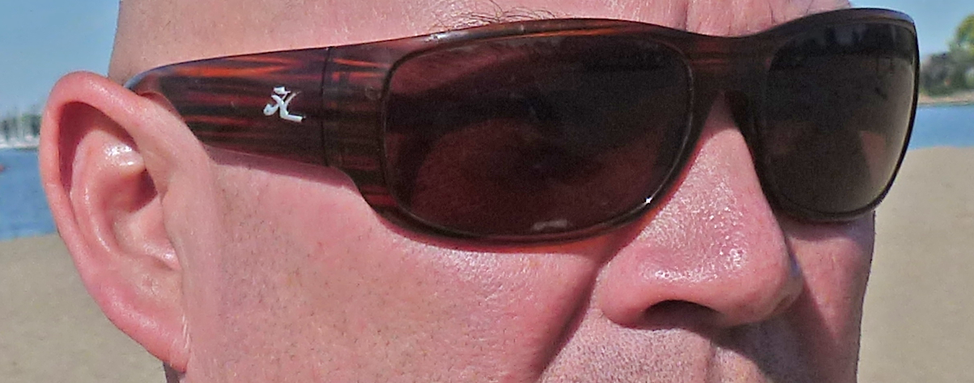
Eye Protection

Slide 11
Sun damages eyes
Cataracts
Macular Degeneration
Photokeratitis
Pterygium
Notes:
Keen eyesight is essential for lifeguards and those they watch over.
Eyesight can be seriously damaged by exposure to the sun. These can be minimized through proper protection.
Cataracts: a clouding of the lens of the eye. Can be caused by excessive sun exposure over a period of years. Primarily affect people later in life. Can be treated by surgery.
Eye injuries include:
Cataracts: A clouding of the lens of the eye
Macular Degeneration: Loss of central vision
Photokeratitis: Damage to the cornea of the eye from exposure to intense light
Pterygium: A callous-like growth that can spread over the white of the eye

Slide 12
Selecting Sunglasses
Filter UV-A and UV-B light
Block 75%-95% visible light
Gray, brown or amber lenses
Glass, plastic, or polycarbonate lenses
Polarized lenses
Notes:
Sunglasses and wide brimmed hat greatly reduce the amount of UV rays reaching the eyes.
Sunglasses need not be expensive.
Select sunglasses which filter out 99% to 100% of both UV-A and UV-B. light. Use lenses that block between 75% and 95% of visible light.
The best color for sunglasses include: gray, brown, green or amber. Avoid blue lenses.
Good quality lenses are generally made of high quality optical glass, plastic, or polycarbonate.
Polarized sun glasses dramatically reduce glare and are recommended for both protection against sun, to reduce eye fatigue and improve observation.

Slide 13
Ear Protection
Infection or irritation to the ears(s)
Swimmer’s ear
Ear Trauma Pain
Inflammation
Itching
Hearing Loss
Discharge
Keep ears dry
Silicon ear plugs
Tight fitting caps and hoods
Drying agents
Cleaning agents
Notes:
Chronic irritation and inflammation of the ear is a frequent problem for lifeguards.
Swimmer’s ear and surfer’s ear, affecting the middle ear, are the most common ear problems.
The most common symptoms of ear trauma include pain, inflammation and itching. Hearing loss and ear discharge can also occur.
Prevention of ear problems includes keeping the ear canal clean and dry.
When ear plugs are used, silicon earplugs are recommended. Additional ear protection includes wearing tight fitting caps and hoods.
Avoid reaching in to the ear.
Physicians can recommend drying agents, as well as cleaning agents that help remove impacted debris.

Slide 14
Infection Control
Infection of healthcare workers through exposure to the body fluids of another person (called cross-infection) is rare, but can occur
Body fluids can carry pathogens, which cause disease
Difficult for lifeguards to protect themselves in beach environment
The best way to avoid infection is to use “universal precautions” — all bodily fluids are assumed to infectious

Slide 15
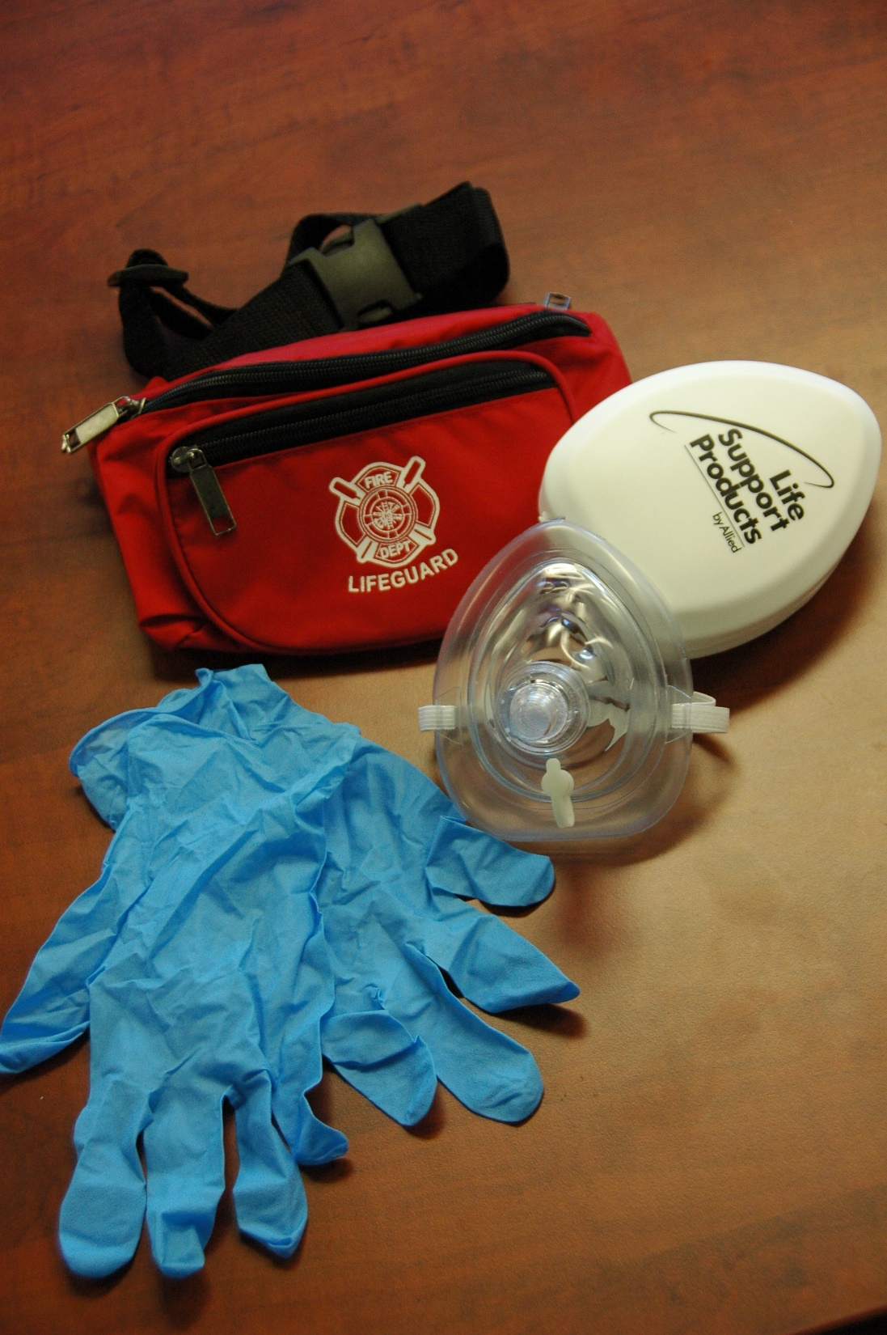
General Recommendations on Exposure

Slide 16
Vaccinations
The CDC recommends:
Hepatitis B
Flu (annually)
MMR (Measles, Mumps, & Rubella)
Varicella (Chickenpox)
Tdap (Tetanus, Diphtheria, Pertussis)

Slide 17
During Water Rescue of a Bleeding Victim
Avoid contact with the victim if possible
Avoid contact with bleeding areas when removing victim from water
During in-water resuscitation, wash away blood or body fluids prior to contact
Wash rescuer’s mouth after contact
Move victim to dry sand to prevent additional in-water exposure

Slide 18
During Medical Treatment of a Victim Ashore
Assume that all body fluids are infectious
Always use mechanical ventilation when possible
Use disposable resuscitation masks and oxygen delivery masks when possible
Wear occlusive gloves for handling bleeding victims
For profuse bleeding, limit exposure by wearing a mask, goggles and an occlusive gown, in addition to occlusive gloves
Wash hands with soap and water after contacting blood, even if gloves are worn
Use diluted bleach or Betadine if blood directly contacts skin
Clean blood and body fluids on equipment with a germicide containing household bleach – air dry
Wear gloves while cleaning

Slide 19
When Infected Items are Found on the Beach
Remove the items using universal precaution
Dispose of items in a manner avoiding exposure to others, consistent with agency regulatory protocol

Slide 20
In Case of Possible Infection
Lifeguards exposed to possible infectious material should follow agency protocol
If no protocol exists, contact a physician

Slide 21
OSHA Requirements
Hepatitis B must be made available by employer
Protective equipment must be provided at no cost
Employers shall ensure protective equipment is used
Employers must have exposure control plan

Slide 22
Daily Preventive Health
Eat healthy
Avoid drugs and alcohol
Get adequate sleep
Stay hydrated
Notes:
Eat balanced diet
Avoid alcohol and drugs
Good night sleep is essential to vigilance
Stay hydrated using water, or in cases of prolonged exertion a sport drink that replenishes essential minerals (electrolytes), but is non-carbonated, non-caffeinated, and low in sugar may be helpful

Slide 23
Post-Traumatic Stress Disorder
Lifeguards are regularly exposed to stressful situations
Death or serious injury to a beach patron can result in trauma to the lifeguard, but there are less dramatic causes
Posttraumatic stress disorder (PTSD) is a psychiatric disorder which may occur after a stressful event
PTSD may result in the rescuer experiencing nightmares, flashbacks, difficulty sleeping and feelings of detachment
Always assume that member of a rescue team could be affected by stress
Organizations are encouraged to confidentially debrief rescuers so that questions and concerns can be addressed
Depending on the severity of the experience, a formal Critical Incident Stress Debriefing (CISD) may be appropriate, led by mental health professional
Supervisors and coworkers are critical in helping colleagues manage stress

Slide 24
Notes:
Divide the class into groups of three. Assign 2 or 3 “Discussion Points” to each group. Ask each group to answer their questions, then share their work with the rest of the group. Finally, link the discussion questions to the lesson objectives as a final check of participant understanding of the chapter

