Slide 1
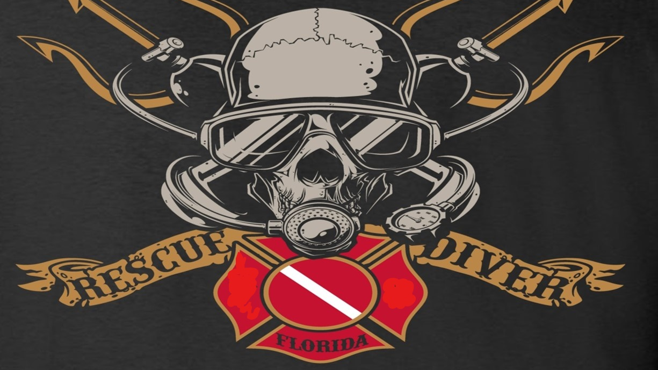
The rescue company 1
Helicopter Swiftwater Rescue

Slide 2
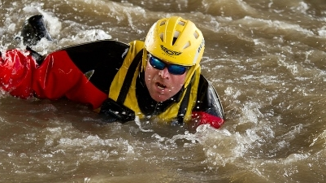
Rope Rescues Shore & Swimming Based Rope Rescues

Slide 3
Shore Based Rope Rescues
Shore base rescues can include rocks in the channel or other structures.
These rescues do not normally utilize swimmers or wading as part of the rescue.

Slide 4
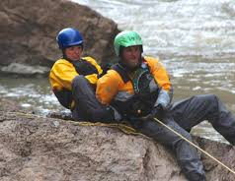
Shore Based Rope Rescues
The shore-based rope rescues include:
stabilization line
Snag line
Inverted paddle snag line

Slide 5
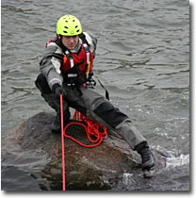
Stabilization Line
Stabilization line is to provide support with which the victim can raise his head above the water to breathe
Particularly in a heads-down foot entrapment.
It provides enough support for the victim to brace themselves against the line with their hands and arms.

Slide 6
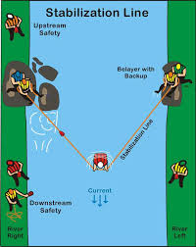

Slide 7
Stabilization Line
The pressure on the belayers is considerable.
The stabilization line can be fatiguing when the time frame becomes extended.
Hip belays are recommended.

Slide 8
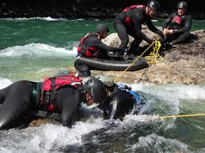
Snag Line
The purpose of the snag line is to position the snag line low enough on the victim to extricate them.
Traditionally, two throw bags filled with river rocks are used to lower the snag in the water and snag the victim
Normally, the snag line is used in conjunction with a stabilization line.

Slide 9
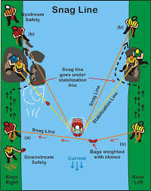

Slide 10
Inverted Paddle Snag Line
The inverted paddle snag line is a variation of the snag line.
The swift current keeps the snag line on the surface.
This technique lowers the snag line on the victim where it can snag the victim and extricate the victim from the entrapment.

Slide 11
Swimming Based Rope Rescues

Slide 12
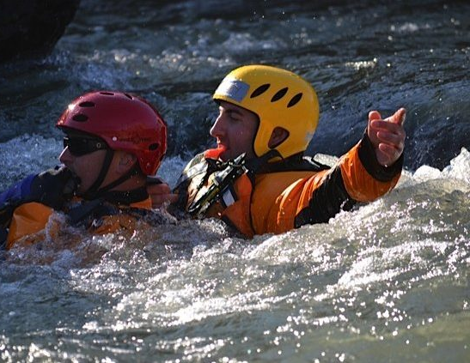
Swimming Based Rope Rescues
Swimming based rope rescues involve situations where the rescuer is wading or swimming to actively rescue the victim.

Slide 13
Swimming Based Rope Rescues
swimming based rope rescues:
Simple rope tether
tethered swimmer or live bait,
V-­lower

Slide 14
Simple Rope Tether
This technique illustrates a technique that can be setup quickly and with little fanfare.
In the simple rope tether, the rescuer uses a belayed line for stability.
In the solo rescue with a paddle, the paddle provides the same stability.

Slide 15
Simple Rope Tether
In the two-person rescue, the second person provides this stability.
In this rescue, the belayer on the shore provides this stability.
Rock, tree, or other object can just as easily provide the belay point

Slide 16
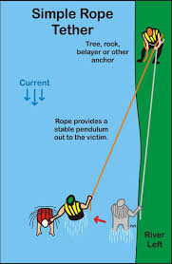

Slide 17
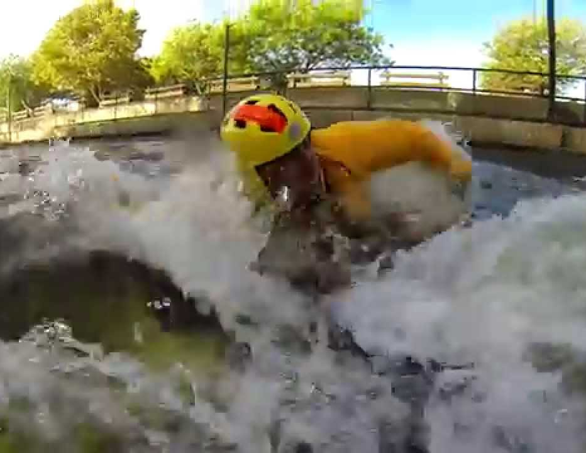
Tethered Swimmer or Live Bait Rescue
The live bait rescue is useful in rescuing an unconscious victim or equipment floating downstream in the current
It is useful in rescuing boaters who come out of their boats in whitewater above a major hazard.

Slide 18
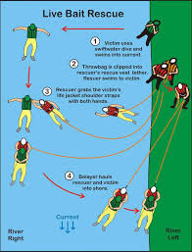

Slide 19
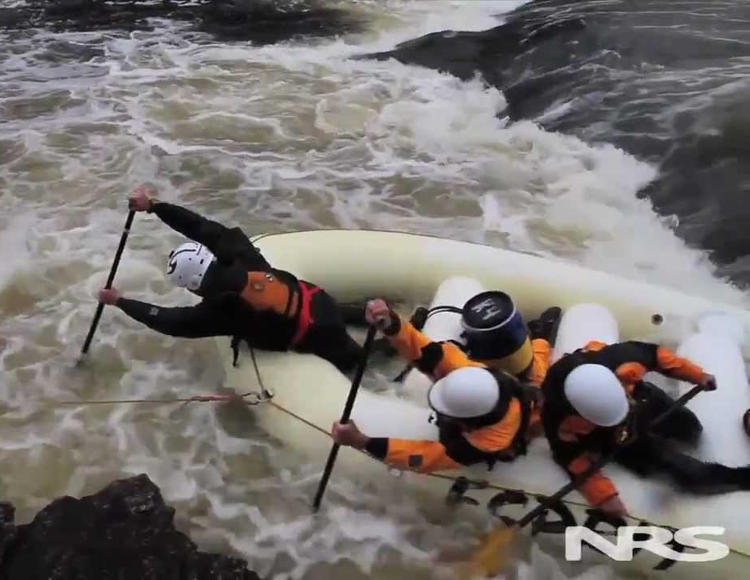
live bait rescue drill Scene #1: Victim Enters Water
Using a Swiftwater entry, the victim enters the water upstream.
The victim swims out into the main current and floats downstream.
Normally, they are simulating an unconscious victim.
it can also be equipment floating downstream or anything that cannot self-rescue.

Slide 20
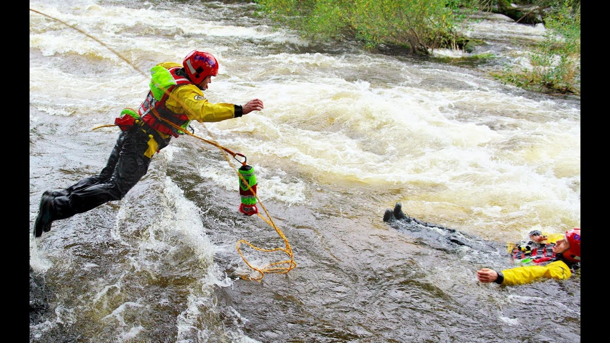
Swiftwater entry
A Swiftwater entry is hands in front of the face with a shallow belly flop dive.

Slide 21
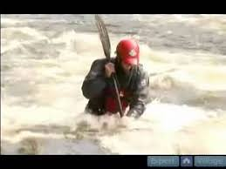
live bait rescue drill Scene #2: Rescuer Enters Water-First
The rescue bag is clipped into the tether of the rescuer's rescue vest.
This allows the rescuer the ability to eject herself from the line if needed.
The line and not the bag is clipped into the rescuer.
This enables only the needed line to be used.

Slide 22
live bait rescue drill Scene #2: Rescuer Enters Water-First
Clipping
Clipping the bag end into the tether results in all the rope in the bag corning out.
Using
Using a Swiftwater entry, the rescuer enters the water and swims toward the victim.

Slide 23
live bait rescue drill Scene #2: Rescuer Enters Water-First
On shore, the assistant feeds the line out of the throw bag.
It is important for the belayer on shore to feed out the line with as little resistance as possible.
To reduce drag on the swimmer, the assistant can allow the rope to float downstream if necessary.

Slide 24
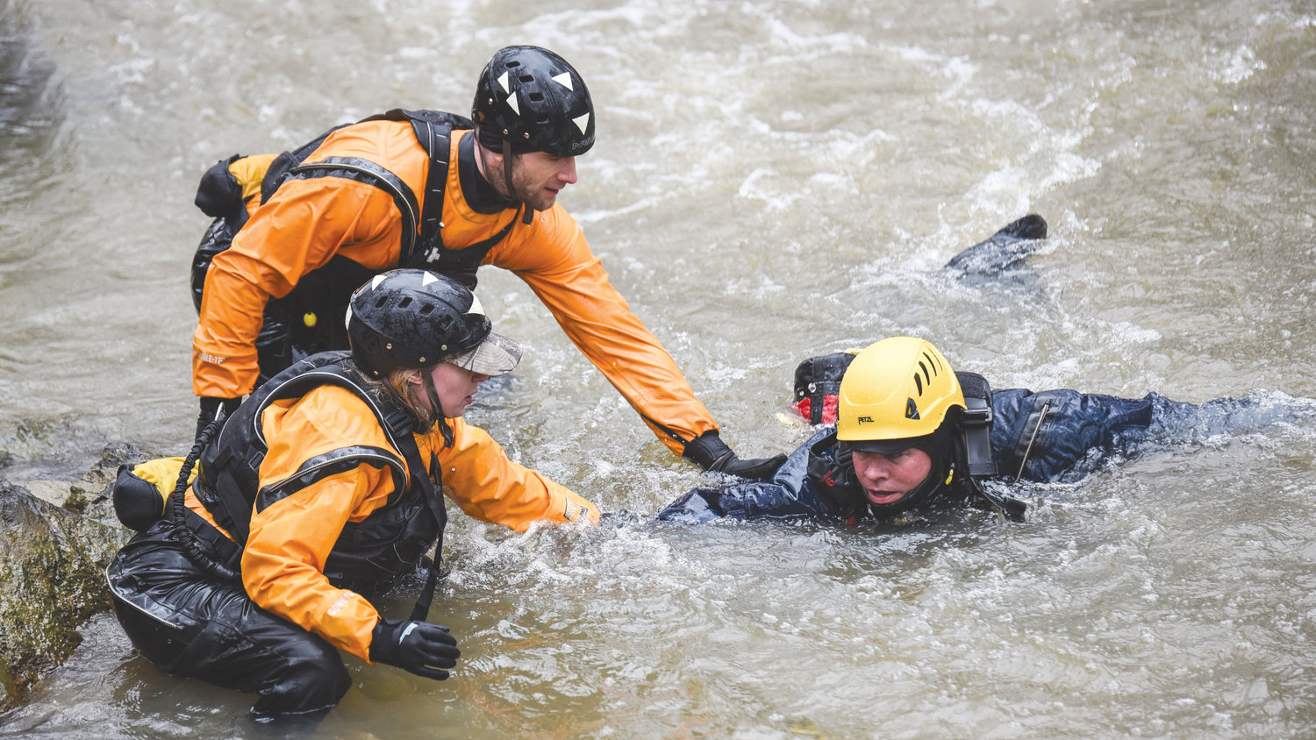
live bait rescue drill Scene #3: Grasping the Victim
The rescuer grasps the victim by the shoulder straps of the life jacket with both hands.

Slide 25
live bait rescue drill Scene #3: Grasping the Victim
If the victim is conscious, some recommend splashing water into the victim's face.
This temporarily disorients the victim which allows for the rescuer to grab a hold of the victim.
With the victim in her grasp, the shore-based assistant or rescuer can haul in and pendulum the rescuer and victim to shore.

Slide 26
live bait rescue drill Scene #4: Hauling into Shore
Both the rescuer and the victim are hauled to shore by the rescue assistants on the shore.
If possible, the rescuers on shore can step laterally or horizontally back on the shore prior to going into a sitting belay.
This increases the pendulum effect and makes hauling the swimmer into shore much easier.

Slide 27
live bait rescue drill Scene #4: Hauling into Shore
If necessary, the rescuer on shore may need to go into a standing belay or a sitting belay.
If needed, the belayer can be backed up with another rescuer.

Slide 28
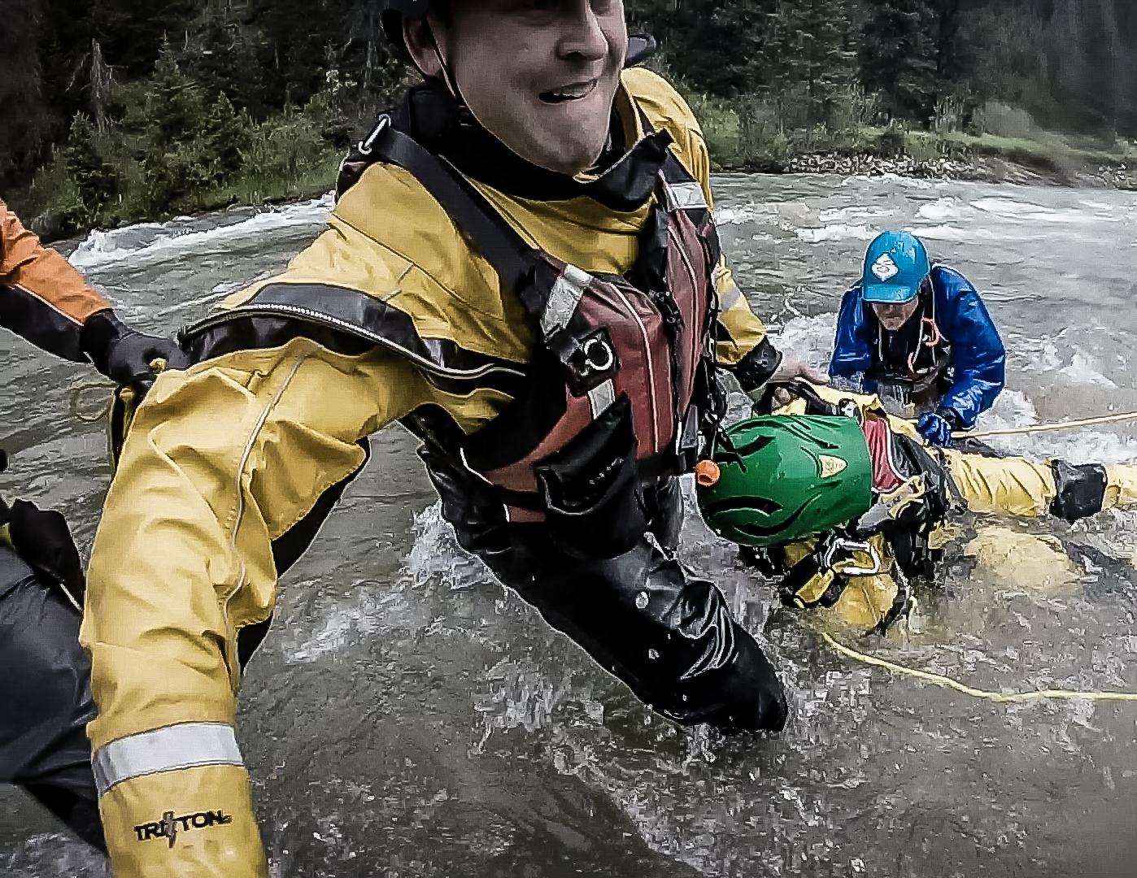
live bait rescue drill Scene #4: Hauling into Shore
Remember, the force on the victim is equal to the force on the belayer
Reducing the force on the belayer with a good pendulum reduces the force on the rescuer and victim
Makes hauling to shore easier.

Slide 29
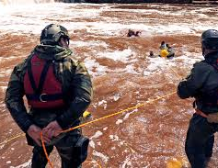
V-Lower
The V-Lower lowers a rescuer in moving water to effect a rescue of a trapped victim.
With one or more belayers on each side of the river, one or more lines are connected and extended across the river.

Slide 30
V-Lower
Two rocks in the river can be used by the belayers to lower the rescuer in a channel of the river.
If possible, setup of the belayers and rescuer should consider the 120° rule to reduce the load on the belayers.

Slide 31
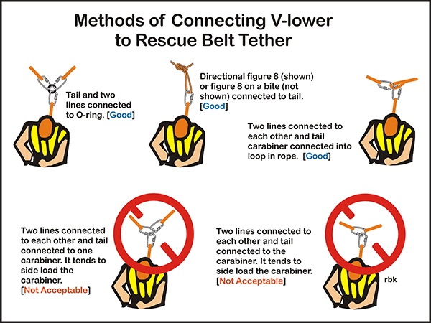

Slide 32
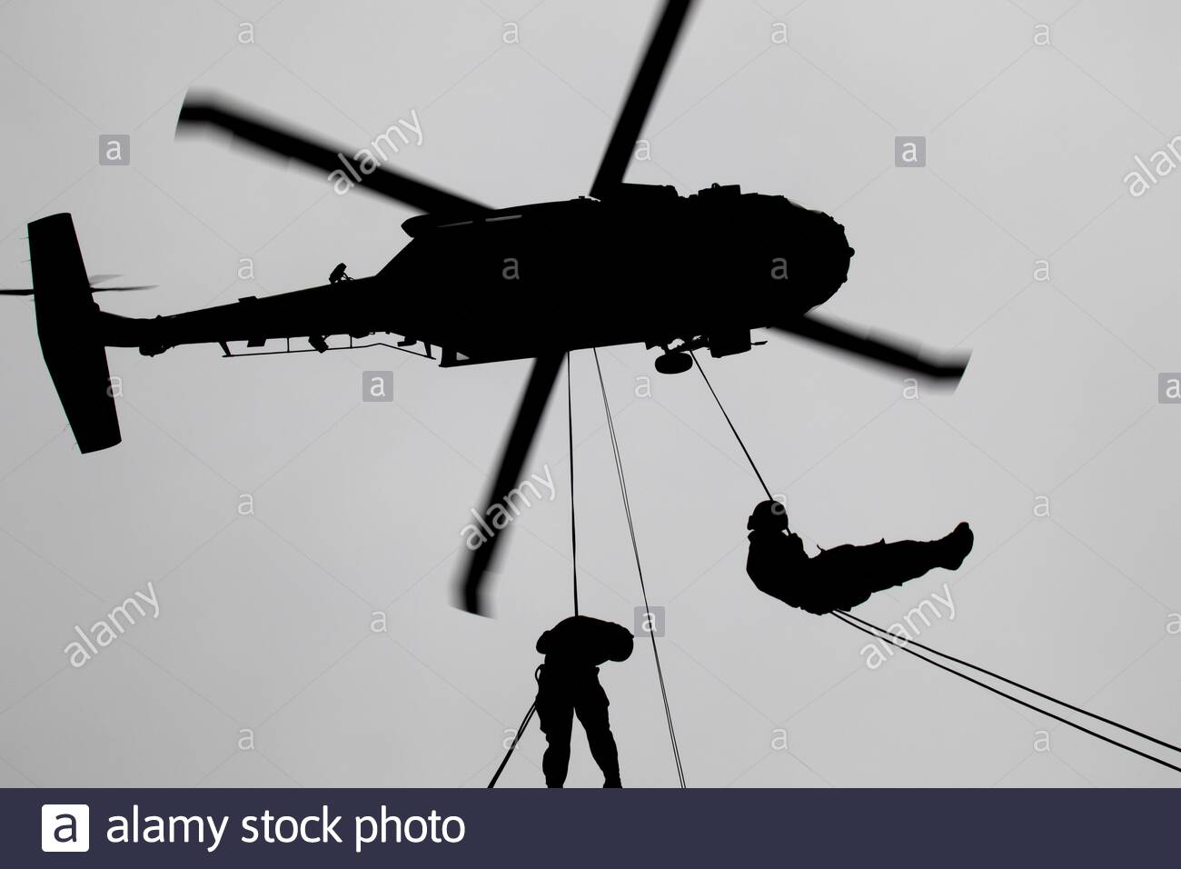
Cinches
As the term suggests, cinches use ropes to grip the victim firmly during the extrication.

Slide 33
simple cinch
The simple cinch converts a stabilization line into a simple cinch.
It shows how one system can easily be converted into another.

Slide 34
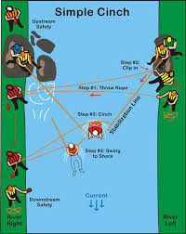

Slide 35
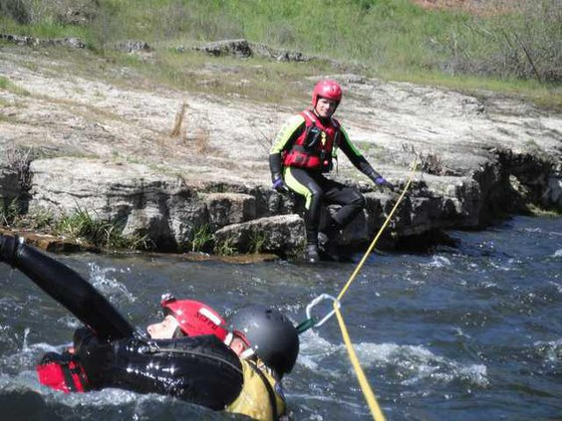
The Kiwi cinch
The Kiwi cinch is a same shore rescue.

Slide 36
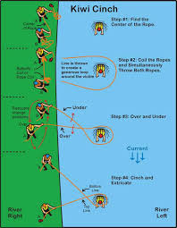

Slide 37
The Carlson cinch
Carlson cinch is a true cinch where the victim will not slip out of the cinch.

Slide 38
