Slide 1
Notes:
Chapter 18: Geriatrics

Slide 2
Chapter 18 Geriatrics
Notes:
Chapter 18: Geriatrics

Slide 3
Patient Assessment Approach for Geriatric Patients
Foundational knowledge plus:
A broader spectrum of symptoms
Subtle presentations of instability
Nonspecific generalized complaints
Multitude of assessment tools
Notes:
Lecture Outline
I. Introduction
A. Patient assessment approach for geriatric patients
1. The community paramedic’s patient assessment approach for geriatric patients is built on his or her paramedic training for emergency care.
2. The patient assessment of the older patient must also incorporate:
a. A broader spectrum of symptoms
b. Subtle presentations of instability
c. Nonspecific generalized complaints
3. Utilizing a multitude of assessment tools may be useful to ensure a thorough patient assessment that accurately reflects the current condition of the patient.

Slide 4
Attitudes Toward and Communication With Older Adults (1 of 3)
Community paramedic’s philosophy
Unbiased approach
Practice egalitarianism
Professional care and conduct
© Irina1977/Shutterstock.
Notes:
Lecture Outline
II. Attitudes Toward and Communication With Older Adults
A. Community paramedic’s philosophy
1. The community paramedic’s basic philosophy should embrace:
a. Taking an unbiased approach to each clinical experience
b. Practicing egalitarianism
c. Providing thoroughly professional care and professional conduct

Slide 5
Attitudes Toward and Communication With Older Adults (2 of 3)
Perform a self-assessment for preconceived attitudes
Avoid
Stereotyping
Becoming apathetic and impartial
Notes:
Lecture Outline
2. To realize this philosophy, the community paramedic must perform a self-assessment for preconceived attitudes that might negatively influence his or her approach to older patients.
a. Failure to take stock of personal attitudes may promote negative stereotyping.
b. The community paramedic’s approach to older patients could unconsciously become apathetic and impartial.

Slide 6
Attitudes Toward and Communication With Older Adults (3 of 3)
To avoid miscommunication, verbal and nonverbal cues should be caring.
Maintain eye contact
Speak slowly
Articulate each word clearly.
Avoid using medical jargon.
Ask patients to explain their discomfort.
Use the LEARN mnemonic.
Notes:
Lecture Outline
3. To avoid problems related to miscommunication, your verbal or nonverbal cues should be consciously caring and benign while speaking to the older patient.
a. Maintain eye contact.
b. Speak slowly.
c. Articulate each word clearly.
d. Avoid using medical jargon
e. Ask patients to explain their discomfort in their own words
f. Use the LEARN mnemonic

Slide 7
The Greater Complexity of Older Adults’ Health (1 of 5)
Modifying the patient assessment
Older patients’ special challenges
Complexity of health conditions
The community paramedic needs to:
Use the Occam’s razor approach
Evaluate internal and external risk factors
Investigate any iatrogenic causes or side effects
Notes:
Lecture Outline
III. The Greater Complexity of Older Adults’ Health
A. Many older patients present special challenges owing to the complexity of their health conditions.
1. The Occam’s razor approach to assessment, diagnosis, monitoring, and management emphasizes that the simplest diagnosis is the most likely diagnosis.
2. The approach to the geriatric patient should include a comprehensive evaluation of both internal and external risk factors.
3. As part of the assessment, the community paramedic should investigate any iatrogenic causes or side effects from a plan of care that may be contributing to the patient’s symptoms.

Slide 8
The Greater Complexity of Older Adults’ Health (2 of 5)
Aging is a subtle process.
Deteriorative changes produces:
A reduction in organ function
A decrease in the ability to maintain homeostasis
An increase in disease susceptibility
Notes:
Lecture Outline
4. Aging is a subtle process, in which changes in the body typically occur gradually.
a. Lean muscle mass decreases by 20%
b. Weight of the kidneys decreases by 80%
c. Serum albumin decreases to approximately 3.8 g/dL
d. Hepatic blood flow decreases by 60%
e. Body weight typically increases more than 38%
5. Deteriorative changes produce:
a. Reduction in organ function
b. Decrease in the ability to maintain homeostasis
c. Increase in disease susceptibility
6. Collectively, these aspects of the aging process render the older adult more susceptible to illness.

Slide 9
The Greater Complexity of Older Adults’ Health (3 of 5)
Cognitive changes in older adults
Gradual or rapid
Most common causes of cognitive impairment in older patients:
Dementia
Depression
Delirium
Notes:
Lecture Outline
B. Cognitive changes in older adults
1. Cognitive changes naturally occur as a person progresses through the various stages of life.
a. Can occur gradually or rapidly
2. There are three parts of memory:
a. Working memory: processes information and executes functions on a routine basis
b. Long-term memory: holds information that has been repeated many times and is being retained
i. Includes semantic memory (memory for facts and general knowledge)
c. Prospective memory: memory necessary to perform actions in the future, such as carrying out a task
3. The most common causes of cognitive impairment in older patients is known as the “three D’s”:
a. Dementia
b. Depression
c. Delirium

Slide 10
The Greater Complexity of Older Adults’ Health (4 of 5)
Always interview patient first
If caregiver available, seek additional details
© Jones & Bartlett Learning. Courtesy of MIEMSS.
Notes:
Lecture Outline
4. Always interview the patient first, but if his or her caregiver is available, and if talking to the caregiver about the patient is appropriate, seek additional details from this person.

Slide 11
The Greater Complexity of Older Adults’ Health (5 of 5)
Establish patient’s cognitive baseline during first patient encounter
Mental status assessment performed each patient assessment
Many older patients have significant cognitive impairment that is undiagnosed.
Never assume confusion is normal.
Notes:
Lecture Outline
5. Establishing a patient’s cognitive baseline during the first patient encounter is essential for an accurate patient assessment throughout the therapeutic relationship.
a. Mental status assessment should be performed during each patient assessment.
b. Many older patients have significant cognitive impairment that is undiagnosed.
c. Never assume confusion is “normal.”

Slide 12
Overview of Geriatric Patient Assessment (1 of 4)
Requirements for patient assessment on older adult:
Greater level of knowledge
More comprehensive history and physical exam
Notes:
Lecture Outline
IV. Overview of Geriatric Patient Assessment
A. Requirements for patient assessment on older adult
1. Performing a patient assessment on an older adult is more complicated and requires a greater level of knowledge from the community paramedic than does the assessment of a younger adult patient.
2. A more comprehensive history and physical examination will lead to a more accurate patient assessment and improved monitoring and management.

Slide 13
Overview of Geriatric Patient Assessment (2 of 4)
The patient assessment proceeds through:
General information
Chief complaint
History of present illness
Past medical history
Family medical history
Notes:
Lecture Outline
B. Format of Patient Assessment
1. The patient assessment in community paramedicine proceeds through:
a. General information
b. Chief complaint
c. History of present illness
d. Past medical history
e. Family medical history

Slide 14
Overview of Geriatric Patient Assessment (3 of 4)
The patient assessment proceeds through (cont’d):
Social history
Medications and allergies
General assessment
Vital signs
Review of systems
Notes:
Lecture Outline
f. Social history
g. Medications and allergies
h. General assessment
i. Vital signs
j. Review of systems

Slide 15
Overview of Geriatric Patient Assessment (4 of 4)
Clinical presentation of older patient encompasses a wide range of symptoms:
Altered mental status
Behavioral changes
Incontinence
Gait disturbances
Weight loss
Falls
Notes:
Lecture Outline
2. An older patient is more likely to have more complex conditions compared to a younger adult.
3. An older patient’s evaluation of his or her quality of life and functional status is an integral part of determining his or her independence.
4. The patient’s level of frailty influences his or her physiologic ability to maintain homeostasis.
5. The community paramedic should recall that the clinical presentation of an older patient may encompass a wide range of symptoms, such as:
a. Altered mental status
b. Behavioral changes
c. Incontinence
d. Gait disturbances
e. Weight loss
f. Falls

Slide 16
History Taking (1 of 10)
General living environment
Chief complaint
History of present illness
Social history
Activities of daily living (ADLs)
Instrumental activities of daily living (IADLs)
Notes:
Lecture Outline
C. History taking
1. The history should include the patient’s:
a. General living environment
b. Chief complaint
c. History of present illness
d. Social history, including the patient’s functional ability to perform:
i. Activities of daily living (ADLs)
ii. Instrumental activities of daily living (IADLs)

Slide 17
History Taking (2 of 10)
Review patient’s current medications
Prescribed
Over-the-counter
Herbal
To identify adverse reactions contributing to presenting symptoms
Notes:
Lecture Outline
2. The history should also include review of the patient’s current medications (prescribed, over-the-counter, and herbal) to help the medical director or the patient’s primary care physician identify any adverse reactions that may be contributing to the presenting symptoms.

Slide 18
History Taking (3 of 10)
General information
Is the home clean?
Is there food in the house?
Are there drugs and alcohol?
Patient’s appearance and demeanor
© mg7/iStock/Getty.
Notes:
Lecture Outline
D. General information
1. Assessment of the home should include the following considerations:
a. Is the home clean or dirty?
b. Is there food in the house?
c. Which medications are in the house or noted among the patient’s belongings?
d. Is the patient at risk of abuse or neglect?
e. Is there evidence of use of drugs or alcohol?
2. Observe the patient’s appearance and demeanor for signs of cognitive impairment.

Slide 19
History Taking (4 of 10)
History of present illness
OPQRST-ASPN
Onset
Provocation/palliation
Quality
Region/radiation
Severity
Time (temporal aspects)
Notes:
Lecture Outline
E. History of present illness
1. The mnemonic OPQRST-ASPN is a useful tool in community paramedicine for describing the present illness.
2. OPQRST-ASPN incorporates the following elements:
a. Onset
b. Provocation/palliation
c. Quality
d. Region/radiation
e. Severity
f. Time (temporal aspects)

Slide 20
History Taking (5 of 10)
OPQRST-ASPN (cont’d)
Associated Symptoms
Pertinent Negatives
Notes:
Lecture Outline
g. Associated symptoms
h. Pertinent negatives

Slide 21
History Taking (6 of 10)
A complete past medical history should include the patient’s:
History of childhood illness
Medical history
Surgical history
Psychiatric history
Family history
Notes:
Lecture Outline
F. Past medical history
1. A complete past medical history includes determining the patient’s:
a. History of childhood illness
b. Medical history
c. Surgical history
d. Psychiatric history
e. Family history
2. Pertinent and relevant medical history should include comorbidities that may be contributing to the chief complaint:
a. Hypertension
b. Diabetes
c. Chronic renal disease
d. Food or drug allergies
e. Emotional or sexual health issues
3. It is essential to obtain a family history, which may reveal hereditary risks for certain disease processes, such as:
a. Hyperlipidemia (high cholesterol levels)
b. Undiagnosed cardiac disease
c. Hypertension (high blood pressure)
G. Social history
1. Older patients who do not have sufficient financial resources or who experience functional impairments often rely on others to meet their daily needs.
2. Family, friends, or neighbors often become unpaid caregivers.
3. The community paramedic must focus on the full scope of the patient’s needs—what are is being provided, when, where, and by whom.
4. If appropriate, informal caregivers who are essential to the care of the geriatric patient may provide additional information about the patient’s medical history.

Slide 22
History Taking (7 of 10)
Medications and allergies
Older population accounts for 30% of all prescriptions written in the United States
Typical older patient takes 4 or 5 prescription drugs and 2 over-the-counter medications
Notes:
Lecture Outline
H. Medications and allergies
1. According to the World Health Organization (WHO), inappropriate use of medicines has become a worldwide risk, increasing the percentage of drug-related problems.
a. The older population accounts for approximately 30% of all prescriptions written in the United States, with the typical older patient taking four or five prescription drugs and two over-the-counter medications.
2. As the number of medications prescribed to an older patient increases, so does the risk of iatrogenic drug-related adverse reactions.
3. For the community paramedic, understanding the principles of pharmacokinetics (ie, absorption, distribution, metabolism, and elimination) in the older patient will assist with identifying medication-induced conditions.
a. Decreased renal mass and blood flow result in reduced drug efficiency.
b. Plasma concentration of medications remains higher for longer periods in older adults (ie, medications are not eliminated quickly).
c. Risk of side effects (eg, altered mental status, confusion, and delirium) is increased.

Slide 23
History Taking (8 of 10)
Medication inventory
Essential part of the assessment of the older patient
Maintaining medication inventory and ensuring compliance are critical to patient’s care
Achieved through accurate documentation of patient’s medications
Notes:
Lecture Outline
4. Medication inventory
a. A thorough medication inventory is essential as part of the assessment of the older patient.
i. Over-the-counter medications (eg, nonsteroidal noninflammatory drugs [NSAIDs], aspirin)
ii. Herbal remedies
iii. New medications (prescription or nonprescription)
iv. Change in medication dosage
b. Maintaining the medication inventory and ensuring compliance are critical to the patient’s continued care and can be achieved only through accurate documentation of the patient’s current medication(s).
c. Medication errors can occur from underdosing and overdosing (accidental or purposeful).

Slide 24
History Taking (9 of 10)
Evaluate prescription bottles for :
Date
Dose
Quantity prescribed
© Jones & Bartlett Learning. Courtesy of MIEMSS.
Notes:
Lecture Outline
d. Community paramedics can determine medication compliance by evaluating prescription bottles for the:
i. Date
ii. Dose
iii. Quantity prescribed

Slide 25
History Taking (10 of 10)
Substance abuse among older adults
If you suspect substance abuse:
Assess the patient’s symptoms
Watch for nonverbal cues
Obtain a medication inventory
Notes:
Lecture Outline
5. Substance abuse among older adults
a. The National Council on Alcoholism and Drug Dependence has reported that 30% of all medications prescribed in the United States are intended for people 65 years and older.
i. Research has indicated that the rate of prescription medication abuse is higher in this population than in younger patients.
ii. A significant factor is insufficient mitigation of pain in patients with chronic conditions.
b. If you suspect substance abuse, assess the patient’s symptoms, watch for nonverbal cues (eg, pinpoint pupils, constipation, memory loss, and slurred speech) and obtain a medication inventory.
c. Medical histories should also include information about personal habits regarding alcohol intake, tobacco use, and caffeine consumption.

Slide 26
Physical Examination (1 of 18)
Four major techniques:
Inspection
Palpation
Percussion
Auscultation
Notes:
Lecture Outline
V. Physical Examination
A. Major techiques
1. As with younger patients, four major techniques are used when performing a physical examination of a geriatric patient:
a. Inspection
b. Palpation
c. Percussion
d. Auscultation

Slide 27
Physical Examination (2 of 18)
For clues to the patient’s condition and underlying disorders, observe the patient’s:
Behavior
Alertness
Grooming
Personal hygiene
Facial expressions
Demeanor
Notes:
Lecture Outline
B. General appearance
1. Look at the patient overall, and get an impression of his or her general appearance. The goal is to formulate a general impression of the patient’s condition.
2. For clues to the patient’s condition and underlying disorders, observe the patient’s:
a. Behavior
b. Alertness
c. Grooming
d. Personal hygiene
e. Facial expressions
f. Demeanor

Slide 28
Physical Examination (3 of 18)
The community paramedic may consider using the five I’s of geriatrics.
Describe the specific challenges of assessing the older adult
Notes:
Lecture Outline
3. When indicated, the community paramedic may consider using assessment tools relating to the five I’s of geriatrics during this stage of the physical examination.
4. Five I’s of geriatrics describe the specific challenges of assessing the older adult:

Slide 29
Physical Examination (4 of 18)
Five I’s of geriatrics
Intellectual impairment
Immobility
Instability
Incontinence
Iatrogenic disorders
Notes:
Lecture Outline
a. Intellectual impairment
i. Key question: Based on the patient’s first response, does he or she appear awake, alert, and attentive?
ii. Mini-Cog tool can be used to detect cognitive impairment.
b. Immobility
i. Key question: How steady are the patient’s gait and balance?
ii. Get Up and Go test can be used to assess the patient’s mobility
c. Instability
i. Key questions: Does the older patient appear frail? Is there evidence of muscle wasting or unplanned weight loss of 10% of total body weight? Are there any signs of dry mucosa, dehydration, or poor dentition or denture fit?
d. Incontinence
i. Key question: Does the patient have control over his or her urinary function?
ii. The DIAPPERS mnemonic
a) Delirium
b) Infection
c) Atrophic urethritis (inflammation of the urethra)
d) Pharmacy-induced
e) Psychological
f) Excess urinary output
g) Restricted mobility
h) Stool impaction
e. Iatrogenic disorders
i. Key question: Could the older patient be experiencing an adverse reaction from interactions among prescribed medications or over-the-counter medications, or from a previous medical procedure?
6. These challenges can be addressed through specific assessment techniques.

Slide 30
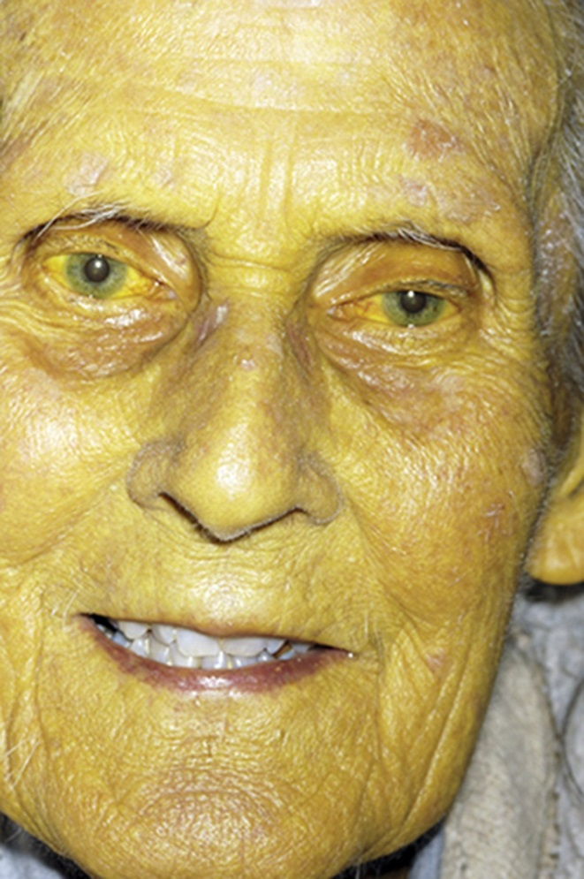
Physical Examination (5 of 18)
Skin assessment
Determine underlying disease process
Potential for abuse
Elasticity
Color
Open wounds
© Dr P. Marazzi/Science Source.
Notes:
Lecture Outline
C. Skin assessment
1. The general appearance of aging skin often provides details that can guide and assist the community paramedic in determining:
a. An underlying disease process
b. The potential for abuse
i. Note location and shape of bruises.
2. Skin that is loose with poor elasticity could be a sign of dehydration.
i. Pale skin may indicate anemia.
ii. Jaundice may indicate hepatitis or cholecystitis.
iii. Generalized pigmentation may suggest hemochromatosis (overingestion of iron).
iv. Dark and thickened skin in the folds of the body (acanthosis nigricans or keratosis nigricans) may indicate type 2 diabetes.
3. Also examine the skin for open wounds and note their location.
a. Arterial insufficiency
b. Venous insufficiency

Slide 31
Physical Examination (6 of 18)
Head and neck assessment
Look for signs of head or face injury.
If there is a head injury, look for altered mental status during neurologic assessment.
Use caution when palpating the neck.
Notes:
Lecture Outline
D. Head and neck assessment
1. Observe the older patient for signs of head or face injury.
2. If there is a possibility of head injury, look for signs of altered mental status during the neurologic assessment.
3. Use caution when assessing and palpating the neck of an older patient.
Arthritic changes in the neck make cervical vertebrae more prone to fracture.
Never manipulate the spine.

Slide 32
Physical Examination (7 of 18)
Cardiorespiratory assessment
Lungs and heart
Circulatory function
Heart sounds
Heart rate and blood pressure
Circulation abnormalities (eg, resistant hypertension)
Notes:
Lecture Outline
E. Cardiorespiratory assessment
1. Lungs and heart
a. Assess the chest for symmetry, rise, and expansion.
b. Observe for bruising, tenderness, or radiating pain to the neck, shoulders, or back.
c. Assess the lungs via auscultation. The community paramedic should be aware that loss of elasticity of the chest wall means that injury to the underlying lung is possible with less force in older people.
d. Assess the heart, noting the apical impulse, rate, and rhythm, as well as any heart sounds, murmurs, rubs, or gallops.
2. Circulatory function
a. Circulatory function reflects the effectiveness of cardiac output
i. Cardiac output = stroke volume × heart rate.
b. The normal aging adult heart is less responsive to stimulation from the nerves that adjust the heart rate and strength of contraction, which can result in a lower heart rate and weaker pulse than expected.
c. Heart sounds
i. Normal heart sounds consist of S₁ and S₂. As a person ages additional heart sounds and murmurs may develop.
ii. When extra heart sounds appear, the community paramedic must document the finding.
iii. Note any heart murmurs and document timing, intensity, location, radiation, quality, pitch, and loudness of the murmur.
g. Heart rate and blood pressure
i. Heart rate, blood pressure, capillary refill, and mental status are all indicators of circulatory status.
ii. Heart rate may be affected by medications commonly taken by older people, especially beta-blockers, calcium channel blockers, and antiarrhythmic medications.
iii. Keep in mind that blood pressure levels considered normal in younger patients may be cause for concern in the older patient.
iv. Low blood pressure is an indicator of hypoperfusion.
v. When an older patient develops hypotension, the community paramedic should determine if there are contributing factors, such as inducement from prescription medications, post-gastrointestinal symptoms, vasovagal stimulation from vomiting, or postprandial hypotension (decrease in blood pressure following a meal).
vi. Assessing volume status, or dehydration, is also different in older patients than in younger patients.
vii. Circulation abnormalities may include resistant hypertension.
a) The prevalence of resistant hypertension in the United States is 70 million persons, or 1 in every 3 adults.
b) There are two categories of resistant hypertension: difficult-to-treat hypertension and truly resistant hypertension.

Slide 33
Physical Examination (8 of 18)
Cardiorespiratory assessment (cont’d)
Airway function
Aging-related changes
Increased work of breathing
Breathing assessment
Lung auscultation
Egophony and bronchophony
Notes:
Lecture Outline
3. Airway function
a. Aging-related changes
i. Airway management in the older adult can be compromised by several common anatomic changes, which results in increased work of breathing.
ii. An older patient’s ability to protect his or her own airway may be compromised as the result of a prior disease (eg, stroke or dementia).
b. Breathing assessment
i. When assessing the effectiveness of breathing in older patients, remember that the normal range for respiratory rate in this age group is the same as that in young adults—12 to 20 breaths/min.
ii. The patient’s clinical presentation determines the severity of pulmonary compromise (audible respiratory wheezes, cough, is the patient speaking in one-word answers).
For the older patient, initial lung auscultation should be performed at the bases first, where rales or crackles will be heard initially, as fluid fills the lung fields from the bottom up.
When further assessment and evaluation are needed, the community paramedic can perform:
i. Egophony
ii. Bronchophony

Slide 34
Physical Examination (9 of 18)
Neurologic assessment
Mental status assessment
Observe the patient
Determine the patient’s orientation to person, place, time, and event
If patient is impaired, determine if impairment is:
Chronic
Acute
Notes:
Lecture Outline
E. Neurologic assessment
1. Mental status assessment
Observe the patient
i. Is the patient alert, responsive, making eye contact, and speaking in a clear voice?
Is the patient’s response appropriate to the questions being asked?
Is the patient in pain?
b. Determine the patient’s orientation to person, place, time, and event
i. Ask what day of the week it is or if the patient knows where he or she is right now.
ii. Confer with a family member or caregiver.
c. Determining whether the patient’s mental status impairment is chronic or acute may indicate the severity of the condition.

Slide 35
Physical Examination (10 of 18)
Neurologic assessment (cont’d)
Depression
In older adults, coincides with physical disorders, disturbances, or loss
Often not recognized or treated
Use Geriatric Depression Scale (GDS) to assess risk
Notes:
Lecture Outline
2. Depression
a. Development in older adults often coincides with neurologic or cardiac disorders, medication side effects, electrolyte disturbances, nutritional deficiencies, and psychosocial loss.
b. Impaired biologic synthesis of serotonin, norepinephrine, and dopamine as a result of the natural aging process may contribute to depression symptoms.
c. Depression is widespread among all adults but is often not recognized or treated.
d. Many older adults face chronic illnesses as well as various social and economic difficulties, and health care professionals may mistakenly conclude that depression is a normal consequence of these problems.
e. Your mental health assessment of the older patient should include both physical conditions and social and economic attributes that may contribute to the diagnosis of depression.
f. Improved mental health screening may improve detection and treatment of mental disorders before drastic consequences, such as suicide, can occur.
i. Ask the patient about suicidal ideation.
ii. The clinical presentation of depression may include blunt affect, avoidance of eye contact, poor hygiene, and behavioral symptoms such as uncooperativeness, moody responses, and social withdrawal.
g. Use the Geriatric Depression Scale (GDS) to assess the risk of depression.

Slide 36
Physical Examination (11 of 18)
Neurologic assessment (cont’d)
Dementia
Slow process of declining cognitive function
Must be cognizant of contributing causes that produce dementia-like symptoms
Prudent history and focused questions
Notes:
Lecture Outline
3. Dementia
a. Dementia is a slow process of declining cognitive function.
b. The community paramedic must be cognizant of contributing causes that may produce dementia-like symptoms.
c. Prudent history and focused questions will help the patient’s physician.

Slide 37
Physical Examination (12 of 18)
Neurologic assessment (cont’d)
Delirium
Rapid onset and brief duration; reversible
Incidence of delirium increases with age
Signs of delirium involve cognitive impairment
Intrinsic and extrinsic factors may contribute
Notes:
Lecture Outline
4. Delirium
a. Delirium, unlike dementia, has a rapid onset and a brief duration and is reversible.
b. As people age, the incidence of delirium increases, often in association with both comorbidities and medical illnesses.
c. Signs of delirium involve cognitive impairment; patients can cycle between hyperalertness and drowsiness, and they may experience perceptual disturbances, such as hallucinations or delusions.
d. Both intrinsic and extrinsic factors may contribute to the development of delirium.

Slide 38
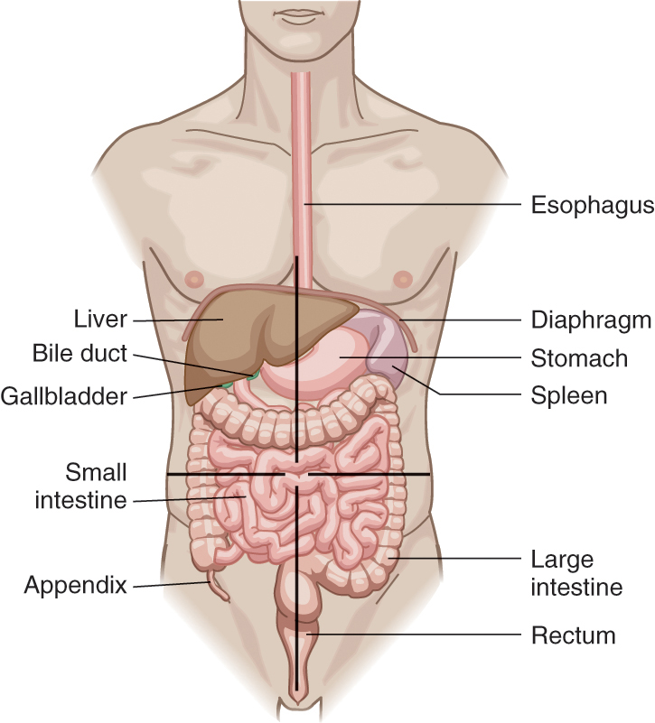
Physical Examination (13 of 18)
Abdominal assessment
Liver, spleen, kidney
Organs may not be in the same location as in a younger patient
© Jones & Bartlett Learning.
Notes:
Lecture Outline
F. Abdominal assessment
1. Assess the liver, spleen, and kidney area for ecchymosis, shape, and pain or tenderness when palpated.
2. Note that the abdominal organs of an older patient will not necessarily be in exactly the same location as in a younger patient.

Slide 39
Physical Examination (14 of 18)
Abdominal assessment (cont’d)
Older patients
Have a blunted immune response
Do not have typical symptoms or physical findings associated with abdominal complaints
Notes:
Lecture Outline
3. Older patients have a blunted immune response, so they do not develop inflammation or an increase in sensory perception as a younger patient with an abdominal condition might.
4. They often do not have the typical symptoms or physical findings associated with abdominal complaints.

Slide 40
Physical Examination (15 of 18)
Musculoskeletal assessment
Normal pathophysiologic changes versus abnormal changes
Evaluate patient’s range of motion (ROM)
Active ROM
Passive ROM
Notes:
Lecture Outline
G. Musculoskeletal assessment
1. To address potential injuries to the older patient, the community paramedic must be able to distinguish between normal pathophysiologic changes that occur with age and abnormal changes.
a. For example, bone and joint deformities may occur with age or may be induced by injuries
2. Muscle or ligament injuries, although less common, will result in reduced movement due to swelling and tendon damage.
a. Evaluate patient’s range of motion (ROM)
i. Active ROM
ii. Passive ROM

Slide 41
Physical Examination (16 of 18)
Musculoskeletal assessment (cont’d)
Reduced movement
Complaints/signs of pain, stiffness, weakness
Arthritis
Kyphosis
© Bill Aron/PhotoEdit, Inc.
Notes:
Lecture Outline
3. Muscle or ligament injuries will result in reduced movement due to swelling and tendon damage.
4. Document the joints assessed and any complaints of pain or signs of stiffness, spasm, or weakness. Occasionally older patients with kyphosis and arthritis of the spine will have discomfort.

Slide 42
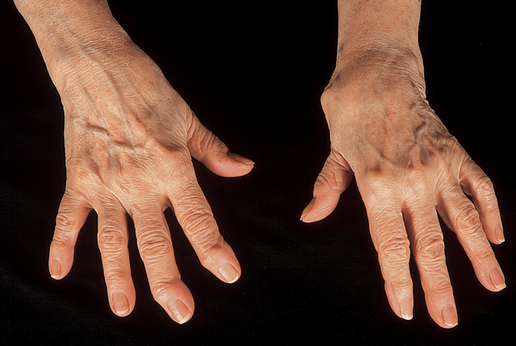
Physical Examination (17 of 18)
Musculoskeletal assessment (cont’d)
Be familiar with typical deformities of fingers
© Joel Gordon Photography.
Notes:
Lecture Outline
5. Deformity of the extremities may be the result of aging or disease, rather than injury.
a. Community paramedics should be familiar with the typical deformities that occur to the fingers in the case of severe arthritis (osteoarthritis and rheumatoid arthritis).

Slide 43
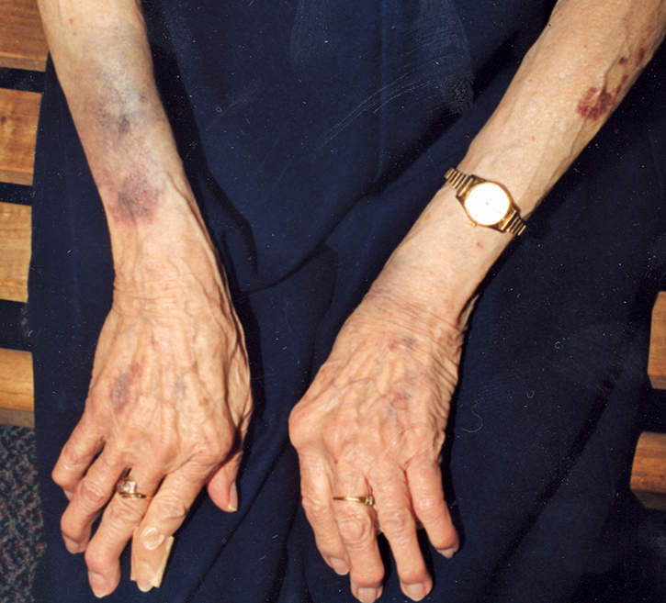
Physical Examination (18 of 18)
Musculoskeletal assessment (cont’d)
Rule of symmetry
Symmetric findings are more likely to be normal
Courtesy of Baltimore County Police Department, Baltimore, Maryland.
Notes:
Lecture Outline
6. The rule of symmetry is an important consideration, especially when assessing an older patient.
a. A physical finding on one side of the body that is present on the other side of the body is more likely to be normal.

Slide 44
Trauma in Older Adults (1 of 2)
Mechanism of injury
Consider the possibility of injury
Decline in vision, decreased range of motion, muscle weakness
Increased risk of falls
Iatrogenic causes (medication side effects)
Leading cause of death in the United States for people of 65 years and older
Notes:
Lecture Outline
VI. Trauma in Older Adults
A. Mechanism of injury
1. During your assessment of older patients, you should consider the possibility of injury.
2. Age-related changes cause an increased risk of injury from many sources, but perhaps most notably falls.
a. Decline in vision
b. Decrease in range of motion
c. Muscle weakness
d. Falls may also occur from iatrogenic causes (eg, medication side effects).
3. According to the Centers for Disease Control and Prevention (CDC), falls are a leading cause of death in the United States for people 65 years and older.

Slide 45
Trauma in Older Adults (2 of 2)
Assessing for trauma
If a question of injury:
Inspect the patient’s physical appearance
Assess for abnormality
Ask more questions
Better to doubt patient’s story and discover medical problem than to miss a potential life threat
Notes:
Lecture Outline
B. Assessing for trauma
1. When there is a question of injury, inspect the older patient’s physical appearance and assess for any abnormality.
2. Determining the mechanism of injury for an older patient involves asking more questions than with patients in any other age group.
a. Example: If an older patient falls, the community paramedic should consider the fall to be a symptom produced by a system failure within the body.
i. Falls caused by weakness, dizziness, or palpitations most likely have a very dangerous underlying cause.
3. When explaining the cause of a fall, some older patients will say they tripped, even if they did not, for fear of being labeled “frail.”
a. Evaluate the patient’s mental status and the surrounding environment
b. If the patient’s account does not seem plausible, then ask questions targeted at determining whether the patient is experiencing physical symptoms.
4. It is better to doubt the patient’s story and discover a serious medical problem than to accept an unlikely explanation and miss a potential life threat.

Slide 46
Elder Abuse (1 of 2)
The community paramedic should be aware of types of abuse:
Physical abuse
Sexual abuse
Neglect
Exploitation
Emotional or financial abuse
Abandonment
Notes:
Lecture Outline
VII. Elder Abuse
A. Defining elder abuse
1. The National Institutes of Health and National Human Resources Association define elder abuse as neglectful or intentional acts performed by a caretaker or family member that has caused or may cause harm or risk of harm to the older adult.
2. The community paramedic should be aware of the different types of abuse:
a. Physical abuse
b. Sexual abuse
c. Neglect
d. Exploitation
e. Emotional or financial abuse
f. Abandonment
3. Notably, 55% of elder abuse cases involve neglect.

Slide 47
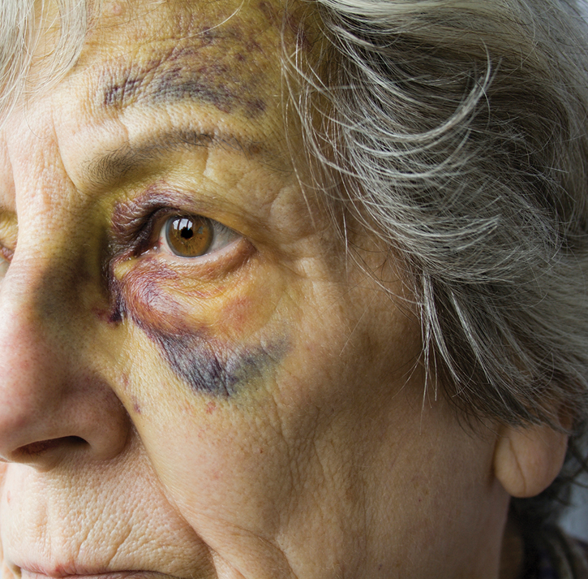
Elder Abuse (2 of 2)
Physical signs
Slap marks
Unexplained burn marks
Unusual bruising
Bruising around breasts or genitals
© triffitt/iStock/Getty.
Notes:
Lecture Outline
4. Physical signs of elder abuse include:
a. Slap marks
b. Unexplained burn marks
c. Unusual bruising
d. Bruising around the breasts or genital areas
5. Signs of neglect include:
a. An unkempt appearance
b. Unusual weight loss
c. Untreated decubitus ulcers (bed sores)

Slide 48
Common Medical Complaints of Geriatric Patients
Shortness of breath
Abdominal pain
Dizziness and vertigo
Fever
Generalized pain
Nausea, vomiting, and diarrhea
Notes:
Lecture Outline
VIII. Common Medical Complaints of Geriatric Patients
A. Shortness of breath
1. Shortness of breath is a common complaint in the older population.
2. As natural physiologic changes occur, functional residual capacity increases, thereby increasing:
a. The older person’s work of breathing
b. Risk for respiratory failure following an injury or disease process.
3. Potential causes
a. Anxiety
b. Cardiac disease (eg, CHF)
c. Pulmonary disease (eg, chronic obstructive pulmonary disease [COPD], bronchitis, asthma, emphysema, and pulmonary emboli)
d. A variety of other medical conditions, such as pain, bleeding, or medication interactions
4. Abdominal pain
a. While assessing the older patient with abdominal pain, remember that a good medical history is the key to successful care.
b. The expected signs and symptoms associated with a particular abdominal problem may be altered or absent in older patients.
5. Potential causes
a. Diffuse abdominal pain may indicate acute pancreatitis, mesenteric ischemia, peritonitis, gastroenteritis, or sickle cell crisis; abdominal distention with nausea and vomiting may be associated with alcohol abuse or a history of gallstones.
b. Epigastric pain may indicate dyspepsia, peptic ulcer, or gastric ulcer.
c. Right upper quadrant pain may indicate cholecystitis, biliary colic, congestive hepatomegaly, or a perforated duodenal ulcer.
d. Right lower quadrant pain may indicate appendicitis, cecal diverticulitis, or Meckel’s diverticulitis.
e. Bilateral right and left lower quadrant pain may indicate abdominal abscess, abdominal hematoma, cystitis, endometriosis, incarcerated hernia, inflammatory bowel disease, pelvic inflammatory disease, renal stone, ruptured abdominal aortic aneurysm, or torsion of the ovarian cyst or testis.
f. Left upper quadrant pain may indicate gastritis or splenic disorder or rupture and associated shock.
6. Assessment
a. The approach to assessment of abdominal pain is the same for the older patient as it is for the younger patient:
i. Observe
ii. Auscultate
iii. Palpate
b. When assessing abdominal pain in the older patient, use the mnemonic OLD CART as a guideline:
i. Onset of pain
ii. Location of pain
iii. Duration of pain
iv. Characteristics of pain
v. Aggravating factors
vi. Relieving factors
vii. Treatment
B. Dizziness and vertigo
1. Dizziness means different things to different people and may be described as:
a. Spinning (vertigo)
b. Lightheadedness
c. Weakness
d. Unsteadiness
e. Wooziness
f. Loss of balance
2. Potential causes
a. Patients complaining of dizziness can be separated into two categories:
i. Those who experience vertigo
ii. Those who do not
b. The most common causes of dizziness with vertigo in the older patient include conditions affecting the peripheral vestibular system (inner ear), including:
i. Benign paroxysmal positional vertigo
ii. Ménière disease
iii. Labyrinthitis
c. Patients with dizziness but no vertigo can be further divided into those with dizziness when active and those with dizziness when resting.
d. Causes of dizziness at rest:
i. Irregular heart rate
ii. Severe hypotension
iii. Hypoxia
iv. Certain heart medications
v. Over-the-counter medications (cold remedies and herbal medications)
e. Causes of dizziness that occurs with a simple activity:
i. Low blood pressure
ii. Dehydration
iii. Anemia
f. Determine if the patient has been eating and drinking fluids on a regular schedule, and ask if he or she took any medication before the onset of dizziness.
g. Determine if the patient has diabetes and whether there are signs of low blood glucose such as tremors or sweating.
h. Other possible causes of vertigo or dizziness include:
i. Non-neurologic disorders that lead to inadequate oxygen (hypoxemia) or glucose (hypoglycemia) levels
ii. Certain hormonal changes (eg, thyroid disease)
iv. Effects of drugs that act on the central nervous system
v. Panic disorder, hyperventilation syndrome, anxiety, or depression
3. Assessment
a. Normal vital signs, oxygen saturation, and blood glucose should help rule out most potentially life-threatening causes of dizziness, such as hypotension, heart rhythm problems, and hypoglycemia.
b. Orthostatic (postural) vital signs may identify a low circulating volume that causes dizziness when the patient is standing.
c. Check for:
i. Nystagmus
ii. Evidence of a previous stroke, such as facial droop, arm drift, or slurred speech.
Auscultate for bruits over the carotid arteries.
C. Fever
1. The approach to identifying the underlying cause of fever in an older patient should encompass both history taking and physical examination.
2. A fever can be defined as an oral temperature that is greater than 100°F (37.8°C) or, in the older patient, a rise of 2°F (1.1°C) from the person’s baseline temperature.
3. Potential causes
a. Fevers of an unknown origin may indicate autoimmune rheumatologic disorders or malignancies (particularly, non-Hodgkin lymphoma).
b. When an older patient presents with a fever and the secondary symptom of a severe headache, consider meningitis.
c. When shaking chills and dyspnea are secondary symptoms, consider pneumonia. Older patients have a higher risk of developing pneumonia; despite antibiotics, pneumonia is a common cause of death in this population.
d. Other causes of fever include infections of the urinary tract, infection in the blood, gastroenteritis, and soft-tissue infections, especially those resulting from pressure ulcers.
e. Although much less frequent, temperature elevation may also be caused by noninfectious problems such as heatstroke, thyroid storm, and aspirin overdose.
4. Assessment
a. The diagnostic approach to a febrile patient should be guided by the severity of the patient’s symptoms.
b. History must include origin, duration, residence, and past travel to determine exposure risks.
c. The older patient may not have an elevated heart rate with temperature increase; instead, he or she may have an altered mental status. If this is the case, suspect a serious infection.
d. Ask about the patient’s immunization status. Influenza can be devastating in this population; thus, a yearly flu vaccination in the fall is very important.
e. Ask the patient or caregiver if the patient’s daily activities have recently changed to determine if there could be a urinary tract infection.
f. Ask if the patient is on medication that is known to alter the fever response (eg, acetaminophen [Tylenol], aspirin, or NSAIDs) or alter the ability to fight infection (eg, steroids such as prednisone).
g. Determine the presence of any other diseases or conditions that may elevate the risk of infection, such as diabetes, kidney stones, or gallstones.
h. As you perform the physical examination, note any red, warm, tender, or swollen skin areas, which may indicate the presence of infection.
i. Specifically, look for pressure ulcers that may have developed over high-pressure areas such as the heels, sacrum, or buttocks.
i. Local or generalized abdominal tenderness upon palpation may also be the result of infection.
j. Fever in an older patient means serious infection until proven otherwise. Older patients with fever must be assessed for the existence of sepsis.
D. Generalized pain
1. Pain is wherever the patient determines it to be.
2. Older people experience pain about twice as often as younger adults.
3. Pain can be:
a. Long-standing (chronic)
b. Of recent onset (acute)
4. Potential causes
a. The causes of acute pain in older people are the same as in younger people, and generally are the result of acute illness or injury.
b. Chronic pain in older people tends to result from the normal wear and tear of aging or the effects of chronic disease.
c. Some of the more common causes are:
i. Musculoskeletal and neurologic disorders (eg, arthritis, osteoporosis; shingles, and nerve damage from diabetes)
ii. Cancer
iii. Depression
d. Psychiatric problems such as depression can cause pain or worsen a patient’s perception of existing pain.
5. Assessment
a. Owing to their decreasing sensory perception, older persons often do not have the typical symptoms seen in younger patients.
b. History is key to pain evaluation. Use open-ended questions to start; follow up with direct questions.
c. An accurate history will reveal the most helpful information concerning the patient’s pain.
i. If the patient cannot provide a history, enlist the help of family, friends, caregivers.
ii. To be successful in the assessment of an older patient with pain, the community paramedic must demonstrate empathy and interest in the patient’s problem.
E. Nausea, vomiting, and diarrhea
1. A community paramedic should automatically assess any older patient experiencing nausea, vomiting, or diarrhea for dehydration.
2. Dehydration in an older patient can cause an altered mental status, rapid weak pulse with hypotension, and an increased risk for stroke or transient ischemic attack.
3. Potential causes include, but are not limited to:
a. Infectious disease
b. Food poisoning (bacterial contamination)
c. Medication-induced nausea, vomiting, and diarrhea
d. Stress (emotions)
e. Obstructed, distended, twisted bowel
Motion sickness
Inner ear infection
Poisoning/overdose
Diabetes
j. Inflammatory bowel disease
k. Constipation
l. Lactose intolerance
4. Assessment
a. Determine if the nausea, vomiting, or diarrhea is acute or chronic.
b. Determine the onset, frequency, appearance, color, and odor of the vomit or stool.
c. Determine the presence of dehydration through vital signs and dry mucous membranes.
d. Recall that nausea, vomiting, and diarrhea can be the result of a problem inside or outside of the gastrointestinal system.
e. Signs and symptoms of gastrointestinal bleeding:
i. Red blood in vomit (hematemesis)
ii. Red blood in stool (hematochezia)
iii. Tarlike stools (melena)

