Slide 1

THE RESCUE COMPANY 1

Slide 2

Helicopter rescue swimmer
Basic Land Navigation

Slide 3
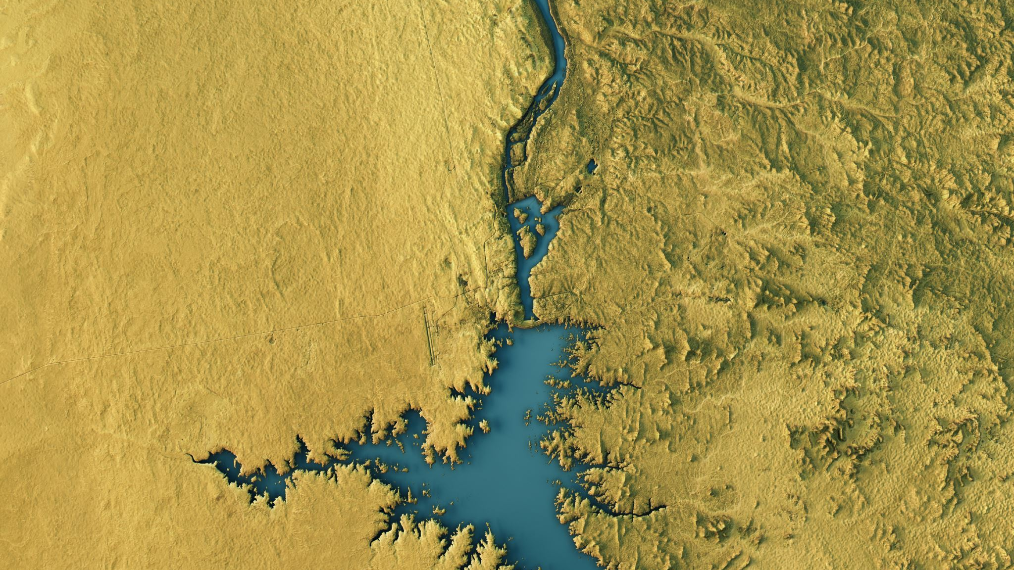
Basic Land Navigation

Slide 4
Overview of Maps
A map is a navigational aid that represents a specific area, such as part of the earth’s surface.
Conventional symbols are used to identify objects and features on a map.
Maps are critical communication tools for incident planning and operations

Slide 5
Key Points When Working With Maps
Datum
Geographic North
Maps Are Not Perfect

Slide 6
Datum
Most maps are made based on a datum (horizontal and vertical)
Which is the origin or reference point from which all points on a map are measured.

Slide 7

commonly used datum includes
North American Datum of 1927 (NAD27)
North American Datum of 1983 (NAD83)
World Geodetic System of 1984 (WGS84).

Slide 8

Datum
The datum is important for Geographic Information Systems (GIS) and GPS applications to ensure consistency of map data.

Slide 9


Geographic North
Maps are usually based on the geographic North Pole (geographic north or true north).
This is important to remember because a compass is based on magnetic north, which is different than geographic north.
Magnetic north changes over time, while geographic north does not change over time.

Slide 10

Geographic North
When using a compass and map together an adjustment has to be made to the compass to account for this difference.

Slide 11

Maps Are Not Perfect
For a map to be considered reliable and accurate, a point or symbol marked on a map must be in proper relation to known landmarks or positions located on the ground.

Slide 12
General Types of Maps
Planimetric Maps
Topographic Maps
Orthophoto Maps

Slide 13

Planimetric Maps
Planimetric maps show the positions of features without showing their relationship to the hills and valleys of the land.

Slide 14
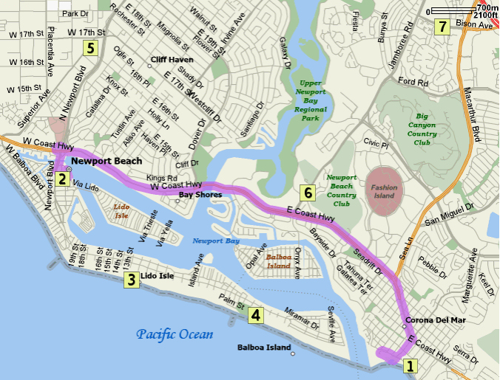
planimetric maps include
Common road maps – road atlas and city maps
Specific area maps – preplan maps, floor plan maps, storm drain maps, sewer and water system maps.
Schematic maps – agency maps and aviation maps.

Slide 15
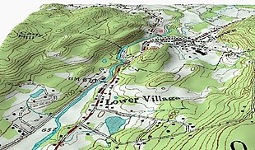
Topographic Maps
Topographic maps are different from planimetric maps because they show both the horizontal and vertical (relief) positions of features.
Hast two types

Slide 16

Topographic Maps
Contour maps
A contour is an imaginary line, where all points on the line are at the same elevation (above or below a specific reference elevation, usually sea level).
Contour lines reveal the location of slopes, depressions, ridges, cliffs, and other topographical features.

Slide 17
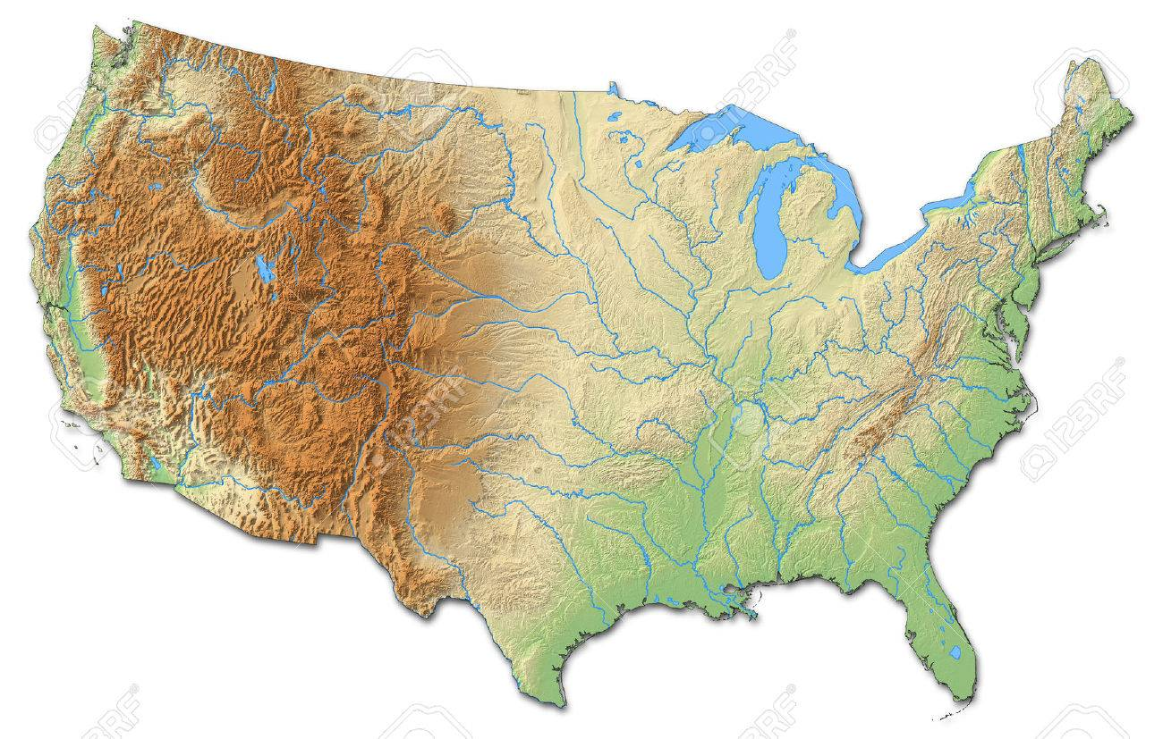
Topographic Maps
Shaded-relief maps
Shaded-relief maps use a shadow effect color to simulate the terrain
Different color shades are used to accentuate the shape of the physical features.
The darker the shading the steeper the slope.

Slide 18
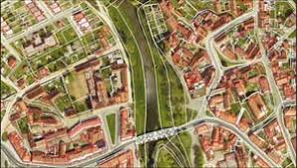
Orthophoto Maps
An orthophoto map is an aerial color-enhanced photograph of the land depicting terrain and other features

Slide 19
Incident Specific Maps
Situation Unit Map
Incident Action Plan (IAP) Map
Operational Briefing Map
Progression Map
Facilities Map
Infrared Map
Structure Protection Map
Air Operations Map
Public Information Map
Fire History Map

Slide 20
Situation Unit Map
The Situation Unit map is the most current map of the incident because it is continuously updated
It is the master map and other incident maps are often derived from this map.
The Situation Unit map is a large topographic map that is computer generated or hand drawn.

Slide 21
Incident Action Plan (IAP) Map
The Incident Action Plan map is the primary map that operations personnel use to accomplish the incident mission.
It represents a snapshot in time and is published daily in the IAP.
It contains the same information that is on the Situation Unit map

Slide 22
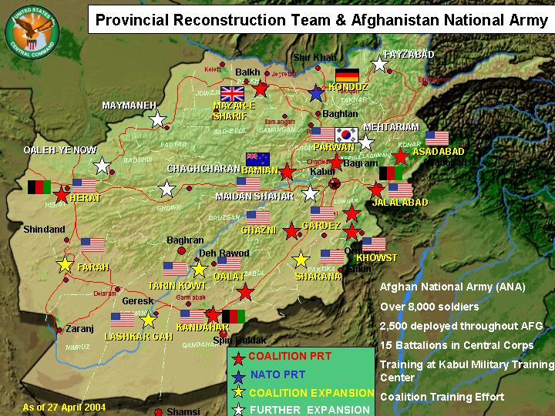
Operational Briefing Map
The Operational Briefing map is used during briefings to discuss work assignments and other details for the upcoming operational period

Slide 23
Progression Map
The Progression map shows how the incident has grown over the landscape according to a time scale and is used to track the incident’s progression
It is a topographic or shaded-relief map that illustrates the changing perimeter, which is distinguishable by color or text.
The size of the Progression map varies.

Slide 24
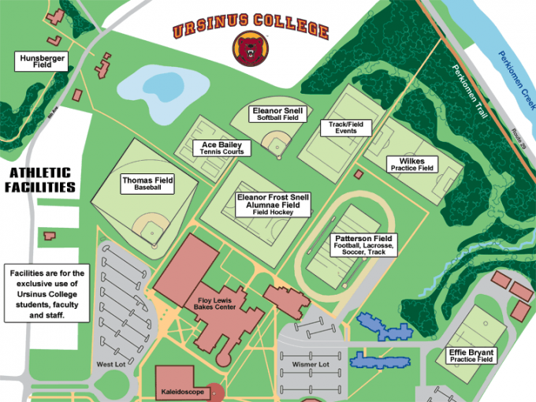
Facilities Map
The Facilities map is used to orient incident staff to the layout of the incident command post and camp.
It is typically on one page, 8½" x 11", and included in the IAP.

Slide 25
Infrared Map
Infrared maps display heat sources and hot spots on a fire incident.
Infrared Interpreters (IRIN) translate information from infrared imagery to the topographic maps.

Slide 26
Structure Protection Map
This map displays locations of improvements (e.g., structures) in relationship to the incident.

Slide 27

Air Operations Map
This is a topographic or shaded-relief map with symbology that pertains to air operations.
It may include temporary flight restrictions and flight hazards.

Slide 28
OTHER MAPS
Public Information Map
This map is used to keep the public informed and does not show tactical details. It shows incident location in relationship to communities and other points of interest.
Fire History Map
The fire history map displays fire perimeter in relationship to previously burned areas.

Slide 29
OTHER MAPS
Ownership Map
This map displays land ownership within and adjacent to the incident perimeter.
Rehabilitation Map
The rehabilitation map displays incident activities that may cause environmental impacts. This map also charts progress of rehabilitation activities.

Slide 30
OTHER MAPS
Fuels/Vegetation Map
This map displays fuels and/or vegetation within and adjacent to the incident perimeter.

Slide 31
Map Legend and Symbols
Most maps have a legend that is used to interpret symbols on the map
Color line delineates a road or land ownership boundary
Symbols that represents a building, stream, or heliport.

Slide 32
Map Legend and Symbols
The symbols used vary with every map, depending upon the purpose of the map.
The legend may also include the map scale and other important information.

Slide 34
Symbol Colors
Map symbols are usually printed in colors with each color representing a class of features.

Slide 35
The colors and features used on incident maps include:
Blue – facilities, water
Red – fire features, origin, roads
Black – roads, control lines, drop points
Orange – fire spread prediction
Green – vegetation

Slide 36
The colors and features used on incident maps include:
Brown – contours, cuts and fills, other relief features
Purple – revised information
Grey – developed areas
Other colors may be used for special purposes.

Slide 37

Types of Symbols
Incident Command System (ICS) has a standardized, color-coded symbol set that was developed specifically for the Incident Command System

Slide 38
Types of Symbols
The ICS symbols are also in the Fireline Handbook.
Additional symbols can be created for incident maps
They must be defined in the legend.

Slide 40
Map Sources
There are several different places to obtain maps.
Federal Agencies – Local, Regional, and National Offices
The local, regional, and national offices for federal agencies often have maps for their specific jurisdiction.
Local/State Agency Offices

Slide 41
Map Sources
Local and state agency offices (forestry, fire, police, emergency management) will have maps of the local area.
Local business offices (real estate, contractors, utility companies, Chamber of Commerce) may also have maps of the local area.
Internet Several agencies have statewide data sets available online.

Slide 42
Map Sources
Mapping Software
Mapping software is now available that offers a variety of features, such as printing maps
plotting points
determining acreage
downloading GPS information (tracks, waypoints, routes).

Slide 43

Map Sources
Mapping Software
Geographic Information System is the major software system that is used for mapping data; however, there are other software products available.

