Slide 1
Chapter 12: Standard Rescue Equipment
Notes:
Describe the reasons standard rescue equipment is essential to professional lifeguards.
Explain the unique components of rescue flotation devices (RFD).
Identify the use and selection of swim fins for rescue purposes.
Identify the value and limitations of rescue boards.
Explain the use of spinal stabilization devices at open water beaches.

Slide 2

Reasons for Use of Standard Rescue Equipment

Slide 3
Support of victim
Lifeguard safety
Speed
Increased efficiency
Notes:
Support of the victim – provides buoyant support for maintenance of victim’s breathing above water surface.
Lifeguard safety – in a panic situation, the victim may grab the lifeguard. Buoyant rescue devices calm panicked victims.
Speed – selected rescue flotation devices speed lifeguard response time.
Increased efficiency – many rescue devices augment the rescue process by increasing victim buoyancy, lifeguard speed and lifeguard energy.

Slide 4
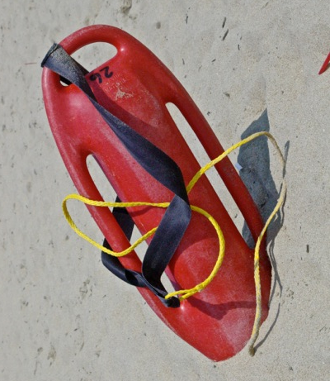
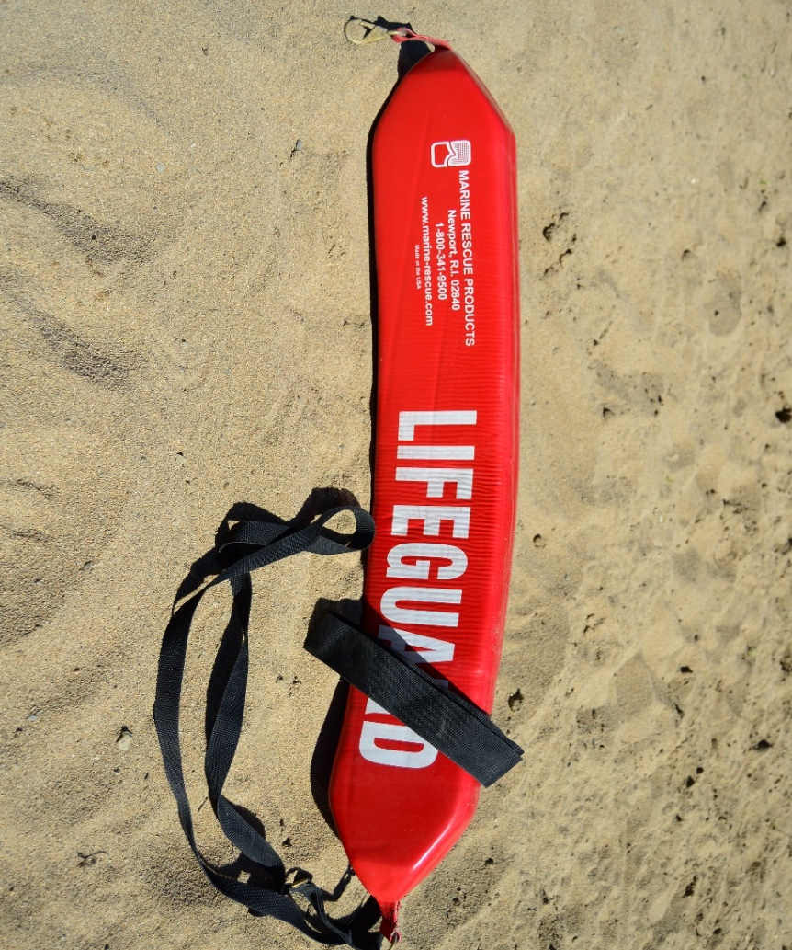
Rescue Floatation Devices (RFD’s)
Rescue Buoy
Durable
Highly visible
Have a handle
Rescue Tube
Soft
Flexible
Can be wrapped
Notes:
The RFD is the principle piece of rescue equipment used by professional lifeguards.
Two types of rescue buoys: rescue buoy and rescue tube.
Rescue buoys are also called rescue cans, torpedo buoys (torps) and Burnside buoys (named for the designer of the modern rescue buoy).
Rescue buoys are durable, highly visible and allow victims to maintain a firm grip.
Rescue tubes are also known as Peterson tubes, after the lifeguard who designed them. The tube can be wrapped around a victim and secured, keeping the victim and lifeguard together through breaking surf.
RFD’s are available in differing sizes for differing rescue conditions.
Three Major Components of an RFD:
Float
Lanyard
Harness
Lifeguards are always expected to have an RFD in their possession.
Reasons for carrying RFD at all times:
Constant readiness
Identification to the public
Identification to fellow lifeguards
Can be used with other rescue equipment

Slide 5
Rescue Buoy Advantages and Limitations
Advantages
Multiple victims
Victim avoidance
Durable
Limitations
Lack of victim security
Hard exterior
Notes:
RFD Advantages and Limitations
All types of RFDs have distinct and Limitations
Rescue Buoy Advantages
Multiple Victims – high buoyancy permits simultaneous support for several victims.
Victim Avoidance – lifeguard can maintain the rescue without victim contact.
Durability – very durable.
Rescue Buoy Limitations
Lack of victim security – cannot attach rescue buoy to a victim.
Hard exterior – hard exterior can injure victims.

Slide 6
Rescue Tube Advantages and Limitations
Advantages
Hydrodynamic
Victim security
Rescue Boat use
Limitations
Single victim use
Lower buoyancy than buoy
Requires more direct contact with victim
Extra maneuver
Lack of defense
Notes:
Rescue Tube Advantages
Hydrodynamic – creates very little drag when towing.
Victim security – victim is wrapped in the buoy.
Rescue Boat Use – soft design keeps tubes from bouncing around in a rescue boat.
Rescue Tube Limitations
Single victim use – designed for one victim (though it can be used for several).
Lower buoyancy than rescue buoy.
Requires physical contact with victim – due to wrapping the tube around the victim, who may be panicked.
Extra maneuver – tube is secured around victim.
Fending off – cannot be used effectively to fend off a panicked victim

Slide 7
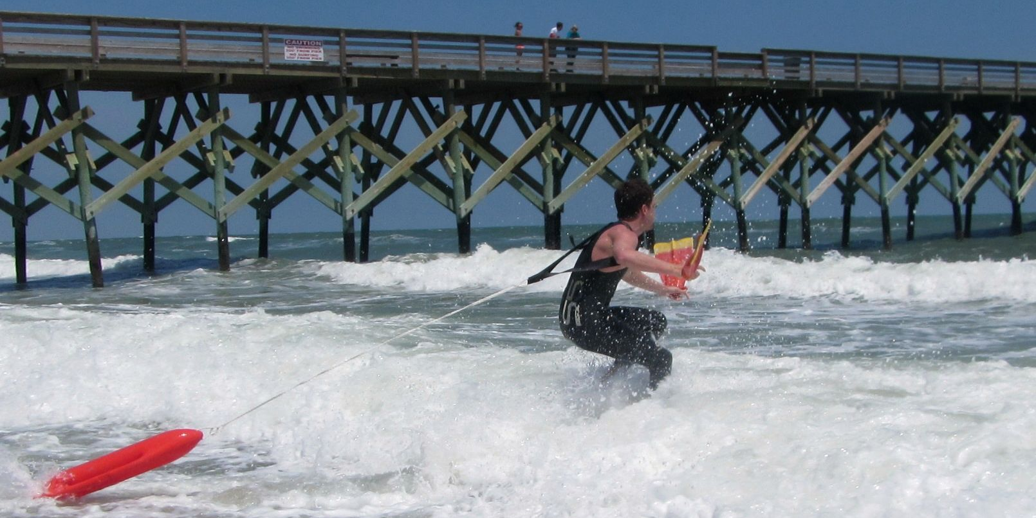
Rescues with Flotation Devices

Slide 8
Water entry
Removal from water
Fouling
Lanyard length
Notes:
Water entry – carry properly to avoid tripping the yourself.
Removal from water – usually it can be dropped upon removal, but and RFD loose in the surf can cause injury to lifeguard and victim.
Fouling – can occur when the lanyard becomes wrapped around an object (ie. propeller of rescue vehicle), endangering lifeguard safety.
Lanyard length – reflects individual lifeguard preference. Must be long enough to allow buoy to clear kicking feet of lifeguard, plus a foot or two.

Slide 9
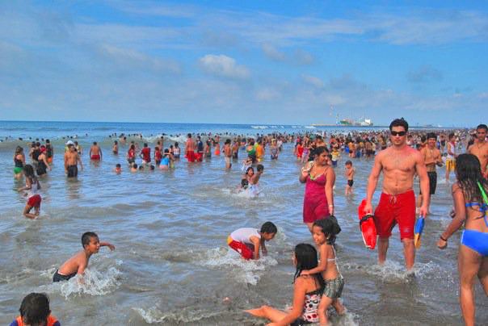
Rescues With Rescue Buoys

Slide 10
Approach from rear
Keep RFD between you and victim
Reach under victims arms and grasp handle
For heavy surf with conscious victim
Use fins when beneficial
Notes:
Because most victims will hold rescue buoy handles, the lifeguard can then swim to shore.
A weak victim will require assistance.
When assisting a victim, approach from the rear, while keeping the RFD in front of the victim.
Lifeguard reaches under the victim’s arms to grasp RFD handles.
RFD is sandwiched between victim and lifeguard.
Use this rescue in heavy surf with a conscious victim.
Swim fins are a valuable asset in this type of rescue.

Slide 11

Rescues with Rescue Tubes

Slide 12
Conscious Victim
The victim can be surrounded by the tube
Use the tube to support and stabilize the victim
Instruct victim to move onto tube, facing the tube put both arms over the tube under the armpits
Move to rear of victim and bring ends of tube together and connect
Calm the victim
Maintain rear position in heavy surf to protect and warn the victim of waves
Notes:
Most valuable feature of the rescue tube is that the victim is surrounded by the tube.
Lifeguard must use the tube to first support the tube for the victim, then stabilize the victim.
Victim is then instructed to move to a position on the tube, facing the tube, placing both arms over the tube under the arm pits.
Lifeguard then moves to rear of victim and brings ends of tube to connection.
Lifeguard must be sure before contact that the victim is calm and will not grab the lifeguard.

Slide 13
Unconscious Victim
Work the victim’s arms over the tube
Connect the tube from the rear
Maintain rear position in heavy surf to protect
Notes:
If the victim is unconscious, the lifeguard works victim arms over the tube, connecting the tube from the rear.
Lifeguard maintains rear position in heavy surf to protect victim and advise victim of upcoming waves.

Slide 14
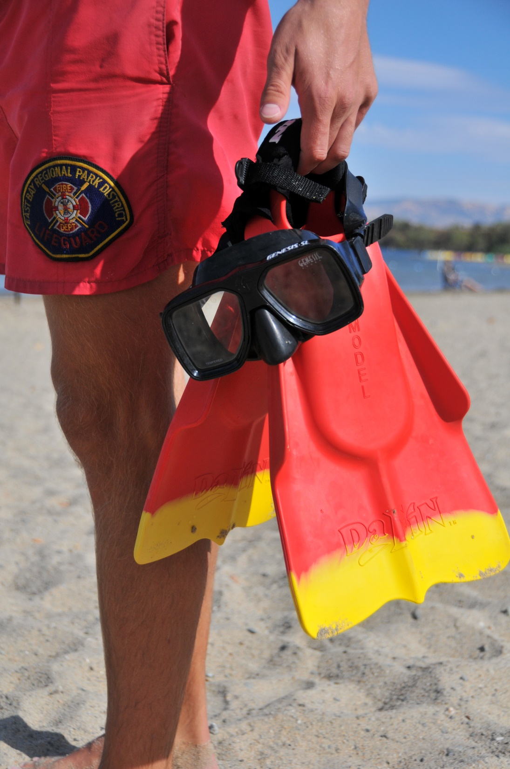
Rescues with Swim Fins

Slide 15
Don harness (one hand for RFD other for both fins)
Drop RFD in water
Put fin in each hand
Don fins when faster to swim than to run
Notes:
Lifeguard dons RFD harness, grabs RFD and lanyard in one hand, with both fins in the other and runs into the water.
Lifeguard then drops RFD and takes one fin in each hand – fins can be used as paddles until water is chest deep.
When swimming is initiated, fins are put on.
Fins should not normally be worn when running.
Fins are removed when returning to shallow water

Slide 16
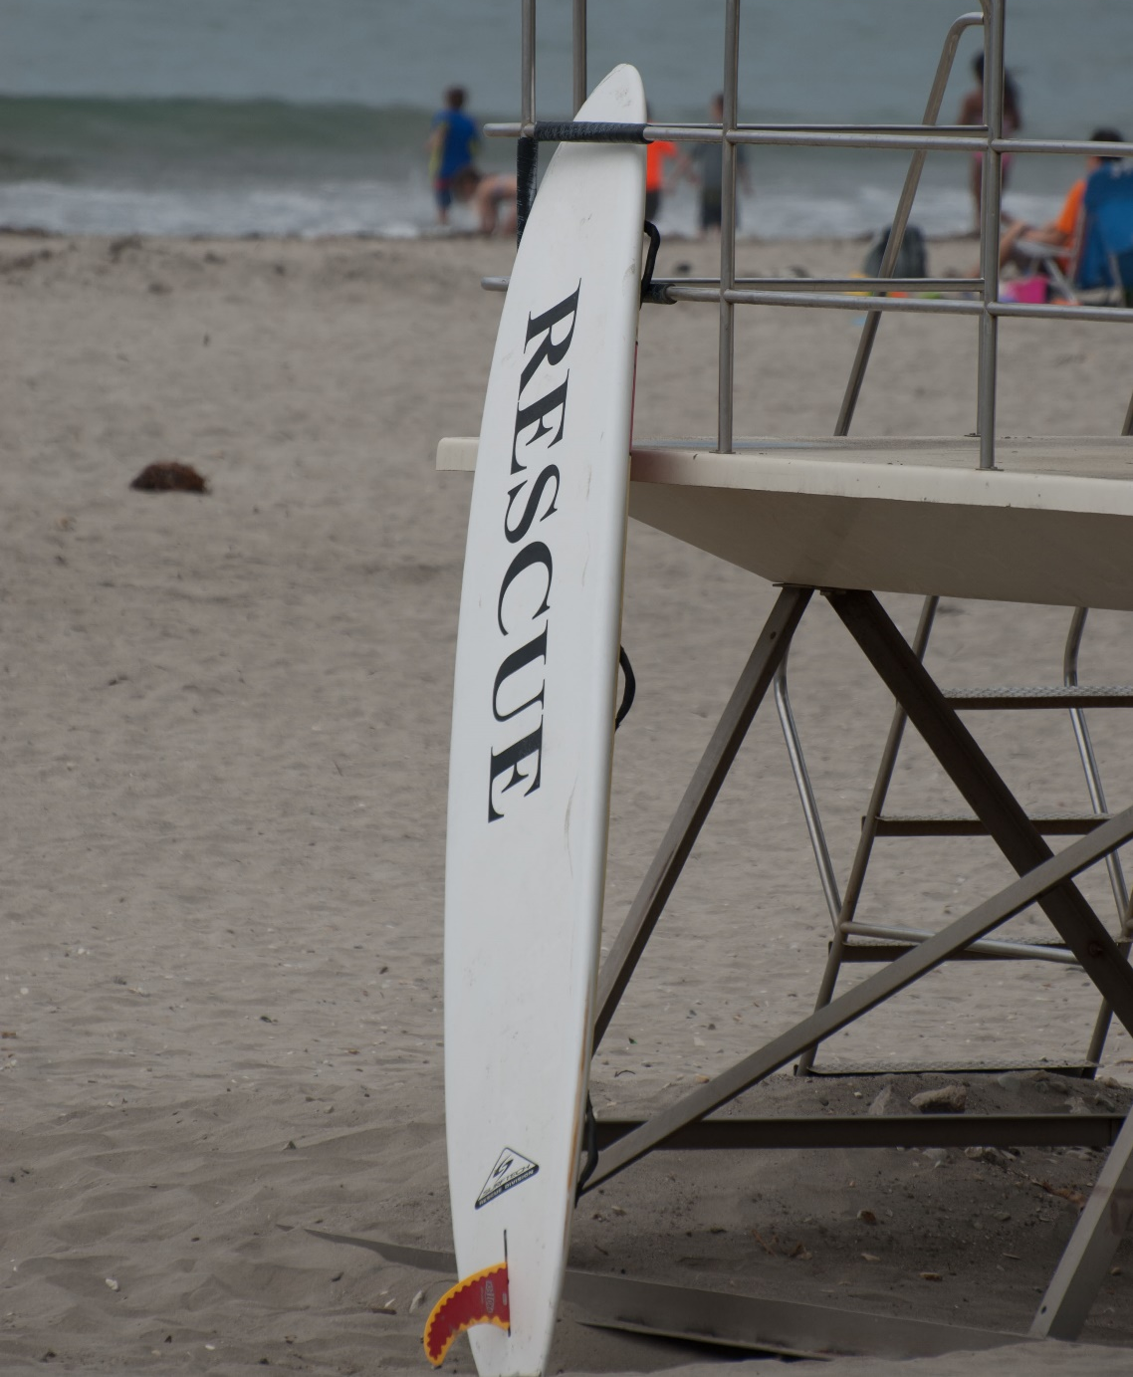
Rescue Boards

Slide 17
Evolved from surfboard
Buoyant and lightweight
Usually 10’-12’ long
Designed to glide on top of water
Skeg
Notes:
Also known as paddleboards and rescue surfboards.
Evolved from the surfboard - valuable pieces of rescue equipment.
Buoyant and lightweight, usually 10’-12’ long.
Designed to move smoothly through water.
Skeg – a fin attached to the bottom of the board – maintains stability but can be a safety risk. Soft flexible skegs can prevent injuries.
Most rescue boards have handles for ease in use and rescue

Slide 18
Rescue Board Advantages
Rescue Board Limitations
Speed
Buoyancy
Lightweight
Viewing platform
Surf conflict
Weight
Lack of maneuverability
Maintenance
Skill requirements
Notes:
Rescue Board Advantages
Speed – permits lifeguards to cover large distances quickly.
Buoyancy – very buoyant and capable of supporting multiple victims.
Lightweight – easily carried and launched.
Viewing platform – provides an elevated vantage point for scanning.
Rescue Board Limitations
Surf conflicts – difficult to move through heavy surf, and may endanger other swimmers.
Weight – can be 30 pounds, which makes the board heavy to lift when out of water.
Lack of maneuverability – not as efficient in a crowded area or an area with multiple obstacles.
Maintenance – expensive to purchase and maintain. If in poor repair, can cause injury to rescuers and swimmers.
Skill requirements – lifeguards must constantly train with the boards to maintain proficiency.

Slide 19
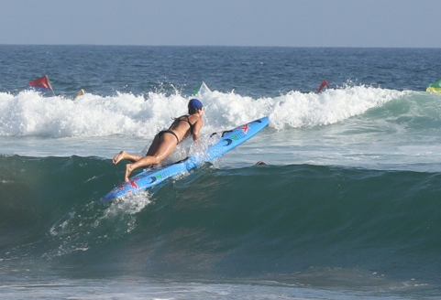
Rescue with Rescue Boards

Slide 20
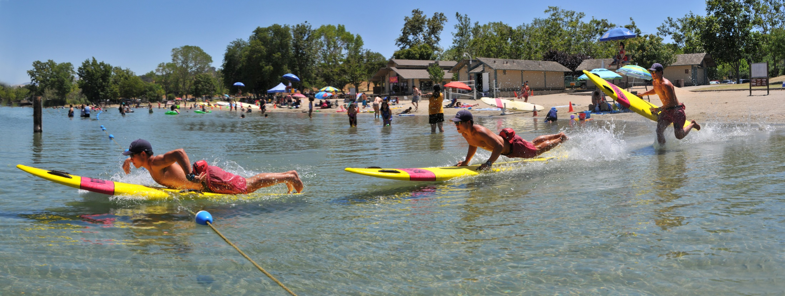
Entry
Slow on land but fast in water
Don’t drag the board
Launch in knee deep water when flat
Balance is important
In surf carry board until waist deep
If unstable trail legs
In deep water paddle
Notes:
Loss of speed on shore when carrying the board is offset by speed of board in water.
Dragging the board is not recommended.
In flat water, rescue boards should be launched and mounted in knee-deep water.
Careful balance is essential for proper use.
In surf conditions, carry board over incoming waves until waist deep, then lifeguard mounts board.
If waves threaten balance, legs can trail in the water with lifeguard holding board through waves – when the wave passes, guard can then mount board and progress to victim.
Deep water – lifeguard paddles.
Initial goal – get board beyond breakers.
Varying surf conditions require skilled use of the board to maintain progress and balance.

Slide 21
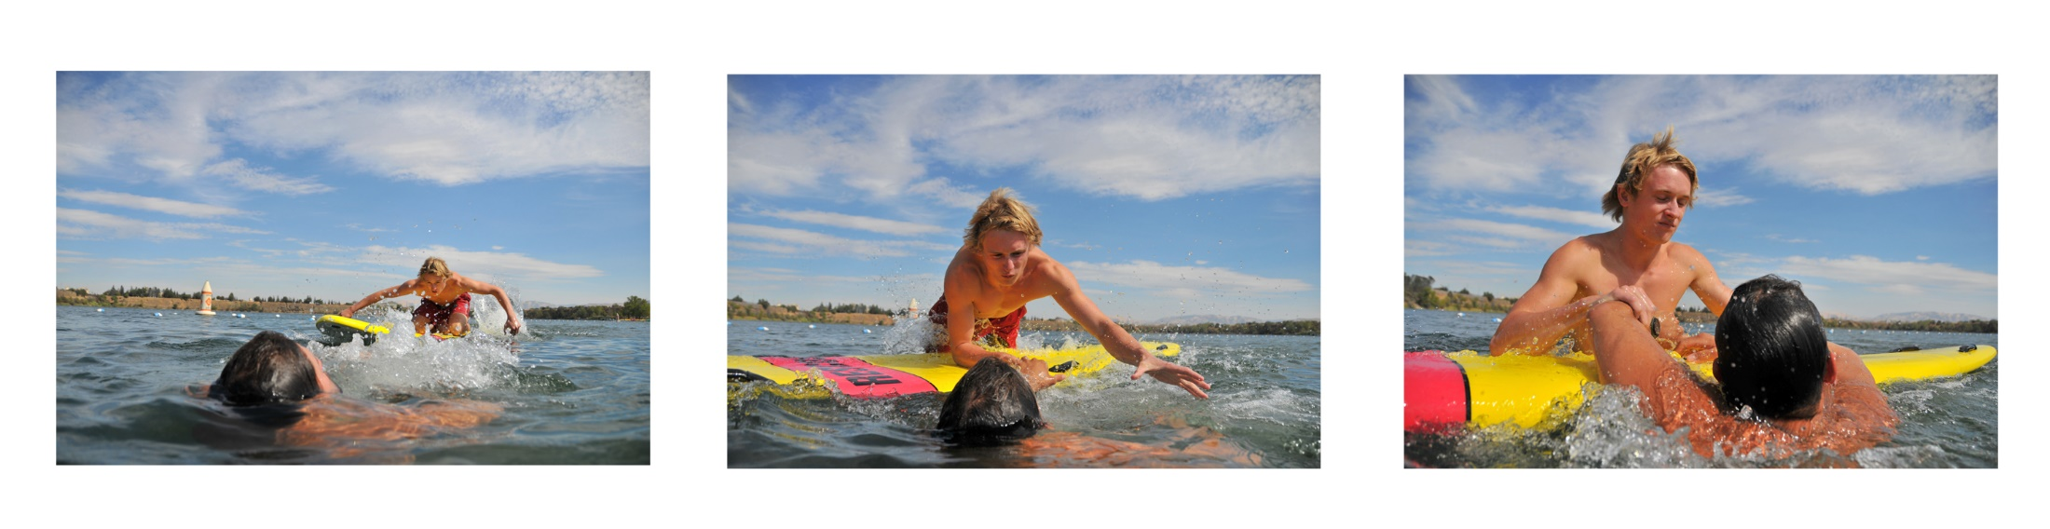
Approach
Trim
Prone position
Kneeling position
To turn drag a foot, shift weight and paddle with one arm
Place board to side of victim
Slide off board
Reach over board
Pull victim on board
Notes:
Trim – maintaining a position on the board with board flat on water.
Prone position – (face down on board) is easiest to master.
Stroke is limited in prone position.
Many lifeguards prefer kneeling position.
To change direction, drag a foot, shift weight or paddle with one arm.
Place nose of board slightly to one side of victim.
Lifeguard slips off board, placing board between self and victim.
Lifeguard pulls victim on to board by reaching over board.

Slide 22
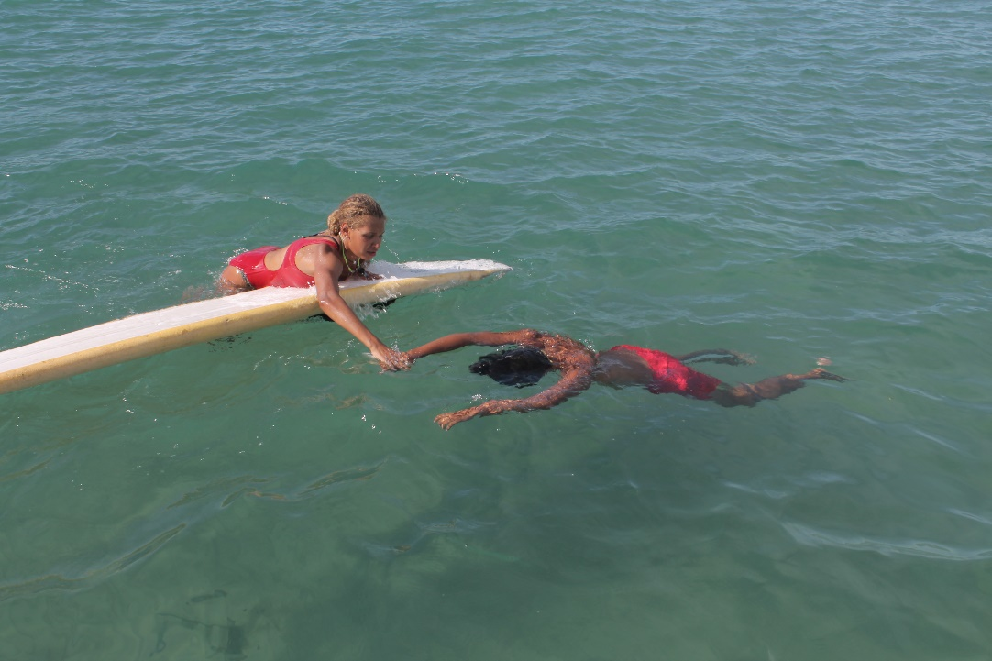
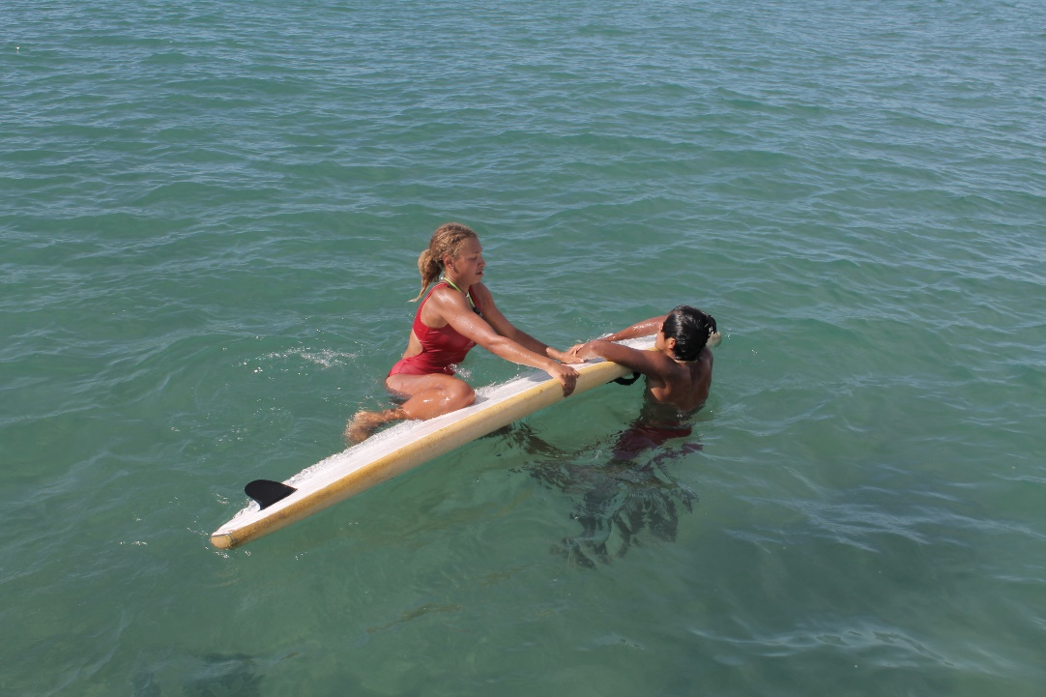
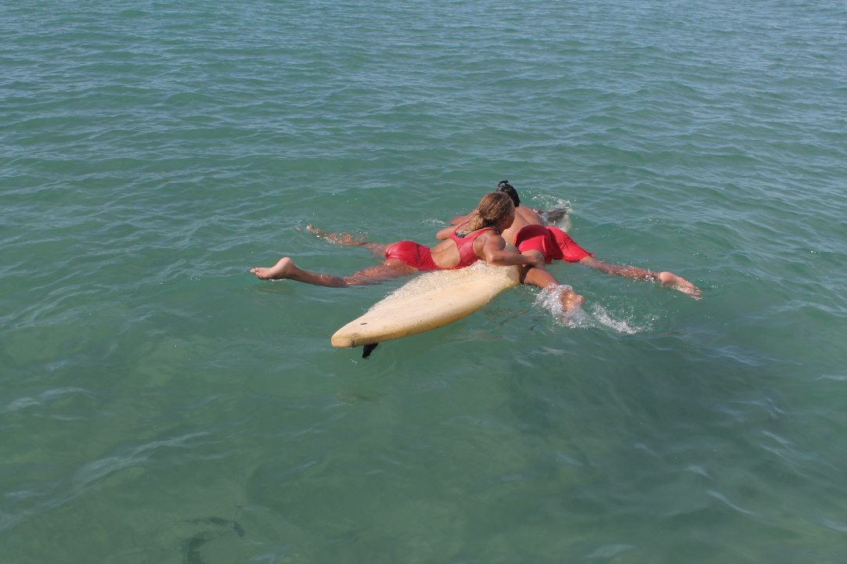
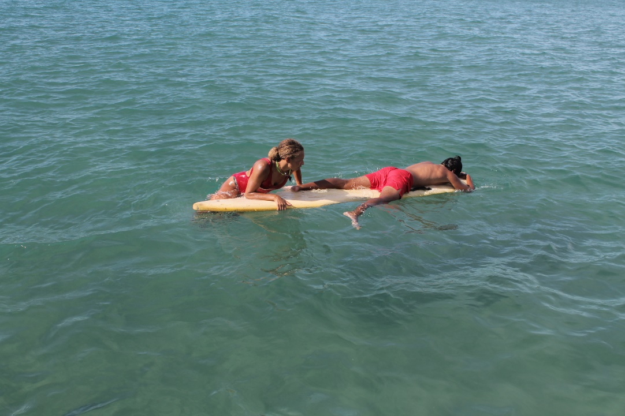

Slide 23
Retrieval
Transport varies
  Float behind board
  Place victim on board
  Can tow victim with attached RFD
Unconscious victims are placed on board
Follow policies regarding heavy surf
Notes:
There is no requirement that victim is loaded on board for retrieval.
Methods for transporting victim to safety vary – can float beside board, can place victim on board, can tow victim attached to a RFD.
Unconscious victims are placed lengthwise on the board.
Surf conditions complicate retrievals.
Many agencies instruct lifeguards not to take victims through breaking surf on rescue boards.
Heavy surf conditions necessitate moving victim from board to rescue boats or lifeguards with RFD’s.
When transporting a victim through surf, board is to be kept perpendicular to waves.

Slide 24
Removal from the Water
Lifeguard must care for either the victim or the rescue board
Don’t leave unattended in the water
Another lifeguard may handle board for you
Notes:
Lifeguard must care for either the victim or the rescue board.
Rescue boards must not be left unattended in the water.
Another lifeguard may assist with removal of the board while the primary guard works with the victim.

Slide 25
Maintenance
Fiberglass rescue boards must be kept in a waxed or non-skid condition
Inspect daily
Store horizontally and never lean on end

Slide 26
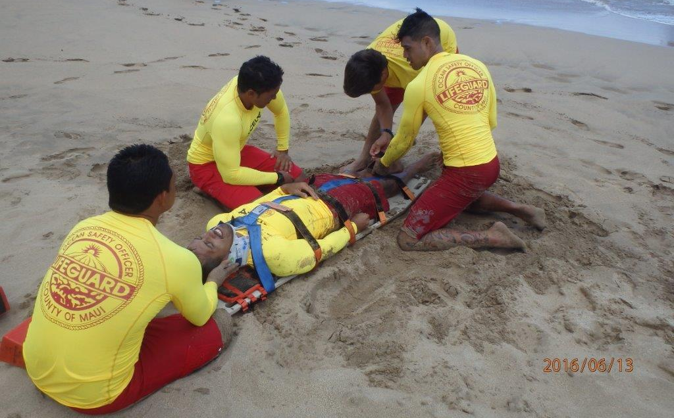
Spinal Stabilization Devices

Slide 27
Spinals are a serious beach injury
All lifeguard agencies should have spineboards
Lifeguards should be fully trained
Notes:
Spinal injuries area possibility at all open water beaches.
Every lifeguard organization should have spinal stabilization devices available for immediate use.
Lifeguards should be fully trained in spinal stabilization techniques.

Slide 28
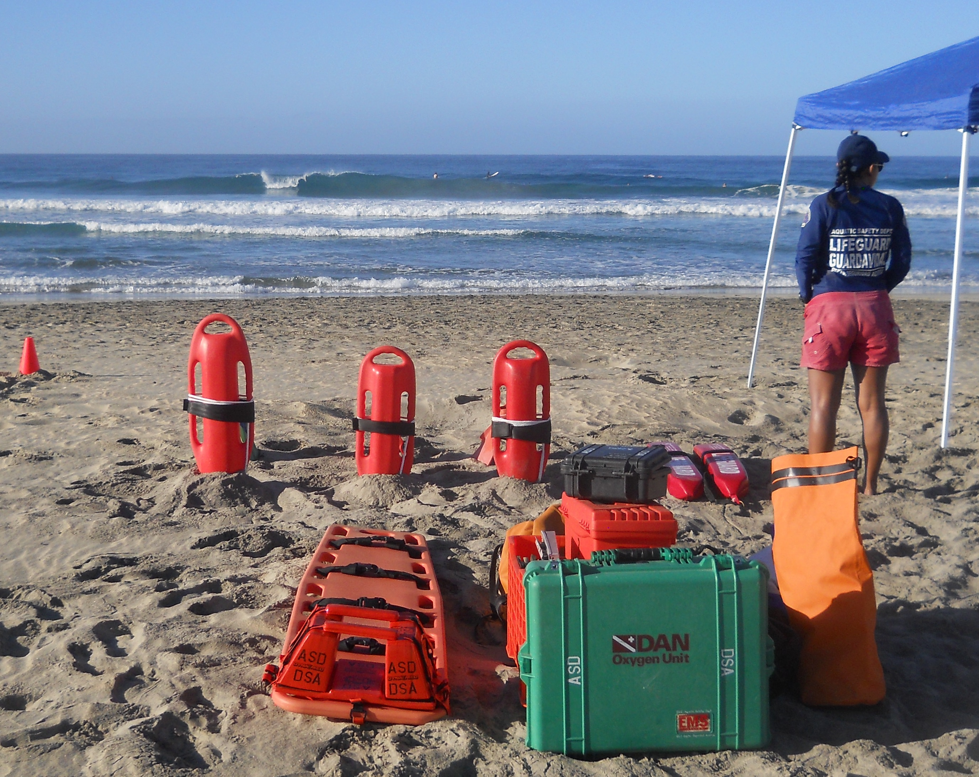
Spinal Stabilization Device Components
Spineboard
Fastening devices
Head and neck
immobilization device
Notes:
Consist of three parts: spineboard, head and neck immobilization device, and fastening devices to hold the person onto the spineboard.
Spineboard – also known as a backboard. Provides a rigid, flat surface to which a person can be attached.
Head and Neck Immobilization Devices – rigid collars which restrict movement. Also called hard collars, Philadelphia collars or by brand name.
Further immobilization of head is provided on each side of head.
Fastening Devices – used to secure the trunk, head and legs to the spineboard.

Slide 29
Notes:
Divide the class into groups of three. Assign 2 or 3 “Discussion Points” to each group. Ask each group to answer their questions, then share their work with the rest of the group. Finally, link the discussion questions to the lesson objectives as a final check of participant understanding of the chapter.

