Slide 1
Notes:
Chapter 22: Immunizations

Slide 2
Chapter 22 Immunizations
Notes:
Chapter 22: Immunizations

Slide 3
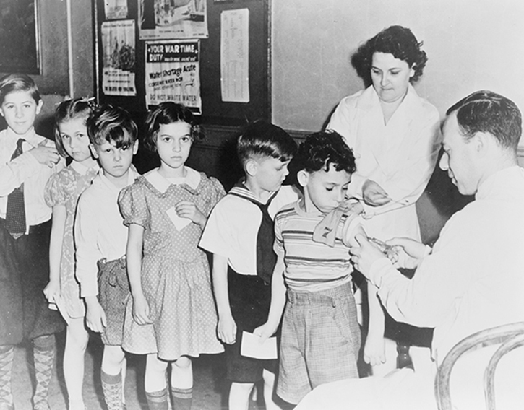
Introduction (1 of 2)
A great advance in modern medicine
Vaccines
Smallpox, polio, measles all but eliminated in United States
Courtesy of Library of Congress, Prints & Photographs Division, Portrait of America Collection [reproduction number LC-USZ62-110440]
Notes:
Lecture Outline
I. Introduction
A. Vaccines represent one of the greatest advances of modern medicine.
1. Through the widespread application of vaccines, the threats posed by many once-feared diseases—smallpox, polio, and measles, for example—have been all but eliminated in the United States and many parts of the world.
2. Government programs and guidelines have ensured widespread vaccination of children in the United States.
a. Children living in poverty remain more likely to not receive the full schedule of vaccines.
b. Vaccine coverage drops off significantly for adults, as they often fail to get boosters and vaccines for diseases such as seasonal influenza.

Slide 4
Introduction (2 of 2)
Community paramedics should seize opportunities to:
Review vaccination histories
Identify gaps
Vaccinate or schedule vaccinations
Notes:
Lecture Outline
3. Community paramedics should seize new opportunities to:
a. Review each patient’s vaccination history
b. Identify gaps
c. Vaccinate or schedule vaccinations for people who do not have full coverage
4. This relatively simple step can greatly contribute to improving the health of not just the individual patient, but the overall community.

Slide 5
The Immune Response (1 of 4)
The body’s defense
The immune system provides immunity
Innate (nonspecific)
Adaptive (specific)
Immune responses
Primary
Secondary
Notes:
Lecture Outline
II. The Immune Response
A. The body’s defense
1. The immune system is responsible for providing immunity, the ability to resist damage from foreign substances or harmful chemicals.
2. The human body has multiple defense mechanisms that work together to provide resistance.
3. An infection may be caused by the presence and multiplication of a disease-causing agent (pathogen), which can be a:
a. Virus
b. Bacterium
c. Fungus
d. Protozoan
B. Innate versus adaptive body defenses
1. Body defenses can be divided into two general categories:
a. Innate (nonspecific)
b. Adaptive (specific)
2. Innate (nonspecific) defense:
a. Present at birth
b. An immune response that is activated each time the body is exposed to a particular challenge.
c. Nonspecific defenses prevent/limit microorganisms and other environmental hazards from entering the body or spreading within it.
3. Adaptive (specific) defense:
a. An immune response that targets specific pathogens
Carried out by lymphocytes and macrophages that recognize and remember certain foreign substances, known as antigens (or allergens)
4. Before a lymphocyte can respond to an antigen, it must be activated.
5. T lymphocytes (T cells) are activated by the presence of processed antigen fragments attached to the surface of an antigen-presenting cell (accessory cell), which may be:
a. Macrophages
b. B lymphocytes (B cells)
c. Other types of cells
6. Antibodies are round, soluble proteins that make up the gamma globulin part of the plasma proteins.
7. There are five major types of antibodies:
a. Immunoglobulin G (IgG; found in plasma and tissue fluids)
b. Immunoglobulin A (IgA; found in exocrine gland secretions, breast milk, tears, nasal fluid, gastric juice, intestinal juice, bile, and urine)
c. Immunoglobulin M (IgM; the first antibody produced in response to infection)
d. Immunoglobulin D (IgD; found on the surfaces of most B cells)
e. Immunoglobulin E (IgE; involved in allergic reactions)
8. Primary immune response: the activation of B cells or T cells after they first encounter the antigens for which they are specialized to react
9. The antibodies are transported to the blood and throughout the body to help destroy antigen-bearing agents.
10. Some of the B cells remain as memory cells so that if the identical antigen is reencountered, clones of these memory cells enlarge and send IgG to the antigen.
11. These memory B cells, along with memory T cells, produce a secondary immune response.
C. Harmful immune responses
1. An immune response that occurs because of a nonharmful substance is called an allergic response.
2. Allergens are a specific type of antigen that triggers allergic responses in sensitive hosts.
3. Another type of reaction involves transplantation and tissue rejection.
a. When a body part is transplanted from one person to another, the receiving patient’s immune system may recognize the transplanted part as foreign and attempt to destroy its tissues, causing a tissue rejection reaction.
4. When the immune system fails to distinguish self from nonself, it may produce autoantibodies as well as cytotoxic T cells that attack and damage the body’s tissues and organs.
a. The “attack against self” is called an autoimmune disorder.

Slide 6
The Immune Response (2 of 4)
The body’s defense (cont’d)
Acquired immunity
Caused by natural events or by administration (oral or injected) of suspensions of killed/weakened pathogens
Naturally acquired active immunity: when disease develops from exposure to pathogen
Notes:
Lecture Outline
D. Acquired immunity
1. Adaptive (acquired) immunity can be caused by natural events or by administration (oral or injected) of suspensions of killed or weakened pathogens or their molecules.
a. Active immunity is long-lasting and occurs when a person produces an immune response to an antigen.
b. Passive immunity occurs when antibodies produced by another person are received by a patient; this type of immunity has only short-term effects.
2. Naturally acquired active immunity occurs when a disease develops from exposure to a pathogen. Resistance then occurs as a result of the primary immune response.

Slide 7
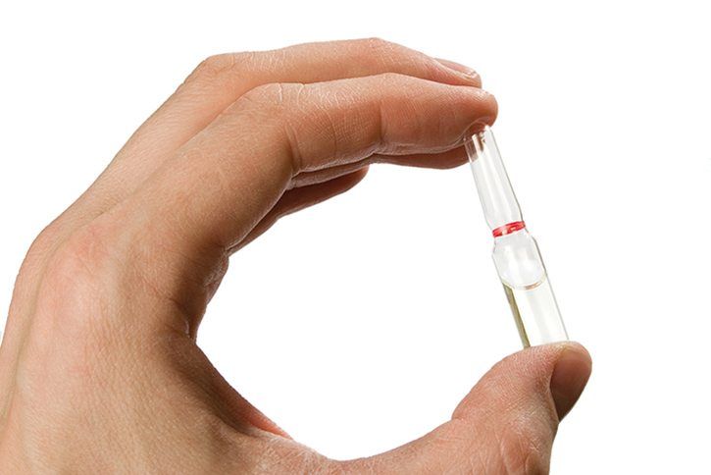
The Immune Response (3 of 4)
Acquired immunity
Vaccines: Artificial acquired active immunity
Bacteria/viruses, pathogenic molecules, a toxoid
© aaaah/Shutterstock.
Notes:
Lecture Outline
3. A vaccine may consist of killed or weakened (attenuated) bacteria or viruses, pathogenic molecules, or a toxoid (a benign version of a toxin from a pathogenic organism.
4. Vaccines cause artificially acquired active immunity to develop.

Slide 8
The Immune Response (4 of 4)
Acquired immunity (cont’d)
Herd immunity:
Generalized resistance to a disease
Large numbers of population have specific immunity to that disease
Notes:
Lecture Outline
5. Herd immunity: generalized resistance to a disease is achieved when large numbers of the population have specific immunity through vaccination to that disease

Slide 9
Types of Vaccines (1 of 3)
Two types
Inactivated (dead)
Live attenuated
Vaccines can also be made via
Genetic engineering (recombinant vaccines)
A toxoid (toxin from infectious organism is chemically altered)
Notes:
Lecture Outline
III. Types of Vaccines
A. Two types of vaccines
1. There are two basic types of vaccines:
a. Inactivated (dead)
b. Live attenuated
2. Vaccines can also be made via:
a. Genetic engineering (recombinant vaccines)
b. A toxoid, in which a toxin from an infectious organism is chemically altered so that it is not dangerous

Slide 10
Types of Vaccines (2 of 3)
Inactivated vaccines are composed of:
Whole viruses
Bacteria
Fractions of whole viruses or bacteria
Organisms in inactivated vaccines are not alive. They cannot
Reproduce
Cause disease
Notes:
Lecture Outline
B. Inactivated vaccines
1. Inactivated vaccines are composed of:
a. Whole viruses
b. Bacteria
c. Fractions of whole viruses or bacteria
2. Organisms in inactivated vaccines are no longer alive. They cannot:
a. Reproduce
b. Cause disease by infection even in a person with a compromised immune system
i. Examples include the polio, hepatitis A, and rabies whole-virus vaccines.
3. Fractional vaccines
a. Fractional vaccines are developed by purifying the components to be included in the vaccine.
i. For example, the polysaccharide capsule of a pneumococcal organism
ii. Examples of polysaccharide vaccines include some pneumococcal, meningococcal, and Salmonella typhi vaccines. Other fractional vaccines include those for hepatitis B, influenza, acellular pertussis (whooping cough), human papillomavirus, anthrax, diphtheria, and tetanus.
4. Recombinant vaccines
a. Recombinant vaccines are inactivated vaccines that are produced by genetic engineering.
i. Examples of recombinant vaccines include some hepatitis B, human papillomavirus, and Salmonella typhi vaccines.

Slide 11
Types of Vaccines (3 of 3)
Live attenuated vaccines
Derived from disease-causing organisms that are weakened (attenuated) by repeated culturing in a lab
Examples: Vaccines for measles, mumps, rubella, varicella and zoster, and influenza
Notes:
Lecture Outline
C. Live attenuated vaccines
1. Live attenuated vaccines are derived from disease-causing organisms that are weakened (attenuated) by repeated culturing in a laboratory.
a. Examples of live attenuated vaccines include those for measles, mumps, rubella, varicella and zoster, yellow fever, rotavirus, influenza (intranasal), and typhus (oral formulation).
b. These vaccines should not be given to people with suppressed immune systems.
D. Toxoid vaccines
1. Toxoid vaccines are created to combat bacteria that secrete toxins. Toxins can be inactivated or detoxified and used as a vaccine.
2. The vaccine helps the immune system fight off the harmful toxin by producing antibodies.
3. Tetanus is the most common toxoid vaccine and is supplied as a solution or a suspension.

Slide 12
Responses to Vaccines (1 of 2)
Inactivated vaccines
Less likely to draw a response
Given when an antibody is already present in the blood
Entire dose of antigen is administered
Multiple doses are always required
Notes:
Lecture Outline
IV. Responses to Vaccines
A. Inactivated and live attenuated vaccines
1. Inactivated vaccines are less likely to draw a response from circulating antibodies than are live vaccines.
a. Inactivated vaccines may be given when an antibody is already present in the blood, such as:
i. In infancy (when children still have passive immunity from maternal antibodies they received during gestation)
ii. Following receipt of antibody-containing blood products.
b. They are not expected to trigger any sort of systemic reaction.
2. When administering an inactivated vaccine, the entire dose of antigen is administered in an injection, and multiple doses are always required.

Slide 13
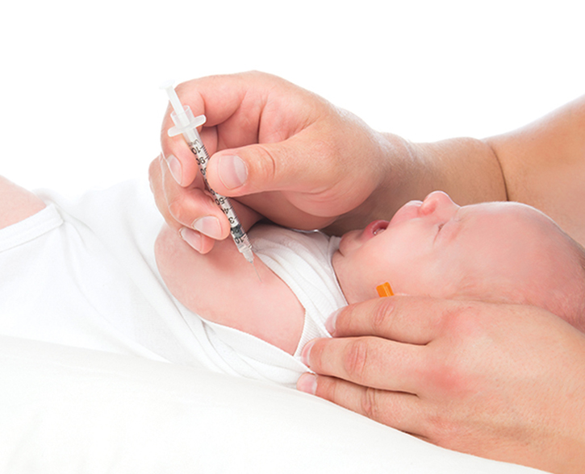
Responses to Vaccines (2 of 2)
Live attenuated vaccines
Immune response identical to having the disease naturally
Can be harmful or fatal
© Dmitry Lobanov/Shutterstock.
Notes:
Lecture Outline
3. In contrast to the muted response seen with inactivated vaccines, the immune response to a live attenuated vaccine is virtually identical to that produced by having the disease naturally.
4. Live virus vaccines can be harmful in some people, causing severe or fatal reactions as a result of uncontrolled replication of the vaccine virus. This response occurs only in immunocompromised people.
a. Examples:
i. People with leukemia or human immunodeficiency virus (HIV) infection
ii. People undergoing steroid treatment, chemotherapy, or radiation therapy

Slide 14
Choosing the Appropriate Vaccine
Administration
Live attenuated and inactivated vaccines can be given during same encounter.
Individual vaccines should not be mixed in same syringe.
Combination vaccines preferred
Notes:
Lecture Outline
V. Choosing the Appropriate Vaccine
A. Administration and making the choice
1. The most widely used vaccines—both live attenuated and inactivated—can be given during the same encounter.
2. Although multiple vaccines may be administered during the same encounter, individual vaccines should not be mixed in the same syringe.
a. Exception: the DTaP-IPV-Hib (Pentacel) (diphtheria, tetanus, whooping cough [pertussis], polio, and Haemophilus influenzae type b [Hib]) combination vaccine
3. Combination vaccines are generally preferred over multiple administrations of single-antigen vaccines.
4. Factors to consider when making this choice include:
a. The number of injections
b. The likelihood of patient return for further vaccinations
c. Vaccine availability
d. The potential for adverse effects
e. Patient or parent choice

Slide 15
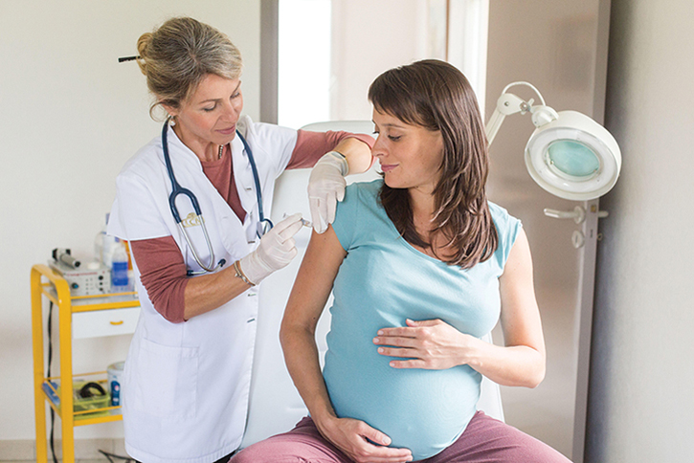
Immunization Schedules (1 of 4)
Recommended schedules
Steady level of immunity (pertussis)
Children are fully immunized at appropriate ages
Herd immunity
© Phanie/Alamy.
Notes:
Lecture Outline
VI. Immunization Schedules
A. Recommended schedules
1. In the United States, the Advisory Committee for Immunization Practices (ACIP) issues recommended immunization schedules for pediatric patients and adults.
2. Immunization schedules help ensure a steady level of immunity, especially when booster shots are required to maintain immunity, such as with pertussis.
3. Administration of all vaccines for which a person is eligible is important to:
a. Prevent missed opportunities
b. Ensure that children are fully immunized at appropriate ages
c. Increase the general protection afforded to the community by herd immunity

Slide 16
Immunization Schedules (2 of 4)
Interval between doses of same vaccine
Most childhood vaccines require 2 or more doses
Schedules for pediatric patients and adults
Vaccine doses should not be administered at intervals:
Shorter than recommended intervals
Earlier than minimum ages
Notes:
Lecture Outline
B. Interval between doses of the same vaccine
1. Most childhood vaccines require two or more doses to ensure an adequate and long-lasting antibody response.
2. The vaccine schedule developed by ACIP is based on studies that identified the recommended ages and intervals between doses of the same antigen to develop optimal protection against the disease.
3. Vaccine doses should not be administered at intervals shorter than the recommended intervals or earlier than the minimum ages.

Slide 17
Immunization Schedules (3 of 4)
May administer vaccine sooner than recommended if the patient:
Is unknown to the community paramedic
Habitually misses appointments
Has other barriers to care
Notes:
Lecture Outline
a. It may be preferable to administer the vaccine sooner than recommended if the patient:
i. Is unknown to the community paramedic
ii. Habitually misses appointments
iii. Has other barriers to care such as lack of transportation

Slide 18
Immunization Schedules (4 of 4)
Catch-up schedules
Doses of vaccines may be administered on a catch-up schedule if:
The child is behind
The child needs to be brought up to date quickly for child care or school entrance
Planned international travel may lead to exposure
Notes:
Lecture Outline
C. Interval between doses of different vaccines
1. If the community paramedic does not administer two live parenteral (injected) vaccines—including the MMR, MMRV, varicella and zoster, and yellow fever vaccines—or the live attenuated influenza vaccine (LAIV) during the same encounter, those vaccinations should be separated by at least 28 days (4 weeks).
2. This interval is intended to reduce or eliminate the interference of the first vaccine with a subsequent vaccine.
3. If two live vaccines are given, but not administered at the same encounter and not separated by 28 days, the second vaccine should be readministered in 4 weeks.
D. Catch-up schedules
1. Doses of vaccines may be administered on an accelerated (catch-up) schedule if:
a. The child is behind
b. The child needs to be brought up to date quickly for child care or school entrance
c. Planned international travel may potentially lead to exposure.

Slide 19
Precautions and Contraindications to Vaccination (1 of 2)
The decision to vaccinate
Patients and parents worry about side effects
At every vaccine assessment, patient should be screened for:
Precautions
Contraindications
Health care providers may hold erroneous beliefs
Notes:
Lecture Outline
VII. Precautions and Contraindications to Vaccination
A. The decision to vaccinate
1. Patients and parents may worry that vaccinations will cause worrisome side effects and should not be given due to the patient’s unique circumstance.
2. To allay these risks, at every vaccine assessment, every patient should be screened for:
a. Precautions (risks to be weighed against the benefits of the vaccine)
b. Contraindications (factors that rule out use of a vaccine)
3. Some health care providers may hold erroneous beliefs that often result in missed opportunities to vaccinate patients.
4. The decision to vaccinate should be based on the overall status of the person rather than any single symptom or condition.

Slide 20
Precautions and Contraindications to Vaccination (2 of 2)
Data from Centers for Disease Control and Prevention. Epidemiology and Prevention of Vaccine-Preventable Diseases. Hamborsky J, Kroger A, Wolfe S, eds. 13th ed. Washington D.C. Public Health Foundation, 2015.
Notes:
Lecture Outline
B. Precautions
1. A precaution is a condition in a patient that might:
a. Increase the chance or severity of a serious adverse reaction from a vaccine
b. Diminish the patient’s ability to produce antibodies to the vaccine
i. Example: a patient with passive immunity to measles from a blood transfusion may not respond to an MMR or varicella vaccine
2. The most common precaution is a moderate or severe acute illness.
3. Children presenting with mild acute illness should be vaccinated on schedule, such as:
a. Colds
b. Otitis media
c. Upper respiratory illness
d. Mild diarrhea
e. Injuries such as a broken arm
4. Disease exposure or recuperation from an illness does not affect the response to a vaccine, nor does it increase the likelihood of an adverse event.
5. An unstable progressive neurologic condition is a precaution to the use of the DTaP vaccine and the Tdap booster.
6. Any history of Guillain-Barré syndrome is a precaution to administration of tetanus-containing vaccines and influenza vaccines.
7. Precautions may be either temporary or permanent.
C. Contraindications
1. Contraindications, in contrast to precautions, describe those circumstances when vaccines should not be administered because serious harm could occur.
a. Example: Administering influenza vaccine to person with a true anaphylactic allergy to eggs could cause serious illness or death.
2. Most contraindications are only temporary, and the vaccine can be given at a later time.
3. In contrast, the following outcomes are considered permanent contraindications to vaccination (ie, the next dose should not be administered):
a. A severe allergic reaction to a prior dose of the vaccine or vaccine component
b. Encephalopathy within 7 days of a pertussis-containing vaccine, not due to other causes
c. Severe combined immunodeficiency as a contraindication to rotavirus vaccine

Slide 21
Special Populations (1 of 3)
Special considerations
Infants and children with certain medical concerns
Temporary contraindications to administration of live attenuated virus vaccines:
Pregnancy
Immunosuppression
Notes:
Lecture Outline
VIII. Special Populations
A. Special considerations
1. Special considerations apply when contemplating vaccination of vulnerable populations, including infants and children with certain medical concerns.
2. Temporary contraindications to administration of live attenuated virus vaccines are pregnancy and immunosuppression, whether caused by drugs or diseases such as HIV infection.
a. A community paramedic who encounters these situations and has questions should contact the medical director prior to proceeding.
3. People in the households of pregnant women or those who are immunosuppressed should be vaccinated. The desired outcome in such a case is a form of herd immunity.

Slide 22
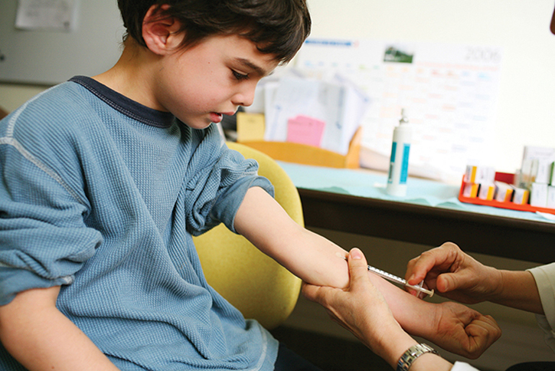
Special Populations (2 of 3)
Vaccinate
Preterm infants
Breastfed babies
Infants and children who need a tuberculin skin test (TST)
© BSIP SA/Alamy.
Notes:
Lecture Outline
B. Medically vulnerable infants and children
1. Preterm infants respond well to vaccines and should be started on the routine vaccination schedule based on their chronological age.
2. Breastfed babies should be vaccinated just like any other child, and breastfeeding is not a contraindication to administration of any vaccine to the mother except for smallpox.
3. Infants and children who need a tuberculin skin test (TST) should be vaccinated.
a. All vaccines, including live virus vaccines, can be given on the same day as the TST, or anytime after the completion of the TST.
b. However, if the child has already received the MMR vaccine, then a wait of at least 4 weeks is needed before a TST can be performed.
4. A new type of tuberculosis blood test, the interferon-gamma-release assay (IGRA), has recently been introduced.
a. The consensus is to handle this test similar to the TST in terms of timing of vaccinations.

Slide 23
Special Populations (3 of 3)
Pregnancy
Live vaccines should not be administered
Inactive vaccines may be administered as indicated
Immunosuppression
Live attenuated viruses should not be administered
Inactivated vaccines are safe, though responses may be muted
Notes:
Lecture Outline
C. Pregnancy
1. Vaccinating a pregnant woman creates some unique concerns due to the potential for infection of the fetus with the pathogenic organism, although this risk is considered only theoretical.
a. Only smallpox vaccine has actually been shown to cause fetal injury.
2. Because of the theoretical possibility of infection transmission, live vaccines should not be administered to pregnant women, or those who anticipate becoming pregnant in the next month.
3. The woman’s pregnancy status should be part of a routine screening for contraindications.
4. Inactivated vaccines cannot replicate, so they cannot cause fetal infection.
5. These vaccines may be administered as indicated, with the exception of the human papillomavirus (HPV) vaccines.
6. Pregnancy increases the risk of complications from influenza; hence vaccination of pregnant women against this infection is advised.
7. Even if she received the vaccine earlier, a pregnant woman should receive a dose of Tdap during each pregnancy.
D. Immunosuppression
1. Immunosuppression renders the affected person highly susceptible to infection with a variety of organisms.
2. Both drugs and diseases can cause immunosuppression.
3. In immunosuppressed people, the usually mild effects of live virus vaccines can be transformed into severe or fatal reactions when the vaccine virus replicates rapidly.
4. Live attenuated viruses should not be administered in immunosuppressed people. In contrast, inactivated vaccines do not replicate and are safe to use in such people, although the response to the vaccine may be muted.

Slide 24
Conducting the Immunization Assessment (1 of 4)
The clinic setting
Staff should remind parents to bring immunization record
Patient’s record compared with state’s record
© Robert Kneschke/Shutterstock.
Notes:
Lecture Outline
IX. Conducting the Immunization Assessment
A. The clinic setting
1. As a community paramedic, you will be administering vaccinations in a clinic setting. If appointments are made for vaccinations, the receptionist staff should remind parents or the people being vaccinated to bring their immunization record.
2. Within the workflow of the clinic, someone should print an immunization record from the state immunization registry system.
a. This record should be compared to the patient’s record on file in the clinic or the electronic medical record, and any missing vaccinations should be reconciled in the clinic system.
b. The next step is to compare the child’s or adult’s current age and vaccine history to the recommended immunization schedule in the United States and determine which vaccines are to be administered at this encounter.

Slide 25
Conducting the Immunization Assessment (2 of 4)
Patients with uncertain/unknown immunization status
When vaccination status is in doubt:
Patients should be considered susceptible to disease
Age-appropriate immunizations should be initiated without delay according to recommended schedule
Notes:
Lecture Outline
B. Patients with uncertain/unknown immunization status
1. The community paramedic may encounter children with uncertain or unknown vaccination status due to a lack of documentation.
2. When their vaccination status is in doubt, patients should be considered susceptible to disease, and age-appropriate immunizations should be initiated without delay according to the recommended schedule.
3. People vaccinated in other countries, regardless of their status (ie, adopted, refugees, immigrants, exchange students), should be vaccinated according to the recommended schedule in the United States.
4. If any questions exist, the best course of action is to:
a. Complete antibody titers
b. Revaccinate the patient

Slide 26
Conducting the Immunization Assessment (3 of 4)
Complete a thorough screening
Have parent or patient fill out form
Community paramedic follows up on possible contraindications
© Hero Images Inc./Alamy.
Notes:
Lecture Outline
C. Identification of precautions and contraindications
1. To prevent serious adverse reactions to vaccination, complete a thorough screening at each immunization encounter.
2. Often the clinic will provide a paper form to be completed by the parent or person being vaccinated.
3. Once the form is complete, the community paramedic should read through the answers and follow up on any possible contraindications.
4. Questions about potential allergies are best asked in a generic way rather than by inquiring about specific vaccine components.

Slide 27
Conducting the Immunization Assessment (4 of 4)
Live attenuated influenza vaccine (LAIV)
Should be given only to healthy children and adults, ages 2 through 49 years
Injectable form of vaccine should be used in cases of contraindication to LAIV administration
Notes:
Lecture Outline
5. LAIV should be given only to essentially healthy children and adults, ages 2 through 49 years.
6. An injectable form of the vaccine should be used in cases when the patient has a contraindication to LAIV administration, such as:
a. Asthma
b. Lung disease
c. Heart disease
d. Kidney disease
e. Metabolic problems such as diabetes
f. A blood disorder
7. To avoid the pregnancy-related risks associated with vaccination, sexually active women who receive live virus vaccines should use effective contraception for 1 month following receipt of these vaccines.

Slide 28
Parents With Concerns About Vaccination
Some parents will be “vaccine hesitant.”
Be prepared to address concerns.
Be aware of your resources.
Remain nonjudgmental.
Discuss specific concerns and provide factual information.
Notes:
Lecture Outline
D. Parents with concerns about vaccinating their child
1. As a community paramedic, you should anticipate that some parents will be “vaccine hesitant.”
a. Questioning the safety of vaccines
b. Selecting only certain vaccines for administration to their child
c. Refusing all vaccines
2. Be prepared to address their concerns.
3. Be aware of your resources for referral to a physician or other more advanced provider.
4. The best approach is to remain nonjudgmental and determine what the parents understand about vaccines and what the nature of their concerns is.
5. You should discuss any specific concerns and provide factual information using language that is appropriate for the parent, stressing when appropriate that a decision not to vaccinate leaves the child vulnerable to infectious disease.
a. Use the Vaccine Information Statement (VIS) from the Centers for Disease Control and Prevention (CDC) as a reference to communicate.
6. Be familiar with the state law where you practice and with the forms parents must complete if they choose to be conscientious objectors.

Slide 29
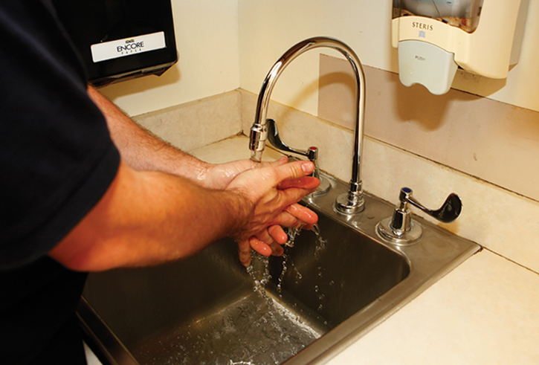
Vaccine Administration (1 of 21)
Minimize risk of transmitting disease
Hand washing
Syringes/needles must be disposable and discarded
Avoid predrawing vaccine
© Jones & Bartlett Learning. Courtesy of MIEMSS.
Notes:
Lecture Outline
X. Vaccine Administration
A. General considerations
1. The community paramedic administering vaccines should take precautions to minimize the risk of transmitting disease to and from the patient.
2. Hand hygiene should be performed before and after each patient contact.
3. Hand washing with warm running water and soap is preferable, but an alcohol-based hand sanitizer may be used if a water tap is not readily available.
4. Syringes and needles must be sterile, be disposable, and have a safety device to prevent a needlestick injury. They should be discarded in puncture-proof, biohazard labeled containers.
5. Avoid predrawing vaccine, as doing so increases the possibility of mix-ups and the uncertainty of vaccine stability.
Different vaccines should not be mixed in the same syringe unless they are specifically licensed for this practice.
Anxiety about injections is common among patients of all ages. Managing the pain associated with a needlestick has the potential to improve the immunization experience.

Slide 30
Vaccine Administration (2 of 21)
Vaccines are packaged in a variety of containers.
Community paramedic should be familiar with each type:
Ampules
Vials
Prefilled syringes
Notes:
Lecture Outline
B. Packaging of vaccines
1. Vaccines may be packaged in a variety of containers. The community paramedic should be familiar with each type and know how to ensure safe use and disposal of that container.

Slide 31
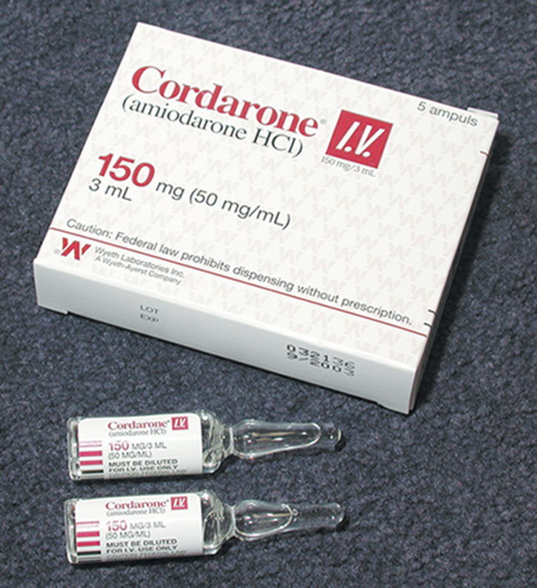
Vaccine Administration (3 of 21)
Ampules
Breakable sterile glass containers
Carry a single dose of vaccine
© Jones & Bartlett Learning.
Notes:
Lecture Outline
Ampules
a. Ampules are breakable sterile glass containers that are designed to carry a single dose of vaccine.
b. When you are drawing a vaccine from an ampule, follow these steps:
i. Check the vaccine to be sure that the expiration date has not passed and that it is the correct drug and concentration.
ii. Shake the vaccine into the base of the ampule. If some of the drug is stuck in the neck, gently thump or tap the stem.
iii. Using a 4- by 4-inch (10- by 10-cm) gauze pad, an alcohol prep, or an ampule breaker, grip the neck of the ampule and snap it off where the ampule is scored. If the ampule is not scored and an attempt is made to break it, some sharp edges may be present. Drop the stem in the sharps container.
iv. Insert a filtered needle into the ampule without touching the outer sides of the ampule. Draw the solution into the syringe, and dispose of the ampule in the sharps container.
v. Hold the syringe with the needle pointing up, and gently tap the barrel to loosen air trapped inside and cause it to rise. Press gently on the plunger to dispel any air bubbles.
vi. Recap the needle using the one-handed method. Dispose of the needle in the sharps container, and attach a standard hypodermic needle to the syringe if necessary to administer the vaccine.

Slide 32
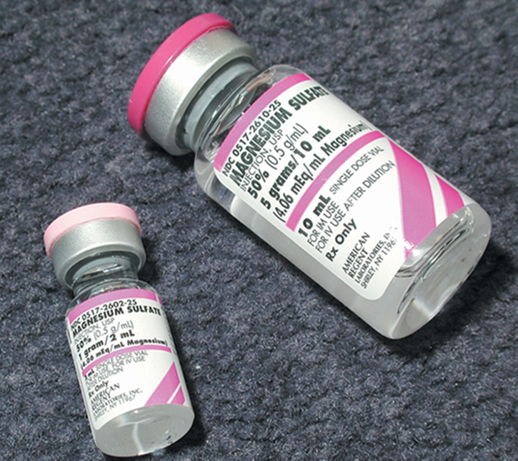
Vaccine Administration (4 of 21)
Vials
Small glass or plastic bottles, rubber top
Contain single or multiple doses of a vaccine
© Jones & Bartlett Learning.
Notes:
Lecture Outline
3. Vials
a. Vials are small glass or plastic bottles with a rubber-stopper top; they may contain single or multiple doses of a vaccine.
b. When you are using a vial of vaccine, you must first determine how much of the drug you will need and how many doses are in the vial.
c. For a single-dose vial, you may draw up the entire amount in the vial. For multiple-dose vials, you should draw up only the amount needed.
i. Remember that once you remove the cover from a vial, it is no longer sterile.
ii. If you need a second dose, clean the top of the vial with alcohol before withdrawing the vaccine.
d. When you are drawing vaccine from a vial, follow these steps:
i. Check the vaccine to be sure that the expiration date has not passed and that it is the correct drug and concentration.
ii. Remove the sterile cover, or clean the top with alcohol if the vial was previously opened.
iii. Wipe the vial’s rubber top with an alcohol prep before touching it with the needle. Determine the amount of vaccine needed, and draw that amount of air into the syringe.
iv. Invert the vial, and insert the needle through the rubber stopper. Expel the air in the syringe into the vial, and then withdraw the amount of vaccine needed.
v. Withdraw the needle, and expel any air in the syringe.
vi. Recap the needle using the one-handed method. Label the syringe if the vaccine is not immediately given to the patient.

Slide 33
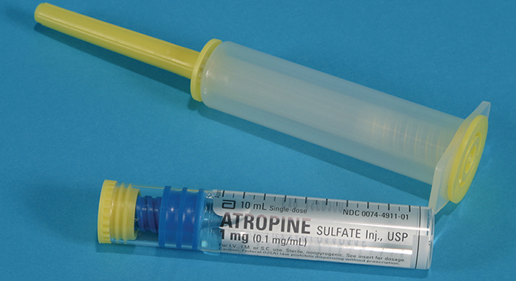
Vaccine Administration (5 of 21)
Prefilled syringes
Two types
Those separated into a glass drug cartridge with syringe
Preassembled plastic prefilled syringes
© Jones & Bartlett Learning.
Notes:
Lecture Outline
4. Prefilled syringes
a. Two types of prefilled syringes exist: those that are separated into a glass drug cartridge with a syringe, and preassembled plastic prefilled syringes.
b. These syringes are designed for ease of use.
c. With many drug cartridge and syringe systems, both pieces of the assembly may contain sharps and should be disposed of properly.
d. To assemble the two-part prefilled syringe:
i. Pop the yellow caps off of the syringe and the drug cartridge
ii. Insert the drug cartridge into the barrel of the syringe
iii. Screw them together
iv. Remove the needle cover, and expel air in the manner previously described
v. Follow the steps for the route by which the vaccine is to be given

Slide 34
Vaccine Administration (6 of 21)
Vaccines may be administered via several different routes.
Intradermal
Subcutaneous
Intramuscular (including Z-track injections)
Notes:
Lecture Outline
Vaccines may be administered via several different routes
a. Intradermal
b. Subcutaneous
c. Intramuscular (including Z-track injections)

Slide 35
Vaccine Administration (7 of 21)
Intradermal vaccine administration
Involve administering a small amount of vaccine, typically less than 1 mL
Use of 1-mL syringe and a 25- to 27-gauge, 3/8- to 1-inch needle
When selecting site, avoid areas with superficial blood vessels.
Notes:
Lecture Outline
C. Intradermal vaccine administration
1. Intradermal injections involve administering a small amount of vaccine (typically less than 1 mL) into the dermal layer just beneath the epidermis.
2. The technique involves the use of a 1-mL syringe (eg, a tuberculin syringe) and a 25- to 27-gauge, 3/8- to 1-inch (10- to 25-mm) needle.
3. When selecting a site for an intradermal injection, avoid areas that contain superficial blood vessels to minimize the risk of systemic absorption of the injected drug.

Slide 36
Vaccine Administration (8 of 21)
Intradermal vaccine administration (cont’d)
Most common anatomical locations are anterior forearm and upper back
Drugs administered this way have a slow rate of absorption; vaccine remains at injection site
Injections usually given at physician’s office or hospital
Notes:
Lecture Outline
4. Because of their high visibility and relative lack of hair, the most common anatomic locations for intradermal injections are the anterior forearm and upper back.
5. Drugs administered intradermally have a slow rate of absorption; there is minimal to no systemic distribution. The vaccine remains locally collected at the site of the injection.
6. Typically, these injections are given in a physician’s office or in the hospital to test a patient for allergies or to perform a purified protein derivative (PPD)—a skin test for tuberculosis.
7. Follow these steps to administer a vaccine via the intradermal route:
a. To assemble the two-part prefilled syringe:
i. Take standard precautions.
ii. Check the vaccine to ensure that it is the correct one, that it is not cloudy or discolored, and that the expiration date has no passed, and determine the appropriate amount to give for the correct dose.
iii. Advise the patient of potential discomfort while explaining the procedure.
iv. Assemble and check equipment needed: alcohol preps and a 1-mL syringe with a 25- to 27-gauge, 3/8- or 1-inch (10- to 25-mm) needle. Draw up the correct dose of vaccine.
v. Cleanse the area for administration using aseptic technique.
vi. Pull the skin taut with your nondominant hand.
vii. Insert the needle at a 10° to 15° angle with the bevel up.
viii. Slowly inject the vaccine while observing for the formation of a wheal, or small bump, which indicates that the vaccine is collecting in the intradermal tissue.
ix. Remove the needle. Immediately dispose of the needle and syringe in the sharps container.
x. Document the vaccine given, route, administration time, and response of the patient.

Slide 37
Vaccine Administration (9 of 21)
Subcutaneous vaccine administration
Given into loose connective tissue between dermis and muscle layer
Volumes of drug administered are usually 1 mL or less
Performed using a 24- to 26-gauge, 1/2- to 1-inch needle
Notes:
Lecture Outline
D. Subcutaneous vaccine administration
1. Subcutaneous injections are given into the loose connective tissue between the dermis and the muscle layer.
2. Volumes of a drug administered subcutaneously are usually 1 mL or less.
3. The injection is performed using a 24- to 26-gauge, 1⁄2- to 1-inch (13- to 25-mm) needle.

Slide 38
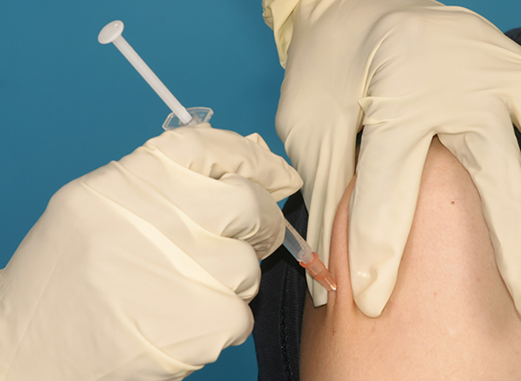
Vaccine Administration (10 of 21)
Common sites for injections
Upper arms
Anterior thighs
Abdomen
© Jones & Bartlett Learning.
Notes:
Lecture Outline
4. Common sites for subcutaneous injections—in both adults and children include:
a. Upper arms
b. Anterior thighs
c. Abdomen
5. Follow these steps to administer a vaccine via the subcutaneous route:
a. Take standard precautions.
b. Check the vaccine to ensure that it is the correct one, that it is not cloudy or discolored, and that the expiration date has not passed, and determine the appropriate amount and concentration for the correct dose.
c. Advise the patient of potential discomfort while explaining the procedure.
d. Assemble and check equipment needed: alcohol preps and a 3-mL syringe with a 24- to 26-gauge needle. Draw up the correct dose of vaccine.
e. Cleanse the area for the administration (usually the upper arm or thigh) using aseptic technique.
f. Pinch the skin surrounding the area, advise the patient of a stick, and insert the needle at a 45° angle.
g. Inject the vaccine and remove the needle. Immediately dispose of the needle and syringe in the sharps container.
h. To disperse the vaccine through the tissue, rub the area in a circular motion with your gloved hand.
i. Properly store any unused vaccine.
j. Document the vaccine given, route, administration time, and response of the patient.

Slide 39
Vaccine Administration (11 of 21)
Intramuscular vaccine administration
Given by penetrating a needle through the dermis and subcutaneous tissue, into muscle layer
Allows a larger volume of vaccine (up to 5 mL) than subcutaneous route
Potential for damage to nerves
Notes:
Lecture Outline
E. Intramuscular vaccine administration
1. Intramuscular injections are given by penetrating a needle through the dermis and subcutaneous tissue and into the muscle layer.
2. This technique allows administration of a larger volume of vaccine (up to 5 mL) than does the subcutaneous route.
3. Because there is the potential for damage to nerves due to the depth of the injection, it is important to choose the appropriate site.

Slide 40
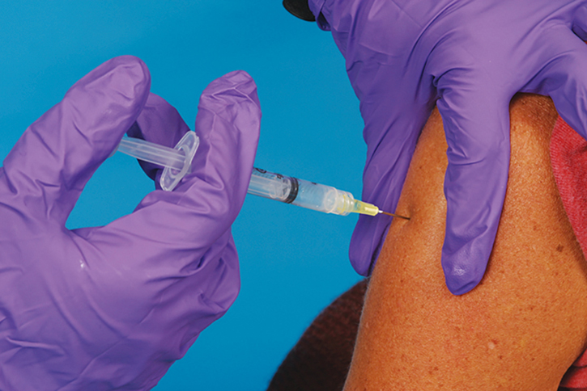
Vaccine Administration (12 of 21)
Common sites for injections
Vastus lateralis muscle
Rectus femoris muscle
Gluteal area
Deltoid muscle
© Jones & Bartlett Learning. Courtesy of MIEMSS
Notes:
Lecture Outline
4. Common anatomic sites for intramuscular injections for adults and children include the following:
a. Vastus lateralis muscle—the large muscle on the lateral side of the thigh
b. Rectus femoris muscle—the large muscle on the anterior side of the thigh
c. Gluteal area—the buttocks, specifically the upper lateral aspect of either side.
i. When injecting into the gluteal area, you should use the upper, outer quadrant to avoid the sciatic nerve.
d. Deltoid muscle—the muscle of the upper arm that covers the prominence of the shoulder. The site for injection is approximately 1½ to 2 inches (38 to 51 mm) below the acromion process on the lateral side.
5. Follow these steps to administer a vaccine via the intramuscular route:
a. Take standard precautions.
b. Check the vaccine to ensure that it is the correct one, that it is not cloudy or discolored, and that the expiration date has not passed, and determine the appropriate amount and concentration for the correct dose.
c. Advise the patient of potential discomfort while explaining the procedure.
d. Assemble and check equipment needed: alcohol preps and a 3- to 5-mL syringe with a 21-gauge, 1- or 2-inch (25- or 51-mm) needle. Draw up the correct dose of vaccine.
e. Cleanse the area for administration (usually the upper arm or the hip) using aseptic technique.
f. Stretch the skin over the cleansed area, advise the patient of a stick, and insert the needle at a 90° angle.
g. Pull back on the plunger to aspirate for blood. The presence of blood in the syringe indicates you may have entered a blood vessel. In such a case, remove the needle and hold pressure over the site. Discard the syringe and needle in the sharps container. Prepare a new syringe and needle, and select another site.
h. If there is no blood in the syringe, inject the vaccine and remove the needle. Immediately dispose of the needle and syringe in the sharps container.
i. Store any unused vaccine properly.
j. Document the vaccine given, route, administration time, and response of the patient.

Slide 41
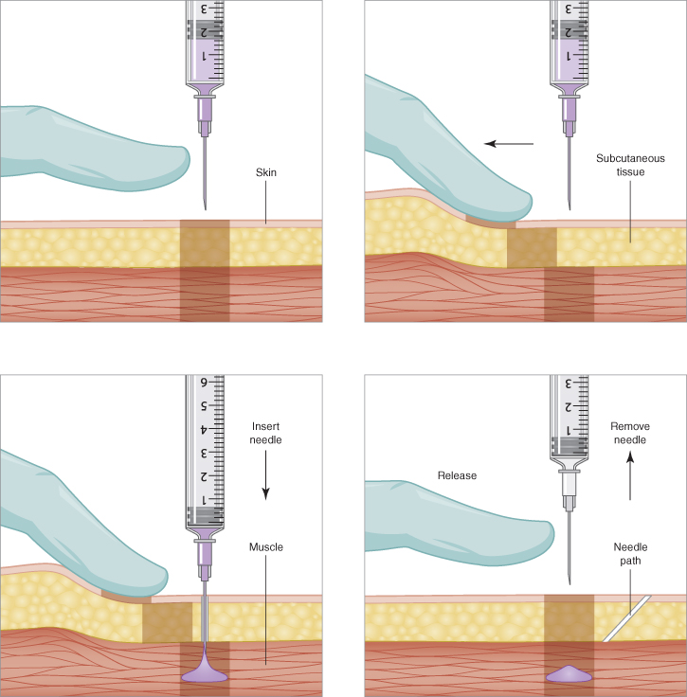
Vaccine Administration (13 of 21)
Z-track injections
Another method of intramuscular injections
Pull patient’s skin/subcutaneous tissue laterally
© Jones & Bartlett Learning
Notes:
Lecture Outline
6. Z-track injections
a. Z-track is another method for administering intramuscular injections.
b. Following the steps for intramuscular administration, before step 5, pull the patient’s skin and subcutaneous tissue laterally.
c. Then prep the site. The injection is performed in the same way, inserting the needle at a 90° angle.
d. Again, pull back on the plunger to check for blood and then inject the vaccine if no blood is present. Once the vaccine has been injected, the needle is removed and the skin and subcutaneous tissue that was being held is released.
e. By displacing the skin initially and allowing it to come back into place, you allow the skin and subcutaneous tissue to seal in the vaccine, which minimizes leakage.

Slide 42
Vaccine Administration (14 of 21)
Oral vaccines
In the United States, only 2 vaccines are administered by the oral route:
Vaccines for rotavirus
Oral typhoid
Notes:
Lecture Outline
F. Oral vaccines
1. In the United States, there are only two vaccines that are administered by the oral route:
a. Vaccines for rotavirus
b. Oral typhoid

Slide 43
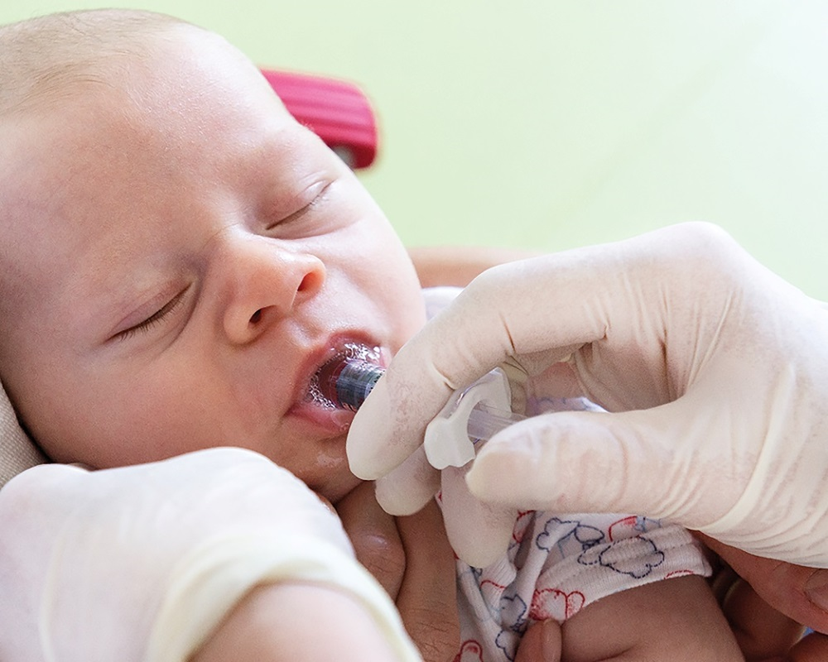
Vaccine Administration (15 of 21)
Oral vaccines (cont’d)
Administer prior to injections
Place applicator inside patient’s cheek, depress plunger
© Dominik Pabis/iStock/Getty.
Notes:
Lecture Outline
2. Oral vaccines should be administered prior to administering injections.
3. The oral applicator is placed inside the patient’s cheek, and the plunger is depressed.

Slide 44
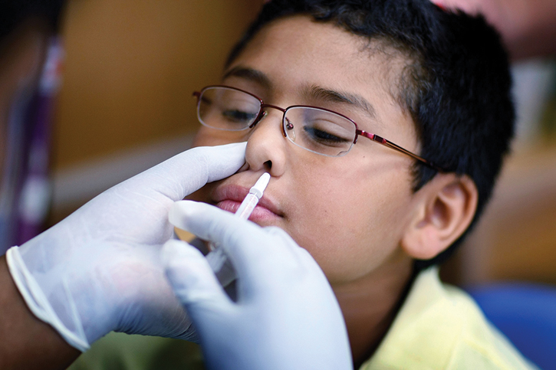
Vaccine Administration (16 of 21)
Nasal vaccines
LAIV may be administered via nasal route
Patients over 2 years and adults younger than 50 years
© Joe Raedle/Getty Images News/Getty.
Notes:
Lecture Outline
G. Nasal vaccines
1. In the United States, the live attenuated seasonal influenza vaccine may be administered via the nasal route.
2. This route should be used for patients over 2 years and adults younger than 50 years.
3. To administer the vaccine, first place the dose divider clip at the end of the applicator’s plunger.
4. The cap is removed from the tip of the applicator, and the tip is placed vertically in the patient’s nostril.
5. The plunger is depressed until it reaches the dose divider clip. The applicator is removed from the patient’s nostril, placed vertically in the other nostril, and the plunger is depressed.

Slide 45
Vaccine Administration (17 of 21)
Reactions to vaccination
Common reactions
Syncope, fear, paleness
Adverse reactions
Local, systemic, allergic
Notes:
Lecture Outline
H. Reactions to vaccination
1. Common reactions
a. Syncope may occur after immunization, particularly in adolescents and young adults.
b. Be aware of the signs that precede fainting, such as extreme fear or paleness, and take appropriate measures to prevent injuries if weakness, dizziness, or loss of consciousness occurs.
c. Whenever possible, patients should be offered the opportunity to sit or lie down following vaccination.
2. Adverse reactions
a. Adverse reactions to vaccination vary from minor to significant and life threatening.
b. The reactions fall into three general categories:
i. Local
ii. Systemic
iii. Allergic
c. An adverse reaction could be a true reaction or a coincidental event, but further investigation is often needed to distinguish between the two.
d. Local reactions occur with an estimated 80% of vaccine doses, depending on the type of vaccine administered.
e. These reactions are most common with inactivated vaccines, particularly those such as DTaP that contain an adjuvant.

Slide 46
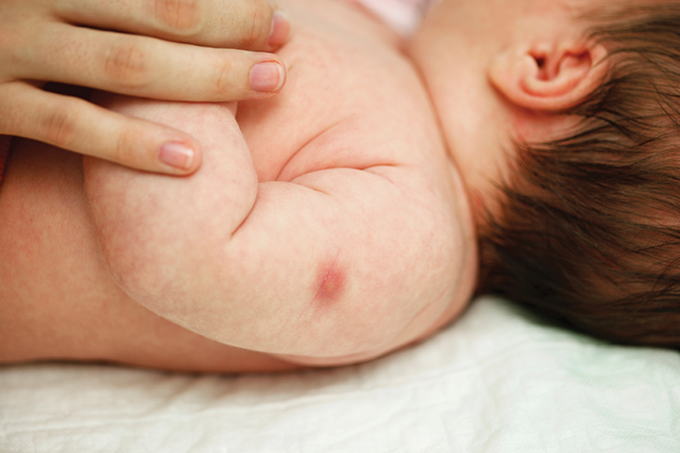
Vaccine Administration (18 of 21)
At injection site, reactions include:
Pain
Redness
Swelling
© art-4-art/iStock/Getty
Notes:
Lecture Outline
f. At the injection site, they typically take the form of:
i. Pain
ii. Redness
iii. Swelling
g. On rare occasions, an Arthus reaction may occur, characterized by severe pain, swelling, induration, edema, and hemorrhage, and occasionally necrosis in the limb receiving the injection, and requiring transfer for emergency department evaluation.

Slide 47
Vaccine Administration (19 of 21)
Systemic reactions are more generalized adverse effects, such as
Fever
Malaise
Muscle aches
Headache
Loss of appetite
Notes:
Lecture Outline
h. Systemic reactions are more generalized adverse effects, such as:
i. Fever
ii. Malaise
iii. Muscle aches
iv. Headache
v. Loss of appetite

Slide 48
Vaccine Administration (20 of 21)
Anaphylactic reactions to vaccines can be life threatening.
These reactions are rare, occurring in fewer than 1 in 500,000 doses of vaccine.
Screen for contraindications
All providers of vaccines should have an emergency protocol and anaphylactic kit.
Notes:
Lecture Outline
i. Anaphylactic reactions to vaccines can be life threatening.
j. An allergic response may be caused by the:
i. Antigen itself
ii. A vaccine component such as fragments of cell culture material, a stabilizer, a preservative
iii. An antibiotic used to inhibit bacterial growth
k. These reactions are extremely rare, occurring in fewer than 1 in 500,000 doses of vaccine, and their risk can be reduced by screening for contraindications, such as a history of a negative reaction after a previous dose of the same vaccine.
l. A list of the specific contraindications to each vaccine to be administered should be available to the community paramedic.
m. All providers of vaccines should have an emergency protocol and an anaphylactic kit at the ready to handle such a reaction.

Slide 49
Vaccine Administration (21 of 21)
Following vaccination, you should document:
Vaccine manufacturer, lot number, and date of administration
Name and title of the vaccine administrator
Site and route of administration
Notes:
Lecture Outline
I. Documentation
1. Following vaccination, you should document the following data in the patient’s record:
a. Vaccine manufacturer, lot number, and date of administration
b. Name and title of the vaccine administrator
c. Site (deltoid, lateral vastus) and route (intramuscular, subcutaneous, intranasal, oral) of administration

Slide 50
Vaccine Storage and Handling
Follow recommended practices
The agency should:
Develop a written plan for daily vaccine-related deliveries
Identify a vaccine coordinator and backup; train staff
Post details of proper storage conditions on refrigerator or freezer
Notes:
Lecture Outline
XI. Vaccine Storage and Handling
A. Recommended practices
1. By following the recommended practices for storage and handling of vaccines, immunization providers play a key role in ensuring the safety and efficacy of vaccines.
2. To ensure those practices are followed, the agency should develop a written plan for all daily vaccine-related activities:
a. Ordering and accepting vaccine deliveries
b. Storing and handling vaccines
c. Managing inventory
d. Managing potentially spoiled vaccines
e. Moving the vaccine to an alternative storage location in the event of mechanical failure of the unit or a power outage
3. The agency should identify a vaccine coordinator and backup. All staff members handling vaccines should be trained on storage and handling procedures.
4. The agency should also post details of proper storage conditions on the door of the refrigerator or freezer in which the vaccines are kept.
B. Temperature control issues
1. Vaccines need to be maintained in specific temperature ranges; if exposed to excessive heat or cold, they may lose their potency.
2. At every step at which the vaccine is handled, the temperature to which the vaccine is exposed must be controlled and verified (called the cold chain of the vaccine).
3. When an agency receives a shipment of vaccines, its personnel should immediately check the integrity of the shipping container and confirm that the product was not exposed to excessive heat or cold during transit.
4. The agency should then store the vaccine in a refrigerator or freezer, based on the manufacturer’s instructions.
5. Each day, temperature of the refrigerator and freezer should be measured twice and the values should be recorded in a log book.
6. To ensure that the refrigerators or freezers remain in good working order and do not experience power interruptions:
a. Do not connect them to ground-flow circuit breakers or breakers activated by a wall switch.
b. Label circuit breakers and plug-ins with signage.
c. A backup generator should be made available.
d. Filling empty space in a freezer or refrigerator with water containers can minimize temperature fluctuations during brief mechanical failures.
e. Hard-sided coolers should be available to move the vaccine to another storage location if needed.
f. Placing a flashlight, a copy of the emergency plan, and guidelines for safe transport of the vaccine in the cooler would be helpful if staff need to work in the dark following a power outage.
C. Vaccine expiration and contamination
1. Determine if the vaccine was stored at the correct temperature.
2. Never use a vaccine if:
a. It should be clear but presents as cloudy.
b. There is any evidence of tampering.
3. If the vaccine may have been compromised, label it with a “Do not use” tag, and then contact the local or state public health immunization program and the vaccine manufacturer for guidance on appropriate steps to take.
4. Before placing the call, be sure to know:
a. The out-of-range temperature
b. The estimated time to which the vaccine was exposed to this condition.
5. Document all steps taken and guidance provided per your agency’s policy. This documentation should be stored with the temperature logs and kept on file for 3 years.

Slide 51
The Role of the Community Paramedic in Vaccination (1 of 5)
Patient-focused setting
Community paramedic could be assigned to focus on high-frequency patients to reduce 30-day readmission rates
Home visits
Very small coolers used for vaccines
Portable anaphylactic kit
Notes:
Lecture Outline
XII. The Role of the Community Paramedic in Vaccination
A. Patient-focused setting
1. Hospitals or clinic systems may assign a community paramedic to focus on high-frequency patients in an effort to reduce 30-day readmission rates.
a. Contact with these patients would take the form of home visits.
b. Very small coolers are commercially available that can be used to transport vaccines for use in the home setting.
c. If this avenue is pursued, the community paramedic would be responsible for maintaining the cold chain of a single dose of vaccine.
d. Community paramedics should bring a portable anaphylactic kit as part of the supplies prepared for the vaccination visit, in the unlikely event that a patient develops an allergic reaction to the vaccine.

Slide 52
The Role of the Community Paramedic in Vaccination (2 of 5)
Population-focused setting
Community paramedic adapts to the specific needs of the community
Example: The homeless
Collecting a personal history is essential when doing an immunization assessment
Notes:
Lecture Outline
B. Population-focused setting
1. Some community paramedics may work in a setting with a population-based focus, in which case their responsibilities may require them to adapt to the specific needs of the community.
a. Example: The homeless
2. In this setting, collecting a history of personal health risks would be essential when doing an immunization assessment.

Slide 53
The Role of the Community Paramedic in Vaccination (3 of 5)
Population-focused setting (cont’d)
Community paramedics
May work as vaccine providers in the immunization clinic of a local public health agency under supervision of a physician
On-site or off-site programs
Notes:
Lecture Outline
3. Community paramedics may also work as vaccine providers in the immunization clinic of a local public health agency under the supervision of a public health physician.
4. This responsibility might include covering routine vaccination clinics (patient-focused setting) or assisting with special vaccination campaigns such as senior influenza vaccination or kindergarten round-up.
5. These clinics may be on-site or off-site programs.

Slide 54
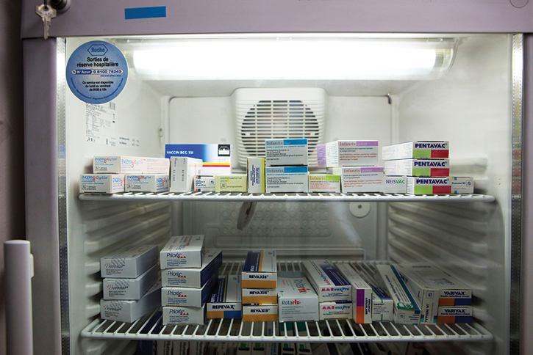
The Role of the Community Paramedic in Vaccination (4 of 5)
Off-site clinic
Maintaining cold chain important aspect of clinic management
Variety of coolers available
© BSIP SA/Alamy.
Notes:
Lecture Outline
a. In an off-site clinic geared toward vaccination, maintaining the cold chain is an important aspect of clinic management.
b. A variety of coolers can be used to store vaccines for this type of clinic: hard-sided coolers, coolers with frozen panels and insulation, and portable electric-powered coolers that can operate as refrigerators or freezers.

Slide 55
The Role of the Community Paramedic in Vaccination (5 of 5)
The mass clinic
Community paramedic may work in a mass clinic setting in response to a:
Local disease outbreak
Pandemic
Community paramedics should be part of annual review of these plans and have just-in-time training
Notes:
Lecture Outline
C. The mass clinic
1. The community paramedic may be assigned to work in a mass clinic setting in response to a local disease outbreak or a pandemic.
2. Organization of these clinics is based upon the incident command system (ICS); the community paramedic should already be familiar with this operational mode as a paramedic.
3. As part of the mass clinic, a community paramedic could function as a triage aide or a symptom evaluator.
4. A community paramedic working in a public health agency should be part of the annual review of these plans and should have just-in-time training when activating a mass clinic plan.

