Slide 1
FIRST ON THE SCENE
WHAT TO DO UNTIL EMS ARRIVES

Slide 2
Lesson 2: “Hands-Only CPR” and the Proper Use of the AED
Notes:
This is a section header slide

Slide 3
Lesson 2: Objectives
This section will focus on “high-quality CPR” and the use of an AED
Recognize the importance of early “high-quality CPR”
Recognize the signs and symptoms of someone in cardiac arrest
Demonstrate the appropriate technique for hands-only CPR
Demonstrate how to correctly use an AED
Notes:
Instructor Notes:
Review lesson objectives with participants.
The instructor may want to see if anyone has any experience with cardiac arrest or has been witness to an event.

Slide 4
What is Happening to the Patient?
Often cardiac arrest and heart attack are used interchangeably. However, they are not the same.
Cardiac arrest is often due to a malfunction that causes the heart to stop beating (pumping blood).
Heart attacks come from a blockage of one or more of the arteries supplying blood flow to the heart.
In cardiac arrest:
Hands-only CPR should be performed when a victim is in cardiac arrest (i.e., no pulse and not breathing effectively)
Survival rates for cardiac arrest outside of the hospital are low. However, recognition and action by bystanders can increase a person’s chances of survival.
Notes:
Instructor Notes:
During the COVID-19 pandemic, New York City had triple the number (3989 patients) of out-of-hospital cardiac arrests between March 1st - April 25th compared to the same timeframe in 2019 (1336 patients). Keep in mind that not all people you may help will be strangers. You could potentially find yourself performing CPR on a family member or friend at home. (https://www.medscape.com/viewarticle/932913)
Following the instructor’s explanation of the difference between heart attack and cardiac arrest, the instructor should give examples of the signs and symptoms of impending cardiac arrest:
Patient symptoms:
Chest pain or discomfort
Heart palpitations
Rapid or irregular heartbeats
Unexplained wheezing
Shortness of breath
Fainting or near fainting

Slide 5
Approaching the Scene
Determine if the scene is safe, then call 911
If the scene is not safe for you to approach, give the 911 dispatcher as much information as you can
Notes:
Instructor Notes:
The instructor should provide simple examples of scene safety.
Do not attempt to move the patient unless necessary.
Can you have people help with creating space and keeping other people away?
Do you feel safe acting in the environment?
If the scene is not safe for you to approach, give the 911 dispatcher as much information as you can.
Ask participants: What are some potential safety concerns with this scene?
Instructor – be prepared to discuss all potential safety concerns in this scene and others.

Slide 6
Assessing the Patient
Approach the victim, determine the patient's responsiveness, and check for breathing.
Ask “Are you ok?”
Tilt the head, lift the chin.
Look. Listen. Feel.
You will want to listen for air movement. Tilting the head will improve patient’s breathing by opening their airway.
Notes:
Instructor Notes:
Teach students the steps to basic patient assessment for breathing.
Approach the victim and ask, “Are you ok?”
To check for breathing, first tilt the victim’s head and gently lift their chin – this will help to open their airway.
Listen for air movement and watch for chest rise and fall.

Slide 7
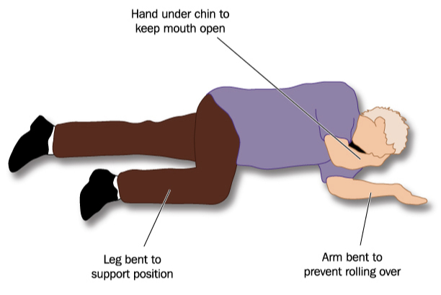
If the Patient is Breathing
If the victim is breathing more than 10 breaths per minute:
Place the victim on their left side
Call 911
Continue to check on the patient until help arrives
Notes:
Instructor Notes:
Explain the “recovery position” to students and note that a different lesson will discuss this position further. If a victim is breathing more than 10 breaths per minute, it is ok to place them on their side and wait for EMS to arrive. However, they should continue to monitor the victim until EMS takes over.
Ensure that all students know how to count breaths to calculate patient’s breathing rate.

Slide 8
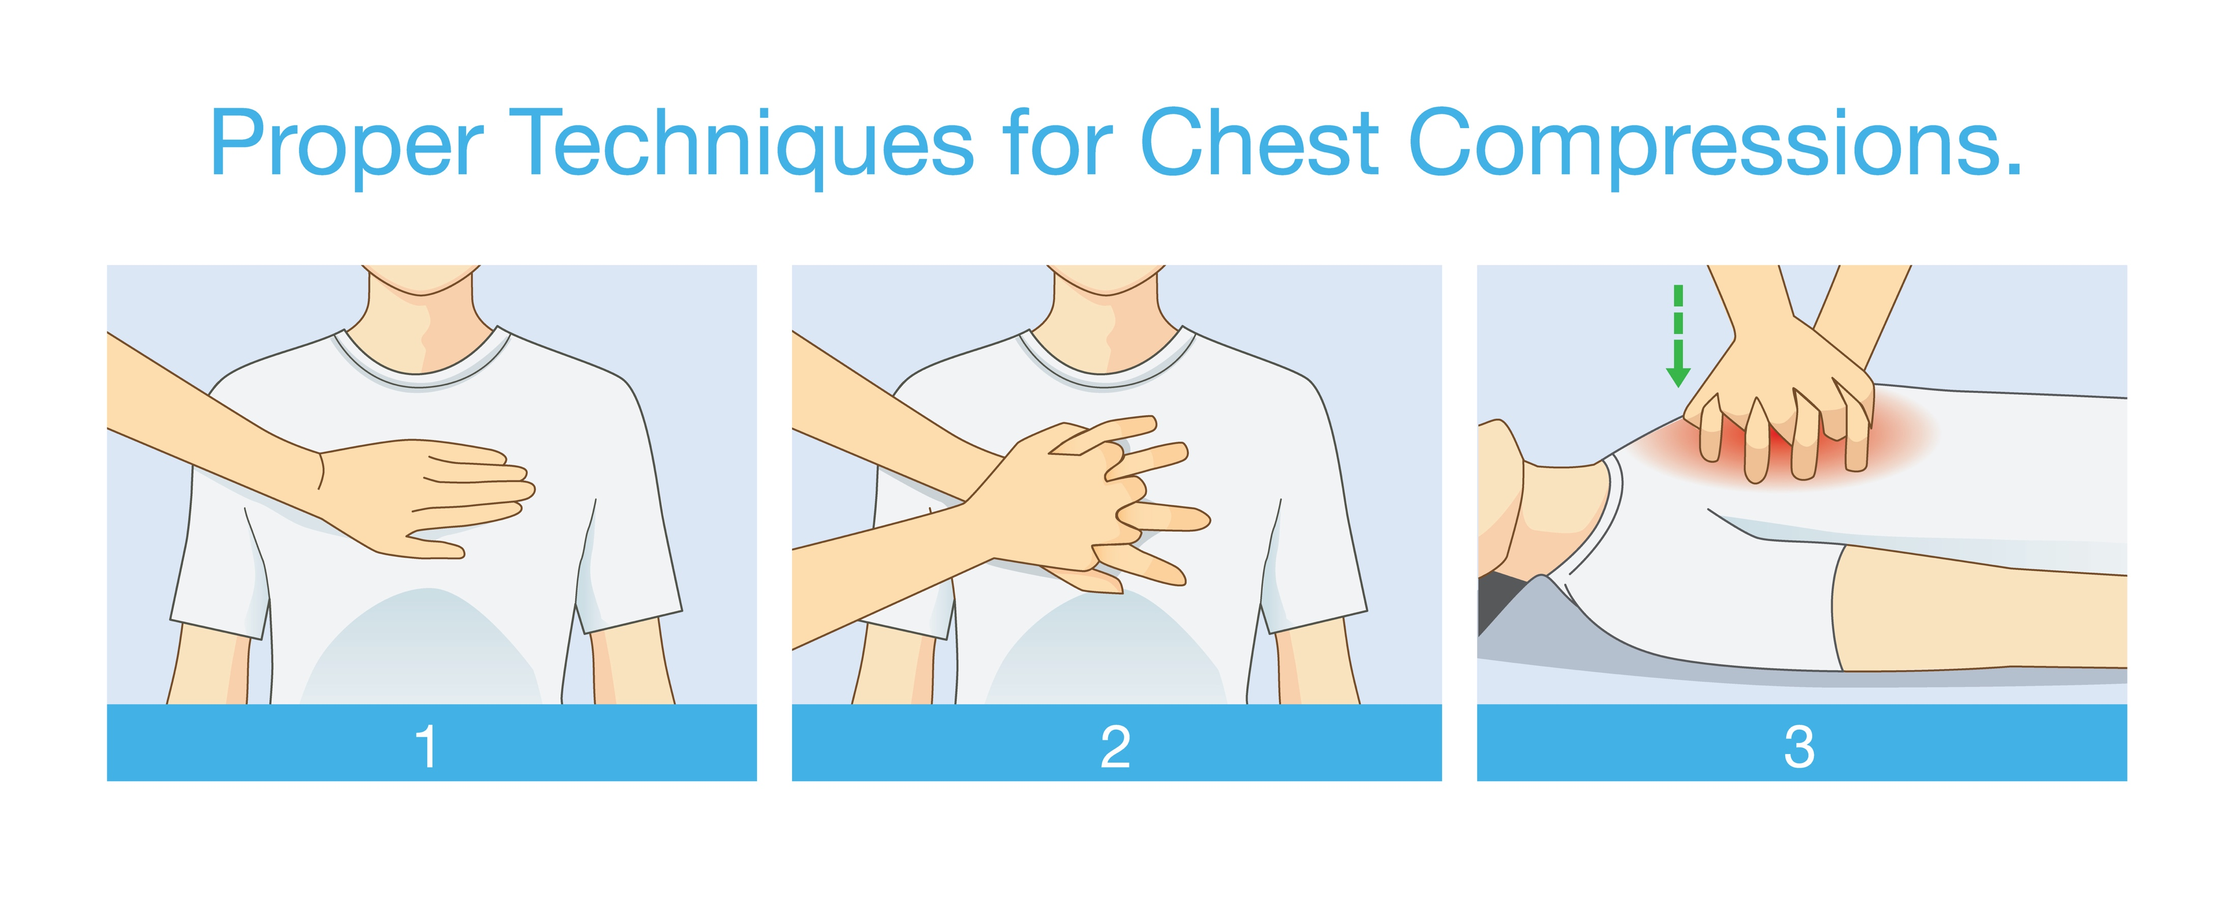
Placement of Hands on the Chest
If the victim is pulseless and not breathing:
Place both hands on the center of the victim's chest.
Begin CPR
Notes:
Instructor Notes:
Discuss the hands-only technique as an appropriate method for CPR.
Although bystander CPR is typically provided for a few minutes, studies continue to support that victims who receive hands-only CPR have a similar survival rate with those who have received CPR via the conventional method.
Additionally, research supports the continued use of hands-only CPR during the COVID-19 pandemic.
Currently, there is no clear evidence on the use of hands-only CPR leading to the transmission of infection.
One study shows less than 10% of cardiac arrests outside of the hospital were diagnosed with COVID-19 from January 1 to April 15.
Thus, the assumption of a potential risk for bystander infection while providing hands-only CPR could be 10% without the use of proper PPE.
Delaying hands-only CPR to put on PPE should be considered when potential of COVID-19 infection is considerably increased.
Bystander hands-only CPR saves greater than 300 lives per 10,000 in out-of-hospital cardiac arrest.
Hands-only technique should be demonstrated following a skills video depicting the skill. Discuss proper hand placement with students. Let them know a video will be shown on the next slide.
References:
https://www.newswise.com/coronavirus/analysis-of-seattle-ems-and-hospital-data-indicates-low-covid-infection-risk-from-bystander-cpr/?article_id=732777
https://assets.researchsquare.com/files/rs-70734/v1/981e2e4d-52bc-4372-a447-87333b48de20.pdf

Slide 9
Victim Intervention
Place both hands on the center of the victim's chest
Push hard and fast
Press 2 inches down
Perform 30 chest compressions, check for breathing, then continue
Chest compressions should be performed at a rate of 100 per minute
Try humming a tune with a 100-bpm beat
Play video: https://www.youtube.com/watch?v=JWCekJzVhuE
Notes:
Instructor Notes:
Play video for students. https://www.youtube.com/watch?v=JWCekJzVhuE.
Discuss with the class songs that have 100 beats per minute. Try the classic “Staying Alive” by the Bee Gees, or “Just Dance” by Lady Gaga.
New York Presbyterian Hospital has a list of songs on their CPR webpage that can be used for CPR practice: https://www.nyp.org/cpr/.

Slide 10
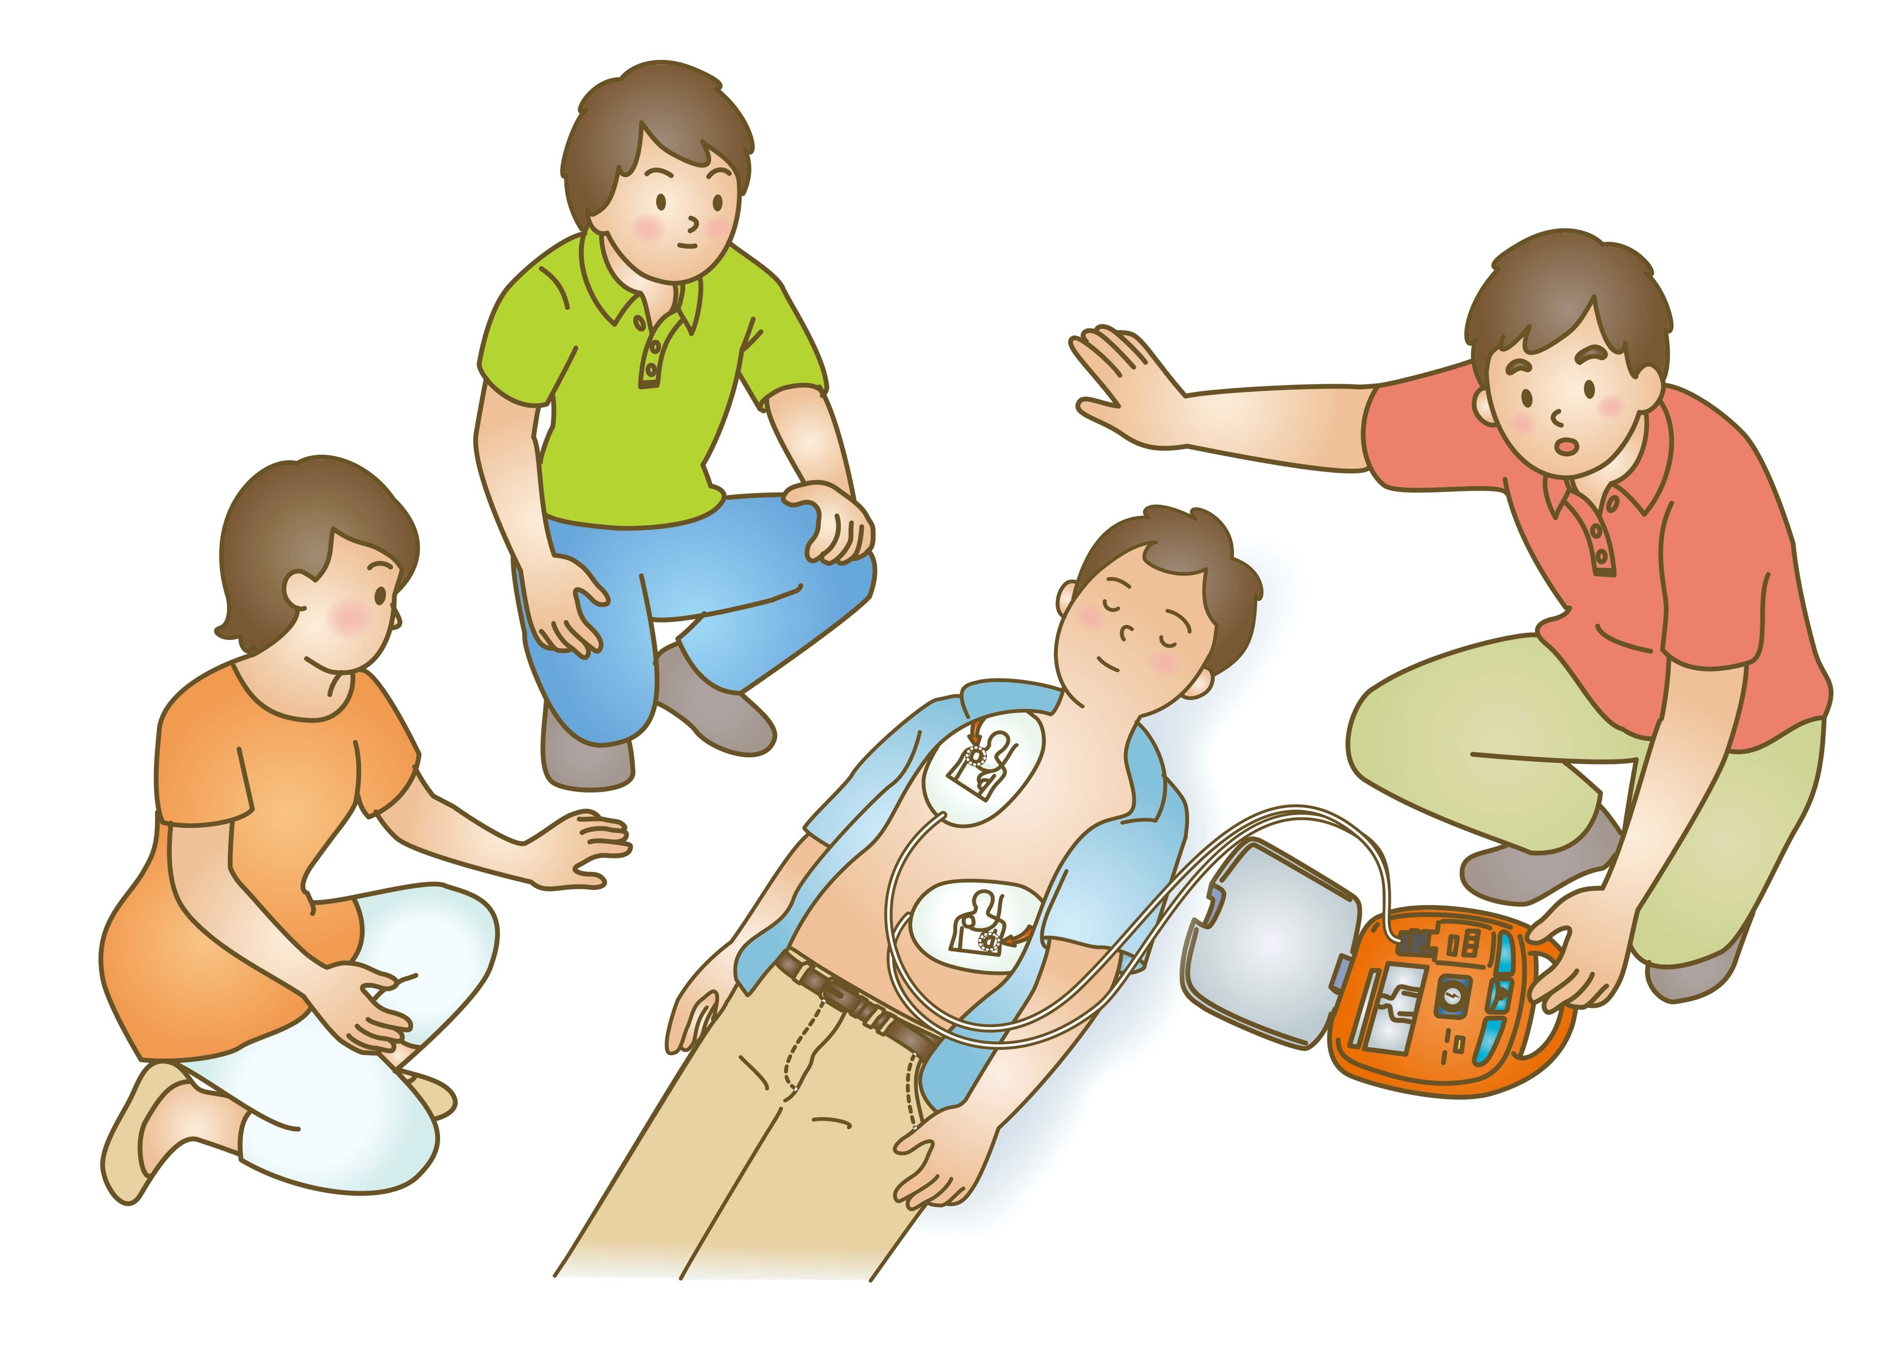
Attaching an AED
Locate the closest AED
Open the AED
Follow prompts
Apply AED to victim’s bare chest
Notes:
Instructor Notes:
The instructor should discuss use of the AED and proper pad placement. Explain different pad placement for infants versus adults.
Discuss what students should do if the AED gives a “no shock advised” message and why that message might appear.
If the AED advises no shock, immediately resume CPR. We do not want interruption of CPR longer than 10 seconds.
When the AED advises no shock, the machine is alerting the rescuer that there is not a rhythm that can benefit from shocking the patient. This is your cue to resume CPR immediately.
Have participants practice proper AED use.
Be prepared to answer common Q&A about AED use. Zoll provides some great answers on their website: https://www.zoll.com/au/medical-products/automated-external-defibrillators/faq/

Slide 11
Lesson 2: Summary
Recognizing signs and symptoms of cardiac arrest
Early recognition will improve survivability
Lessons from the course:
Scene safety
Hands-only CPR
Apply AED
Recognize what to do when “no shock advised”
Notes:
Instructor Notes:
Review summary points with class.

Slide 12
Lesson 2: Wrap-Up
Notes:
Instructor Notes:
Ask students if they have any questions about this lesson.

