Slide 1
Fourth Edition
Lesson 2: Respiratory Emergencies
Notes:
Instructor Notes
Welcome to Lesson 2: Respiratory Emergencies.

Slide 2
Lesson Objectives
Review the anatomy and physiology of the pediatric airway and ventilation.
Differentiate between respiratory distress and failure in pediatrics.
Discuss management of pediatric patients with respiratory emergencies using the Pediatric Assessment Triangle and XABCDE.
Use the most appropriate pediatric airway management intervention based on the patient’s assessment findings.
Notes:
Instructor Notes
Discuss the learning objectives and the importance of thoroughly understanding each one.
Review the anatomy and physiology of the pediatric airway and ventilation.
Differentiate between respiratory distress and failure in pediatrics.
Discuss management of pediatric patients with respiratory emergencies using the Pediatric Assessment Triangle and XABCDE.
Use the most appropriate pediatric airway management intervention based on the patient’s assessment findings.

Slide 3
Introduction
Respiratory diseases and infections are most common reasons for pediatric visits to the ED.
25% of pediatric visits to a physician are due to respiratory illness.
Respiratory complications include:
Asthma
Bronchiolitis
Acute bronchitis
Croup
Pneumonia
Anaphylaxis
Drowning
Choking
Notes:
Instructor Notes
17% of all children in the U.S. received emergency care in 2015.
Upper respiratory diseases and infections were among the most common reasons for pediatric ED visits.
Respiratory emergency ED visits peaked through the months of October to March from 2011 to 2015.
Similarly, 25% of all pediatric visits to a physician are due to respiratory diseases.
10% of those visits are due to asthma complications.
Additional frequent pediatric respiratory complications include bronchiolitis, acute bronchitis, croup, pneumonia, anaphylaxis, laryngomalacia, drowning, and choking.

Slide 4
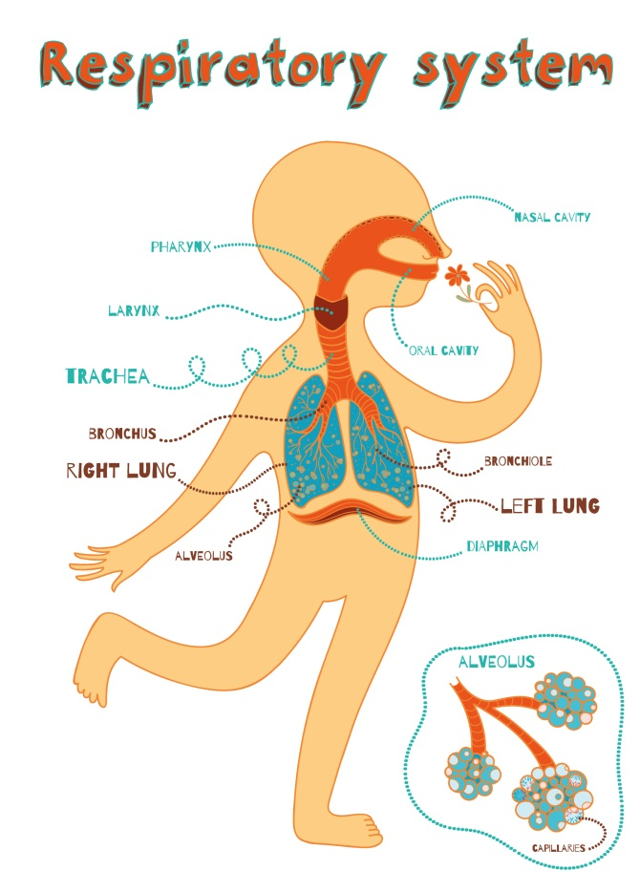
Normal Pediatric Respiratory Anatomy
© Shusha Guna/Shutterstock
Notes:
Instructor Notes
Discuss the anatomy and physiology of the pediatric upper and lower airways.
Children have a higher metabolic oxygen demand and lower lung volumes, resulting in reduced oxygen reserves.
Children also have higher respiratory rates than adults.
The increased respiratory rates aid in overcoming the lower lung volumes.
Significant distress could be caused by even a minor compromise to the airway or breathing.
The diaphragm plays a greater role in breathing for infants, leading to mainly abdominal respirations.
By the age of 6, breathing becomes more thoracic due to the development of the musculature in the chest wall.
Upper airway
The tongue is larger and the mandible shorter in the young child.
In infancy, the child is an obligate nasal breather until 5 months of age.
Prominent adenoids and tonsils are frequently found in preschool-age children.
The larynx is relatively higher in the neck in children.
The cricoid ring is located approximately at the level of the C4 vertebrae at birth, C5 at age 6, and C6 as an adult.
Vocal cords are angled in an anterior-inferior to posterior-superior fashion.
Lower airway
Airways of infants and children are smaller, less rigid, and more prone to obstruction.

Slide 5
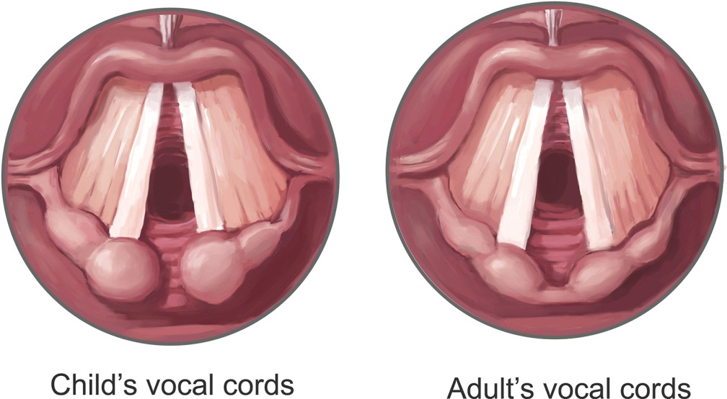
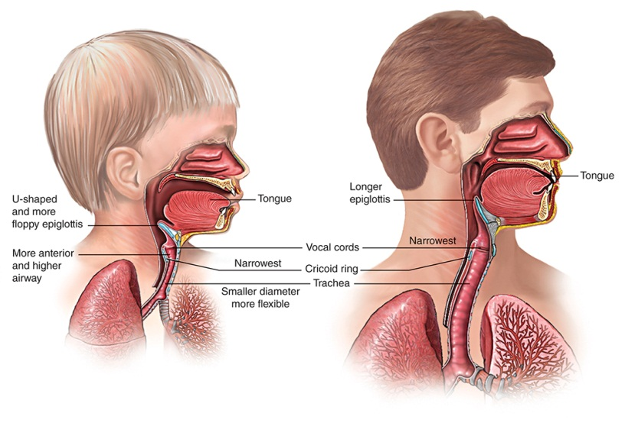
Pediatric vs. Adult
© Science History Images/Alamy Stock Photo
Notes:
Instructor Notes
Discuss the differences in the anatomy and physiology of the airway in pediatrics versus adults.
The narrowest portion of the airway in children younger than 10 years of age is at the level of the cricoid cartilage.
May need increased suctioning due to a smaller nasopharynx and nares, leading to increased occlusion.
Babies are nose breathers up to 6 months.
Keeping the nose clear is critical for good air exchange.
Explain that the airway in children is more funnel shaped versus the cylinder shape for an adult.
Share how the funnel shape makes the airway easier to collapse when the neck is flexed.
Smaller oral cavity accompanied with a larger tongue increases the likelihood of obstruction.
Due to the glottis and larynx being higher in the neck, risk for aspiration is increased.
Underdeveloped neck muscles make it more difficult to compensate for trauma, edema, and spasms.
Infants and toddlers rely more on the diaphragm than adults do to breathe.

Slide 6
Respiratory Distress, Failure, and Arrest
 | Respiratory Distress | Respiratory Failure | Respiratory Arrest
Respiratory Rate | Tachypnea | Tachypnea or Bradypnea | Apnea
Work of Breathing | Inadequate respiratory effort; nasal flaring, accessory muscle use | Increased or decreased respiratory effort | No respiratory effort
Adventitial Breath Sounds | Abnormal airway sounds; grunting, stridor | Abnormal airway sounds; grunting, stridor, wheezing, crackles, diminished air movement | No air movement
Cardiovascular changes | Tachycardia | Heart rate reduces as they become increasingly hypoxic; cyanosis, mottling | Bradycardia; Cardiopulmonary arrest
Mental Status | Normal | Decreased level of consciousness | Comatose
Notes:
Instructor Notes
Respiratory distress, failure, and arrest are linked to the physiologic response from the many types of hypoxic stress.
Discuss causes of hypoxic stress.
Asthma, croup, pertussis, bronchiolitis, pneumonia, and chest trauma.
Respiratory distress is respiratory compensation.
The brain is getting enough oxygen.
The child may appear somewhat normal.
Respiratory failure occurs when the infant or child has used their energy reserves and is no longer able to compensate.
This is when the child is decompensating.
An abnormal appearance or cyanosis coupled with an increased work of breathing indicates respiratory failure.
The heart slows as the child becomes increasingly hypoxic.
Respiratory arrest is the lack of breathing effectively.
Cardiopulmonary arrest is forthcoming without the support of oxygenation and ventilation.
To differentiate between “Quick/Not Quick”, you must be proficient with the PAT.
Note the appearance and work of breathing as you first approach your patient.
When you contact the patient, are they responding appropriately for their age (appearance)?
A lethargic child needs prompt attention and treatment.
Observe the child’s work of breathing.
Specifically, look for chest wall retractions, excessive and abnormal use of the accessory muscles of respiration, and nasal flaring.

Slide 7
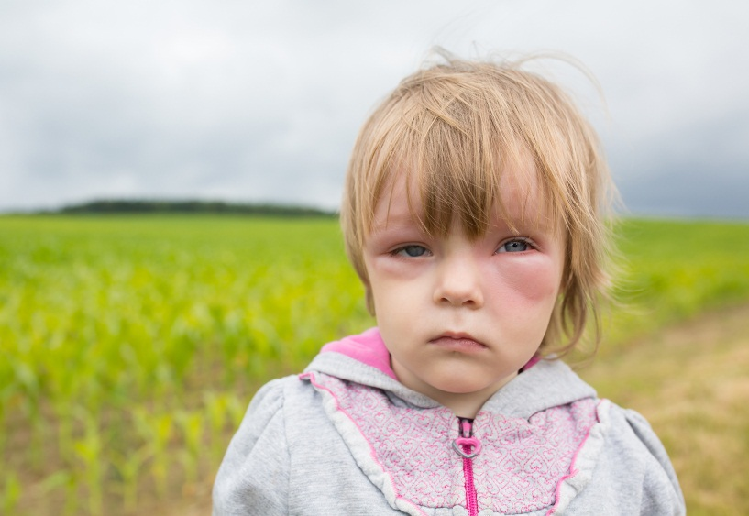

Common Upper Respiratory Emergencies
Anaphylaxis
Foreign body obstruction (FBO)
© Vadim Ratnikov/Shutterstock
© Ole.CNX/Shutterstock
Notes:
Instructor Notes
Discuss the common upper respiratory emergencies found in pediatrics.
Foreign body obstruction (FBO)
One of the leading causes of accidental death in pediatrics.
Round foods are the most likely to be fatal in kids.
Hot dogs are the most common.
Grapes, nuts, and candy are also common.
Non-food, latex balloons are the leading cause of choking ending in death.
Mechanical obstruction in the airway that may be from the pharynx to the bronchus.
Infants and toddlers are the highest risk.
Signs and symptoms: Sudden onset of gagging, choking, coughing, stridor, respiratory distress without the presence of a fever.
Treatment
Avoid agitating and keep in position of comfort if child is crying, coughing, able to speak.
DO NOT perform FBO maneuvers.
Severe respiratory distress
Prepare to perform FBO maneuvers.
BLS.
Child: Abdominal thrusts until unresponsive, then begin CPR.
Infant: Five back blows, followed with five compressions until unresponsive, then begin CPR.
Finger sweep for the object only if the object is seen when visualizing the airway.
ALS
If basic maneuvers are unsuccessful, pediatric laryngoscopy and Magill forceps may be used to remove object.
Anaphylaxis
Triggered by an exposure to an antigen.
Food, insect stings, and medications are the most common causes of anaphylaxis in pediatrics.
Food ingestion is 37-85% of all anaphylaxis cases.
Peanuts, tree nuts, seeds, and milk are the most common triggers.
Signs and symptoms: Tightness or swelling of the tongue or throat, wheezing, respiratory distress/failure, hives, nausea/vomiting, itching, abdominal pain, tachypnea, tachycardia.
Treatment
Epinephrine IM ASAP.
Oxygen if saturation levels fall below 94%.
IV fluids.
Beta-agonist for bronchospasm.
Methylprednisolone.
Diphenhydramine for hives and angioedema.

Slide 8
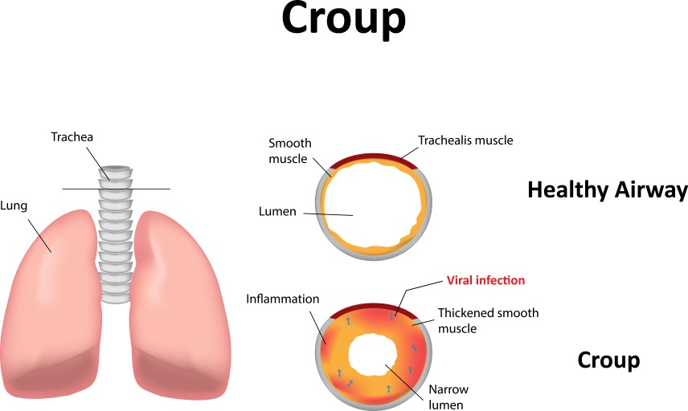
Common Upper Respiratory Emergencies
Croup
Viral
Acute laryngotracheobronchitis (LTB)
Bacterial
Retropharyngeal abscess (RPA)
Tracheitis
© joshya/Shutterstock
Notes:
Instructor Notes
Discuss the common upper respiratory emergencies found in pediatrics.
Croup
The most common cause of obstruction in pediatrics aged 6 months to 6 years.
Symptoms are worse at night or when agitated.
Viral
Most caused by parainfluenza virus.
Signs and symptoms: Barking cough, “crowing sounds,” inspiratory stridor, low-grade fever, respiratory distress, restlessness, hoarseness, sore throat, difficulty swallowing, and tachypnea.
Bacterial
Retropharyngeal abscess (RPA)
Swelling of the retropharyngeal nodes located between esophagus and the cervical vertebrae
Signs and symptoms
Difficulty breathing or swallowing, cough, fever, limitation of neck movement, tachypnea, tachycardia, swollen cervical lymph nodes.
May mimic the presentation for epiglottitis.
Tracheitis
Signs and symptoms: Copious secretions, productive cough, high fever, no drooling, tachypnea.
Treatment
Croup
Studies support that pediatric patients suffering from croup are commonly mistreated and given albuterol as initial treatment.
Stridor is often mistaken for wheezing-stridor, an upper airway inspiratory sound.
Initial treatment for moderate to severe croup should be nebulized epinephrine to reduce upper airway edema.
Oxygen if saturation levels fall below 94%.
Corticosteroids for even mild cases of croup to reduce inflammation.
Humidified therapy.
Retropharyngeal abscess /bacterial tracheitis
Antibiotics
Antipyretics

Slide 9
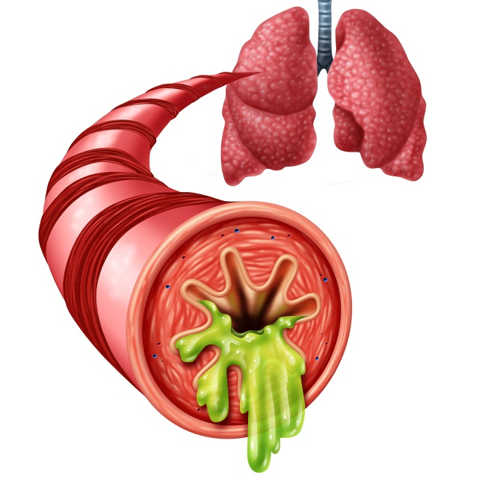
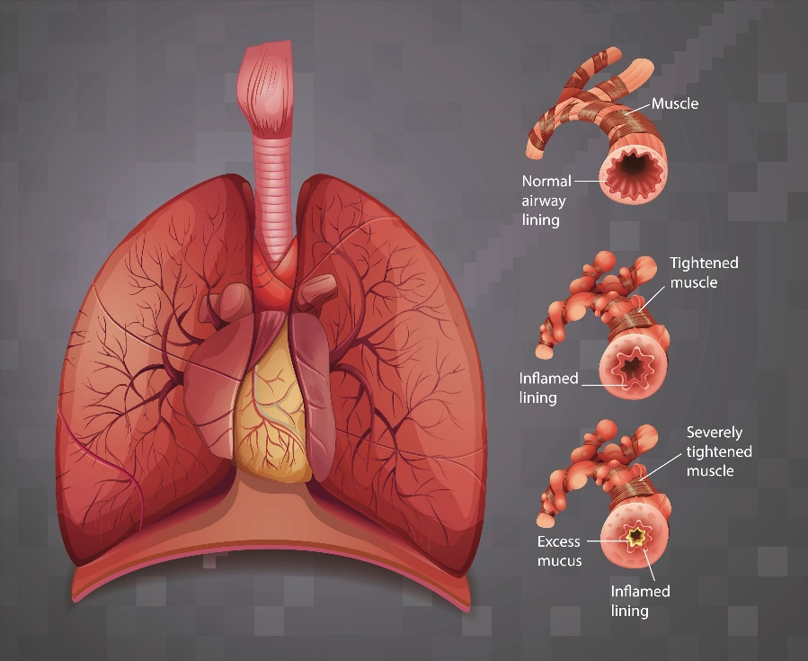
Common Lower Respiratory Emergencies
Bronchiolitis
Asthma
© Lightspring/Shutterstock
© BlueRingMedia/Shutterstock
Notes:
Instructor Notes
Discuss the common lower respiratory emergencies found in pediatrics.
Asthma
The most common pediatric disease, affecting approximately 5 million pediatrics in the U.S.
Chronic disease of small airway inflammation.
Bronchospasm, mucous production, and airway inflammation cause poor gas exchange through obstruction.
Signs and symptoms: Wheezing, respiratory distress, chest tightness, tachypnea, accessory muscle use when breathing, lethargy, tachycardia.
Treatment: Bronchodilators, epinephrine, corticosteroids, oxygen, BiPAP.
Bronchiolitis
Respiratory syncytial virus (RSV)
The most common infectious agent in pediatrics younger than 2 years of age causing upper respiratory infections leading to bronchiolitis.
While in older children the symptoms may be mild, RSV can be fatal in younger kids.
Signs and symptoms: Nasal congestion, runny nose, cough, nausea/vomiting, lethargy, poor appetite, tachypnea, respiratory distress with wheezing, inspiratory crackles, and/or accessory muscle use, fever, and tachycardia.
Treatment: Focus on opening the airway with suctioning.
Bulb suctions work well with infants.
May use saline to assist with suctioning nares.
Hypertonic saline nebulization may be beneficial to patients.
Avoid oxygen unless saturation falls below 94%.
Antipyretics for fever.
Studies do not support a consistent benefit of using albuterol or nebulized epinephrine in these patients.
Some studies support the use of high-flow nasal cannula (HFNC) in pediatrics.
Has been linked to an increase in the wash-out of nasopharyngeal dead space, lung mucociliary clearance, and oxygen delivery compared with other oxygen delivery systems.
Further research may lead to additional pediatric indications. such as acute asthma and weaning from invasive ventilation.

Slide 10
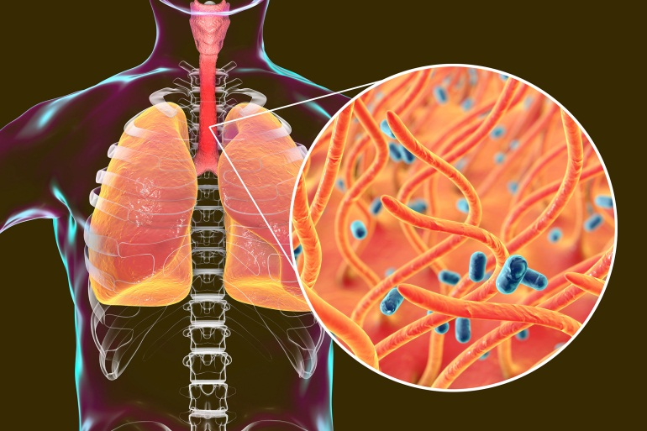
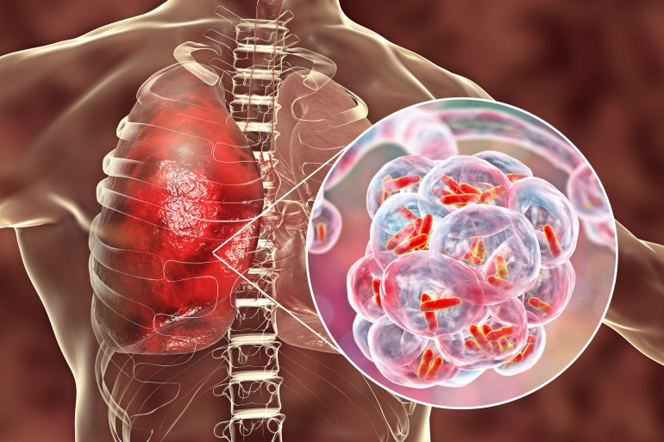
Common Lower Respiratory Emergencies
Pertussis
Pneumonia
© Kateryna Kon/Shutterstock
© Kateryna Kon/Shutterstock
Notes:
Instructor Notes
Discuss the common lower respiratory emergencies found in pediatrics.
Pneumonia
Can be viral or bacterial.
The leading cause of mortality in pediatrics younger than 5 years of age globally.
Most pediatric deaths are in developing countries.
Signs and symptoms: Nasal congestion, fever, cough, loss of appetite, chills, tachypnea, respiratory distress with grunting or wheezing and/or accessory muscle use, chest pain, cyanosis, and tachycardia.
Treatment
Supportive care and treatment of symptoms.
Nasal suctioning in infants.
Oxygen for hypoxia.
Avoid unless saturation falls below 94%.
Antipyretics for fever.
IV fluids for dehydration.
Antibiotics for bacterial pneumonia.
Pertussis
“Whooping cough” or “100-day cough”
Bacterial infection of the respiratory tract.
More serious in infants and younger pediatrics.
Older pediatrics tend to have milder symptoms.
In 2017, the CDC reported more than 18,000 cases of pertussis in the U.S.
The WHO reported 63,000 deaths in pediatrics younger than 5 years of age around the globe in 2013.
Most were from developing countries with limited access to the vaccine.
Signs and symptoms: Runny nose, low-grade fever, cough, respiratory distress, vomiting during coughing spells, and lethargy after coughing spells.
Treatment
Vaccine is the best prevention.
Antipyretics.
Suction nares, as needed.
Oxygen if saturation is below 94%.
Ventilatory assistance, as needed, for periods of apnea.
Prone position ventilation (PPV) may be necessary to improve oxygenation if patient is in severe distress.

Slide 11
Case 1
Dispatch
You and your partner respond to a residence for a 11-month-old male with a fever and in respiratory distress. It is a cold, winter evening. The air temperature is 20°F (−6.7°C).
Notes:
Instructor Notes
For students other than prehospital practitioners, dispatch information can be modified.
What are your initial concerns and possible differential diagnosis from the dispatch information?
Initial impression begins when the dispatch information is received.
Initial concern: Febrile infant with respiratory distress.
Differential diagnosis:
Due to the time of year
Croup
Bronchiolitis
RSV
Pertussis
Epiglottitis
Tracheitis
Pneumonia
Discuss the importance of scene assessment and awareness.
Expand on how it applies to this case.
Case 1 involves a 11-month-old male with a fever and in respiratory distress.
Diagnosis: RSV-bronchiolitis.

Slide 12

Initial Observations
© TimmyTimTim/Shutterstock
Used with permission of the American Academy of Pediatrics, Pediatric Education for Prehospital Professionals, © American Academy of Pediatrics, 2000
Notes:
Instructor Notes
Discuss the following initial findings at the scene.
As you arrive at the front entrance of the home you are met by the mother, who appears anxious.
PAT
Appearance: Restless.
Work of breathing: Nasal flaring, intercostal retractions.
Circulation: Skin is warm and clammy.
Mother tells you she took the infant to his pediatrician yesterday due to low-grade fever.
He was swabbed and tested positive for RSV 3 days ago.
Mom was advised to treat fever with antipyretics and suction nasal drainage frequently.
Mom told to call 911 if condition or breathing got worse
Discuss additional precautions or concerns that may be warranted based on initial observations.
Any form of acidosis can lead to an increased respiratory rate, such as fever.
Parents may believe the child is in respiratory distress, but instead the child has some other primary condition/cause.

Slide 13
Discussion
Is this patient “Quick” or “Not Quick”?
Have you identified respiratory distress, failure, or arrest?
Notes:
Instructor Notes
Is this patient “Quick” or “Not Quick”?
The patient is “Quick.”
Expand on how this determination was made.
Have you identified respiratory distress, failure, or arrest?
This patient is in respiratory distress.
How was this determination made?
Nasal flaring, intercostal retractions.

Slide 14
Primary Survey
Primary survey
X – No bleeding found.
A – Open, with copious amounts of clear nasal drainage.
B – Respirations rapid with nasal flaring and intercostal retractions. Lung sounds, expiratory wheezes
C – Brachial pulses are strong and regular. Capillary refill time is brisk. Skin is warm and clammy.
D – Alert and restless; GCS = 15 (E4, V5, M6).
E – Lying in mother’s arms.
Notes:
Instructor Notes
Discuss the primary survey and PAT findings.
Note that the PAT is completed prior to the primary survey.
Ask participants to explain any abnormal findings of the patient, whether physically and/or developmentally, and why.
Discuss any life threats identified in this case.
Life threats include tachypnea, nasal flaring, and intercostal retractions.
Primary survey
X – No bleeding found.
A – Open, with copious amounts of clear nasal drainage.
B – Respirations rapid with nasal flaring and intercostal retractions. Lung sounds, expiratory wheezes.
C – Brachial pulses are strong and regular. Capillary refill time is brisk. Skin is warm and clammy.
D – Alert and restless; GCS = 15 (E4, V5, M6).
E – Lying in mother’s arms.
What would your initial treatment be?
Discuss treatment options per local guidelines and policy.
Treatment should be focused on supportive care.
Suctioning of the nares should be done at this point.
Blow-by oxygen.
Participant engagement
Remind participants that recognizing and managing respiratory distress in pediatrics is of utmost importance.

Slide 15
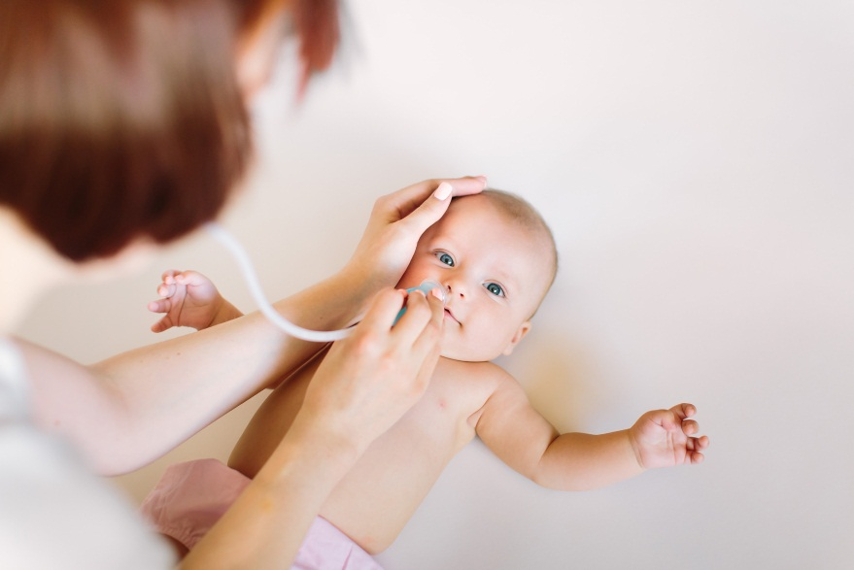
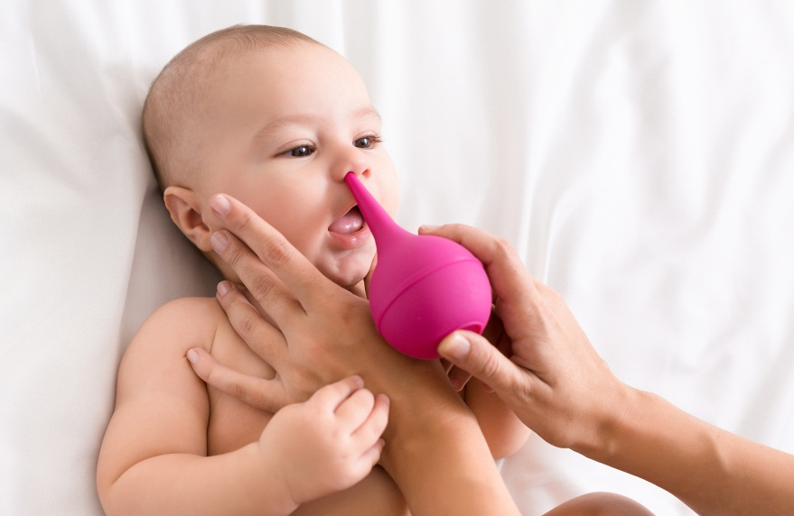
Suctioning
When should you suction your patient?
How would nasal suctioning assist young children?
What supplies are needed for effective nasal suctioning?
What is the process for performing nasal suctioning?
How often should you suction?
© SofikoS/Shutterstock
© Prostock-studio/Shutterstock
Notes:
Instructor Notes
When should you suction your patient?
Suctioning should be used when breathing difficulty is recognized due to obstruction.
How would nasal suctioning assist young children?
Suctioning the nares will make breathing and feeding easier for young children.
Due to infants breathing primarily through their nares, mucus can make breathing difficult for young children.
Take the time to educate caregivers on the use of nasal suctioning.
What supplies are needed for effective nasal suctioning?
Expand on pediatric equipment availability in your region.
Discuss suction options per local guidelines and policy.
Bulb syringe.
Saline nose drops.
Towel or tissue.
What is the process for performing nasal suctioning?
The child should begin on his/her back.
This will be uncomfortable for your patient.
Allow caregiver to assist when possible.
Three to four saline nose drops would be placed in each nostril. Do one side at a time.
Wait approximately a minute to allow the saline to thin the mucus.
Use the bulb syringe to suction each nostril.
Ensure you clear the bulb syringe of mucus in towel or tissue after each suction.
You may not need to use saline drops when suctioning if mucus is not too thick.
How often should you suction?
You should suction until the airway is clear and breathing is improved.
Expand on the importance of suctioning to ensure adequate ventilations.

Slide 16
Detailed Assessment
History taking
O – Gradual
P – None
Q – N/A
R – None
S – Unknown
T – 3 days
Notes:
Instructor Notes
Review history taking using the OPQRST mnemonic.
O – Gradual
P – None
Q – N/A
R – None
S – Unknown
T – 3 days
Participant engagement
Discuss the importance of continuously reevaluating pediatric airway and breathing.
Expand on additional measures that may be used to calm the patient, such as methods in which the caregiver can assist healthcare personnel.

Slide 17
Detailed Assessment
History taking
S – Difficulty breathing, nasal flaring, accessory muscle use, copious amounts of nasal drainage.
A – No known allergies.
M – None.
P – RSV, bronchiolitis.
L – Took a few bites of cereal this afternoon. He became agitated while drinking milk an hour ago.
E – Has gotten worse over the last 3 days. Physician advised to call EMS if breathing got worse. Suctioning was not helping.
R – History of RSV-bronchiolitis, age, nasal drainage.
Notes:
Instructor Notes
Review history taking using SAMPLER.
S – Difficulty breathing, nasal flaring, accessory muscle use, copious amounts of nasal drainage.
A – No known allergies.
M – None.
P – RSV, bronchiolitis.
L – Took a few bites of cereal this afternoon. He became agitated while drinking milk an hour ago.
E – Has gotten worse over the last 3 days. Physician advised to call EMS if breathing got worse. Suctioning was not helping.
Parents were not aware of using saline drops to assist with suctioning.
R – History of RSV-bronchiolitis, age, nasal drainage.

Slide 18
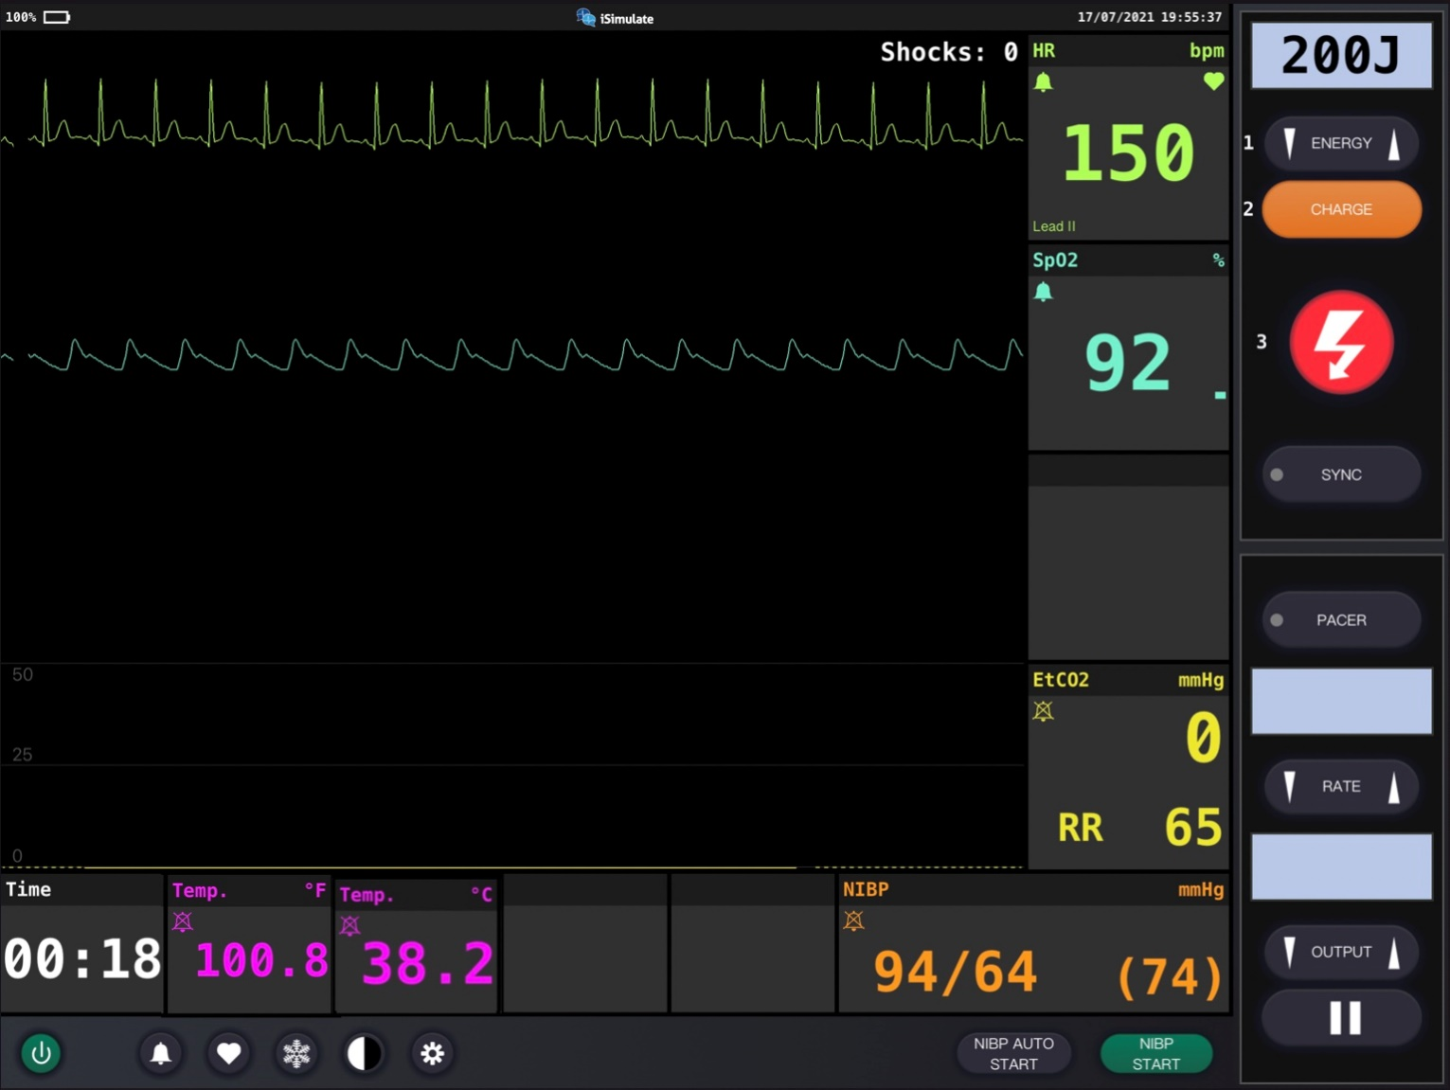
Vital Signs
Notes:
Instructor Notes
Discuss what the vital signs tell us about the patient.
SpO₂: 92% on room air and an improvement with suctioning and high-flow blow-by oxygen.
He is hypoxic.
Unable to obtain ETCO₂ due to increasing agitation of child when attempting to place on patient.
Along with his adventitious lung sounds, the diagnostics indicate he is in respiratory distress.
Participant engagement
Discuss expected typical vital signs for age.

Slide 19
Detailed Assessment
Notes:
Instructor Notes
*Ask participants: Given the age of this child, would you perform a head-to-toe or toe-to-head assessment?
HEENT
Head: Unremarkable
Eyes: PERRL
Ears: Unremarkable
Nose: Copious amounts of clear nasal drainage, nasal flaring
Throat: Unremarkable
Heart and lungs
Lung sounds: Expiratory wheezes. Heart sounds are normal, no murmur.
Respirations rapid with intercostal retractions.
Neuro
Circulation, motor, and sensory (CMS) intact, restless and easily agitated.
Abdomen and pelvis
Soft, nontender. Bowel sounds are normal.
Upper extremities
Unremarkable
Lower extremities
Unremarkable

Slide 20
Treatment
BLS
Monitor airway.
Administer humidified oxygen.
Position of comfort.
ALS
BLS care.
Antipyretics.
Critical care
BLS/ALS care.
Monitor for signs of respiratory failure and need for PAI.
Notes:
Instructor Notes
Ask students how they would treat this patient according to their local protocol and scope of practice.
The patient should be treated with supportive care.
Be prepared for rapid deterioration.
Patient management
What are your goals for this patient?
The patient should be treated with supportive care.
Be prepared for rapid deterioration.
Promptly identify respiratory distress, failure, and/or arrest, and intervene for patients who require escalation of therapy.
Deliver appropriate therapy by differentiating other causes of pediatric respiratory distress.
Would bronchodilators or corticosteroids work in this patient?
The American Academy of Pediatrics does not support any treatment other than supportive care and oxygen support as effective in patients with bronchiolitis.
Studies show bronchodilators do not shorten the symptoms or length of stay.
Bronchodilators, nebulized epinephrine, and corticosteroids are not effective or recommended.
Bronchodilators do not usually help with bronchiolitis because of the secretion and inflammation causing the wheezes versus bronchoconstriction with asthma.
Infants are obligatory nasal breathers, so the best treatment is adequate nasal suctioning.
Hypertonic saline nebulization may be beneficial to this patient.
How has your differential diagnosis changed?
RSV-bronchiolitis
Pneumonia

Slide 21
Ongoing Management
Reassess the patient.
Where is the most appropriate treatment destination and why?
Can you safely transport this child in your ambulance?
Will you allow mom and dad to ride in the ambulance?
Notes:
Instructor Notes
Discuss the ongoing management options based on scope of practice and local protocols.
Reassess the patient for the need of repeat suctioning.
The patient is continuously monitored during transport while you prepare intubation and positive pressure ventilation equipment.
SpO₂ rises to 95% and the patient appears less agitated and restless.
There are no further changes during transport to the emergency department.
Where is the most appropriate treatment destination and why?
Discuss the transportation destination options for pediatrics in your region.
Share with students when and if it would be appropriate to bypass certain facilities for this patient.
This infant should be transported to the closest appropriate facility.
How would you safely transport this child in your ambulance?
Discuss policies and procedures for transporting pediatrics in your region.
The father handed you the infant’s own car seat to use during transport.
Will you allow mom and dad to ride in the ambulance?
Family-centered care is a priority, so we recommend allowing one parent to ride in the ambulance with the EMS crew if safety allows.
We encourage EMS to include this family member in the care of their infant as a member of their care team.
The mother rode with EMS crew and was restrained to the bench seat.

Slide 22
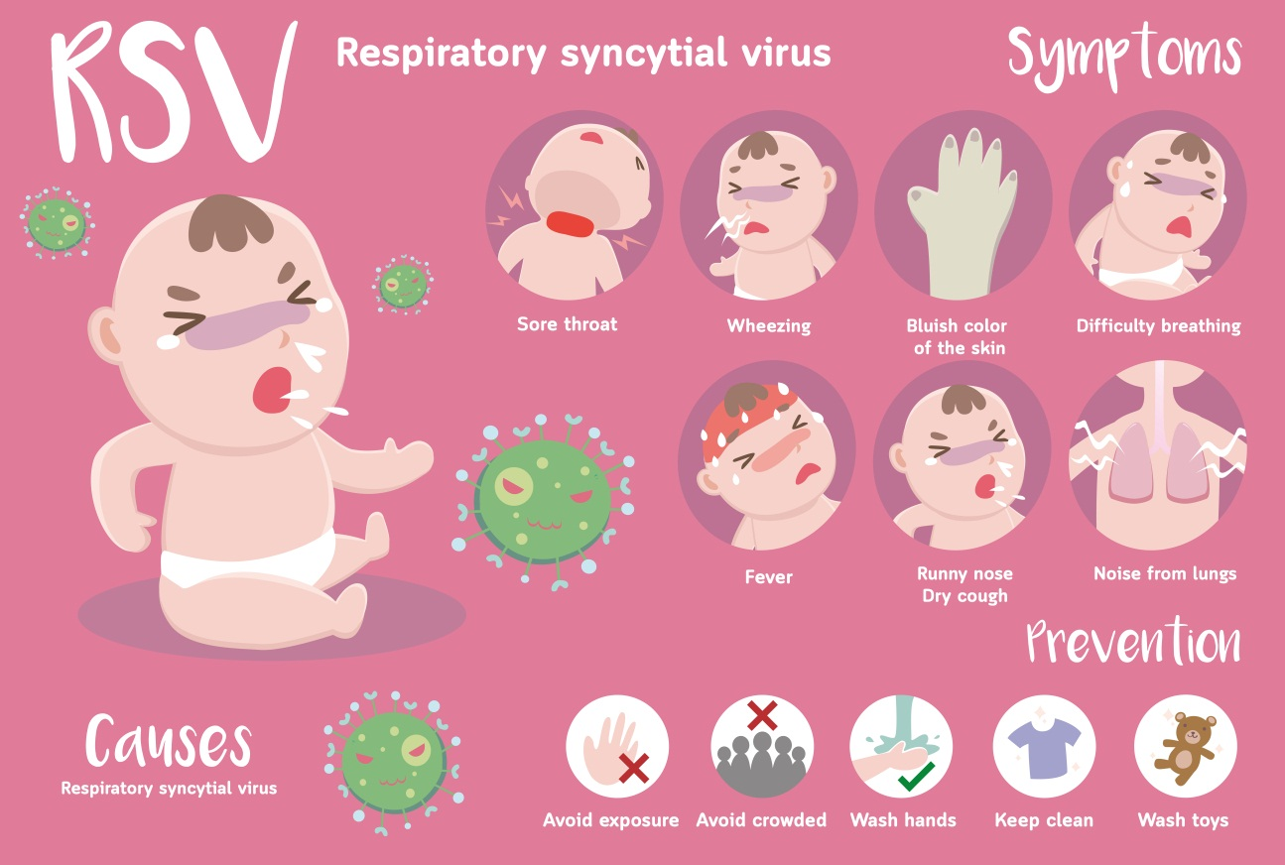
Case Wrap-Up
Diagnosis: RSV-bronchiolitis
© nekoztudio/Shutterstock
Notes:
Instructor Notes
RSV is the most cause of bronchiolitis in pediatrics.
Additional viruses that may cause bronchiolitis:
Parainfluenza
Influenza
Adenovirus
Case closure
At the hospital, chest x-ray showed hyper expansion and interstitial markings.
Continued humidified oxygen and began an IV with a fluid bolus.
Admitted due to continuous hypoxemia.
Discharged with full recovery after spending a week in the hospital.

Slide 23
Case 2
Dispatch
You and your partner respond to a local school for a 12-year-old female in respiratory distress. It is a warm, spring afternoon. The air temperature is 72°F (22.2°C).
Notes:
Instructor Notes
For students other than prehospital practitioners, dispatch information can be modified.
What are your initial concerns and possible differential diagnosis from the dispatch information?
Initial impression begins when the dispatch information is received.
Initial concern: 12-year-old with respiratory distress.
Differential diagnosis
Asthma
Hyperventilation
Foreign body obstruction
Cystic fibrosis
Pneumonia
Anaphylaxis
Discuss the importance of scene assessment and awareness.
Expand on how it applies to this case.
Case 2 involves a 12-year-old female in respiratory distress.
Diagnosis: Asthma exacerbation.

Slide 24

Initial Observations
© Image Point Fr/Shutterstock
Used with permission of the American Academy of Pediatrics, Pediatric Education for Prehospital Professionals, © American Academy of Pediatrics, 2000
Notes:
Instructor Notes
Discuss the following initial findings at the scene.
As you arrive at the front entrance you are met by the administrative assistant and directed to the nurse's station.
PAT
Appearance: Fatigued.
Work of breathing: Intercostal retractions, accessory muscle use, and auditory wheezing.
Circulation: Skin is flushed and diaphoretic.
The nurse advises you the patient was diagnosed with asthma at 3 years of age and has a history of being hospitalized for her asthma exacerbations.
The nurse further advises you the patient is in her office regularly due to her asthma.
This time is different as she typically is fine using her inhaler after recess.
With rest and use of her inhaler, she typically goes back to class without complaint the remainder of the day.
She has received 4 puffs of her MDI albuterol without relief.
She came in after recess to the nurse's station in respiratory distress where she received 4 puffs of her MDI without relief.
Mother has been notified and will be meeting you at the ED.
Discuss additional precautions or concerns that may be warranted based on initial observations.

Slide 25
Discussion
Is this patient “Quick” or “Not Quick”?
Have you identified respiratory distress, failure, or arrest?
Notes:
Instructor Notes
Is this patient “Quick” or “Not Quick”?
The patient is “Quick.”
Discuss how you made this determination.
Have you identified respiratory distress, failure, or arrest?
This patient is in respiratory distress.
Expand on how this determination was made.

Slide 26
Primary Survey
Primary survey
X – No bleeding found.
A – Patent.
B – Respirations rapid and shallow with intercostal retractions and accessory muscle use. Auditory wheezing present.
C – Radial pulses are strong and regular. Capillary refill time is brisk. Skin is flushed and diaphoretic.
D – Alert and fatigued; GCS = 15 (E4, V5, M6).
E – Sitting on exam table.
Notes:
Instructor Notes
Discuss the primary survey and PAT findings.
Note that the PAT is completed prior to the primary survey.
Ask participants to explain any abnormal findings of their patient(s), whether physically and/or developmentally, and why.
Discuss any life threats identified in this case.
There are life threats: tachypnea, accessory muscle use, intercostal retractions, auditory expiratory wheezes.
Primary survey
X – No bleeding found.
A – Patent.
B – Respirations rapid and shallow with intercostal retractions and accessory muscle use. Auditory wheezing present.
Unable to complete a sentence without stopping to take a breath.
C – Brachial pulses are strong and regular. Capillary refill time is brisk. Skin is flushed and diaphoretic.
D – Alert and fatigued; GCS = 15 (E4, V5, M6).
E – Sitting on exam table in obvious respiratory distress.
What would your initial treatment be?
Discuss treatment options per local guidelines and policy.
Treatment should be focused on reversing hypoxia.
Oxygen.
Nebulized combination of albuterol and ipratropium bromide.

Slide 27
Determine Level of Asthma
Notes:
Instructor Notes
Discuss and explain the process for differentiating between the levels of severity for asthma.
Share the importance of moving quickly in the management of severe asthma.

Slide 28
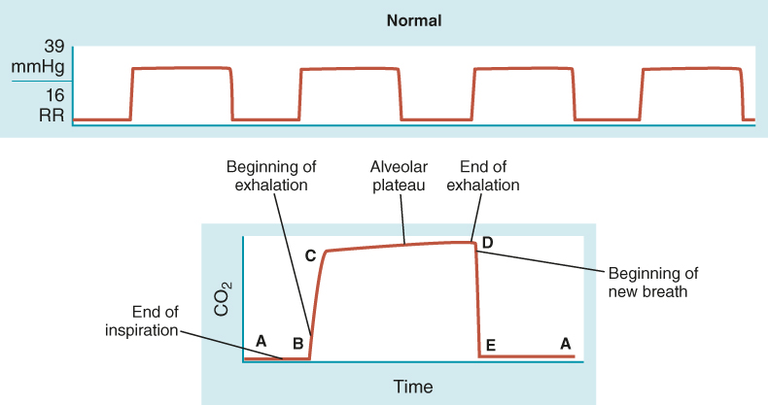
Determine Level of Asthma
Notes:
Instructor Notes
Obtaining ETCO₂ waveform will aid in the differentiation of the severity of asthma exacerbation. Discuss the normal waveform.
Phases 1–4
Normal ETCO₂ is 35–45 mmHg.

Slide 29
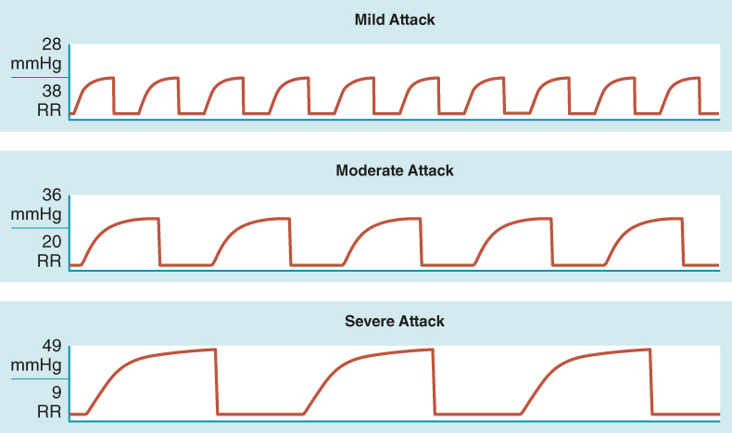
Determine Level of Asthma
Notes:
Instructor Notes
Obtaining ETCO₂ waveform will aid in the differentiation of the levels of asthma.
The airway obstruction associated with asthma results in a decrease in airflow, leading to alveolar ventilation.
A “shark fin” appearance develops as noted above, indicating a change in airflow.
This is due to the clearing of the alveoli being uneven, causing a rising curve at phase 3.
A mild attack may begin with a faster respiratory rate and lower end-tidal carbon dioxide.
As the severity increases from mild to moderate to severe, note that the respiratory rate is decreasing while the ETCO₂ is increasing.
Discuss and note why the “shark fin” appearance remains unchanged.

Slide 30
Detailed Assessment
History taking
O – Sudden
P – Worse when lying down
Q – Moderate discomfort
R – None
S – No pain
T – 30 minutes
Notes:
Instructor Notes
Review history taking using the OPQRST mnemonic.
O – Sudden
P – Worse when lying down
Q – Moderate discomfort
R – None
S – No pain
T – 30 minutes

Slide 31
Detailed Assessment
History taking
S – Difficulty breathing, accessory muscle use, intercostal retractions, unable to speak in full sentences, and auditory wheezing.
A – No known allergies.
M – Albuterol, beclomethasone dipropionate.
P – Asthma, bronchitis.
L – Lunch in the cafeteria.
E – Has gotten worse over the last hour.
R – History of asthma.
Notes:
Instructor Notes
Review history taking using SAMPLER.
S – Difficulty breathing, accessory muscle use, intercostal retractions, unable to speak in full sentences, and auditory wheezing.
A – No known allergies.
M – Albuterol, beclomethasone dipropionate.
P – Asthma.
L – Lunch in the cafeteria.
E – Has gotten worse over the last hour.
She received 4 puffs from MDI an hour ago and returned to nurse’s station as breathing difficulty got worse.
R – History of asthma.
Participant engagement
Discuss the importance to continuously reevaluate pediatric airway and breathing.
Expand on additional measures that may be used to calm the patient.

Slide 32
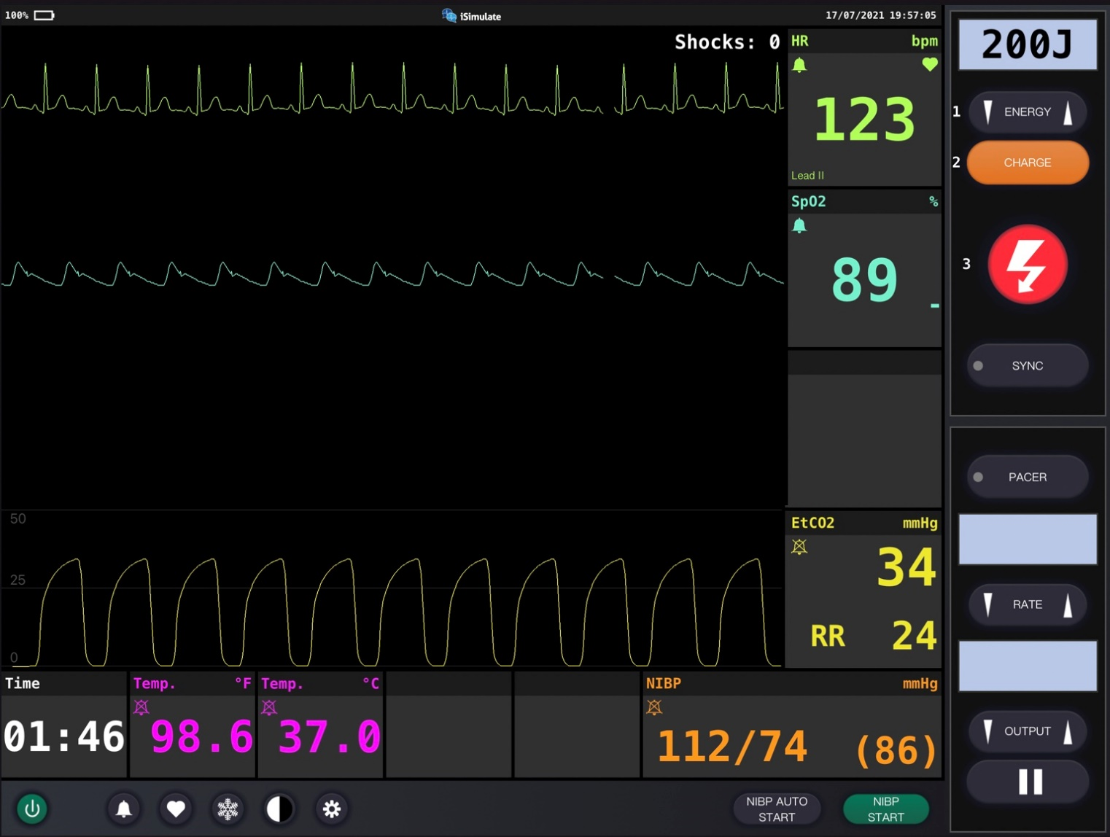
Vital Signs
Notes:
Instructor Notes
Discuss what the vital signs tell us about the patient.
SpO₂: 89% on room air, increases to 94% with oxygen and nebulized combination of albuterol and ipratropium bromide.
She is hypoxic.
Along with her adventitious lung sounds, the diagnostics indicate she is in respiratory distress.
Participant engagement
Discuss expected typical vital signs for age.
Is the patient in this case having a mild, moderate, or severe attack?
This patient is having a moderate attack.
Expand on how this determination was made.

Slide 33
Detailed Assessment
Notes:
Instructor Notes
*Ask participants: Given the age of this child, would you perform a head-to-toe or toe-to-head assessment ?
HEENT
Head: Unremarkable
Eyes: PERRL
Ears: Unremarkable
Nose: Unremarkable
Throat: Unremarkable
Heart and lungs
Lung sounds: Expiratory wheezes. Heart sounds are normal, no murmur.
Respirations rapid with intercostal retractions and accessory muscle use.
Absence of breath sounds should be concerning.
Neuro
Circulation, motor, and sensory (CMS) intact, anxious.
Abdomen and pelvis
Soft, nontender. Bowel sounds are normal.
Upper extremities
Unremarkable
Lower extremities
Unremarkable

Slide 34
Treatment (1 of 2)
BLS
Monitor airway.
Administer oxygen.
Nebulized combination of albuterol and ipratropium bromide.
Position of comfort.
ALS
BLS care.
Corticosteroids.
Consider magnesium.
Monitor for hypotension and need for IV fluids.
Notes:
Instructor Notes
Ask students how they would treat this patient according to their local protocol and scope of practice.
Patient management
What are your goals for this patient?
The patient should be treated with aggressive airway management to prevent further decline.
Be prepared for rapid deterioration.
Promptly identify respiratory distress, failure, and/or arrest, and intervene for patients who require escalation of therapy.
Deliver appropriate therapy by differentiating other causes of pediatric respiratory distress.
Consider magnesium if patient’s condition worsens.
BiPAP may assist with delaying intubation.
Ketamine is gaining favor as an adjunctive bronchodilator at subdissociative doses.
However, further research is needed on its use in the EMS or ED settings.
Would bronchodilators or corticosteroids work in this patient?
Studies support oxygen and beta-2-agonists as the first-line treatment for acute asthma exacerbation.
Bronchodilators will counter bronchospasm through relaxing bronchial smooth muscle and increasing mucous clearance.
Studies suggest corticosteroid therapy increases patient recovery time and decreases hospital and ED stays.
Corticosteroid effects are dependent on time of administration.
30-minute delay in administration of a corticosteroid will increase ED treatment time by 1 hour.
Oral and IV corticosteroids have the same bioavailability and physiologic effects.
What are revised potential differential diagnoses?
Asthma
Anaphylaxis

Slide 35
Treatment (2 of 2)
Critical care
BLS/ALS care.
Consider BiPAP/CPAP for adolescents and older.
Epi/ketamine if severe.
Monitor for signs of respiratory failure and need for PAI.
Notes:
Instructor Notes
Ask students how they would treat this patient according to their local protocol and scope of practice.
Patient management
What are your goals for this patient?
The patient should be treated with aggressive airway management to prevent further decline.
Be prepared for rapid deterioration.
Promptly identify respiratory distress, failure, and/or arrest, and intervene for patients who require escalation of therapy.
Deliver appropriate therapy by differentiating other causes of pediatric respiratory distress.
Consider magnesium if patient’s condition worsens.
BiPAP may assist with delaying intubation.
Ketamine is gaining favor as an adjunctive bronchodilator at subdissociative doses.
However, further research is needed on its use in the EMS or ED settings.
Would bronchodilators or corticosteroids work in this patient?
Studies support oxygen and beta-2-agonists as the first-line treatment for acute asthma exacerbation.
Bronchodilators will counter bronchospasm through relaxing bronchial smooth muscle and increasing mucous clearance.
Studies suggest corticosteroid therapy increases patient recovery time and decreases hospital and ED stays.
Corticosteroid effects are dependent on time of administration.
30-minute delay in administration of a corticosteroid will increase ED treatment time by 1 hour.
Oral and IV corticosteroids have the same bioavailability and physiologic effects.
What are revised potential differential diagnoses?
Asthma
Anaphylaxis

Slide 36
Pediatric Intubation
What do we know?
Complications?
Notes:
Instructor Notes
What do we know?
Endotracheal intubation is often a life-saving treatment but should be avoided in pediatric patients with severe asthma.
It exposes the child with asthma to an extensive iatrogenic risk.
It is extremely challenging to match an asthma patient’s hyperventilation rate, and lower tidal volumes must be used to avoid any barotrauma from hyperinflation.
Pediatric intubations have been identified in studies as a high-risk, low-frequency procedure and should be used only as a last resort.
Lower lung volumes mean less reserve and fewer seconds before desaturation ensues.
A child who becomes hypoxic will quickly decompensate, potentially leading to a hypoxic brain injury, bradycardia, and cardiac arrest.
Intubation does not make it easier to ventilate pediatric patients.
Many ventilators used in the prehospital setting are unable to be adjusted to meet the ventilatory needs of pediatrics.
The lack of training and inexperience with providers in pediatric intubations is common, leading to poor success rates.
In 2017, a study reported a first-attempt intubation success rate from 66% to 79%.
It also suggested completing a minimum of 57 intubations in order to achieve a 90% success rate.
A 2019 study supports the use of an extraglottic device in all pediatric age groups being associated with decreased need for prehospital intubations.
Another study published in 2016 reports an increased number of pediatric intubation attempts being independently connected to an increase of desaturation (SpO2 < 80%) and severe desaturation events (SpO2 < 70%).
Complications
Younger pediatrics may need a towel to elevate the shoulders and prevent potential obstruction.
Visualizing a pediatric airway may be difficult due to larynx being more anterior and superior.
Using a curved blade makes it difficult to visualize airway due to large and floppier epiglottis.
Straight blades work better in younger kids.
Right mainstem intubation is extremely likely due to the trachea being shorter in pediatrics.

Slide 37

Pediatric Intubation
When should you intubate your patient?
What should be used to confirm tube placement?
Notes:
Instructor Notes
When should you intubate your patient?
Pediatric endotracheal intubation should be the last resort in your toolbox.
All airway management resources should be exhausted prior to intubating your patient.
Intubation does not make it easier to ventilate pediatric patients.
Know your limitations.
It is your responsibility to maintain competency with all skills.
Knowing when not to do something is just as important as knowing when to do something.
Continued intubation skills practice with pediatric mannequins reinforces techniques needed to be successful.
Remember the following:
Children have a higher metabolic oxygen demand and lower lung volumes, resulting in reduced oxygen reserves, leaving fewer seconds before desaturation follows.
A child who becomes hypoxic will decompensate rapidly, potentially leading to a hypoxic brain injury, bradycardia, and cardiac arrest.
What should be used to confirm tube placement?
Discuss various equipment available in your region to confirm tube placement.
Capnography should be used with all intubations to aid in confirming tube placement.
No waveform means the ET tube is not in the trachea.
Discuss additional waveforms that may cause intubation complications.
Inadequate seals, rebreathing, or obstructions.

Slide 38
Ongoing Management
Reassess the patient.
Where is the most appropriate treatment destination and why?
Can you safely transport this child in your ambulance?
Notes:
Instructor Notes
Discuss the ongoing management options based on scope of practice and local protocols.
Reassess the patient’s airway status throughout transport.
Initiate IV and administer corticosteroid.
Patient status improves and becomes less anxious during transport.
There are no further changes during transport to the emergency department.
Where is the most appropriate treatment destination and why?
Discuss transportation destination options for pediatrics in your region.
Prehospital professionals should be familiar with the Pediatric Readiness Project.
It is critical that the destination has the necessary pediatric equipment and expertise to handle any pediatric emergency.
Knowing your regions ED capabilities in meeting the needs of an injured or ill child will improve patient outcomes.
Share with students when it would be appropriate to bypass certain facilities for this patient.
This patient should be transported to the closest appropriate facility with pediatric ICU capabilities due to potential for respiratory failure.
How would you safely transport this child in your ambulance?
Discuss policies and procedures for transporting pediatrics in your region.
This patient was restrained to the stretcher safely.

Slide 39
Case Wrap-Up
Diagnosis: Asthma exacerbation
© Love You Stock/Shutterstock
Notes:
Instructor Notes
Asthma is one of the most prevalent chronic diseases among pediatrics.
It is the third leading cause of hospitalization in pediatrics.
Asthma exacerbation is the primary cause children seek emergency care.
Case closure
At the hospital, audible wheezing continues to be auscultated.
Continued oxygen administration.
Receives another 2 albuterol/ipratropium aerosols.
IV methylprednisolone was administered.
Respiratory rate and oxygen levels improve in the ED.
Discharged from ED to follow up with primary care physician.

Slide 40
Lesson Wrap-Up
The number one reason parents take their children to the emergency room is due to respiratory emergencies.
Differentiating respiratory distress, failure, and arrest in pediatrics is vital.
Prompt recognition and management of respiratory emergencies could reduce recovery times and improve patient outcome!
Coming Up, Lesson 3: Pediatric Trauma Emergencies
Notes:
Instructor Notes
The number one reason parents take their children to the emergency room is due to respiratory emergencies.
Although many respiratory emergencies are mild and can be treated at home, many others are life-threatening, requiring rapid airway management.
Respiratory emergencies can be scary for patients and their families.
Maintaining a patient- and family-centered care approach will ensure better patient outcomes.
Differentiating respiratory distress, failure, and arrest in pediatrics is vital.
Prompt recognition and management of respiratory emergencies could reduce recovery times and improve patient outcome!
Coming Up, Lesson 3: Pediatric Trauma Emergencies.

Slide 41

Questions?
© Nujumuddin Mohamad Yaman/EyeEm/Getty Images
Notes:
Instructor Notes
Allow time for a question-and-answer session about the topics presented in the lesson.

