Slide 1
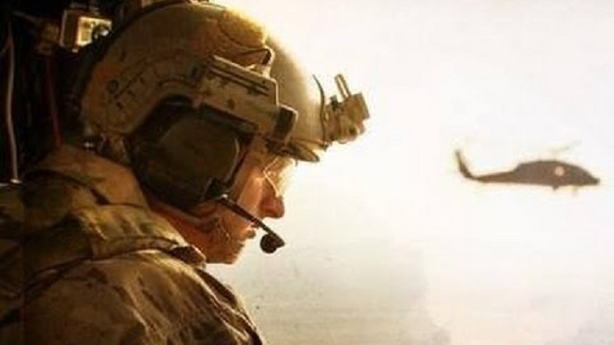
The rescue company 1

Slide 2
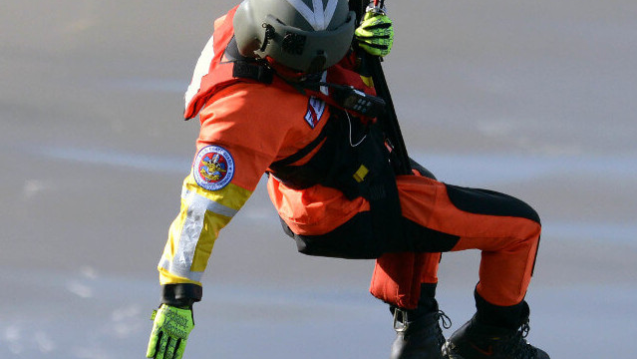
HELICOPTER SHORT-HAUL part 2

Slide 3
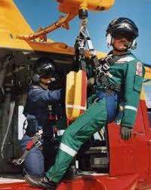
Rescuer Head-to-toe Safety Checklist (HEC Techniques)
Helmet - properly fitted, chin strap fastened.
Eye protection - secured.
Fire resistant clothing -collar up, flight suit zipped, and loose items around neck tucked in.

Slide 4
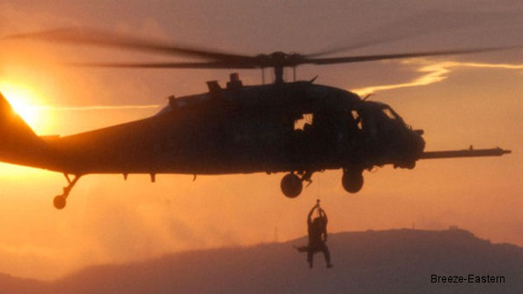
Rescuer Head-to-toe Safety Checklist (HEC Techniques)
Radio - operational and correct frequency selected.
Gloves - on.

Slide 5
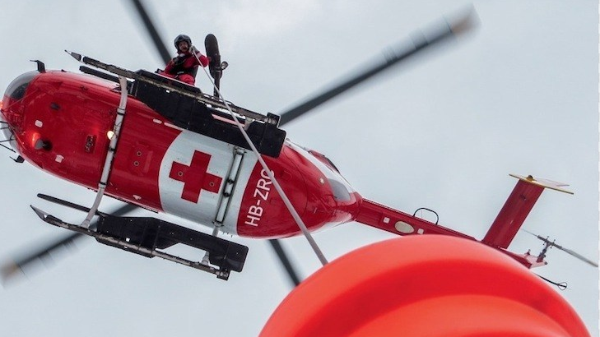
Rescuer Head-to-toe Safety Checklist (HEC Techniques)
Sleeves - down and secured over gloves.
Harness - properly fitted, buckles correctly fastened, no twists, and loose straps secured. Double-check follow-through buckles. Means of attachment is properly secured to harness and locking carabiners are functional.

Slide 6
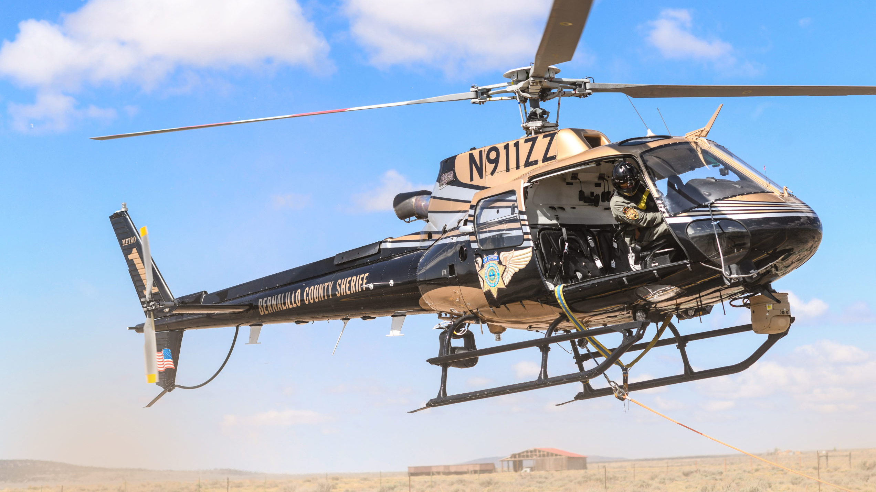
Rescuer Head-to-toe Safety Checklist (HEC Techniques)
Knife - easily accessible and secured.
Footwear -Aviation Life Support Equipment (ALSE) approved
Top of boots covered -pants or flight suit provides coverage in seated position, if riding in aircraft.

Slide 7
Helicopter Short-Haul Checklist (Pre-Mission)
Cargo - non essential items removed. Additional equipment secured.
Cabin - configured for short-haul mission (e.g. doors removed, etc.)
Anchor- anchor points and release system installed, tested, and secure.

Slide 8
Helicopter Short-Haul Checklist (Pre-Mission)
Short-haul line - correctly attached to primary and backup anchors.
Spotter attachment - tether secure.
Seat belts - secured and operational.

Slide 9
Helicopter Short-Haul Checklist (Pre-Mission)
Radios - operational (radio check performed) and correct frequency selected.
Intercom - operational. (Use of a "hot microphone" is not advisable, due to other air traffic or ground personnel attempting to make radio contact).

Slide 10
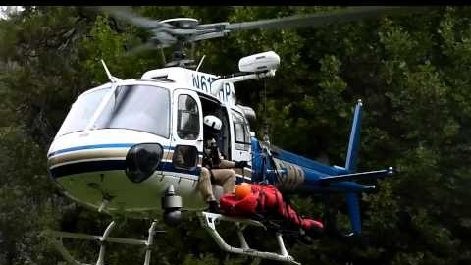
QUALIFICATIONS AND REQUIREMENTS

Slide 11
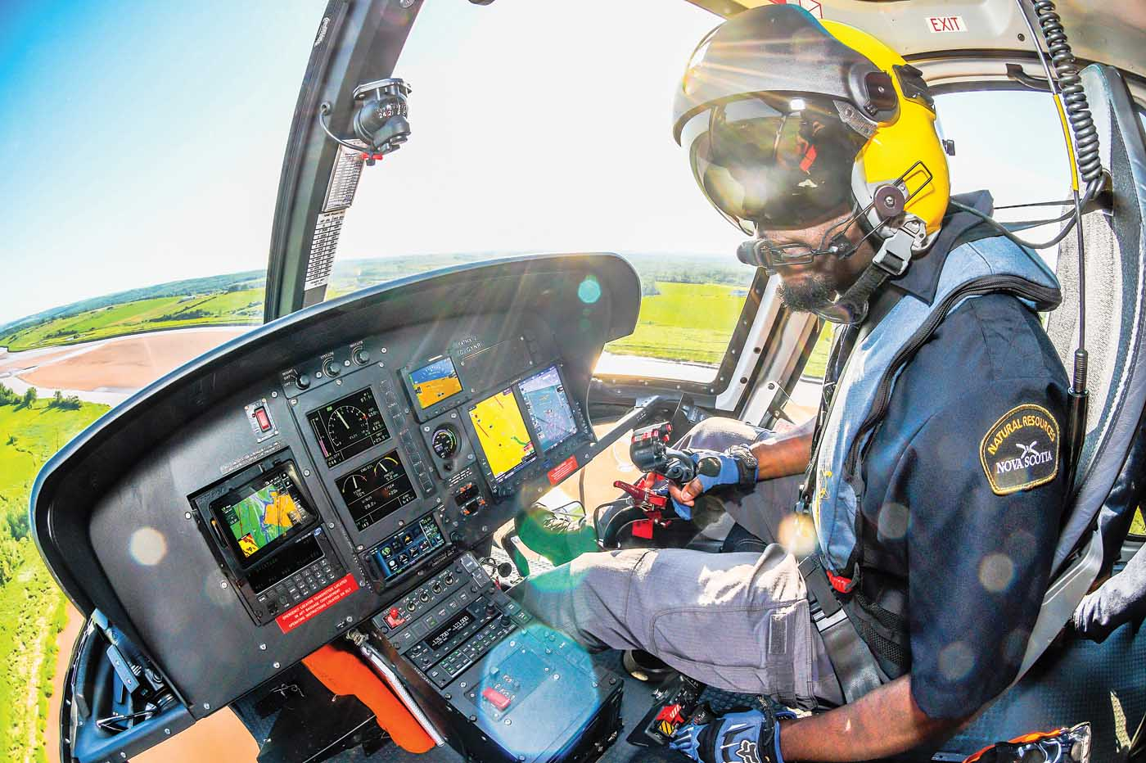
PILOT REQUIREMENTS
A safe and effective short-haul program is highly dependent upon precision longline skills. Accordingly, pilots must comply with the following minimum requirements:

Slide 12
PILOT REQUIREMENTS
Qualified in accordance with 14 CFR 133 for Class A and B external load operations and meet pilot requirements identified in the procurement document.
50 hours Pilot-In-Command (PIC) in make and model in the preceding 12 months.

Slide 13
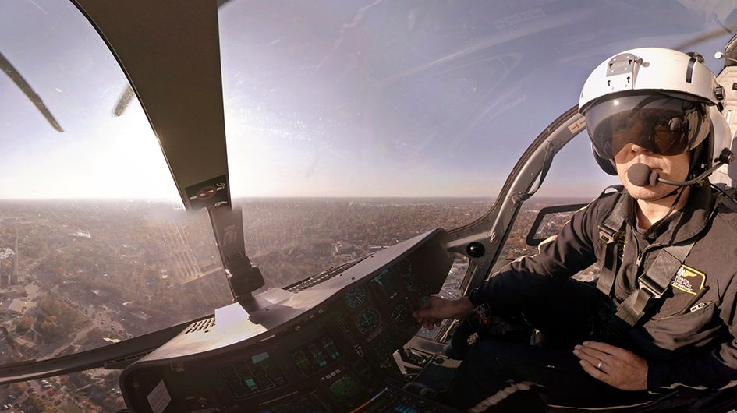
PILOT REQUIREMENTS
25 hours of vertical reference experience requiring precision placement in the preceding 12 months.

Slide 14
PILOT REQUIREMENTS
Approved for longline operations.
Pass the OAS-administered Short-Haul Pilot Practical Test outlined in the lnteragency Helicopter Practical Test Standards (PTS).

Slide 15
PILOT REQUIREMENTS
Complete annual operational training with the using unit.
Understand short-haul techniques, short-haul/spotter signals and operational concerns.

Slide 16
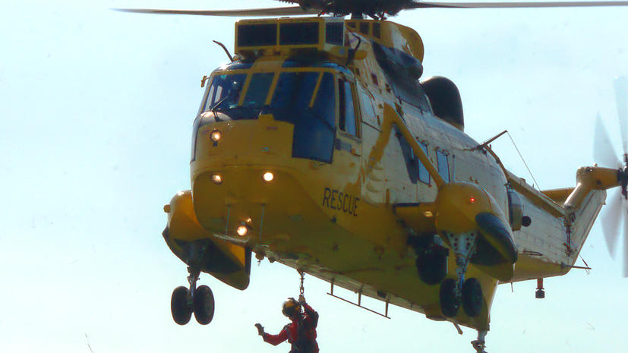
PILOT REQUIREMENTS
Demonstrate ability to work with the short-haul spotter(s).

Slide 17
SPOTTER AND SHORT-HAULER REQUIREMENTS
Spotters and short-haulers must complete the following minimum requirements. Additional training may be required of an individual based on the complexity of the program.

Slide 18
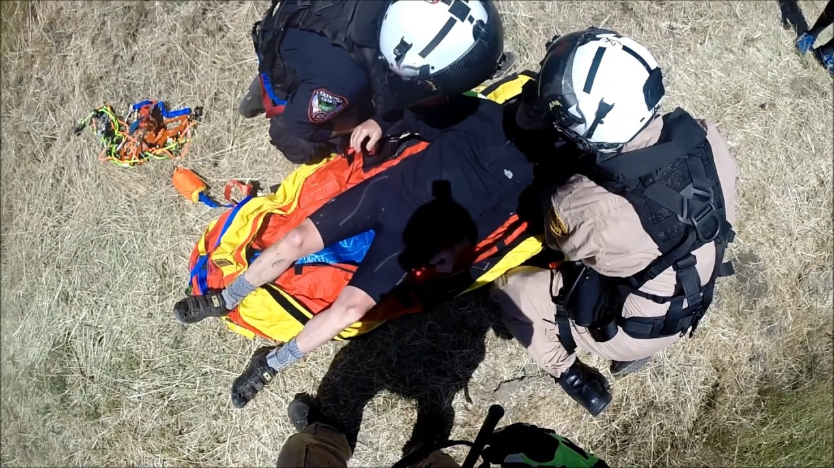
Check Spotter
Have demonstrated ability as an instructor and assisted in the training of at least two Spotters.

Slide 19
Check Spotter
Have completed the Interagency Helicopter Crewmember course.
Be familiar with the helicopter procurement documents.

Slide 20
Under the supervision of a qualified check spotter:
Demonstrate knowledge of the inspection, care and maintenance of short-haul equipment.
Demonstrate ability to rig the helicopter for short-haul, to provide a safety briefing and to conduct a safety check of short-haul personnel without procedural error.

Slide 21
Under the supervision of a qualified check spotter:
Demonstrate knowledge of emergency procedures.
Spot six loads of short-haul personnel, two in typical terrain. If applicable, spot four loads of cargo (e.g., a rescue litter) without procedural error.

Slide 22
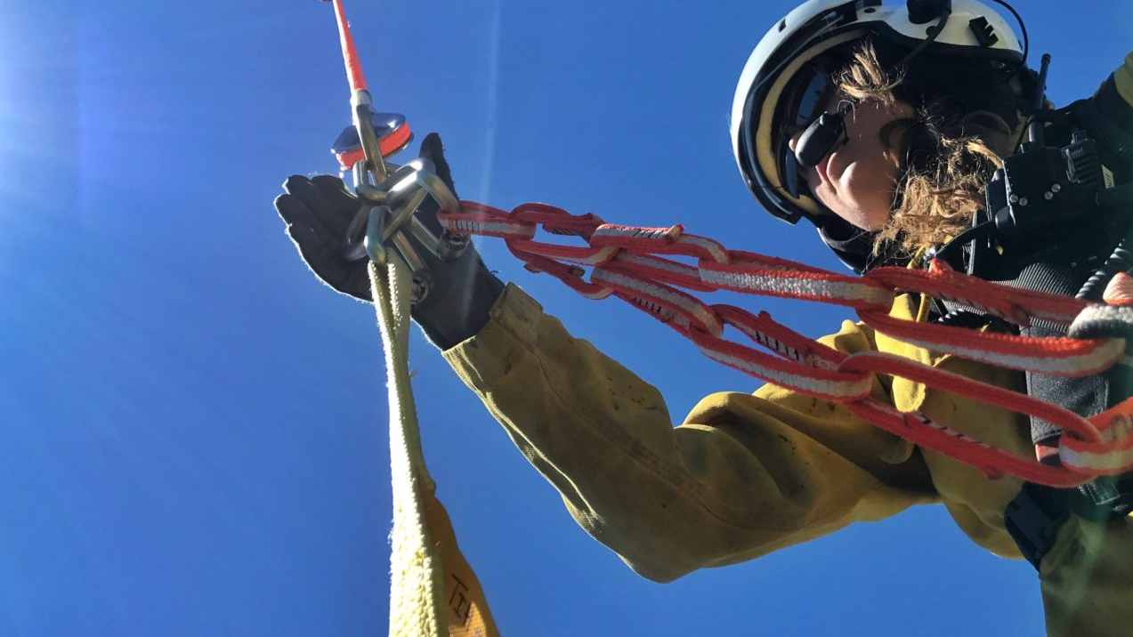
Under the supervision of a qualified check spotter:
Demonstrate ability to work with the pilot.
Demonstrate knowledge of risk assessment and mission structure.

Slide 23
Short-Hauler
Have completed the lnteragency Helicopter Crewmember Training course .
Demonstrate knowledge of the inspection, care and maintenance of short-haul equipment and rigging.

Slide 24
Short-Hauler
Demonstrate knowledge of short-haul procedures.
Demonstrate knowledge of emergency procedures.

Slide 25
Short-Hauler
Complete a minimum of four short-hauls, two in typical terrain, without procedural error.
Demonstrate knowledge of mission components and ability to perform risk assessments.

Slide 26
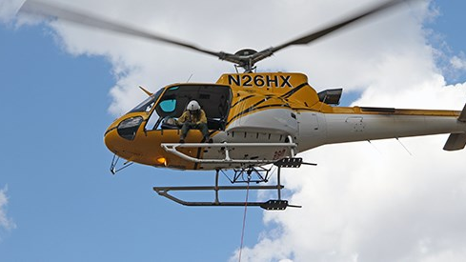
PROFICIENCY REQUIREMENTS

Slide 27
Pilot Proficiency
Precision longline, which may include HEC every 30 days. HEC mission every 90 days.

Slide 28
Pilot Annual Refresher
Meet Operational training. Demonstrate ability to short-haul.

Slide 29
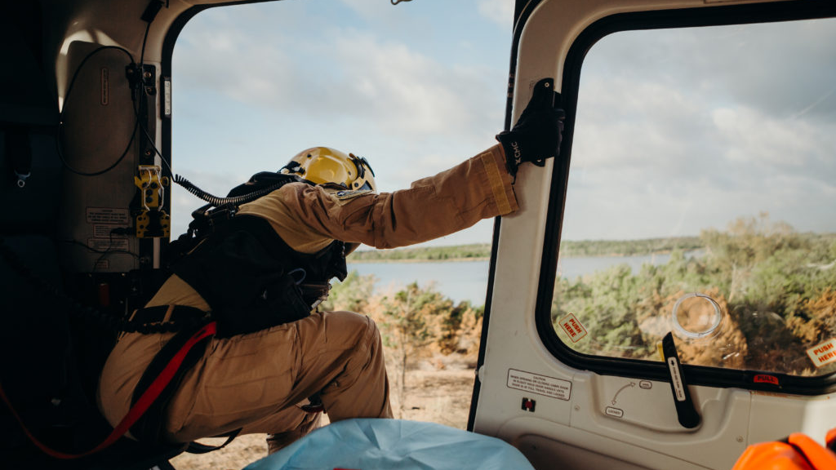
Check spotter Proficiency
Operational training. Spot four loads without procedural error.

Slide 30
Short-Hauler Proficiency
Operational training. Complete two short-hauls, one of which must be in typical terrain, without procedural error.

