Slide 1
Lesson 1: Introduction
Taking Safety to the Streets
Notes:
Instructor Notes
Lesson 1 provides an introduction and overview of the emergency medical services (EMS) Safety program.
Expand on the following points:
The National Association of Emergency Medical Technicians (NAEMT) developed the EMS Safety course in an effort to reduce the risk of death and injury to EMS practitioners.
This is a critical point that should be stressed—due to the high numbers of injuries and fatalities among EMS practitioners, NAEMT took the step to develop a program to prevent injuries and save lives.
It is the hope of NAEMT and the EMS Safety Committee that the EMS Safety program serves as the cornerstone for the development of a culture of safety throughout EMS.
A profession-wide culture of safety is essential for the development of a safe EMS workplace in every agency.

Slide 2

Your Instructor
Notes:
Instructor Notes
Your passion for safety should be demonstrated at the beginning and throughout the EMS Safety course to maximize student engagement. As appropriate, your name, title, rank, and contact information should be shared via business cards or simply by writing them on the available visual media.
Expand on the following points:
Share your experience, qualifications, and current role in creating a culture of safety in your workplace.

Slide 3
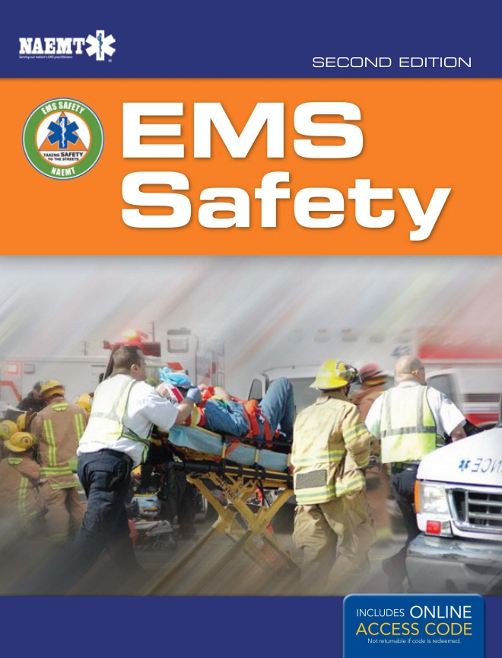
Course Manual
A practical orientation to building a culture of safety
Includes:
  Supplemental information.
  Resources to make learning about safety part of your daily life.
Notes:
Instructor Notes
Expand on the following points:
Stress the concept that taking the EMS Safety course is a starting point in helping to create a culture of safety.
Time constraints limit the amount of material which can be presented in the classroom, so the course manual was designed to provide reference information for both agencies and EMS practitioners to use in recognizing and responding to the ever-changing dangers in the EMS workplace.
The course manual includes:
Supplemental information.
Resources to make learning more about safety issues in EMS part of your daily life.

Slide 4
Completion Criteria
To earn a certificate of completion:
  Attend the entire course
  Score 76% or higher on the post-test
Four-year renewal cycle
Notes:
Instructor Notes
Expand on the following points:
Stress that EMS Safety is not a certification course.
Participants will receive a certificate of completion by attending the entire EMS Safety course and scoring 76% or higher on the post-test.
The certificate of completion should be considered to be a learner’s permit which gives participants the tools to better respond to new technologies, ambulance design standards, and new risks in the field.
The certificate of completion is good for 4 years.

Slide 5
Course Logistics
Registration
Course evaluation
  EMS Safety is a work in progress.
Notes:
Instructor Notes
Distribute the registration form to participants to complete.
Expand on the following points:
Instruct participants to complete all of the items on the registration form marked with an asterisk.
Participants should use their home addresses to receive a free NAEMT membership and CECBEMS (Continuous Education Coordinating Board for Emergency Medical Services) credit.
Stress the need for legibility and accuracy in the registration form.
Inaccurate documentation may make CECBEMS credit unavailable.
At the end of the course, participants will have an opportunity to complete a course evaluation.
Participant feedback is vital.
Stress that the EMS Safety Committee takes their input seriously and uses it to make revisions and updates to the course.

Slide 6
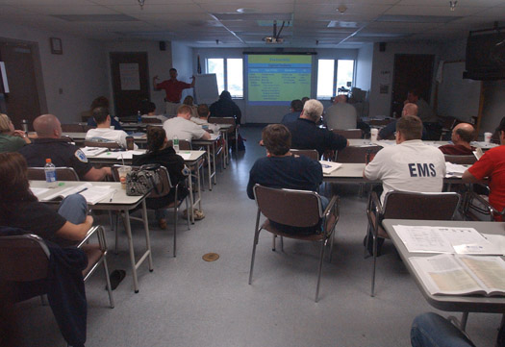
Housekeeping
Bathroom
Break areas
Emergency exits
Phones and pagers
Snacks and drinks
Smoking area
© Jones & Bartlett Learning. Courtesy of MIEMSS.
Notes:
Instructor Notes
Expand on the following points:
Direct participants to the location of the bathroom, break areas, and emergency exits.
Discuss your policy on the use of phones and pagers in the classroom.
Discuss the policies and procedures of the hosting facility.
For example, no eating or drinking in the classroom.
Note that healthy eating, adequate hydration with appropriate fluids, and refraining from smoking are all part of a healthy lifestyle, and are also helpful in creating a positive learning environment.

Slide 7

Taking Safety to the Streets
Notes:
Instructor Notes
Expand on the following points:
Now that you have finished with the housekeeping, begin discussing the specifics of creating a culture of safety.

Slide 8
An Unsafe Profession
High injury and fatality rate
  Fatality rate for EMS practitioners is 2.5 times the national average.
  Nonfatal injury rate for EMS practitioners is five times higher than for other health care workers.
  EMS practitioners are seven times more likely to miss work as the result of an injury.
Notes:
Instructor Notes
Expand on the following points:
EMS is an unsafe profession with a high injury and fatality rate.
Paid, volunteer, private service, fire-based EMS practitioners are all at risk.
The fatality rate for EMS practitioners is 2.5 times the national average.
The nonfatal injury rate for EMS practitioners is five times higher than for other health care workers.
EMS practitioners are seven times more likely to miss work as the result of an injury.
Note that the statistics onscreen are the best that are available. The absence of an effectively used central data repository for EMS limits our ability to obtain accurate, current data.

Slide 9
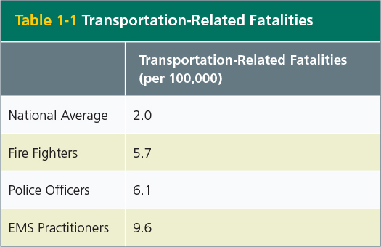
How Dangerous Is EMS?
Notes:
Instructor Notes
Expand on the following points:
Although this data comes from a 2006 article, “EMS, First Responders & Crash Injury,” published in Topics in Emergency, the comparisons are still useful.
Ask:
“Why do you think more EMS practitioners are killed in transportation-related fatalities than fire fighters and law enforcement?”

Slide 10
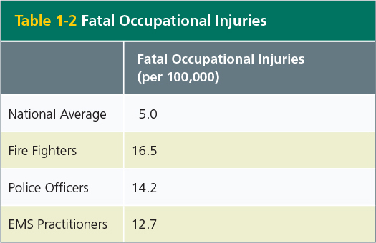
EMS an Unsafe Profession
How Dangerous Is It?
Notes:
Instructor Notes
Expand on the following points:
The data presented in the table onscreen is from the 2002 article “Occupational Fatalities in Emergency Medical Services: A Hidden Crisis,” published in the Annals of Emergency Medicine.
Although over a decade old, this article has stood the test of time as evidence of the dangers experienced by all emergency responders.

Slide 11
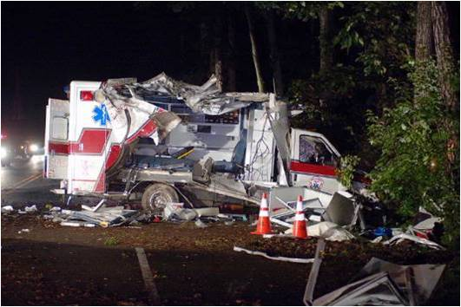
Mortality Rate
Statistics do not tell the whole story
Courtesy of Glen Luedtke.
Notes:
Instructor Notes
Expand on the following points:
Mortality statistics have been described as human faces with the tears wiped away.
Let’s explore some real-life cases that reflect the true pain that the numbers do not always reflect.
This motor vehicle crash occurred on June 17, 2008.
A paramedic and patient were killed when the emergency vehicle operator swerved to avoid a deer and sideswiped a tree.
At the time of the impact, Paramedic Stephanie Callaway of Sussex County EMS, Delaware, was on the bench seat, caring for the 85-year-old patient.
The emergency vehicle operator and the second EMT in the patient compartment were both injured as well.

Slide 12
Paramedic Stephanie Callaway
Paramedic for 7 years
Field Training Officer
Public Information Officer
President of the Paramedic Association
Survived by her husband and two children
Notes:
Instructor Notes
Expand on the following points:
At the time of her death, Stephanie was a paramedic for 7 years.
She was also a Field Training Officer, Public Information Officer, and President of the Paramedic Association.
She is survived by her husband and two small children.

Slide 13
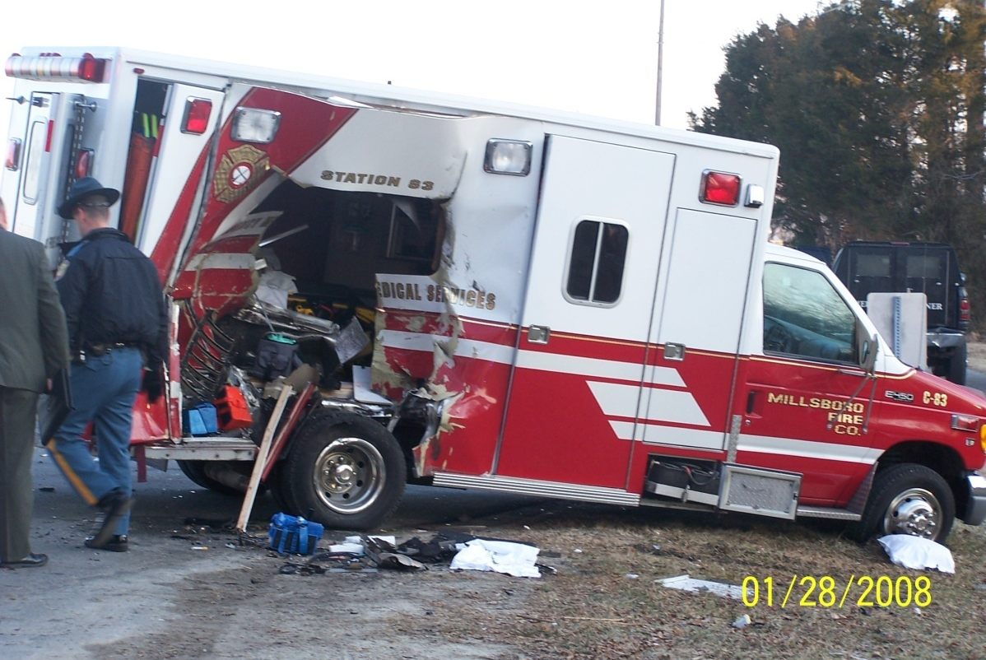
Critically Injured Paramedic
Courtesy of Glen Luedtke.
Notes:
Instructor Notes
Expand on the following points:
This Motor Vehicle Commission (MVC) also occurred in Delaware.
Returning from a call, the ambulance was stopped at a stop sign.
A sport utility vehicle (SUV) left the roadway and struck the ambulance broadside, creating a hole in the passenger compartment.
At the time of the impact, a paramedic was sitting in the captain’s chair, seat belt unfastened because it was not long enough to accommodate him.
He was hurled through the opening made by the SUV and suffered a major head injury, requiring 2 years of rehabilitation.
The emergency vehicle operator was also critically injured and the EMT in the patient compartment sustained non-life-threatening injuries.
The driver of the SUV was found dead at the scene.
Ask:
“What do you think about the seat belt not being long enough for the paramedic in the captain’s chair?”
Ask:
“Did the paramedic, his partner, and the management team know that the seat belt was not long enough before the MVC?”

Slide 14
Paramedic Shot by Motorist
Motorist flagged down the ambulance
Paramedic approached the car; driver pointed a gun at him
Paramedic was shot in the hand
Motorist fled the scene
Paramedic admitted to hospital in stable condition
  Underwent surgery to repair his hand
Notes:
Instructor Notes
Expand on the following points:
This incident occurred in West Virginia
A motorist flagged down the ambulance.
When the paramedic approached the car, the driver pointed a gun at him.
The paramedic was shot in the hand when he attempted to push the gun away.
The motorist fled the scene and the paramedic was transported to the hospital.
He was admitted to hospital in stable condition and underwent surgery to repair his hand.
At the time of the incident, the paramedic was 50 years old and a 7-year veteran. An investigation into the incident continues and there have been no arrests.
Ask the participants: “What does this event tell you about scene safety?”
Ask the participants: “What impact might a hand injury have on your ability to work?”

Slide 15
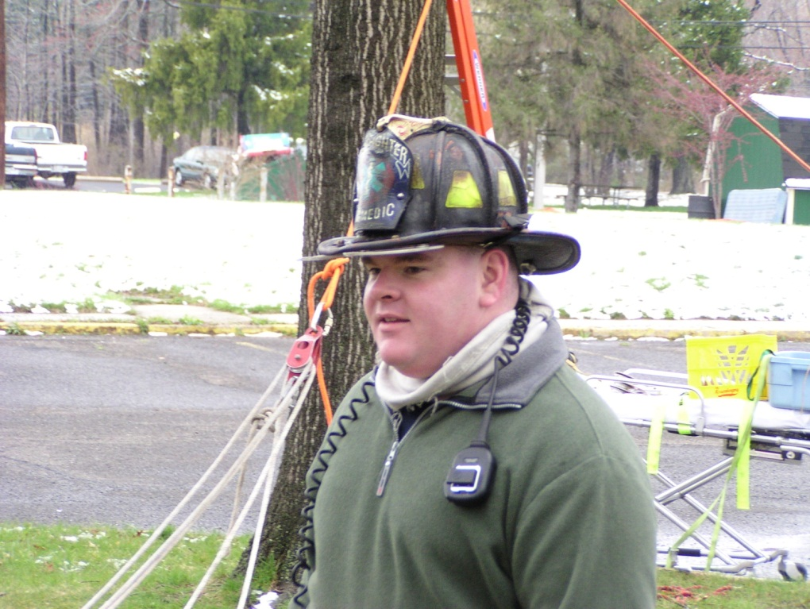
Paramedic Dan McIntosh
Responding to report of suicidal person
  The patient ran away
Suffered a fatal acute myocardial infarction (AMI) while chasing the patient
Courtesy of Bensalem EMS.
Notes:
Instructor Notes
Expand on the following points:
This incident occurred in Bensalem, Pennsylvania, on March 7, 2010. It was the first paramedic line-of-duty death for the township.
Paramedic Dan McIntosh responded to a report of a suicidal person.
The patient took off on foot as Dan approached him.
Dan chased after the patient and while running, he suffered a fatal AMI.
The patient was treated for mental illness.
Dan was 39 years old and a 13-year veteran. He left behind his wife and two young children.

Slide 16
Fire Fighter/EMT Michelle Smith
Fatally struck while tending to a patient in roadway
Driver was intoxicated
  Later convicted of homicide with an automobile
Notes:
Instructor Notes
Expand on the following points:
On December 20, 2009, fire fighter and EMT Michelle Smith responded to an MVC in Delaware City, Delaware.
While caring for a motorcycle collision victim in the roadway, Michelle was fatally struck by a car.
The driver was intoxicated and later convicted of homicide with an automobile.
Michelle was 29 years old and left behind a 12-year-old daughter.

Slide 17
Your Experience
Remain standing if:
  You are or have been an EMS practitioner.
  You have been jostled or thrown around in the back of an ambulance.
  You have been injured on duty.
  You are no longer working in the field because of an on-duty injury.
Notes:
Instructor Notes
Ask every participant to stand up. The bullet points will dissolve one at a time.
Tell the participants to keep standing if:
“You are or have been an EMS practitioner.”
“You have been jostled or thrown around in the back of an ambulance.”
“You have been injured on duty.”
“You are no longer working in the field because of a collision-related injury.”

Slide 18
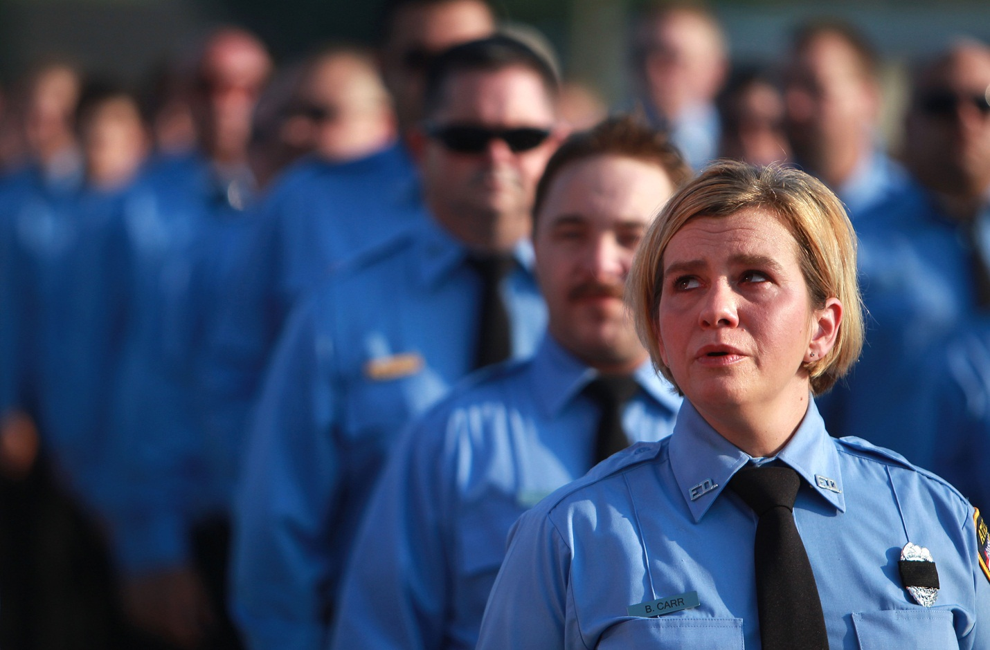
Line-of-Duty Death Remembrance
© Frank Robertson/Chillicothe Gazette/AP Photo.
Notes:
Instructor Notes
Ask participants to relate their experiences with line-of-duty deaths and events which resulted in severe injuries. Share your experiences too.
Expand on the following points:
Note the fatal occupational injuries statistic = 12.7 per 100,000 fatalities.
After the discussion, take a moment of silence to remember friends and colleagues who have died in the line of duty.

Slide 19
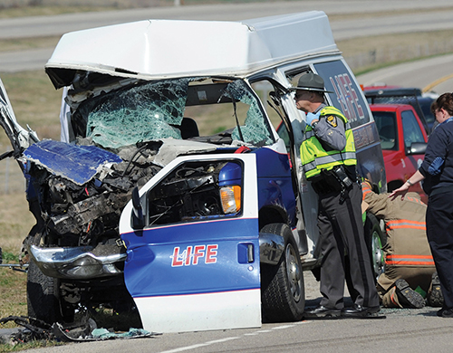
Ambulance Crashes
Twelve per day between 1992 and 2011
  65 % result in property damage
  34% in injuries
  Less than 1% fatalities
Who is impacted by these events?
© Frank Robertson/Chillicothe Gazette/AP Photo.
Notes:
Instructor Notes
Expand on the following points:
According to National Highway Traffic Safety Administration, between 1992 and 2011 there were about 12 ambulance crashes per day.
Most crashes resulted in property damage, about one-third resulted in injuries, and fortunately less than 1% resulted in fatalities.
Who is impacted by these events?

Slide 20
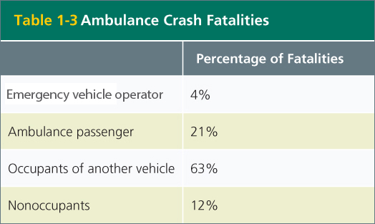
Ambulance Crash Fatalities
Emergency vehicle operator 4%
Ambulance passenger 21%
Occupants of another vehicle 63%
Nonoccupants 12%
Notes:
Instructor Notes
Expand on the following points:
Ask:
“Is it surprising that the emergency vehicle operator is killed in 1 of 25 fatal ambulance crashes?”
Ambulance passengers are at five times the risk of dying than the emergency vehicle operator.
Occupants in other vehicles are at 15 times greater risk of dying than the emergency vehicle operator.
Nonoccupants are at three times greater risk of dying than the emergency vehicle operator.
Ask:
“What do these facts demonstrate about the responsibility that emergency vehicle operators accept when driving an ambulance?”

Slide 21
A Change in Culture
How much has EMS changed?
  Gloves
  Seat belts
  Intersections
  Lights and sirens
  Distracted driving
  Fatigue
  Stress
Notes:
Instructor Notes
Expand on the following points:
Discuss how the culture of safety has changed within EMS.
Ask:
“Is there anyone who does not realize the importance of personal protective equipment in avoiding exposure to potentially life-threatening pathogens?”
Consider the importance of seat belts, the hazards of intersections, the appropriate use of lights and sirens, and the growing number of distracted drivers in developing a safe driving environment.
Ask:
“How many EMS practitioners think about addressing these issues in their daily practice?”
For example, there is increasing evidence that the acute and cumulative effects of fatigue have erosive effects on well-being.
Ask:
“Do we as EMS practitioners take the time to put ourselves first?”

Slide 22
Change Starts With You
Goal of EMS Safety
  Change the safety culture in the EMS profession.
    This will be achieved through your actions.
    Your behaviors will give evidence of your belief in the importance of safety practices.
Notes:
Instructor Notes
Expand on the following points:
State the goal of the EMS Safety course.
The goal of the EMS Safety course is to change the safety culture in the EMS profession, by changing the safety culture in your organization through the actions of you, as individual EMS practitioners, whose behaviors give evidence of your belief in the importance of safety practices.
Safety training is not an isolated phenomenon. Safety is a component of every aspect of EMS.
You cannot drive an ambulance, care for patients, and take care of yourself if you are not constantly aware of the potential safety hazards.

Slide 23
Course Design
EMS Safety includes:
  Six core lectures
  Discussion format
  Interactive skill stations
  Real-life case studies
Safety is dynamic.
  Active participation is key.
Notes:
Instructor Notes
Expand on the following points:
The EMS Safety course includes:
Six core lectures
Discussion and interaction opportunities during the lectures and skill stations
Real-life case studies in the lectures
Explain to the participants that the success of EMS Safety depends on their active participation.
Ask the participants to share their experiences, views, and suggestions.

Slide 24
Core Lectures
Crew Resource Management
Emergency Vehicle Safety
Roadway Operations
Patient Handling
Patient, Practitioner, and Bystander Safety
Personal Health
Notes:
Instructor Notes
Expand on the following points:
The six core lectures in the EMS Safety course are:
Crew Resource Management
Emergency Vehicle Safety
Roadway Operations
Patient Handling
Patient, Practitioner, and Bystander Safety
Personal Health
Each of the lectures will:
Describe the unsafe aspects of working in EMS
Describe how to identity the potential hazards in daily activities
Describe the cultural changes required to make EMS safer

Slide 25
Let’s Get Started!
Questions?
Notes:
Instructor Notes
Ask the participants if they have any questions.
Once you have addressed any questions, immediately proceed to the crew resource management lecture.

