Slide 1
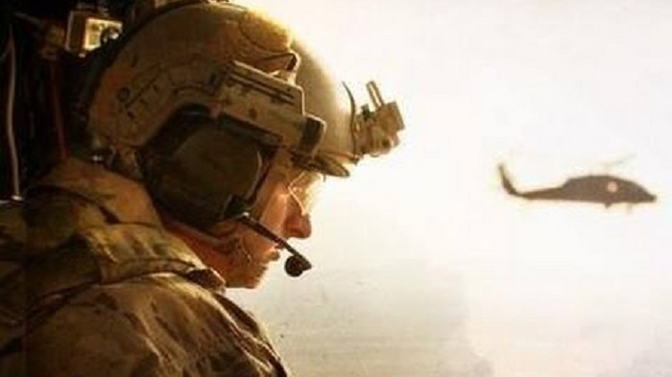
The rescue company 1

Slide 2
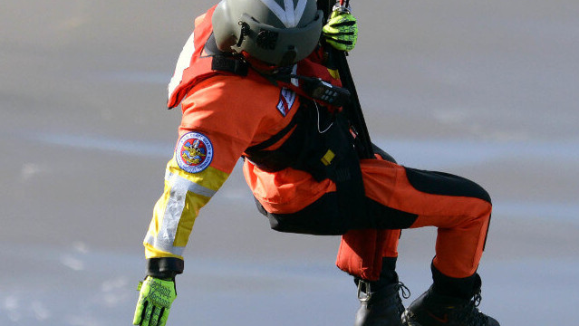
HELICOPTER
Rescue Appliances

Slide 3
Helicopter Rescue Bags
Designed for the specific purpose as an aerial patient transport device

Slide 4

Helicopter Rescue Bags
helicopter rescue bags (heli-rescue bags) have proven themselves to be more aerodynamic than a rigid basket stretcher alone.

Slide 5

Collapsible Rescue Basket
also referred to as McCauley Basket, is primarily designed for lifting one survivor at a time during a hoist rescue.

Slide 6
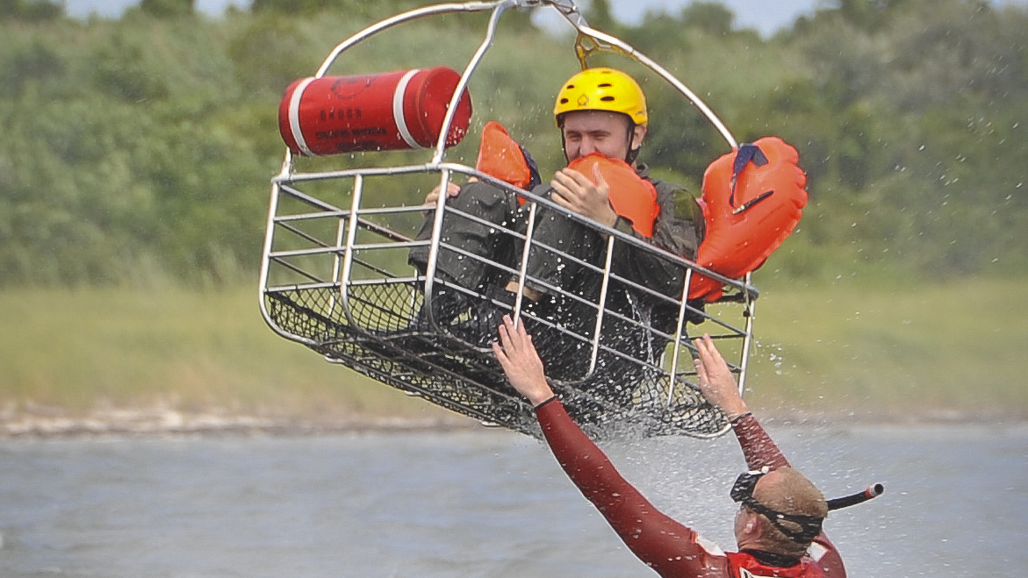
Collapsible Rescue Basket
There is a larger commercially produced version, which can transport more than one subject.

Slide 7
Rescue Net (Billy Pugh Net)
The rescue net (Billy Pugh Net model 872-SF) is a standard rescue device utilized by the US Navy.

Slide 8
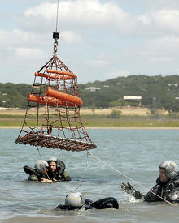
Rescue Net (Billy Pugh Net)
With its flotation collar, it is deployed in the maritime environment for situations involving multiple subjects.

Slide 9
Medevac Litter
The litter has a system of flotation components to provide increased protection for a packaged subject during a maritime rescue. It

Slide 10
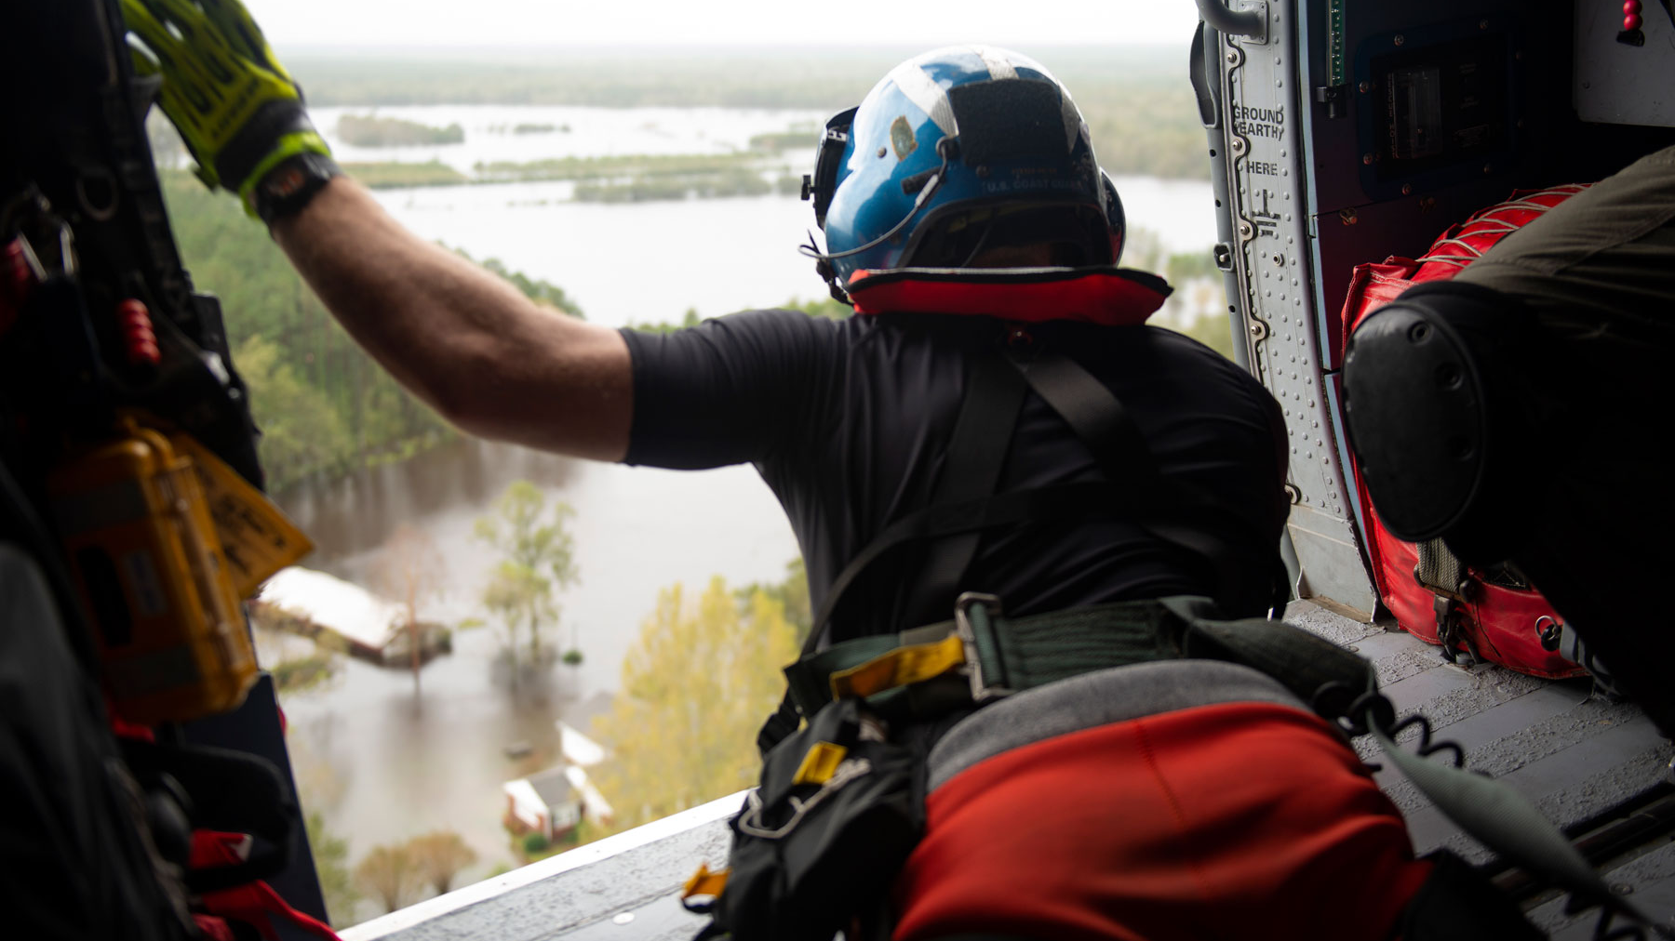
Medevac Litter
is constructed of a tubular stainless steel frame and skids with a break-apart design.

Slide 11
Rescue Seat or Forest Penetrator
developed during the Vietnam War(circa 1966) to replace the horse-collar lifting device being used at the time (which would not penetrate the vegetation canopy when deployed from a helicopter).

Slide 12
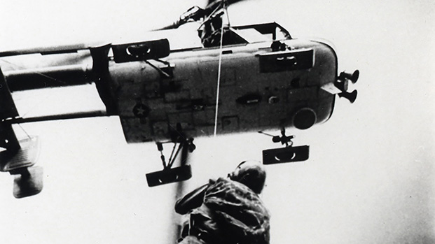
Rescue Seat or Forest Penetrator
This device is designed to accommodate up to three seated subjects for hoisting, however two is much more practical.

Slide 13
Rescue Strop
(aka "horse-collar") is designed as a retrieval device for uninjured personnel.

Slide 14
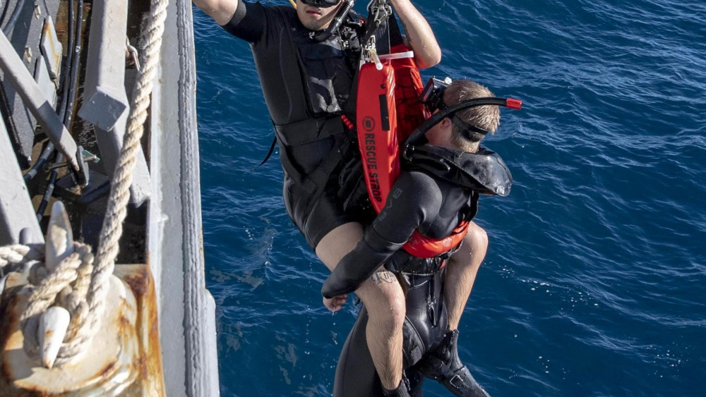
Rescue Strop
The rescue strop fits around the chest of a single subject and is connected back to the rescue hook assembly

Slide 15
Human Extraction and Lifting Device (HELD)
can be placed on a subject in a closed or open configuration and allows cinching around the chest for a secure means of rescue or extraction.

Slide 16
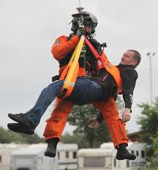
Human Extraction and Lifting Device (HELD)
When placed around a subject the device can be secured without having to open the hoist hook gate.

Slide 17
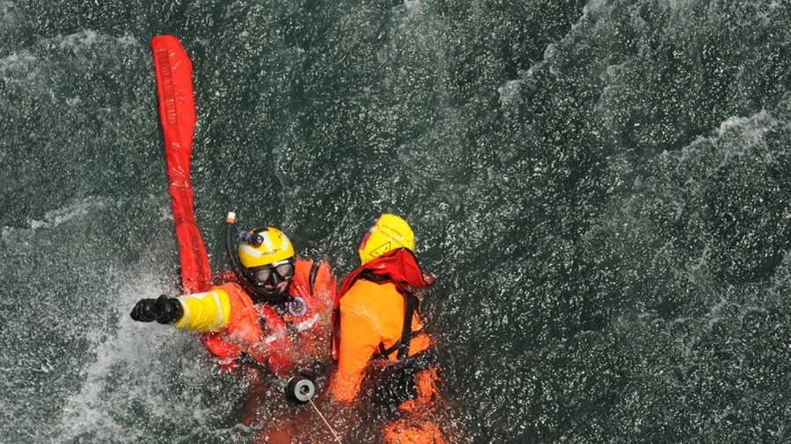
Caution
Deploying a rescue strop to a subject without the aid of a rescuer is not recommended. Rescue strop recovery without proper application has resulted in subjects falling out of the device during extraction with fatal consequences.

Slide 18
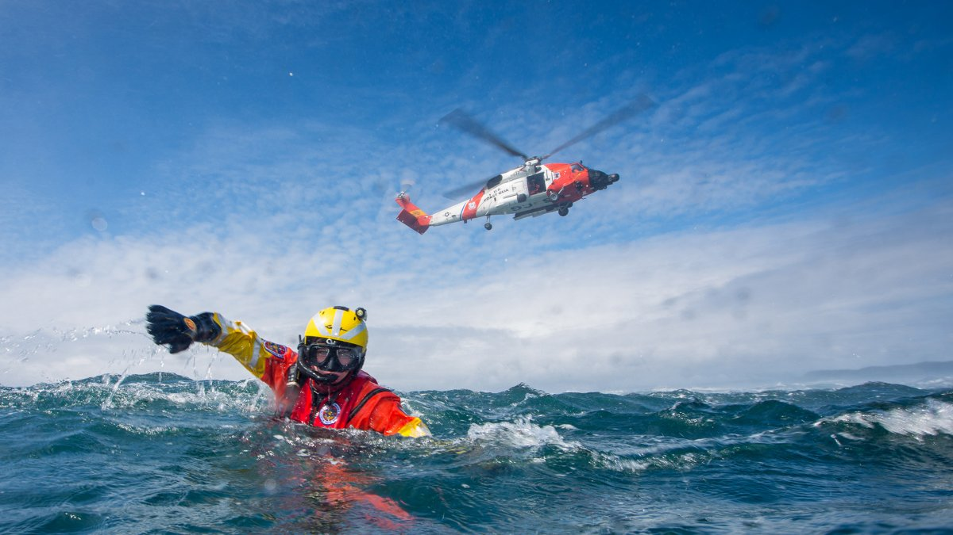
"hypothermic lift"
A "hypothermic lift" (referred to as "double-lift method" by USN) is utilized for water rescue of hypothermic subjects.

Slide 19
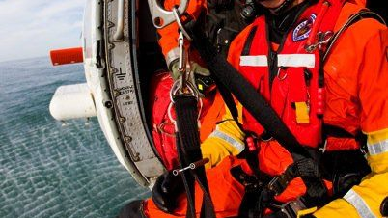
"hypothermic lift"
The rescue strop is used in conjunction with a second quick strop, placed in a manner to lift from behind the subject's knees placing them in a semi semi-supine position.

Slide 20
Quick Strop
A slider buckle cinched down against the chest of a subject, used in conjunction with a groin strap, provides security during hoisting

Slide 21
Quick Strop
is similar in design to the rescue strop.
It is placed under the arms, around the back, or over the head of a subject.
It can be deployed quickly around a subject.

Slide 22
Rescue Evacuation Triangle
(Petzl Pitagor)
The Petzl EvacuationTriangle (Petzl Pitagor) is a quick application extraction seat, which can be used for hoist or short-haul extractions of a subject

Slide 23
Rescue Evacuation Triangle
(Petzl Pitagor)
It is designed to fit around adults and smaller subjects down to 44 lbs. (20 kg).

Slide 24
Rescue Evacuation Triangle
(Petzl Pitagor)
The evacuation triangle is not designed to be utilized on victims who have sustained potential significant spinal injury unless the situation does not allow time to appropriately secure the victim's spine in a more appropriate device.

Slide 25
Screamer Suit
manufactured by Rainy Day Equipment, is a quick donning vest-style rescue device which permits rapid extrication of a subject by means of short-haul or hoisting.

Slide 26
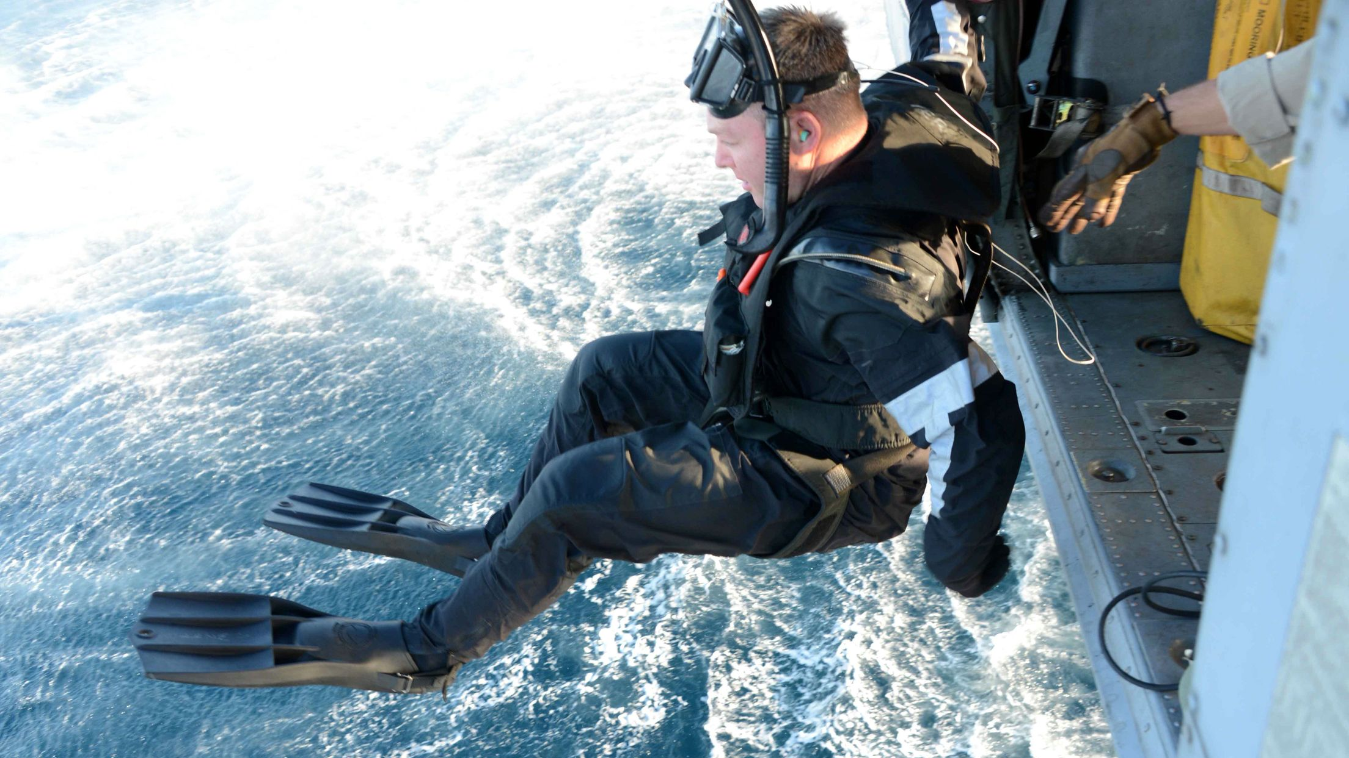
Screamer Suit
It hold the subject in a semi seated manner

Slide 27
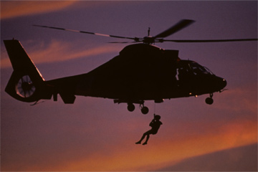
Screamer Suit
not intended for a patient with a spinal injury or other injury requiring a litter evacuation

Slide 28
Screamer Suit
The device, which adjusts from small patients to large patients up to 500 lbs. (227 kg)
avoids the delay associated with putting on a harness.

Slide 29
Hoisting Vest
The military hoisting vest is constructed of lightweight nylon mesh material and is designed to accommodate one person.

Slide 30
Screamer Suit
To ease donning and size adjustment of the vest, two adjustable torso straps are easily attached to the lifting V-Ring for hoisting.
The vest takes up little room and is easily donned for transfer of uninjured or ambulatory personnel. It should not be utilized for water rescues.

