Slide 1
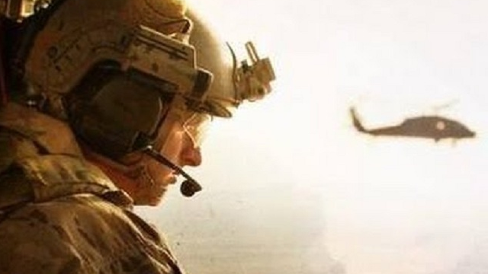
THE RESCUE COMPANY 1

Slide 2
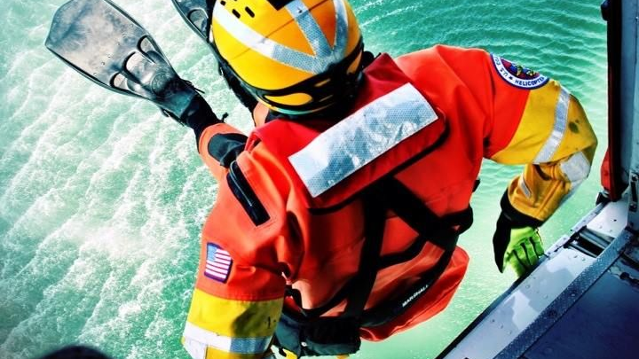
Helicopter rescue swimmer Helicopter Rappel part 2

Slide 3
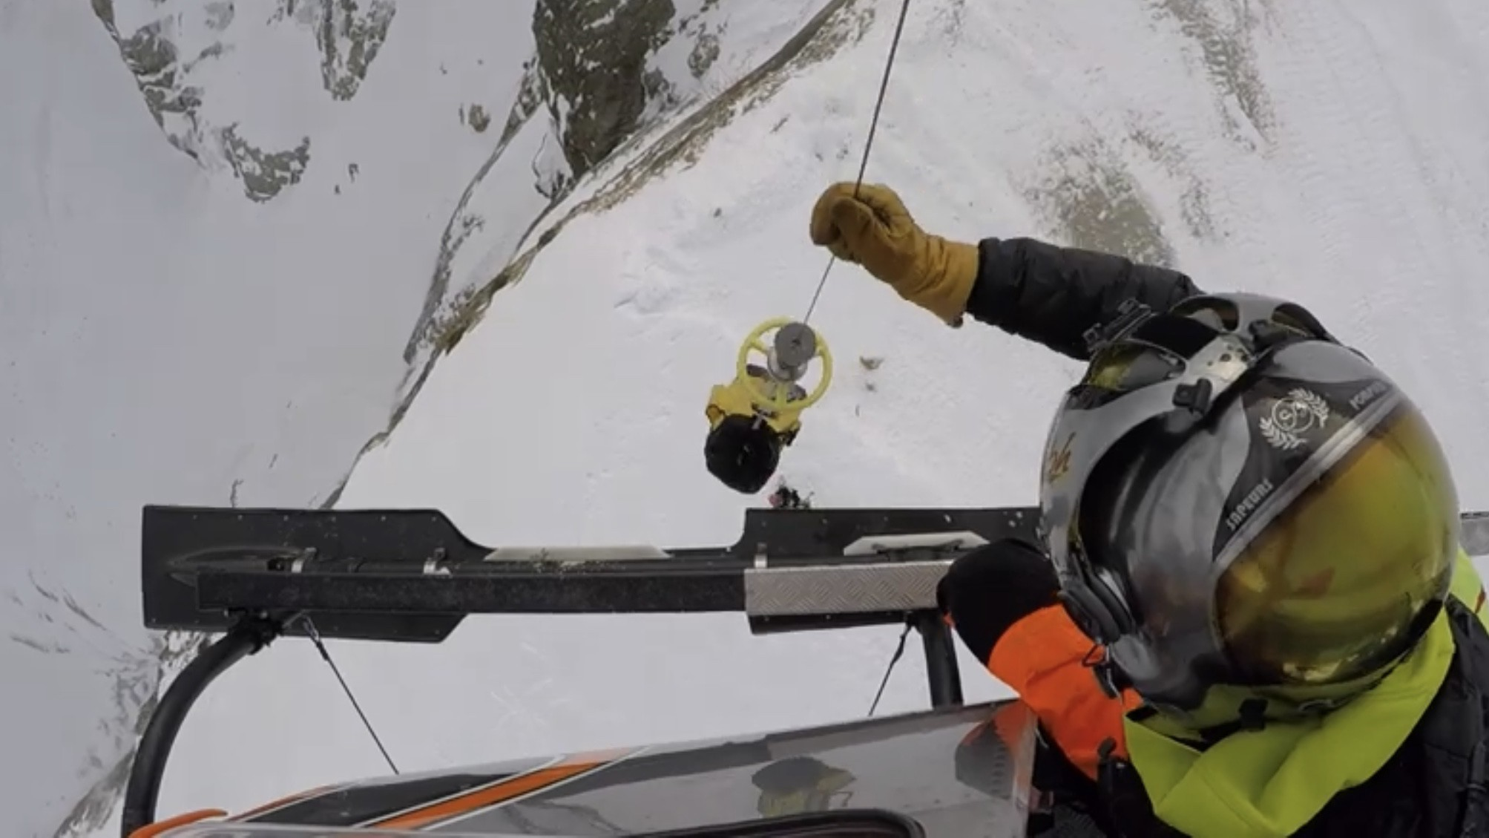
Rescue Rope Setup

Slide 4
Rescue Rope Setup
The rescue rope setup is an optional method used to lower the rappeller if he becomes entangled. It is used with the self-equalizing setup and the pre­ equalized cordelette.

Slide 5
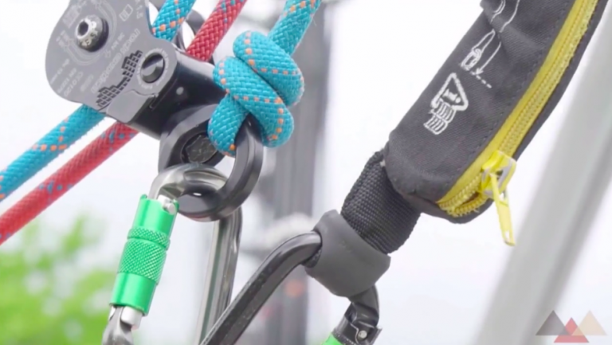
Rescue Rope Setup
The rescue rope must be the same or within 2mm difference of the rappel line

Slide 6
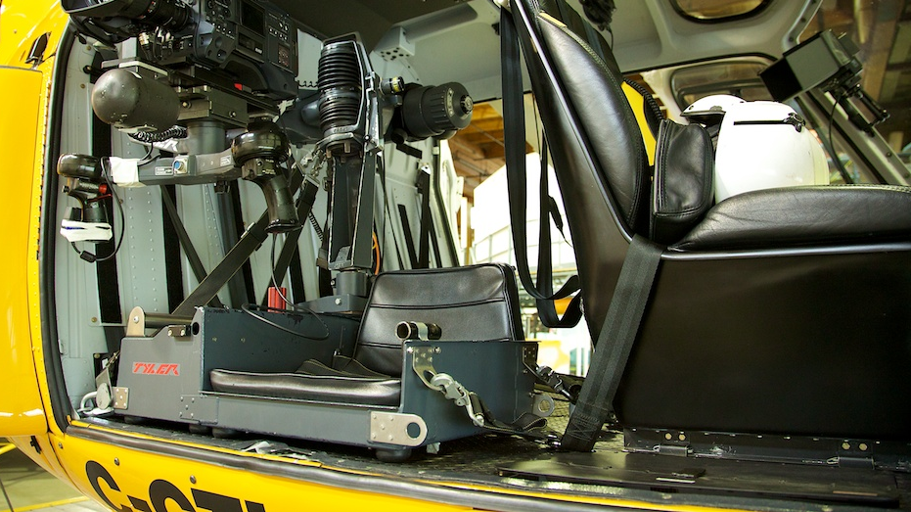
Rigging procedures for attachment of the rescue rope to the equalizing

Slide 7
Rigging procedures for attachment of the rescue rope to the equalizing
Join the ends of the rescue rope and rappel rope using a rethreaded figure eight.
Use an overhand knot to join the ropes if the knot is positioned before any guiding carabiners (i.e., hoist).
The overhand knot can slip through a carabiner if needed.

Slide 8
Rigging procedures for attachment of the rescue rope to the equalizing
Clip the rescue rope through the 1OK attach­ment carabiner of the self-equalizing or pre equalized anchor.
Ensure the joining knot between the rescue and rappel ropes is on the rappelling side of the carabiner.

Slide 9
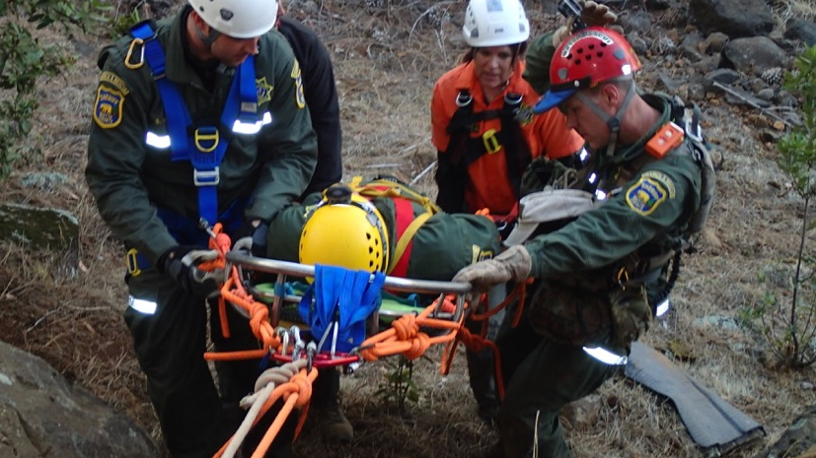
Rigging procedures for attachment of the rescue rope to the equalizing
Tie a releasable knot system on the 1OK attach­ ment carabiner using the rescue rope.
The releasable knot is tied with a munter hitch, a mule knot, and an overhand knot.

Slide 10
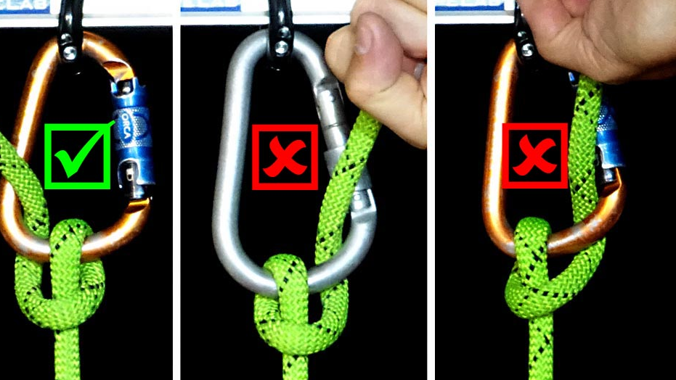
Rigging procedures for attachment of the rescue rope to the equalizing
Load the munter hitch to the correct position before the mule and overhand knots are tied. The mule and overhand knots are tied to the running end (rappel side) of the rope.

Slide 11
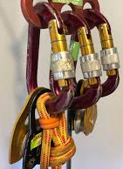
Rigging procedures for attachment of the rescue rope to the equalizing
Ensure the carabiner with the releasable knot is in line with the rappel and not at an angle.

Slide 12
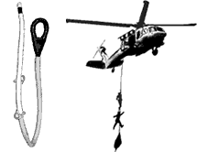
Rigging procedures for attachment of the rescue rope to the equalizing
Tie a figure eight on a bight to the standing end of the rescue rope and attach to a hard point in the aircraft.
This prevents the rescue rope from being fed through completely when lowering the rappeller.

Slide 13
Rigging procedures for attachment of the rescue rope to the equalizing
Gain control of the standing end of the rescue rope, remove the overhand knot and pull on the rescue rope to release the mule knot.
Slowly lower the rappeller to the ground. The crew chief or assistant HRST master must call out the remaining distance to the ground.

Slide 14
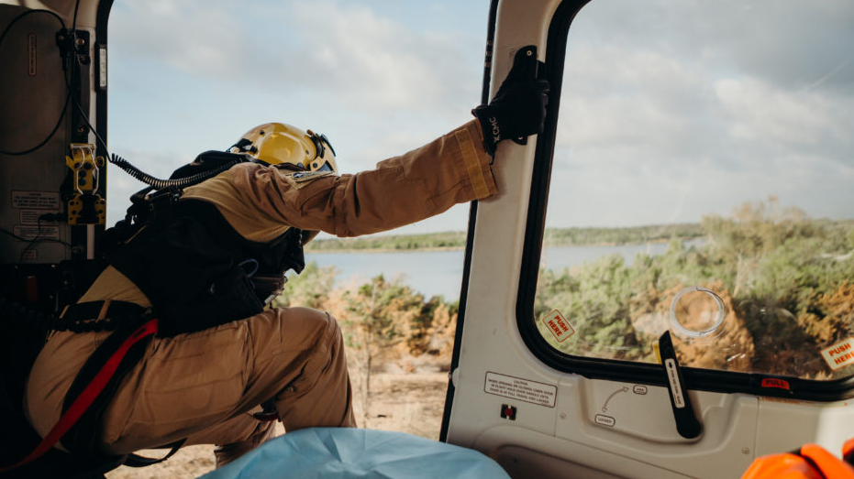
Hook Up

Slide 15
Hook Up
The rope master reaches down and grabs the running end of the rope with his left hand.
The rope master calls the roper forward.
The roper faces the HRST master and places his left hand on the HRST master's right shoulder.

Slide 16
Hook Up
The rope master instructs the roper to grab the running end of the rope (right hand, palm down, thumb toward body) just below the HRST master's left hand. This acts as the roper's brake hand.

Slide 17
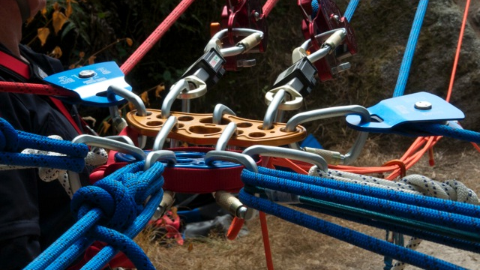
Note
A left-hand wrap for the left-handed rappel is not authorized. All ropers will brake with the right hand.

Slide 18
Hook Up
The roper places the running end of the rope in the small of his back.
The HRST master takes the standing end of the rope and snaps it down into the carabiner, wraps that end around the bottom (solid end) of the carabiner, and snaps it down into the cara­biner again.

Slide 19
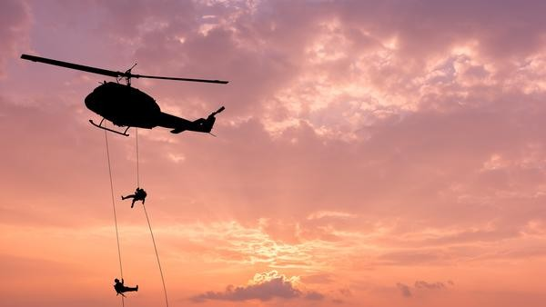
Warning
Should the rope be wrapped from the running end rather than the standing end, the rappel system will fail and serious injury may occur.

Slide 20
Hook Up
The carabiner gate is then locked shut.
The rope master instructs the roper to lean back and test the brake.
Upon command from the rope master, the roper assumes the L-shaped position (feet shoulder width apart, knees locked, upper body bent slightly forward).

Slide 21
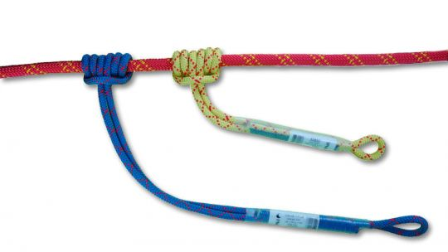
Hook Up
The rope master gives the command "Go."
The roper looks over his right shoulder, throws his right arm out to the side, and loosens his grip, which allows the rope to slide through his hand and allows him to descend.

Slide 22
Hook Up
The roper proceeds to rappel using his left hand as a guide hand on the rope between him­ self and the anchor point and his right hand as the brake.
The roper must ensure that all loose clothing near the carabiner is tucked in tightly to prevent it from becoming entangled in the carabiner.

Slide 23
Hook Up

Slide 24
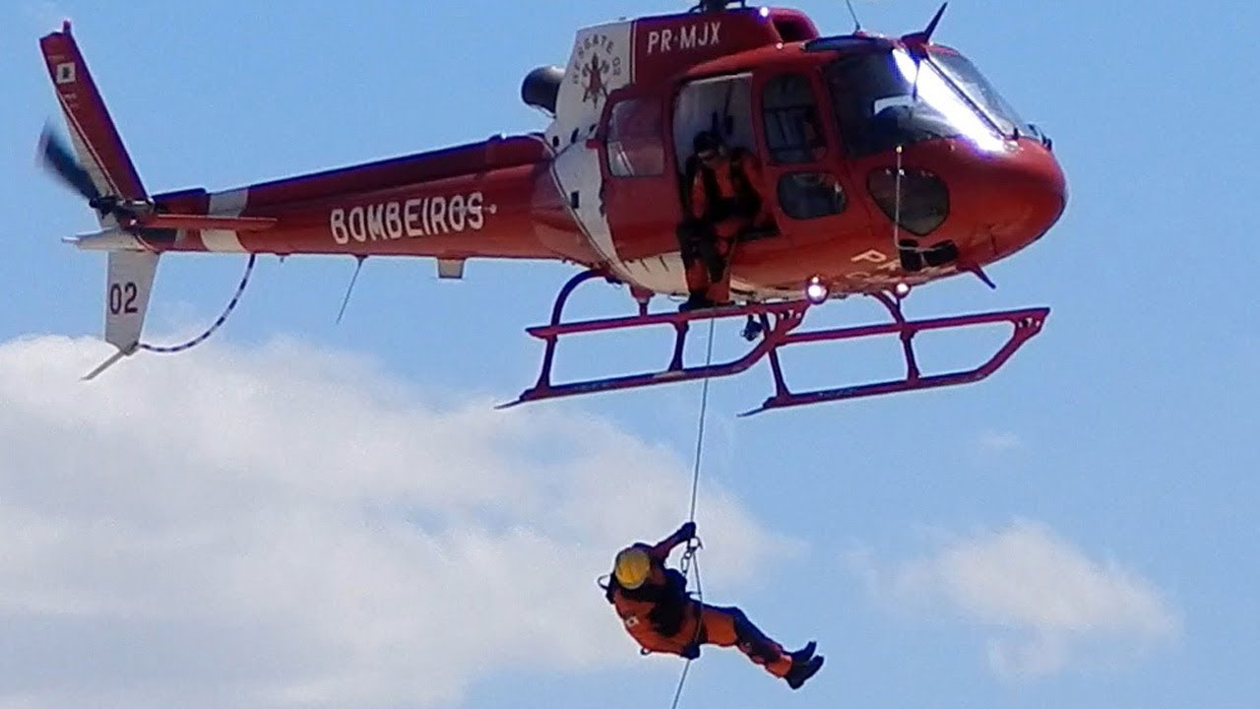
Roper Responsibilities

Slide 25
Roper Responsibilities
Understand and comply with all aspects of rope rescue operations and emergency procedures.
Ensure all safety equipment is properly donned and inspected by an rope master.

Slide 26
Roper Responsibilities
Ensure seat belts are hooked-up prior to takeoff and unbuckle only on command of the rope master.
Maintain eye contact with the rope master at all times prior to beginning a descent.

Slide 27
Roper Responsibilities
Make deliberate movements toward the rope station while maintaining a hand hold in the helicopter at all times.
Grasp ropes firmly when directed by the HRST master.

Slide 28
Roper Responsibilities
Control
Control descent speeds and brake to avoid mJury.
Look down
Look down at the ground while descending .
Move
Move rapidly away from the rope upon landing.

Slide 29
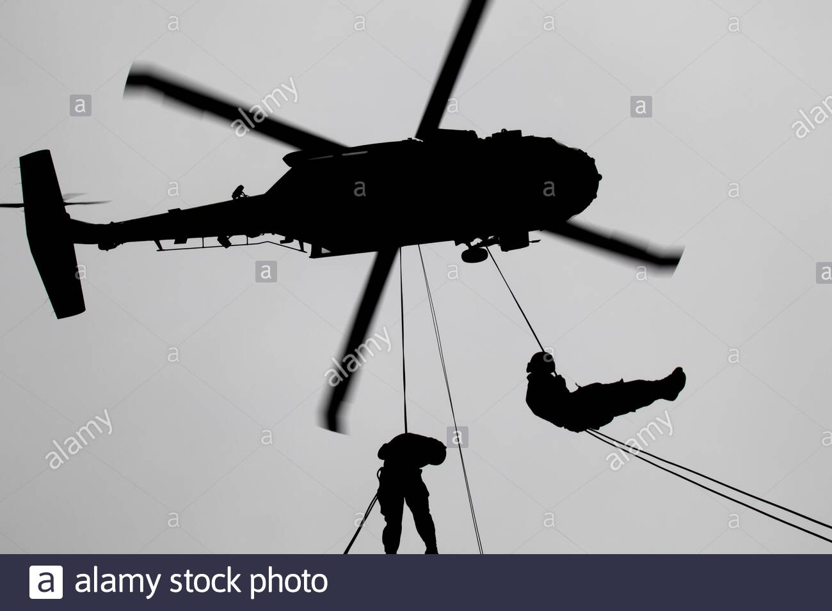
Sequence of Events

Slide 30
Sequence of Events
Load on command from the crew chief and inspect the installation of the rappel rope.
Don your safety belt and perform an ICS check.

Slide 31
Sequence of Events
“ICS check ."
Once the aircraft commander responds, the rope master acknowledges, "/ have you loud and clear" or "I have you the same" or " I have you weak ."

Slide 32
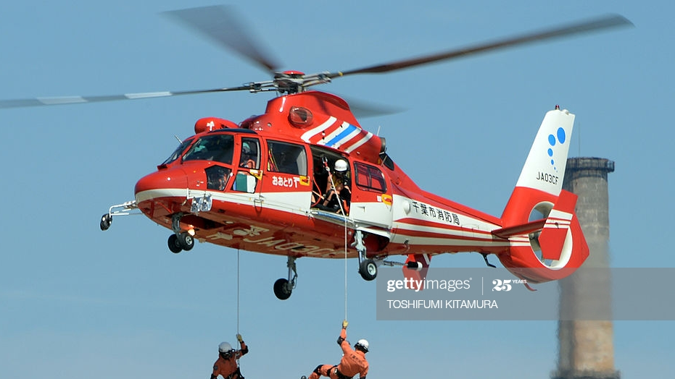
Sequence of Events
Once all ropers are seated and strapped in, the rope master notifies the crew chief that "Ropers are ready.“
After take off, the ropers remain strapped in and the HRST master remains oriented through periodic updates from the aircraft commander.

Slide 33
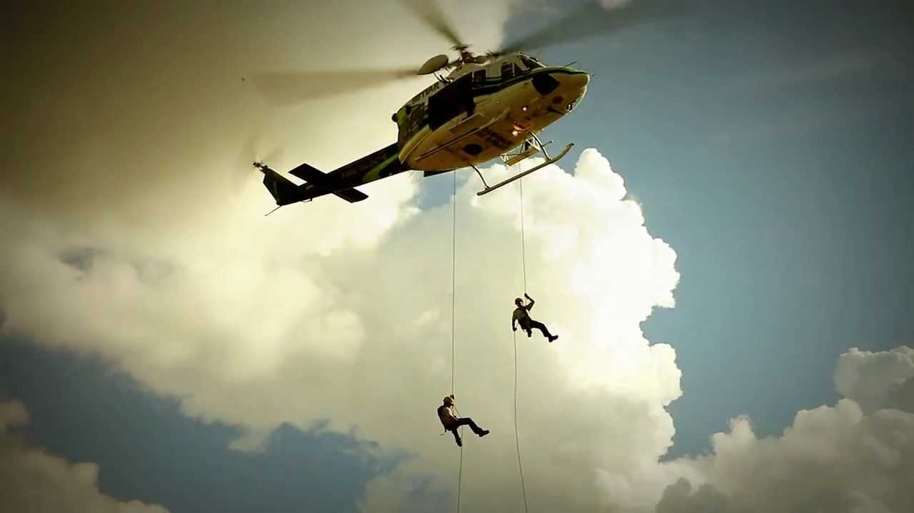
Sequence of Events
Once the aircraft commander gives the " 2-minut e" warning, the rope master responds, "Roger, 2 min­utes."
The rope master holds up two fingers and each roper holds up two fingers on each gloved hand to indicate the "2-minute" command.

Slide 34
Sequence of Events
The rope master ensures that each roper has his helmet, eye protection, and gloves and is ready to go.
For crew door operations, the crew chief assists the rope master by opening the crew door.
Note: At no time will the rope master leave an open rope station unattended.

Slide 35
Sequence of Events
The aircraft commander gives the "I -minute" call. The rope master responds, "Ro ger, 1 minute."
The rope master gives the "1-minute" command to the ropers using hand-and-arm signals.

Slide 36
Sequence of Events
Ropers make final checks of all gear.
Once the helicopter is in a stable hover the aircraft commander gives the command "Deploy the rope."
When the rope master can see the target directly below, he responds, "Roger, deploy the rope."

Slide 37
Sequence of Events
Once the helicopter is in a stable hover and the rope master can see the target directly below, he deploys the rope.
The rope master verifies that the rope is not fouled, on the deck, and on target, then he tells the aircraft commander "Rope on the deck."

Slide 38
Sequence of Events
The rope master uses hand-and-arm signals to com mand a roper to "Unbuckle" and "Take position" at the edge of the crew door exit. These commands are directed to one roper. All others remain seated and strapped in until told to unbuckle and take position

Slide 39
Sequence of Events
The rope master blocks the opening of the crew door prior to hooking up the roper.
The rope master ensures that he has physical con trol of the roper to prevent loss of balance and falling out of the helicopter.
The rope master maintains this control until the roper is sent out and begins his descent down the rope.

Slide 40
Sequence of Events
The rope master hooks the roper into the system, tells the aircraft commander, "First man on the rope," physically controls the roper to the edge of the bottom step of the crew door or the edge of the heli­copter (if the crew door is removed), and verifies the belay man is set (unless a self-belay system is being used).

Slide 41
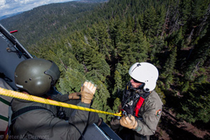
Sequence of Events
The rope master uses hand-and -arm signals to direct the roper to assume the L-shaped position over the edge and continues giving the roper the L position signal until he is ready to send him.

Slide 42
Sequence of Events
The rope master gives the roper the" Go" hand-and­ arm signal.
The roper pushes out and descends from the helicop­ter and starts his rappel.
The rope master monitors the roper all the way to the deck.

Slide 43
Sequence of Events
Continue with remaining ropers.
The rope master ensures that after each roper is on the deck the belay man is reset before sending out the next roper.

Slide 44
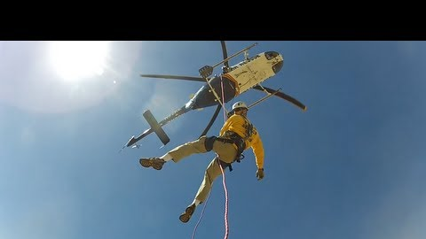
Sequence of Events
When the last roper is off the rope, the HRST master tells the aircraft commander "Last man off rope" and "Rope being pulled to the 6 o'clock (or whichever was briefed) position" or "Rope retrieved."

