Slide 1
The rescue company 1
Helicopter Swiftwater Rescue

Slide 2
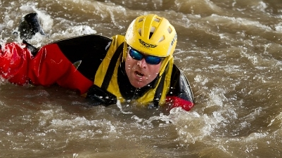
Wading, Swimming, and Crossings

Slide 3
Wading, Swimming, and Crossings
Rescuers have a need to move around in the water to effect rescues.
They can wade in the water, swim, or use crossing techniques.
A secondary benefit of wading and swimming is that they increase the comfort level of rescuers in the water.

Slide 4
Wading Techniques
solo wading with a paddle
two-person wading
four-person wading
Pyramid
in-line crossing.

Slide 5
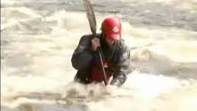
solo wading with a paddle

Slide 6
two-person wading

Slide 7
Four-Person "Huddle

Slide 8
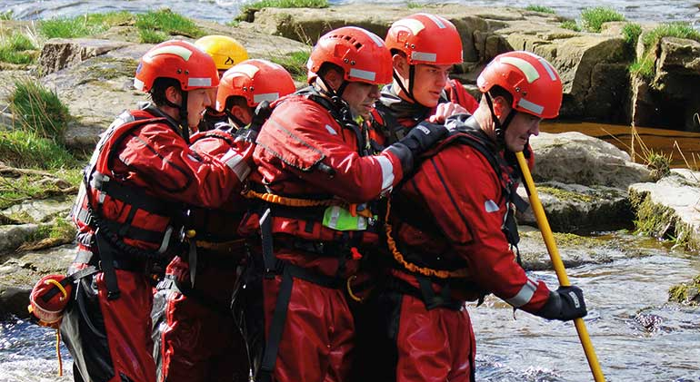
Pyramid

Slide 9
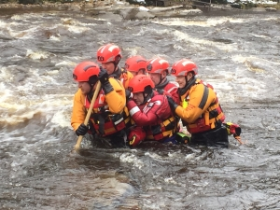
Pyramid
The pyramid can move a lot of people in the water and it can be used to alter the river dynamics.

Slide 10
in-line crossing

Slide 11
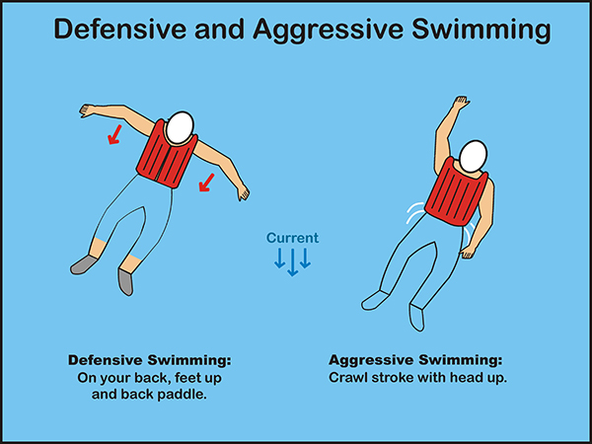
Swiftwater Swimming Techniques
Defensive
Aggressive

Slide 12
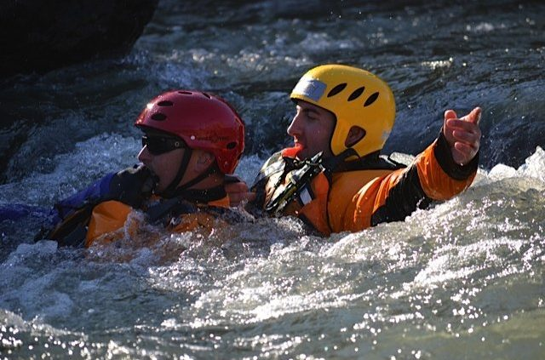
defensive swimming
the swimmer floats on her back with her feet on the surface and pointing downstream.

Slide 13
defensive swimming
If the swimmer wants to move laterally or across the current, she rotates her body so that is no longer parallel with the current and uses her arms to back paddle.

Slide 14
defensive swimming
Back paddling at an angle against the current executes the basic back ferry.
Also, it slows the downstream movement of the swimmer. Both are good outcomes.

Slide 15
Aggressive swimming
is the crawl stroke with the head up out of the water as much as possible so that the swimmer can see where she is swimming.
When swimming, the emphasis is on pulling the swimmer through the water with the arms.

Slide 16
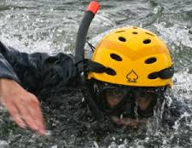
Aggressive swimming
Excessive kicking uses more energy than the propulsion it provides.

Slide 17
The barrel roll
is a technique used to help a swimmer break the eddy line and enter the eddy. For the purposes of discussion the barrel roll is broken into three phases.

Slide 18
The barrel roll
Entry
As the swimmer approaches the eddy, the swimmer in defensive swimmer mode reaches over into the eddy with his right arm and plants the hand into the upstream moving water in the eddy.

Slide 19
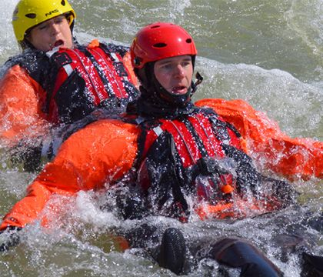
The barrel roll
Scoop the eddy water with the right hand and barrel roll over the arm. This tends to move or rotate the body laterally into the eddy.

Slide 20
The barrel roll
The swimmer scoops the water and begins the rotation in the entry phase.
In a continuous rolling motion the swimmer rotates over on his stomach into what would be considered an aggressive swimming position.

Slide 21
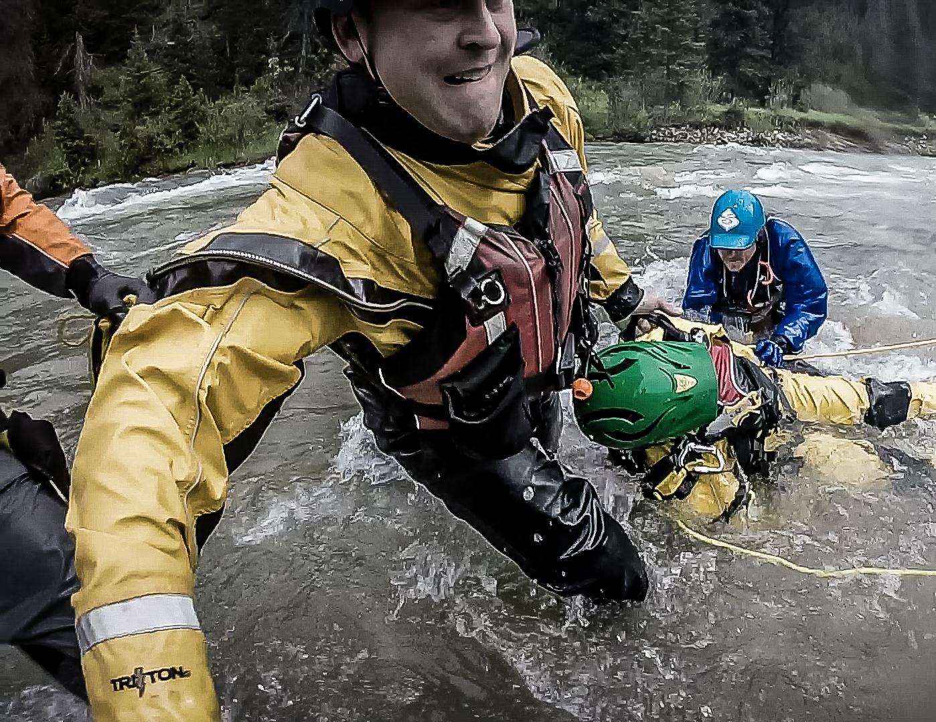
The barrel roll
Recovery
In a continuous motion, the swimmer continues the role until there is one full rotation.
The swimmer is on his back in the defensive swimming mode.

Slide 22
The barrel roll
Recovery
If needed, barrel roll again.
It may be necessary to cover more distance to make it into the eddy.

Slide 23
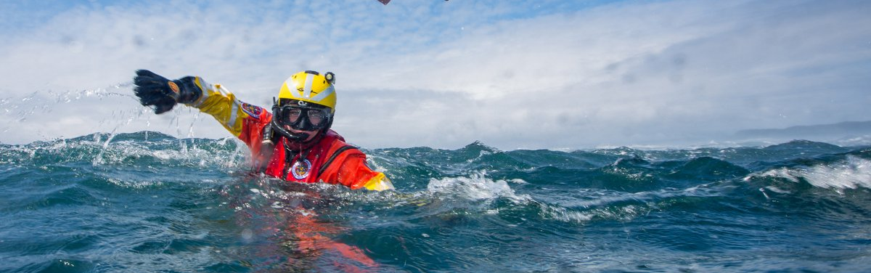
The barrel roll
Recovery
The barrel roll can end in either the defensive swimming mode (shown) or the aggressive swimming

Slide 24
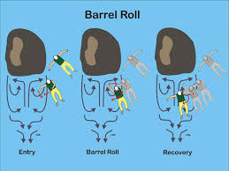

Slide 25
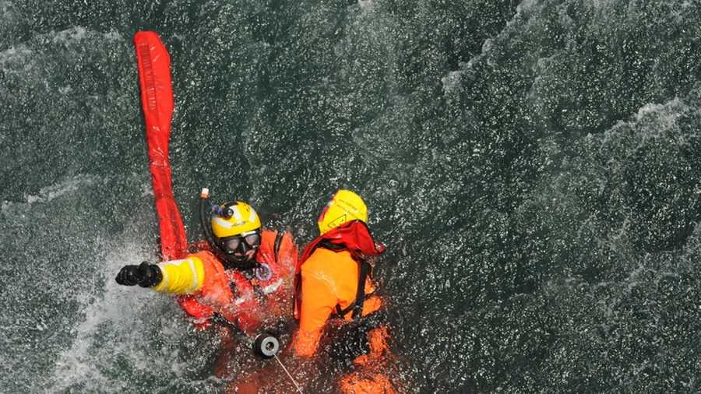
The back ferry
is a fundamental technique used to maneuver a swimmer or boat in moving water.

Slide 26
The back ferry
most swimmers in the defensive swimming mode intuitively preform the back ferry.
In a canoe, kayak or raft, the back ferry occurs with the bow of the boat pointing downstream and with the boater facing downstream.

Slide 27
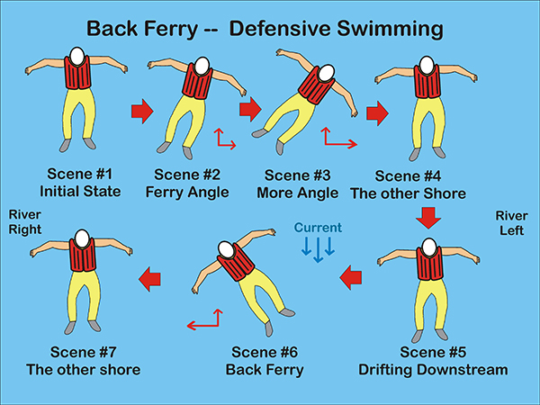

Slide 28
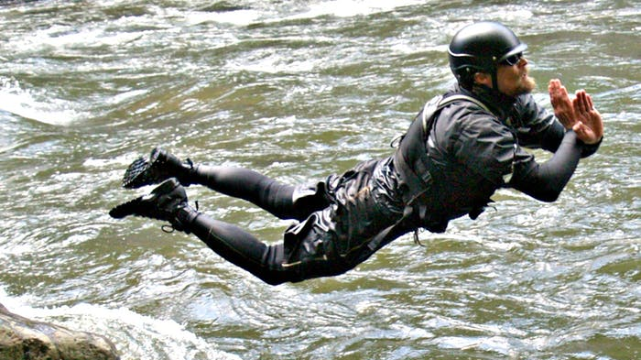
Using Defensive and Aggressive Swimming to Swim a Rapids

Slide 29
Scene #1: Defensive Swimming Position
The swimmer is in the main current in the defensive swimming position. Feet are up and pointing downstream.
The swimmer maybe floating or back paddling slowly. Initially, the swimmer is going with the flow.

Slide 30
Scene #2: Back Ferry to Eddy
The swimmer decides to swim to the eddy.
The swimmer assumes a ferry position and points his body toward the shore (i.e. eddy) to which he want to back ferry.
The swimmer's body is no longer parallel with the current.

Slide 31
Scene #2: Back Ferry to Eddy
Generally, the greater the angle the greater the back-paddling effort that is required.
For the back ferry to work, the swimmer must be back paddling against the current.
The swimmer back ferries with aggressive back paddling toward the eddy.

Slide 32
Scene #3: Barrel Roll into the Eddy
The barrel roll helps the swimmer break the eddy line and move laterally into the eddy.
The swimmer reaches the eddy line.

Slide 33
Scene #3: Barrel Roll into the Eddy
He barrel rolls into the eddy by reaching into the eddy with his right arm and rolling over the eddy line into the eddy.
More than one roll may be needed.

Slide 34
Scene #4: Swimmer Drops Out Bottom of Eddy
Depending on what the swimmer wants to do
he can swim back upstream to the rock
hang-out in the neutral portion of the eddy or drop out the bottom of the eddy in the slower moving downstream current.

Slide 35
Scene #4: Swimmer Drops Out Bottom of Eddy
The swimmer decides to drop out the bottom of the eddy and back ferry to the eddy on the river left shore.

Slide 36
Scene #5: Back Ferry to the other Shore
Still in the defensive swimming position, the swimmer positions himself to back ferry.
As the strength of the current increases, the swimmer will need to back paddle harder to reach the other shore.

Slide 37
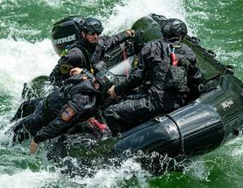
Scene #5: Back Ferry to the other Shore
The swimmer may even need to switch over to aggressive swimming to maintain sufficient force to maintain the ferry angle.

Slide 38
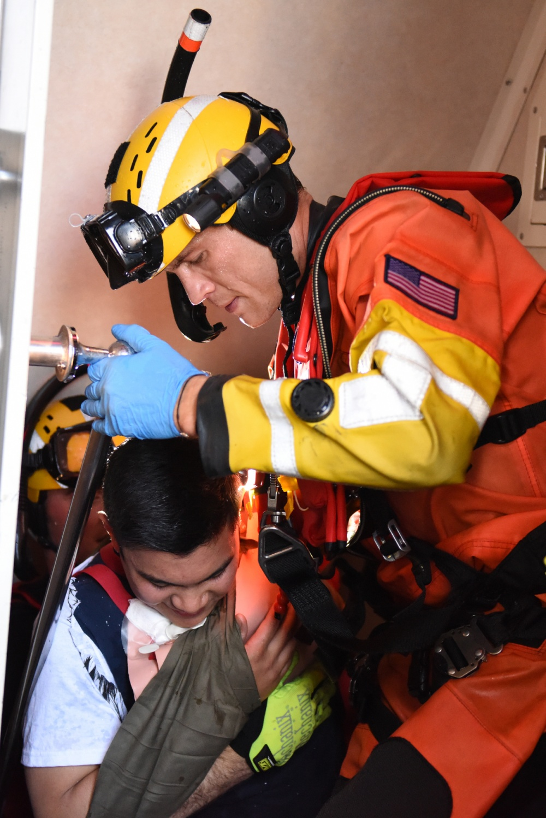
Scene #6: Switches to Aggressive Swimming
The swimmer decides that he needs to flip over and aggressively swim (i.e. crawl stroke) to reach the eddy on river left.
He maintains his ferry angle.

Slide 39
Scene #7: Barrel Roll into Eddy
The swimmer barrel rolls into the eddy on river left using a barrel roll.
In this case, the swimmer reaches into the eddy with his left arm and barrel rolls into the eddy.

Slide 40
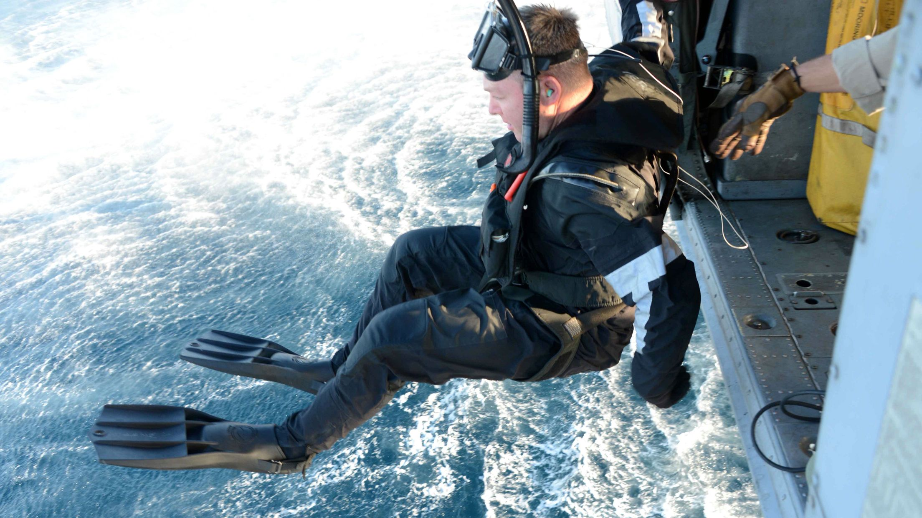
Scene #8: Swims to Shore
Using the eddy current, the swimmer decides to swim to shore in the aggressive swimming mode.

Slide 41
