Slide 1
Notes:
Chapter 20: Nutrition

Slide 2
Chapter 20 Nutrition
Notes:
Chapter 20: Nutrition

Slide 3
Introduction
Improving quality of life
Eating well
Maintaining a healthy body weight
Being physically active
© iStockphoto/Thinkstock/Getty.
Notes:
Lecture Outline
I. Introduction
People choose the foods they eat for various reasons.
1. Rarely do people choose foods solely in an effort to provide their bodies with the most efficient, healthful fuel sources available.
2. Preparing and sharing food is deeply important in many cultures.
a. Way of showing love for one’s family
b. Serves as important part of social interaction
3. Unfortunately, in today’s often hectic world, many of us have developed unhealthy eating habits.
4. Eating well, maintaining a healthy body weight, and being physically active are instrumental in improving quality of life.
a. Older adults may not eat well due to numerous reasons.
b. People with chronic diseases may have specific dietary needs that may or may not be met.

Slide 4
Understanding the Need for Nutrition in Health
The community paramedic’s role
Raise the bar of paramedicine
Be a role model for patients and peers
Understand basic concepts of food and nutrition
Assist patients in following a food plan
Notes:
Lecture Outline
II. Understanding the Need for Nutrition in Health
A. The community paramedic’s role
1. The challenge in educating people to use nutrition to improve their health is to provide straightforward, useful information without being insulting or intimidating.
2. The community paramedic’s efforts to understand nutrition should be more than just an exercise in memorizing information such as a list of drug dosages.
3. As a community paramedic, you have the opportunity to:
Raise the bar of paramedicine
Be not only knowledgeable and engaged but also a role model for your patients and peers
4. The community paramedic needs to understand the basic concepts of food and nutrition to assist patients in following a food plan created by a nutritionist under the direction of the patient’s physician.
a. Examples of tasks you may be asked to perform:
i. Working with patients with diabetes to reduce carbohydrate intake
ii. Monitoring the intake of foods that affect the actions of medications such as warfarin
iii. Determining ways to assist people who depend on nutrient-poor foods such as ramen noodles to access more nutrient-rich foods, such as fresh foods and vegetables

Slide 5
Nutritional Guidelines (1 of 2)
Evolution of nutritional guidelines
Reflect better understanding of nutrition
Changes in lifestyle
© JGI/Tom Grill/Getty.
Notes:
Lecture Outline
III. Nutritional Guidelines
A. Evolution of nutritional guidelines
1. Guidance from the US government has evolved over the years to reflect a better understanding of basic nutrition and changes in lifestyle, with the goal being to ensure good health across the life span.
2. The current version of the USDA guidelines, the “Dietary Guidelines for Americans, 2015–2020,” focuses on the need for many Americans to select more nutrient-dense foods and beverages.

Slide 6
Nutritional Guidelines (2 of 2)
Dietary Guidelines for Americans, 2015–2020
Eat at a calorie level to maintain healthy weight
Focus on variety, nutrient density
Limit added sugars, saturated fats, sodium
Shift to healthier food and beverage choices
Support healthy eating patterns
Notes:
Lecture Outline
3. The guidelines emphasize the following:
a. Following a healthy eating pattern, which includes eating at a calorie level to achieve and maintain a healthy body weight, support nutrient adequacy, and reduce the risk of chronic disease
b. Focusing on variety, nutrient density, and the amount of food needed to meet nutrient needs within all food groups and within calorie limits
c. Limiting added sugars, saturated fats, and unnecessary sodium intake
d. Shifting to healthier food and beverage choices, including those that are nutrient-dense and span the food groups
e. Supporting healthy eating patterns in all phases of life

Slide 7
Nutritional Balance
Ensure a balance of:
Carbohydrates
Protein
Fat
Vitamins
Minerals
Fiber
Phytochemicals
Notes:
Lecture Outline
IV. Nutritional Balance
A. Nutritional balance
1. Requires ensuring a balance of energy sources such as carbohydrates, protein, and fat as well as a sufficient quantity of vitamins and minerals, including fiber and phytochemicals
a. There should be a balance in the number of calories consumed and those expended through activity.

Slide 8
Food Groups
The US Department of Agriculture (USDA) currently defines 5 food groups:
Fruits
Vegetables
Grains
Dairy
Protein
Notes:
Lecture Outline
B. Food groups
1. The USDA currently defines five food groups:
a. Fruits
b. Vegetables
c. Grains
d. Dairy
e. Protein
f. Although not a food group, oils are recommended for their nutritional value and are found in food sources such as nuts, fish, olives, avocados, cooking oil, and salad dressings.
i. Ideally, they should not include trans-fatty acids or cholesterol.

Slide 9
Nutritional Components of Food (1 of 2)
The nutritional components of food
Diet for normal human growth requires 45 essential nutrients
Deficiencies create negative health outcomes
Also beneficial: fiber, phytochemicals
Notes:
Lecture Outline
C. The nutritional components of food
1. Nutrients are the chemicals in food that are essential for life.
2. The diet for normal human growth, development, and maintenance requires 45 essential nutrients.
3. Deficiency in a nutrient for a length of time can result in a negative health outcome (eg, lack of iron can result in anemia).
4. Other substances in food may not fit the definition of nutrients but are beneficial to the body.
a. Fiber can enhance digestion.
b. Phytochemicals, which function as antioxidants, may reduce the risk of heart disease and cancer by combining with or neutralizing free radicals.

Slide 10
Nutritional Components of Food (2 of 2)
Six classes of nutrients
Macronutrients: Carbohydrates, proteins, fats (needed by the body in large quantities)
Micronutrients: Vitamins and minerals (needed by the body in small quantities)
Water
Notes:
Lecture Outline
5. Six classes of nutrients regulate body processes and contribute to body structures.
a. Macronutrients: carbohydrates, proteins, and fats needed by the body in large quantities
b. Micronutrients: vitamins and minerals only needed in small quantities
c. Water

Slide 11
Macronutrients (1 of 8)
Carbohydrates
Made of carbon, hydrogen, and oxygen
Commonly described as starches or sugars
Found in fruits, grains, vegetables, legumes
Simple or complex
© Ayd/Shutterstock.
© Krunoslav Cestar/Shutterstock
Notes:
Lecture Outline
D. Macronutrients
1. Carbohydrates
a. Made of carbon, hydrogen, and oxygen
b. Commonly described as starches or sugars, they can be found in fruits, grains, vegetables, and legumes (dry beans and peas).
c. Two types of carbohydrates
i. Simple carbohydrates (sugars such as glucose, fructose, galactose)
ii. Complex carbohydrates (starches, glycogen, and fiber)

Slide 12
Macronutrients (2 of 8)
Lipids (fats)
Contain carbon, oxygen, and hydrogen
Found in meat, dairy products, and some plants (avocados, olives, coconuts)
Types of lipids
Triglycerides, phospholipids, sterols
Notes:
Lecture Outline
2. Lipids (fats)
a. Lipids are organic compounds that contain carbon, oxygen, and hydrogen.
b. Naturally occurring lipids or fats are found in meat and dairy products and some plants, including avocados, olives, and coconuts.
c. Types of lipids
i. Triglycerides
ii. Phospholipids
iii. Sterols

Slide 13
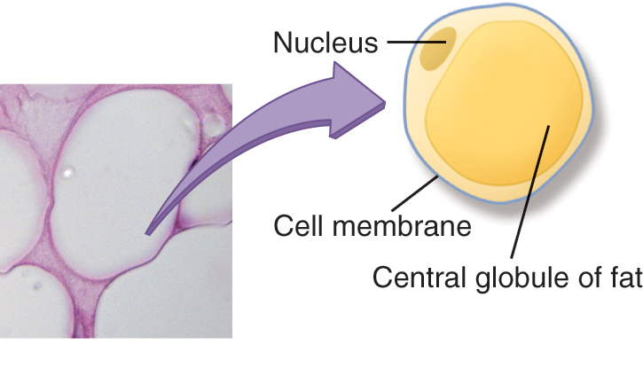
Macronutrients (3 of 8)
Lipids (cont’d)
Fatty acids
Excess dietary fat
Visceral fat
Subcutaneous fat
Micrograph: © Donna Beer Stolz, Ph.D., Center for Biologic Imaging, University of Pittsburgh Medical School. © Jones & Bartlett Learning.
Notes:
Lecture Outline
d. Fatty acids
i. Key building blocks that may be attached to a triglyceride or present as free compounds; determine the characteristics of a fat and provide flavors to certain foods like butter
ii. Nonessential fatty acids are made by the body; essential fatty acids are provided from food.
iii. Omega-3, omega-6, and omega-9 fatty acids can be burned as energy and used to synthesize new compounds.
e. Triglycerides
i. Consist of three fatty acids attached to a molecule of glycerol
ii. Rich and efficient source of calories
f. Excess dietary fat (ie, fat that is not immediately used to provide energy needed by the body) intended to hold us over during times of caloric deficit is stored in fat or adipose tissue.
i. Visceral fat or subcutaneous fat

Slide 14
Macronutrients (4 of 8)
Lipoproteins
Very low-density lipoprotein (VLDL)
Intermediate-density lipoprotein (IDL)
High-density lipoprotein (HDL)
Low-density lipoprotein (LDL)
Notes:
Lecture Outline
f. Lipoproteins
Very low-density lipoprotein (VLDL) is a triglyceride-rich compound formed in the liver and intestines. VLDL gradually releases triglycerides to the body cells.
Diets high in saturated and trans fats stimulate the release of VLDL and triglycerides from the liver.
iii. Intermediate-density lipoprotein (IDL) is approximately 40% triglycerides; these compounds acquire cholesterol from high-density lipoprotein (HDL) as the HDL travels through the bloodstream, then return to the liver, where the liver cells convert the IDL to low-density lipoprotein (LDL).

Slide 15
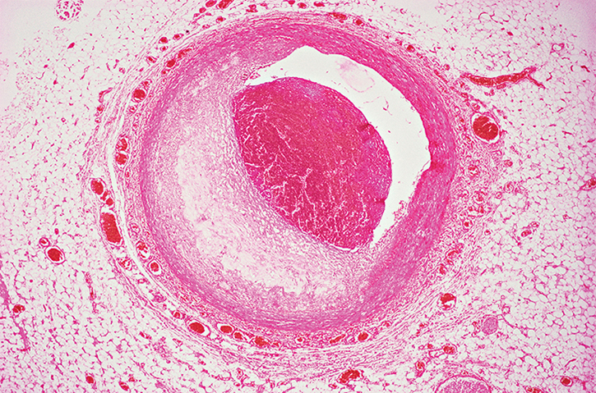
Macronutrients (5 of 8)
Lipoproteins (cont’d)
Trans-fatty acids raise LDL and reduce HDL levels
Increased risk for atherosclerosis
© IS_ImageSource/iStock/Getty.
Notes:
Lecture Outline
h. Trans-fatty acids raise LDL levels and reduce HDL levels, a combination that may increase the risk for atherosclerosis and heart disease.
i. Conversely, HDL protects against atherosclerosis and heart disease by picking up cholesterol released by dying cells and arterial plaques, thereby preventing their accumulation.
j. Lipids are an important consideration when discussing dietary needs with patients.
k. Current recommendations from the American Heart Association (AHA) stress consumption of two servings of oily fish, such as tuna or salmon, each week.

Slide 16
Macronutrients (6 of 8)
Proteins
Transport oxygen, vitamins, and minerals to target cells
Act as enzymes to catalyze chemical reactions
Act as hormones that serve as chemical messengers for regulatory functions
Notes:
Lecture Outline
3. Protein
a. Proteins are critical for good health. They:
i. Transport oxygen, vitamins, and minerals to target cells
ii. Act as enzymes to catalyze chemical reactions
iii. Act as hormones that serve as chemical messengers for regulatory functions

Slide 17
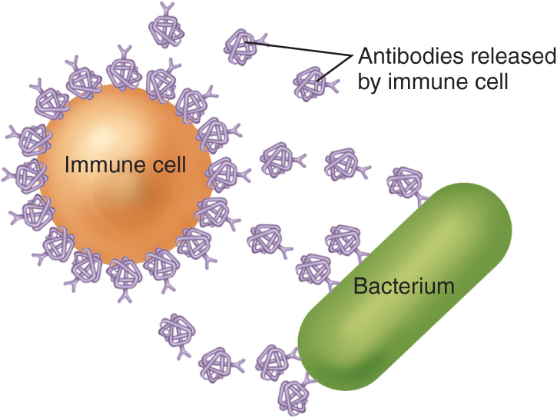
Macronutrients (7 of 8)
Proteins (cont’d)
Maintain fluid and acid−base balance
Serve as components of antibodies that support immunity
© Jones & Bartlett Learning.
Notes:
Lecture Outline
iv. Maintain fluid and acid–base balance
v. Serve as components of antibodies that support immune function

Slide 18
Macronutrients (8 of 8)
Proteins (cont’d)
If not enough protein, the body will break down muscle to access stored protein
Wasting of organs and other tissues
Too much protein can lead to kidney problems, osteoporosis, heart disease, obesity, gout, some cancers
Notes:
Lecture Outline
b. Proteins are organic compounds composed of smaller building blocks called amino acids.
i. There are 20 different amino acids.
ii. Nine are considered essential amino acids and must be provided through the diet.
c. Proteins build and maintain body structures, regulate body processes, provide energy, replace skin cells and keep hair, skin, and nails healthy through the production of collagen and keratin.
d. If there is not enough protein, the body will break down muscle to access stored protein, which can cause wasting of organs and other tissues.
e. Excessively high protein levels can contribute to kidney problems, osteoporosis, heart disease, obesity, gout, and some cancers.

Slide 19
Micronutrients (1 of 4)
Vitamins
Organic compounds that contain carbon and hydrogen and, in some cases, other elements
Keep organs and tissues functioning
Notes:
Lecture Outline
E. Micronutrients
1. Vitamins
a. Organic compounds that contain carbon and hydrogen and, in some cases, oxygen, nitrogen, phosphorus, sulfur, and other elements
b. The role of vitamins is to regulate body processes such as blood clotting and calcium balance and generally act to keep organs and tissues functioning.

Slide 20
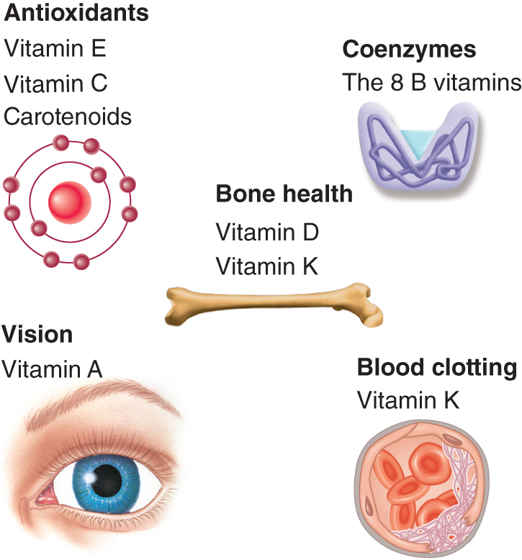
Micronutrients (2 of 4)
Vitamins (cont’d)
Do not yield energy directly
Roles in extraction of energy from fats, proteins, and carbohydrates
Fat-soluble or water-soluble
© Jones & Bartlett Learning.
Notes:
Lecture Outline
c. Vitamins do not yield energy directly but have roles in the extraction of energy from fats, proteins, and carbohydrates.
d. Types of vitamins
i. Fat-soluble
a) Vitamins A, D, E, and K
b) Accumulate in the tissues and can be stored in the body indefinitely
ii. Water-soluble
Vitamin C, eight B vitamins, folate, pantothenic acid, and biotin
Filtered by the kidneys and excreted in urine
Unlike fat-soluble vitamins, water-soluble vitamins do not need lipoprotein carriers to enter the cells.

Slide 21
Micronutrients (3 of 4)
Minerals
Simple, inorganic substances
At least 16 are essential to health
Macrominerals
Sodium
Potassium
Calcium
Notes:
Lecture Outline
2. Minerals
a. Simple, inorganic substances, at least 16 of which are essential to health
b. Macrominerals (needed in relatively large quantities as compared with other minerals)
i. Sodium (Na)
ii. Potassium (K)
iii. Calcium (Ca)

Slide 22
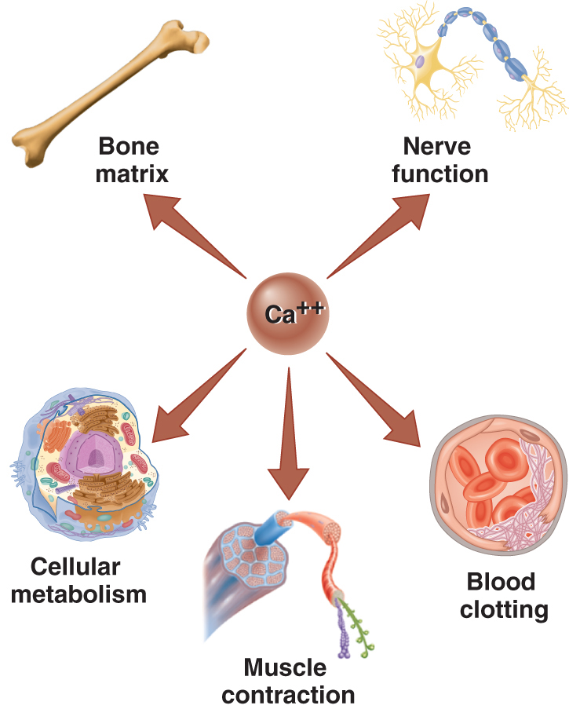
Micronutrients (4 of 4)
Macrominerals (cont’d)
Chloride
Phosphorus
Magnesium
© Jones & Bartlett Learning.
Notes:
Lecture Outline
iv. Chloride (Cl⁻)
v. Phosphorus (P)
vi. Magnesium (Mg)
c. Microminerals (small quantities are needed to maintain a healthy body)
i. Iron
ii. Zinc
iii. Copper
iv. Manganese
v. Molybdenum
vi. Selenium
vii. Iodine
viii. Fluoride

Slide 23
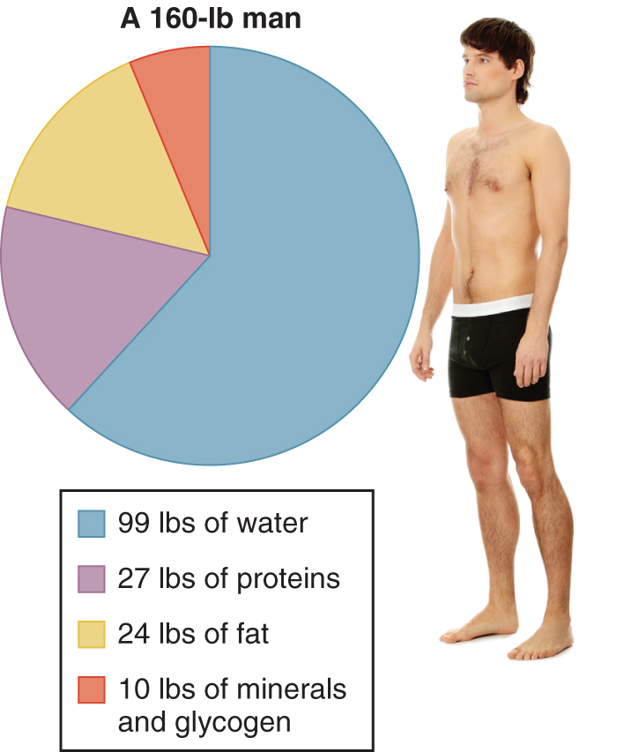
Water (1 of 2)
Water
Temperature control
Lubrication of joints
Transport of nutrients/wastes
Facilitation of metabolism
Maintenance of acid–base balance
© Piotr Marcinski/Shutterstock; © Jones & Bartlett Learning.
Notes:
Lecture Outline
F. Water
1. Water is the most essential nutrient. The human body is nearly 60% water.
2. Water in the body includes dissolved minerals called electrolytes; each cell must have the right mix of water and electrolytes to survive.
3. Water’s roles include:
a. Temperature control
b. Lubrication of joints
c. Transport of nutrients and wastes
d. Facilitation of metabolism
e. Maintenance of acid–base balance

Slide 24
Water (2 of 2)
Dehydration: the body does not have enough water
Can lead to constipation, hypertension, heart disease, glaucoma, diabetic complications
Water intoxication: a person overhydrates beyond the kidneys’ ability to eliminate the excess water
Notes:
Lecture Outline
4. Dehydration occurs when the body does not have enough water.
a. Chronic dehydration can lead to constipation, hypertension, heart disease, glaucoma, and diabetic complications.
5. Water intoxication occurs when a person overhydrates beyond the kidneys’ ability to eliminate the excess water.
a. Particularly a problem when a person rehydrates with large quantities of water and no electrolytes

Slide 25
Components of a Well-Balanced Diet for a Healthy Adult
Template for good nutrition relies on 2 basic concepts:
Maintain calorie balance over time to sustain a healthy weight
Focus on consuming nutrient-dense foods and beverages
Notes:
Lecture Outline
V. Components of a Well-Balanced Diet for a Healthy Adult
A. The template for good nutrition relies on two basic concepts:
1. Maintain calorie balance over time to achieve and sustain a healthy weight
2. Focus on consuming nutrient-dense foods and beverages
3. The goal is to effect a gradual change by decreasing caloric intake and increasing caloric expenditure.
4. To make better choices, we need to pay more attention to the packaged foods we buy or invest in preparing our own meals with nutrient-rich content.
5. Helping your patients achieve good nutritional health includes three guiding principles:
a. First, ensure that all patients have access to nutritious foods and opportunities for physical activity.
b. Second, facilitate individual behavior through helping the patient to implement the nutritionist’s food plan.
c. Third, set the stage for lifelong healthy eating, physical activity, and weight management behaviors.

Slide 26
Digestion and Absorption Issues
At any step in the digestion process, patients can have problems
Influences on digestion: psychological, chemical, bacterial
Some issues include: Constipation, diarrhea, lactose intolerance, gas, gastroesophageal reflux disease (GERD), colorectal cancer
Notes:
Lecture Outline
VI. Digestion and Absorption Issues
A. Influences and issues
1. Once chewed and swallowed, food is broken down in the gastrointestinal system, nutrients are extracted, and the rest is eliminated as waste.
2. At any step in this process, patients can have problems—with eating, swallowing, digestion, nutrient extraction, or elimination—that interfere with proper nutrition.
3. Influences on digestion and absorption also include:
a. Psychological influences
b. Chemical influences
c. Bacterial influences
4. Some digestion and absorption issues include:
a. Constipation (often caused by diets low in fiber and water and high in fat)
b. Diarrhea (can be caused by stress, intestinal irritation, or lactose intolerance)
b. Lactose intolerance
c. Gas
d. Dyspepsia (indigestion caused by impaired digestion)
e. Heartburn
f. Gastroesophageal reflux disease (GERD) (gastric contents move backward into the esophagus, causing tissue damage and pain)
g. Peptic ulcer (a sore that forms in the duodenum or lining of the stomach)
h. Diverticulosis
i. Irritable bowel syndrome (IBS)
j. Colorectal cancer

Slide 27
Food–Drug Interactions
Drugs can affect the way the body uses nutrients.
Certain foods and nutrients can enhance or interfere with the effects of drugs.
Be aware of the common drug interactions.
Ask your patients specific questions.
Notes:
Lecture Outline
VII. Food-Drug Interactions
A. Food, drugs, and supplements
1. Drugs can affect the way the body uses nutrients and can alter the activity of other drugs.
2. Certain foods and nutrients, in turn, can enhance or interfere with the effects of drugs.
3. Some herbal, vitamin, or mineral supplements can interact with prescription and over-the-counter drugs.
4. As a community paramedic, you need to be aware of the more common drug interactions that may affect your patients:
a. Acetaminophen (Tylenol), when used in combination with alcohol, can cause liver toxicity.
b. Tetracyclines should not be taken with milk, as milk decreases absorption of these drugs.
c. Other antibiotics such as amoxicillin, penicillin, and erythromycin should not be taken with food, as drug absorption will be decreased in such a case.
d. Warfarin (Coumadin) should not be taken with food rich in vitamin K, as this combination will decrease the drug’s effectiveness.
e. The combination of alcohol and antihistamines increases the risk for drowsiness.
f. Grapefruit juice can increase the absorption of certain antihypertensive agents.
g. Naproxen (Aleve) should be taken with food or milk to decrease the potential for gastrointestinal irritation.
h. If ibuprofen (Motrin) is used with alcohol, there is an increased risk for liver damage or bleeding in the stomach.
5. All too often, patients fail to advise their doctor about the supplements they are taking or consumption of alcohol, so you may need to make a point of asking specific questions about these products during history taking.

Slide 28
How a Nutritional Assessment Is Performed (1 of 3)
By a nutritionist, under the direction of a patient’s physician
Evaluating current nutritional health; risks or deficiencies in diet
Template of patient’s diet compared against dietary standard
Notes:
Lecture Outline
VIII. How a Nutritional Assessment Is Performed
A. A nutritional assessment is performed by a nutritionist under the direction of the patient’s physician.
1. Performing a nutritional assessment requires evaluating the current nutritional health of the patient, including identifying risks or deficiencies in his or her diet.
2. A nutritional assessment will begin with determining if the patient is undernourished or overnourished—may or may not be related to weight.
a. Food history
b. Questionnaire
3. Once the nutritionist has a good template of the patient’s diet, it is compared against the dietary standard to determine overages or deficits, especially where key nutrients are not being consumed in sufficient supply.
a. Especially where sufficient key nutrients are not being consumed
4. The assessment of a patient’s nutritional needs should take into consideration:
a. Balance
b. Adequacy
c. Nutrient density
d. Food choices
e. Moderation
f. Calorie control
g. Need for variety
5. A balance of food groups (vegetables, fruits, grains, meat, beans, oil, and milk), energy sources (proteins, fats, and carbohydrates), and nutrients (vitamins and minerals) is important.
6. A healthy balance matches the caloric intake with the activity expenditure.
7. Nutrient density is a ratio of nutrient content to energy content.
a. Nutrient-dense foods are high in vitamins and minerals and low in calories.

Slide 29
How a Nutritional Assessment Is Performed (2 of 3)
Weight assessment
Age is a considerable factor
Overweight (obesity)
Risk of heart disease, stroke, diabetes, hypertension, metabolic syndrome, cancer
Underweight
Undernourished; underlying disease or other factors
Notes:
Lecture Outline
B. Weight assessment
1. According to a 2014 article in the Journal of the American Medical Association, 17% of children and teenagers and 35% of adults in the United States are obese.
2. Age is a considerable factor in weight fluctuations. As people age, obesity increases the risk of heart disease, stroke, diabetes, hypertension, metabolic syndrome, and some forms of cancer.
3. Unintended weight loss may be due to frailty, disability, or illness.
4. Being overweight or underweight can lead to an increase in morbidity and mortality.
5. Overweight or obesity
a. Many factors are responsible for obesity. Some can be controlled; some cannot.
i. Biologic, genetic, and lifestyle factors all influence the tendency to gain and maintain weight.
b. Unlike biologic and genetic factors, lifestyle and behavioral factors that influence weight can potentially be altered.
i. Lack of exercise
ii. Eating out
iii. Emotional eating
c. The key to a healthy eating pattern is moderation.
i. Including a variety of foods in the diet is a good plan for patients.
d. Calorie control is difficult, as counting calories can be challenging for many people. Nevertheless, it is important for weight maintenance.
There are a number of websites, apps, and devices devoted to tracking calories and physical activity, and the community paramedic can advise the patient to look into these resources.
6. Underweight
a. Underweight people do not have the same risks as people with obesity except when the underweight condition is caused by being undernourished.
b. Deficits in vitamins, minerals, and proteins can cause fatigue and compromised immune function.
c. Factors that may lead to underweight:
i. Biologic factors including loss of appetite or disinterest in eating
ii. Metabolic or hereditary factors
iii. Psychological eating disorders
iv. Reaction to psychological or emotional stress
v. Substance abuse
vi. Underlying disease

Slide 30
How a Nutritional Assessment Is Performed (3 of 3)
Alcohol use
Chronic alcohol use
Cause or exacerbate mental health disorders
May interfere with nutrient absorption
May cause damage to lining of gastrointestinal tract/esophagus
Contributes to poor eating habits and patient being undernourished
Notes:
Lecture Outline
C. Alcohol use
1. Chronic alcohol abuse:
a. Can cause or exacerbate mental health disorders
b. May interfere with nutrient absorption
c. May cause damage to the lining of the gastrointestinal tract and esophagus
2. Because excess alcohol consumption contributes to poor eating habits and puts the patient at risk of being undernourished, it needs to be factored into the nutritional assessment by the nutritionist.

Slide 31
Role of the Community Paramedic
The basic food plan
Written food plans created by nutritionists for:
Scheduled eating
Weight change processes
Improved meal planning
Goals: patient driven, achievable, evaluated
Community paramedic’s goal: help patients make changes that empower and motivate
Notes:
Lecture Outline
IX. Role of the Community Paramedic
A. The basic food plan
1. Written food plans can be created by nutritionists for:
a. Scheduled eating
b. Weight change processes
c. Improved meal planning
2. Goals should be patient driven, achievable, and evaluated often.
3. For the community paramedic, the goal is working with patients to help make changes that will empower and motivate them.
a. Identify ways to help patients achieve success without causing undue stress.
b. Do not give them too many goals at one time.
c. Have them explain in their own words what they understand to assess whether you need to reinforce certain concepts.

Slide 32
Implementing the Food Plan (1 of 9)
You need to know the patient’s:
Medical diagnoses
Challenges in terms of performing activities of daily living
Medications/supplements
Lifestyle
Notes:
Lecture Outline
X. Implementing the Food Plan
A. Preparing yourself
1. Before you visit the patient, be prepared with as much information as you can gather from:
a. The patient’s plan of care
b. Meetings with the health care team
c. Medical records, if permitted
2. You want to know:
a. The patient’s medical diagnoses
b. Which challenges the patient may have in terms of ability to perform activities of daily living
c. The patient’s medications and supplements
d. The patient’s lifestyle

Slide 33
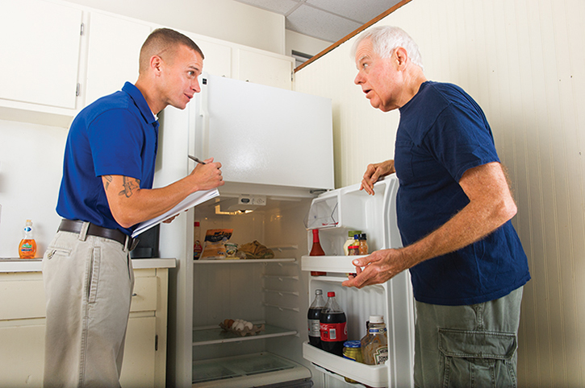
Implementing the Food Plan (2 of 9)
You need to know (cont’d):
Attitude toward change
Goals
Availability of nutritious food
© Jones & Bartlett Learning.
Notes:
Lecture Outline
e. Attitude toward change
f. The goals for this patient and recommended ways to accomplish them via the food plan
3. You need to understand not only what the patient eats and drinks but whether nutritious food is available to the patient and whether the person is able to shop for and prepare such food.

Slide 34
Implementing the Food Plan (3 of 9)
Approaching the patient
Communication, respect, trust
Acknowledge and validate patient’s feelings
© Jones & Bartlett Learning.
Notes:
Lecture Outline
B. Approaching the patient
1. The patient may feel some initial apprehension as he or she interacts with the community paramedic in a role usually associated with a nurse or a physician.
2. You can clarify that your role is to act as the “eyes and ears” of the physician, serving as part of the collaborative health care team that is assisting the patient in his or her recovery.
3. Gaining patients’ participation will require good communication based on respect, trust, and a willingness to examine lifelong assumptions about food and diet.
4. Acknowledge and validate their feelings, and help them understand that your goal is to clarify serious risks to their health and help implement a plan to mitigate these risks.

Slide 35
Implementing the Food Plan (4 of 9)
Personal preferences
Plan tailored to individual
Choices reflect customs, beliefs, habits
Patient’s budget
© Rawpixel.com/Shutterstock.
Notes:
Lecture Outline
C. Considering personal preferences
1. Personal food preferences need to be understood to create a functional food plan for a person.
2. On a very basic level, people choose foods based on taste, which may also incorporate smell and texture.
3. Food choices may also reflect customs, beliefs, and habits.
In particular, family and culture are often factors that define which foods a person does or does not like.
Religious observances may also determine what we eat and when.
4. Most of us are creatures of habit in terms of how frequently and at what times we eat.
5. Another consideration is the patient’s budget for food.
6. Each food plan must be tailored to the individual patient by the nutritionist.
a. If you discover a new piece of information while working with the patient, document this for consideration by the health care team.

Slide 36
Implementing the Food Plan (5 of 9)
Tools for the community paramedic
Food labels required to include:
A statement of identity
The net contents of the package
The name and address of manufacturer
The packer or distributor
A list of ingredients/nutritional information
May include preservatives and additives
Notes:
Lecture Outline
D. Tools for the community paramedic
1. Food labels
a. If necessary, community paramedics should educate patients on how to read and understand food labels.
b. Federal regulations specify what can and what cannot go on a food label and which foods are required to carry such labels.
i. Nutrition Labeling and Education Act (NLEA)
c. Food labels are required to include five elements:
i. A statement of identity
ii. The net contents of the package
iii. The name and address of the manufacturer
iv. The packer or distributor
v. A list of ingredients and nutritional information
d. Preservatives and additives must also be included, along with eight major food allergens:
i. Fish
ii. Soy
iii. Tree nuts
iv. Eggs
v. Wheat
vi. Peanuts
vii. Milk
viii. Crustaceans

Slide 37
Implementing the Food Plan (6 of 9)
Food labels (cont’d)
Nutrition facts enable consumers:
To determine whether product is nutritious
To have a basis of comparison with other products
Notes:
Lecture Outline
e. Nutrition facts enable consumers to determine whether a product is nutritious and offers them a basis of comparison with other products.

Slide 38
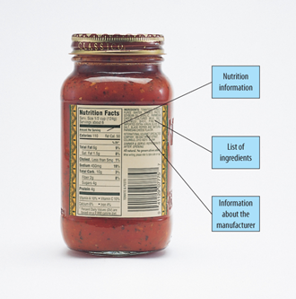
Implementing the Food Plan (7 of 9)
Food labels (cont’d)
Look at:
Serving size
Ingredients
Daily values
© Jones & Bartlett Learning.
Notes:
Lecture Outline
f. Attention should be paid to:
i. Serving size
ii. Ingredient list
iii. Daily values (dietary standards that compare the amount of nutrients in a food to the amount recommended for daily consumption)
iv. Health claims

Slide 39
Implementing the Food Plan (8 of 9)
Education
Prevent food-related diseases
Food safety
Food storage
Food preparation
© tab62/Shutterstock.
Notes:
Lecture Outline
E. Education
1. Food safety
a. Most food-related diseases are caused by:
i. Microorganisms introduced by unclean hands and food preparation surfaces
ii. Insufficient cooking
iii. Failure to refrigerate foods properly
b. Such microorganisms may be bacteria, viruses, or even parasites.
c. People who are young, old, or immunocompromised are most seriously affected.
d. Foodborne illness occurs when there is a pathogen, a host, and some sort of interaction between the two that results from ingestion of a particular food.
i. Some infections are caused directly by a pathogen; others stem from a toxin produced by a pathogen.
e. Food contamination can occur at any point from the farm or ranch to the grocer’s shelf to the consumer’s plate.
i. Contamination can also occur in crop fields, during food processing, by unsanitary food handling, or during food preparation.
ii. Measures to ensure food safety include checking the expiration dates on foods and not opening cans that are bulging at the top.
2. Food storage
a. When shopping or cooking:
i. Separate raw, cooked, and ready-to-eat foods
ii. Read the label of each product to identify its storage instructions
iii. Refrigerate perishables as soon as possible, and make sure the refrigerator is set at the optimal temperature
3. Food preparation
a. One of the most important steps patients can take to ensure food safety is to establish a safe and sanitary place to prepare food.
b. Some simple habits can eliminate many of the risks associated with food preparation:
i. Clean hands and cooking surfaces often, especially after handling raw foods and produce.
ii. Clean fruits and vegetables with cold water before eating.
iii. Refrigerate foods as soon as possible, and do not leave them out too long before cooking.
iv. Defrost foods in the refrigerator rather than at room temperature.
v. Avoid cross-contaminating foods.
vi. Ensure food is cooked at the proper temperature to kill pathogens. Thoroughly cooking eggs, for example, will lessen the risk of Salmonella infection.
vii. Avoid using unpasteurized milk or juice, raw sprouts, and undercooked meat or poultry.
viii. Use a clean cutting board. To clean the cutting board, wash it with hot water, soap, and a scrub brush, and then sanitize it in a dishwasher or with a bleach solution.
ix. Wash the tops of cans before opening them.
x. Do not eat raw dough made with eggs.
xi. Never place cooked food on the same surface where raw food was prepared without first washing the surface.
xii. Refrigerate leftovers as soon as possible and date them so they will not be left too long.

Slide 40
Implementing the Food Plan (9 of 9)
Fluid balance
Without water, cellular metabolism is impaired
Older adults
Reduced thirst response and/or kidney function
Measure of adequate hydration: color of urine
Notes:
Lecture Outline
4. Fluid balance
a. Water is essential to all body functions. Without it, cellular metabolism is impaired.
b. Older adults in particular should pay attention to how much water they consume, as they may have a reduced thirst response and/or reduced kidney function.
Patients should pay attention to their fluid intake and adjust it accordingly even when not driven by thirst.
How much fluid is enough depends on:
i. Age
ii. Size
iii. Body composition
iv. Activity level
v. The weather
e. One measure of adequate hydration is the color of urine.

Slide 41
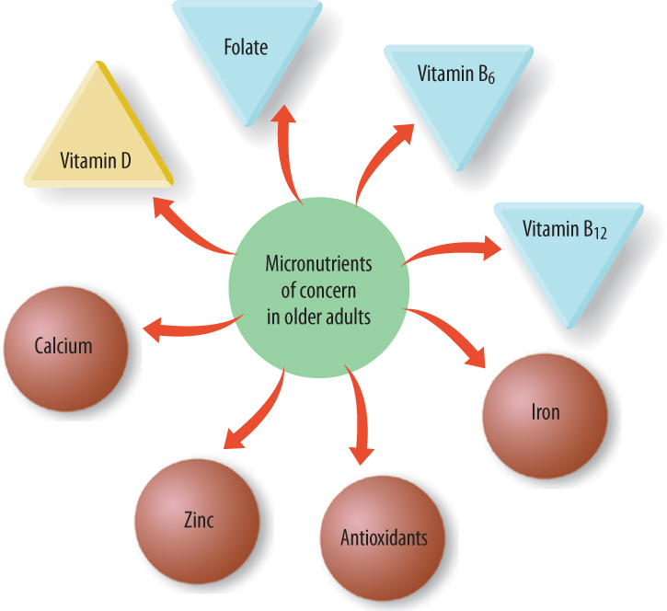
Nutritional Needs of Older Adults (1 of 2)
Older adults’ nutritional status
Age-related changes impact nutritional needs
Protein, vitamins
Fluids, fiber
© Jones & Bartlett Learning.
Notes:
Lecture Outline
XI. Nutritional Needs of Older Adults
A. Factors affecting older adults’ nutritional status
1. Age-related changes have a direct impact on nutritional requirements.
a. Decreased muscle mass in older adults creates a need for higher consumption of high-quality protein.
b. Decreased immune function creates a need for increased intake of vitamin B 6, antioxidants, vitamin E, zinc, and high-quality protein.
c. Increased gastric pH calls for increased vitamin D.
d. Decreased kidney function creates a need for increased fluids.
e. Increased oxidative stress, potential cognitive impairment, and degenerative eye issues call for greater amounts of antioxidants such as beta-carotene, vitamin C, and vitamin E.
f. Slowed gastric mobility means there is an increased need for fiber.

Slide 42
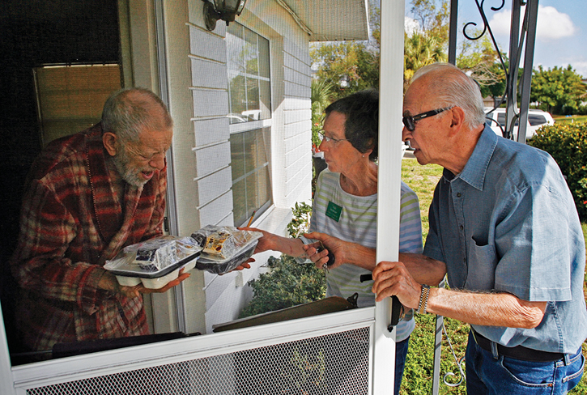
Nutritional Needs of Older Adults (2 of 2)
Meeting older adults’ nutritional needs
Medical conditions
Economic, social, physical challenges
Meals on Wheels
© ZUMA Press Inc/Alamy.
Notes:
Lecture Outline
B. Medical conditions affecting older adults’ nutritional status
1. Assessing mental health status is important in late adulthood.
2. Common medical conditions that affect older adults’ nutritional status are:
a. Depression
b. Anorexia (loss of appetite)
c. Alzheimer disease
d. Arthritis
e. Bowel and bladder regulations issues
f. Dental health problems
g. Vision issues
h. Osteoporosis
i. Weight issues
3. All of these conditions can occur in concert with chronic medical conditions, and all of them can affect the patient’s ability to prepare, eat, and metabolize food.
C. Meeting the nutritional needs of older adults
1. Challenges to older people in terms of obtaining adequate nutrition may include:
a. Economic factors (low or fixed income)
b. Social isolation
c. Physical restrictions
d. Inability to shop for and prepare food
2. For those still living independently, services such as Meals on Wheels or other senior nutrition programs can be valuable in ensuring adequate nutrition.
3. As a community paramedic you should be aware of the various resources in your community.

Slide 43
Nutritional Needs of Patients With Chronic Diseases (1 of 8)
Dietary care should take all patient comorbidities into consideration
May affect nutritional status
Often involve special dietary restrictions
Community paramedic should consider interactions of medications and supplements
Notes:
Lecture Outline
XII. Nutritional Needs of Patients With Chronic Diseases
Dietary care should take into consideration all patient comorbidities
1. They may affect nutritional requirements for the individual patient.
2. Often chronic medical conditions will involve special dietary considerations that may be new and unfamiliar to the patient.
3. The community paramedic should also consider how certain foods will interact with the patient’s prescription medications and over-the-counter supplements.

Slide 44
Nutritional Needs of Patients With Chronic Diseases (2 of 8)
Diabetes
Recommendations for Type 1
Healthy eating
Physical activity
Insulin by injection
© BSIP SA/Alamy.
Notes:
Lecture Outline
B. Diabetes
1. According to the Centers for Disease Control and Prevention, 29.1 million people have diabetes and of those 29.1 million, 8.1 million are undiagnosed.
2. Stress, illness, obesity, lack of exercise, and a history of gestational diabetes increase the risk of developing diabetes, but the most certain predictive factor is family history.
3. Nutritional needs
a. The typical Western diet, which contains too much fat and not enough fruits, vegetables, and fiber, raises a person’s risk of developing diabetes.
i. Exacerbated by the lack of exercise common in the Western culture
ii. In particular, the risk of developing type 2 diabetes increases with weight gain, and the most significant factor in risk reduction is weight loss.
b. Regular exercise improves carbohydrate and lipid metabolism, lowers blood pressure, and reduces the risk of heart disease.
c. People with diabetes need to closely monitor their food intake.
d. Well-balanced meals in the right amounts will help maintain healthy glucose blood levels.
e. With diabetes, it is as important to monitor how one eats as much as what one eats.
f. Consistent calorie and carbohydrate intake helps keep blood glucose from spiking or dropping.
4. Challenges
a. With patients who have type 1 diabetes, challenges may be caused by the long-term effects of the disease, such as:
i. Blindness
ii. Nerve damage
iii. Amputations
b. Older adults with diabetes may also have other chronic diseases such as:
i. Renal insufficiency
ii. Chronic obstructive pulmonary disease
iii. Heart disease
c. Such comorbidities create a challenge for the community paramedic who is trying to address nutritional issues related to all of these different disease states.
d. Some patients with chronic diabetes may have cognition and memory issues or may be depressed.
e. Encourage and support healthy eating habits while honoring the dietary preferences of the patient.
5. Recommendations
a. For patients with type 1 diabetes, the best management principles include:
i. Healthy eating
ii. Physical activity
iii. Insulin by injection
iv. Closely monitoring blood glucose concentration

Slide 45
Nutritional Needs of Patients With Chronic Diseases (3 of 8)
Diabetes (cont’d)
Recommendations for Type 2
Healthy eating
Physical activity
Blood glucose testing
Weight control (most important factor)
Notes:
Lecture Outline
b. Patients with type 2 diabetes can also benefit from:
i. Healthy eating
ii. Physical activity
iii. Blood glucose testing
iv. Weight control is the single most important factor.
c. In general, as a community paramedic working with patients with diabetes, you should address their nutritional needs based on:
i. Personal and cultural preferences
ii. Access to food options
iii. Willingness to make behavioral changes

Slide 46
Nutritional Needs of Patients With Chronic Diseases (4 of 8)
Chronic obstructive pulmonary disease (COPD)
Recommendations
Keep up energy
Weight management
Reduce carbon dioxide levels (avoid cereal, white bread, pasta, rice)
Notes:
Lecture Outline
C. Chronic obstructive pulmonary disease
1. Chronic obstructive pulmonary disease (COPD) is a collective term that includes emphysema and chronic bronchitis.
2. Both of these conditions obstruct airflow into and out of the lungs, as a result of loss of elasticity and/or inflamed airways that may also be clogged with mucus.
3. Nutritional needs
a. Nutritional goals for patients with emphysema revolve around providing adequate energy to minimize unwanted weight loss and loss of lean body mass and to prevent malnutrition.
b. The patient’s high energy needs can be met by following a healthy, balanced diet.
c. Patients with chronic bronchitis have excess mucus secreting into their bronchial tubes, which may compromise breathing and lung capacity.
d. Nutritional goals should be aimed at keeping the patient at a healthy weight, which will help to facilitate breathing and preventing malnutrition.
e. The pulmonary status of patients with COPD may be improved by reducing carbon dioxide levels.
i. Both carbon dioxide and carbon monoxide are produced by the metabolism of refined carbohydrates.
ii. Patients should avoid sugary foods such as cereal, white bread, and large amounts of pasta or rice.
4. Challenges
a. Weight is a common problem for patients with COPD, albeit in opposite ways for patients with emphysema and those with chronic bronchitis.
i. Patients with emphysema tend to be underweight.
ii. Patients with chronic bronchitis tend to be overweight.
b. Good nourishment is necessary for patients with emphysema to meet their energy needs
c. Patients with chronic bronchitis need to strive to keep off weight.
d. A hallmark of COPD is retention of carbon dioxide, which will make a patient feel weak and tired.
e. The consumption of foods that reduce carbon dioxide levels will, therefore, help keep their energy up and increase their quality of life.
f. Symptoms commonly noted with COPD can interfere with eating or the enjoyment of eating:
­i. Dyspnea may interfere with swallowing and chewing or cause mouth breathing, which can alter the taste of food.
ii. Chronic mucus production causes frequent coughing.
iii. Certain medications may have side effects that interfere with a normal appetite and cause anorexia.
iv. Loss of appetite may occur secondary to fatigue.
5. Recommendations
a. Obese people with COPD need to manage their weight yet keep up their energy to deal with breathing problems.

Slide 47
Nutritional Needs of Patients With Chronic Diseases (5 of 8)
COPD (cont’d)
Reduce snacking
Reduce intake of sugary/fatty foods
Wear a cannula
© abalcazar/Getty.
Notes:
Lecture Outline
b. They should eat three regular balanced meals but reduce snacking; make vegetables a large part of each meal; if they need a snack, make it fruit; and reduce intake of sugary and fatty foods.
c. The goal should be to deter weight gain and gradually lose the excess weight.
For patients who occasionally depend on oxygen, it may be beneficial to wear a cannula while eating, as both eating and digestion require extra oxygen.
When patients with COPD experience exacerbations of their disease, the following measures may prove helpful:
i. Instead of eating large meals, eat smaller meals more frequently.
ii. Consider softer foods that do not require much chewing. Consume with nutrient-rich drinks made with fortified milk.
iii. Eat slowly and chew foods thoroughly to avoid swallowing air.

Slide 48
Nutritional Needs of Patients With Chronic Diseases (6 of 8)
Congestive heart failure (CHF)
Recommendations
Provide sufficient calories for healthy weight
Provide protein needed for energy
Monitor sodium and fluid intake
Notes:
Lecture Outline
D. Congestive heart failure
1. Congestive heart failure (CHF) may occur after a myocardial infarction or as a result of diseased or damaged heart valves, coronary artery disease, or chronic hypertension.
2. Nutritional needs
a. Increased energy needs of the heart and lungs along with a potential decrease in food intake secondary to early satiety and fatigue commonly lead to protein malnutrition in patients with heart failure.
b. This combination can also lead to weight loss.
c. The diet should include sufficient calories to maintain a healthy weight and should provide the protein needed for energy.
3. Challenges
a. The most important nutritional care goals are to ensure adequate protein and monitor sodium and fluid intake, especially for patients suffering from CHF.

Slide 49
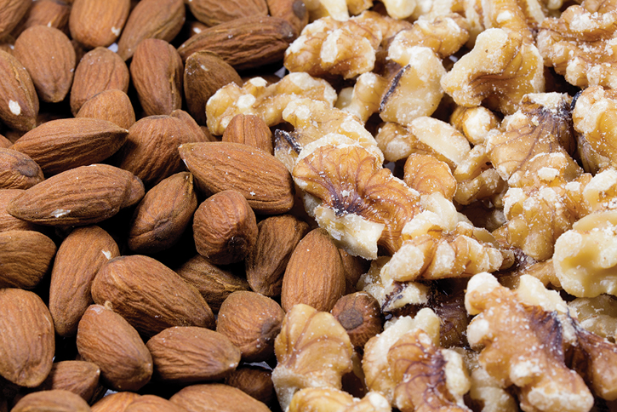
Nutritional Needs of Patients With Chronic Diseases (7 of 8)
CHF (cont’d)
Follow heart-healthy diet
Lower fat and cholesterol
Nuts
© Wlad74/Shutterstock.
Notes:
Lecture Outline
4. Recommendations
a. CHF is a heart problem, so follow recommendations for a heart-healthy diet.
b. Lowering fat and cholesterol intake means:
i. Avoiding fatty cuts of meat
ii. Avoiding fried foods
iii. Eating more fish
iv. Using fat-free and low-sodium milk and dairy products
v. Eating mostly whole-grain cereals and breads
vi. Using canola or olive oil
vii. Limiting the use of mayonnaise, margarine, butter, and sour cream
c. Patients should prefer consumption of:
i. Poultry
ii. Fruits
iii. Green leafy vegetables
iv. Whole grains
v. Legumes
vi. Flaxseed
vii. Canola oil
viii. Soybeans
d. Nuts will increase the levels of beneficial omega-3 fatty acids, which:
i. Inhibit platelet aggregation
ii. Mute the inflammatory immune response
iii. Act as mild vasodilator

Slide 50
Nutritional Needs of Patients With Chronic Diseases (8 of 8)
Mental health
Disorders are common in the United States
Omega-3 fatty acids
Folate supplementation
Limit caffeine, increase fruits and vegetables, ensure good fluid intake
Notes:
Lecture Outline
E. Mental health
1. Mental health disorders are common in the United States.
2. In some cases, a mental health disorder is the primary condition; in other cases, they coexist with other illnesses.
a. Example: A patient who is suffering from depression because of a debilitating health condition such as COPD.
3. Nutritional needs
a. Omega-3 fatty acids may reduce the severity of some mental health conditions, such as:
i. Alzheimer disease
ii. Depression
iii. Bipolar disorder
b. Folate supplementation, in addition to medication, has been found to help reduce symptoms in patient with:
i. Depression
ii. Bipolar disorder
iii. Schizophrenia
4. Challenges
a. People living with mental illness may also be living with substance abuse disorders.
b. As a community paramedic, you may not be able to change that behavior, but you should be aware of the nutritional deficiencies and medical conditions associated with abuse of specific substances.
c. If the substance abuse causes periods of altered behavior, the patient may be unwilling or unable to shop, prepare food, and pay attention to nutritional needs.
d. Although medications for mental disorders are helpful, their side effects can be problematic and may have implications for the patient’s diet and nutritional status.
e. Consult a medication reference guide to see if there are any potential food interactions with medications that the patient is taking.
5. Recommendations
a. Because people with mental illness may have problems maintaining normal sleep patterns, caffeine intake should be limited to 1 to 2 cups per day and preferably limited to the morning hours to avoid sleep disruption.
b. Neuroleptic medications can also cause constipation. Eating fruits, vegetables, and whole grains and ensuring good fluid intake will help patients avoid this problem.
c. Patients with mental illness may need a more rigid food plan from the nutritionist.

Slide 51
Patients With Special Diets (1 of 2)
Vegetarian diets can be incomplete
Diets of vegans may be deficient in:
Zinc
Calcium
Vitamin D
Riboflavin
Iron
Vitamin B₁₂
Notes:
Lecture Outline
XIII. Patients With Special Diets
A. Reasons for special diets include:
1. Personal preferences like vegetarianism or veganism
2. Religious dictates
3. Management of disease
4. Food allergies
5. Weight management
B. Vegetarian diets
1. Reasons people become vegetarians:
a. An aversion to eating animal products
b. Religious beliefs
c. Environmental concerns
d. Meat is not available
e. They believe a vegetarian diet is helpful.
2. Subgroups of vegetarians include:
a. Lacto-ovo-vegetarians
b. Vegans
c. Fruitarians
d. Pesco-vegetarians
e. Similar diets include the Mediterranean, macrobiotic, and Paleolithic diets.
3. Vegetarian diets are beneficial in that they are low in fat and cholesterol and are high in magnesium and folate. Fresh fruits and vegetables provide higher amounts of antioxidants, as well as dietary fiber and phytochemicals.
4. Vegetarians are less likely to develop heart disease due to lower blood cholesterol levels. They also have lower incidence of prostate and colorectal cancer.
5. Nevertheless, vegetarian diets can be incomplete—especially the more restrictive ones.
6. The diets of vegans may be deficient in:
a. Zinc
b. Calcium
c. Vitamin D
d. Riboflavin
e. Iron
f. Vitamin B₁₂
7. Fruitarian and macrobiotic diets may lack even more essential nutrients.
C. Strategies to assist patients with special diets
1. The key with any special diet is to get a clear picture of which dietary restrictions may exist and why.
2. You need to clarify the absolute “do’s and don’ts” based on patient request.
3. If those mandates eliminate certain essential nutrients, the food plan from the nutritionist must consider alternative and acceptable ways to provide them.

Slide 52
Patients With Special Diets (2 of 2)
Recommendations for vegetarians
Grains, vegetables, legumes, nuts
Protein-rich foods
Eggs/dairy
© Fudio/iStock/Getty.
Notes:
Lecture Outline
D. Alternative sources of nutrients
1. Recommendations for vegetarians include specific amounts of:
a. Grains
b. Vegetables
c. Legumes
d. Nuts
e. Other protein-rich foods
2. Those people who eat eggs and dairy products can more easily meet their need for protein.
3. Vegans who eat a variety of grains, vegetables, and legumes may also meet the protein requirement.
4. Besides choosing a variety of foods, other recommendations include:
a. Choosing whole, unrefined foods
b. Avoiding sweetened and fatty foods

