Slide 1
THE RESCUE COMPANY 1

Slide 2
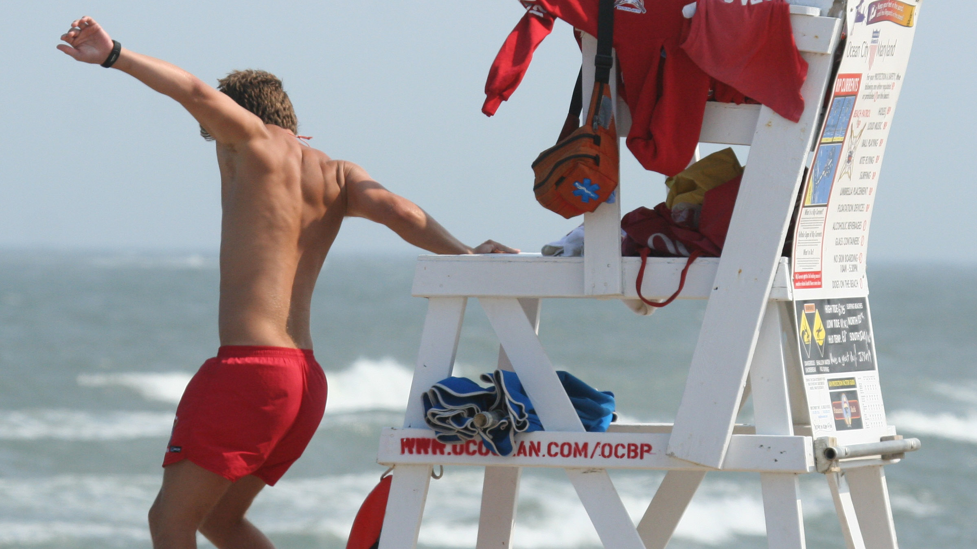
BASIC RESCUE EQUIPMENT

Slide 3
Rescue Tube
The rescue tube is a 45- to 54-inch vinyl, foam-filled tube with an attached tow line and shoulder strap
When performing patron surveillance, a lifeguard should always keep a rescue tube ready to use.
Keep the strap of the rescue tube over the shoulder and neck.

Slide 4
Rescue Tube
Hold the rescue tube across the thighs when sitting in a lifeguard chair or across the stomach when standing.
Hold the excess line to keep it from getting caught in the chair or other equipment when starting the rescue.

Slide 5
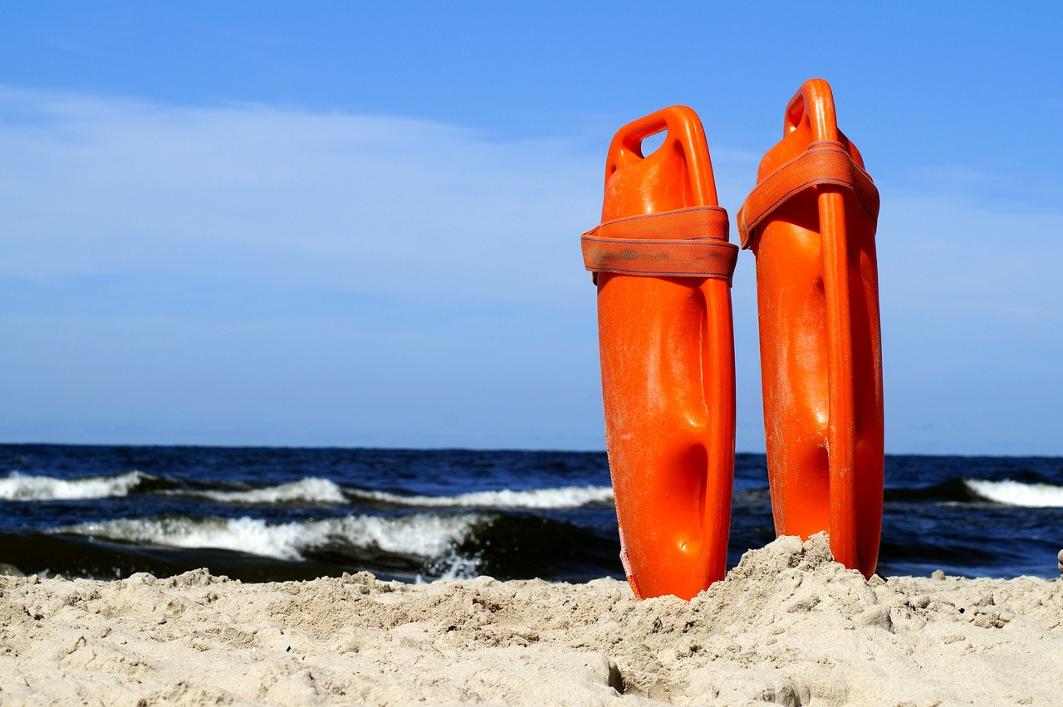
Rescue Tube

Slide 6
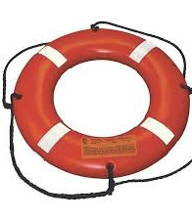
Ring Buoy
The ring buoy is made of buoyant material typically rang­ing from 20 to 30 inches in diameter

Slide 7
Ring Buoy
A ring buoy with an attached line allows the lifeguard to pull the vic­tim to safety without entering the water.
The typical line length ranges from 30 to 60 feet.

Slide 8
Rescue Board
Some waterfronts use rescue boards as standard equip­ment.
Rescue boards are made of plastic or fiberglass and are shaped similar to a surfboard

Slide 9
Rescue Board
The res­cue board is fast, stable and easy to use.
It is used by lifeguards to quickly paddle out long distances and can hold the lifeguard and one or more victims.

Slide 10
Rescue Board
Hold onto the sides about mid-board when entering the water
When the water is knee-deep, lay the rescue board on the water and push it forward.
Climb on just behind the middle and lie down

Slide 11
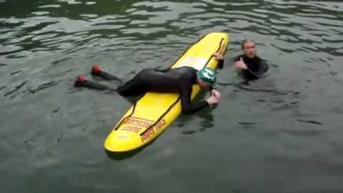
Rescue Board
Paddle until reaching the victim.
To effec­tively paddle and keep the victim in sight
Paddle a few strokes and get into a kneeling position.
When patrolling on a rescue board, sit or kneel on it for better visibility.

Slide 12
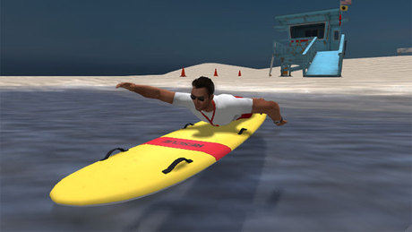
Rescue Board
In calm water, point the bow (front end) of the rescue board toward the victim.
From a kneeling position, paddle with both arms mov­ing and recovering at the same time.

Slide 13
Rescue Board
From the prone position, paddle with either an alternating arm movement (front crawl arm stroke) or with both arms moving and recovering at the same time.

Slide 14
Rescue Board
Keep the head up and keep the victim in sight.
In rough water or high winds, adjust the angle of ap­proach as needed.

Slide 15
To rescue a distressed swimmer or active victim with a rescue board
Approach
Approach the victim from the side so that the side of the board is next to the victim
Grasp
Grasp the victim's wrist and slide off the rescue board on the opposite side.
Help
Help the victim reach his or her arms across the res­cue board. Encourage the victim to relax and be calm
Kick
Kick to turn the board toward shore.

Slide 16
To rescue a distressed swimmer or active victim with a rescue board
Hold
Hold the rescue board stable and help the victim onto it.
Tell
Tell the victim to lie on his or her stomach facing the bow.
Make
Make sure that the bow is not underwater .
Climb
Carefully climb onto the board from the back with the lifeguard's chest between the victim's legs.

Slide 17
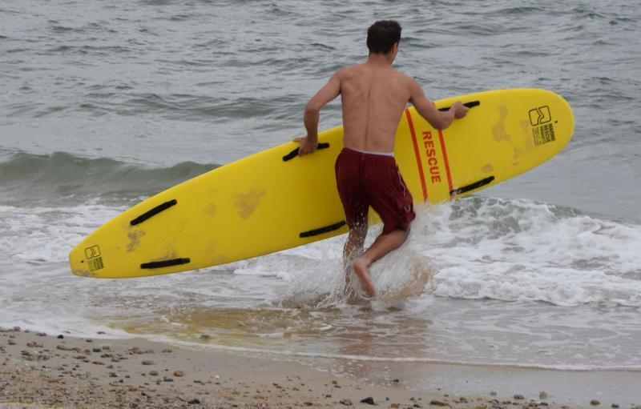
To rescue a distressed swimmer or active victim with a rescue board
Paddle the rescue board to shore.
Slide off the board and help the victim off the board and onto shore with a walking assist.

Slide 18
unconscious or cannot hold or climb onto the rescue board
Approach the victim from the side.
Posi­tion the board so that the victim is slightly forward of the middle of the board.

Slide 19
unconscious or cannot hold or climb onto the rescue board
Grasp the victim's hand or wrist and slide off the board on the opposite side, flipping the rescue board over to­ward the lifeguard.
Hold the victim's arm across the board with the victim's chest and armpits against the far edge of the board

Slide 20
unconscious or cannot hold or climb onto the rescue board
Grasp the far edge of the rescue board with the other hand.
Kneel on the edge of the rescue board using the life­guard's own body weight to flip the board toward the lifeguard again
Catching the victim's head as the board comes down.

Slide 21
unconscious or cannot hold or climb onto the rescue board
Position
Position the victim lying down lengthwise in the middle of the board with the victim's head toward the bow.
Kick
Kick to turn the board toward shore.
Climb
Carefully climb onto the board from the back with the chest between the vic­tim's legs.

Slide 22
unconscious or cannot hold or climb onto the rescue board
Be careful not to tip the rescue board and keep the legs in the water for stability.
Paddle the rescue board to shore.

Slide 23
Using Watercraft for Rescues
Lifeguard should practice to become skilled in managing them in all rescue situations and all-weather conditions.
To use a watercraft for rescues, the lifeguard should follow these basic guidelines:

Slide 24
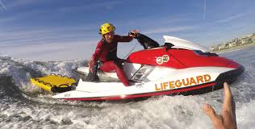
Watercraft guidelines
Extend an oar to the victim and pull him or her to the stern (rear) of the craft.
It is the most sta­ble area on which to hold.

Slide 25
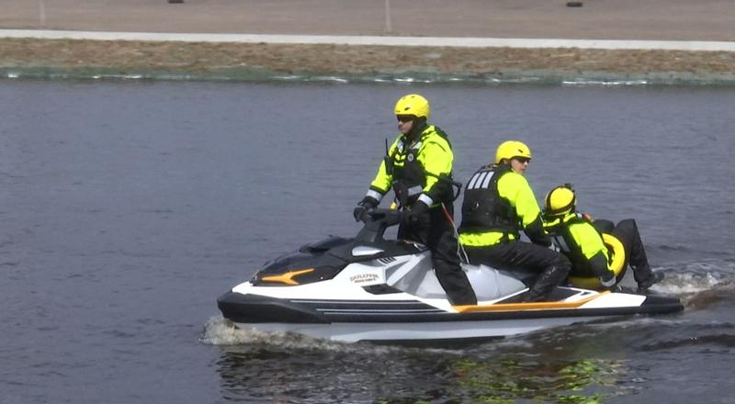
Watercraft guidelines
If the victim cannot hold the oar or equipment, move the stern close to the victim.
Pull the victim to the stern by the wrist or hand.

Slide 26
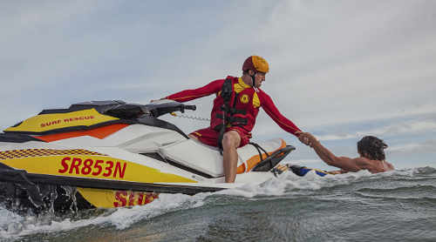
Watercraft guidelines
Have the victim hang onto the stern while moving the watercraft to safety.
If the victim needs to be brought onto the craft be­cause the water is very cold or the victim is fatigued, help the victim over the stern

Slide 27
When using a motorized watercraft
Approach
Always approach the victim from downwind and downstream.
Shut off
Shut off the engine about three boat-lengths from the victim, and coast or paddle to the victim.
Bring
Bring the victim on board before restarting the engine.

Slide 28
Mask and Fins
A mask and fins should be used in an underwater search for a missing person.
Use well-maintained equipment that is sized properly and fits well.

Slide 29
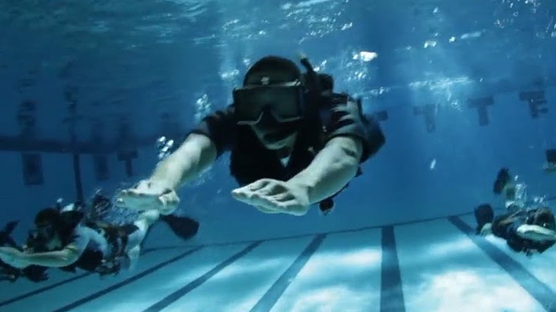
Mask
A mask is made up of soft, flexible material, with non­-tinted, tempered safety glass and a head strap that is easily adjusted.
A mask should be chosen that allows blocking or squeezing of the nose to equalize pressure.

Slide 30
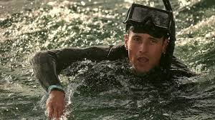
Mask
Some masks have additional features such as molded nosepieces or purge valves.
Regardless of the design, proper fit is the primary concern.

Slide 31
To check that a mask fits properly
Place the mask against the face without using the strap.
Keep hair out of the way.
Inhale slightly through the nose to create a slight suc­tion inside the mask.
This suction should keep the mask in place without being held.

Slide 32
To check that a mask fits properly-
A good fit keeps wa­ter from leaking into the mask.
Adjust the strap so that the mask is comfortable.
If it is too tight or too loose, the mask may not seal properly.

Slide 33
To check that a mask fits properly-
Try the mask in the water.
If it leaks a little, tighten the strap.
If it continues to leak, check it again with suc­tion.
A different size may be needed

Slide 34
To check that a mask fits properly-
To prevent the mask from fogging, rub saliva on the inside of the face plate, and rinse the mask before putting it on.
Commercial defoggers also can be used.

Slide 35
Fins
Fins provide more speed and allow users to cover greater distances with less effort.
A good fit is impor­tant for efficient movement.

Slide 36
Fins
Fins come with different sized blades.
Larger fins are faster but require more leg strength.
Fins should match the user's ability.

Slide 37
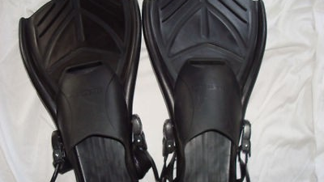
Fins
Wetting the feet and fins first makes it easier to put them on.
Do not pull the fins on by the heels or straps of the fins.
This can cause a break or tear.
Push the foot into the fin, and then slide the heel or strap up over the heel.

Slide 38
Fins
Use a modified flutter kick that has a kicking action that is deeper and slower, with a little more knee bend, than the usual flutter kick.

Slide 39
Fins
It is easier to swim underwater using only the legs.
Keep the arms relaxed at the side.
In murky water, hold the arms out in front to protect the head.

Slide 40
Entering the Water with Mask and Fins
It is important for lifeguards to learn how to enter the wa­ter safely while wearing the equipment.
Lifeguards should enter using a slide-in entry or with a stride jump when entering from a height of less than 3 feet.
Never en­ter head-first wearing a mask and fins.

Slide 41
Entering the Water with Mask and Fins
Put one hand over the mask to hold it in place, keeping the elbow close to the chest.
Make sure no swimmers or other objects are below.

Slide 42
Entering the Water with Mask and Fins
Step out with a long stride over the water, but do not lean forward.
While entering the water, the fins slow the downward motion.
Swim keeping the arms at the side and face in the water.

