Slide 1
Fourth Edition
Lesson 6: Pediatric Cardiac Events
Notes:
Instructor Notes
Welcome to Lesson 6: Pediatric Cardiac Events. This lesson will discuss the most common pediatric dysrhythmias and management of the cardiac arrest patient.

Slide 2
Lesson Objectives
Identify the major classifications of pediatric cardiac rhythms.
Differentiate between pediatric cardiac events.
Discuss management of pediatric dysrhythmias.
Explain the epidemiology of sudden cardiac arrest.
Discuss management of post resuscitation care.
Notes:
Instructor Notes
Discuss the learning objectives and the importance of thoroughly understanding each one.
Identify the major classifications of pediatric cardiac rhythms.
Differentiate between pediatric cardiac events.
Discuss management of pediatric dysrhythmias.
Explain the epidemiology of sudden cardiac arrest.
Discuss management of post resuscitation care.

Slide 3
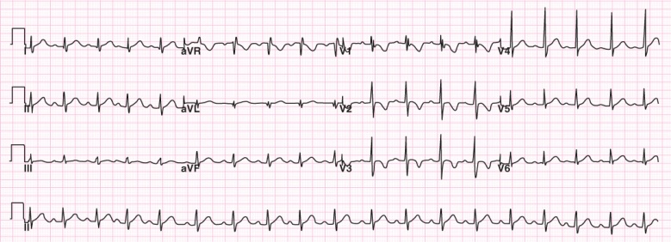
Normal Pediatric ECG
Heart rate >100 beats/min
Rightward QRS axis
Notes:
Instructor Notes
Additional information in the highlighted sections is important!
Discuss the expected normal pediatric ECG.
Normal QRS axis in neonates and infants
At birth, all neonates have a rightward axis because of relative right ventricular hypertrophy.
Most pronounced at 1 to 2 months of age. The axis slowly migrates from right to left as the left ventricular myocardium hypertrophies to account for the postnatal increase in systemic vascular resistance.
A normal axis is expected to be seen by age 6 months. A persistent rightward axis can be indicative of congenital heart disease or a cardiomyopathy.
T waves
The precordial T-wave configuration changes over time.
For the first week of life, T waves are upright throughout the precordial leads.
After the first week, the T waves become inverted in V1-3 (juvenile T-wave pattern).
This T-wave inversion usually remains until ~ age 8; thereafter, the T waves become upright in V1-3.
However, the juvenile T-wave pattern can persist into adolescence and early adulthood.
Q waves
Narrow (average 0.02 seconds and less than 0.03 seconds).
Usually less than 5 mm deep in left precordial leads and aVF.
May be as deep as 8 mm in lead III in children younger than 3 years.
Expand on abnormal Q waves if they:
Appear in the right precordial leads (i.e., V1, as with severe RVH).
Are absent in the left precordial leads (e.g., LBBB).
Are abnormally deep (ventricular hypertrophy of the volume-overload type).
Are abnormally deep and wide (myocardial infarction or fibrosis).
Right ventricular dominance is common in young children and replaced by left ventricular dominance gradually.
Dominant R wave in V1-3.
Normal for pediatrics and young adults.
RSR’ pattern in V1.
Typically resolves by 3 years of age but may remain in some pediatrics until 8 to 12 years of age.

Slide 4
Pediatric Cardiac Rhythms
Tachycardia
Bradycardia
Pulseless ventricular tachycardia
Ventricular fibrillation
Pulse electrical activity (PEA)
Asystole
Notes:
Instructor Notes
55.1 in 100,000 children experience arrythmias that require emergency care.
Discuss the various pediatric cardiac rhythms.
Tachycardia
Elevated heart rate than expected normal for age.
Review expected high heart rates for the various age groups.
Can be narrow complex or wide complex.
Bradycardia
Decreased heart rate than expected normal for age.
Review expected low heart rates for the various age groups.
Pulseless ventricular tachycardia
Coordinated ventricular contractions replaced with rapid, ineffective contractions.
Insufficient organ perfusion and heart failure.
Ventricular fibrillation
Rapid and irregular electrical impulses causing the ventricles of the heart to quiver, cutting off blood supply to the vital organs.
Pulse electrical activity (PEA)
Organized cardiac electrical activity with the absence of a palpable pulse.
No organ perfusion.
Asystole
No visible electrical activity on the ECG.
Referred to as a flatline.

Slide 5
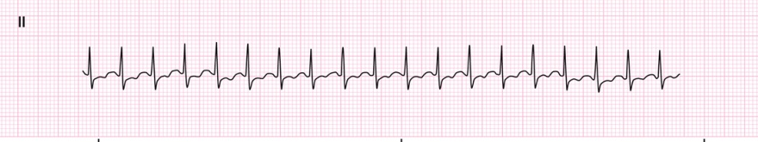
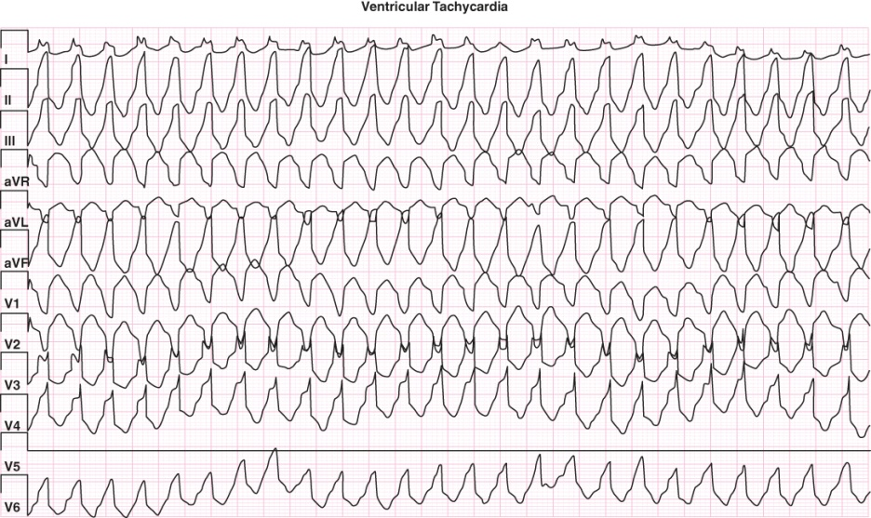
Tachycardias
Supraventricular Tachycardia
Ventricular Tachycardia
Notes:
Instructor Notes
In infants and children, a tachycardia is present if the heart rate is faster than the upper limit of normal for the patient’s age.
A tachycardia may represent either a normal compensatory response to the need for increased cardiac output or oxygen delivery or an unstable dysrhythmia.
HR is usually less than 220 beats per minute in infants or 180 beats per minute in children.
Supraventricular tachycardia
Most common symptomatic dysrhythmia of childhood.
Onset of the rhythm occurs abruptly.
HR is usually more than 220 beats per minute in infants or 180 beats per minute in children.
Ventricular tachycardia
Relatively uncommon in infants and children, but it may be seen in children who have had cardiac surgery, myocarditis, cardiomyopathy, or myocardial tumor.
Other causes of VT include long QT syndrome, electrolyte imbalances, acquired heart disease, drug toxicity, and idiopathic causes.
May be monomorphic or polymorphic.
Child can present as stable or unstable.

Slide 6
Physical Findings
Infants
Fussiness
Lethargy
Irritability
Poor feeding
Sweating during feeding
Children
Lightheadedness
Syncope
Dyspnea
Weakness
Nervousness
Palpitations
Chest pain/pressure
Notes:
Instructor Notes
Discuss the physical findings, which often include the following:
Infants
History of fussiness, lethargy, irritability, poor feeding, and sweating during feeding.
Pallor, cough, and respiratory distress may be observed if heart failure is present.
Infants may tolerate the rapid ventricular rate associated with SVT for 24 hours, but approximately 50% of them will develop signs of heart failure within 48 hours and may deteriorate rapidly.
Children
Lightheadedness, syncope, dyspnea, weakness, nervousness.
Complaints of palpitations, dizziness, and chest pain or pressure.
Signs of shock may be evident depending on the duration and rate of the tachycardia.
A child with normal cardiovascular function may tolerate a rapid ventricular rate for several hours before signs of heart failure or shock develop.

Slide 7
SVT Treatment
Used with permission of the American Academy of Pediatrics, Pediatric Education for Prehospital Professionals, © American Academy of Pediatrics, 2000
© Jones and Bartlett Publishers. Courtesy of MIEMSS.
© bymuratdeniz/ E+/Getty Images
© natnaree sangkaew/Shutterstock
© diy13/Shutterstock
Notes:
Instructor Notes
Discuss the treatment options for SVT.
Complete the PAT and perform an initial assessment and obtain a focused history, including family history for ventricular dysrhythmias or sudden death.
Administer oxygen, if indicated; ensure effective oxygenation and ventilation.
Apply cardiac monitors and establish vascular access.
Identify the cardiac rhythm (including rate, QRS width, and regularity).
Obtain a 12-lead ECG but do not delay emergency care.
Stable vs. unstable
If the child is STABLE, consider vagal maneuvers, adenosine, and transport.
If the child is UNSTABLE, consider sedation and synchronized cardioversion.

Slide 8
SVT Treatment
Stable
Vagal maneuvers
Fluid administration
Adenosine
Unstable
Consider sedation
Synchronized cardioversion
Notes:
Instructor Notes
Stable
Vagal Maneuvers:
Vagal maneuvers are recommended as first-line option.
Apply ice pack to face but do not occlude mouth and nose.
Blow through a partially occluded straw.
Blow into a 10mL syringe for 15 seconds.
Fluid Administration:
20ml/kg fluid bolus (sometimes a little fluid is all they need).
Adenosine:
Adenosine acts at specific adenosine receptors to cause a temporary block of conduction through the AV node, interrupting these reentry circuits.
1st dose 0.1mg/kg rapid IV push
2nd dose 0.2mg/kg rapid IV push
Unstable:
Sedation
Consider sedation with midazolam 0.05mg/kg IV/IO
Synchronized cardioversion rarely needed
Initial 0.5-1J/kg
Repeat at 2J/kg
Discuss additional treatment options
Perform synchronized cardioversion if unstable
A study supports a decreased reaction to the first dose of adenosine and greater chances of adenosine-refractory SVT in younger children.
Contact medical control if SVT persists after adenosine dose(s).
PEARLS:
Discuss treatment options in your area and how they may vary per organization
Do not separate child from the caregiver.
Monitor for respiratory depression and hypotension after sedation.
Continuous pulse oximetry and end tidal CO2 should be monitored.
Document all rhythm changes and interventions with ECG.

Slide 9
Ventricular Tachycardia Treatment
Used with permission of the American Academy of Pediatrics, Pediatric Education for Prehospital Professionals, © American Academy of Pediatrics, 2000
© Jones and Bartlett Publishers. Courtesy of MIEMSS.
© bymuratdeniz/ E+/Getty Images
© natnaree sangkaew/Shutterstock
© diy13/Shutterstock
Notes:
Instructor Notes
Discuss the treatment options for ventricular tachycardia
Complete the PAT and perform an initial assessment and obtain a focused history, including family history for ventricular dysrhythmias or sudden death.
Administer oxygen if indicated; ensure effective oxygenation and ventilation.
Apply cardiac monitors and establish vascular access.
Identify the cardiac rhythm (including rate, QRS width, and regularity).
Obtain a 12-lead ECG but do not delay emergency care.
Stable vs Unstable
If the child is
STABLE contact medical control and consider giving adenosine IV to help differentiate SVT from VT.
UNSTABLE, consider sedation and electric cardioversion.
If the child does NOT HAVE A PULSE, START CPR.

Slide 10
Ventricular Tachycardia (With Pulse) Treatment
Stable
Fluid administration
Consider adenosine
Unstable
Consider sedation
Synchronized cardioversion
Notes:
Instructor Notes
Discuss other potential causes with students:
Hyperkalemia
Tricyclic overdose
Consider sodium bicarbonate 1mEq/kg early in the intervention.
Stable
Consider contacting medical control for adenosine to differentiate SVT from VT.
Give adenosine IV to help differentiate SVT from VT.
First dose: 0.1 mg/kg rapid IV push.
Second dose: 0.2mg/kg rapid IV push.
Unstable
Sedation
Consider sedation with midazolam 0.05 mg/kg IV/IO.
Synchronized cardioversion
Initial 0.5‒1 J/kg.
Repeat at 2 J/kg.
Discuss additional treatment options.
Perform synchronized cardioversion if patient is unstable.
Consider other antiarrhythmics based on system protocols or phone consultation with pediatric specialist and/or medical director.
Amiodarone vs. lidocaine
Amiodarone not shown to be superior. Contact medical control if considering amiodarone, because it may affect further treatment.
A study shows that adverse effects of amiodarone are dose related and common in pediatrics.
Dose-related risks of amiodarone IV should be considered with continuous arrythmias in pediatrics.
PEARLS
For witnessed/monitored ventricular tachycardia, try having the child cough.
Maximum dose of antiarrhythmic should be given before changing to another antiarrhythmic.
Obtain a 12-lead after conversion.
Closely monitor the child’s blood pressure and ECG during transport.

Slide 11
Case Study
Dispatch
  It is 4:30 a.m. You and your partner are responding to a 12-month-old female who “won’t stop crying” at a two-story family residence. Outside temperature is 77°F (25°C).
Notes:
Instructor Notes
For students other than prehospital practitioners, dispatch information can be modified.
What are your initial concerns and possible differential diagnosis from the dispatch information?
Initial impression begins when the dispatch information is received.
Initial concerns:
Child is fussy, “won’t stop crying” with flulike symptoms.
Differential diagnosis:
COVID-19
Influenza
Dehydration
Maltreatment/nonaccidental trauma
Intussusception/abdominal pain
Cardiac dysrhythmia
Accidental ingestion
Discuss the importance of scene assessment and awareness.
Expand on how it applies to this case.
Case 1 involves a 12-month-old female with fussiness and crying all night.
Diagnosis: SVT.

Slide 12

Initial Observations
© christinarosepix/Shutterstock
Used with permission of the American Academy of Pediatrics, Pediatric Education for Prehospital Professionals, © American Academy of Pediatrics, 2000
Notes:
Instructor Notes
Discuss the initial findings at the scene and PAT findings.
The parent is waiting for you outside in her vehicle. Child is secured in their car seat.
PAT
Appearance: Alert, active, inconsolable.
Work of breathing: Crying, no audible sounds or distress.
Circulation: Skin is normal and pink.
Parent states that the child has “been fussy and crying all night.”
Parent states child has not eaten well and “she felt a little warm.”
The parent drove around the block to put her to sleep, and a car ride usually works.
Discuss additional precautions or concerns that may be warranted based on initial observations.

Slide 13
Discussion
Is this patient “Quick” or “Not Quick”?
Have you identified possible red flags?
Notes:
Instructor Notes
Is this patient “Quick” or “Not Quick”?
The patient is “Not Quick.”
Expand how this determination was made.
Have you identified any possible red flags?
Crying, inconsolable.
Participant engagement:
Remind participants that completing a thorough assessment and history in pediatrics is of utmost importance.

Slide 14
Primary Survey
    Primary survey
      X ‒ No bleeding found.
      A ‒ Open, crying.
      B ‒ Rapid with good rise and fall of the chest. Lung sounds are clear bilaterally.
      C ‒ Brachial pulses are strong, rapid, and regular. Capillary refill time is <2 seconds. Skin is warm and pink.
      D – Alert, active; GCS = 15 (E4, V5, M6).
      E – Sitting in car seat of vehicle.
Notes:
Instructor Notes
Discuss the primary survey.
Note that the PAT is completed prior to the primary survey.
Ask participants to explain any abnormal findings of their patient(s), whether physically and/or developmentally, and why.
Discuss any life threats identified in this case.
There are no life threats.
Primary survey
X ‒ No bleeding found.
A ‒ Open, crying.
B ‒ Rapid with good rise and fall of the chest. Lung sounds are clear bilaterally.
C ‒ Brachial pulses are strong, rapid, and regular. Capillary refill time is <2 seconds. Skin is warm and pink.
D ‒ Alert and active; GCS = 15 (E4, V5, M6).
E ‒ Sitting in car seat of vehicle.
What would your initial treatment be?
Discuss treatment options per local guidelines and policy.
Treatment should be focused on calming child and reducing cardiac demand.
Reduce possible fever.
Expand on early measures that may be used to maintain normal body temperature.

Slide 15
Detailed Assessment
History taking
  O – Rapid
  P – Unclear
  Q – Unable to assess
  R – Unable to assess
  S – Unknown
  T – 6 hours
Notes:
Instructor Notes
Review history taking using the OPQRST mnemonic.
O – Rapid
P – Unclear
Q – Unable to assess
R – Unable to assess
S – Unknown
T – 6 hours
Participant engagement:
Discuss the importance of continuously reevaluating pediatric mental status.
Expand on additional measures that may be used to calm the patient.

Slide 16
Detailed Assessment
History taking
    S ‒ Loss of appetite, vomited once, very fussy and inconsolable, warm to touch.
    A ‒ No known allergies.
    M ‒ Tylenol 4 hours ago for fever.
    P ‒ None.
    L ‒ Has not eaten since 1900. Ate a few bites of baby food at 1700.
    E ‒ Has not slept all night. Hospital nurse advised to call EMS.
    R – Possible infection.
Notes:
Instructor Notes
Review history taking using SAMPLER.
S ‒ Loss of appetite, vomited once, very fussy and inconsolable, warm to touch.
A ‒ No known allergies.
M ‒Tylenol 4 hours ago for fever.
P ‒ None.
L ‒ Has not eaten since 1900. Ate a few bites of baby food at 1700.
E – Has not slept all night. Hospital nurse advised to call EMS.
R – Possible infection.

Slide 17
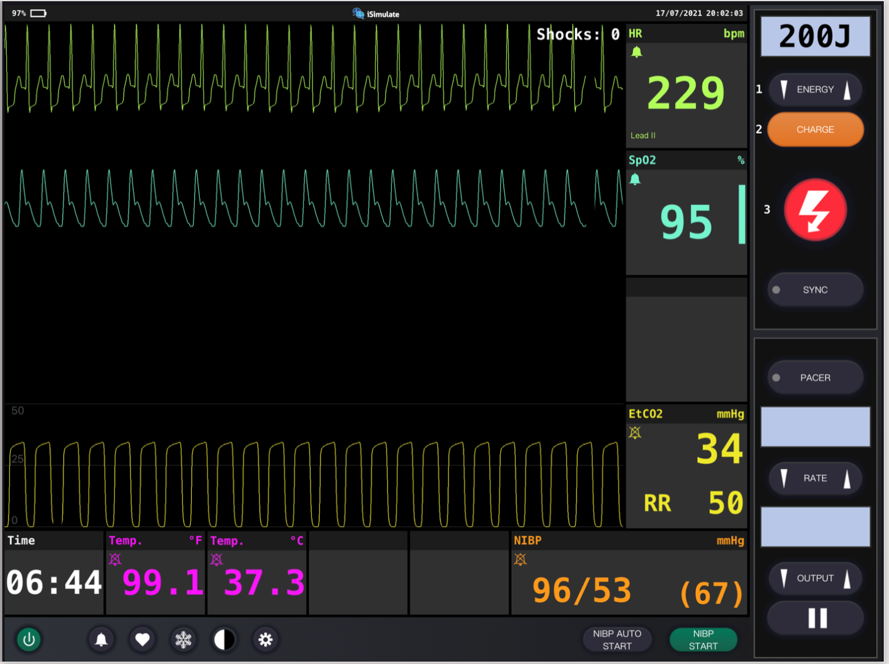
Vital Signs
Notes:
Instructor Notes
Discuss what the vital signs tell us about the patient.
SpO₂: 95% on room air.
Is oxygen needed?
Discuss treatment options in your region.
ETCO₂ is 34.
Discuss reason for low ETCO₂.
Excess CO₂ exhaled through hyperventilation.
Respiratory rate is 50.
Blood pressure is 96/53.
If shock, why isn’t BP low?
Child is compensating.
Blood glucose is 94.
Weight is 10 kg per length-based tape.
Diagnostics indicate SVT.
Participant engagement:
Discuss typical vital signs for age.
Discuss the indication of the low ETCO₂.
Expand on initial measures that may be used to slow the heart rate.

Slide 18
Detailed Assessment
Notes:
Instructor Notes
HEENT
Head: Moist mucous membranes
Eyes: PERRL
Ears: Unremarkable
Nose: Mucus present
Throat: Unremarkable
Heart and lungs
Lung sounds, clear bilaterally. Heart sounds are normal, no murmur.
Respirations rapid with good rise and fall. (Crying.)
Neuro
Circulation, motor, and sensory (CMS) intact. Capillary refill is <2 seconds. Rapid brachial pulse. Inconsolable.
Abdomen and pelvis
Soft, nontender. Bowel sounds are normal.
Upper extremities
Unremarkable
Lower extremities
Unremarkable

Slide 19
Treatment
BLS
  Monitor airway.
  Consider oxygen.
  Vagal maneuvers.
  Position of comfort.
ALS
  BLS care.
  Provide fluid bolus via IV/IO.
Critical care
  BLS/ALS care.
  Administer fluid.
  Consider adenosine.
  Consider sedation and synchronized cardioversion.
Notes:
Instructor Notes
Ask students how they would treat this patient according to their local protocol and scope of practice.
Patient management:
What are your goals for this patient?
Discuss treatment options for this patient.
The patient should be treated with supportive care.
Be prepared for rapid deterioration.
Stress that in many cases less may be more.
What conditions are part of your potential differential diagnosis?
COVID-19
Influenza
Dehydration
Maltreatment/nonaccidental trauma
Intussusception/abdominal pain
Cardiac dysrhythmia
Accidental ingestion

Slide 20
Ongoing Management
Reassess the patient.
Where is the most appropriate treatment destination and why?
Can you safely transport this child in your ambulance?
Will you allow the parent to ride in the ambulance?
Would you increase PPE?
Notes:
Instructor Notes
Discuss the ongoing management options based on scope of practice and local protocols.
Fluid administration of 20 mL/kg.
10 kg per length-based tape = 200 mL.
Reassess the patient for volume overload.
Ice pack to face; do not occlude nose or mouth (vagal maneuver).
The patient is continuously monitored during transport.
Blood pressure stays stable and heart rate decreases to 140.
Respiratory rate decreases to 30 with ETCO₂ of 36.
There are no further changes during transport to the emergency department.
Where is the most appropriate treatment destination and why?
Discuss transportation destination options for pediatrics in your region.
Share when and if it would be appropriate to bypass certain facilities for this patient.
This child should be transported to the closest appropriate facility.
How would you safely transport this child in your ambulance?
Discuss policies and procedures for transporting pediatrics in your region.
Will you allow parent to ride in the ambulance?
Family-centered care is a priority, so we recommend allowing one parent to ride in the ambulance with the EMS crew if safety allows.
We encourage EMS to include this family member in the care of their infant as a member of their care team.
The parent rode with EMS crew and was restrained to the bench seat.
Would you increase PPE due to flulike illness? Possible COVID-19?

Slide 21

Case Wrap-Up
Diagnosis: Supraventricular tachycardia
© Shidlovski/Shutterstock
Notes:
Instructor Notes
Supraventricular tachycardia (SVT) is the most common pathologic rhythm disturbance requiring treatment in children.
Case wrap-up:
At the hospital, additional 12-lead ECGs were obtained.
Child was admitted to the hospital for further evaluation.
Discharged with full recovery after spending a day of observation in the hospital.
Follow-up was scheduled with a pediatric cardiologist.

Slide 22
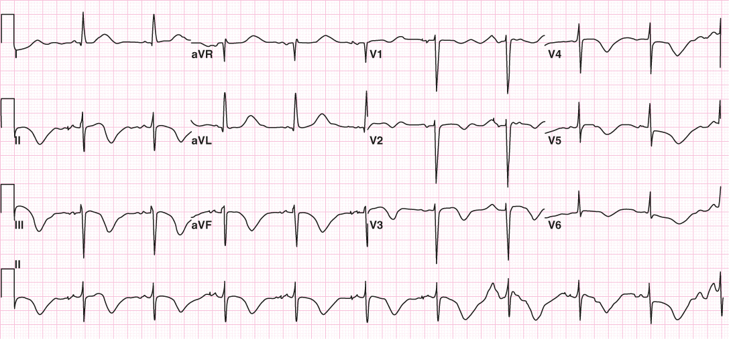
Bradycardia
From Arrhythmia Recognition: The Art of Interpretation, courtesy of Tomas B. Garcia, MD.
Notes:
Instructor Notes
In patients with bradycardia, the heart rate is abnormally lower than what is normal for age.
A sinus bradycardia may be normal in conditioned adolescent athletes and in some children during sleep.
Common causes of bradycardia:
Hypoxia
Vagal stimulation
Electrolyte disturbance
Hypothermia
Increased intercranial pressure
Overdoses
Management of a symptomatic sinus bradycardia is directed at identifying and treating the underlying cause.

Slide 23
Common Findings Associated With Bradycardia
History
Respiratory
Neurologic
Circulation
Notes:
Instructor Notes
Discuss the physical findings, which often include the following:
History of fussiness, lethargy, irritability, poor feeding
Apnea, poor respiratory effort
Lightheadedness, syncope, dyspnea, weakness
Altered mental status, seizure activity
Altered mental status can be sign of shock or if the patient has increased cranial pressure (ICP).
Hypotension
Signs of shock may be evident depending on the duration and rate of the bradycardia.

Slide 24
Bradycardia Treatment
Used with permission of the American Academy of Pediatrics, Pediatric Education for Prehospital Professionals, © American Academy of Pediatrics, 2000
© Jones and Bartlett Publishers. Courtesy of MIEMSS.
© bymuratdeniz/ E+/Getty Images
© natnaree sangkaew/Shutterstock
© nokwalai/Shutterstock
Notes:
Instructor Notes
Discuss the treatment options for bradycardia.
Complete the PAT and perform an initial assessment and obtain a focused history, including family history for ventricular dysrhythmias or sudden death.
Administer oxygen, if indicated; ensure effective oxygenation and ventilation.
Apply cardiac monitors and establish vascular access.
Identify the cardiac rhythm (including rate, QRS width, and regularity).
Obtain a 12-lead ECG but do not delay emergency care.
Identify and treat possible reversible causes of the bradycardia, which may include:
Hypoxia, increased vagal tone
Acidosis
Hypothermia
Hypovolemia
Overdose, such as calcium channel blockers (e.g., verapamil, diltiazem), digoxin, clonidine, opioids, and beta-blockers (e.g., propranolol)

Slide 25
Bradycardia Treatment
Stable
Monitor closely and transport.
  Unstable
  Correct hypoxia.
  Initiate CPR, if appropriate.
  Administer epinephrine.
  Administer atropine.
  Treat reversible causes.
  Consider transcutaneous pacing.
Notes:
Instructor Notes
Stable
Monitor, assess, and transport.
Unstable (i.e., poor cardiac output)
Correct hypoxia.
Administer oxygen and ventilate, if needed.
Initiate CPR.
Apply chest compressions.
If the child’s HR is slower than 60 beats per minute and the child is unresponsive, with signs of poor perfusion (e.g., acute changes in mental status, hypotension, delayed capillary refill, abnormal skin color) despite oxygenation and ventilation, begin chest compressions and ventilations.
Reassess the patient after 2 minutes to determine if bradycardia and signs of hemodynamic compromise persist.
Administer epinephrine.
0.01 mg/kg (0.1mL/kg) IV/IO of epinephrine 0.1 mg/mL every 3 to 5 minutes.
Administer atropine.
0.02 mg/kg IV/IO, may repeat every 5 minutes.
Treat reversible causes.
Hypoglycemia: Dextrose 10%, 5 mL/kg IV/IO (newborns 2‒4 mL/kg)
Acidosis: Sodium bicarbonate 1 mEq/kg IV/IO
Hyperkalemia: Calcium gluconate 50 mEq/kg ZIV/IO and sodium bicarbonate 1 mEq/kg IV/IO
Overdose:
Opiate: Naloxone 0.1 mg/kg IV/IO/IM/IN
Calcium channel/beta-blocker: Calcium gluconate 20 mg/kg IV/IO, glucagon 0.1 mg/kg IV/IO, epinephrine infusion 0.1 mcg/kg/min
Consider transcutaneous pacing.
Transcutaneous pacing is not the first intervention that should be attempted in the stabilization of patients with bradycardia.
PEARLS
Give atropine if the bradycardia is the result of suspected increased vagal tone, primary AV block, or cholinergic drug toxicity.
Be sure to aggressively oxygenate the child and support respiratory effort.
Pacing is most likely to be necessary for children who develop blocks in AV conduction after cardiovascular surgery.
Patients with denervated hearts following heart transplantation may also require pacing.

Slide 26
Case Study 2
Dispatch
  You and your partner are responding to a 7-year-old “drowning, unresponsive” call at a river park. It is 1730 p.m. on a Saturday evening. Outside temperature is 94°F (34.4°C).
Notes:
Instructor Notes
For students other than prehospital practitioners, dispatch information can be modified.
What are your initial concerns and possible differential diagnosis based on the dispatch information?
Initial impression begins when the dispatch information is received.
Initial concerns
Scene safety
Special rescue
Possible cardiac arrest
Differential diagnosis
Head trauma
Seizure
Arrhythmia
Near drowning
C-spine trauma
Accidental ingestion
Discuss the importance of scene assessment and awareness.
Expand on how it applies to this case.
Case 2 involves a 7-year-old female who fell into a fast-moving river.
Diagnosis: Drowning, bradycardia to PEA.

Slide 27
Initial Observations
  A bystander waves you over. You see a female lying on the ground with a life vest around her waist. She is not moving. A family member is performing hands-only CPR.
Used with permission of the American Academy of Pediatrics, Pediatric Education for Prehospital Professionals, © American Academy of Pediatrics, 2000
Notes:
Instructor Notes
Discuss the following initial findings at the scene:
A bystander waves you over. You see a female lying on the ground with a life vest around her waist. She is not moving. A family member is performing hands-only CPR.
PAT
Appearance: Unresponsive
Work of breathing: Apneic
Circulation: Cyanosis
Family member states, “we were swimming in the river when she suddenly disappeared.”
According to the bystander, the child was found downstream entangled in tree roots.
Bystander states child was “blue and not breathing.”
Discuss additional precautions or concerns that may be warranted based on initial observations.

Slide 28
Discussion
Is this patient “Quick” or “Not Quick”?
Have you identified any possible red flags?
Notes:
Instructor Notes
Is this patient “Quick” or “Not Quick”?
The patient is “Quick.”
Expand how this determination was made.
Have you identified any possible red flags?
Unresponsive, apneic, cyanotic
Participant engagement:
Remind participants that completing a thorough assessment and history in pediatrics is of utmost importance.
Remind participants that “Quick” does not always mean “Load and Go.”
Expand on additional measures that may be used to maintain normal body temperature.

Slide 29
Primary Survey
    Primary survey
      X ‒ No bleeding found.
      A – Clear, no obstruction.
      B – Apneic.
      C – Absent brachial pulses. Skin is cyanotic, cold, and wet to touch.
      D – Unresponsive; GCS = 3 (E1, V1, M1).
      E – Lying supine on ground.
Notes:
Instructor Notes
Discuss the primary survey and PAT findings.
Note that the PAT is completed prior to the primary survey.
Ask participants to explain any abnormal findings of their patient(s), whether physical or developmental, and why.
Discuss any life threats identified in this case.
There are life threats.
Primary survey
X – No bleeding found.
A – Clear, no obstruction.
B – Apneic.
C – Nonpalpable brachial pulses. Skin is cyanotic, cold, and wet to touch.
D – Unresponsive; GCS = 3 (E1, V1, M1).
E – Lying supine on the ground.
What would your initial treatment be?
Discuss treatment options per local guidelines and policy.
Treatment should be focused on improving hypoxia and cardiac output.
Student engagement:
Start high-quality CPR
Begin BVM
How would you rewarm the patient?
Discuss methods to rewarm the patient.
Delaying rewarming can result in the patient arriving at the hospital colder than on scene.

Slide 30
Life Threat Management
How do you ensure high-quality CPR in pediatric patients?
Notes:
Instructor Notes
Do your priorities differ from those for adults? If so, how?
Pediatric cardiac arrest is most commonly a secondary event as a result of profound hypoxia or shock.
Priority should be given to ensuring adequate ventilation and oxygenation.
How do you optimize delivery of CPR?
Provide choreographed, high-quality CPR.
Pediatric cardiac arrest survival requires effective BLS care.
Effective ventilations and chest compressions have greater success of resuscitating your patient than chest compressions by themselves.
A study supports a 31.8% increase of effective CPR with integrating a trained CPR coach into resuscitation teams.
Discuss hands-only CPR.
Hands-only CPR may be recommended for adults but is not recommended for pediatrics.
Hands-only CPR in severely hypoxic child is not ideal. Need to prioritize airway management.
Review CPR with rates/depths.
Compression procedures differ for a child and an infant.
Child
Hand should be placed on the lower half of the sternum.
Rate = 100‒120 compressions per minute.
Depth= 2 inches (5 cm) with complete recoil.
Infant
Two thumbs, with hands encircling the chest.
For two-rescuer CPR, the recommended method is the two thumbs with hands encircling the chest technique.
Rate= 100‒120 compressions per minute.
Depth= 1.5 inches (4 cm) with complete recoil.
Single-rescuer CPR ratio is 30:2.
For two-rescuer the ratio changes to 15:2.
Recap: Effective CPR includes chest compressions with a depth of 4‒5 cm (40‒50mm) and a chest compression rate of 100‒120 compressions per minute.

Slide 31
Detailed Assessment
History taking
  O – 30 minutes
  P – Unknown
  Q – None
  R – None
  S – Unknown
  T – 30 minutes
Notes:
Instructor Notes
Review history taking using the OPQRST mnemonic.
O – 30 minutes
P – Unknown
Q – None
R – None
S – Unknown
T – 30 minutes
Participant engagement:
Discuss the importance of continuously reevaluating pediatric mental status.

Slide 32
Detailed Assessment
History taking
    S ‒ Unresponsive, apneic, hypothermic
    A ‒ No known allergies
    M ‒ None
    P ‒ None
    L ‒ Snack at 1600
    E ‒ Fell into fast moving river
    R – None
Notes:
Instructor Notes
Review history taking using SAMPLER.
S ‒ Unresponsive, apneic, hypothermic
A ‒ No known allergies
M ‒ None
P ‒ None
L ‒ Snack at 1600
E ‒ Fell into fast moving river; found unresponsive and not breathing
R – None

Slide 33
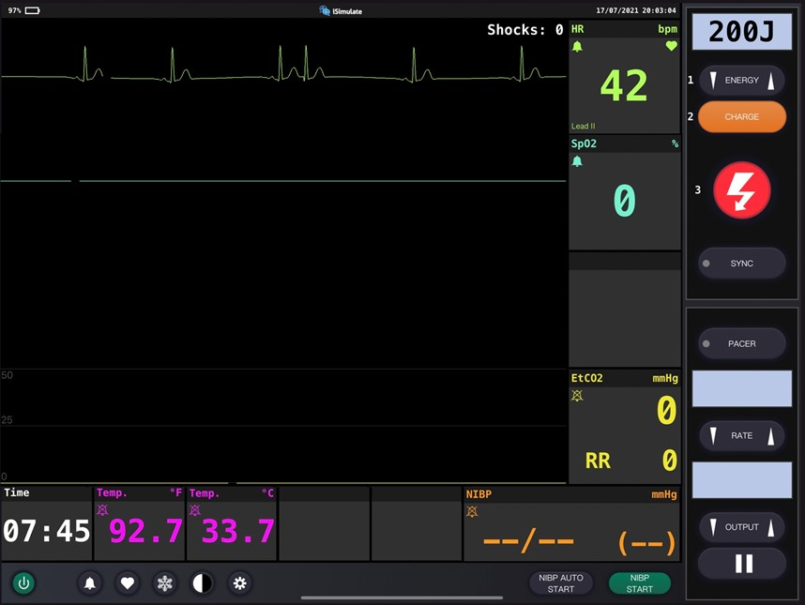
Vital Signs
Notes:
Instructor Notes
Discuss what the vital signs tell us about the patient:
SpO₂: Unable to obtain
Is oxygen needed? Why are you unable to obtain SpO₂?
SPO2 is difficult to obtain due to hypothermia and poor perfusion.
An ETCO2 of 54 can be obtained if ventilations are being performed by the provider.
Discuss the indication of the high ETCO₂
Trapped CO₂ from hypoxia
Respiratory rate is 0. Respiratory rate rises to 20 with ventilatory assistance.
Discuss importance of ventilation and oxygenation.
Blood pressure is unable to be obtained.
Why?
Blood pressure cannot be obtained with heart rate of 42.
Blood glucose is 121.
Weight is 25 Kg per length-based tape.
Diagnostics indicate cardiac arrest and hypothermia

Slide 34
Detailed Assessment
Notes:
Instructor Notes
HEENT
Head: Small abrasion to forehead
Eyes: PERRL, slow to react
Ears: Unremarkable
Nose: Unremarkable
Throat: Unremarkable
Heart and lungs
Lung sounds, bilateral rhonchi with BVM
No spontaneous respirations
Neuro
Unresponsive
Abdomen and pelvis
Soft, nontender
Upper extremities
Cyanotic, cold, various abrasions
Lower extremities:
Cyanotic, cold, various abrasions

Slide 35
Ongoing Management
Reassess the patient.
Where is the most appropriate treatment destination and why?
Can you safely transport this child in your ambulance?
Will you allow the parent to ride in the ambulance?
Be prepared for rapid deterioration.
Notes:
Instructor Notes
The patient’s condition continues to deteriorate.
Discuss the continued management options for this patient based on scope of practice and local protocols.
Initiate appropriate therapy.
Discuss advanced airway management.
When is epinephrine indicated?
Expert opinions vary.
Hold epinephrine until body temperature is over 30°C and double the time interval between doses until 35°C, or
Administer epinephrine as per standard recommendations for 3 doses, and then assess clinical response.
PEARL: In a primary hypothermic event leading to cardiac arrest, consider holding epinephrine until core body temperature is over 30°C and then doubling the time interval between doses until the temperature is over 35°C.
Where is the most appropriate treatment destination and why?
Discuss transportation destination options for pediatrics in your region.
Share when and if it would be appropriate to bypass certain facilities for this patient.
This child should be transported to the closest appropriate facility.
ECMO center if possible, for rewarming.
How would you safely transport this child in your ambulance?
Discuss policies and procedures for transporting pediatrics in your region.
This patient should be transported on a rigid board to enable effective chest compressions.
Will you allow parent to ride in the ambulance?
We encourage EMS to include this family member in the care of their child as a member of their care team.
The parent rode with EMS crew restrained in the front seat.
No patient is dead until they are warm and dead.

Slide 36
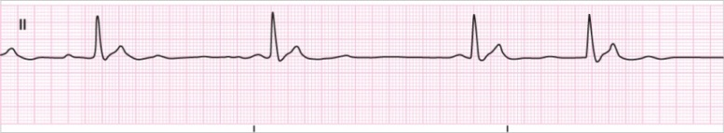
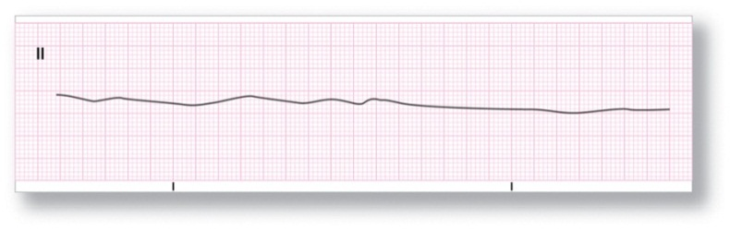
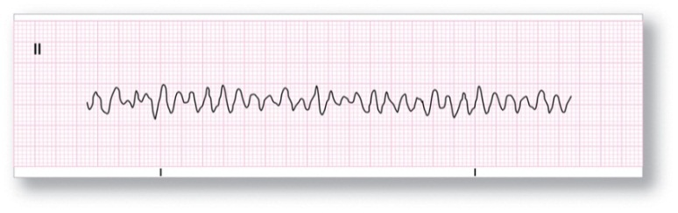
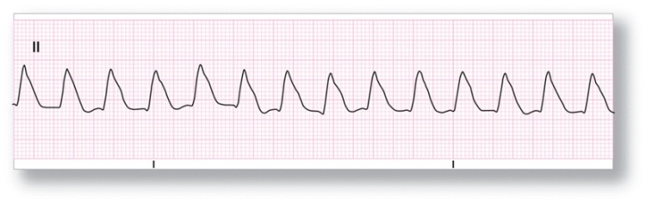
Cardiac Arrest
Pulseless electrical activity (PEA)
Asystole
From Arrhythmia Recognition: The Art of Interpretation, courtesy of Tomas B. Garcia, MD.
Ventricular fibrillation
From Arrhythmia Recognition: The Art of Interpretation, courtesy of Tomas B. Garcia, MD.
Pulseless ventricular tachycardia
From Arrhythmia Recognition: The Art of Interpretation, courtesy of Tomas B. Garcia, MD.
Notes:
Instructor Notes
In these dysrhythmias, the patient will be in cardiac arrest.
Immediately start CPR.
PEA and asystole most common initial rhythms in pediatric cardiac arrest (93.5% of patients).
Pulseless electrical activity
Not a shockable rhythm.
Pulseless electrical activity is a clinical situation, not a specific dysrhythmia.
PEA exists when organized electrical activity (other than VT) is observed on the cardiac monitor, but a pulse is absent.
PEA has a poor prognosis unless the underlying cause can be rapidly identified and appropriately managed.
Asystole
Not a shockable rhythm.
Reflects an absence of ventricular electrical activity. Also known as ventricular standstill.
Poor outcomes associated in pediatric patients.
Ventricular fibrillation
Shockable rhythm.
Pediatrics who receive high-quality CPR and those that respond to early defibrillation from witnessed sudden cardiac arrest have the best documented outcomes.
VF is a ventricular dysrhythmia during which there is no organized depolarization of the ventricles.
The ventricular myocardium quivers and, as a result, there is no effective myocardial contraction and no pulse.
Rhythm is irregularly irregular with chaotic deflections that vary in shape and amplitude.
No normal-looking waveforms are visible.
Pulseless ventricular tachycardia
Shockable rhythm.
Coordinated ventricular contractions replaced with rapid, ineffective contractions.

Slide 37
Cardiac Arrest Treatment
Used with permission of the American Academy of Pediatrics, Pediatric Education for Prehospital Professionals, © American Academy of Pediatrics, 2000
© parinoi/ Shutterstock
© bymuratdeniz/ E+/Getty Images
© natnaree sangkaew/ Shutterstock
© nokwalai/ Shutterstock
Notes:
Instructor Notes
Discuss the treatment options for cardiac arrest patients.
Perform an initial assessment using the PAT and obtain a focused history, including family history for ventricular dysrhythmias or sudden death.
Begin immediate high-quality, choreographed CPR.
Ensure effective oxygenation and ventilation.
Apply cardiac monitors and establish vascular access.
Administer epinephrine within 10 minutes of arrest.
Identify and treat reversible causes.

Slide 38
Treat Children Like We Treat Adults
Initiate high-quality CPR on scene.
Consider choreographed CPR.
Provide immediate and continuous compressions.
Optimize airway management (BLS > ALS).
Apply early defibrillation, when indicated.
Integrate family-centered care.
Consider system resources and most appropriate disposition based on protocols.
Notes:
Instructor Notes
Discuss how treatment should be similar to that for adults to improve survivability.
Initiating CPR on scene is critical!
Pediatric survival outcomes:
Survival is less than 10% for pediatric patients following out-of-hospital cardiac arrest.
In a 2005-2012 study of pediatrics aged 3 days to 19 years with 2244 patients (1017 infants, 594 children, and 633 adolescents):
Infants had the lowest rate of survival (3.7%) compared to children (9.8%) and adolescents (16.3%).
IV/IO access attempts and fluid administration were associated with improved survival.
Advanced airway attempts were not associated with survival.
Resuscitation drugs were associated with decreased survival.

Slide 39
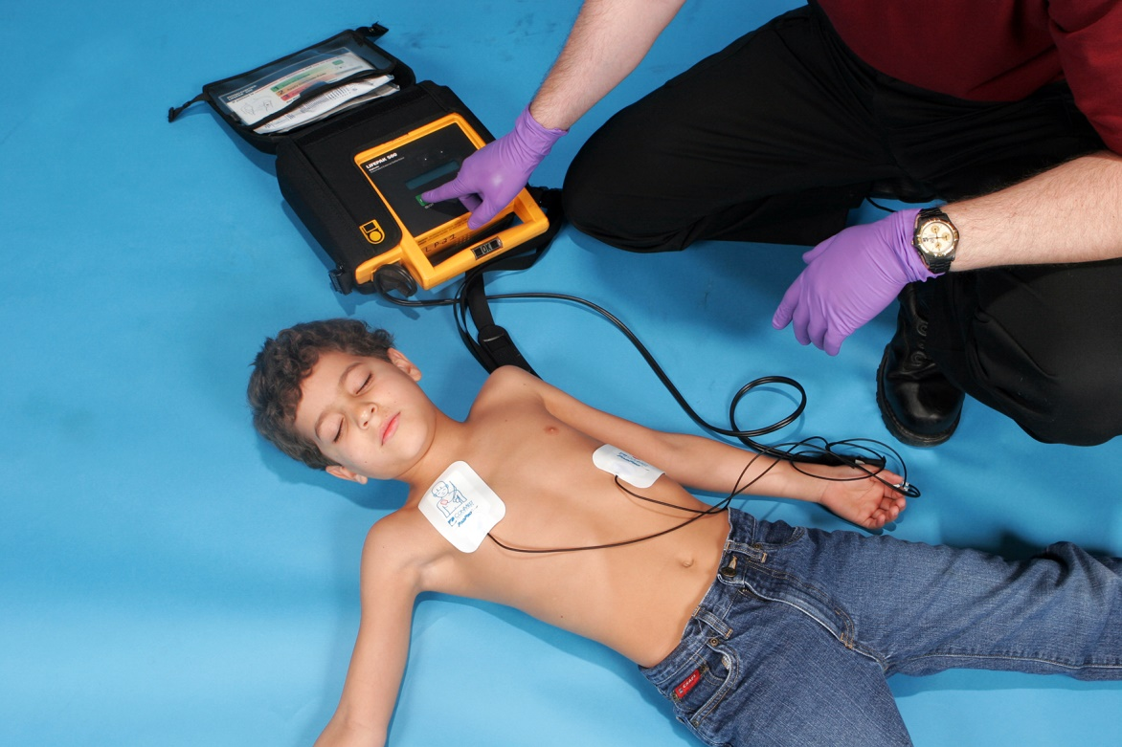
Cardiac Arrest Treatment: Shockable
Notes:
Instructor Notes
Discuss cardiac arrest treatment for shockable rhythms (VF and pulseless VT).
Begin immediate high-quality, choreographed CPR with ventilations. (Chest compression only is not effective in pediatric patients.)
Deliver shock at 2 J/kg.
Immediately after the shock is delivered, resume compressions using choreographed CPR, changing compressors every 2 minutes.
Initiate IV or IO access if not already established.
Administer epinephrine 0.01 mg/kg (0.1 mL/kg) every 4 minutes.
Administer lidocaine or amiodarone 5mg/kg (may repeat up to 2 times).
Continue 2-minute cycles.
These 2-minute cycles of rhythm check -> shock if indicated -> CPR -> administer med will continue as long as VF or pulseless VT persists.
Consider system resources and appropriate disposition based on local protocols.

Slide 40
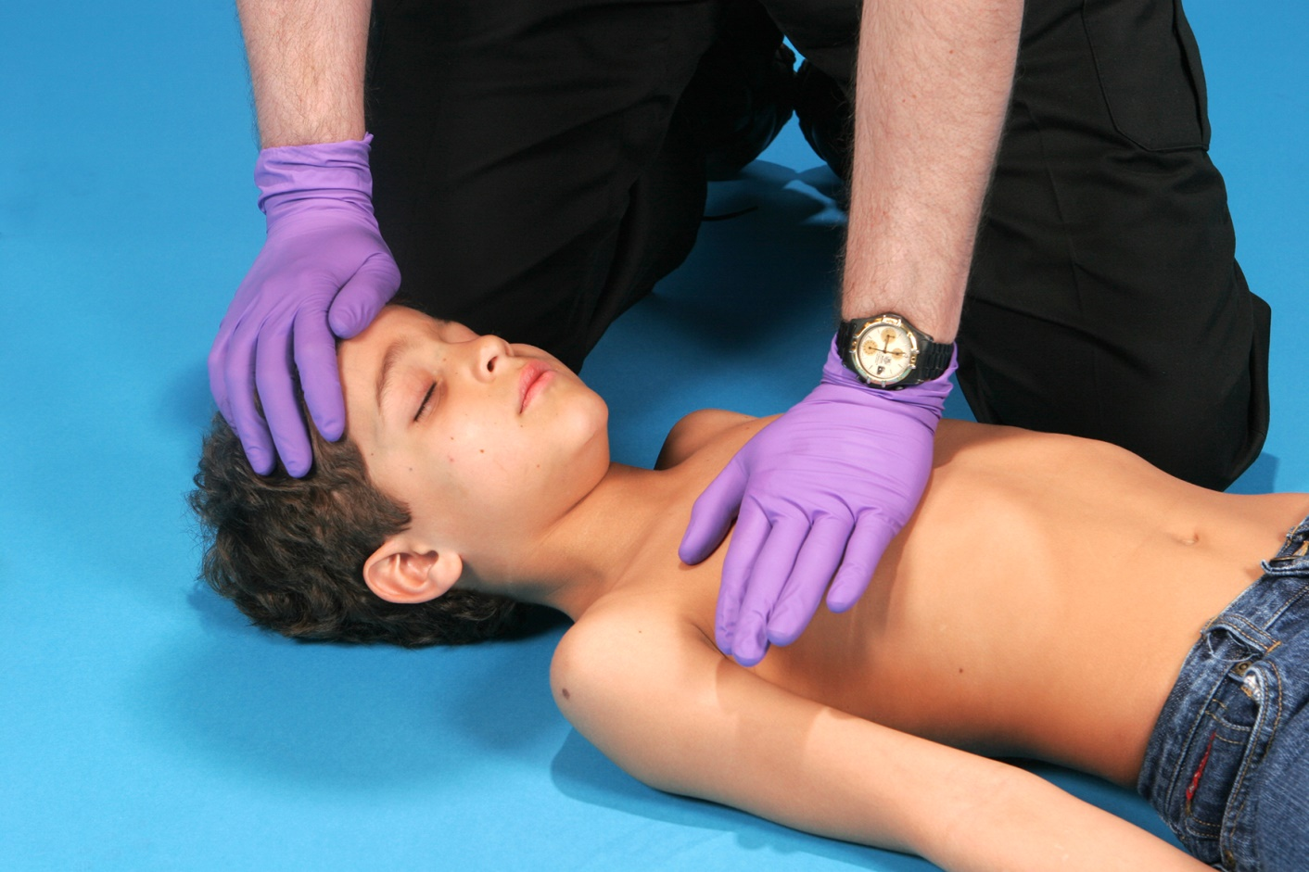
Cardiac Arrest Treatment: NOT Shockable
Notes:
Instructor Notes
Discuss cardiac arrest treatment for nonshockable rhythms (asystole and PEA).
Begin immediate choreographed CPR with ventilations. (Chest compression only is not effective in pediatric patients.)
Initiate IV or IO access if not already established.
Administer epinephrine 0.01 mg/kg (0.1 mL/kg) every 4 minutes.
Identify and treat reversible causes:
Hypovolemia
Hypoxia
Acidosis
Hypoglycemia
Hypo-/hyperkalemia
Hypothermia
Tension pneumothorax
Cardiac tamponade
Toxins
Pulmonary thrombosis
Coronary thrombosis
Continue 2-minute cycles.
These 2-minute cycles of rhythm check -> shock if indicated -> CPR -> administer med will continue as long as PEA or asystole persist or efforts are terminated.

Slide 41
Case Progression: Reassessment
    Reassessment findings
      X ‒ No bleeding found.
      A – Intubated.
      B – Assisted with ventilator.
      C – Brachial pulses absent. Skin cyanotic, cool to touch, dry.
      D – Unresponsive; GCS = 3 (E1, V1, M1).
      E – Lying on EMS stretcher.
Used with permission of the American Academy of Pediatrics, Pediatric Education for Prehospital Professionals, © American Academy of Pediatrics, 2000
Notes:
Instructor Notes
Discuss the reassessment findings.
Ask participants to explain any changes found from initial survey of their patient completed on scene.
Discuss any life threats identified in this case.
There are life threats.
The patient is in cardiopulmonary arrest.
PAT
Appearance: Unresponsive
Work of breathing: Apneic
Circulation: Cyanotic
Primary survey
X – No bleeding found.
A – Intubated.
B – Apneic.
C – Brachial pulses absent. Skin cyanotic, cool to touch, dry.
D – Unresponsive; GCS = 3 (E1, V1, M1).
E – Lying on EMS stretcher.

Slide 42
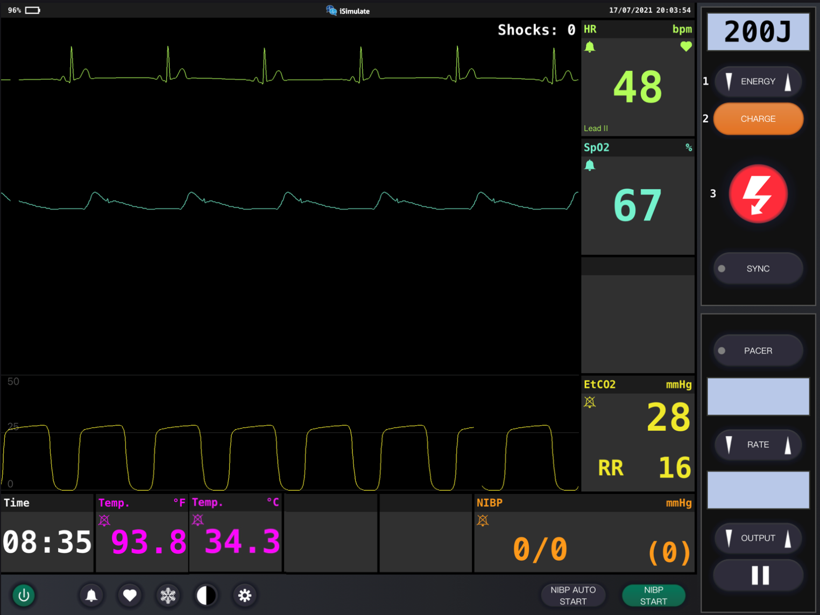
Vital Signs
Notes:
Instructor note:
Discuss what the vital signs tell us about the patient:
SpO₂: 67%
ETCO₂ is 28.
Discuss low ETCO₂.
Respiratory rate is assisted with ventilator
Discuss importance of ventilation and oxygenation.
No blood pressure
Blood glucose is 97.
Diagnostics indicate PEA and hypothermia
Participant engagement:
Has your treatment changed?
Discuss how the treatment for this patient has changed and options per local guidelines and policy
Treatment should be focused on improving hypothermia, hypoxia and cardiac output
Expand on measures that may be used to increase perfusion and outcomes.
Discuss the importance of continued rewarming.

Slide 43
Treatment
BLS
  Monitor airway.
  Provide oxygen and ventilations.
  Restrict spinal motion.
  Provide effective CPR.
  Rewarm.
ALS
  BLS care.
  Warm fluid bolus via IV/IO.
Critical Care
  BLS/ALS care.
  Administer epinephrine.
  Provide positive pressure ventilation.
  Consider advanced airway management.
Notes:
Instructor Notes
Ask students how they would treat this patient according to their local protocol and scope of practice.
The patient must be aggressively oxygenated and ventilated.
Hypoxia is primary cause.
The patient must be warmed.
For patients not already intubated, ALS care at this point should include consideration of supraglottic airway device.
Patient management:
Discuss goals for this patient.
Be prepared for rapid deterioration.
Promptly identify shock for patients who require escalation of therapy.
Deliver appropriate therapy by differentiating other causes of pediatric bradycardia.
What conditions are part of your potential differential diagnosis?
Hypoxia
Overdose
Intentional injury
Hypothermia

Slide 44
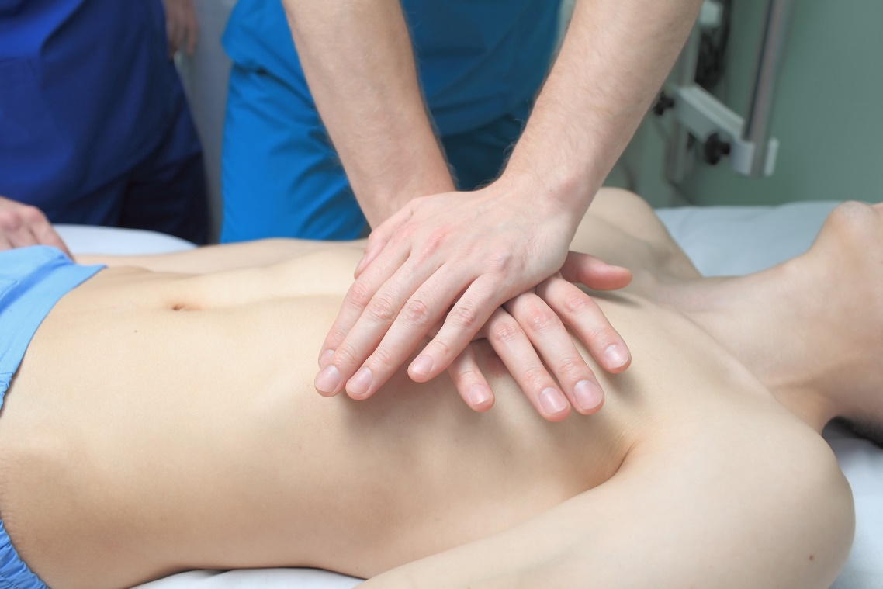
Ongoing Management
Reassess the patient.
© sfam_photo/Shutterstock
Notes:
Instructor Notes
Discuss the ongoing management options based on scope of practice and local protocols.
Chest compressions are continued until return of spontaneous circulation (ROSC).
Warm fluid administration of 20 mL/kg (25 kg based on age = 500 mL).
Continue rewarming measures.

Slide 45
Case Wrap-Up
Diagnosis: Drowning, PEA
Notes:
Instructor Notes
Drowning is the leading of unintentional death in pediatrics between 1 to 4 years of age.
It is the third leading cause of death from unintentional injury in pediatrics younger than 14.
PEA
Oxygenation and ventilation
High-quality CPR
Hypothermia is common in drownings.
Focus on managing the hypothermia.
Case wrap-up:
The patient is transported to the closest appropriate ED with no ROSC during transport.
A warming blanket and warm IV fluids were provided at ED.
The patient was transferred to the PICU.
The child remained hypothermic with a temperature under 35°C.
She did not rewarm with the above measures and eventually received extracorporeal rewarming.
This was very effective and well tolerated.
She was eventually discharged from hospital within 4 weeks with significant neurologic deficits.

Slide 46
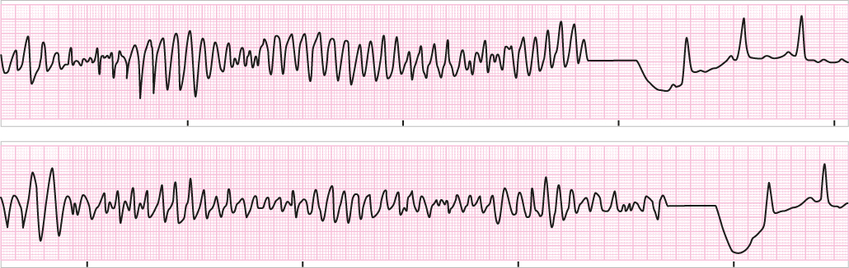
ROSC
Post-resuscitation
Notes:
Instructor Notes
Post resuscitation
Discuss the management of pediatric post-resuscitation options based on scope of practice and local protocols.
Upon ROSC, obtain vitals.
BP is the most important.
Cardiac output is key! Cardiac output = Neuro function. We need to save BRAIN!
Continue ventilatory support.
Maintain ETCO₂ of greater than 20 mm Hg.
Administer fluids.
Administer fluid bolus to maintain circulation: 20 mL/kg.
Consider push-dose pressor (vasopressor).
Consider a pressor infusion.
Improve circulation to the brain.
Improve neurological outcome.

Slide 47

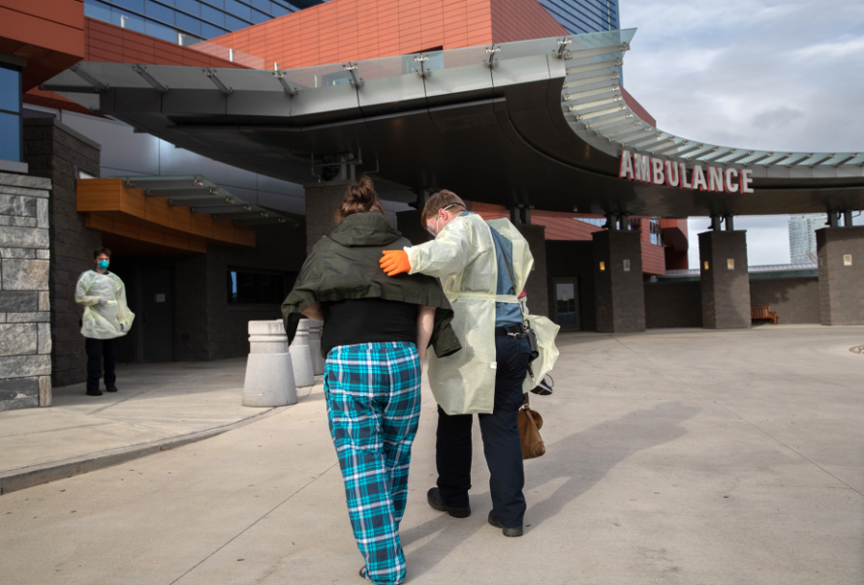
COPE
Compassionate Options for Pediatric EMS (COPE)
© SpeedKingz/Shutterstock
© John Moore/Getty Images News/Getty Images
Notes:
Instructor Notes
Compassionate Options for Pediatric EMS (COPE)
16,000 pediatrics suffer from cardiopulmonary arrest annually.
This leads to an increased need for providing EMS personnel with the educational opportunities on how to communicate with families in these circumstances (e.g., no ROSC) and self-care for the prehospital provider.
Ongoing management may continue after patient care is transferred to a healthcare facility or a death called in the field.
In many instances, EMS personnel must communicate with parents, bystanders, and providers when a child dies in the field from trauma or medical illness.
COPE is a project that provides EMS personnel with the tools to handle pediatric death before, during, and after the encounter.
The focus is to alleviate personal secondary trauma leading to PTSD among all involved with pediatric death.
COPE will assist EMS personnel with the guidance to communicate and comfort families.
Also includes a better understanding of self-care for the EMS provider
More information on COPE can be found on the EMS for Children Innovation and Improvement Center (EIIC) website at https://emscimprovement.center/news/cope-compassionate-options-pediatric-ems/.

Slide 48
Lesson Wrap-Up
Identifying differences in pediatric ECGs allows for proper diagnosis of dysrhythmias.
Treating children like adults allows the provider to make easier decisions in treatment.
Above all, communicate with the family and the medical providers.
Keep the focus on family-centered care.
Coming Up, Lesson 7: Toxicological Emergencies.
Notes:
Instructor Notes
Identifying differences in pediatric ECG allows for proper diagnosis of dysrhythmias.
Identifying the major classifications of pediatric cardiac rhythms is as easy as “Too Fast, Too Slow, or Not Enough.”
Treating children like we do adults allows the provider to make easier decisions in treatment.
Post-resuscitation care is key in reducing neurological devastation.
Above all, communicate with the family throughout the care and, when necessary, provide closure for the family and the medical providers.
Coming Up, Lesson 7: Toxicological Emergencies.

Slide 49

Questions?
© Nujumuddin Mohamad Yaman/EyeEm/Getty Images
Notes:
Instructor Notes
Allow time for a question-and-answer session about the topics presented in the lesson.

