Slide 1
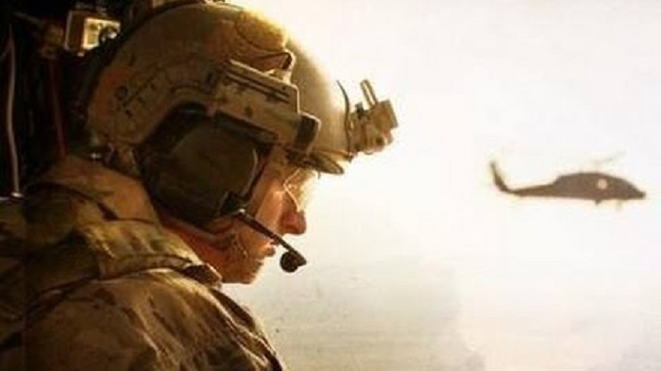
The rescue company 1

Slide 2
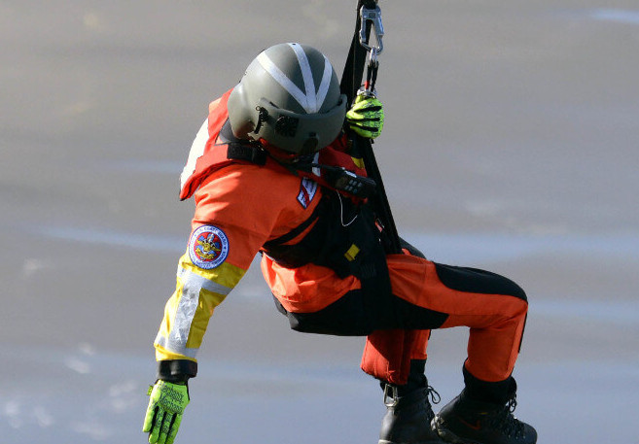
HELICOPTER SHORT-HAUL part 3

Slide 3
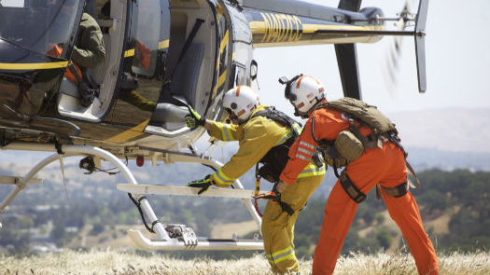
SHORT-HAUL OPERATIONS SEQUENCE

Slide 4
SHORT-HAUL OPERATIONS SEQUENCE
A load calculation for reconnaissance flight/proposed site/operation.
Reconnaissance flight.
Mission planning.

Slide 5
SHORT-HAUL OPERATIONS SEQUENCE
Mission briefing, with risk assessment.
Ship configured for short-haul.
Short-haul operation completed.
Mission debriefed.

Slide 6
HELICOPTER LOAD CALCULATIONS AND FLIGHT RESTRICTIONS
Interagency Helicopter Load Calculation will be completed
Flight operations and procedures will be conducted from 1/2 hour before official sunrise until 1/2 hour after official sunset.
Visibility for short-haul operations will be in accordance with applicable policy.

Slide 7
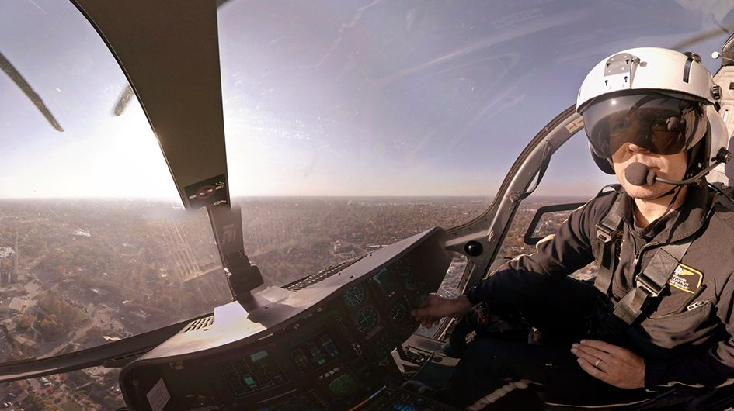
RECONNAISSANCE FLIGHT AND MISSION PLANNING
The purposes of the reconnaissance flight is to size up the scene, determine if short-haul is the appropriate response and, if so, collect the necessary environmental data and aircraft performance data necessary for the risk analysis. The flight is also used to identify suitable short-haul and staging sites.

Slide 8
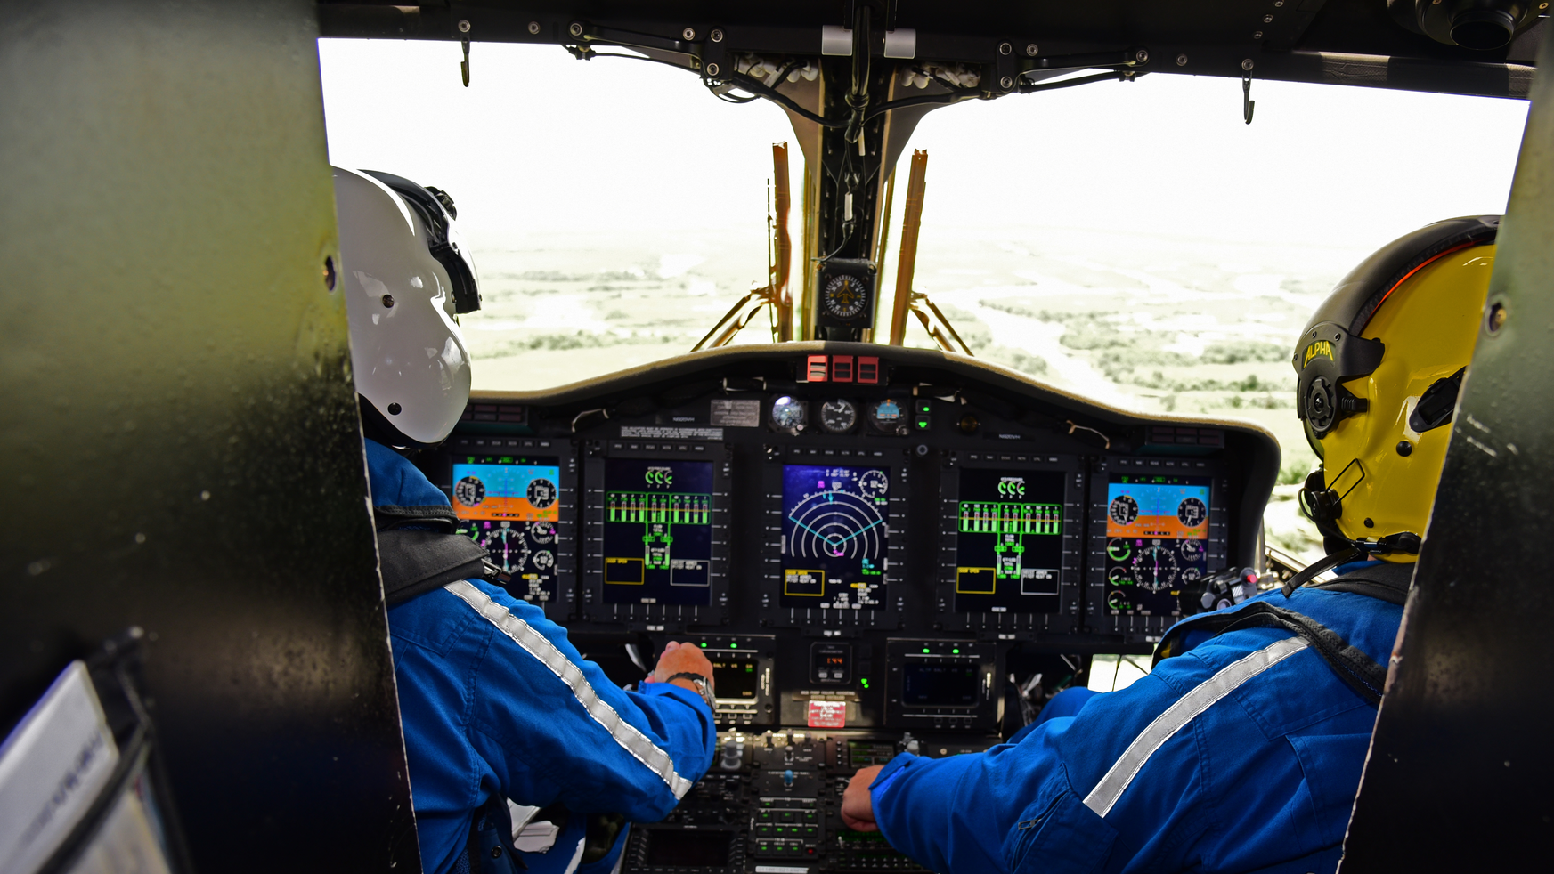
RECONNAISSANCE FLIGHT AND MISSION PLANNING
The Spotter will assist with navigation and be alert to hazards (use hazard map, watch for other aircraft, clearances, wires, changing conditions, etc.).
The Spotter and Pilot will evaluate the short-haul site, staging site, and contingency insertion/extraction sites

Slide 9
RECONNAISSANCE FLIGHT AND MISSION PLANNING
A hover out of ground effect (HOGE) power assurance check, to include a positive rate of climb check, will be performed near the short-haul site.

Slide 10
RECONNAISSANCE FLIGHT AND MISSION PLANNING
Based on information gathered during the reconnaissance flight, the Pilot and Spotter will make the final determination if a short-haul is within the performance capabilities and power limitations of the helicopter.

Slide 11
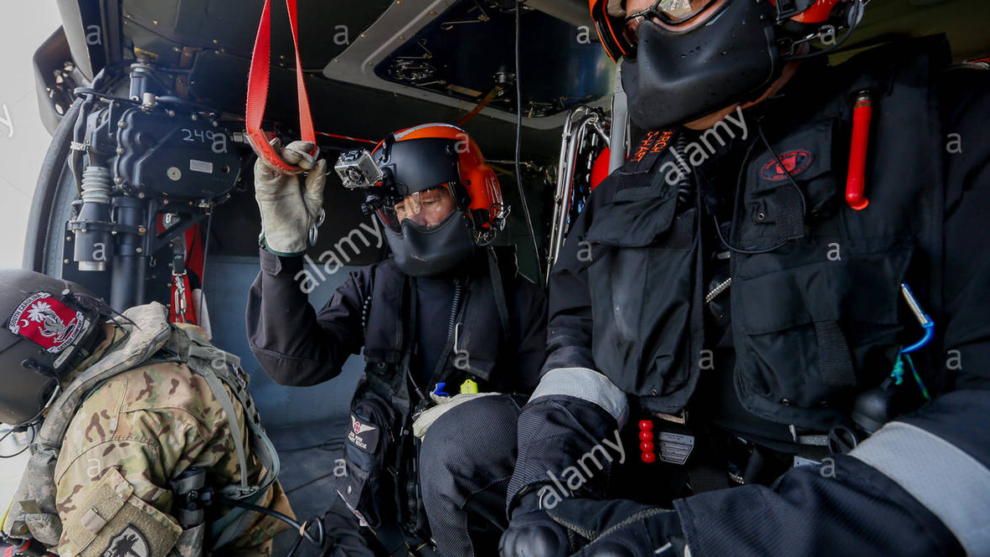
RECONNAISSANCE FLIGHT AND MISSION PLANNING
The incident command team will make the final decision as to whether or not a short-haul is warranted after consideration of all other factors.

Slide 12
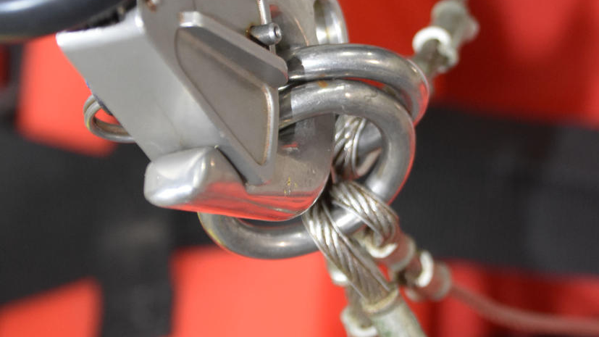
AIRCRAFT RIGGING

Slide 13
AIRCRAFT RIGGING
Short-haul rope inspected and deployed.
Ballast bag secured.
Secondary attachment installed correctly and inspected.
Short-haul rope steel ring hooked into primary cargo hook.

Slide 14
AIRCRAFT RIGGING
Short-haul rope steel ring connected to secondary attachment with a locking carabiner.
Primary/Secondary Attachment release checks.
Pilot's primary electrical

Slide 15
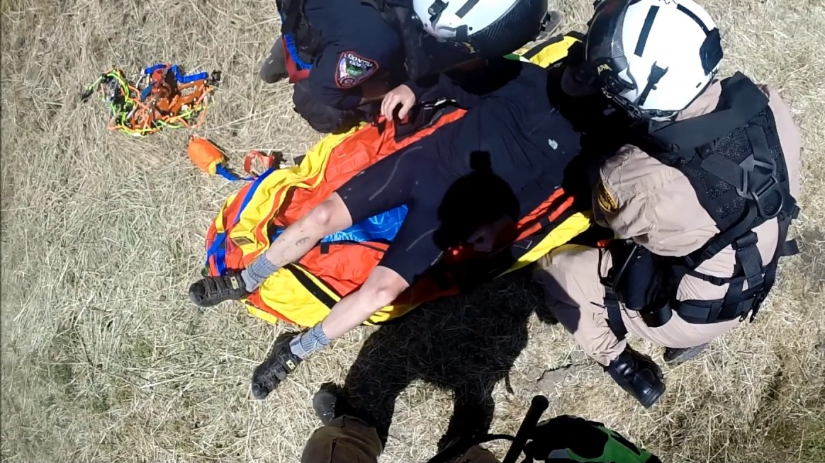
SHORT-HAULER INDIVIDUAL/BUDDY EQUIPMENT CHECK
A Short-hauler individual/buddy equipment check will be completed prior to any short-haul operation.
All steps of the equipment check should be visual, tactile and verbal for thoroughness.
Individuals being checked will be attentive to each step of the process. Inspection will be from head to toe and adapt to specific equipment used.

Slide 16
SHORT-HAULER INDIVIDUAL/BUDDY EQUIPMENT CHECK
Radio -Attached under the harness and connected to the helmet. Radio on, correct frequency selected, scan off.
Harness - Properly donned, strap ends stowed, no twists, adjusted per individual.
Knife - Readily accessible and secured.

Slide 17
SHORT-HAULER INDIVIDUAL/BUDDY EQUIPMENT CHECK
Clothing, Footwear & Gloves - Mission appropriate.
Tether -Appropriately attached to harness, carabiner(s) properly attached to tether.
Anchor(s) - Ready for deployment (applicable only to programs employing anchoring of short-haulers to terrain).

Slide 18
SPOTTER INDIVIDUAL/BUDDY EQUIPMENT CHECK
A Spotter individual/buddy equipment check will be completed prior to any short-haul operation.
All steps of the equipment check should be visual, tactile and verbal for thoroughness.

Slide 19
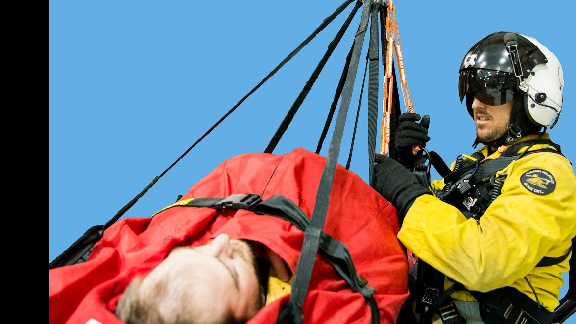
SPOTTER INDIVIDUAL/BUDDY EQUIPMENT CHECK
Individuals being checked will be attentive to each step of the process. Inspection will be from head to toe and adapt to specific equipment used.
When a partner is not available, a self-check will be performed. Helmet secured with chin strap.

Slide 20
SPOTTER INDIVIDUAL/BUDDY EQUIPMENT CHECK
Radio - Connected to onboard radio and intercom system. Short-haul frequency selected.
Harness - Properly donned, strap ends stowed, no twists, adjusted per individual.
Knife - Readily accessible and secured.

Slide 21
SPOTTER INDIVIDUAL/BUDDY EQUIPMENT CHECK
Clothing, Footwear & Gloves - Mission appropriate.
Tether -Appropriately attached to harness, carabiner(s) properly attached to tether and to aircraft.

Slide 22
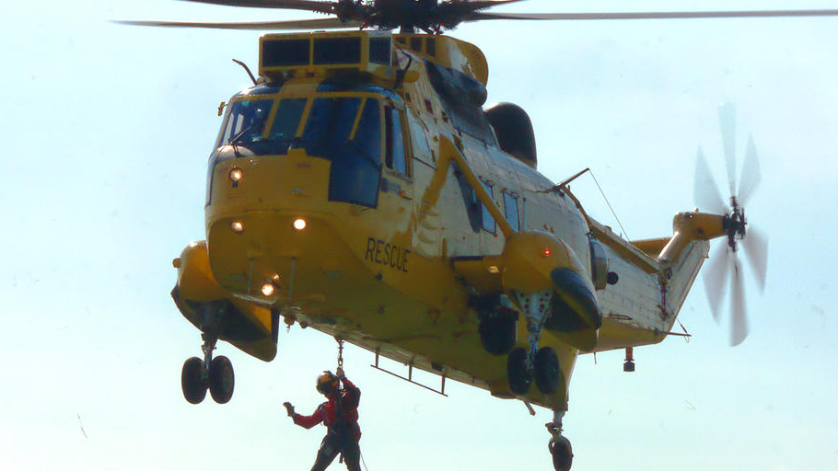
SHORT-HAUL INSERTION/EXTRACTION PROCEDURES AND COMMUNICATIOns

Slide 23
SHORT-HAUL INSERTION/EXTRACTION PROCEDURES AND Communication
During short-haul operations the Spotter/Pilot will request/verify that the radio frequency is cleared for "emergency traffic only" and will advise when initiating operations and when complete with operations.

Slide 24
SHORT-HAUL INSERTION/EXTRACTION PROCEDURES AND Communication
A radio check should be done to establish communications between the aircraft and appropriate short-haul personnel, including Pilot, Spotter, short-haulers and ground crewmembers.
Radio communication between the aircraft and the short-hauler(s) will be conducted between the Pilot and the short-hauler(s) unless the pilot delegates communications to the Spotter.

Slide 25

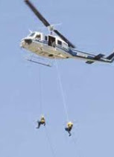
Short-haul Extraction Operations
Pilot initiates final approach to the extraction site, slows descent and stabilizes the rope.
Communication is established between short-haulers and aircraft.
Short-hauler relays

Slide 26
Short-haul Extraction Operations
Winds.
Known hazards.
Weights.
Configuration, e.g., "Two short-haulers and Bauman bag".

Slide 27
Short-haul Extraction Operations
Short-hauler states, "Ready to receive". Response from helicopter to ground crew, "inbound".
Short-hauler(s) may assist pilot by calling out distances of end of the rope (ring) above the canopy/obstacles and will assist pilot in calling out distances of end of the rope (ring) above ground. All radio traffic should be clear and concise.

Slide 28
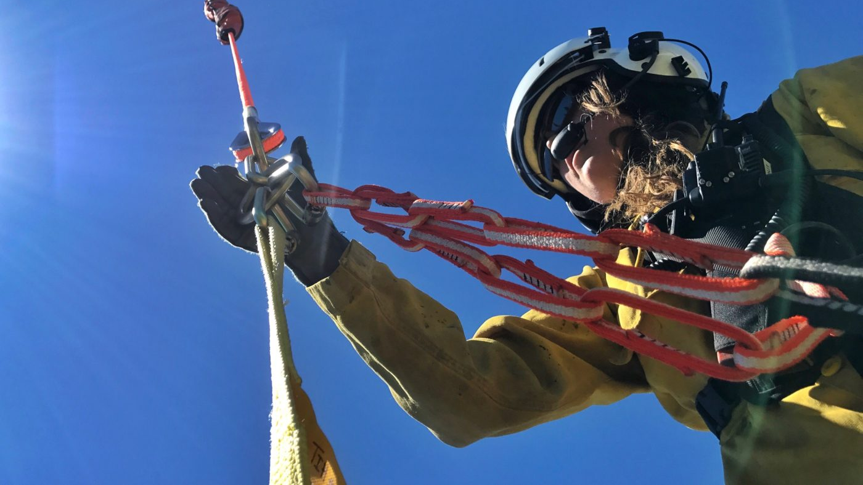
Short-haul Extraction Operations
When applicable, short-hauler will indicate load "entering canopy".
Short-hauler will call distance from lowest point on rope (ring/load) to the ground "five zero

Slide 29
Short-haul Extraction Operations
Pilot responds "Copy, five zero" at the start of the cadence.
Height above ground will then be delineated by calling out "four zero, three zero, two zero, one zero, eye level." No mirrored responses to these calls are given by the Pilot.
When the short-hauler has control of the line, the short-hauler communicates "got it", indicating to the Pilot to hold and maintain hover.

Slide 30
Short-haul Extraction Operations
When ready, the Pilot radios short-hauler to "hook up" and Spotter gives the "hook up" signal.
Once hooked in, acknowledgment of readiness is made between the short-haulers.

Slide 31
Short-haul Extraction Operations
The short-hauler communicates "ready" and gives the "lift" signal.
Pilot states "coming up" and lifts short-hauler(s). Short-hauler communicates "clear of obstacles" and gives the "clear of obstacles" signal when appropriate.

Slide 32
Short-haul Insertion Operations
Pilot initiates final approach to the insertion site, slows descent and stabilizes the short hauler(s )/load on the rope.

Slide 33
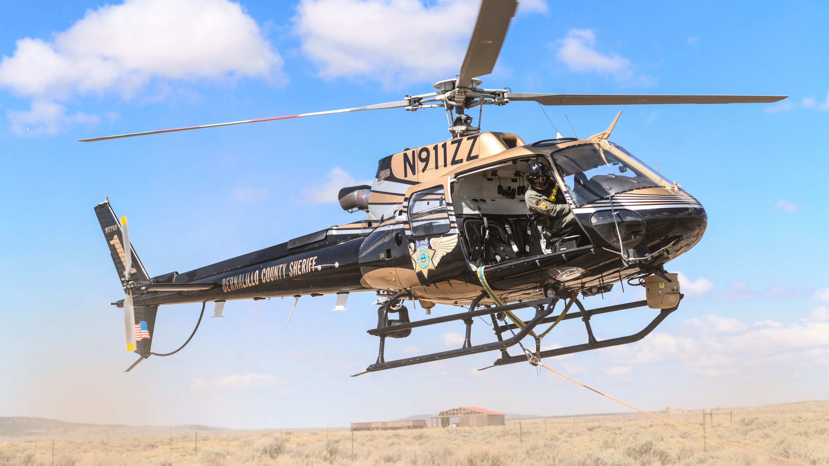
Short-haul Insertion Operations
Short-hauler(s) will assist Pilot by calling out distances ofload above the canopy/obstacles and will assist pilot in calling out distances ofload above ground. Short-hauler(s) will also point out any hazards to the Pilot. All short-hauler radio traffic should be clear and concise.

Slide 34
Short-haul Insertion Operations
When applicable, short-hauler may indicate load "entering canopy".
Short-hauler will call distance from lowest point on the rope to the ground "five zero".

Slide 35
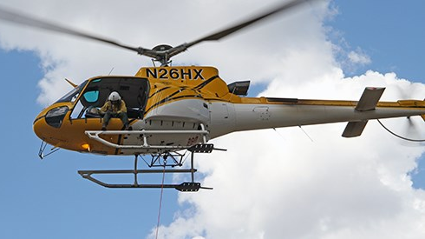
Short-haul Insertion Operations
Pilot responds "copy, five zero" at the start of the cadence.
Height above ground will then be relayed by calling out "four zero, three zero, two zero, one zero." No mirrored responses to these calls are given by the Pilot

Slide 36
Short-haul Insertion Operations
When the short-hauler is on the ground and ready to unhook, short-hauler communicates "secure" and unhooks. The pilot will acknowledge by responding "unhook" and the spotter gives the "unhook" signal.

Slide 37
Short-haul Insertion Operations
Short-hauler radios the pilot that they are clear of the line by stating "clear" and gives the "lift" hand signal.
Pilot states "coming up" and lifts empty rope. Short-hauler communicates "clear of obstacles" and gives the "clear of obstacles" signal when appropriate for forward flight.

Slide 38
In-flight Considerations
Short-haul rope should be flown with line ballast in order to prevent excessive trailing behind the aircraft in forward flight.
Forward flight should not exceed 60 mph with the short-haul rope deployed.

Slide 39
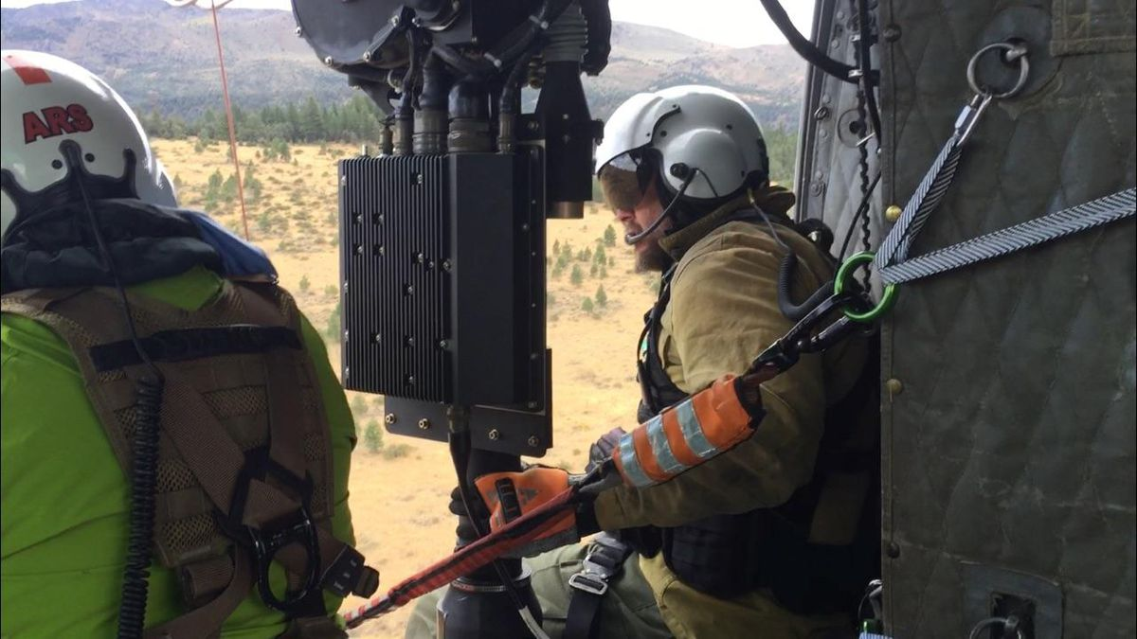
In-flight Considerations
In-flight spinning or position changes may be reduced by short-hauler extending an arm or a leg.
Radio communication quality is best if the helmet boom mic is flush against the lips and cupped by hand and the head is turned away from the wind.

Slide 40
Loss of Radio Communication Considerations
If radio communication cannot be established on the initial approach (no HEC), the evolution should be aborted until radio communication can be re-established.

Slide 41
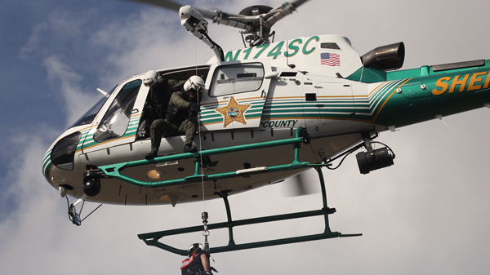
In-flight Considerations
If radio communication is lost during the insertion or extraction sequence with HEC, the mission may continue using hand signals. Loss of radio communication does not necessitate cessation of the mission, but should be evaluated on a case-by-case basis

Slide 42
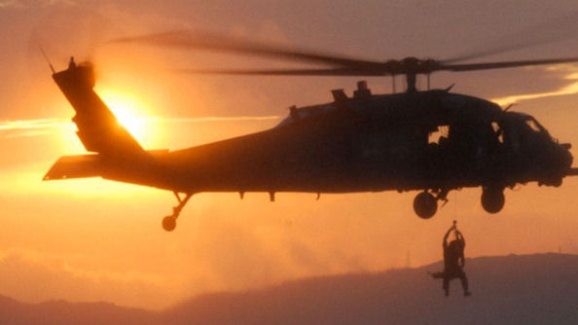
In-flight Considerations
If radio communication is lost at any time during the transport or ferry portion of the short-haul insertion or extraction, the Pilot and Spotter may opt to return to the staging site.
If the short-hauler(s) lose radio communication or wish to terminate the mission, they should initiate the "wave-off' hand signal.

Slide 43
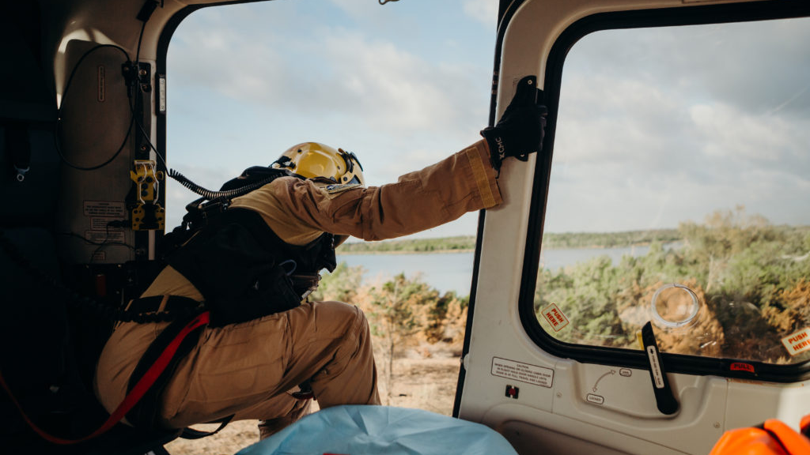
Communication Within Aircraft Between Spotter and Pilot
Task assignment is agreed upon between Spotter and Pilot prior to any short-haul mission, including delegation of radio communication with short-haulers or ground personnel.

Slide 44
Communication Within Aircraft Between Spotter and Pilot
Flight hazards are communicated using common terms such as up, down, left, right, forward, and back.
Distances from obstacles should be communicated in feet.

Slide 45
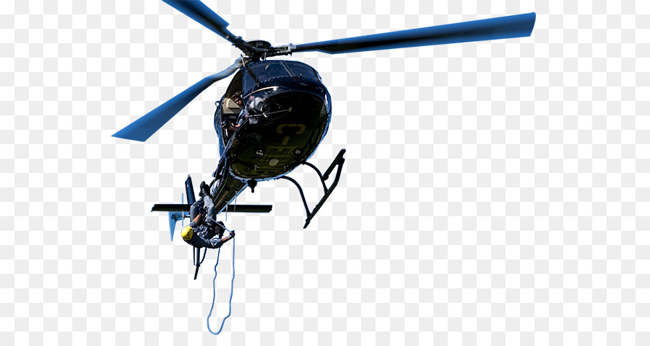
SHORT-HAUL HAND SIGNALS
Onboard Spotter Hand Signals

Slide 46
WAVE-OFF

Slide 47
WAVE-OFF
Wave-off indicates the need to stop and do the opposite of current operations. This is performed by waving one outstretched arm back and forth on a horizontal plane

Slide 48
HOOK/UNHOOK
This is performed by holding one outstretched arm with a closed fist in a stationary position.

Slide 49
LIFT
This is performed by extending one forearm upward from shoulder height in a 90° angle bend at the elbow. With fingers outstretched, rotate in a circular motion.

Slide 50
CLEAR OF OBSTACLES
This is performed by extending one arm out in front of the body using a chopping motion. Fingers are to be outstretched in a vertical plane.

Slide 51
OK? /OK!
This is performed by tapping one hand on the top of haulers helmet.

Slide 52
HOLD HOVER
This is performed by extending one arm out to the side of the body at shoulder height. This is to be held in a stationary position with a closed fist.

Slide 53
WAVE OFF
This is performed by extending two arms over head and waving back and forth.

