Slide 1
A positive state of mind is the key to survival in an outdoor emergency.

Slide 2
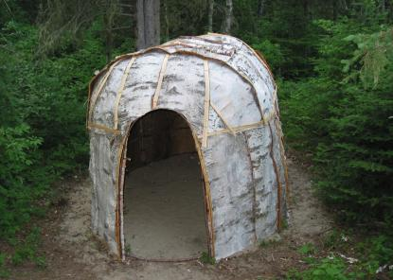
Shelters

Slide 3
1) Shelter
Adequate to protect from wind/rain/snow/ etc..

Slide 4
SHELTER SITE SELECTION
When you are in a survival situation and realize that shelter is a high priority, start looking for shelter as soon as possible. As you do so, remember what you will need at the site. Two requisites are--
It must contain material to make the type of shelter you need.
It must be large enough and level enough for you to lie down comfortably.

Slide 5
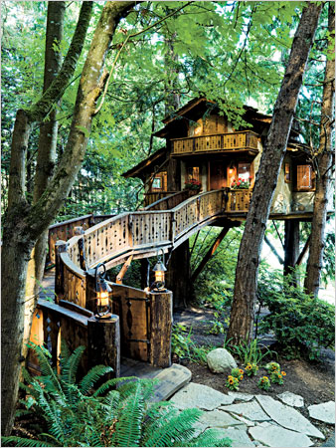
TYPES OF SHELTERS

Slide 6
When looking for a shelter site, keep in mind the type of shelter (protection) you need. However, you must also consider--
How much time and effort you need to build the shelter.
If the shelter will adequately protect you from the elements (sun, wind, rain, snow).
If you have the tools to build it. If not, can you make improvised tools?
If you have the type and amount of materials needed to build it.

Slide 7
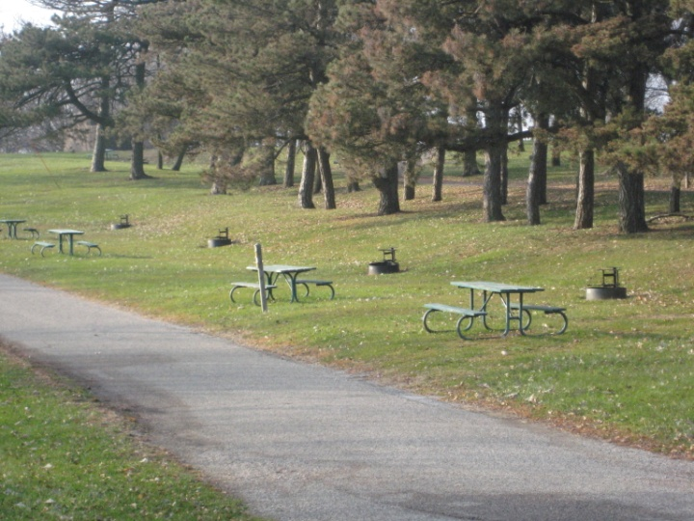
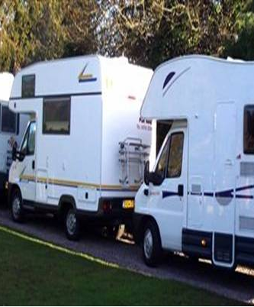
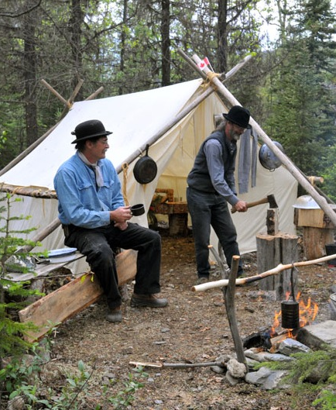
Site Selection
Large enough and level enough for both you and your equipment.
Close to construction materials.
Close to signaling and recovery site
Close to food and water source.

Slide 8
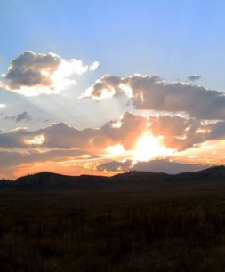
General
–Southern exposure (in cold weather)
–Drainages
Shelter opening should face East.

Slide 9
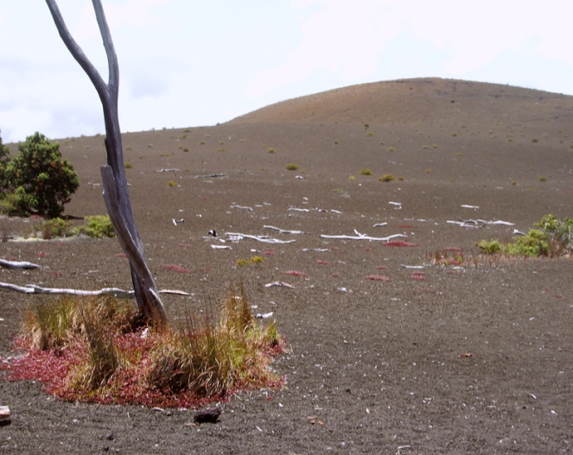
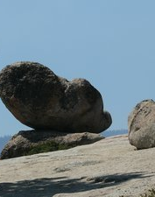
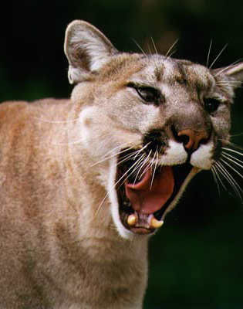
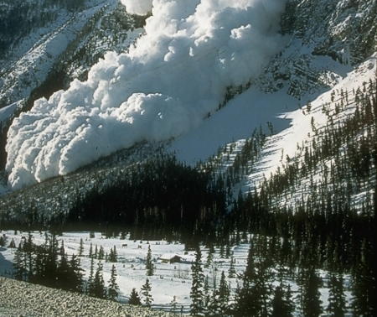
Safety considerations
Animal trails
Avoid avalanche slopes
Drainages
Unstable rock formations
Below dead trees

Slide 10
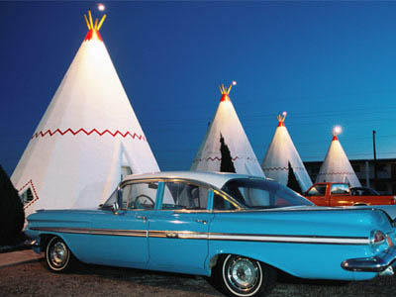
Types of Shelters

Slide 11
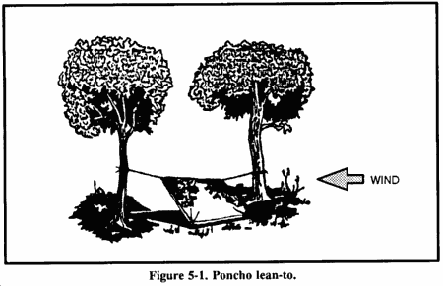
Poncho Lean-To

Slide 12
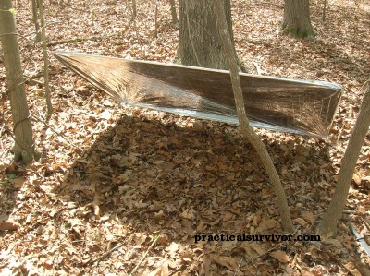
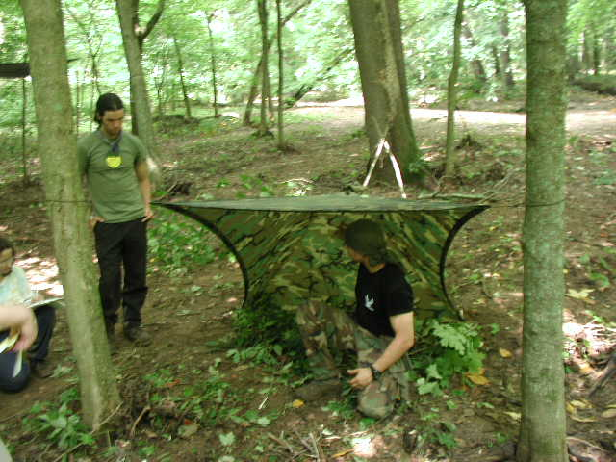
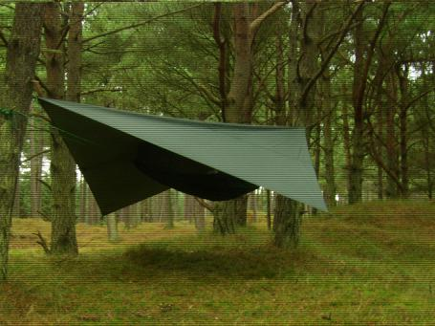
Tarps

Slide 13
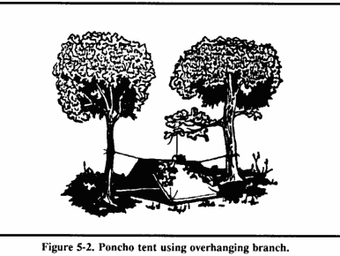
Poncho Tent

Slide 14
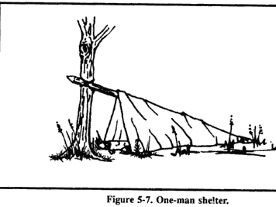
One-Man Shelter

Slide 15
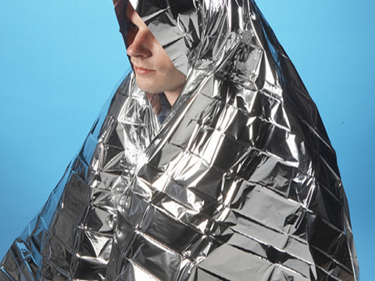
Space Blankets

Slide 16
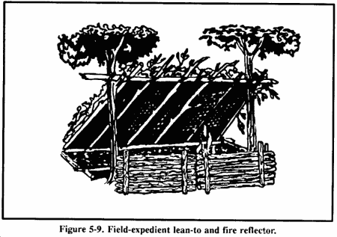
Lean-To

Slide 17
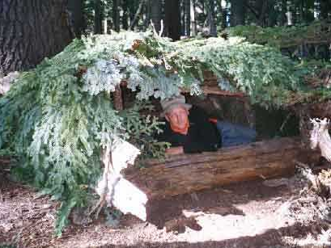

Slide 18
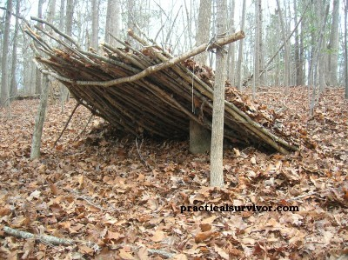

Slide 19
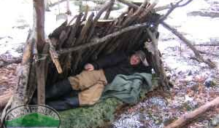

Slide 20
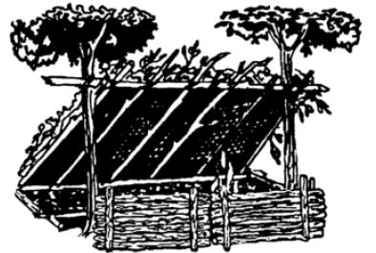

Slide 21
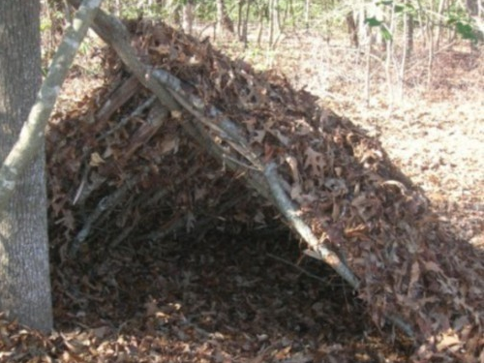
Double Lean-To or Debris Hut

Slide 22
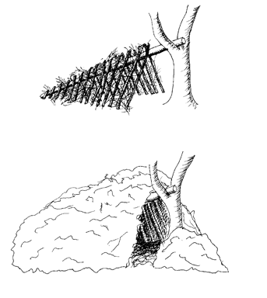

Slide 23
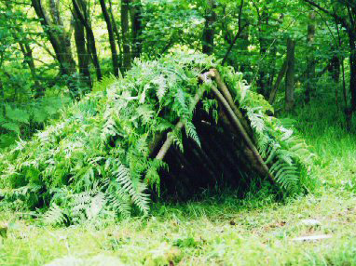

Slide 24
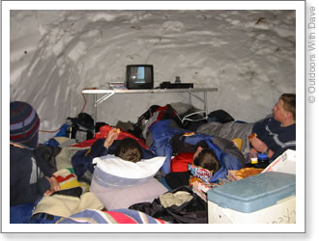
Snow caves

Slide 26
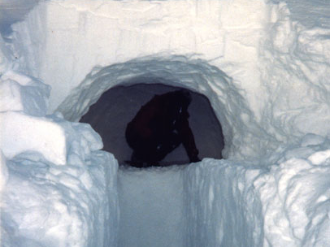

Slide 27
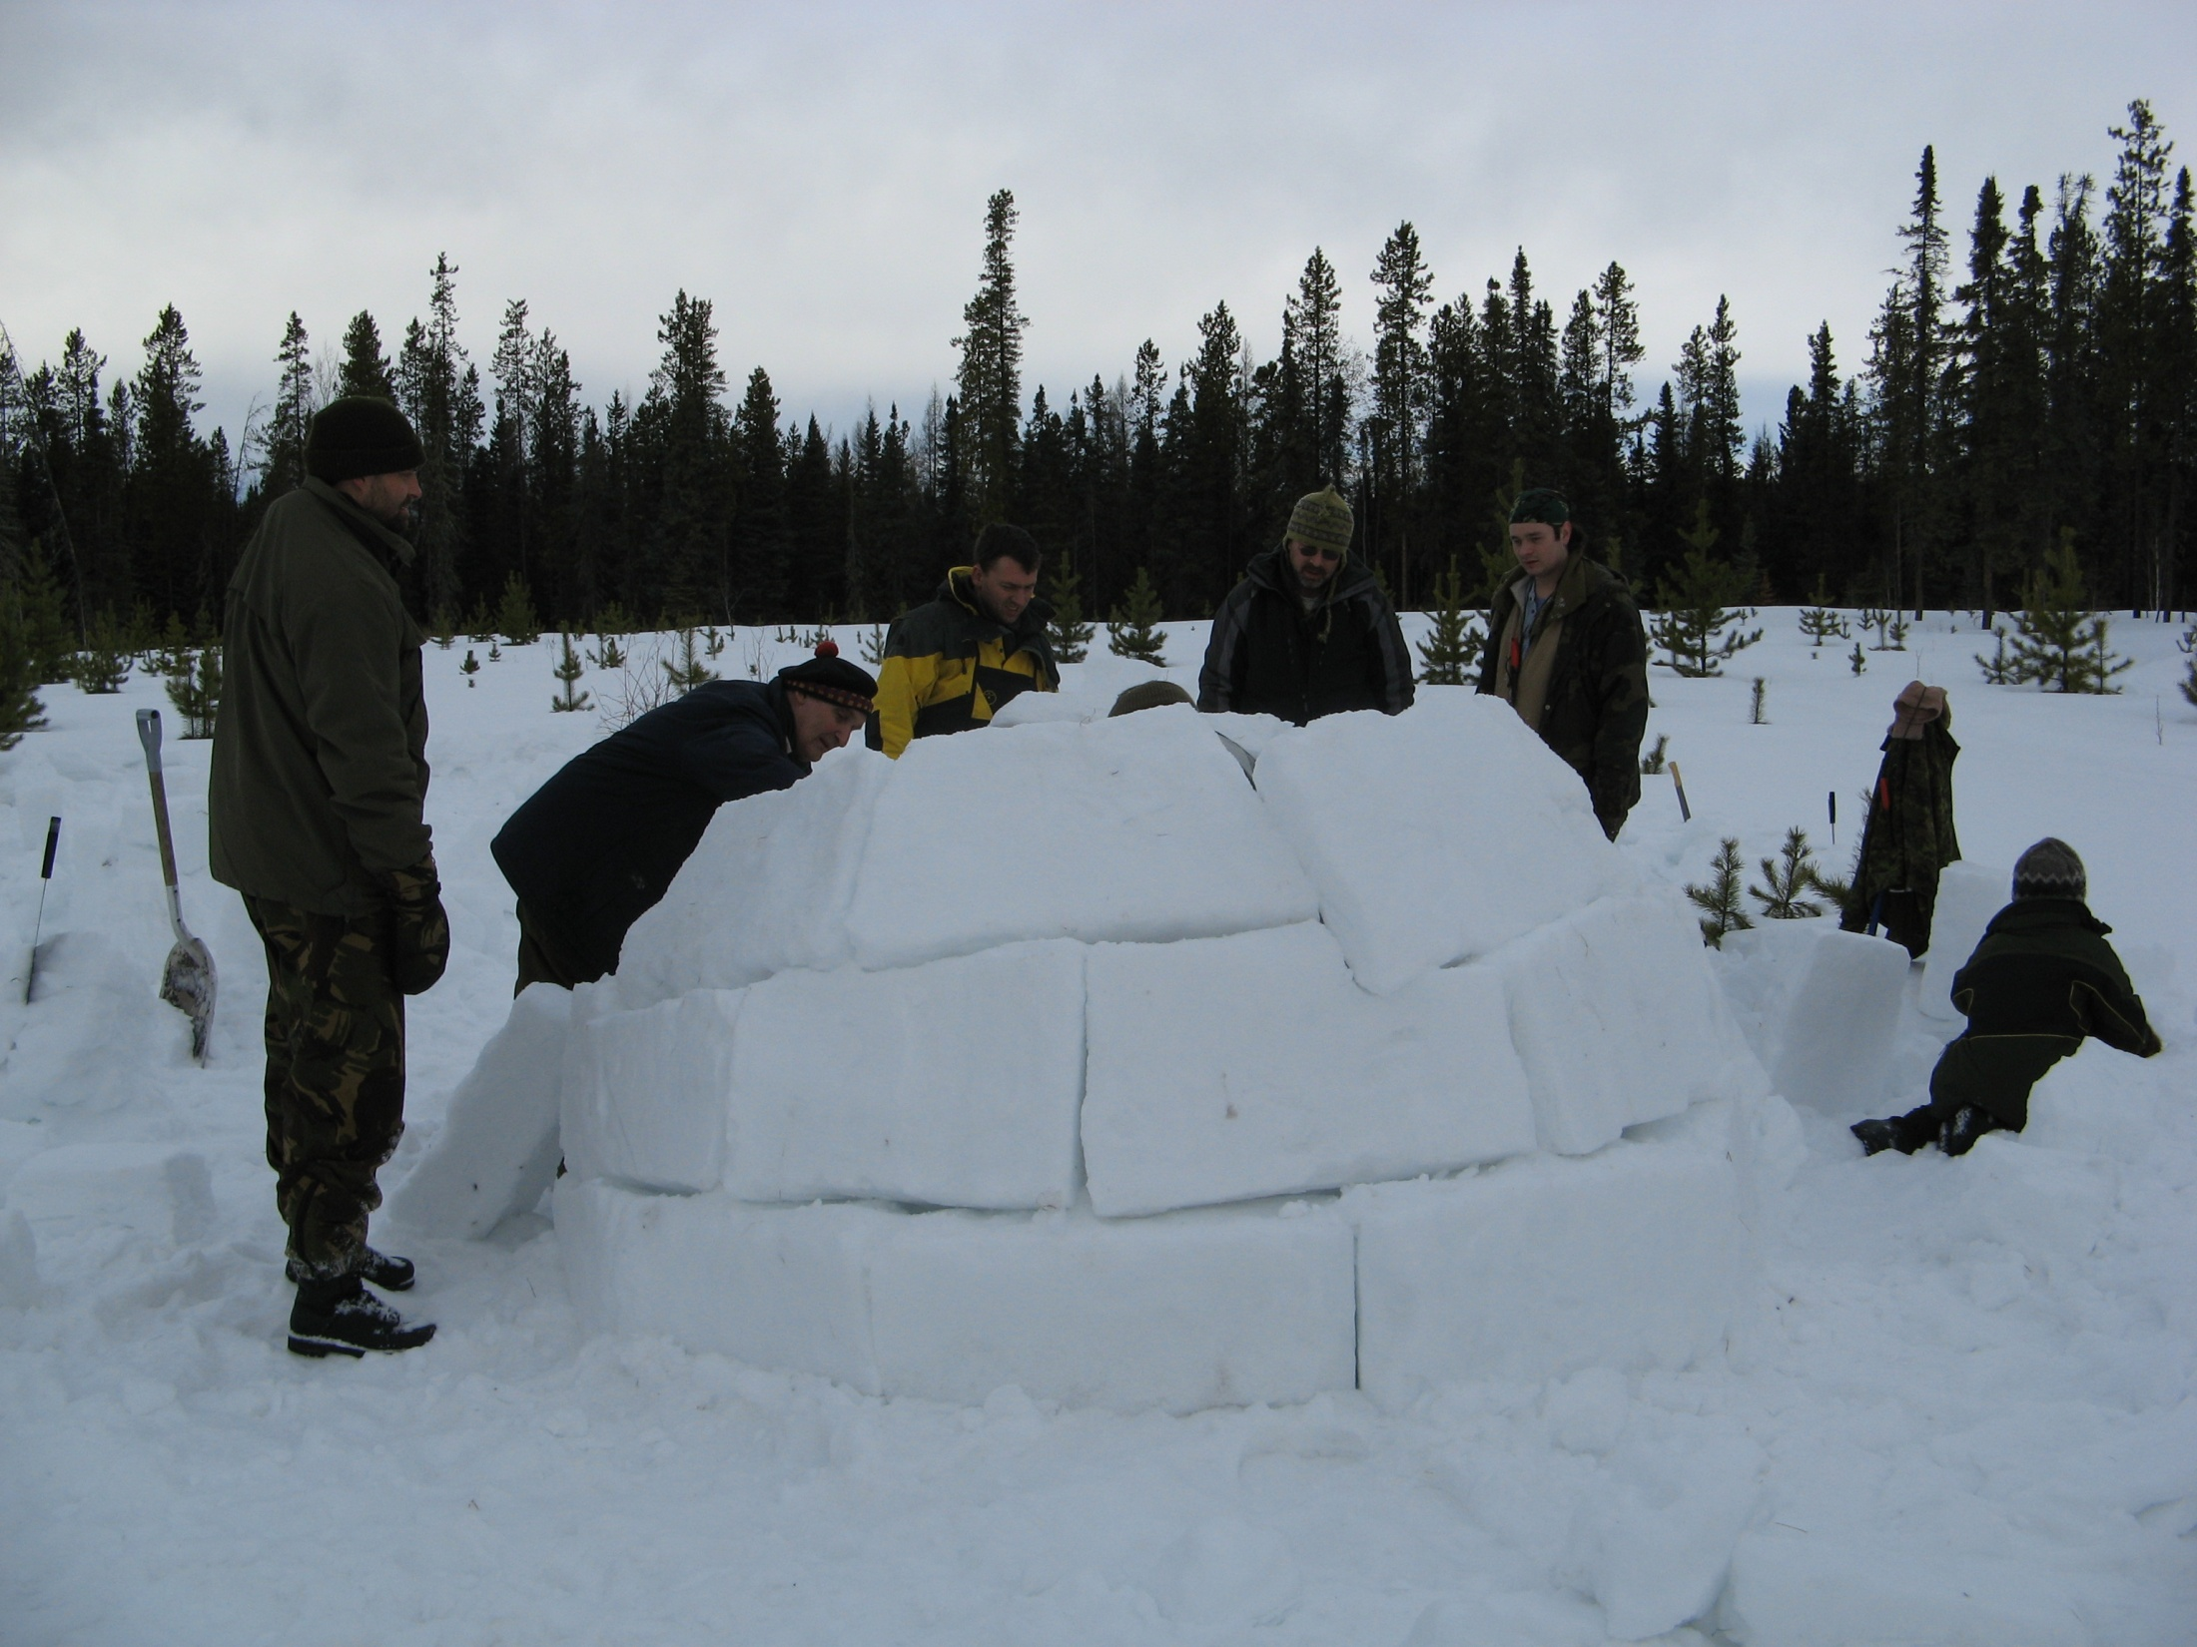

Slide 28
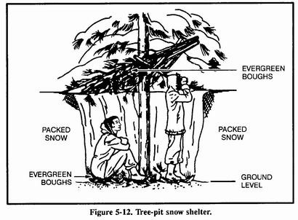
Tree pit snow shelter

Slide 29
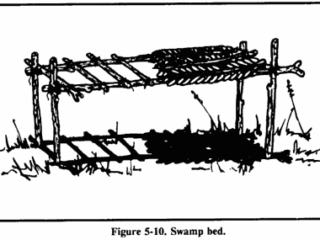
Swamp Bed

Slide 30
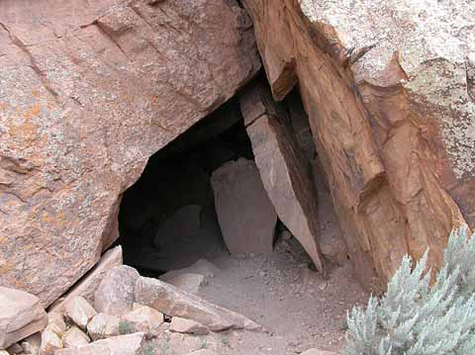
Natural Shelters
caves,
rocky crevices,
clumps of bushes,
small depressions,
large rocks on leeward sides of hills,
large trees with low-hanging limbs,
fallen trees with thick branches.

Slide 31
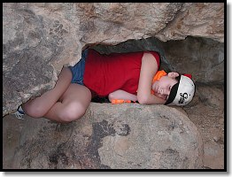
Rock outcroppings

Slide 32
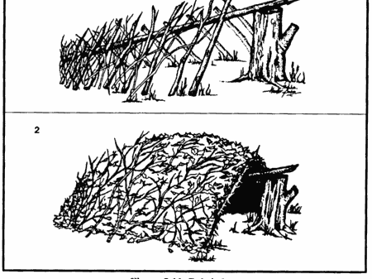
Debris Hut

Slide 33
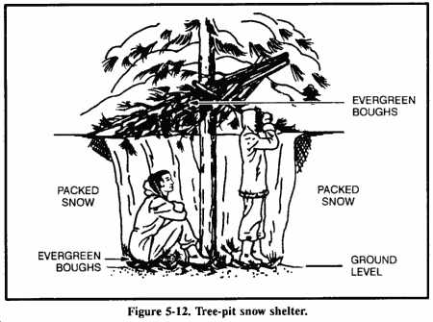
Tree-Pit Snow Shelter

Slide 34
Site Selection
Large enough and level enough for both you and your equipment.
Close to construction materials.
Close to signaling and recovery site
Close to food and water source.

Slide 35
Safety considerations:
Avoid Animal trails
Avoid avalanche slopes
Southern exposure (in cold weather)
Avoid Drainages
Shelter opening should face East.
Avoid Unstable rock formations
Basic principles of Tarp/natural shelters.
Avoid building your shelter below dead trees

Slide 36
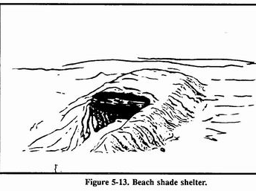
Beach/Desert shade shelter

Slide 37
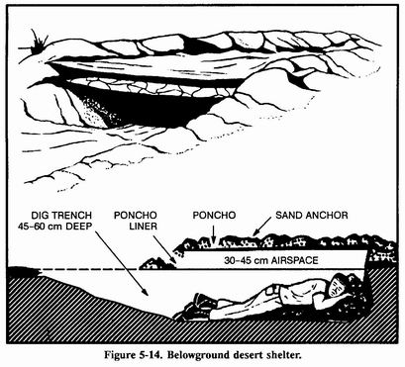
Below ground desert shelter

