Slide 1
The rescue company 1

Slide 2
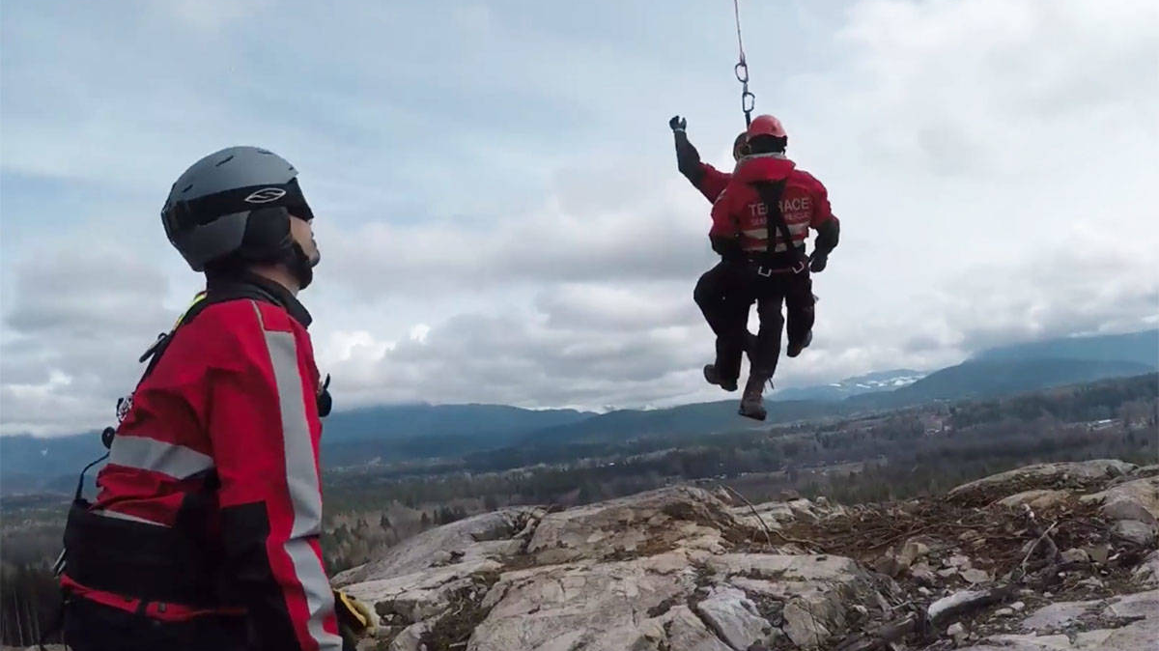
Wilderness Search and Rescue

Slide 3
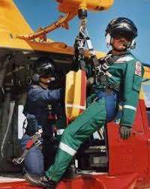
Introduction
There are three levels to Wilderness Search and Rescue
Awareness
Operations
Technician

Slide 4
Reference
WAC 296-305-05113 Technical Rescue Operations Specialties
NFPA 1670 Chapter 4 General Requirements
NFPA 1670 Chapter 10 Wilderness Search and Rescue

Slide 5
Definitions
Wilderness
Wilderness is generally defined as a natural environment on Earth that has not been modified by human activity.
Search and Rescue
The process of locating lost, missing, or overdue individuals and removing them from danger.
Wilderness Search and Rescue
The act of conducting search and rescue in the wilderness.

Slide 6
Definitions
Unified Command
In the Incident Command System, a Unified Command is an authority structure in which the role of incident commander is shared by two or more individuals, each already having authority in a different responding agency.
Ten Essentials
Considered the essential items to have while in the wilderness.

Slide 7
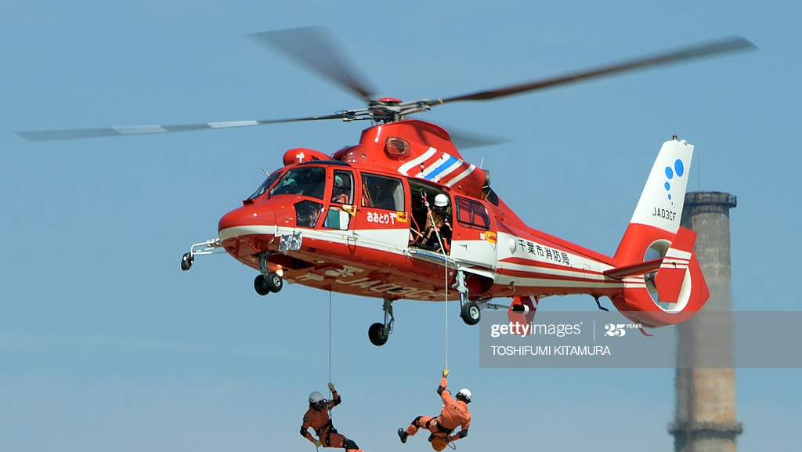
Procedure
In the event of a callout to the wilderness the units shall report to the on-scene incident commander to receive further orders. If the IC is not aware of the team’s policy for wilderness search and rescue, then the crew shall advise the IC of their procedure.

Slide 8
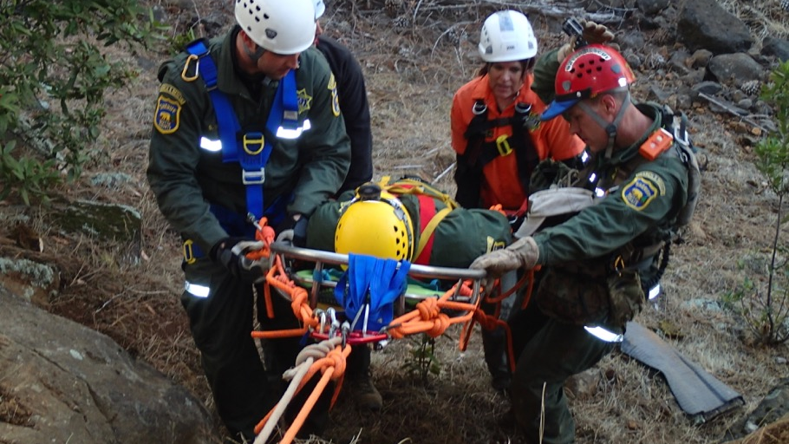
Procedure
If our units are the first to arrive, the first on scene crew(s) shall obtain the following:
Number of patients or lost civilians
Last location seen
Condition of patients or civilians
What equipment did they have with them

Slide 9
Procedure
Personnel operating at a wilderness search and rescue shall:
Be able to recognize the need for a wilderness search and rescue type response.
Initiate the emergency response system for wilderness search and rescue (Call out for SAR), and interface with them.
Initiate site control and scene management.

Slide 10
Procedure
Personnel operating at a wilderness search and rescue shall:
Establish a unified command (of within District 22 boundaries).
Recognize the general hazards associated with wilderness search and rescue incidents.
Recognize the limitations of conventional emergency response skills and equipment in various wilderness environments.

Slide 11
Procedure
Personnel operating at a wilderness search and rescue shall:
Initiate the collection and recording of information necessary to assist operational personnel in a wilderness search and rescue.
Identifying and isolating any reporting parties and witnesses.

Slide 12
Procedure
Personnel operating at a wilderness search and rescue shall:
Size up existing and potential conditions at incidents where wilderness search and rescue will be performed.
Provide the specialized medical care and protocols that are unique to the wilderness environment.

Slide 13
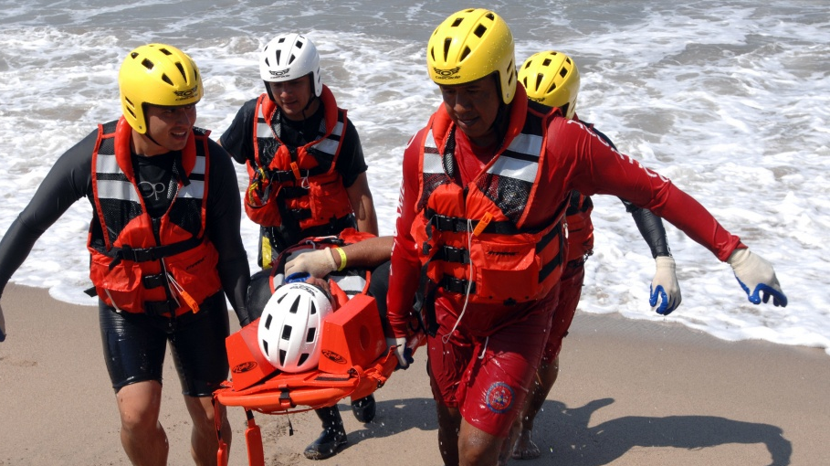
Procedure
Use personal survival, body management, and preparedness skills for the specific wilderness environments in which a rescuer could become involved.
Recognize the need for the provision, environmental protection through clothing systems applicable to the specific wilderness environments in which the rescuer could become involved.

Slide 14
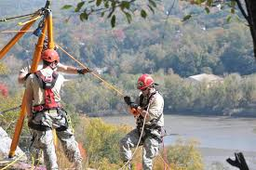
Procedure
Selecting, caring for, and using personal medical and support equipment and packing it with due regard to how it will be carried.
Traveling through various wilderness environments in which the rescuer could become involved while minimizing the threats to safety.

Slide 15
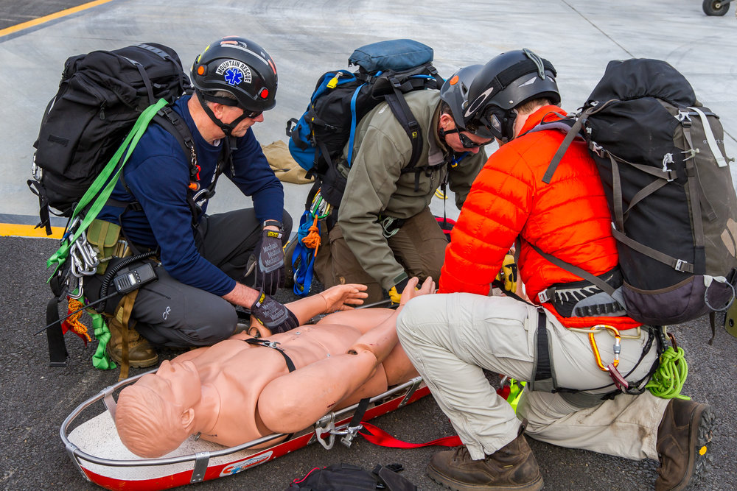
Procedure
Using land navigation techniques that use map and compass as well as any methods of navigation and position reporting utilized by the responding organizations with which the responder could become involved.

Slide 16
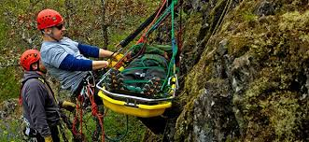
Procedure
Procuring the necessary maps and navigational and topographical information.
Modifying actions and urgency as applicable to a rescue versus a recovery.
Acquiring information on current and forecast environmental factors, including weather, temperature, precipitation, winds, avalanche risk, and tide levels.

Slide 17
Procedure
Accessing and extricating individuals from wilderness environments and terrain encountered in the response area (As long as they are on trail and it is safe to do so and the benefit outweighs the risk).

Slide 18
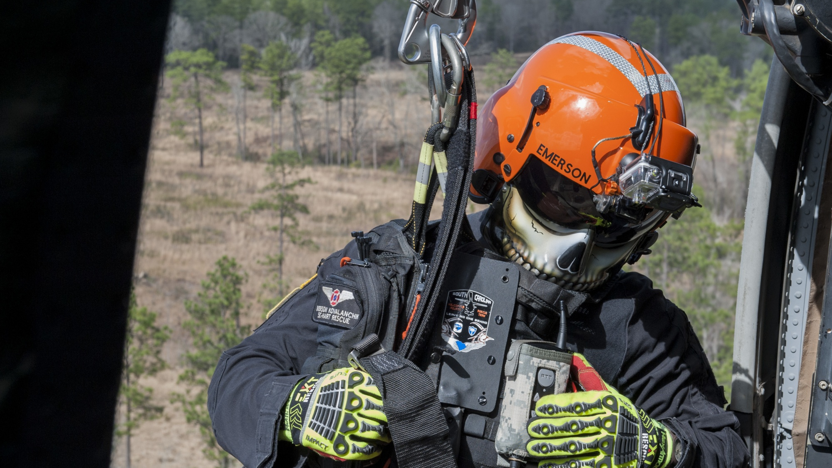
Procedure
Working in and around any aircraft, watercraft, and special vehicles used for SAR operations while minimizing threats to rescuers. Recognizing the team’s limitations regarding accessing and/or evacuating a victim.

Slide 19
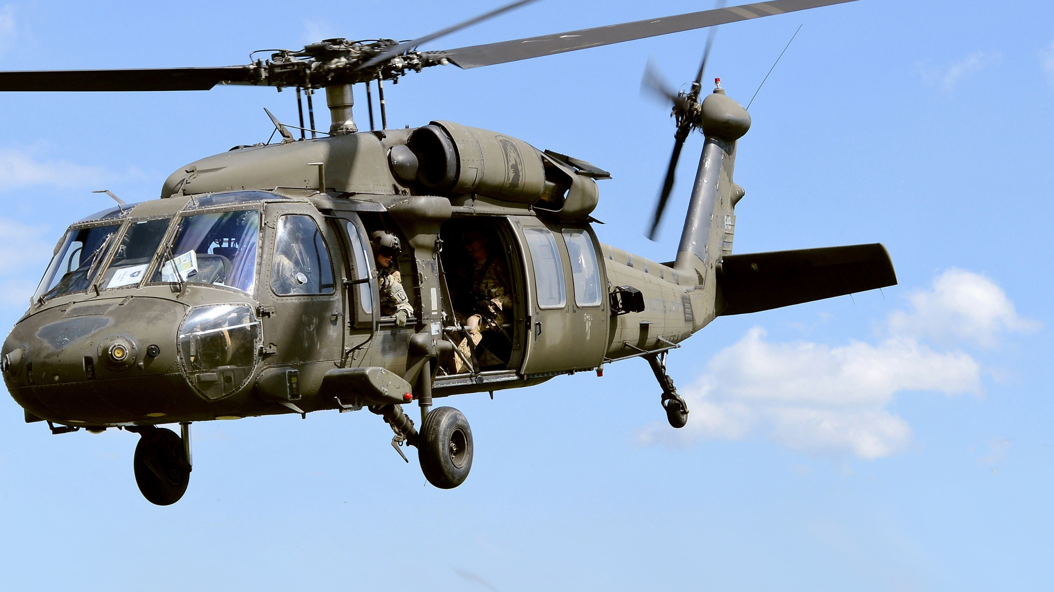
Ten Essentials/Items provided in our wilderness pack in each Aid Unit
Navigation – Be sure to carry a map of the area you intend to travel, a compass, and the knowledge of how to use them. If you use a GPS unit, be sure you are familiar with the unit. Bring a map and compass as a backup as electronics can malfunction unexpectedly.
Sun Protection – Sunglasses and sunblock should be carried, even on cloudy days. Eye protection should be worn during snow travel to prevent snow-blindness which is a painful and debilitating condition.

Slide 20
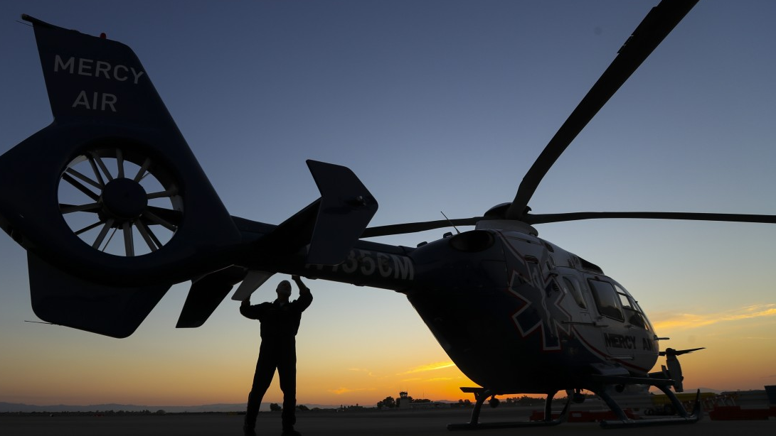
Ten Essentials/Items provided in our wilderness pack in each Aid Unit
Insulation – Weather can change suddenly. Be prepared for the worst possible weather you could encounter. Items you should include are a waterproof jacket, an extra layer of warmth (such as a fleece sweater), extra socks, gloves, and a warm hat.
Illumination – In the event your trip lasts longer than anticipated, you could find yourself on trail in the dark. Having a flashlight or headlamp could be the difference between getting off the mountain tonight or having to wait until the next day.

Slide 21
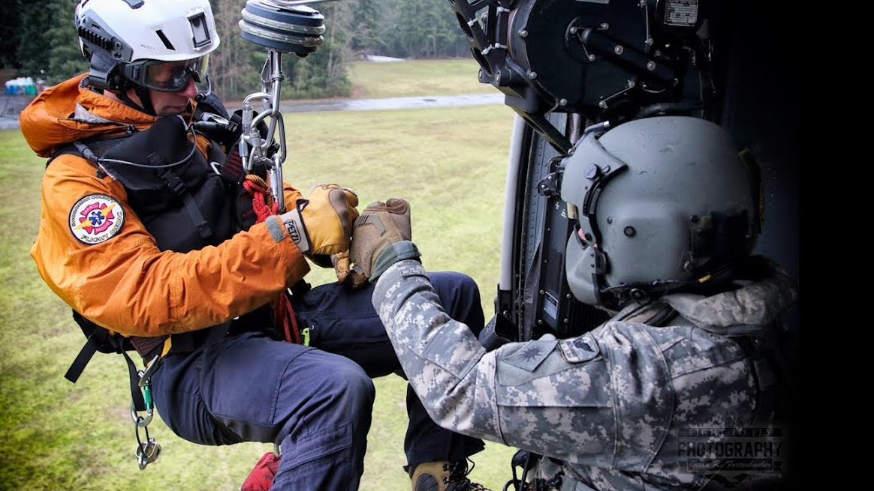
Ten Essentials/Items provided in our wilderness pack in each Aid Unit
First Aid Supplies – There is no exact list of what a person should carry for a particular trip, but here are some suggestions that would be appropriate. Band aids, adhesive tape, gauze pads, tweezers, over-the-counter pain reliever and antihistamine, compression bandage (such as an Ace bandage), and a triangle bandage to act as an arm sling.

Slide 22
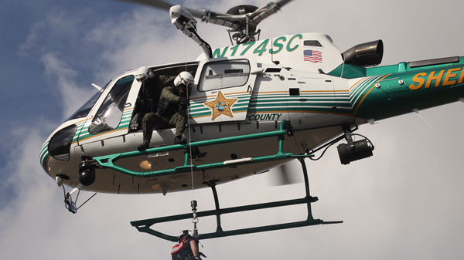
Ten Essentials/Items provided in our wilderness pack in each Aid Unit
Fire – It can become very cold at night, even in the summer, and an emergency fire could be a lifesaver. Some suggestions would be a lighter, fire-starter, matches, chemical heat tabs, etc.
Repair Kit & Tools – Items can and will break. Build yourself an emergency repair kit to deal with backpacks that won’t zip, tears in clothing, tent poles that snap, etc. Some suggestions are duct tape, knife, safety pin, fabric patches, safety pins, etc.

Slide 23
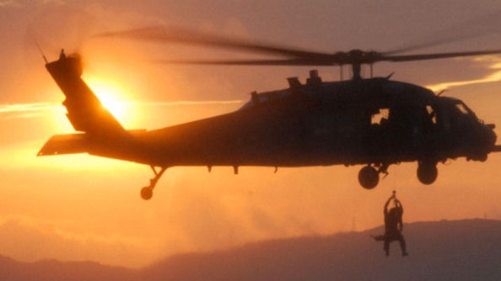
Ten Essentials/Items provided in our wilderness pack in each Aid Unit
Nutrition – Besides bringing a regular amount for the expected duration of your trip, be sure to bring extra in case you are out longer than planned, especially foods that require no cooking such as nuts, bars, etc

Slide 24
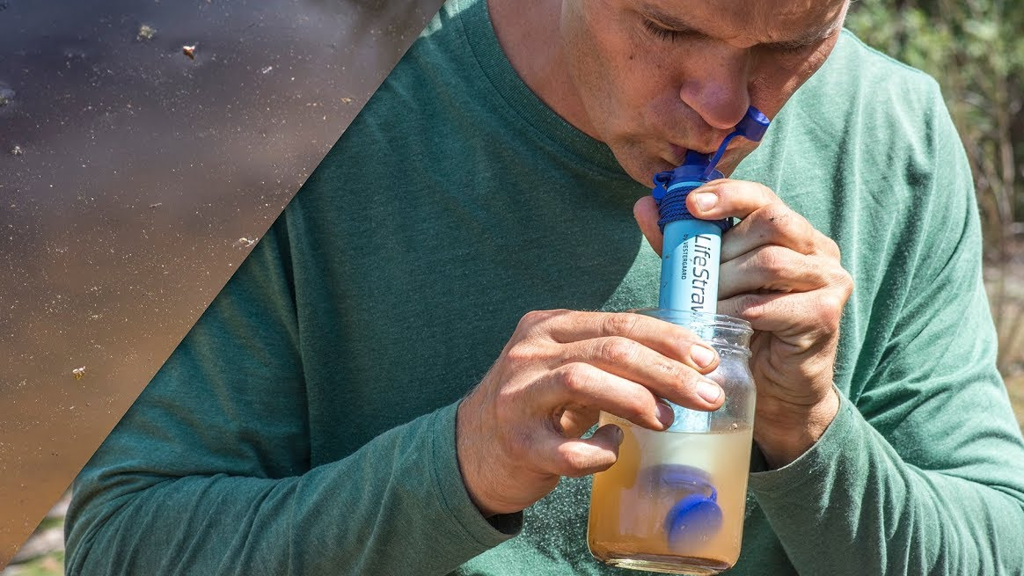
Ten Essentials/Items provided in our wilderness pack in each Aid Unit
Hydration – Remember that we drink more when we are expending extra energy so account for that when you are deciding how much water to bring. If you plan on filtering or treating water on the way, verify that water will be available and that your filtering system is working correctly before you go.

Slide 25
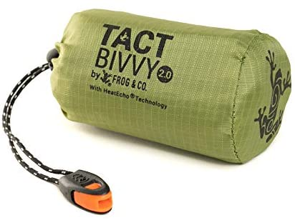
Ten Essentials/Items provided in our wilderness pack in each Aid Unit
Emergency Shelter – For day hikers, this doesn't have to be a full tent, but something that will provide some warmth and help protect from the elements. Even an emergency space blanket or bivy will provide additional protection.

Slide 26
NFPA 1670 Chapter 4 Wilderness SAR/ Company Discussion
Operating at the awareness level we shall be able to:
Recognize the need for a wilderness search and rescue response.

Slide 27
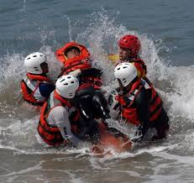
NFPA 1670 Chapter 4 Wilderness SAR/ Company Discussion
Initiate a SAR response
Initiate site control and scene management

Slide 28
NFPA 1670 Chapter 4 Wilderness SAR/ Company Discussion
Be able to recognize the general hazards associated with wilderness search and rescue
What are the hazards?
Recognize the type of terrain involved in wilderness search and rescue
What type of terrain could be involved? Are we setup for this type of specialty for each of your terrain examples?
Recognize the limitations of conventional emergency response skills and equipment
Will our conventional operations work in the wilderness?
all information needed, in most cases until SAR.

Slide 29
NFPA 1670 Chapter 4 Wilderness SAR/ Company Discussion
Initiate the collection and recording of information necessary to assist operational personnel
What information do we want to gather?
Name(s)
DOB
Last Known Location
Condition
Equipment they had with them
We also want to start recording information as it comes in as well as our operations.
Try to keep them onsite until you can gather information

Slide 30
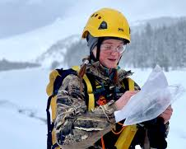
NFPA 1670 Chapter 4 Wilderness SAR/ Company Discussion
Identify and isolate any reporting parties and witnesses
all information needed, in most cases until SAR

Slide 31
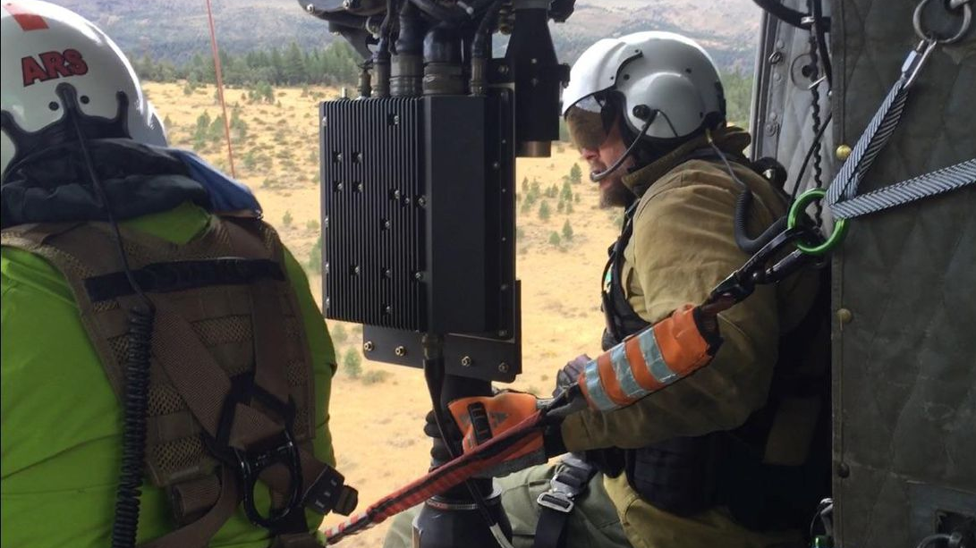
NFPA 1670 Chapter 4 Wilderness SAR/ Company Discussion
When operating at the operations level we shall be able to:
Size up existing and potential conditions where the operation will be performed
What are we sizing up?
Can we operate in these conditions? Terrain, daylight, weather.

Slide 32
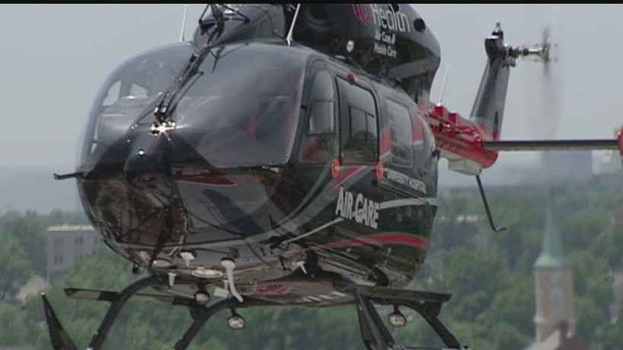
NFPA 1670 Chapter 4 Wilderness SAR/ Company Discussion
Requesting and interfacing with SAR
Anytime that we are operating in the wilderness SAR SHALL be requested.
A unified command shall be setup

Slide 33
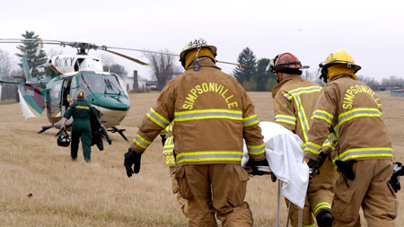
NFPA 1670 Chapter 4 Wilderness SAR/ Company Discussion
Provide medical care that meets protocol for wilderness response
Spinal Mobilization Restriction
Risk of SMR versus benefits should be weighed in special circumstances such as prolonged extrication from remote wilderness or technical rescue situations. Risks include emesis with subsequent airway compromise, pressure sores and extreme patient discomfort. Rescuer must carefully consider the index of suspicion for injury.

Slide 34
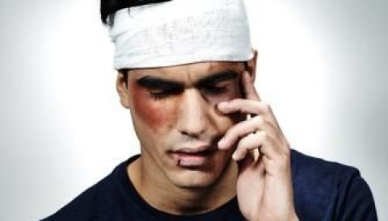
NFPA 1670 Chapter 4 Wilderness SAR/ Company Discussion
Wound care
Designation of Condition: Significant tissue trauma in a wilderness setting resulting in open wounds is at an increased risk of infection over and above what is normally encountered by EMS.

Slide 35
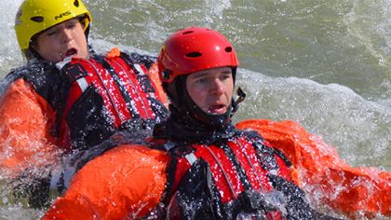
NFPA 1670 Chapter 4 Wilderness SAR/ Company Discussion
Use personal survival, body management, and preparedness skills.
Travel through the wilderness while minimizing risk to the rescuers?
Acquire information on current and forecasted weather

