Slide 1
THE RESCUE COMPANY 1

Slide 2
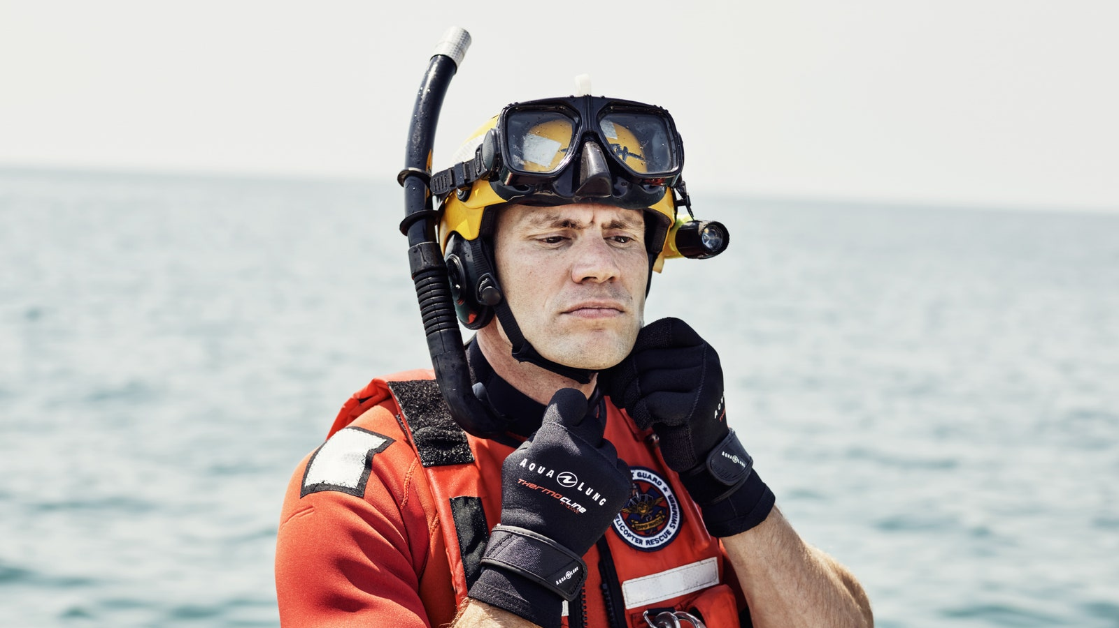
Rescue skills

Slide 3
RESCUE APPROACHES
The best way to swim to the victim is with a modified front crawl or breaststroke

Slide 4
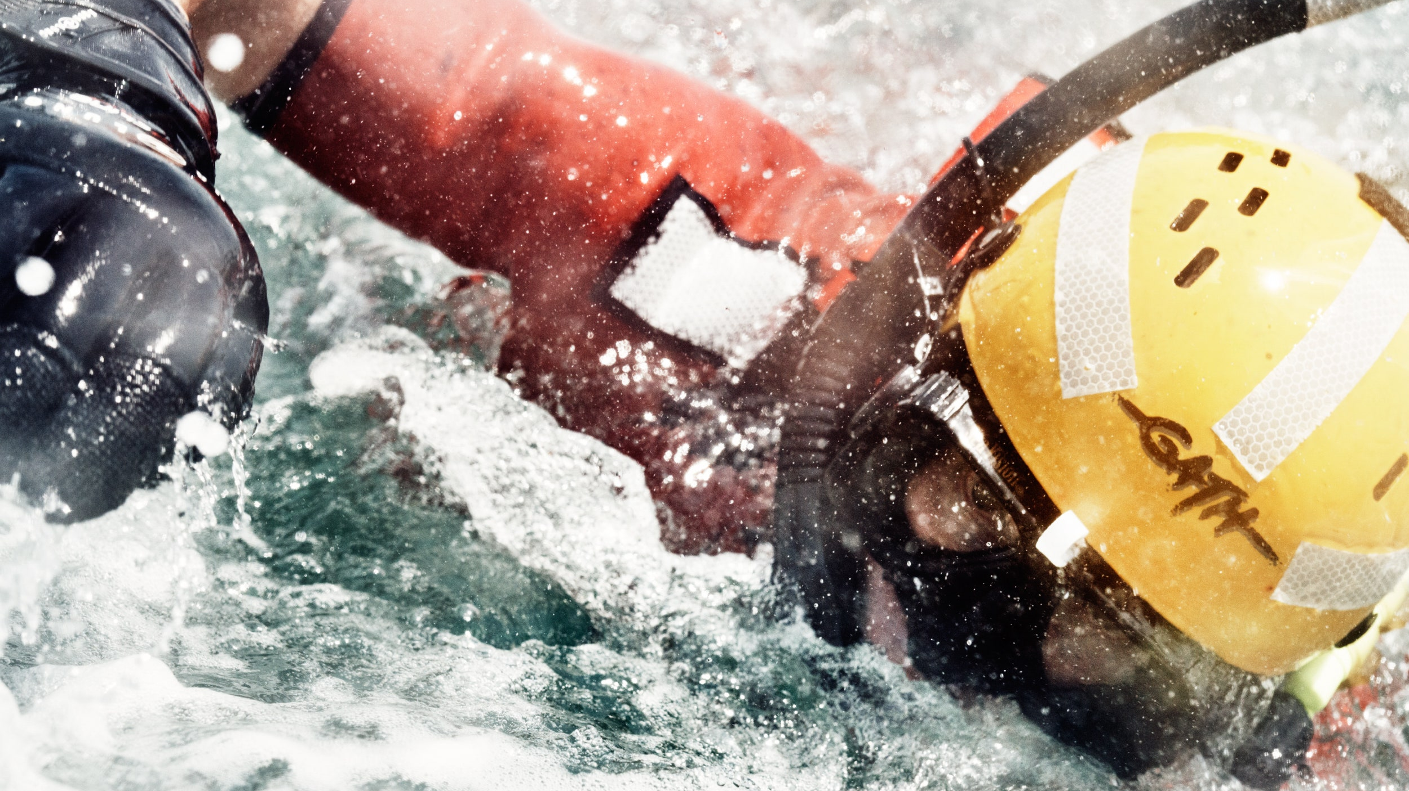
RESCUES AT OR NEAR THE SURFACE
Swimming Extension Rescue
Active Drowning Victim Rear Rescue
Passive Drowning Victim Rear Rescue

Slide 5
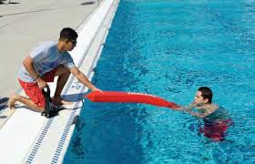
Swimming Extension Rescue
The swimming extension rescue works well for a dis­tressed swimmer.
To perform a swimming extension res­cue

Slide 6
Swimming Extension Rescue
Approach
Approach the victim from the front.
Extend
Extend the end of the rescue tube to the victim.
Tell
Tell the victim to hold on to the rescue tube and kick if he or she can.

Slide 7
Swimming Extension Rescue
Tow
Tow the victim to safety.
Be
Be sure to maintain visual contact.
Reassure
Reassure the victim.

Slide 8
Active Drowning Victim Rear Rescue

Slide 9
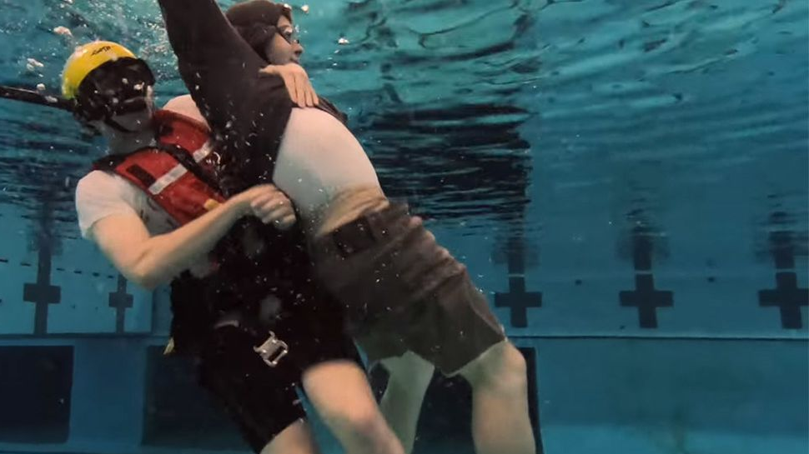
Active Drowning Victim Rear Rescue
The active drowning victim rear rescue can be used for either a distressed swimmer or an active drowning vic­tim.

Slide 10
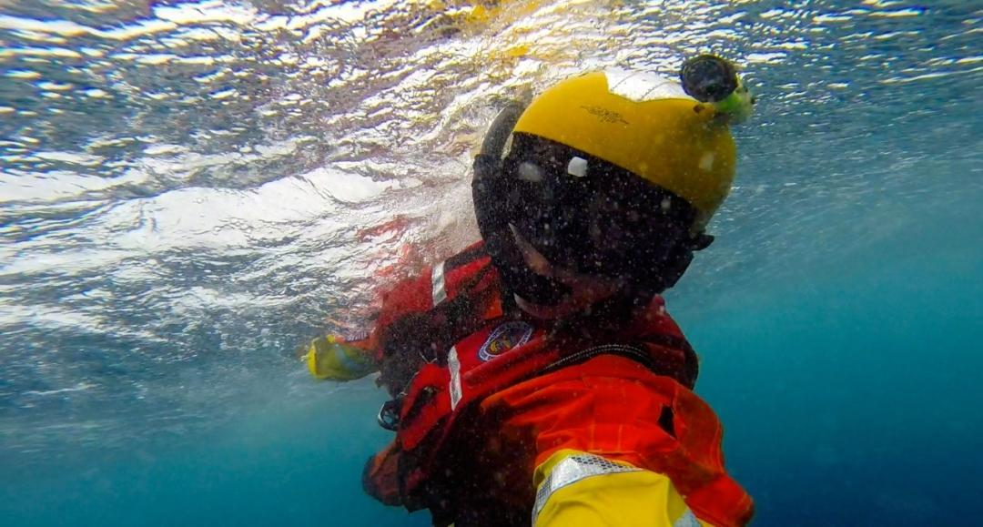
Active Drowning Victim Rear Rescue
Approach the victim from behind
This may require swimming past, under, and around the victim.

Slide 11
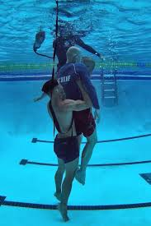
Active Drowning Victim Rear Rescue
Reach under the victim's armpits and grasp the shoul­ders firmly.
Squeeze the rescue tube between the rescuer's chest and the victim's back

Slide 12
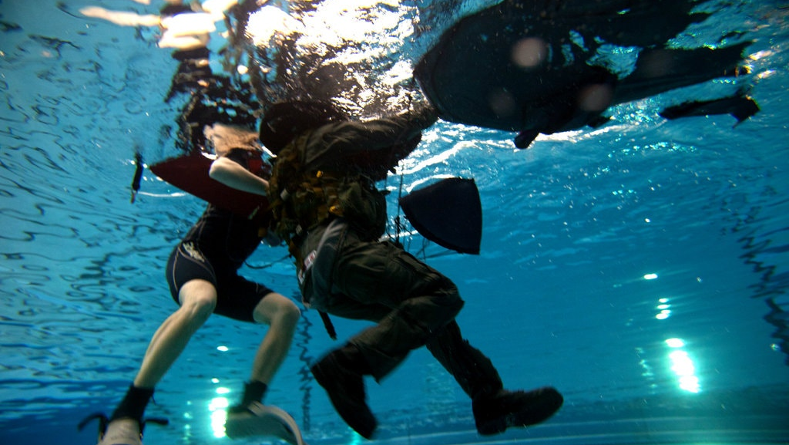
Active Drowning Victim Rear Rescue
Keep the rescuers head to one side to avoid being hit by the victim's head if it moves backward.

Slide 13
Active Drowning Victim Rear Rescue
Lean back and pull
Lean back and pull the victim onto the rescue tube
Use
Use the rescue tube to support the victim so the vic­tim's mouth is out of the water.
Reassure
Reassure the victim.
Tow
Tow the victim to safety.

Slide 14
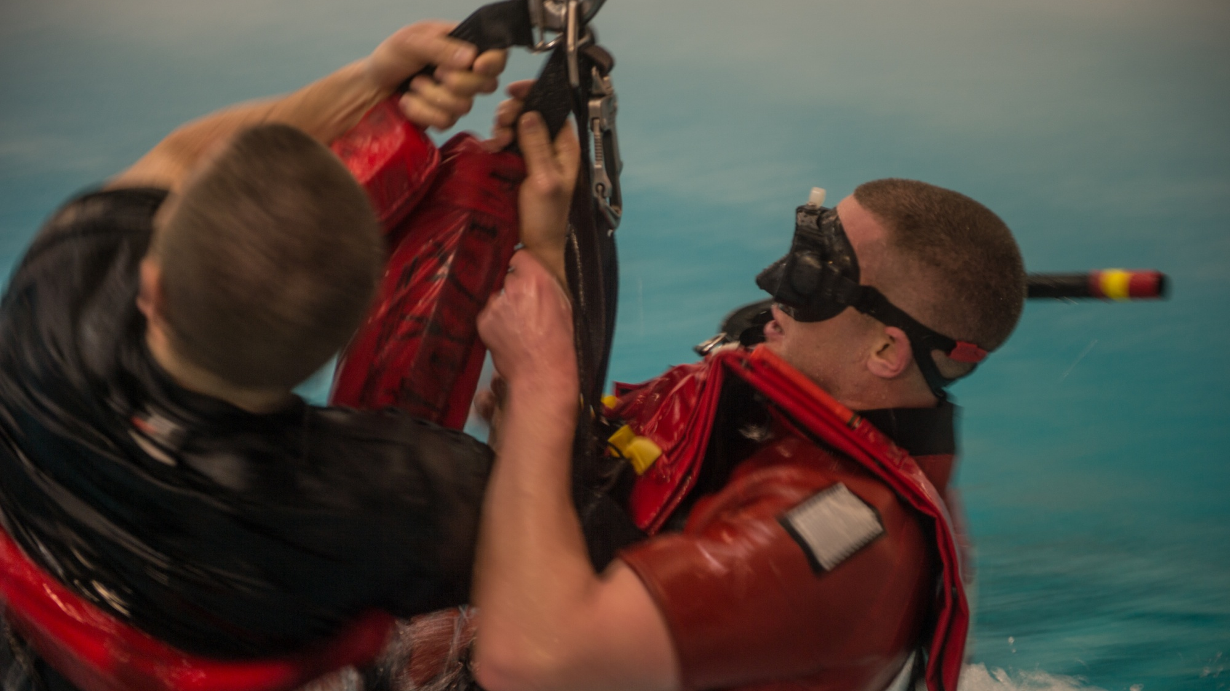
Passive Drowning Victim Rear Rescue

Slide 15
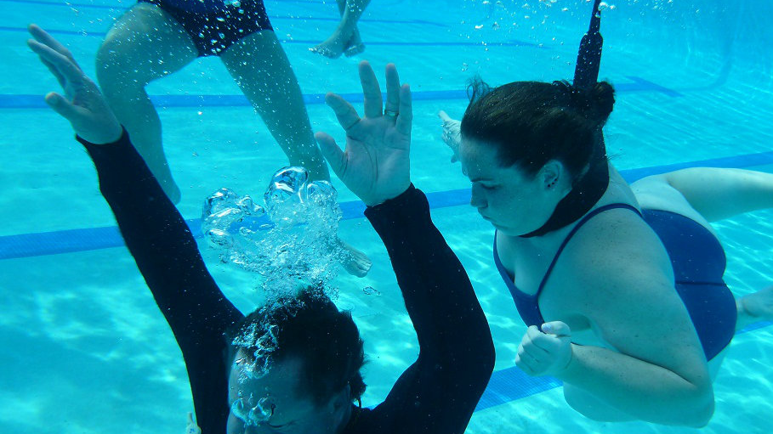
Passive Drowning Victim Rear Rescue
Passive Drowning Victim Rear Rescue Use the passive drowning victim rear rescue when the victim is at or near the surface, seems unconscious and a head, neck or back injury is not suspected.

Slide 16
Passive Drowning Victim Rear Rescue
Approach the victim from behind.
Reach under the victim's armpits and grasp the shoul­ders firmly.
The rescuer may be high on the victim's back when doing this.
Squeeze the rescue tube between the rescuer's chest and the victim's back.

Slide 17
Passive Drowning Victim Rear Rescue
Keep
Keep his or her head to one side to avoid being hit by the victim's head if it moves backward.
Roll
Roll the victim over by dipping the lifeguard's shoulder and rolling onto the back so that the victim is face-up on top of the rescue tube.
Tow
Tow the victim to safety.

Slide 18
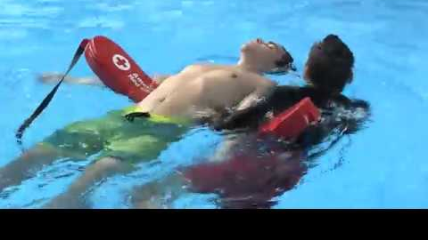
Passive Drowning Victim Rear Rescue
Tow the victim to safety. For greater distances, use one hand to stroke.
Reach the right arm over the victim's right shoulder and grasp the rescue tube.
Then use the left hand to stroke. Or reach with the left arm and stroke with the right hand.

Slide 19
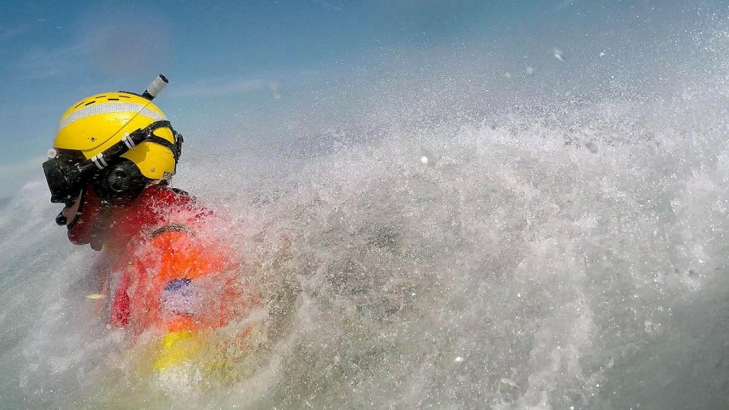
RESCUING A SUBMERGED VICTIM

Slide 20
RESCUING A SUBMERGED VICTIM
Passive Submerged Victim-Shallow Water
Active or Passive Submerged Victim ­Deep Water
Active or Passive Submerged Victim Rescue-Deep Water

Slide 21
Passive Submerged Victim-Shallow Water

Slide 22
Passive Submerged Victim-Shallow Water
Swim
Swim or quickly walk to the point near the victim's side.
Let go
Let go of the rescue tube but keep the strap around the shoulders.
Face in
Face in the same direction as the victim
Submerge and reach down
Submerge and reach down to grab the victim under the armpits.

Slide 23
Passive Submerged Victim-Shallow Water
Pick
Simultaneously, pick the victim up.
Move forward and roll
Move forward and roll the victim face-up upon surfacing.
Grab
Grab the rescue tube and position it under the victim's shoulders.

Slide 24
Passive Submerged Victim-Shallow Water
Move
Move the victim's arm that is closest to the lifeguard down to the side of the victim.
Reach
Reach the right arm over the victim's right shoulder and grasp the rescue tube
Arm over
or reach with the left arm over the victim's left shoulder and grasp the rescue tube.
Move
Move the victim quickly to safety.

Slide 25
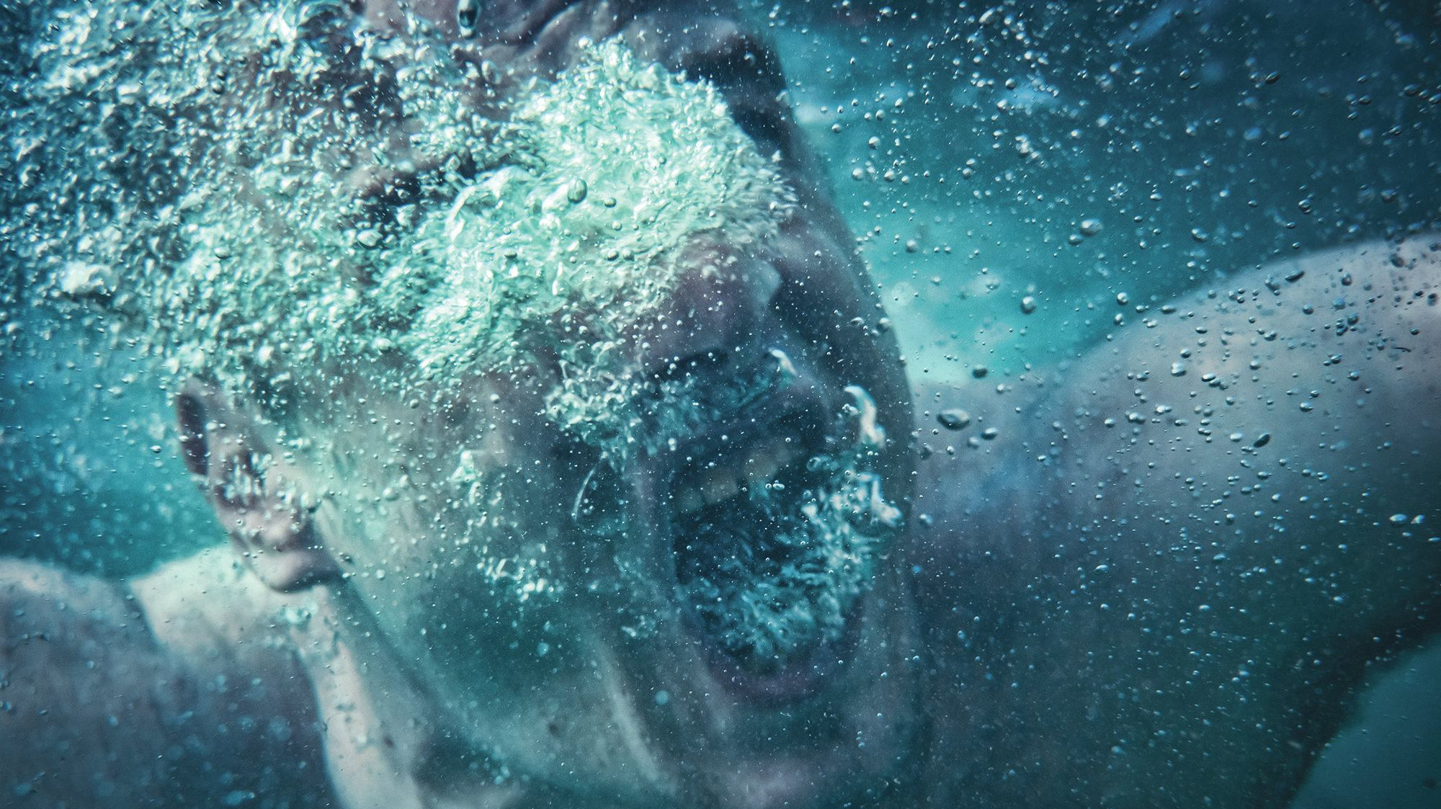
Active or Passive Submerged Victim Deep Water

Slide 26
Active or Passive Submerged Victim Deep Water
Swim
Swim to a point near the victim. Release the rescue tube but keep the strap around the shoulders.
Position
Position his or her body vertically, then at the same time press both hands down and kick strongly to raise his or her body out of the water.
Take
Take a breath with the arms at the sides and let his or her body sink underwater. Keep the legs straight and together.

Slide 27
Active or Passive Submerged Victim Deep Water
As downward momentum slows, turn the palms out­ward and sweep the hands and arms upward and overhead.

Slide 28
Active or Passive Submerged Victim Deep Water
Repeat
Repeat this arm movement until deep enough to reach the victim.
Hold
Hold the victim in a face-up position on the rescue tube.
Move
Quickly move the victim to safety.

Slide 29
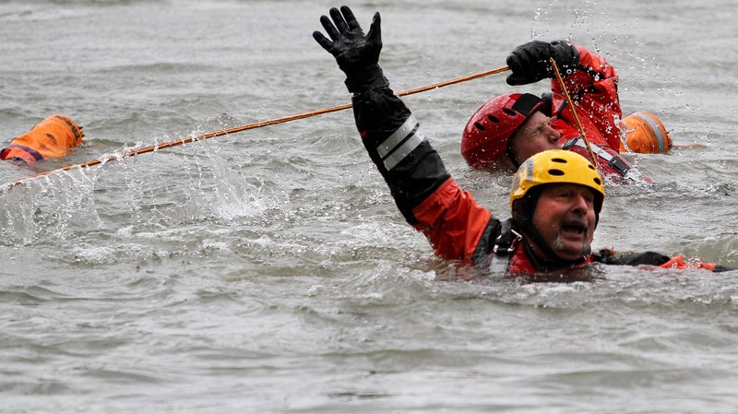
ESCAPES

Slide 30
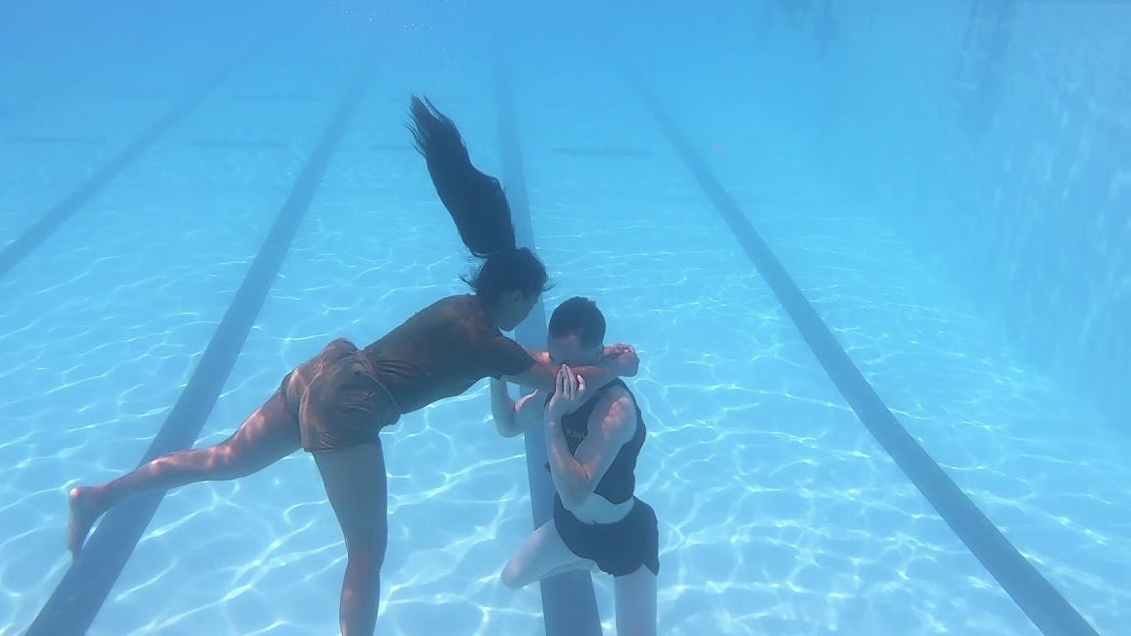
ESCAPES
As soon as the victim grabs hold, take a quick breath.
Tuck the chin down.
Turn the head to either side.
Raise the shoulders and submerge with the victim.

Slide 31
ESCAPES
Grasp
Once underwater, grasp the victim's elbows or the un­dersides of the victim's arms just above the elbows.
Push up
Forcefully push up and away.
Keep
Keep the chin tucked, the arms fully extended, and the shoulders raised until free.

Slide 32
ESCAPES
Quickly swim underwater out of the victim's reach.
Surface and reposition the second attempt.

Slide 33
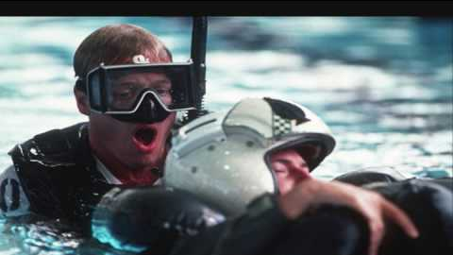
MULTIPLE-VICTIM RESCUE

Slide 34
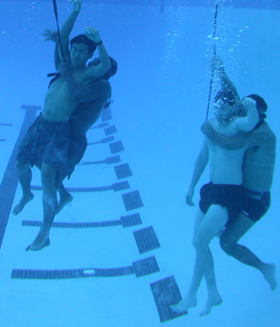
MULTIPLE-VICTIM RESCUE
Sometimes two or more victims need to be rescued.
A victim may grab a nearby swimmer to try to stay above the water.

Slide 35
MULTIPLE-VICTIM RESCUE
Several rescue swimmers should perform a multiple­ victim rescue if possible.
At least one rescue swimmer should check the bottom for possible submerged victims while other rescue swimmer rescue the victims at the surface.

Slide 36
If there is only one lifeguard rescuing two victims who are clutching each other
Approach
Approach one victim from behind.
Reach
Reach under the victim's armpits and grasp the shoul­ders.
Squeeze
Squeeze the rescue tube between his or her chest and the victim's back.
Keep
Keep the head to one side of the victim's head.

Slide 37
If there is only one lifeguard rescuing two victims who are clutching each other
Use
Use the rescue tube to support both victims with their mouths out of the water.
Talk
Talk to the victims to help reassure them.
Support
Support both victims until other rescuer’s arrive or the victims calm down enough to help move to safety.

