Slide 1
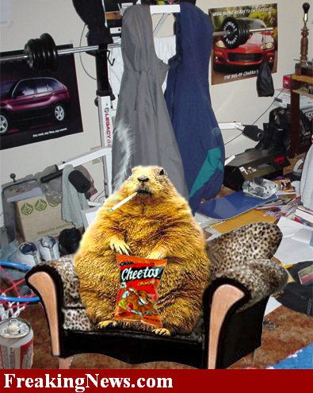
FOOD

Slide 2
Not really necessary. You can survive 4-5 weeks without food.

Slide 3
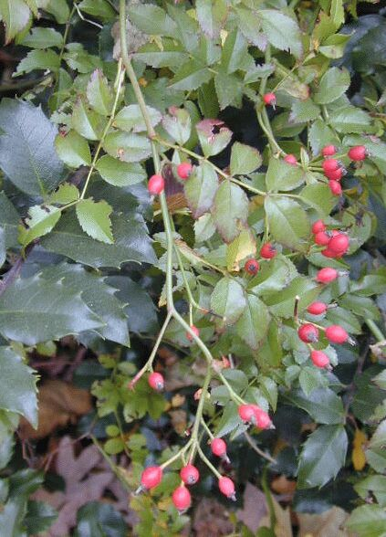
Types of wild foods:

Slide 4
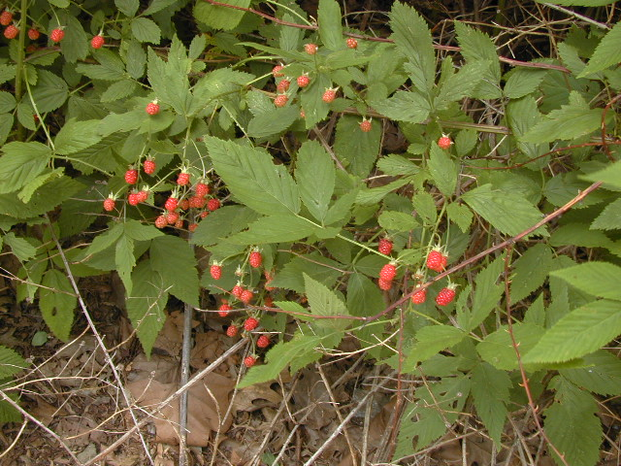
Green Plants:

Slide 5
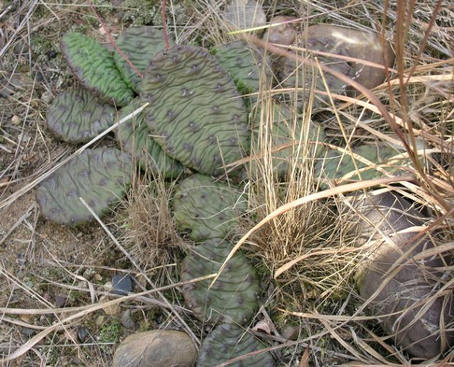
Take a lot of Energy, not very digestible, Must make positive ID !

Slide 6
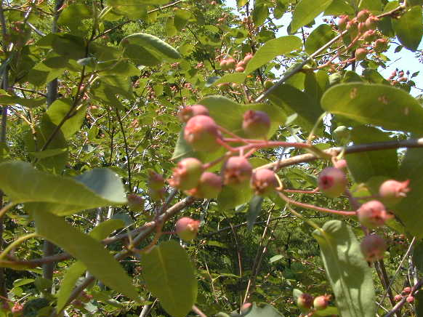
Berries:
Service berries

Slide 7
Dandelions
All parts are edible

Slide 8
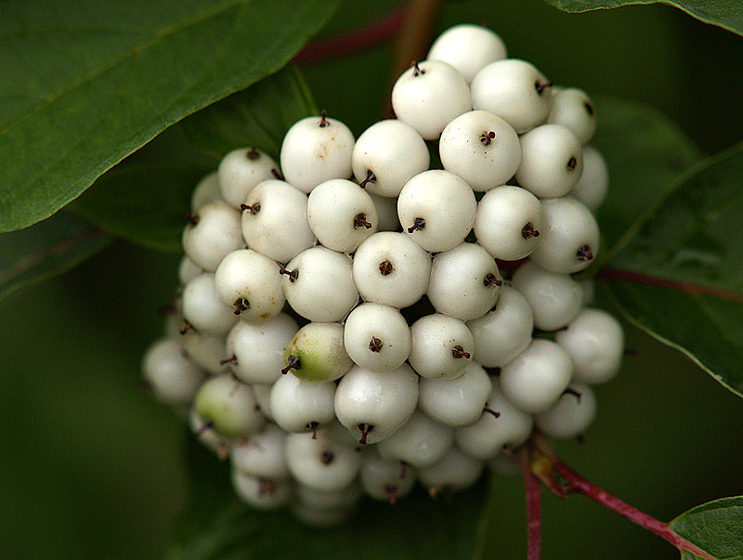
White and Yellow Berries:
95 % are Poisonous

Slide 9
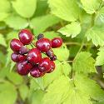
Red Berries:
50 % are Poisonous

Slide 10
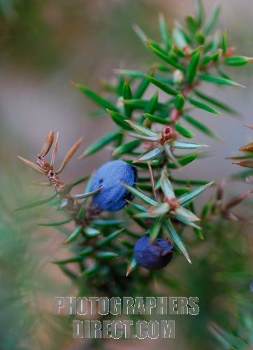
Blue and Black Berries
85 % are edible
15 % Among the most poisonous

Slide 11
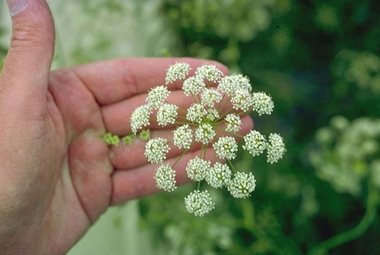
Poisonous plants
Water hemlock

Slide 12
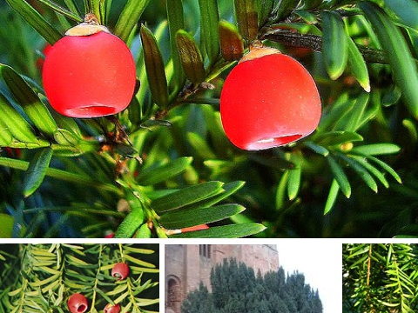
Poisonous plants
English Yew

Slide 13
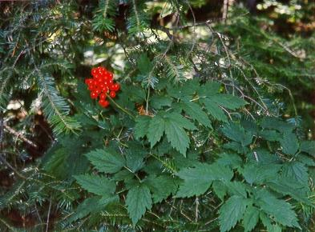
Poisonous plants
Bane Berry

Slide 14
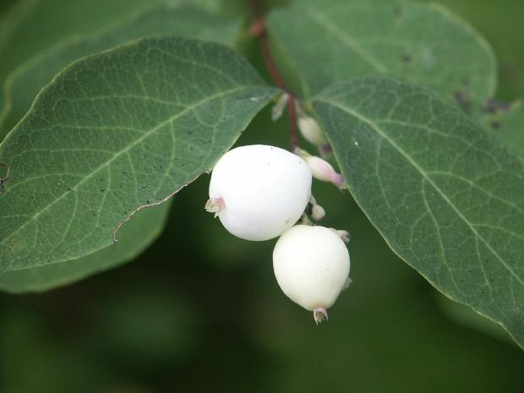
Poisonous plants
Snow Berry

Slide 15
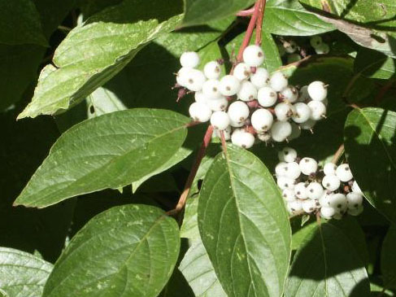
Poisonous plants
Red-Osier Dogwood

Slide 16
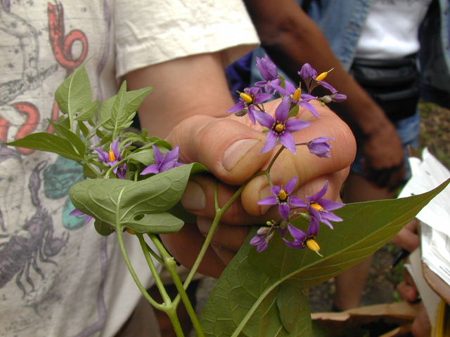
Poisonous plants
Nightshade

Slide 17
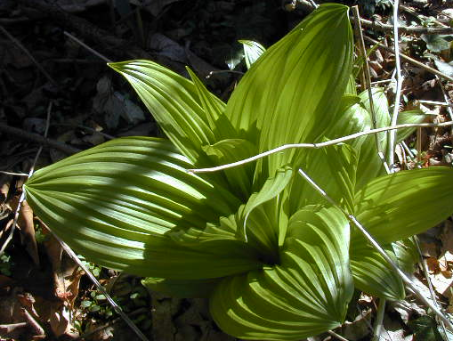
Poisonous plants
False Hellebore

Slide 18
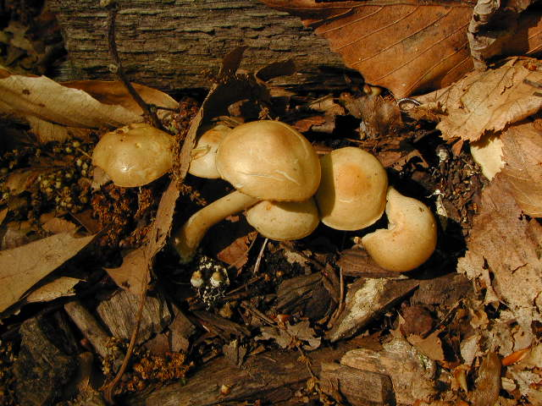
Mushrooms:

Slide 19
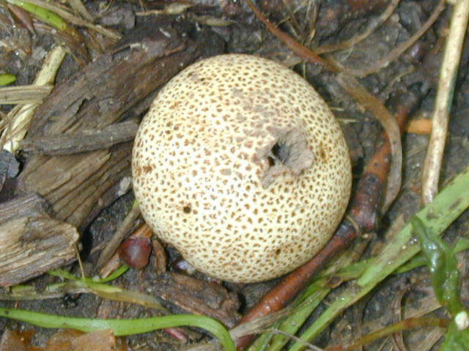
Avoid unless you can make 100 % positive ID

Slide 20
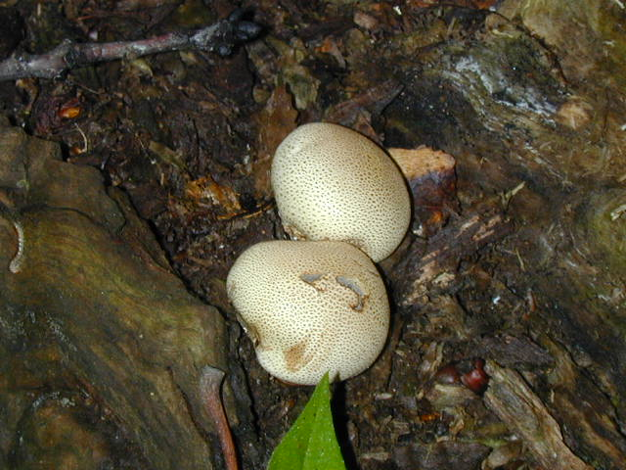

Slide 21
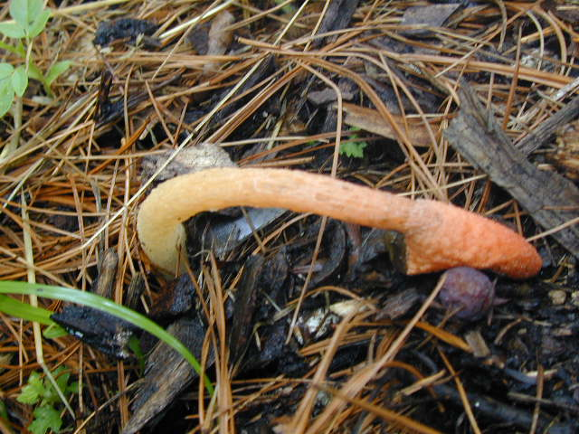

Slide 22
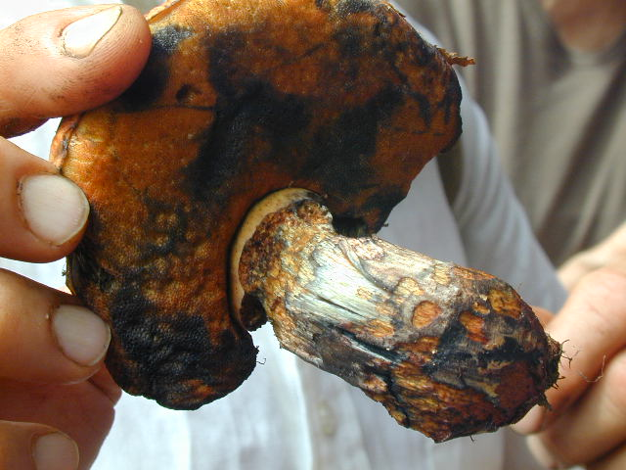

Slide 23
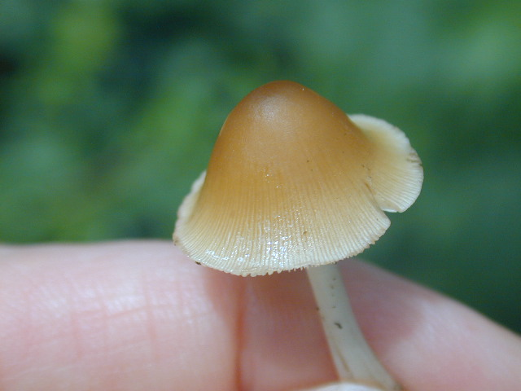

Slide 24
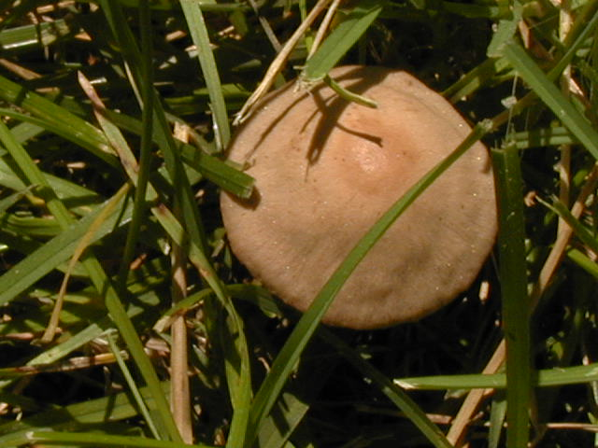

Slide 25
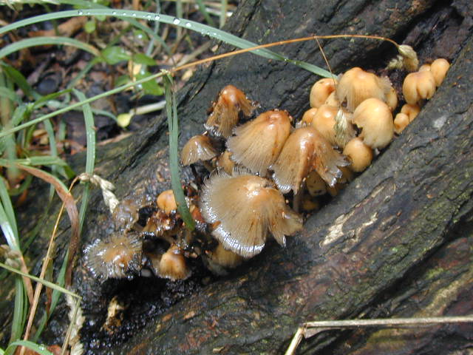

Slide 26
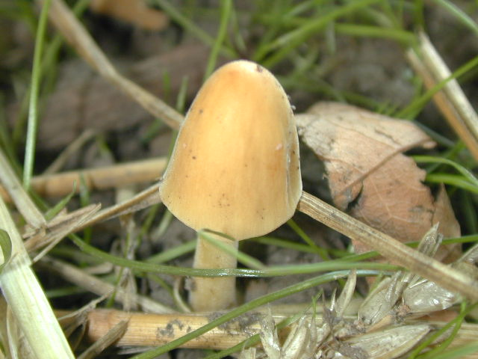
Every Mushroom you have seen so far has been poisonous!

Slide 27
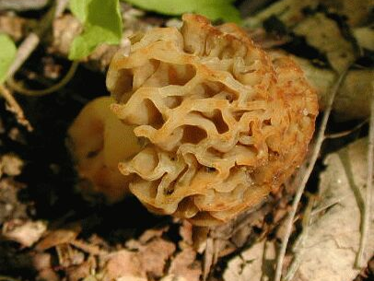
The following mushrooms are edible
Morel

Slide 28
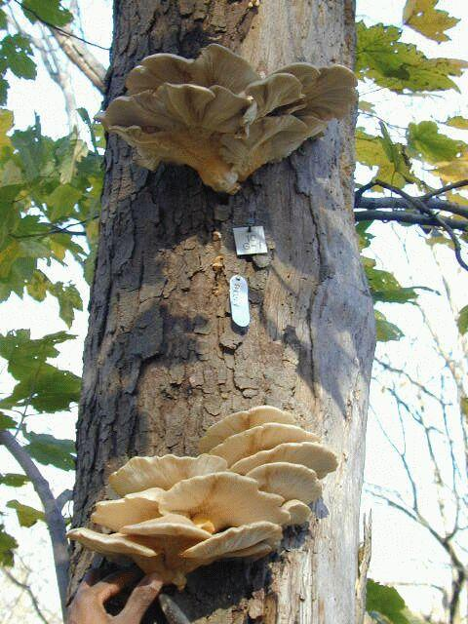
edible
Oyster mushroom

Slide 29
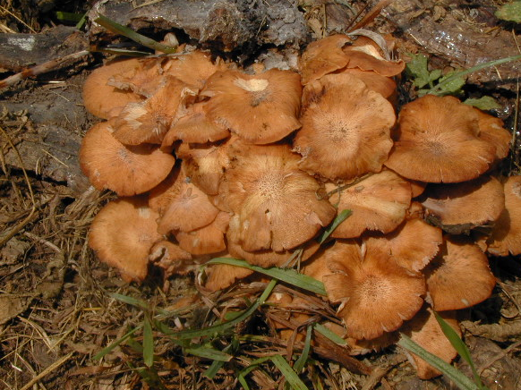
Ringless honey mushroom
Edible after cooking. Get sick if eaten raw. Very delicious.

Slide 30
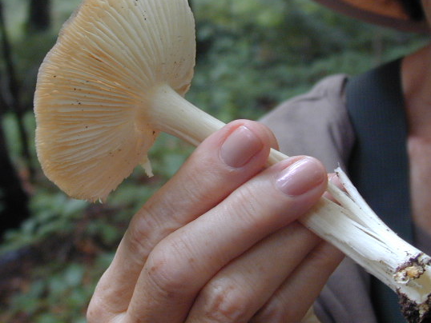
Milky mushroom

Slide 31
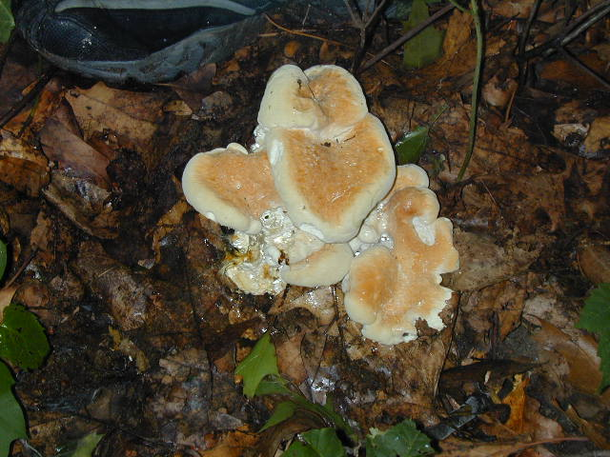
Berkeley's poly pore

Slide 32
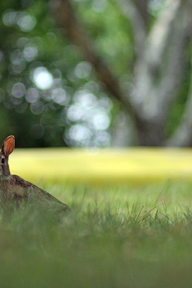
Small Game

Slide 33
Difficult and time consuming to snare

Slide 34
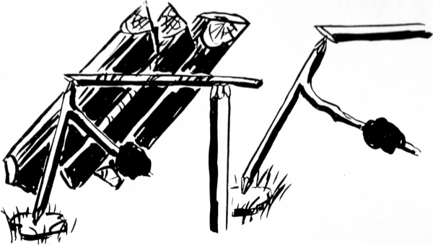
Slip Release Of Bait Stick

Slide 35
Noose Snare Sticks For Small Birds

Slide 36
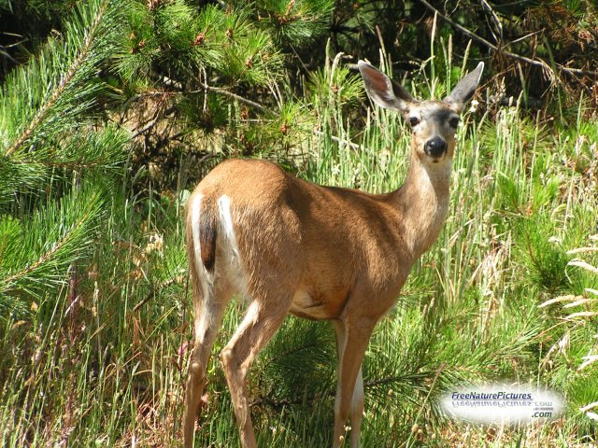
Hunting larger game

Slide 38
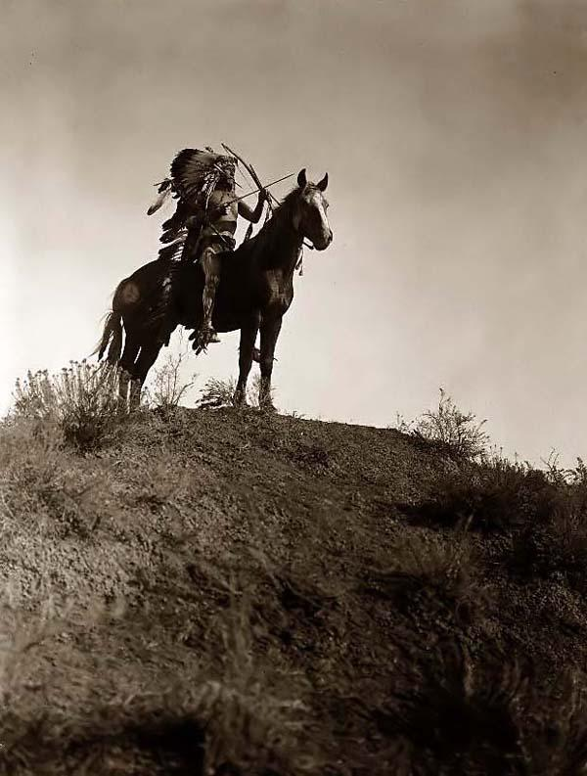
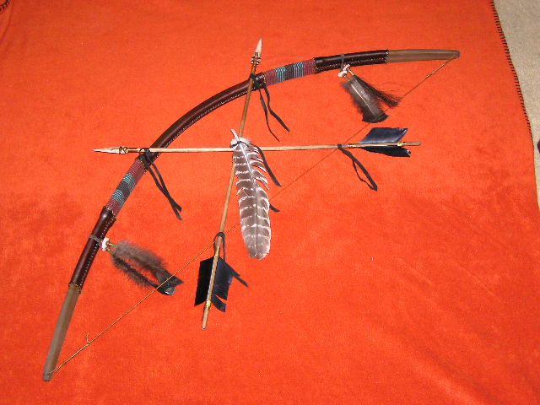
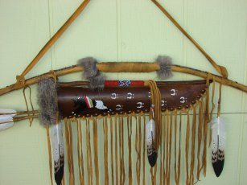

Slide 39
Pine trees

Slide 40
Most pines are edible

Slide 41
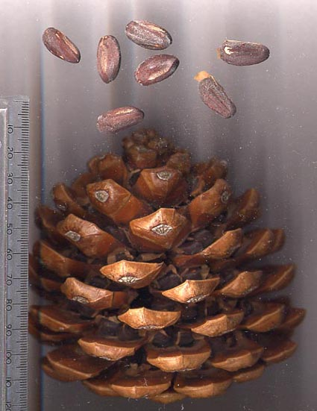

Slide 42
So what’s the best survival food??

Slide 43
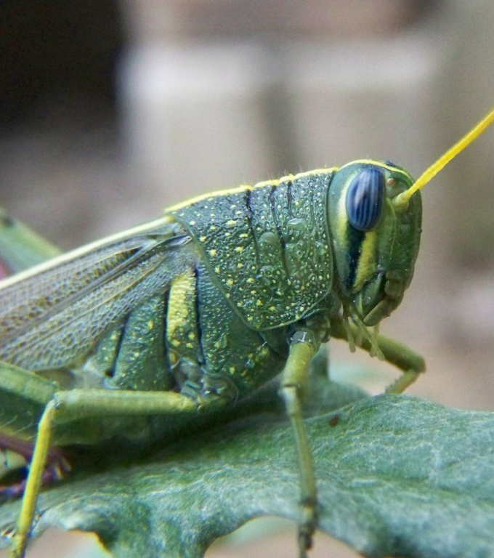
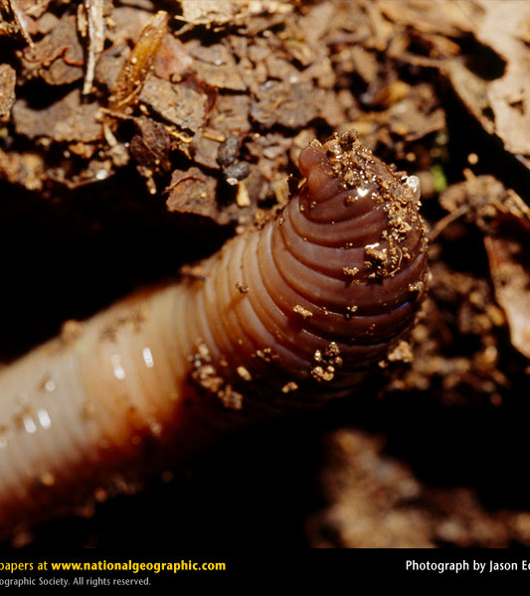
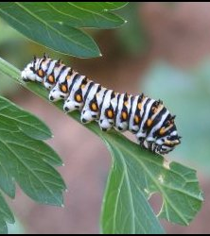
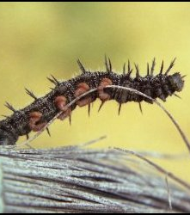
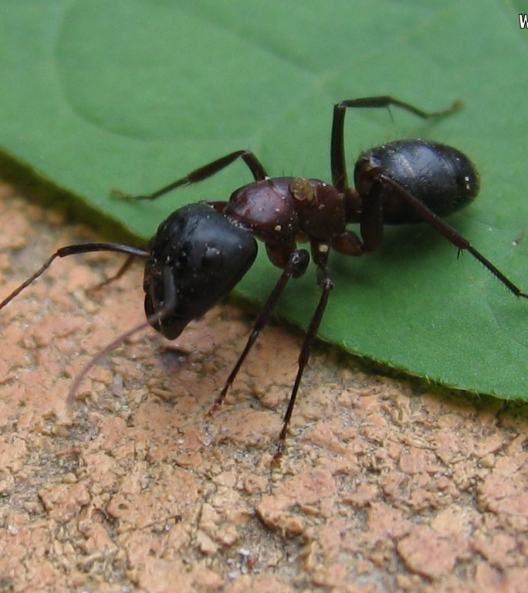
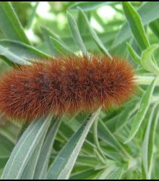

Slide 44
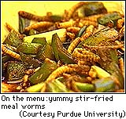
INSECTS!!!
Plentiful
Easy to catch
Nutritious
Delicious

Slide 45
Recipies
APPETIZERS
Dry Roasted Grasshoppers Spread fresh, frozen and cleaned insects on paper towels on a cookie sheet. Bake at 200° for 1-2 hours until desired state of dryness is reached. Check state of dryness by attempting to crush insect with spoon. From Orkin Garlic Butter Fried Grasshoppers 1/4 cup butter 6 cloves garlic, crushed 1 cup cleaned insects*
Melt butter in fry pan. Reduce heat. Sauté garlic in butter for 5 minutes. Add insects. Continue sautéing for 10 - 15 minutes, stirring occasionally. From Orkin

Slide 46
Recipies
Grasshopper Fritters from 'Ronald Taylor's "Butterflies in My Stomach"
3/4 cup sifted flour 1 tsp. baking powder 1 tsp. salt 3/4 c milk 1 egg, slightly beaten 1 c grasshoppers 1 pt. heavy cream beaten stiff
Sift flour, baking powder and salt together into a bowl. Slowly add milk and beat until smooth. Add egg and beat well. Pluck off grasshopper wings and legs, heads optional. Dip insects in egg batter and deep fry. Salt and serve. from Amazing Grasshopper Recipes.

Slide 47
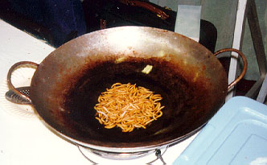
worms

Slide 48
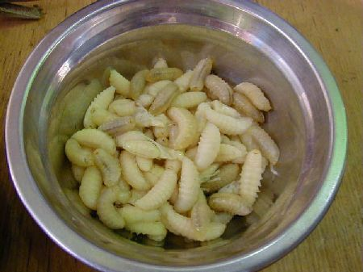
Better than french fries!!

Slide 49
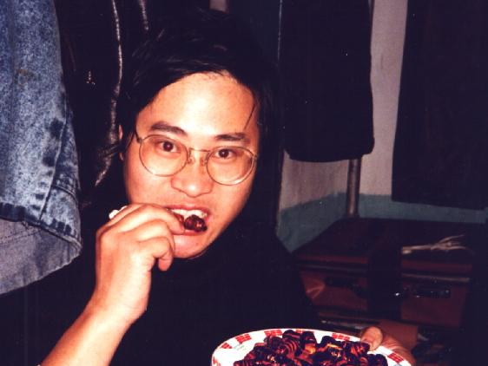

Slide 50
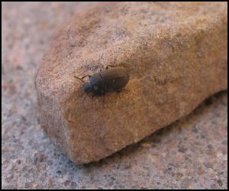
They’re everywhere

