Slide 1
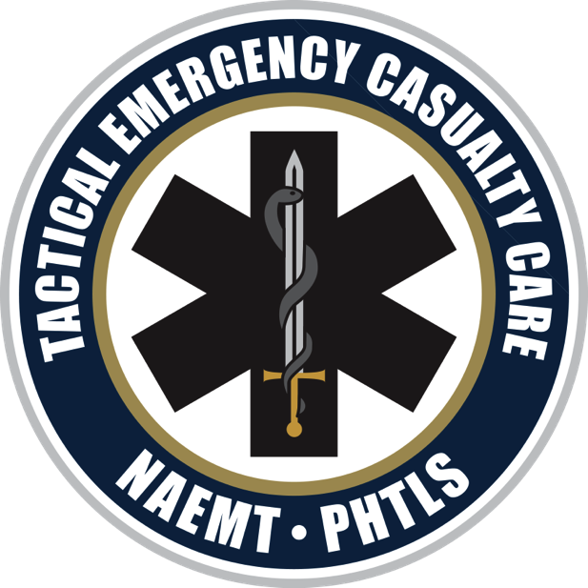
Tactical Emergency Casualty Care Pediatric Care
Notes:
Tactical Emergency Casualty Care (TECC) is the new standard of prehospital casualty care. Medical care in the tactical environment may be quite different than that provided during normal civilian operations; therefore, previous medical training may not have contained the material presented in this course.

Slide 2
Pediatric Direct Threat Care (DTC) (1 of 2)
The principles of medical care for the pediatric casualty during the DTC phase are no different than those of any other casualty.
Notes:
While pediatric patients require a different care approach, the tenants of care during the DTC phase are essentially the same: move to an area of safety, apply self aid, and control bleeding.

Slide 3
Pediatric Direct Threat Care (DTC) (2 of 2)
Mitigate any threat, and move to a safer position.
Direct the casualty to move to a safer position and apply self-aid if able.
Consider the type of instructions given to the pediatric patient.
Use simple words and gestures to give directions.
Notes:
A child's reaction to an ongoing incident will vary depending on their stage of learning development.

Slide 4
DTC Casualty Extraction
Instruct the victim to move to safety if at all possible.
If the victim cannot move, develop a tactically feasible rescue plan.
Remember that this is a dynamic environment.
Extraction of the pediatric casualty may be easier because of body size.

Slide 5
DTC Medical Care
Do not hesitate to apply a tourniquet to a pediatric casualty for a life-threatening extremity hemorrhage.
Apply high and tight over clothing.
Tighten until bleeding stops.
Place casualty in recovery position if tactically feasible.
Notes:
Stop life-threatening external hemorrhage if feasible. Providers should not hesitate to apply tourniquets to pediatric casualties.
Apply a tourniquet over the clothing as proximal (high) on the limb as possible. Tighten until cessation of bleeding, and move to safety. Consider moving to safety prior to application if the situation warrants. If no tourniquet is available or application of one is not tactically feasible, consider instructing the casualty to apply direct pressure to the wound. Consider quickly placing the casualty, or directing the casualty to be placed, in a position to protect the airway if tactically feasible.

Slide 6
Pediatric Indirect Threat Care (ITC)
If not already done during DTC, apply tourniquet for any life-threatening extremity hemorrhage.
Reassess any tourniquet applied during DTC.
For any total or partial amputation, apply tourniquet regardless of bleeding.
Use wound packing with hemostatic dressing for wounds not amenable to tourniquet placement.
Notes:
For a compressible hemorrhage not amenable to tourniquet use, or as an adjunct to tourniquet removal (if evacuation time is anticipated to be longer than 2 hours), correctly apply a hemostatic agent and an appropriate pressure bandage. Before releasing a tourniquet on a casualty who has received IV fluid resuscitation for hemorrhagic shock, ensure a positive response to resuscitation efforts (i.e., a peripheral pulse normal in character and normal mentation).

Slide 7
Airway ITC
As in the nontactical situation, the pediatric airway is, in some ways, more difficult to manage than that of an adult, but in other ways it is easier.
The size of the head in relation to the torso causes flexion of the spine and leads to airway obstruction if the casualty is placed supine.
Notes:
Placing a pediatric patient in the recovery position may provide a better outcome.

Slide 8
Unconscious Casualty Without Airway Obstruction
Monitor the patient.
Consider nasopharyngeal airway, as necessary.
Place casualty in the recovery position.
Caution is advised in patients with suspected spine injury (based upon mechanism of injury).
Notes:
Even without an obstructed airway, you must always continue to monitor for changes.
Use of a nasal airway helps to ensure patency of patients airway.
If possible, use the recovery position as a preemptive move for vomiting or development of airway compromise.
Where possible attempt to get brief history of mechanism of injury.

Slide 9
Casualty With Airway Obstruction or Impending Airway Obstruction
Use chin lift or jaw thrust maneuver.
Consider nasopharyngeal airway.
Allow conscious casualty to assume position that best protects the airway, including sitting up.
Place unconscious casualty in the recovery position.

Slide 10
Escalating Airway Management (1 of 2)
Airway positioning may be enhanced by elevation of the shoulders.
Bag-mask ventilation is equivalent to intubation in the pediatric prehospital population.
Consider oral/nasotracheal intubation.
Notes:
Positioning of the airway is dependent upon the child's size. For example, the positioning for a 6 month old is different than the positioning for a 15 year old. While preference may change depending on age, the principle remains the same: the airway needs to be maintained.

Slide 11
Escalating Airway Management (2 of 2)
Consider appropriately sized supraglottic devices.
Apply oxygen if available.
Consider surgical/invasive airway.
Needle cricothyroidotomy may be considered if signs of puberty are absent.
Surgical cricothyroidotomy may be considered if signs of puberty are present.
Notes:
Supraglottic devices that are specifically designed for pediatric patients may work well in some situations due to their blind insertion technique. Care must be given to correctly size all pediatric airway adjuncts.

Slide 12
Breathing ITC
Consider the likelihood of tension pneumothorax for patients with blunt or penetrating torso trauma who present with increasing respiratory distress.
Notes:
In a casualty with progressive respiratory distress and known or suspected torso trauma, consider tension pneumothorax. Needle thoracostomy should be
performed on the side of the injury, using the largest gauge (minimum 18-gauge) and the longest length appropriate for body size and chest wall thickness.

Slide 13
Chest Decompression
Second intercostal space in the midclavicular line
Needle should be lateral to (outside of) the nipple line and directed away from the heart.
4th to 5th intercostal space in the midaxillary line

Slide 14
Open/Sucking Chest Wound
Seal the wound with a vented chest seal, if available.
If a nonvented chest seal or a field-expedient device is used, diligent reassessment for the development of a tension pneumothorax is necessary.
Notes:
Adaptation of a commercially available chest seal may be necessary. Care should be taken based on the size of the patient.

Slide 15
Circulation ITC
IO access is considered the primary approach for rapid fluid administration.
IV fluids: 20 mL/kg body weight and reassess.
Repeat bolus after 30 min if needed.

Slide 16
Hypothermia ITC
Pediatric patients are more susceptible to hypothermia than adults are.
The head is proportionately larger and responsible for more heat loss.
Remove wet clothing.
Use commercial warming devices or field-expedient devices as needed.
Consider casualty collection point (CCP) in a heated area if tactically feasible.

Slide 17
Pain Management
Consider oral or rectal administration for non-narcotic medications.
Avoid nonsteroidal anti-inflammatory medications: interfere with platelet function.
Consider atomized narcotic medications per protocol.
Notes:
Consider oral or rectal (if available) non-narcotic medications such as Tylenol (10–15 mg/kg/dose may be repeated q4h) for mild to moderate pain. Avoid the use of nonsteroidal anti-inflammatory medications (e.g., aspirin, ibuprofen, naproxen, ketorolac) in the trauma patient, as these medications interfere with platelet functioning and may exacerbate bleeding.
Narcotic pain medications should be utilized per protocol. Consider utilization of mucosal atomizer devices (MADs). Exercise caution when using narcotic medications, fentanyl (1.5 mcg/kg intranasal, maximum of 100 mcg in children over 1 year of age) or ketamine (1.5 mg/kg IV) for moderate to severe pain in pediatric patients, as they have higher volumes of distribution.
Consider adjunct administration of antiemetic medicines. Have naloxone readily available whenever administering opiates. Monitor for adverse effects such as respiratory depression or hypotension.

Slide 18
Pediatric Evacuation Care
Maintain interventions started during DTC and ITC phases.
Disperse casualties according to local mass-casualty incident (MCI) protocols if necessary.
Provide proper report and documentation to the conventional transporting units.
Continuously monitor airway, breathing, and circulation issues.

Slide 19
Questions

